Slide 1
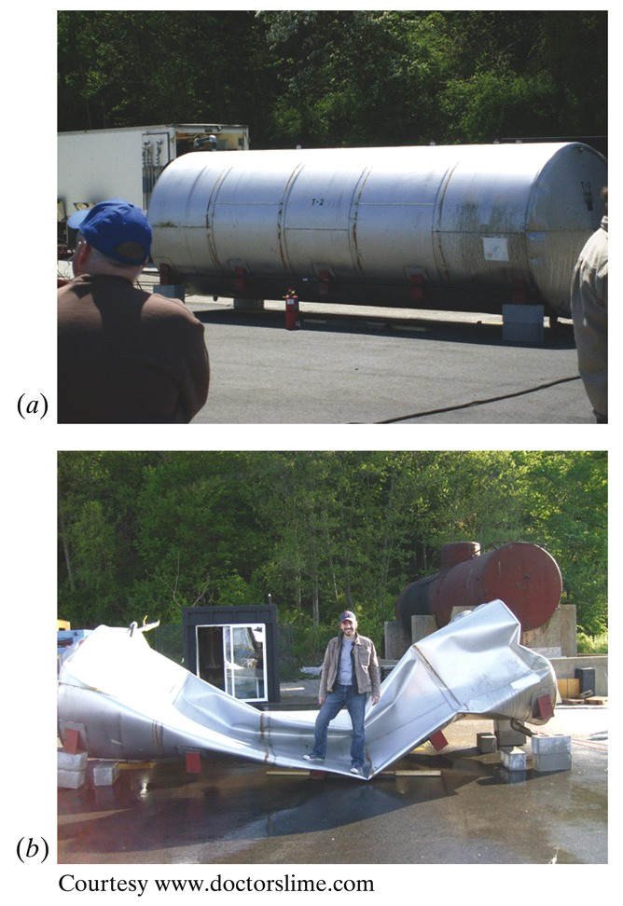
الديناميكا الحرارية والميكانيكا الإحصائية للغازات المثالية
Instructor:
Name: Dr. Zain Yamani
Director of CENT-KFUPM
[www.kfupm.edu.sa/cent]
Phone: 013-860-4363
Mobile: 0504608515
E-mail: zhyamani@kfupm.edu.sa
Time of meetings: Saturdays 9.30 – 11.30 a.m.
المحاضرة الخامسة
28 رجب، 1439 هـ

Slide 2
قبل بداية الشرح! ☺☺
سنقدم على موضوع الفيزياء الإحصائية.
ما نريد نغطيه (بعد شرائح قليلة).
كيف سنختم الدورة:
السبت القادم (و لكن الغالب سنبدأ مبكرا.. عند الثامنة)
أعتمد عليكم في قراءة الأبواب: 12، 13 و 14 من الكتاب المقرر.
ربما تكون دروس متفرقة (بعد/ قبل؟؟ رمضان) تسهب في ما أنوي أن أختصره.
ما نريد نغطيه (بعد شرائح قليلة).
مما يشجعني على إغلاق الدورة عدم الالتفات اللازم لتقييد الدروس، فكيف بالقراءة؟؟ (و غيرها)

Slide 3
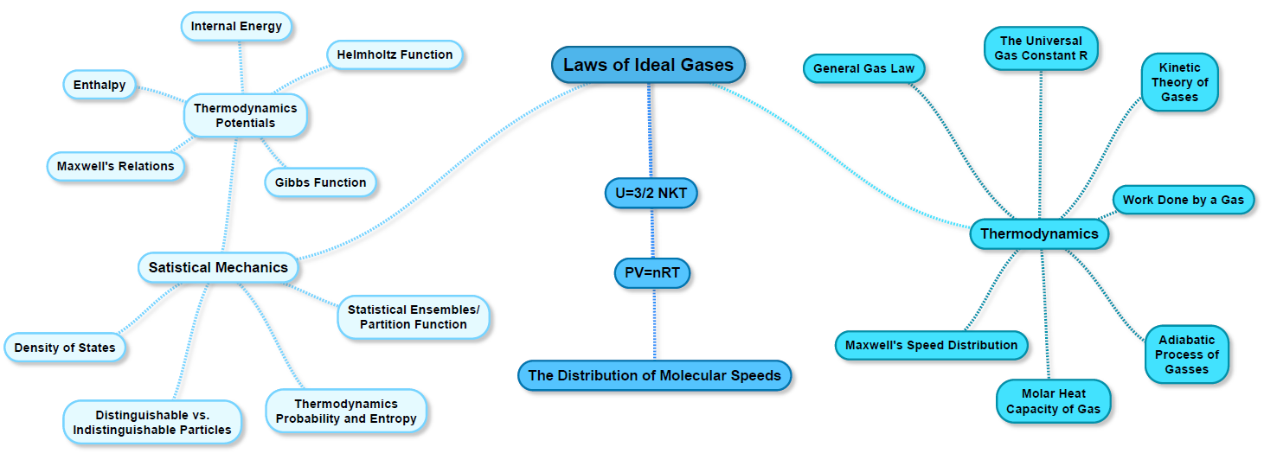

Slide 4
Statistical Thermodynamics (or Statistical Mechanics)
The Big Picture
Energy states and energy levels; degeneracy
Macrostates and microstates
Thermodynamic probability (W_{k}: Wahrscheinlichkeit) or Statistical count
Distinguishable and indistinguishable particles
B-E statistics; F-D statistics; B statistics; M-B statistics
B-E distribution function; F-D distribution function; M-B distribution function

Slide 5
Statistical Thermodynamics (or Statistical Mechanics)
The Big Picture
The statistical interpretation of entropy
The partition function (Z: Zustandssumme) or the sum over states
Thermodynamic properties of a system (the relation between Z & (F or G, the characteristic equations) to get: P, S, …etc.
Apply to IG:
The Sackur-Tetrode equation (for S)
P V = N k T
U = 3/2 N k T (for monatomic IG)

Slide 6
Legendre transformations & TD potentials
What do we need to know to completely determine the TD properties of a substance?
Equation of state + Energy equation
or
The characteristic equation (esp. F or G)

Slide 7
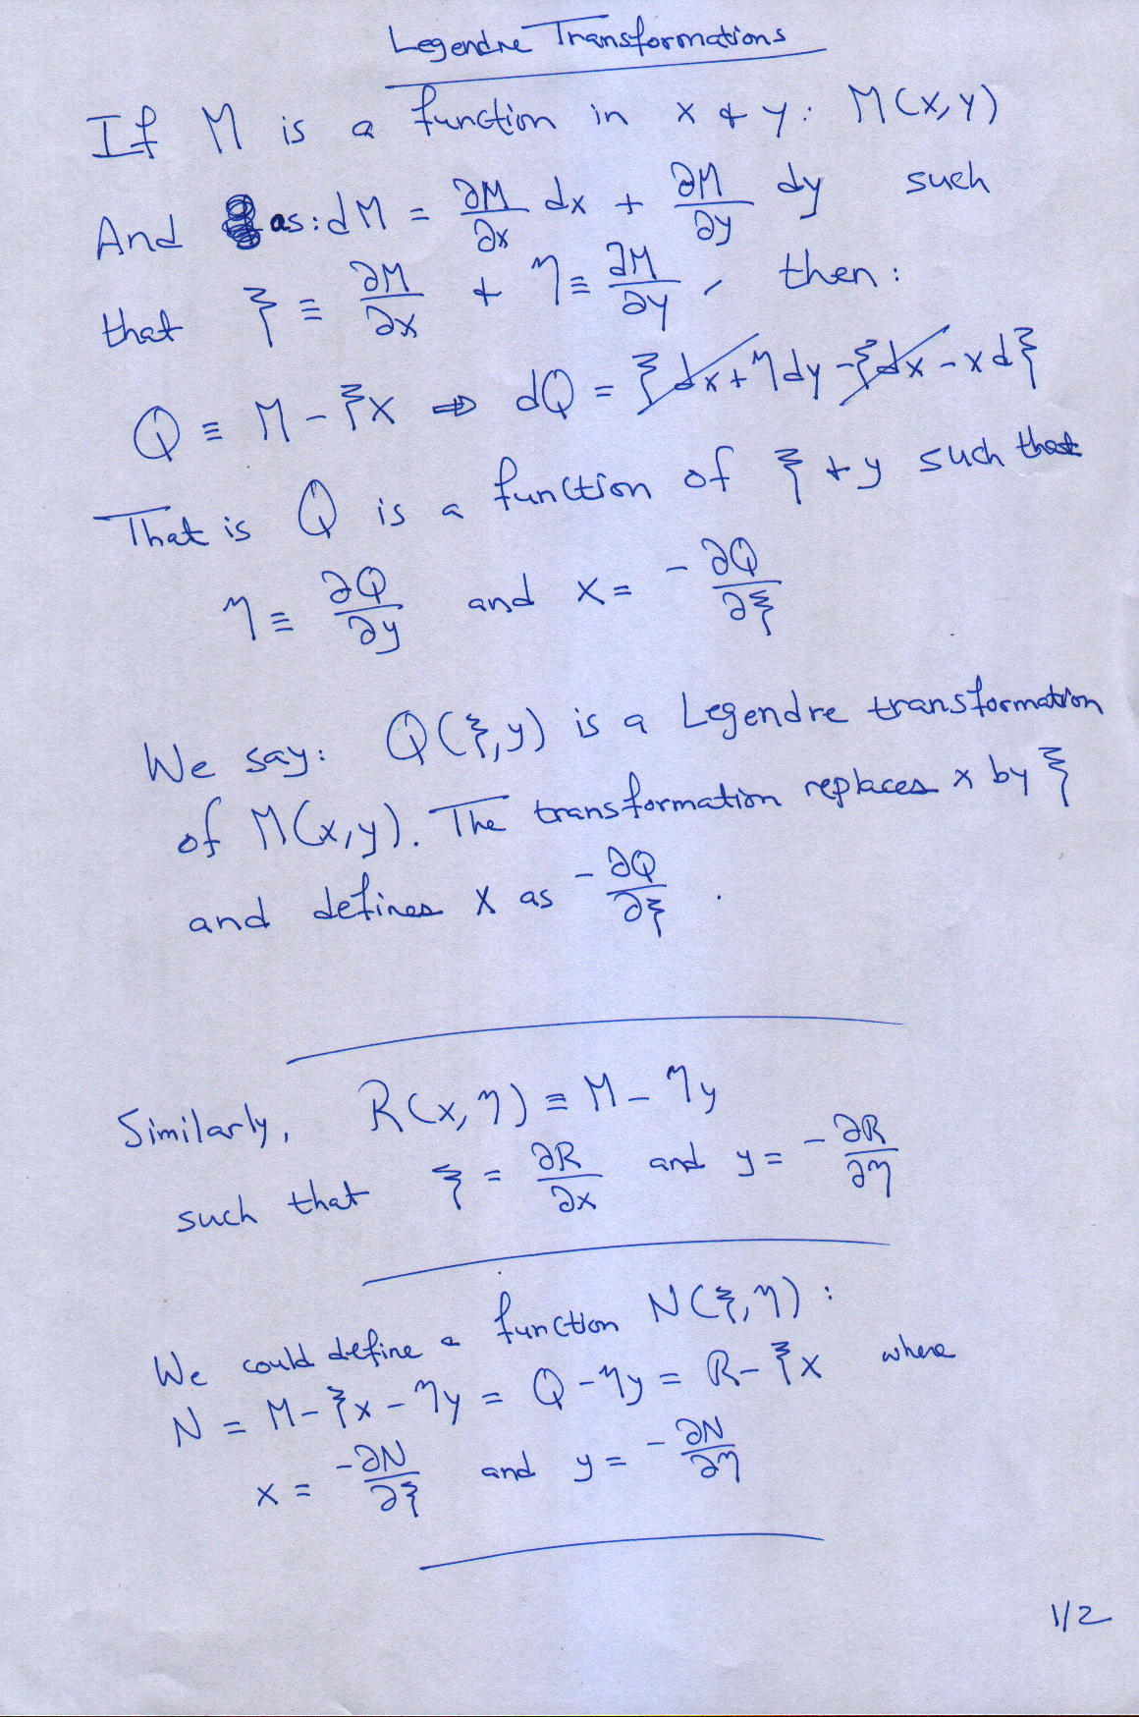
Legendre transformations & TD potentials

Slide 8
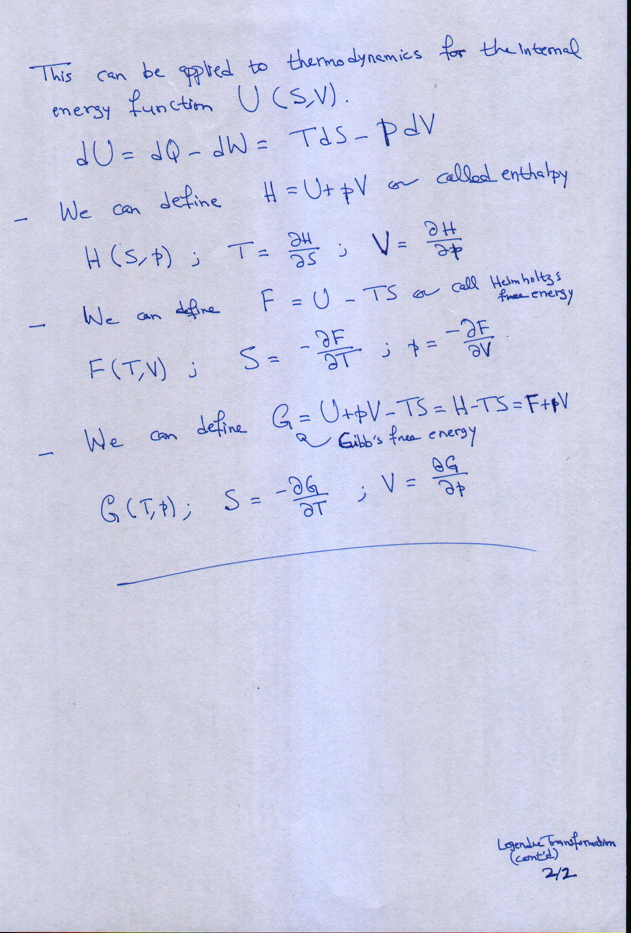
Legendre transformations & TD potentials

Slide 9
Maxwell’s Relations

Slide 10
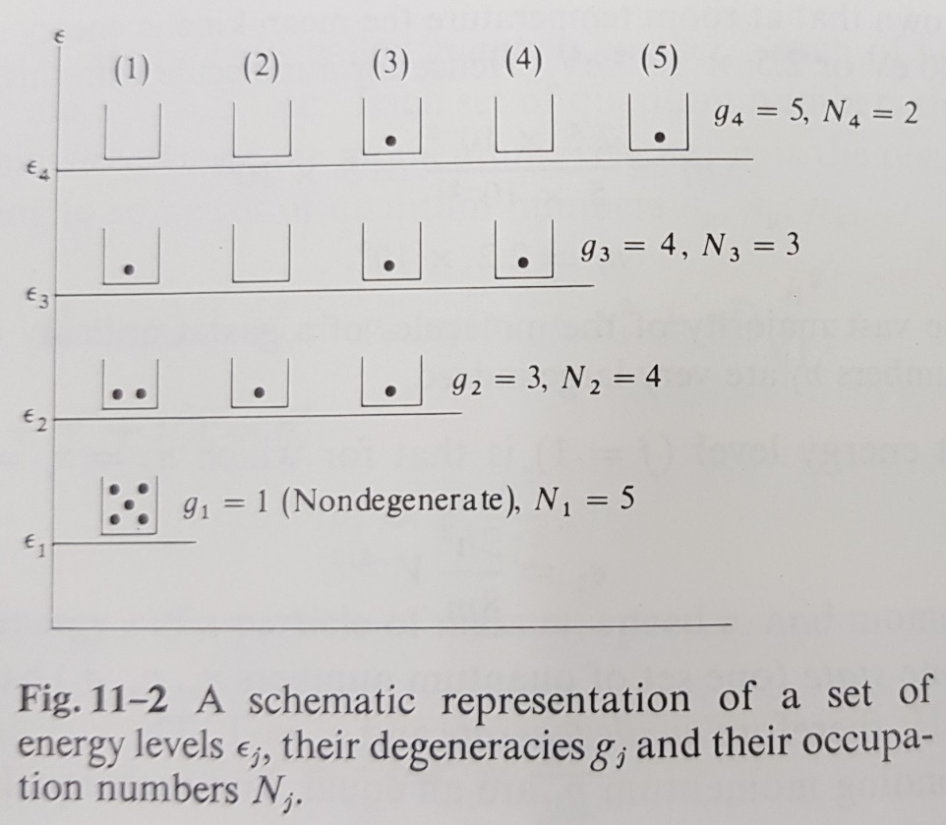
The basic postulate of statistical thermodynamics
All possible microstates of an isolated assembly are equally probable.
Energy states
Energy levels
Degeneracy
Occupation number
Macrostate (or configuration)
Microstate
Indistinguishable particles
Distinguishable particles
Carter’s chapter-12

Slide 11
What do we mean by macrostate?
The macrostate is specified by the number of particles in each of the energy levels of the system.
What do we mean by microstates?
The microstate:
for a system of indistinguishable particles is specified by the number of particles in each energy state.
for a system of distinguishable particles is specified by the energy state of each particle.

Slide 12
What do we mean by all possible microstates of an isolated assembly?

Slide 13
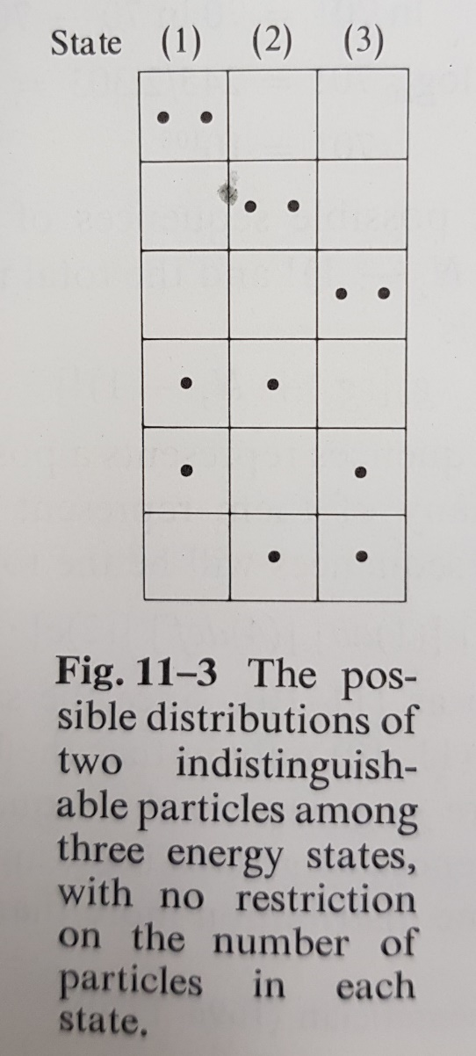
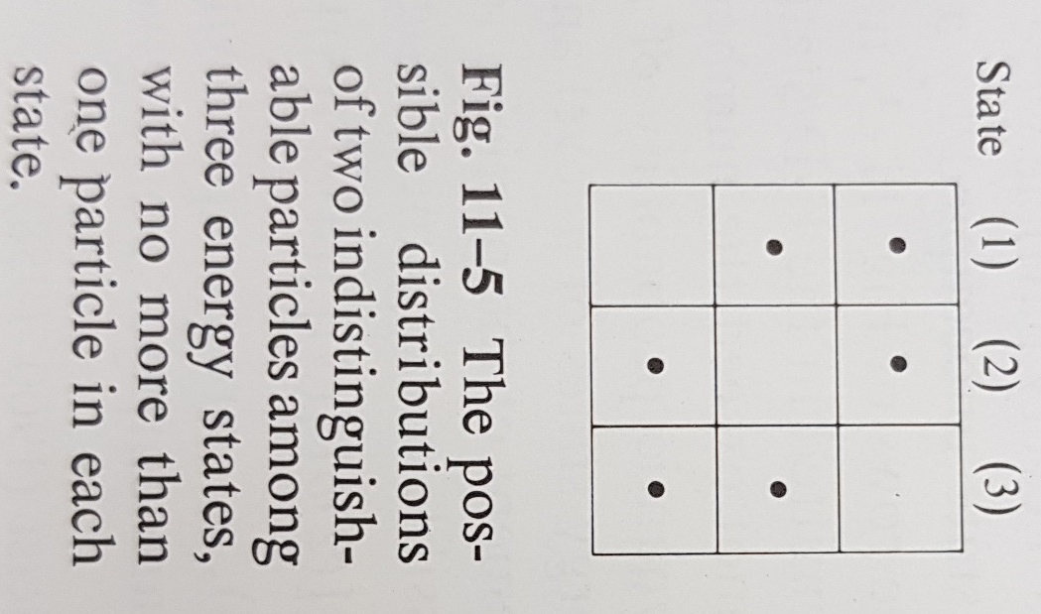
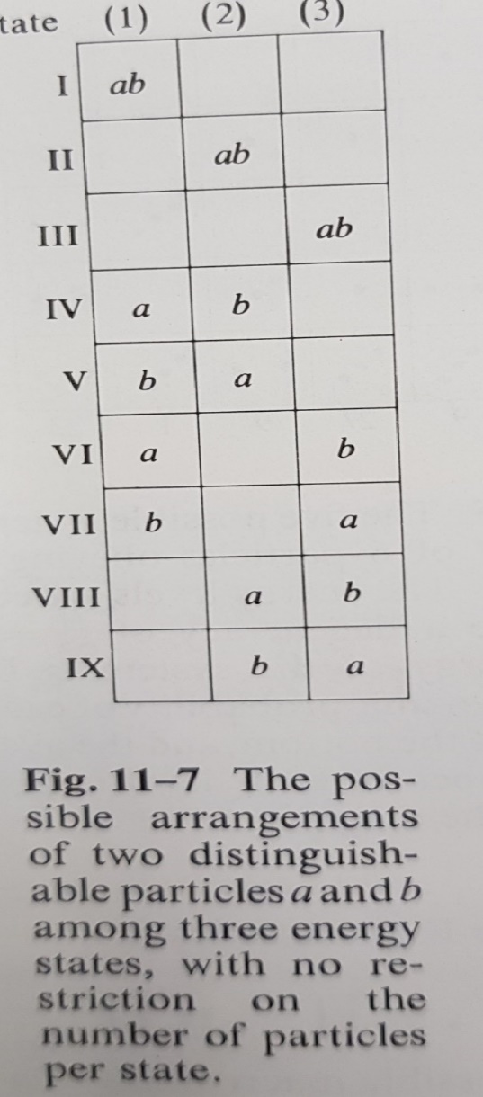
Respect statistical considerations (indistinguishable bosons, fermions, or distinguishable)

Slide 14
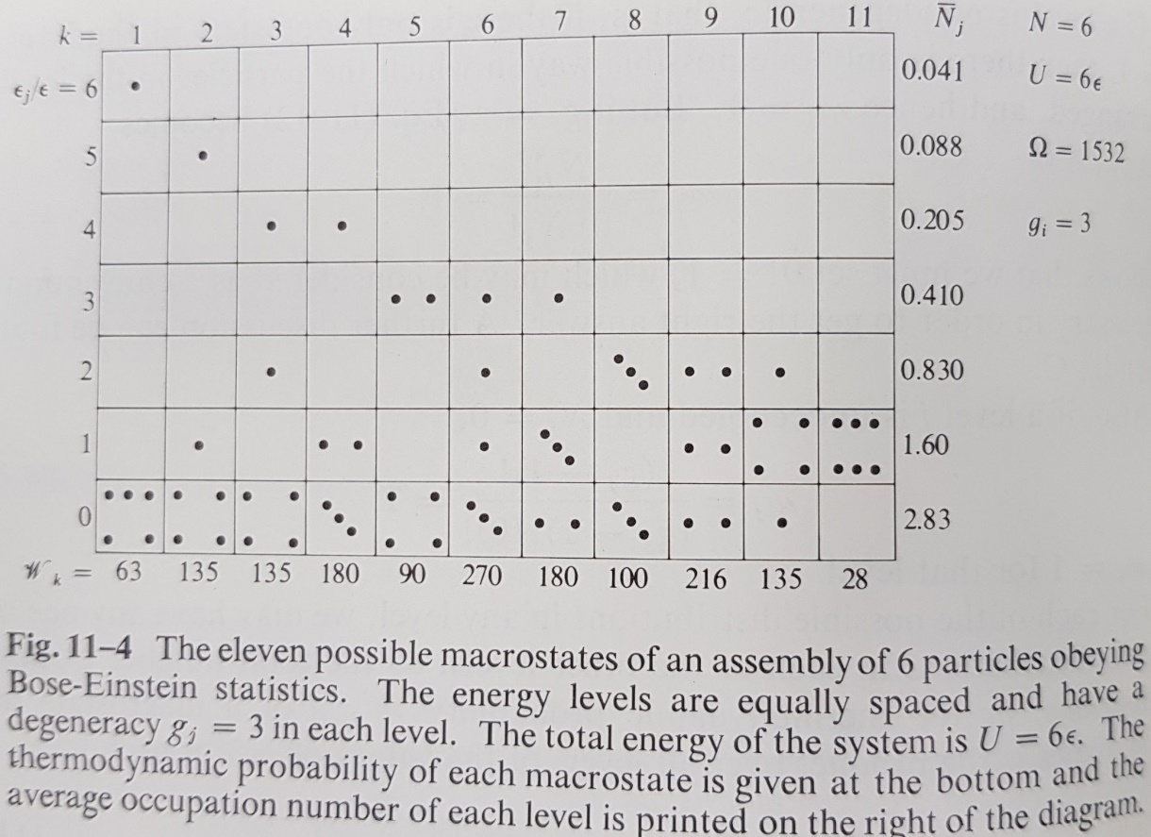
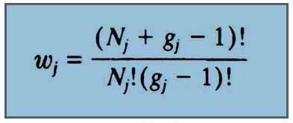
Respect conservation laws (of energy, number of particles)
Thermodynamic probability (W_{k} or w_{k}) of a macrostate: the number of ways the k^{th} macrostate can be achieved. [aka: statistical count]
Thermodynamic probability (Ω) of the system
(true) probability is: p_{k} = w_{k}/Ω
Average occupation number

