Slide 1
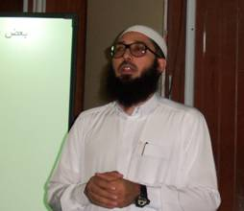
نشاط علمي صيفي مسا﻿ئل متنوعة في أساسيات ا﻿لفيزياء
زين بن حسن يماني
مدير مركز التميز البحثي لتقنية النانو بجامعة الملك فهد للبترول والمعادن
نائب رئيس مجلس إدارة الجمعية العلمية السعودية للعلوم الفيزيائية
المحاضرة الرابعة
20 شعبان، 1434 هـ

Slide 2
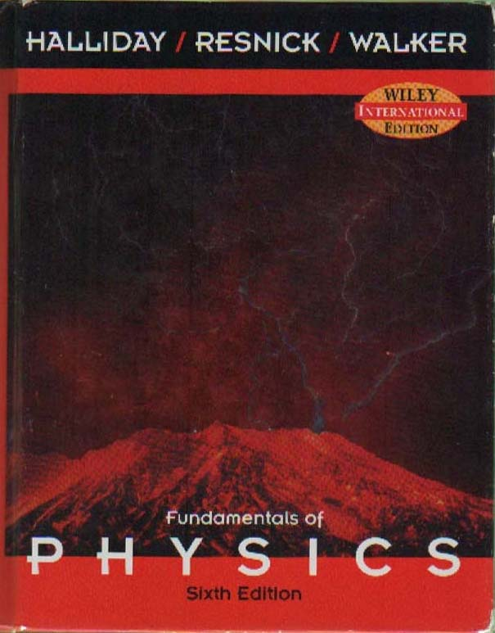
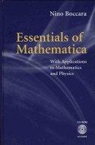
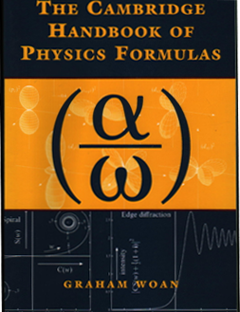
معالجة الصعوبات في المجموعة الرابعة من الأسئلة
ما ينبغي علينا تعلـّمه من الفيزياء في مرحلة البكلريوس
خاتمة..
Fundamentals of Physics by David Halliday, Robert Resnick, and Jearl Walker
http://faculty.kfupm.edu.sa/phys/zhyamani/Arabic/Dawrat/Physics%20Review-1434-SPS/PR-1434-SPS.html
الحلول الصحيح يمكن أخذها من ملفات الموقع

Slide 3
Topics in Undergraduate Physics
Classical Mechanics: “Classical Dynamic of Particles and Systems”, by Marion and Thornton
Electricity and Magnetism: “Introductory Electrodynamics”, by Griffith
Quantum Mechanics: “Modern Quantum Mechanics” by Sakurai, or “Principles of Quantum Mechanics” by Shankar
Thermodynamics: “Classical and Statistical Thermodynamics”, by Carter
Solid State Physics: “Introduction to Solid State Physics” by Kittel.
Electronics: “Electronic Principles”, by A.P. Malvino
For Math, I suggest:
Calculus: Calculus with Analytic Geometry, by Swokowski
Mathematical Physics:
Mathematical Methods for Physicists, by Arfken or,
Mathematical Methods of Physics by Mathews and Walker

Slide 4
Some suggested Topics that I might give in the coming months
How to use Mathematica to do useful physics education [gives some general background about the power of Mathematica, and then go into specific examples of how codes are developed for insightful physics programming].
Research activity on (nano) photocatalysis; patents; …
FTIR as an application of Fourier Transforms (FT). Start with a hardcore review about FT synthesis/ analysis. I can probably add another application (in optics/ lens) for FT. This will demonstrate that FT is not just a mathematical tool to solve some equation
How things work.. including for example isotope separation, (atomic) clocks, batteries, ABS, and more
Dealing with Helmholtz equation (along with Poisson/ Laplace equations) in mathematical methods.. trying to figure out the ‘big picture’.
The use of the concept of Potential in physics
Quasi-particles in solid state physics
Concepts related to semiconductor physics
Semiconductor devices and circuits!!
Modern day (optical) spectroscopy
Analytical, Optical and Microscopic Materials Characterization
13. Used Math: some math in physics including integration, trigonometry, a bit of special functions.. try to give students a better taste to mathematics.
14. Solve qualifying exams problems.. and/ or GRE problems.

Slide 5
Can we do Better??

Slide 6
Can we do Better??
Time and effort commitment
Continuity
Reading, investigating, researching
Long time working groups
Propagating good culture

