Slide 1
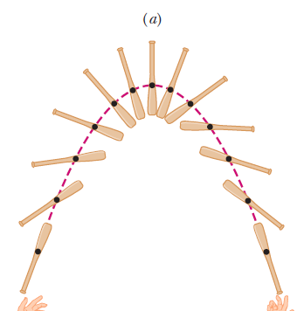
Center of Mass and Linear Momentum

Slide 2
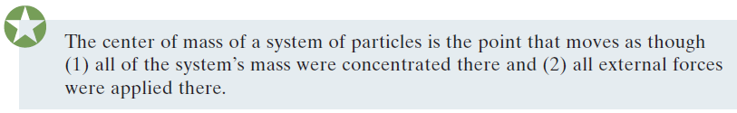
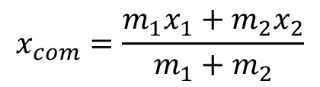


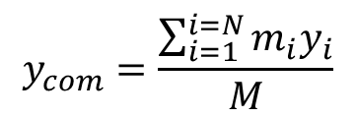
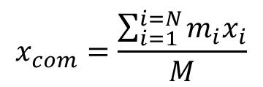
CENTER OF MASS
$$x_{com}=\frac{\sum_{i=1}^{i=N}{m_{i}x_{i}}}{M}$$
$$y_{com}=\frac{\sum_{i=1}^{i=N}{m_{i}y_{i}}}{M}$$
$$z_{com}=\frac{\sum_{i=1}^{i=N}{m_{i}z_{i}}}{M}$$
$${\vec{r}}_{com}=\frac{\sum_{i=1}^{i=N}{m_{i}{\vec{r}}_{i}}}{M}$$
Systems of Particles
Two particles system
$$x_{com}=\frac{m_{1}x_{1}+m_{2}x_{2}}{m_{1}+m_{2}}$$

Slide 3
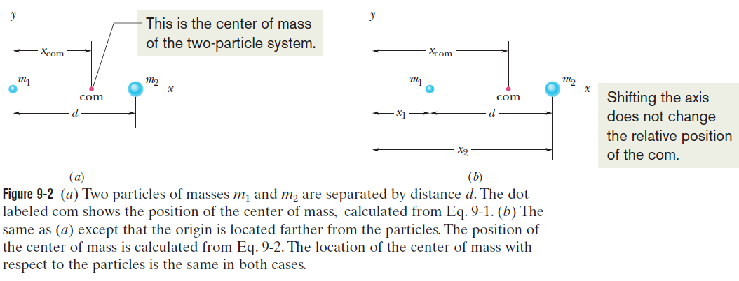

Slide 4



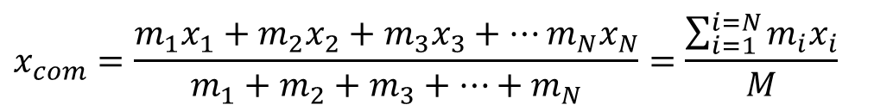

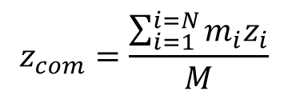
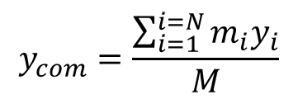
Many Particles.
Three Dimensions.
$$x_{com}=\frac{m_{1}x_{1}+m_{2}x_{2}+m_{3}x_{3}+…m_{N}x_{N}}{m_{1}+m_{2}+m_{3}+…+m_{N}}=\frac{\sum_{i=1}^{i=N}{m_{i}x_{i}}}{M}$$
$$x_{com}=\frac{\sum_{i=1}^{i=N}{m_{i}x_{i}}}{M}$$
$$y_{com}=\frac{\sum_{i=1}^{i=N}{m_{i}y_{i}}}{M}$$
$$z_{com}=\frac{\sum_{i=1}^{i=N}{m_{i}z_{i}}}{M}$$
$$\vec{r}=x\hat{i}+y\hat{j}+z\hat{k}$$
$${\vec{r}}_{com}=x_{com}\hat{i}+y_{com}\hat{j}+z_{com}\hat{k}$$
$${\vec{r}}_{com}=\frac{\sum_{i=1}^{i=N}{m_{i}{\vec{r}}_{i}}}{M}$$

Slide 5
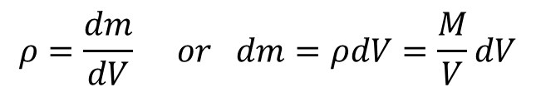



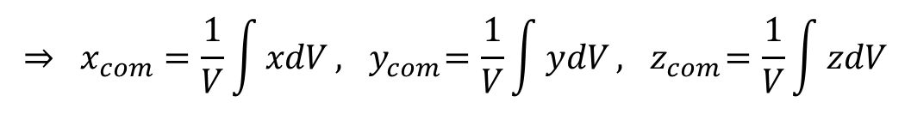


Solid Bodies
If $ρ$ is uniform then:
$$x_{com}=\frac{1}{M}\int{x dm,}$$
$$y_{com}=\frac{1}{M}\int{y dm},$$
$$z=\frac{1}{M}\int{z dm}$$
$$ρ=\frac{M}{V}$$
$$ρ=\frac{dm}{dV} or dm=ρdV=\frac{M}{V}dV$$
$$⇒ x_{com}=\frac{1}{V}\int{xdV}, { y}_{com}=\frac{1}{V}\int{ydV},{ z}_{com}=\frac{1}{V}\int{zdV}$$

Slide 6
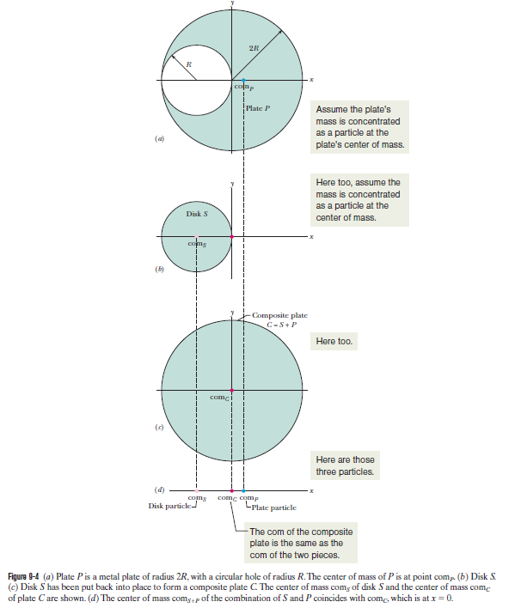

Slide 7
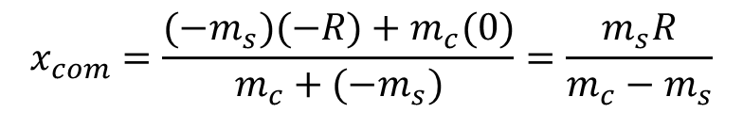

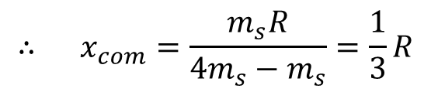
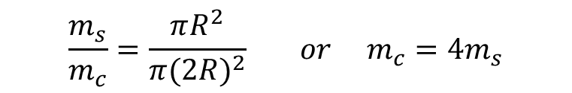
Imagine the mass of the small disk is $−m_{s}$ then if add it to the plate C you will Get the plate P. Hence, we have two masses $−m_{s}$ and $m_{c}$ ,there x-center of mass is;
Now, since the mass is proportional to the area then;
$$x_{com}=\frac{(−m_{s})(−R)+m_{c}(0)}{m_{c}+{(−m}_{s})}=\frac{m_{s}R}{m_{c}−m_{s}}$$
$$\frac{m_{s}}{m_{c}}=\frac{πR^{2}}{π{(2R)}^{2}} or m_{c}=4m_{s}$$
$$∴ x_{com}=\frac{m_{s}R}{{4m}_{s}−m_{s}}=\frac{1}{3}R$$

Slide 8

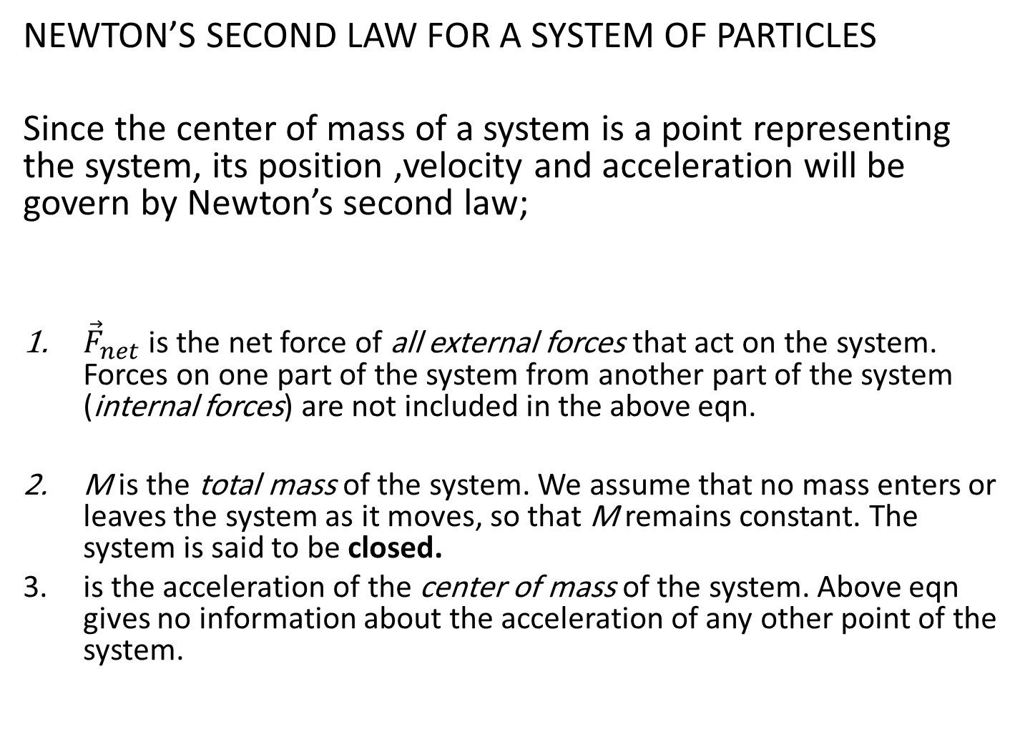
NEWTON’S SECOND LAW FOR A SYSTEM OF PARTICLES
Since the center of mass of a system is a point representing the system, its position ,velocity and acceleration will be govern by Newton’s second law;
${\vec{F}}_{net}$ is the net force of all external forces that act on the system. Forces on one part of the system from another part of the system (internal forces) are not included in the above eqn.
M is the total mass of the system. We assume that no mass enters or leaves the system as it moves, so that M remains constant. The system is said to be closed.
is the acceleration of the center of mass of the system. Above eqn gives no information about the acceleration of any other point of the system.
$${\vec{F}}_{net}=M{\vec{a}}_{com}$$

Slide 9

Proof of the above equation
$$F_{net,x}=Ma_{com,x} F_{net,y}=Ma_{com,y} F_{net,z}=Ma_{com,z}$$
$$M{\vec{r}}_{com}=m_{1}{\vec{r}}_{1}+m_{2}{\vec{r}}_{2}+m_{3}{\vec{r}}_{3}+…+m_{N}{\vec{r}}_{N}$$
$$M{\vec{v}}_{com}=m_{1}{\vec{v}}_{1}+m_{2}{\vec{v}}_{2}+m_{3}{\vec{v}}_{3}+…+m_{N}{\vec{v}}_{N}$$
$$M{\vec{a}}_{com}=m_{1}{\vec{a}}_{1}+m_{2}{\vec{a}}_{2}+m_{3}{\vec{a}}_{3}+…+m_{N}{\vec{a}}_{N}$$
$$M{\vec{a}}_{com}={\vec{F}}_{net,1}+{\vec{F}}_{net,2}+{\vec{F}}_{net,3}+…+{\vec{F}}_{net,N}$$
$$M{\vec{a}}_{com}={\vec{F}}_{net}$$

