Slide 1
Kinetic Energy and Work

Slide 2
Energy
It is difficult to define energy. We deal with energy in almost any thing in our daily life our motion and thing that we use such as cars, phones lighting …… etc.
Energy can exist in many different forms such as heat, kinetic or mechanical energy, light, potential energy, electrical energy,
Chemical and nuclear energy.
Technically, energy is a scalar quantity associated with the state (or condition) of a system.

Slide 3
We can thing of energy as the capacity to do work( will be defined later) through force.
There are many cases of motion that are very difficult to analyze using Newton’s laws of motion.
e.g. an object sliding down irregular incline.
In such cases we use the concept of work and kinetic energy with out resorting to Newton’s laws.

Slide 4

Kinetic energy K associated with the state of motion.
$K=\frac{1}{2}mv^{2}$
$1 Joule=1 J =kg\frac{m^{2}}{s^{2}}=Nm$

Slide 5
work
Work is a process by which we transfer energy in to or out of a system by a mean of force acting on the system.
If energy transferred to the system work is positive.
If energy transferred out of the system work is negative.
system
Energy
W > 0 work been done on the system
system
Energy
W < 0 work been done by the system

Slide 6

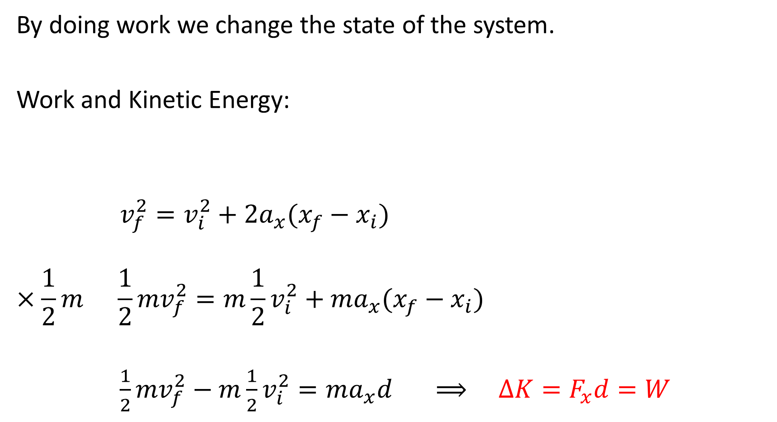







By doing work we change the state of the system.
Work and Kinetic Energy:
$v_{f}^{2}=v_{i}^{2}+2a_{x}(x_{f}−x_{i})$
$$×\frac{1}{2}m {\frac{1}{2}mv}_{f}^{2}=m{\frac{1}{2}v}_{i}^{2}+ma_{x}(x_{f}−x_{i})$$
${\frac{1}{2}mv}_{f}^{2}−m{\frac{1}{2}v}_{i}^{2}=ma_{x}d ⟹ ∆K=F_{x}d=W$
$$a_{x}$$
$$\vec{F}$$
$$\vec{F}$$
$$a_{y}=0$$
$$F=constant$$
$$x_{i}$$
$$x_{f}$$
d
$${K_{f} K}_{i}$$

Slide 7

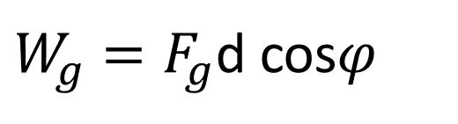
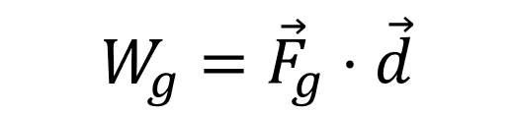
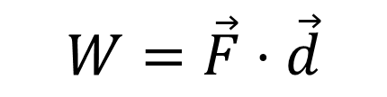
${W=F}_{x}d=Fcosφ d$
Work done by constant force:
Work done by general force: $W=\int_{i}^{f}{\vec{F}⋅}d\vec{r}$
Work done by gravitational force:
$$W=\vec{F}⋅\vec{d}$$
$$W_{g}={\vec{F}}_{g}⋅\vec{d}$$
$W_{g}=F_{g}$d cos$φ$

Slide 8






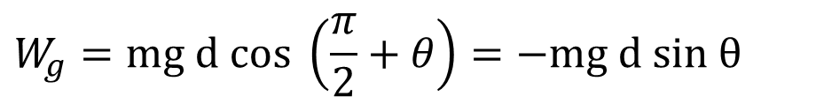







Work done by gravity:
$$+y$$
$$\vec{d}=∆x \hat{i}+∆y \hat{j}$$
$$∆x$$
$${\vec{F}}_{g}=−mg \hat{j}$$
$$y_{f}$$
$W_{g}={\vec{F}}_{g}⋅\vec{d}=(−mg \hat{j}$) $⋅\left(∆y \hat{j}\right)=−mg$ $∆y=−mg d sin θ$
$$\vec{d}$$
$$∆y$$
We will get the same result as follow:
$$θ$$
$$W_{g}={\vec{F}}_{g}⋅\vec{d}=mg d cos φ$$
$$y_{i}$$
$$+x$$
$$φ$$
$$W_{g}=mg d cos \left(\frac{π}{2}+θ\right)=−mg d sin θ$$
$${\vec{F}}_{g}$$

Slide 9
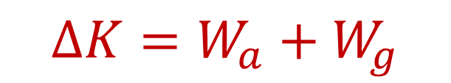





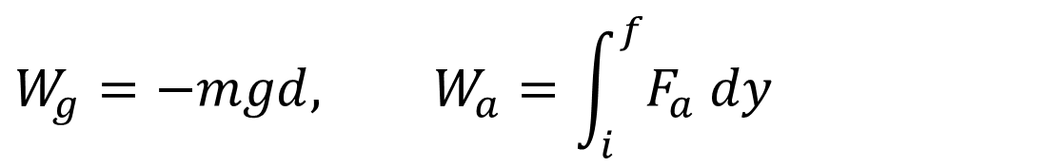
Work In lifting and lowering an object:
Lifting an object up a distance d:
$$If we lift the object from rest to rest then ∆K=0=W_{a}+W_{g}$$
$$⟹ W_{a}=−W_{g} ⟹ W_{a}=mgd$$
$$∆K=W_{net}$$
$$∆K=W_{a}+W_{g}$$
$$\vec{d}$$
$${\vec{F}}_{a}$$
$$W_{g}=−mgd, W_{a}=\int_{i}^{f}{F_{a} dy}$$
$${\vec{F}}_{g}$$

Slide 10

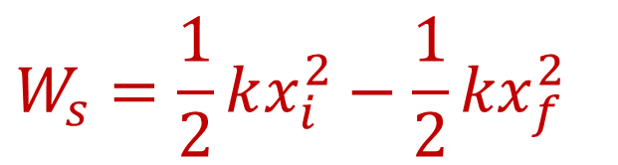
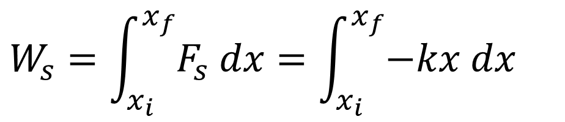
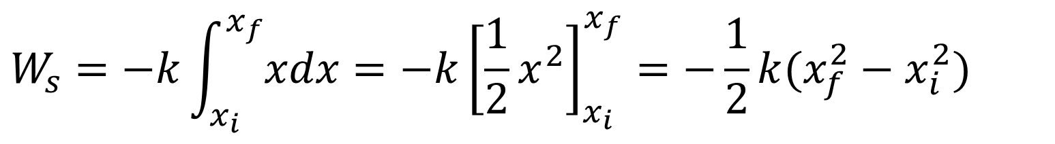
Work done by spring:
$${\vec{F}}_{s}=−k\vec{d} \text{(}\text{Hooke}\text{’}\text{s} \text{law}\text{)}$$
$$F_{s}=−kx$$
$$W_{s}=\int_{x_{i}}^{x_{f}}{F_{s} dx}=\int_{x_{i}}^{x_{f}}{−kx dx}$$
$$W_{s}=−k\int_{x_{i}}^{x_{f}}{xdx}=−k{\left[\frac{1}{2}x^{2}\right]}_{x_{i}}^{x_{f}}=−\frac{1}{2}k(x_{f}^{2}−x_{i}^{2})$$
$$W_{s}=\frac{1}{2}kx_{i}^{2}−{\frac{1}{2}kx}_{f}^{2}$$

Slide 11
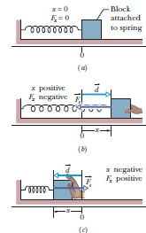

Slide 12
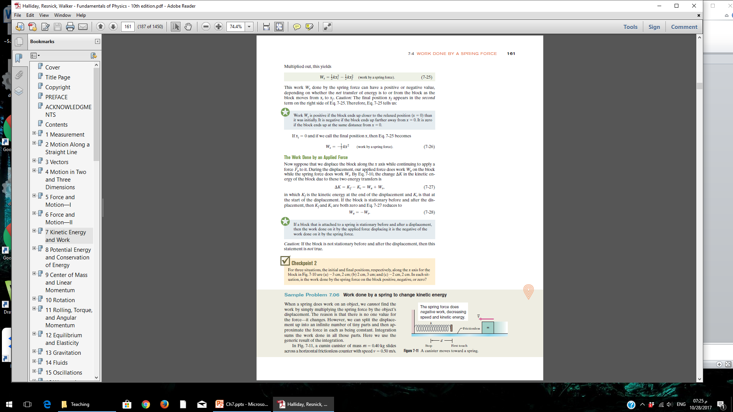
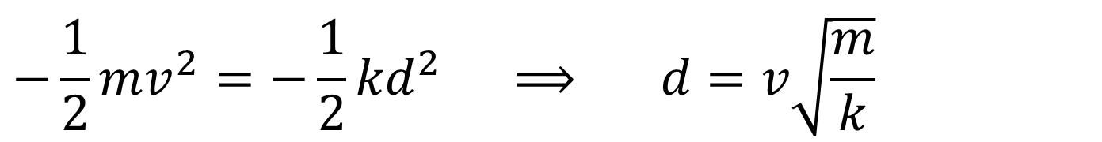
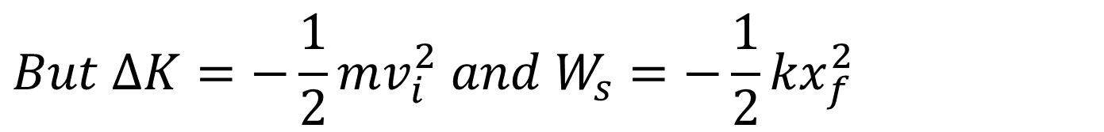

$$But ∆K=−\frac{1}{2}mv_{i}^{2} and W_{s}=−{\frac{1}{2}kx}_{f}^{2}$$
$$∆K=W_{s}$$
$$−\frac{1}{2}mv_{}^{2}=−{\frac{1}{2}kd}_{}^{2} ⟹ d=v\sqrt{\frac{m}{k}}$$

Slide 13

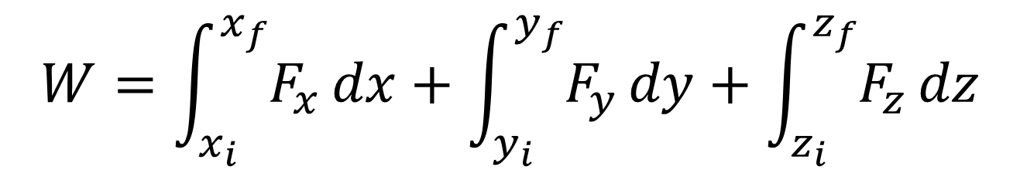
WORK DONE BY A GENERAL VARIABLE FORCE
$$W=\int_{i}^{f}{\vec{F}⋅}d\vec{r}$$
$$W=\int_{x_{i}}^{x_{f}}{F_{x}}dx+\int_{y_{i}}^{y_{f}}{F_{y}}dy+\int_{z_{i}}^{z_{f}}{F_{z}}dz$$

Slide 14
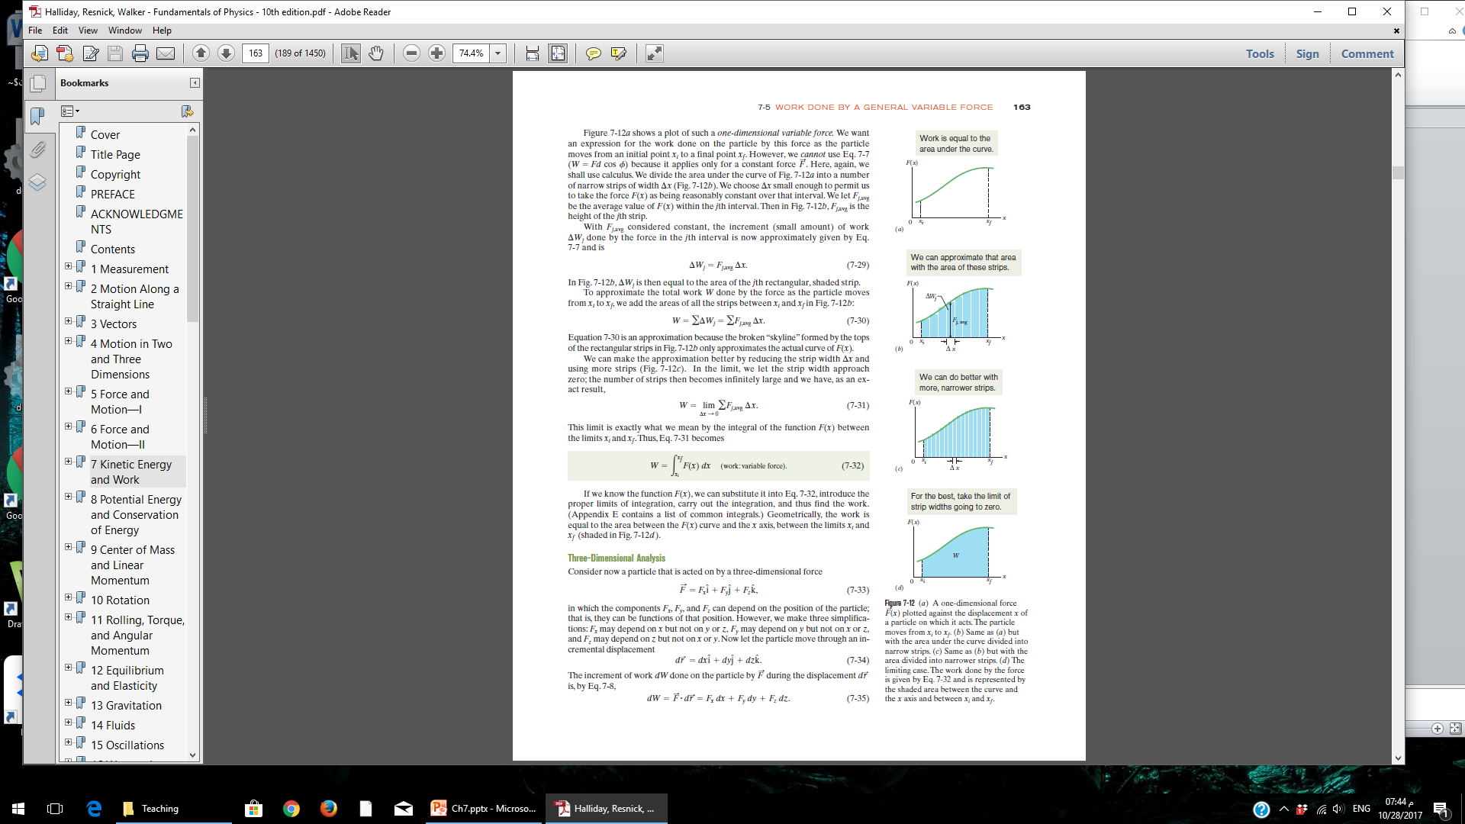

Slide 15
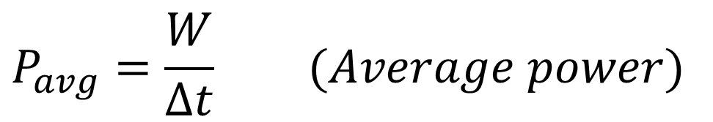
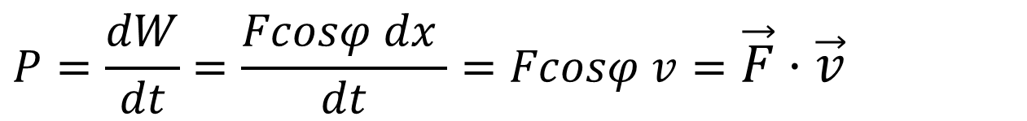
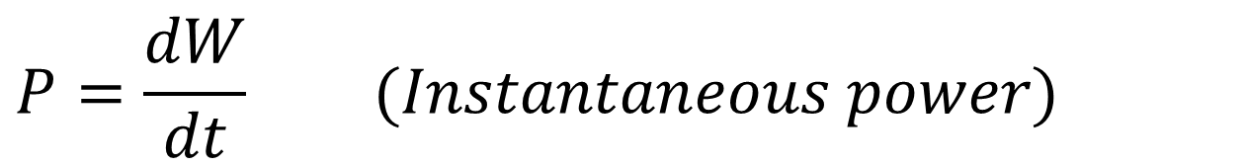
Power
$$P_{avg}=\frac{W}{∆t} (Average power)$$
$$1 watt=1 W=1 J/s$$
$$P=\frac{dW}{dt} (Instantaneous power)$$
$$P=\frac{dW}{dt}=\frac{Fcosφ dx }{dt}=Fcosφ v=\vec{F}⋅\vec{v}$$
$$P=\vec{F}⋅\vec{v} (Instantaneous power)$$

