Slide 2
Friction

Slide 3
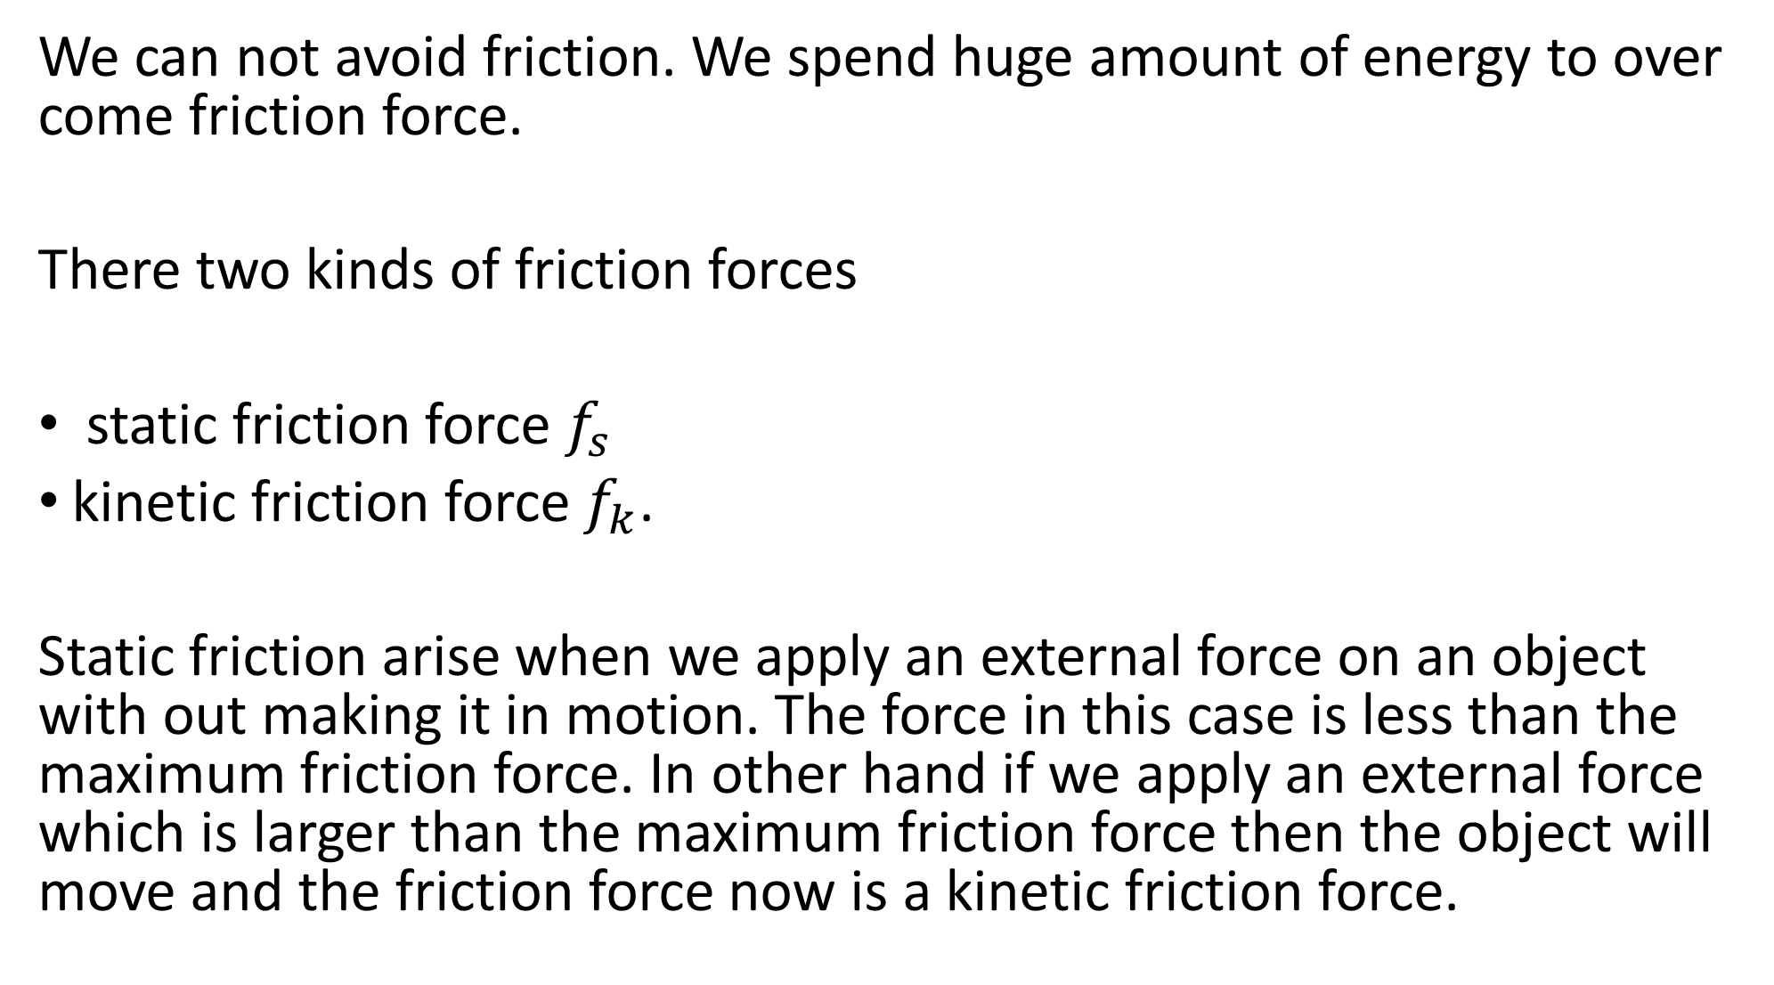
We can not avoid friction. We spend huge amount of energy to over come friction force.
There two kinds of friction forces
static friction force $f_{s}$
kinetic friction force $f_{k}$.
Static friction arise when we apply an external force on an object with out making it in motion. The force in this case is less than the maximum friction force. In other hand if we apply an external force which is larger than the maximum friction force then the object will move and the friction force now is a kinetic friction force.

Slide 4


The direction of the friction force is always opposite to the motion is there is motion and opposite to the intended motion if the object is stationary.
External force
friction force
M
$$F_{a}$$
$$f$$

Slide 5




















I$f F is higher than f_{smax}$ the object start moving
M
$$f$$
$$f_{s1}$$
M
$$F_{1}$$
$$f_{smax}$$
$$f_{k}$$
M
$$f_{s2}$$
$$F_{2}$$
$$f_{s3}$$
$$f_{s2}$$
M
$$f_{s3}$$
$$F_{3}$$
$$f_{s1}$$
$$f_{smax}$$
M
$$F$$
$$F_{4}$$
$F_{1 }{ F}_{2}{ F}_{3} F_{4 }{ F}_{5}$
M
$$f_{k}$$
$$F_{5}$$
M
$$F_{6}$$
$$f_{k}$$

Slide 6

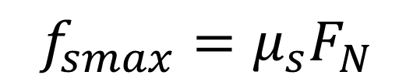




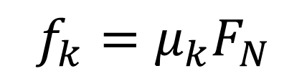

$$f_{smax}=μ_{s}F_{N}$$
$$f_{k}=μ_{k}F_{N}$$
$$Fsinθ$$
$$F_{N}$$
$$θ$$
$$F$$
$$Fcosθ$$
m
$$mg$$

Slide 7
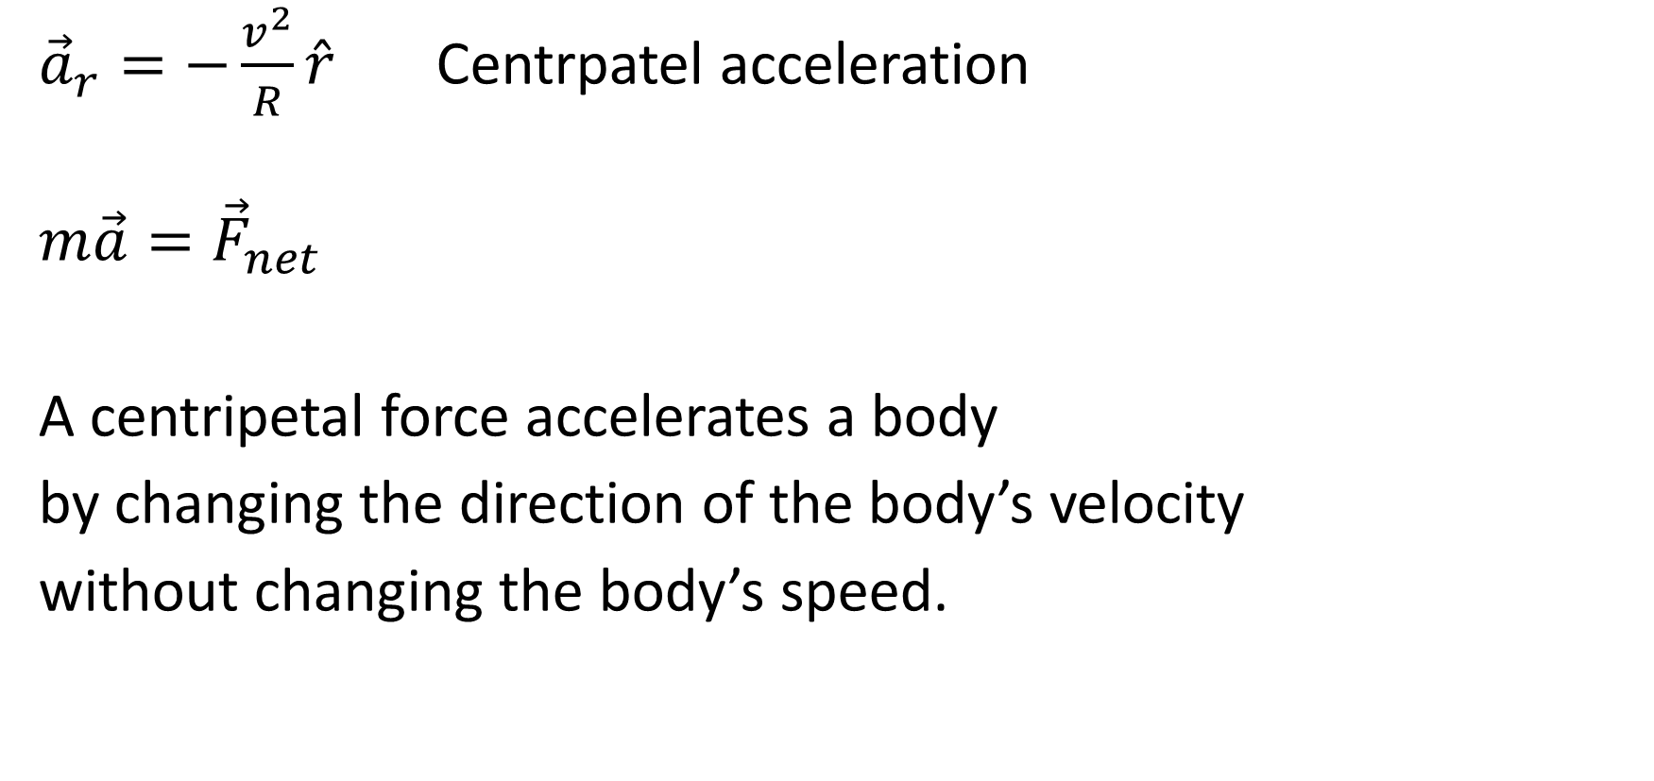




Uniform Circular Motion
$$\vec{v}$$
${\vec{a}}_{r}=−\frac{v^{2}}{R}\hat{r}$ Centrpatel acceleration
$${m\vec{a}=\vec{F}}_{net}$$
A centripetal force accelerates a body
by changing the direction of the body’s velocity
without changing the body’s speed.
$$\vec{v}$$
$$\vec{r}$$
$$T$$
$$R$$

Slide 8
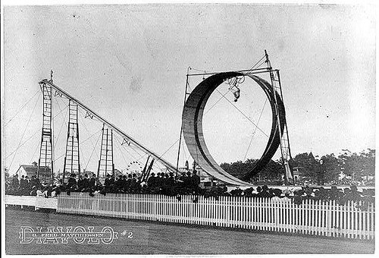


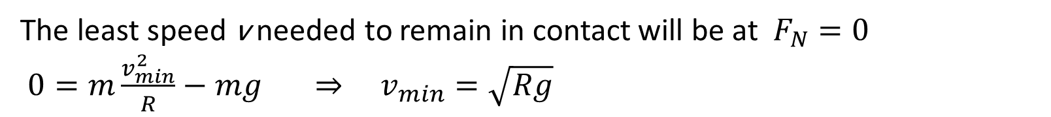
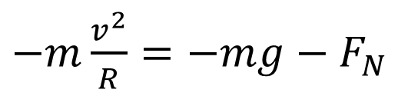
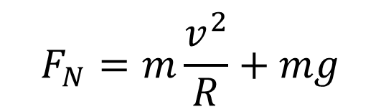

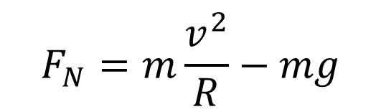

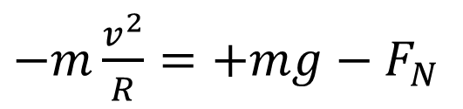
$$F_{N}=m\frac{v^{2}}{R}−mg$$
$−m\frac{v^{2}}{R}=−mg−$ $F_{N}$
$$F_{N}$$
The least speed v needed to remain in contact will be at $F_{N}=0$
$0=m\frac{v_{min}^{2}}{R}−mg ⇒ v_{min}=\sqrt{Rg}$
$$mg$$
$−m\frac{v^{2}}{R}=+mg−$ $F_{N}$
$$F_{N}$$
$$F_{N}=m\frac{v^{2}}{R}+mg$$
$$mg$$

Slide 9

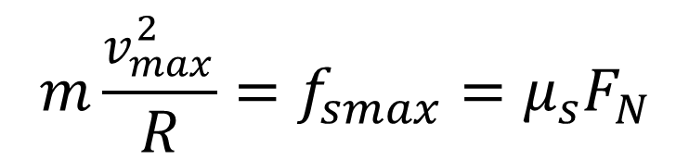
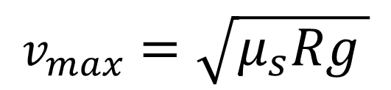

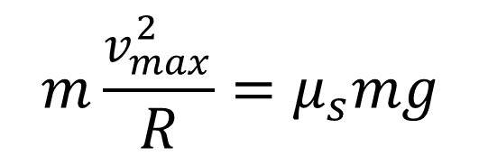




Car in flat circular turn
$$\vec{v}$$
$$−m\frac{v^{2}}{R}=−f_{s}$$
$$f_{s}$$
$$m\frac{v_{max}^{2}}{R}=f_{smax}=μ_{s}F_{N}$$
$$F_{N}$$
$$m\frac{v_{max}^{2}}{R}=μ_{s}mg$$
$$f_{s}$$
$$mg$$
$$v_{max}^{}=\sqrt{μ_{s}Rg }$$

Slide 10
Car in banked circular turn

Slide 11





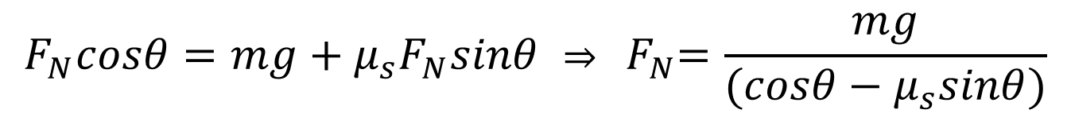


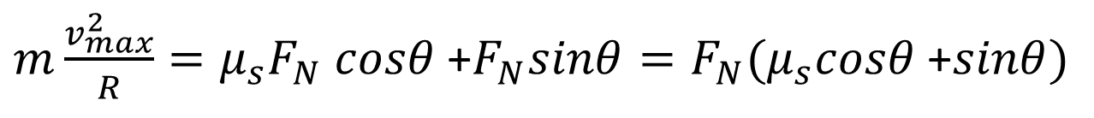




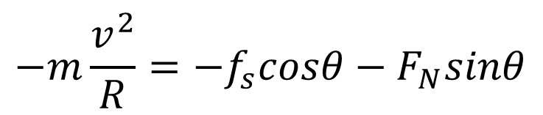
$$F_{N}$$
$$F_{N}cosθ$$
$$−m\frac{v^{2}}{R}=−f_{s}cosθ−F_{N}sinθ$$
$$F_{N}cosθ=mg+f_{s}sinθ$$
$$F_{N}sinθ$$
$$θ$$
$$R$$
$m\frac{v_{max}^{2}}{R}=μ_{s}F_{N}$ $cosθ$+$F_{N}sinθ=F_{N}(μ_{s}cosθ \text{+}sinθ)$
$$f_{s}cosθ$$
$$f_{s}sinθ$$
$$f_{s}$$
$$θ$$
$$F_{N}cosθ=mg+μ_{s}F_{N}sinθ ⇒ { F}_{N}=\frac{mg}{(cosθ−μ_{s}sinθ)}$$
$$mg$$
$m\frac{v_{max}^{2}}{R}={\frac{mg}{(cosθ−μ_{s}sinθ)}(μ}_{s}cosθ$+$sinθ)⇒ v_{max}^{}=\sqrt{\frac{Rg(sinθ+μ_{s}cosθ)}{(cosθ−μ_{s}sinθ)}}$

Slide 12
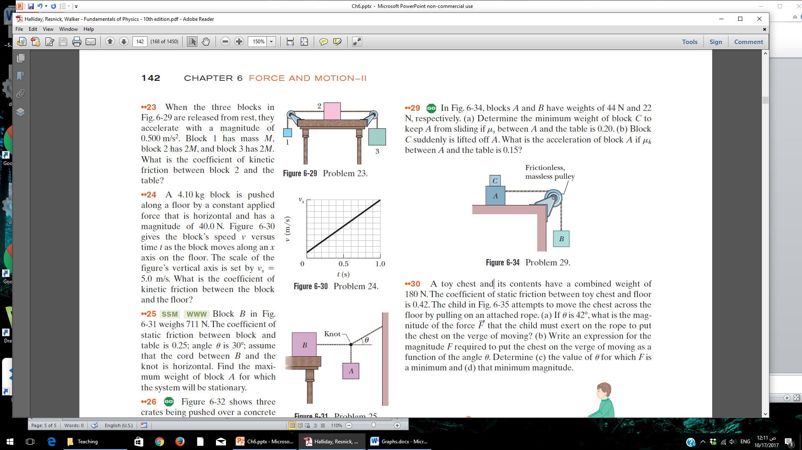

Slide 13
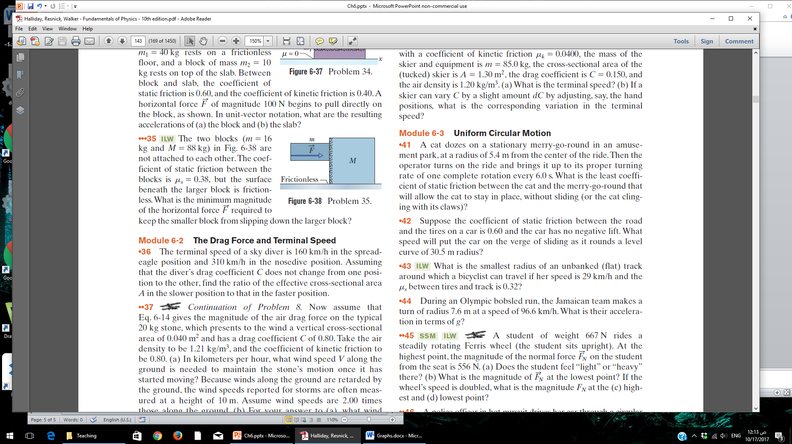

Slide 14
