Slide 1
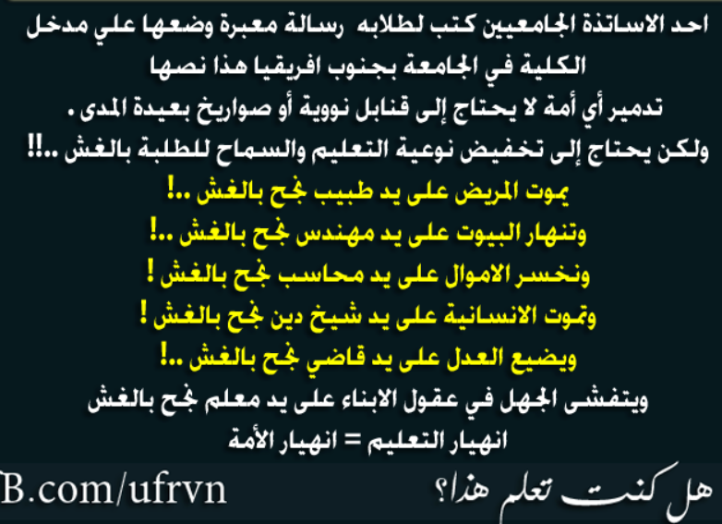

Slide 2
Force and Motion I

Slide 3
The change in velocity of a body is due to an interaction between the body and its surrounding.
An interaction that cause an acceleration of body is called a force ( push or pull).
Newton discover the relation between the force and the acceleration it causes.
There are two types of forces:
contact forces and field forces

Slide 4
Newton worked in many areas of mathematics and physics. He developed the theories of gravitation in 1666, when he was only 23 years old. Some twenty years later, in 1686, he presented his three laws of motion in the "Principia Mathematica Philosophiae Naturalis."

Slide 5
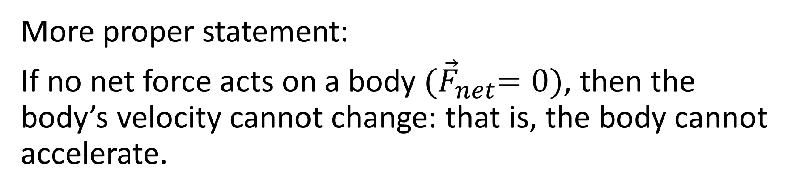
Newton’s First Law
If no force acts on a body, then the body’s velocity cannot change: that is, the body cannot accelerate.
More proper statement:
If no net force acts on a body ${(\vec{F}}_{net}=0)$, then the body’s velocity cannot change: that is, the body cannot accelerate.
${\vec{F}}_{net}=0$ means that the forces are in equilibrium

Slide 6
Inertial reference frames:
An inertial reference frame is one that Newton’s laws holds. (frame that is stationary or moves with constant velocity)
Inertia: the resistance an object has to a change in its state of motion ( which is a manifestation of mass).

Slide 7
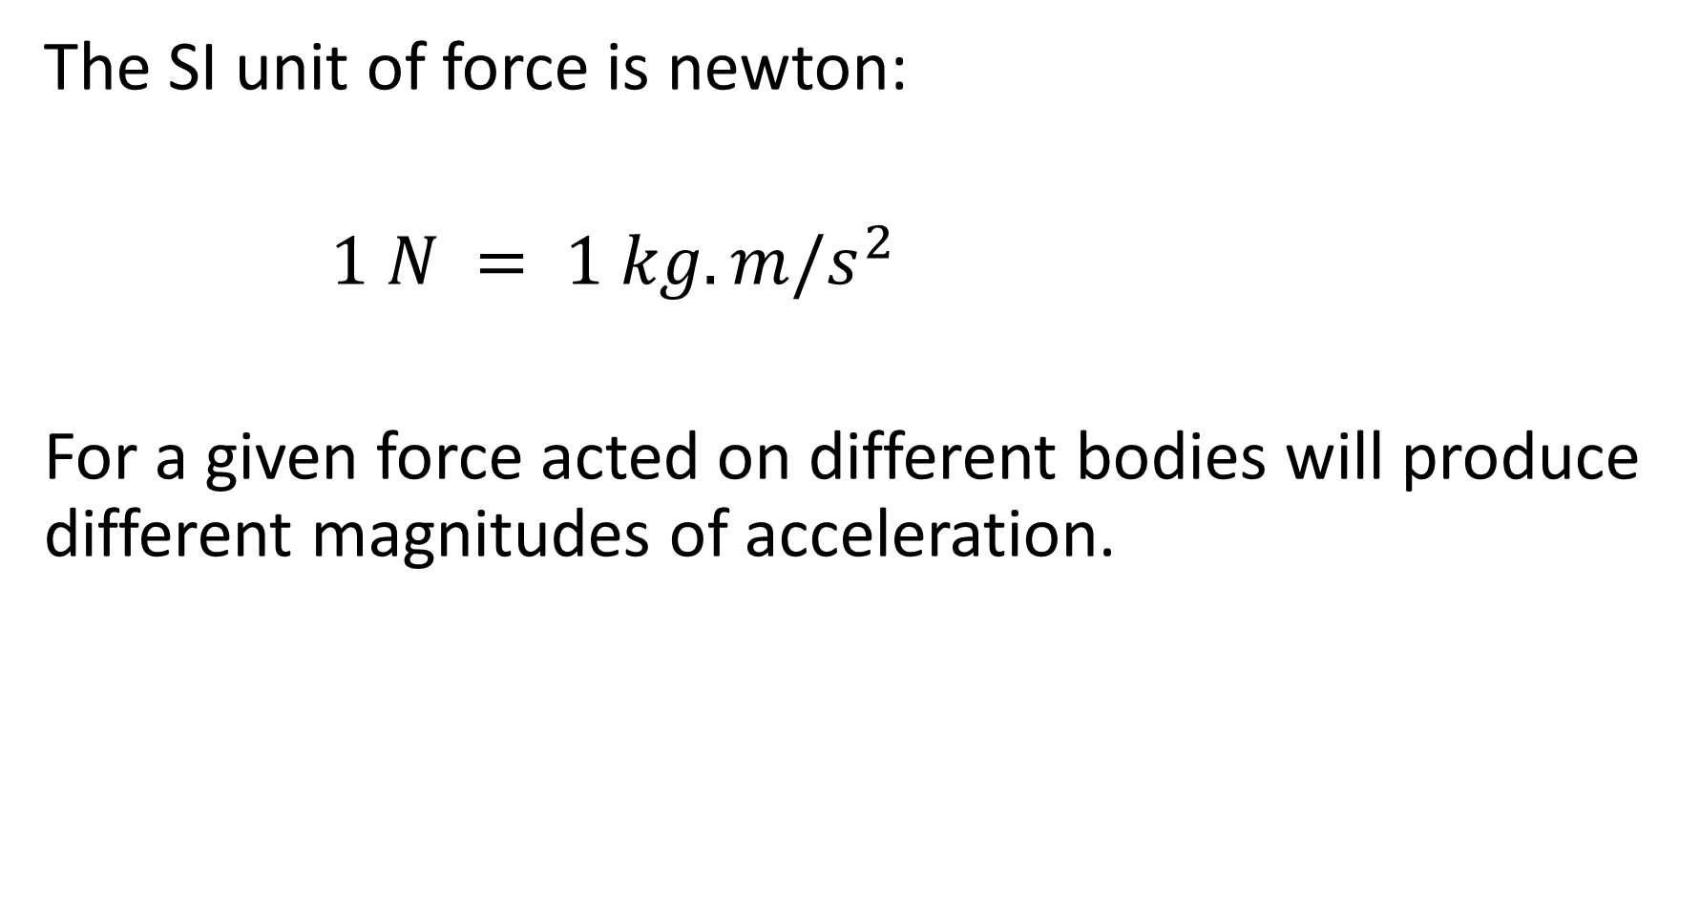
The SI unit of force is newton:
$1 N = 1 kg. m/s^{2}$
For a given force acted on different bodies will produce different magnitudes of acceleration.

Slide 8

Definitions
A system is a collection of two or more bodies.
External force is an out side force acted on the bodies inside the system.
Internal force is an inside force acted between the bodies of the system.
${\vec{F}}_{net}$ includes only external forces
Internal force
External force
system
T
m
M
F

Slide 9

Newton’s second law:
$${\vec{F}}_{net}=m\vec{a}$$
$$F_{{net}_{x}}=ma_{x}{ F}_{{net}_{x}}=\sum_{i=1}^{N}{F_{i_{x}}}$$
$$F_{{net}_{y}}=ma_{y}$$
$$F_{{net}_{z}}=ma_{z}$$

Slide 10

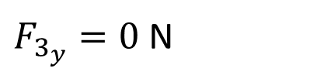
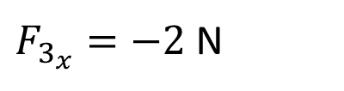
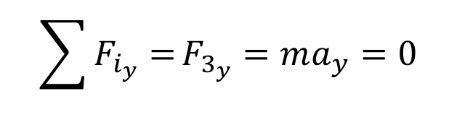
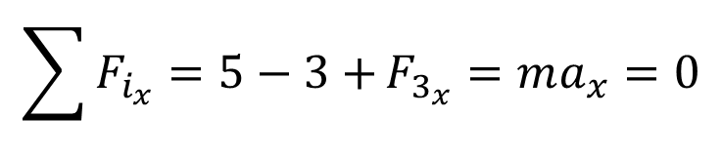
To solve problem about Newton’s law you may need to draw a free body diagram for example:
Three forces${\vec{F}}_{1}=5\hat{i},{\vec{F}}_{1}=−3\hat{i}$ and ${\vec{F}}_{3}$ acted on an object. The object remain at rest during the action of the forces. Find the magnitude and direction of the third force
$$\sum{F_{i_{x}}=5−3+}F_{3_{x}}=ma_{x}=0$$
3N
M
5N
+
$F_{3_{x}}=−2$ N
$$\sum{F_{i_{y}}=}F_{3_{y}}=ma_{y}=0$$
$F_{3_{y}}=0$ N

Slide 11





Another example:
A puck having a mass of 0.3 kg slides on a horizontal frictionless surface. Two forces ($\left|{\vec{F}}_{1}\right|=5,\left|{\vec{F}}_{2}\right|=8$) acts on the puck as shown
Determine the acceleration of the puck’s acceleration.
$${\vec{F}}_{2}$$
+
+
$${60}^{o}$$
$${20}^{o}$$
$${\vec{F}}_{1}$$
$m\vec{a}=\sum{{\vec{F}}_{i}=(8 cos60\hat{i}+8 sin60\hat{j})}+$ $\left(5 cos20\hat{i}−5 sin20\hat{j}\right)=8.7\hat{i}+6.8\hat{j}$

Slide 12


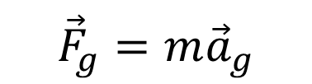
Some particular Forces
Gravitational Force
${\vec{a}}_{g}=−g\hat{j}$
The weight (w=mg) of a body is the magnitude of the net force required to prevent the body from falling freely.
$${\sum{F_{y}=m}a}_{y}$$
$$w−mg=m\left(0\right) ⟹ w=mg$$
$${\vec{F}}_{g}=m{\vec{a}}_{g}$$
+
w
$$a_{y}=0$$
+
mg

Slide 13




$${\vec{F}}_{N}$$
Normal force
Friction Force
The direction of the friction force is opposite to the direction of motion
if it is in motion and opposite to the intended motion if it is stationary.
$${\vec{F}}_{g}$$
$$\vec{f}$$
$${\vec{F}}_{a}$$

Slide 14


Tension Force
the tension force is directed a way from the body and along the cord.
$$\vec{T}$$
$${\vec{F}}_{g}$$

Slide 15



Newton’s Third Law.
When two bodies interact, the forces on the bodies from each other are always equal in magnitude and opposite in direction.
Body B
$${\vec{F}}_{AB}=−{\vec{F}}_{BA}$$
$${\vec{F}}_{AB}$$
$${\vec{F}}_{BA}$$
Body A

Slide 16





${\vec{F}}_{CT}$ & ${\vec{F}}_{TC}$ are third-law pair
${\vec{F}}_{CE}$ & ${\vec{F}}_{TE}$ are third-law pair
${\vec{F}}_{CT}$ & ${\vec{F}}_{CE}$ are not third-law pair
$${\vec{F}}_{CT}$$
$${\vec{F}}_{TC}$$
$${\vec{F}}_{CE}$$
$${\vec{F}}_{EC}$$

Slide 17
Applying Newton’s Laws
Draw a free body diagram of the problem that shows all forces.
Define the positive direction.
Assume the direction of the acceleration.
(after solving the problem for the acceleration, if the sign of result of the acceleration is positive then your assumption of the acceleration direction is correct.
However, if the sign of acceleration is negative then the direction of acceleration is opposite to your assumption.)
Solve the problem using Newton’s laws applied to the system or some of the object in the system.

Slide 18





S.P. 5.03
+
$${\vec{F}}_{N}$$
M
$$\vec{T}$$
$$\vec{T}$$
$${\vec{F}}_{Mg}$$
m
+
$${\vec{F}}_{mg}$$

Slide 19





+
$${\vec{F}}_{N}$$
$$\vec{T}$$
$$\vec{T}$$
M
m
+
$${\vec{F}}_{Mg}$$
$${\vec{F}}_{mg}$$

