Slide 1
Measurements

Slide 2
Science and engineering are based on measurements, observation and comparisons.
The main objective of physics is to understand things happening in nature. We, the physicist always try to predict things by formulating ,what we observed and measured, by fundamental laws that allow us to predict the result of future experiments.
The outcome of what we are doing was the origin of many technologies such as electronics, optics, nuclear energy, special materials etc.

Slide 3
We describe natural phenomena by few base physical quantities ,that can be measured , such as length, time , mass, electric current, temperature, Luminous Intensity and the amount of substance.
Each base physical quantity has a standard value and unit that a sign to it. Example:
In SI unit system
Length is measured in meters (m)
Time is measured in seconds (s)
Mass is measured in Kilograms (kg)
All other physical quantities can be derived from the above base physical quantities such as force, velocity, energy etc.

Slide 4
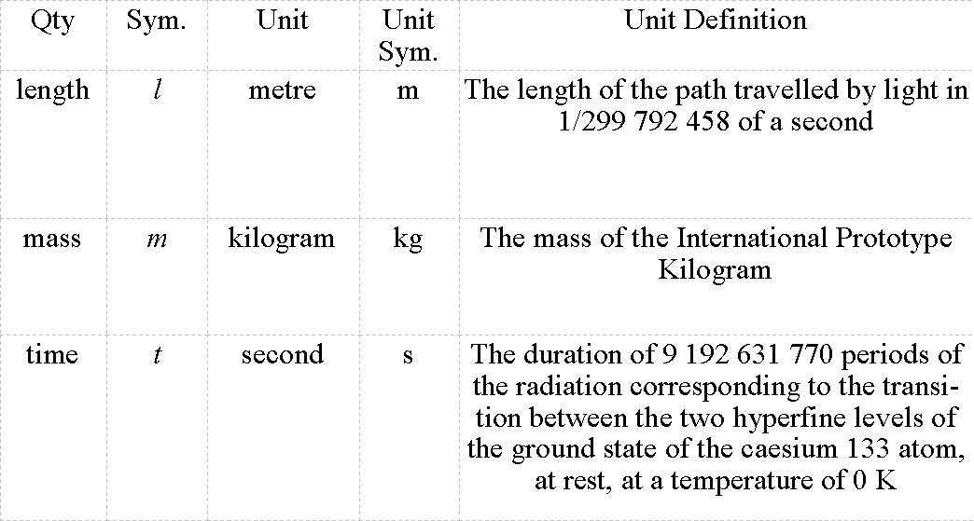

Slide 5
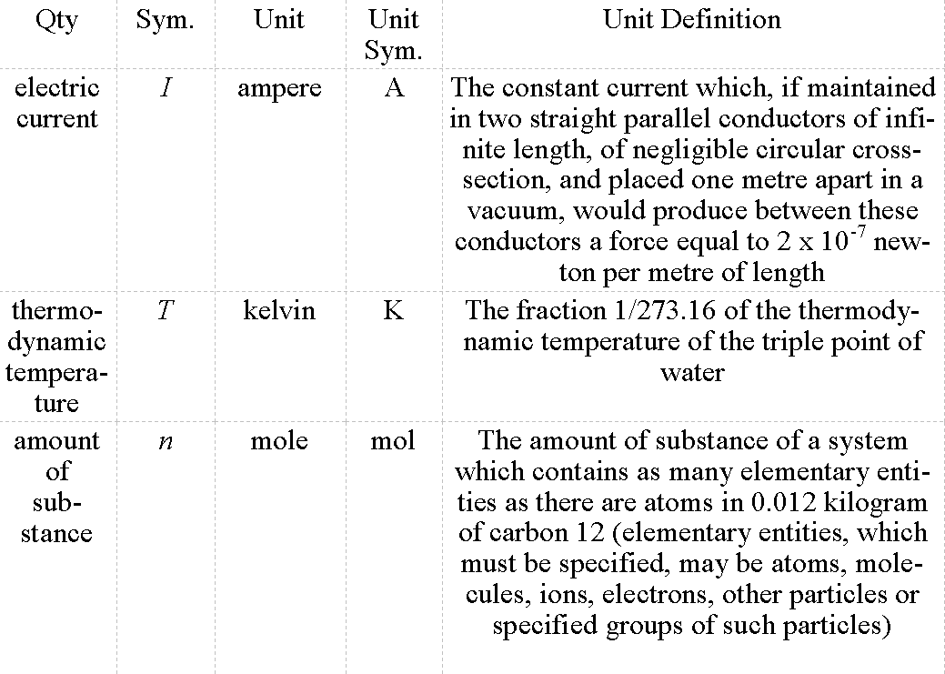

Slide 6
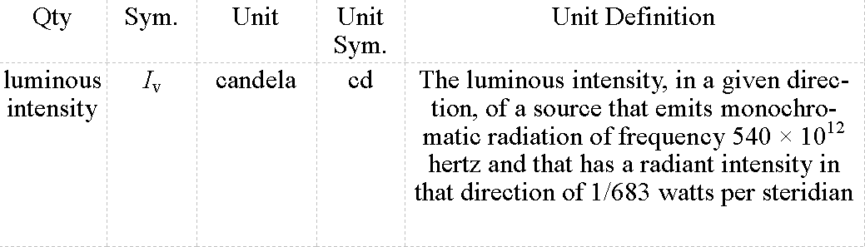
https://www.technologyuk.net/physics/measurement-and-units/physical-quantities-and-si-units.shtml

Slide 7
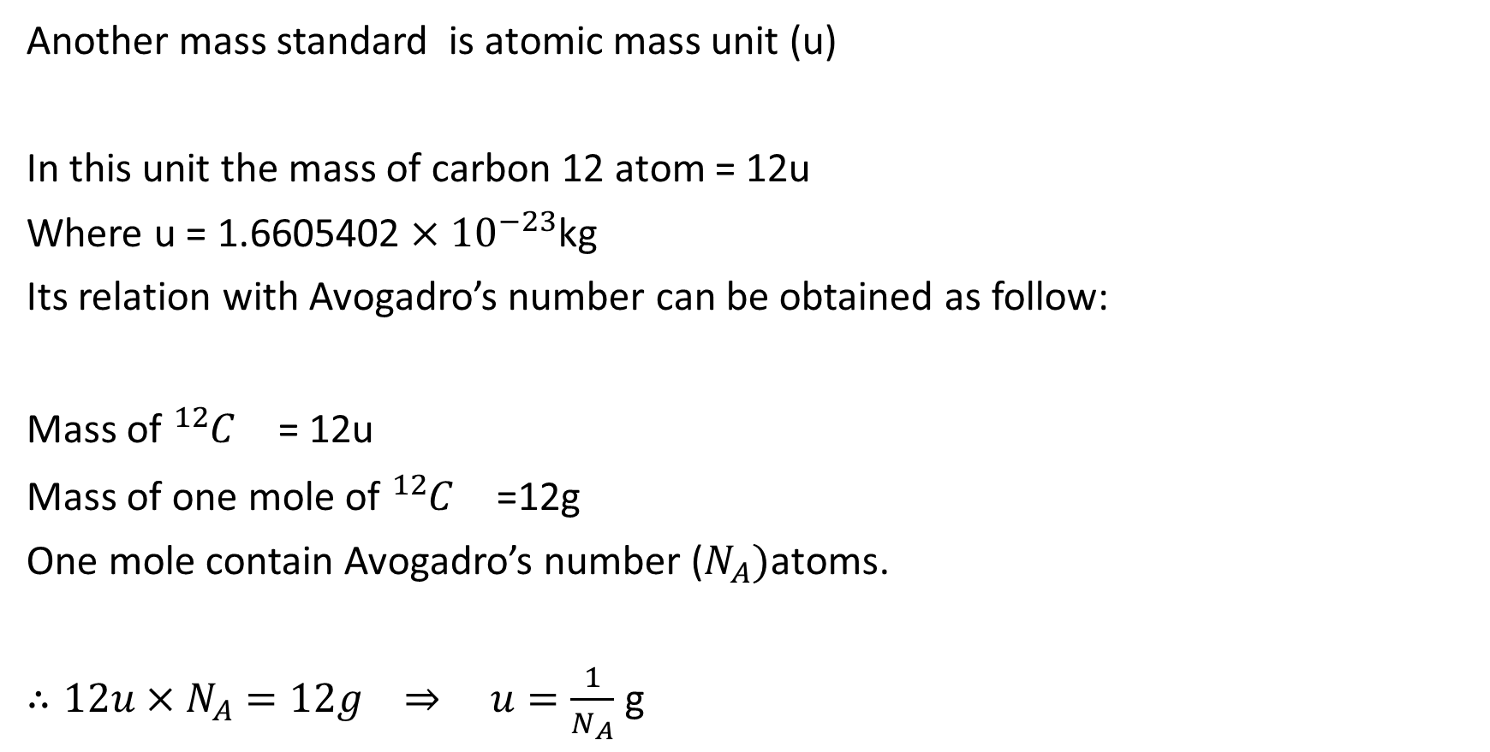
Another mass standard is atomic mass unit (u)
In this unit the mass of carbon 12 atom = 12u
Where u = 1.6605402 $×{10}^{−23}$kg
Its relation with Avogadro’s number can be obtained as follow:
Mass of ${{}_{}^{12}C}^{}$= 12u
Mass of one mole of ${{}_{}^{12}C}^{}$=12g
One mole contain Avogadro’s number ($N_{A})$atoms.
$∴12u×N_{A}=12g ⇒ u=\frac{1}{N_{A}}$ g

Slide 8
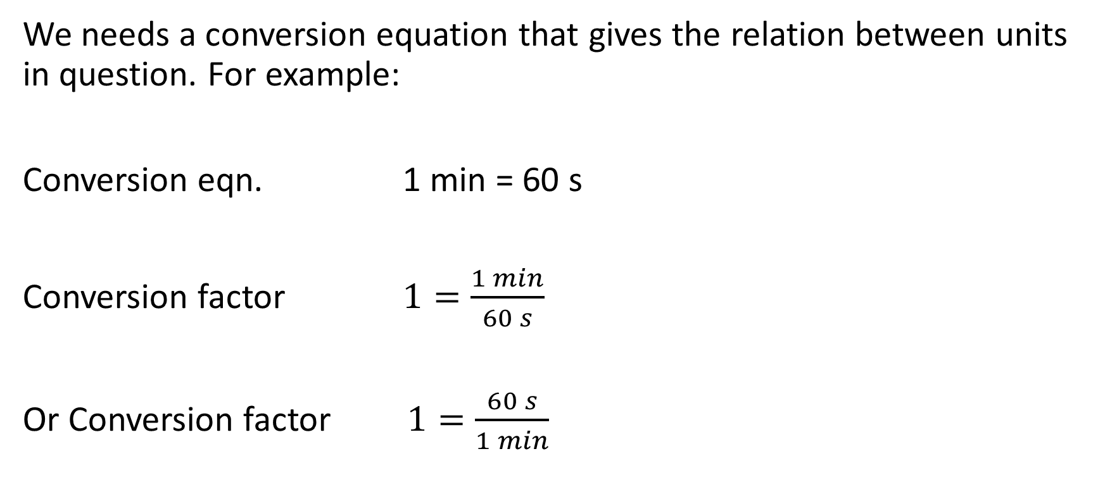
Changing Units
We needs a conversion equation that gives the relation between units in question. For example:
Conversion eqn. 1 min = 60 s
Conversion factor $1=\frac{1 min}{60 s}$
Or Conversion factor $1=\frac{60 s}{1 min}$

Slide 9
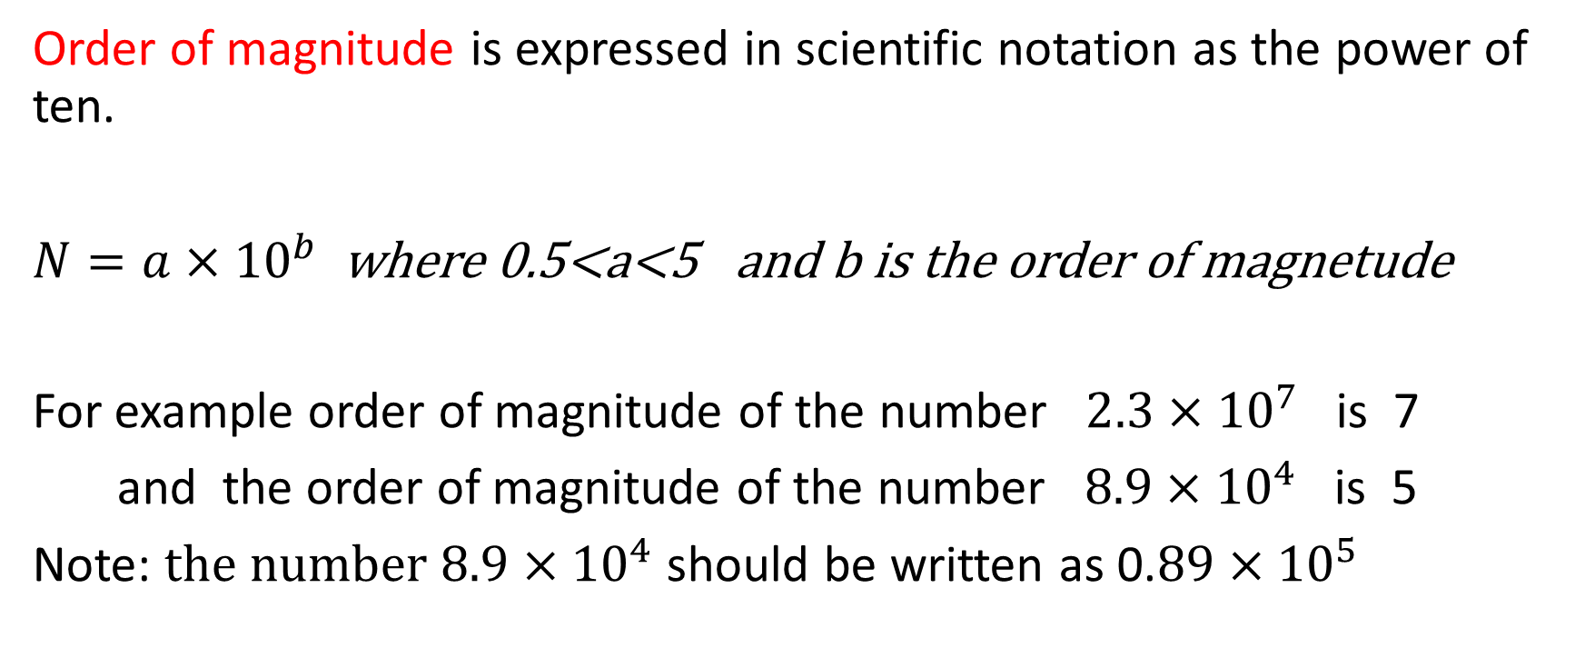
Order of Magnitude
Order of magnitude is expressed in scientific notation as the power of ten.
$N=a×{10}^{b}$ where 0.5<a<5 and b is the order of magnetude
For example order of magnitude of the number $2.3×{10}^{7}$ is 7
and the order of magnitude of the number $8.9×{10}^{4}$ is 5
Note: $the number 8.9×{10}^{4}$ should be written as 0.$89×{10}^{5}$

Slide 10
Significant Figures (S.F.) and Decimal Places (D.P.)
The number 51.1 has three S.F. and one D.P.
The number 51.10 has four S.F. and two D.P.
The number 511.0 has four S.F. and one D.P.
The number 0.0511 has three S.F. and four D.P.

Slide 11
Math With Significant Figures Significant Figures (S.F.) and Decimal Places (D.P.)
In multiplication and division:
the number of S.F. of the result is equal to the S.F. of the number that has the least S.F.
In addition and subtraction :
the number of D.P. of the result is equal to the D.P. of the number that has the least D.P.

Slide 12
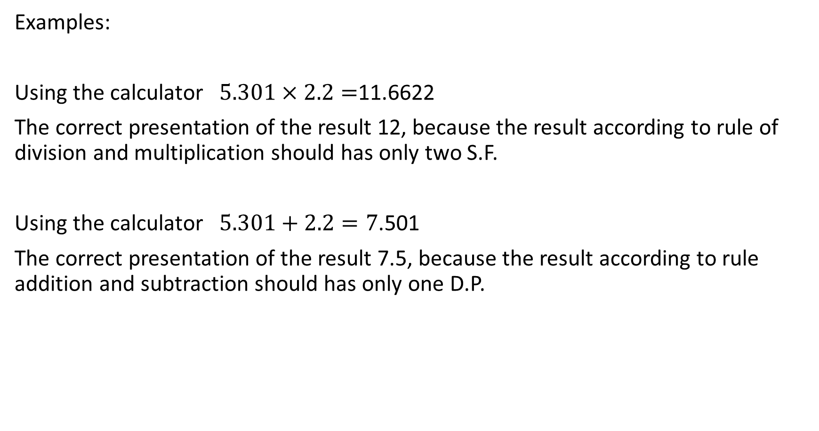
Examples:
Using the calculator $5.301×2.2=$11.6622
The correct presentation of the result 12, because the result according to rule of division and multiplication should has only two S.F.
Using the calculator $5.301+2.2=7$.501
The correct presentation of the result 7.5, because the result according to rule addition and subtraction should has only one D.P.

Slide 13
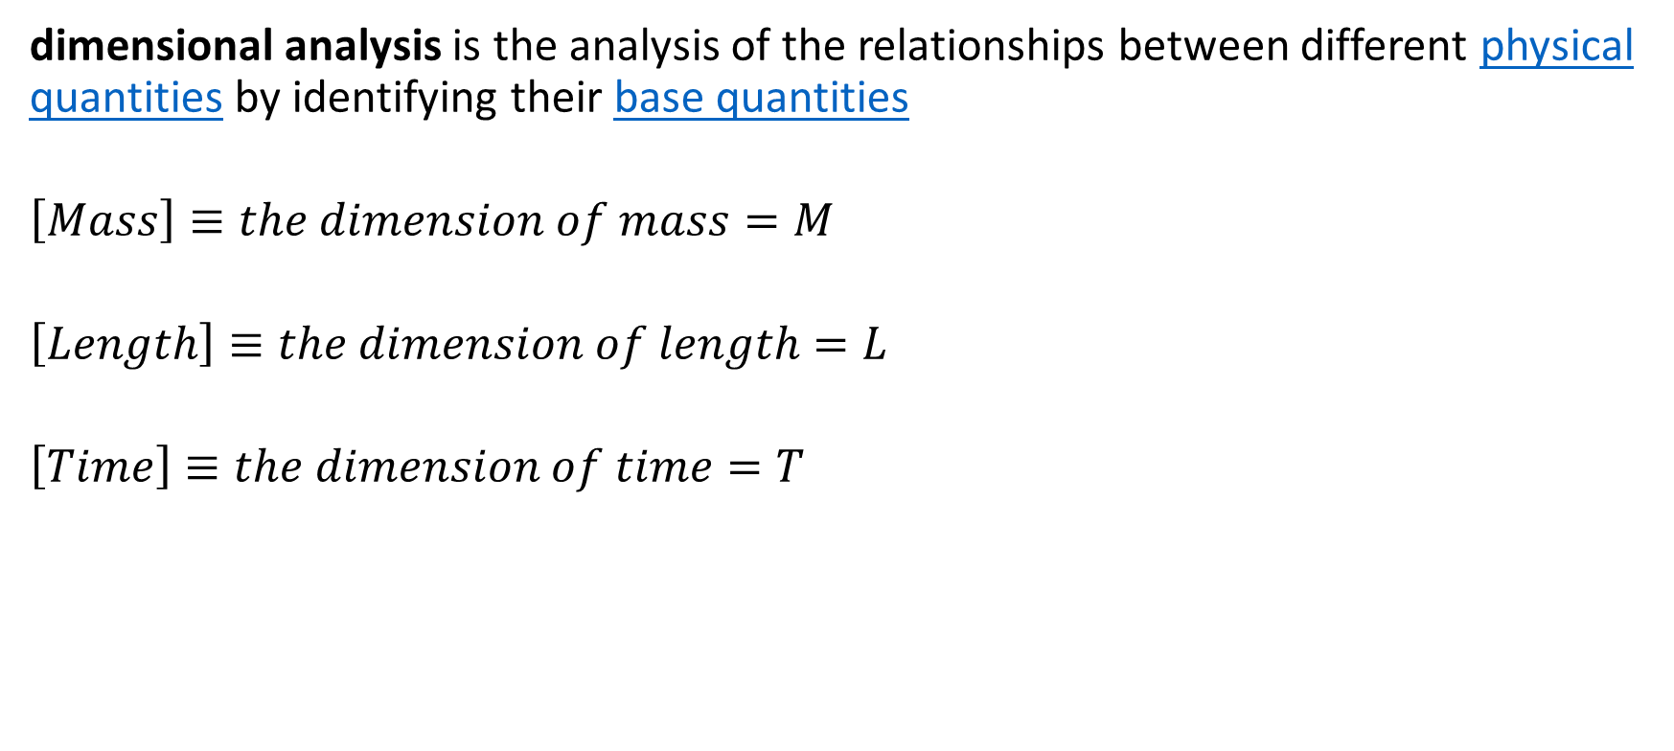
Dimensions Analysis
dimensional analysis is the analysis of the relationships between different physical quantities by identifying their base quantities
$$\left[Mass\right]≡the dimension of mass=M$$
$$\left[Length\right]≡the dimension of length=L$$
$$\left[Time\right]≡the dimension of time=T$$

