Slide 1
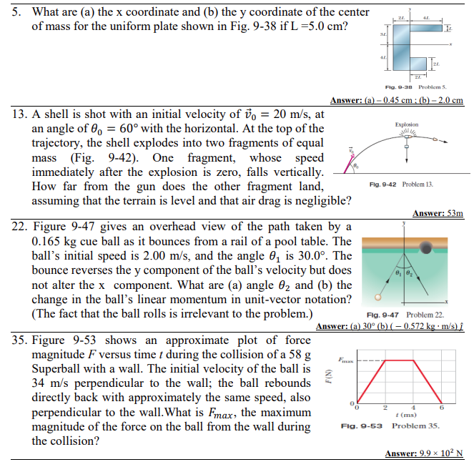

Slide 2
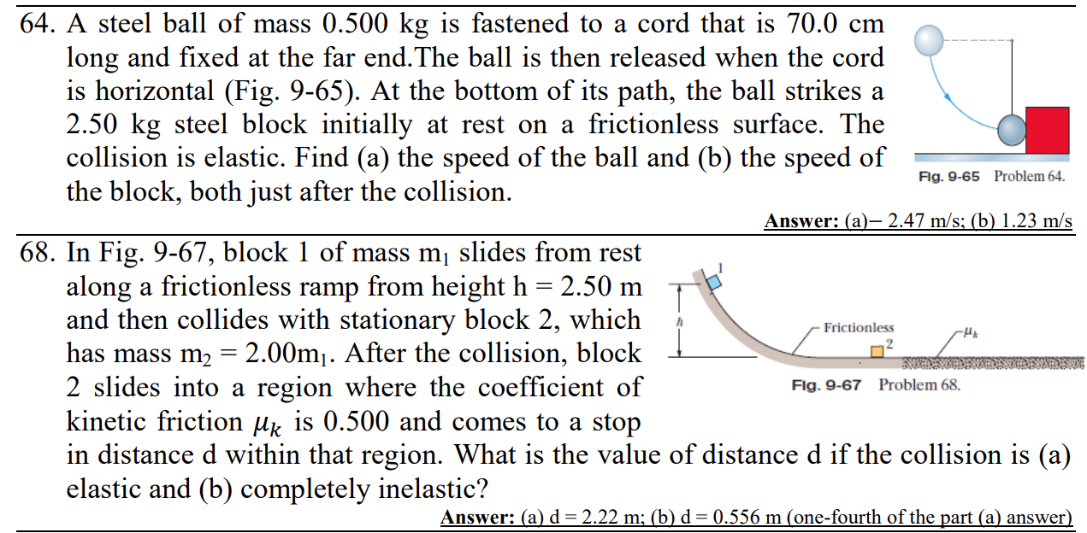

Slide 3
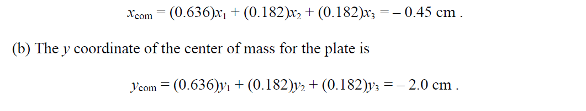

Slide 4
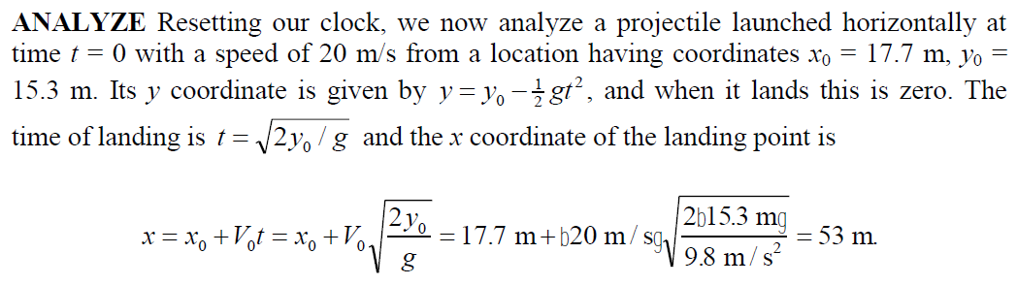

Slide 5
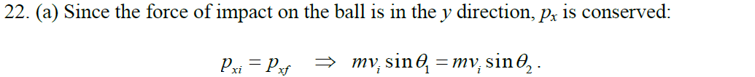
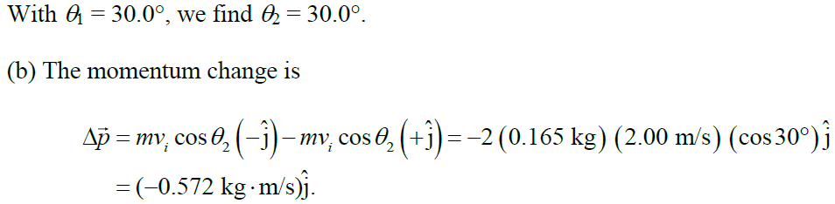

Slide 6
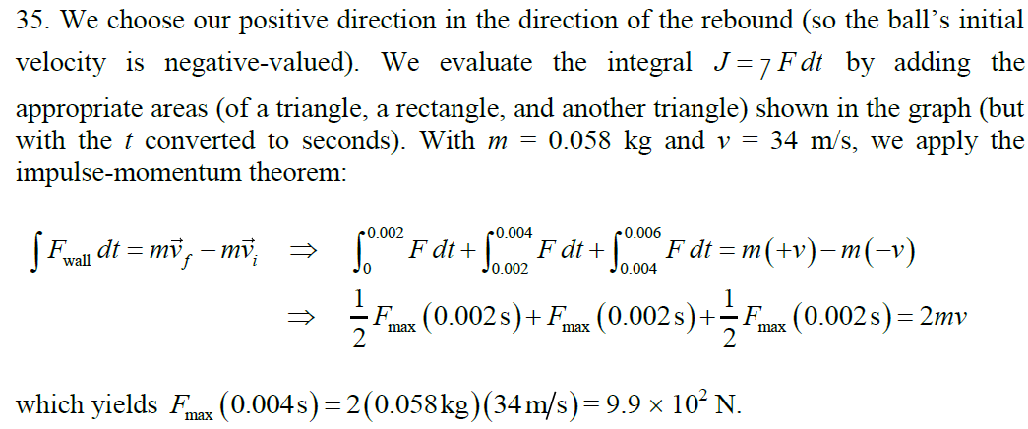

Slide 8
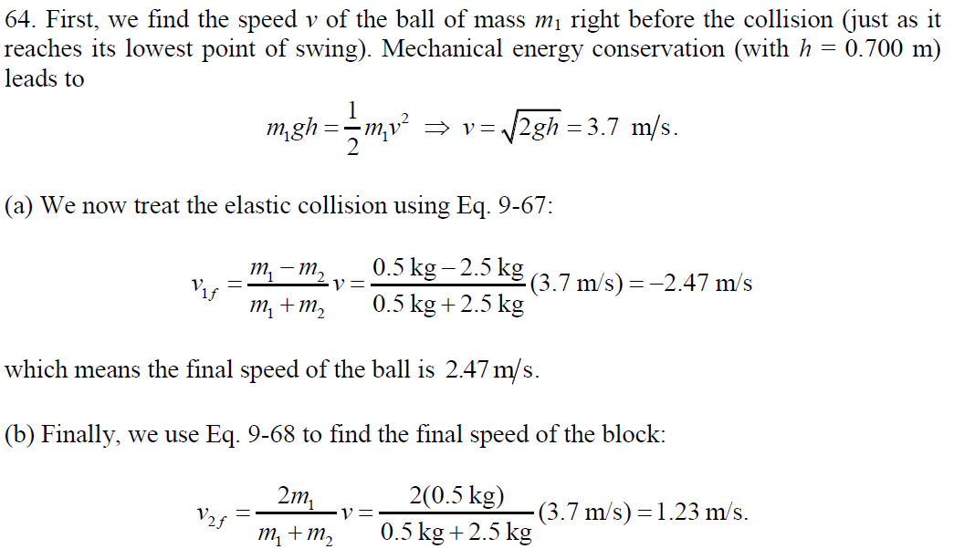

Slide 10
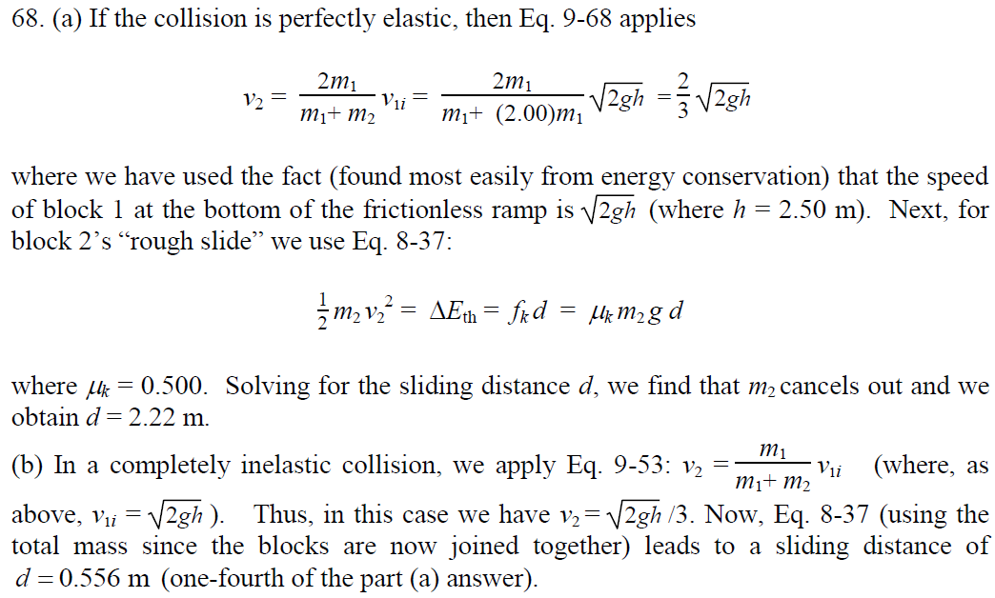

Slide 11
Example
What are (a) the x coordinate and (b) the y coordinate of the center of mass for the uniform plate shown in the figure if L = 5.0 cm?

Slide 12
Example
A stone is dropped at t = 0. A second stone, with twice the mass of the first, is dropped from the same point at t = 100 ms. (a)How far below the release point is the center of mass of the two stones at t = 300 ms? (Neither stone has yet reached the ground. (b) How fast is the center of mass of the two stone system moving at that time?

Slide 13
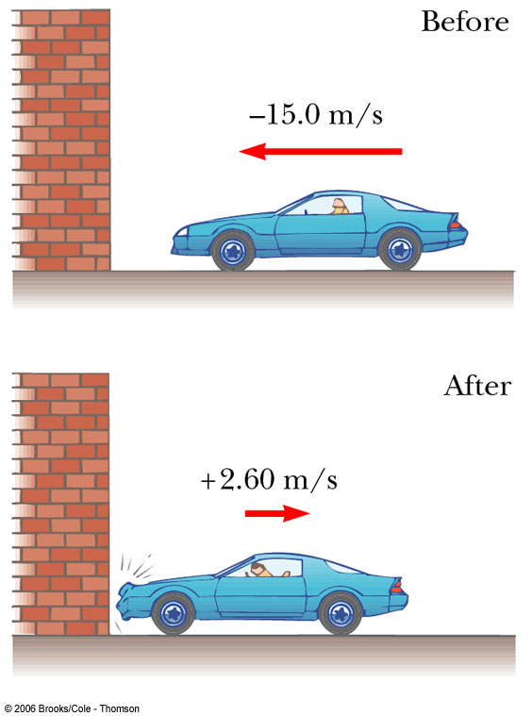
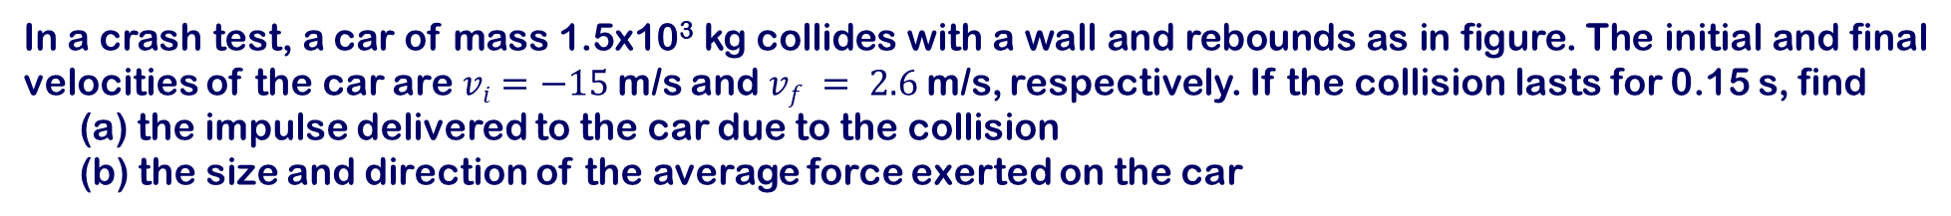
Example
In a crash test, a car of mass 1.5x10³ kg collides with a wall and rebounds as in figure. The initial and final velocities of the car are $vi=−15$m/s and $vf = 2.6$m/s, respectively. If the collision lasts for 0.15 s, find
(a) the impulse delivered to the car due to the collision
(b) the size and direction of the average force exerted on the car

Slide 14
Example

Slide 15
Example
After a 0.300-kg rubber ball is dropped from a height of 1.75 m, it bounces off a concrete floor and rebounds to a height of 1.50 m. (a) Determine the magnitude and direction of the impulse delivered to the ball by the floor. (b) If the time the ball is in contact with the floor is t = 0.05 s, calculate the average force the floor exerts on the ball

Slide 18
Two blocks of masses m and 3m are placed on a frictionless, horizontal surface. A light spring is attached to the more massive block, and the blocks are pushed together with the spring between them. A cord initially holding the blocks together is burned; after that happens, the block of mass 3m moves to the right with a speed of 2.00 m/s. (a) What is the velocity of the block of mass m? (b) Find the system’s original elastic potential energy, taking m = 0.350 kg.

Slide 19
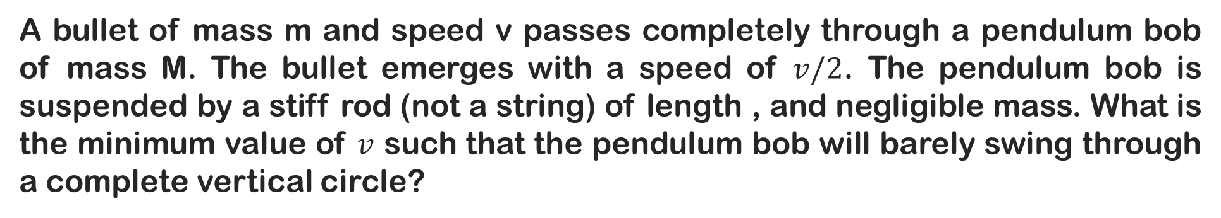
A bullet of mass m and speed v passes completely through a pendulum bob of mass M. The bullet emerges with a speed of $v/2$. The pendulum bob is suspended by a stiff rod (not a string) of length , and negligible mass. What is the minimum value of $v$ such that the pendulum bob will barely swing through a complete vertical circle?

Slide 20
A railroad car of mass 2.50 x 10⁴ kg is moving with a speed of 4.00 m/s. It collides and couples with three other coupled railroad cars, each of the same mass as the single car and moving in the same direction with an initial speed of 2.00 m/s. (a) What is the speed of the four cars after the collision? (b) How much mechanical energy is lost in the collision?

Slide 21
A 1.25-kg wooden block rests on a table over a large hole. A 5.00-g bullet with an initial velocity v_{i} is fired upward into the bottom of the block and remains in the block after the collision. The block and bullet rise to a maximum height of 22.0 cm. Calculate the initial velocity of the bullet from the information provided.

Slide 22
Two blocks are free to slide along the frictionless, wooden track shown in the Figure. The block of mass m₁ = 5.00 kg is released from the position shown, at height h =5.00 m above the flat part of the track. The block of mass m₂ = 10.0 kg, initially at rest. Assuming the two blocks collide elastically. Calculate the maximum height to which m₁ rises after the elastic collision.

