Slide 1
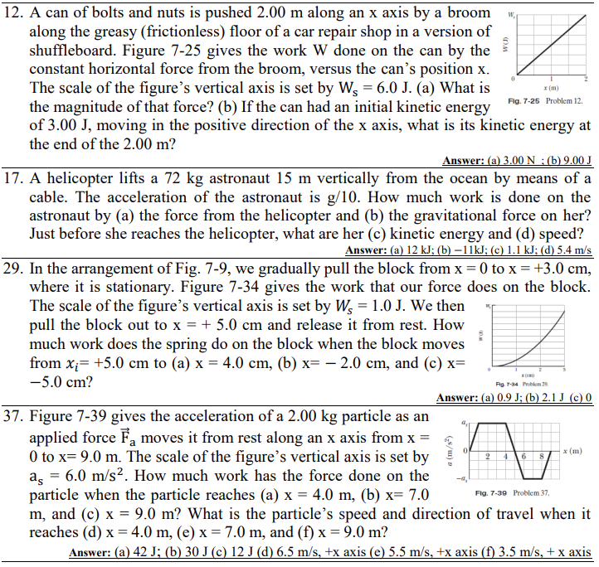

Slide 4
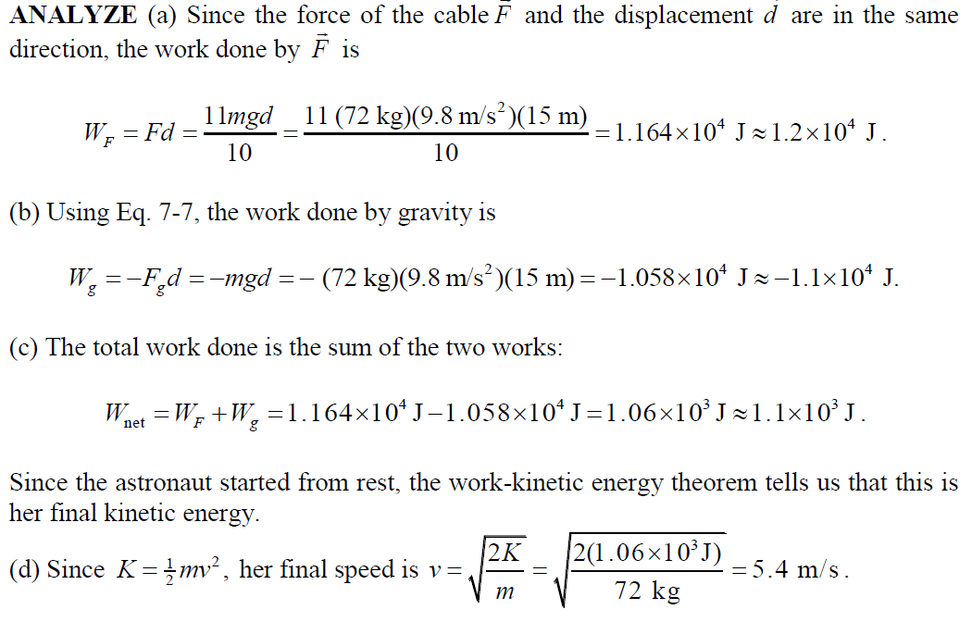

Slide 5
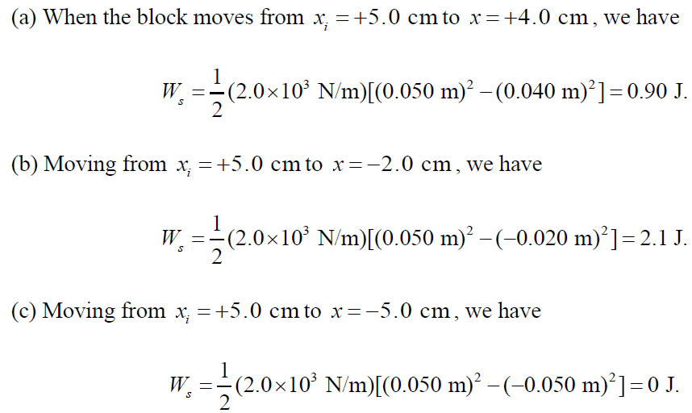

Slide 7
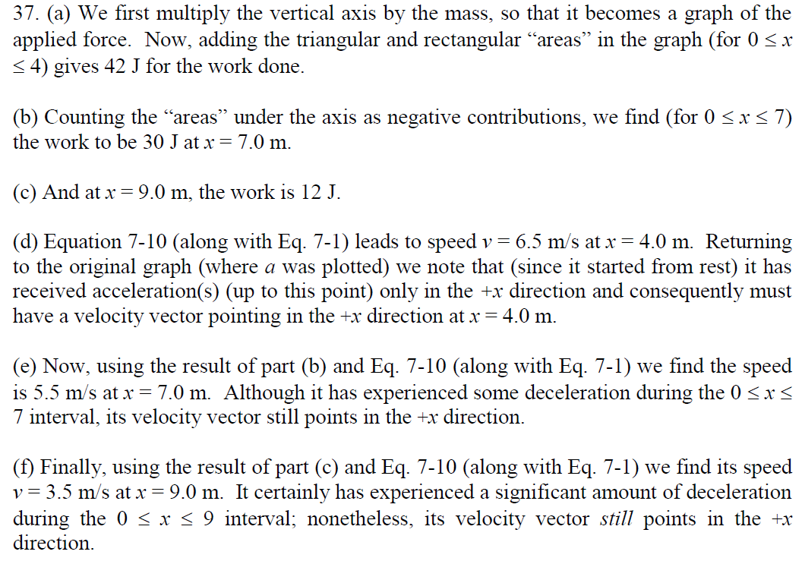

Slide 9
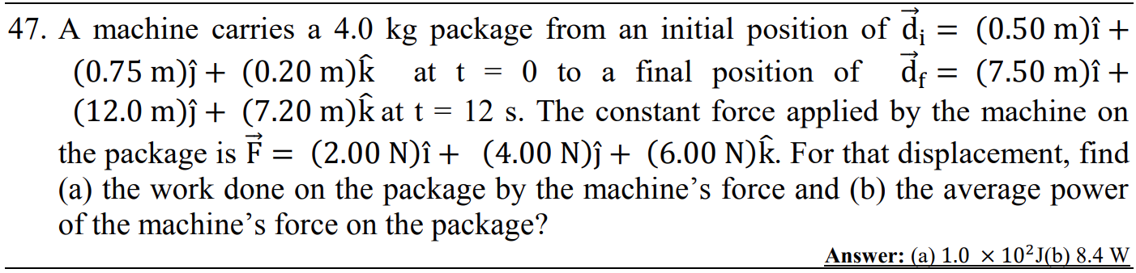
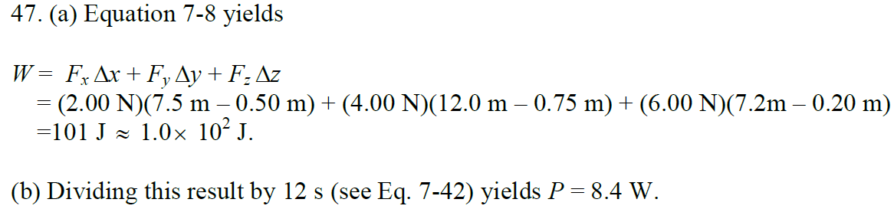

Slide 10
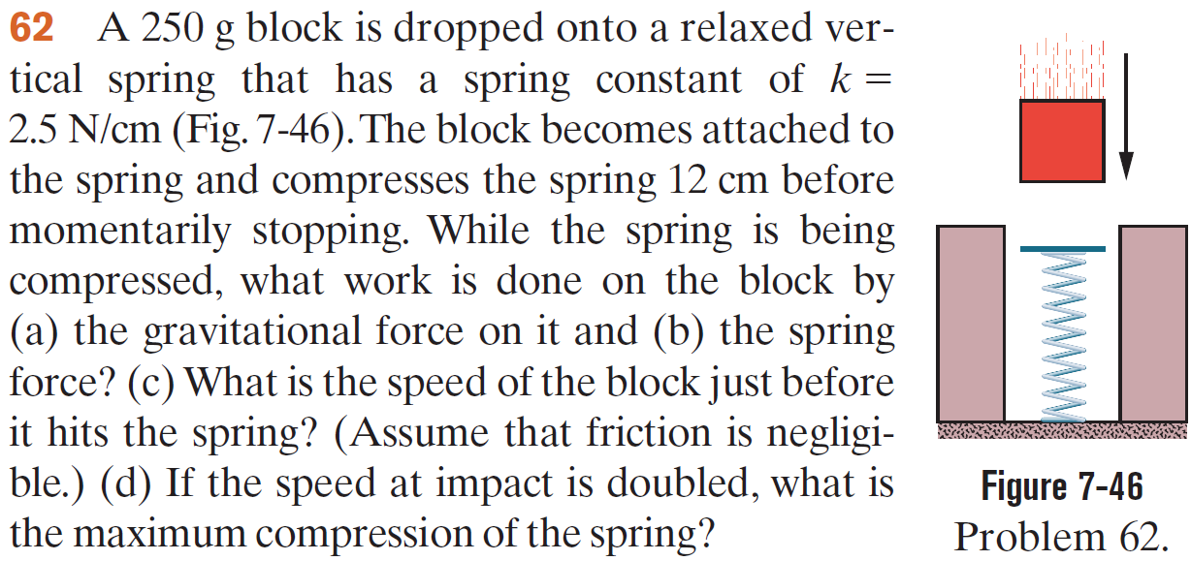

Slide 11
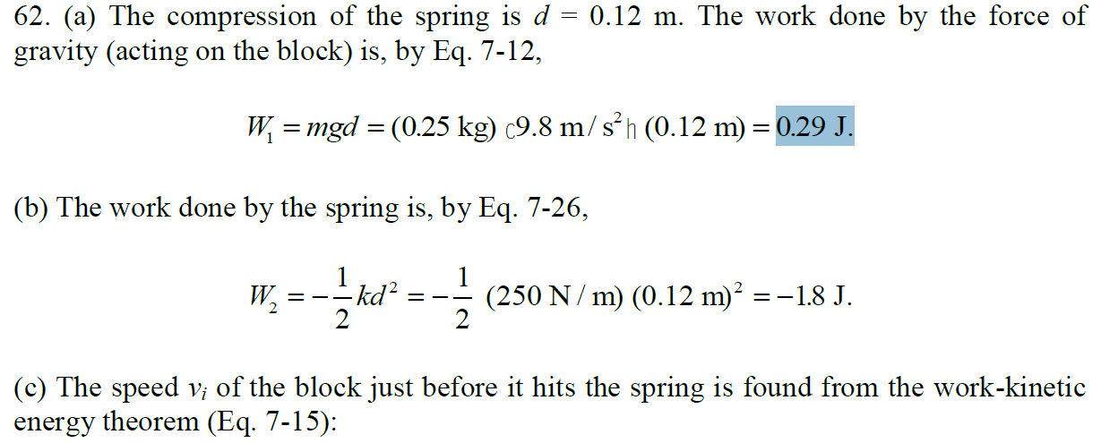

Slide 12
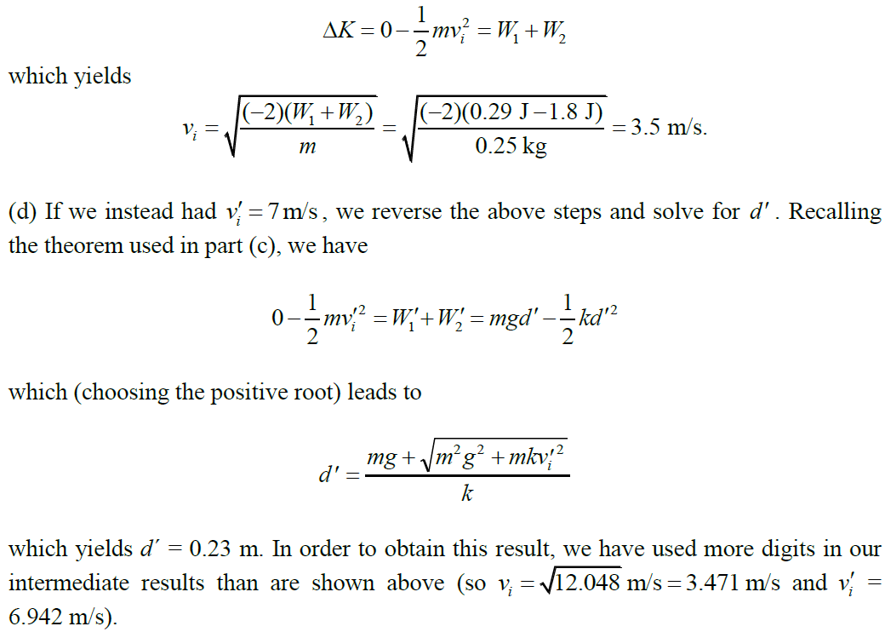

Slide 15
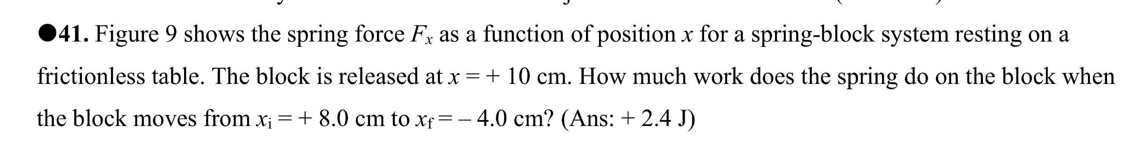
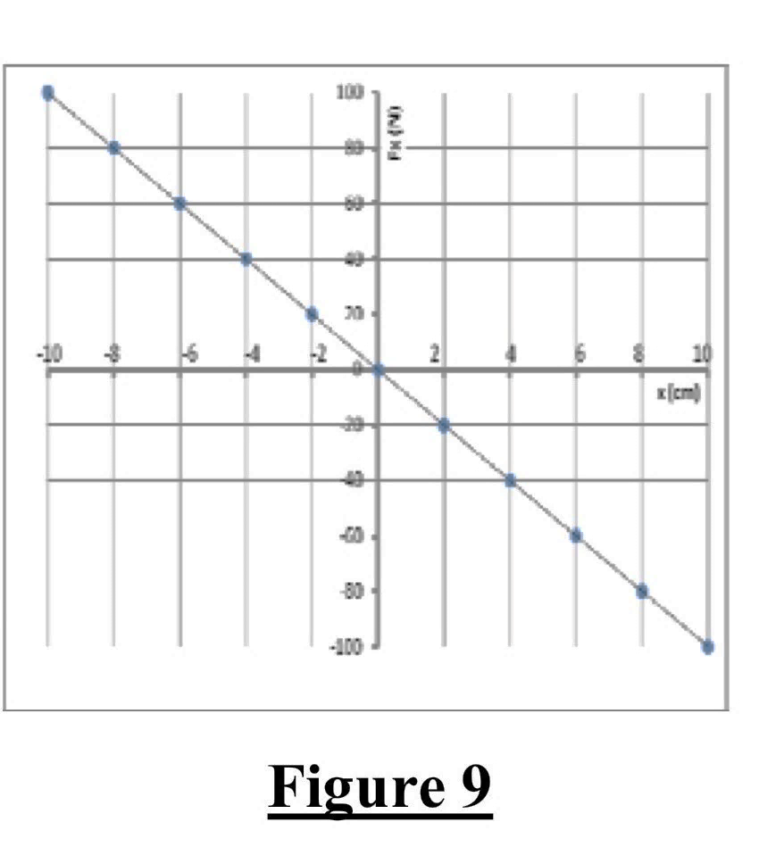

Slide 18
A helicopter lifts a 72 kg astronaut 15 m vertically from the ocean by means of a cable. The acceleration of the astronaut is g/10. How much work is done on the astronaut by (a) the force from the helicopter and (b) the gravitational force on him? Just before she reaches the helicopter, what are his (c) kinetic energy and (d) speed?

Slide 19
A block is sent up a frictionless ramp along which an x axis extends upward. The figure gives the kinetic energy of the block as a function of position x; the scale of the figure’s vertical axis is set by K_{s} = 40.0 J. If the block’s initial speed is 4.00 m/s, what is the normal force on the block?

