Slide 1
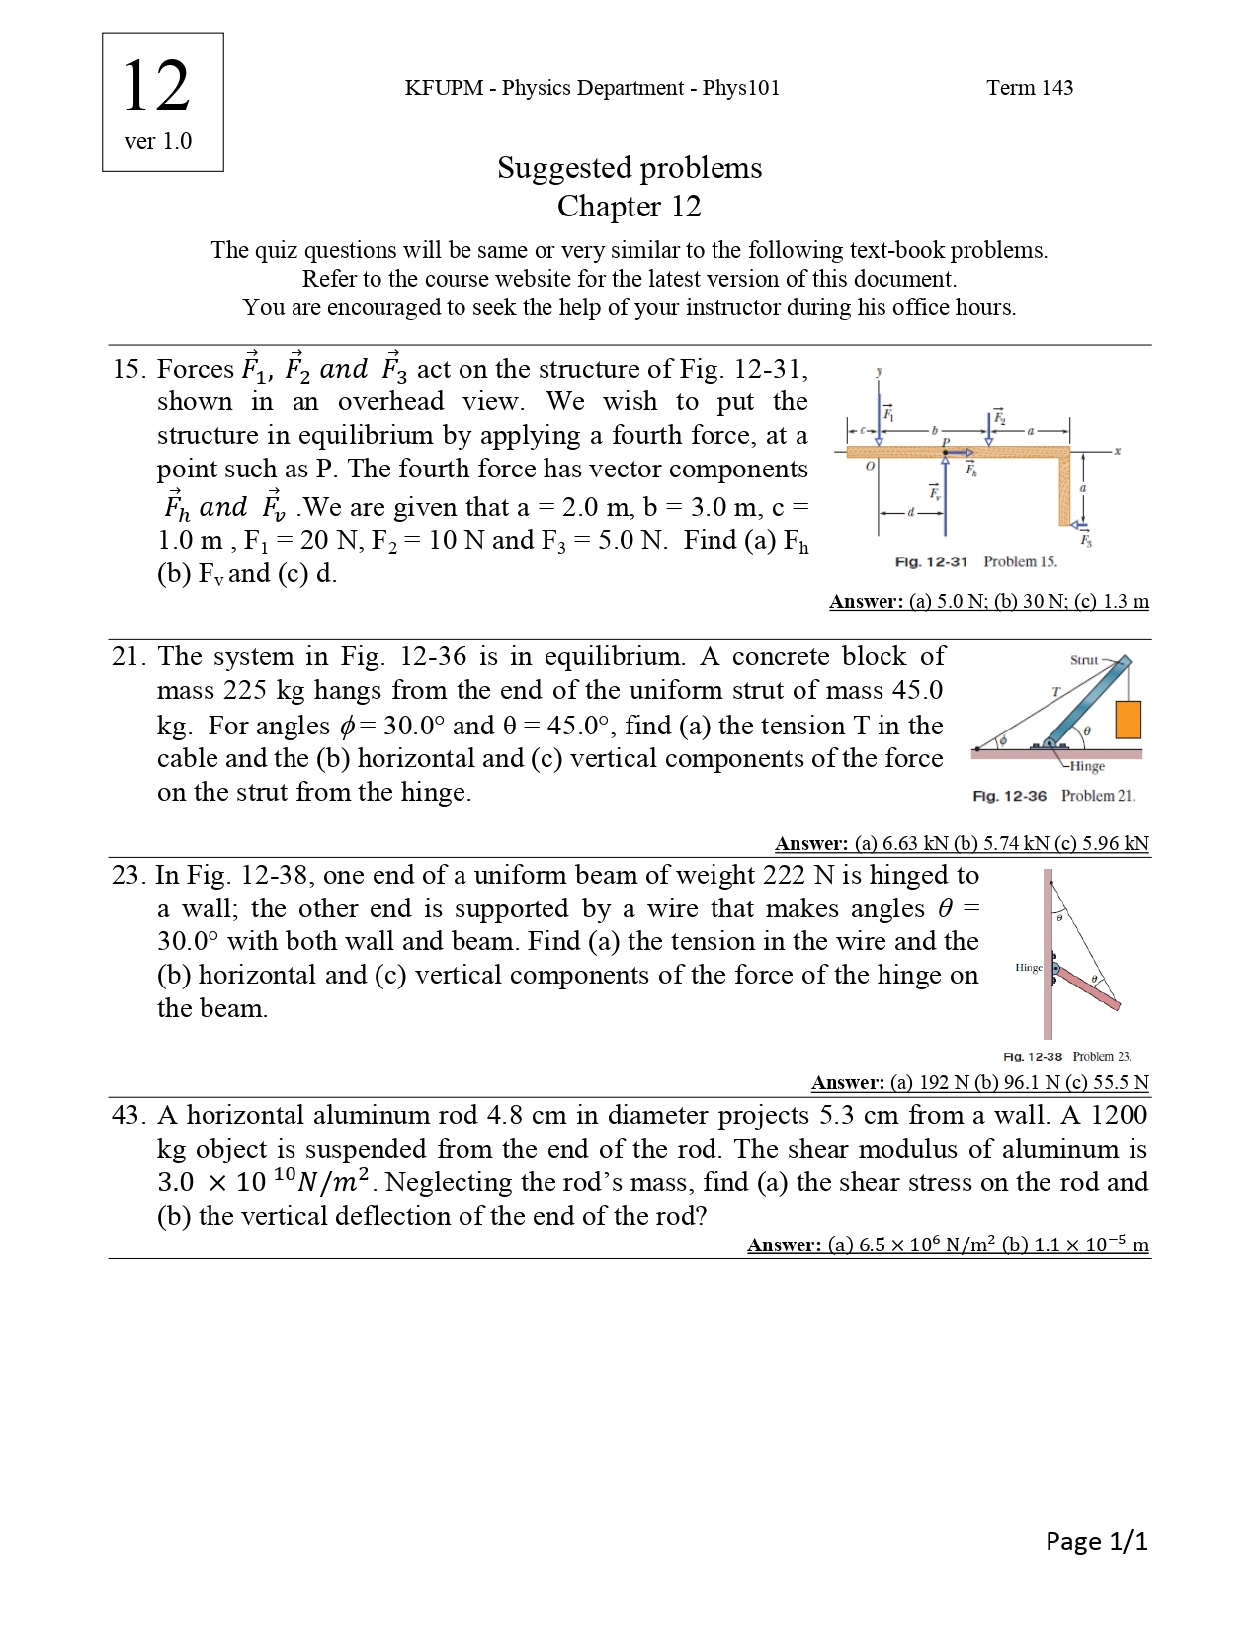

Slide 2
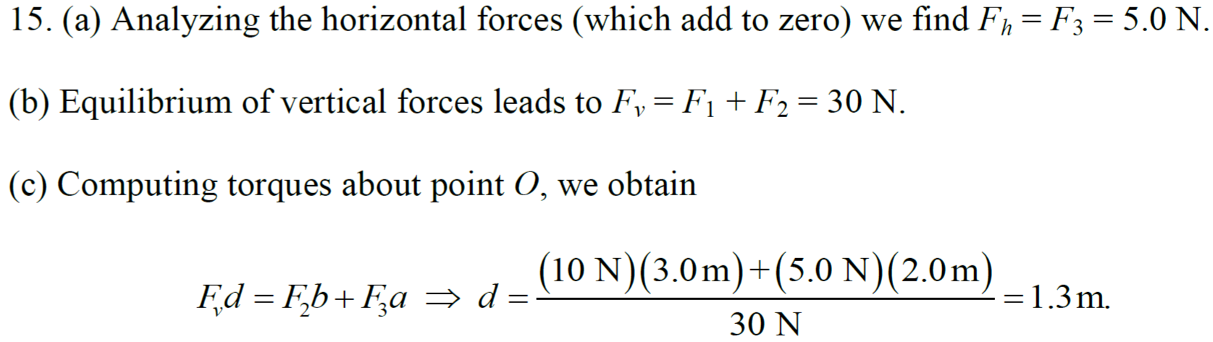

Slide 4
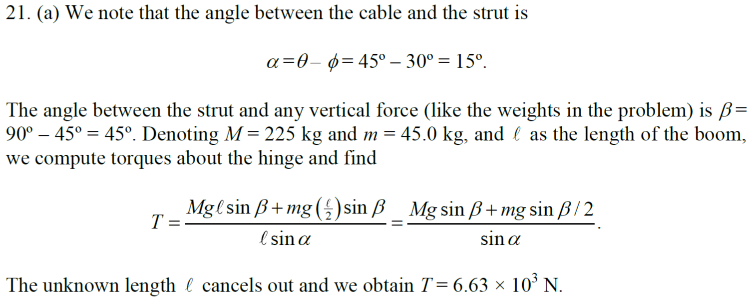

Slide 5
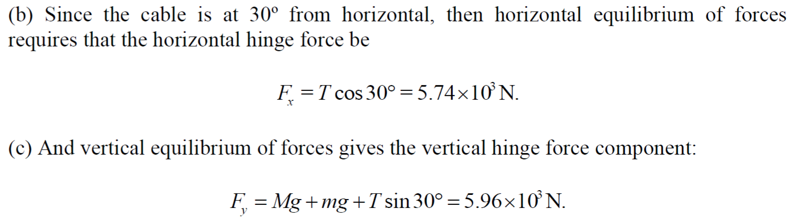

Slide 7
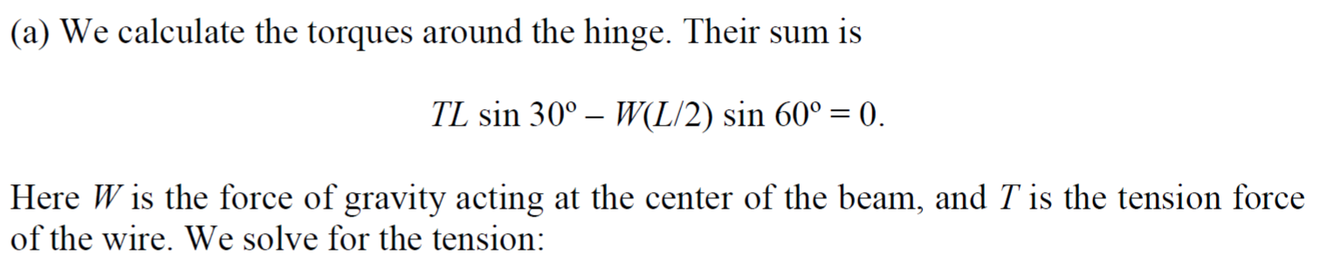
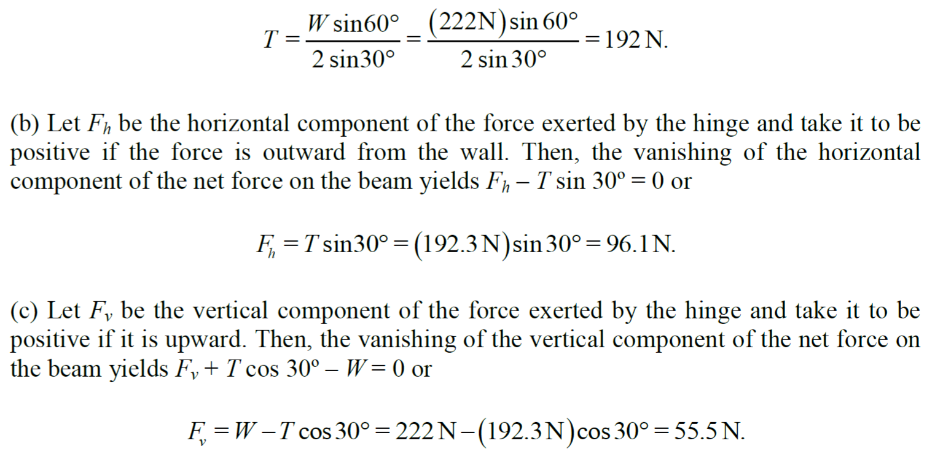

Slide 10
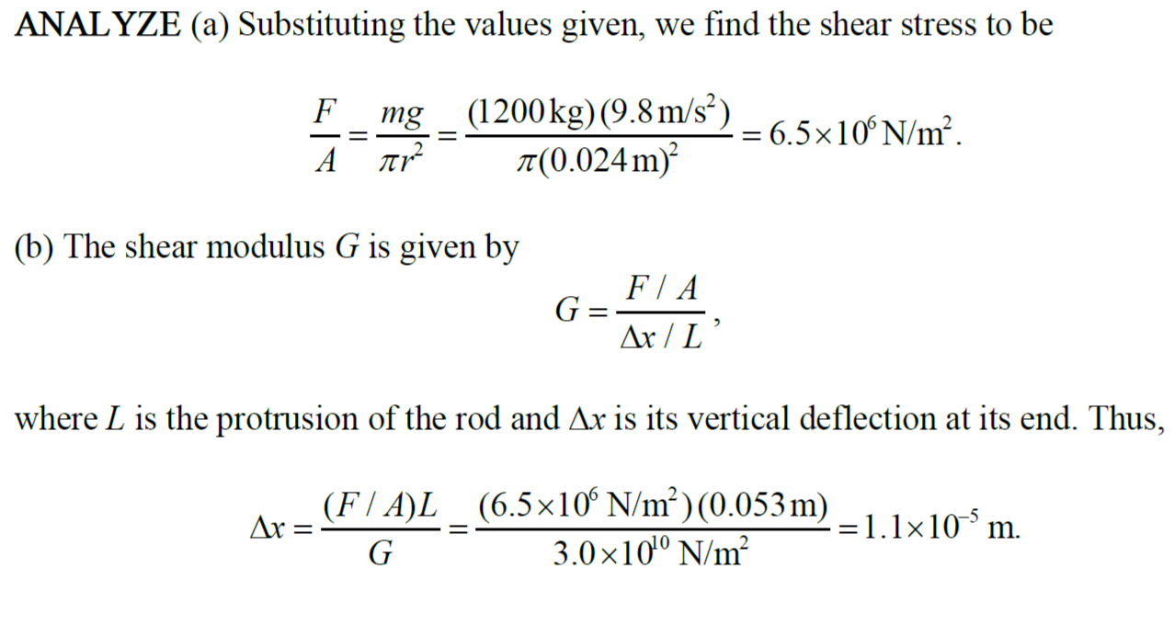

Slide 15
A climber with a weight of 533.8 N is held by a belay rope connected to her climbing harness and belay device; the force of the rope on her has a line of action through her center of mass. The indicated angles are θ = 40.0° and φ = 30.0°. If her feet are on the verge of sliding on the vertical wall, what is the coefficient of static friction between her climbing shoes and the wall?

