Slide 1
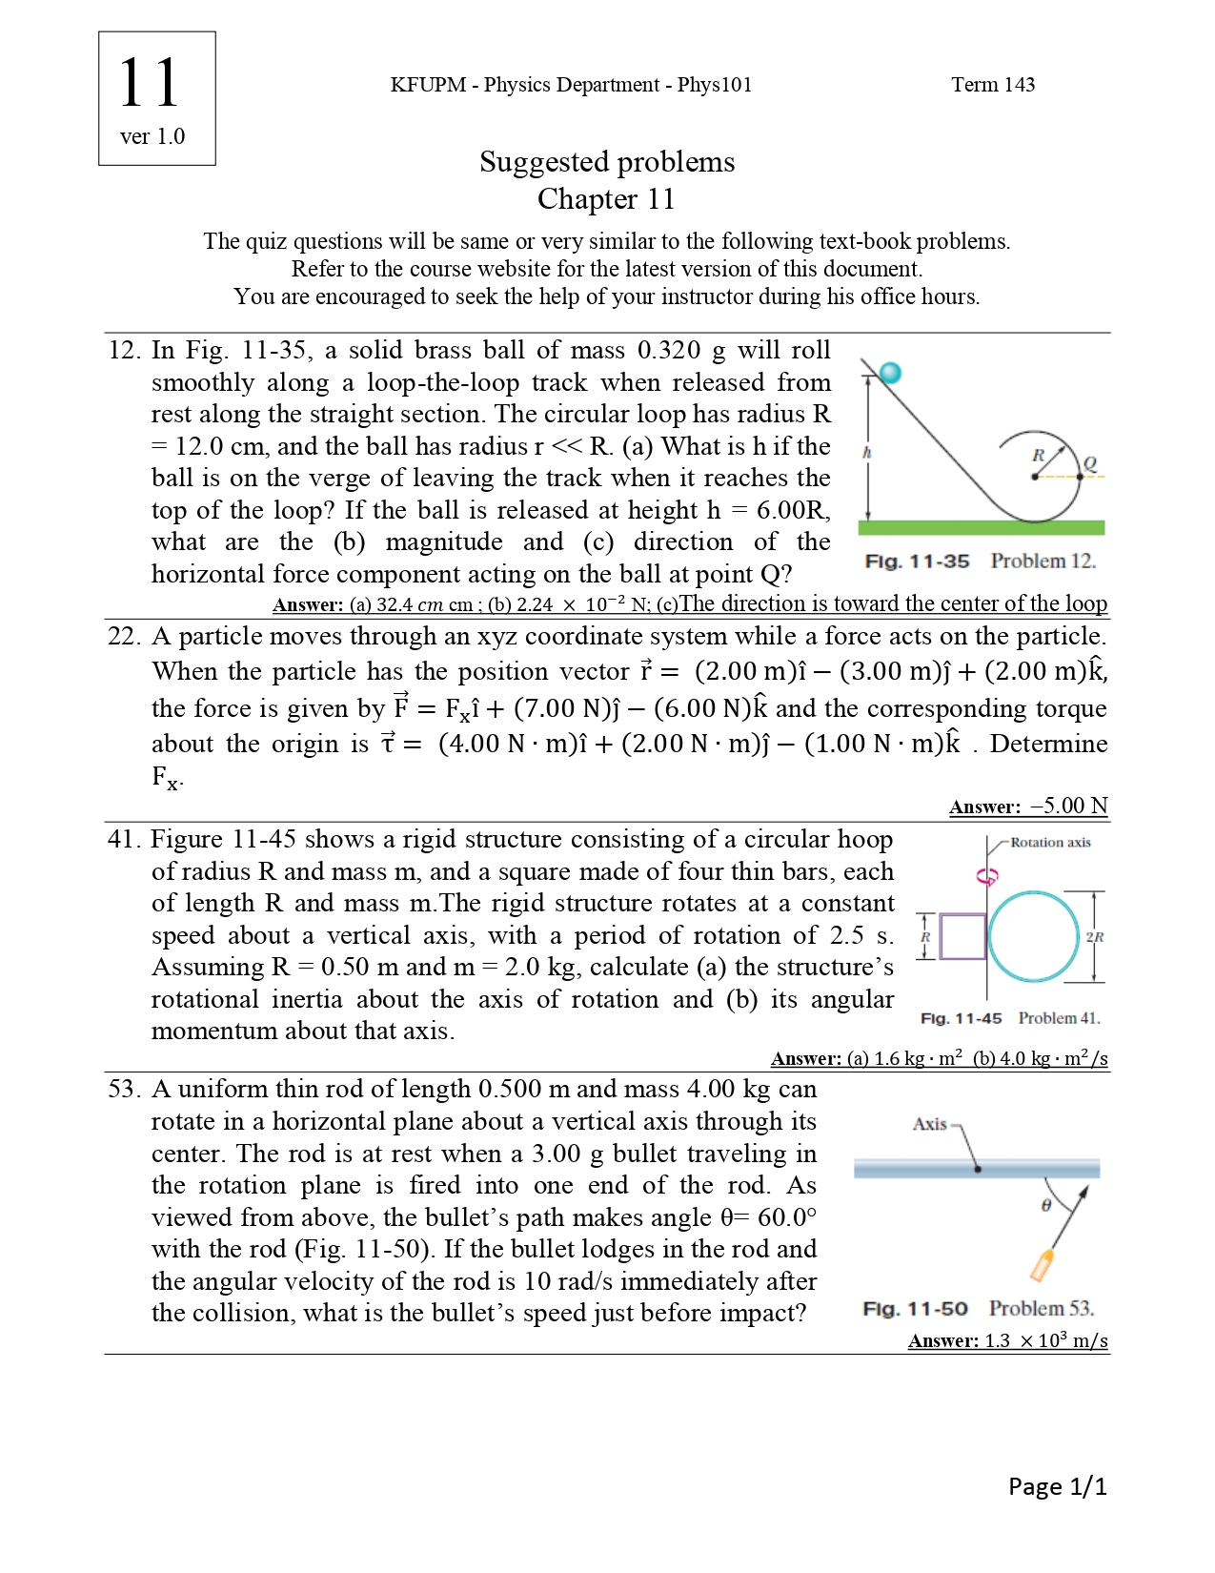

Slide 3
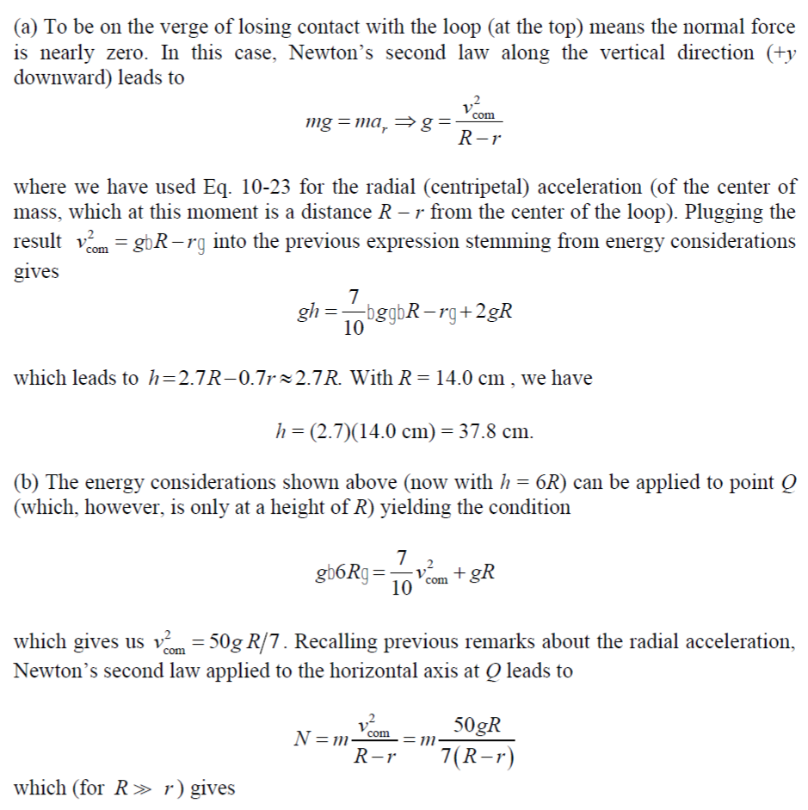

Slide 4
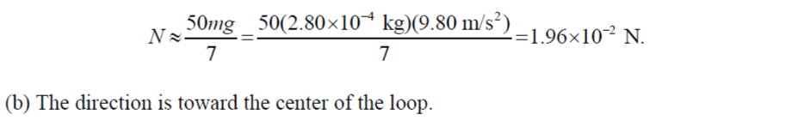

Slide 6
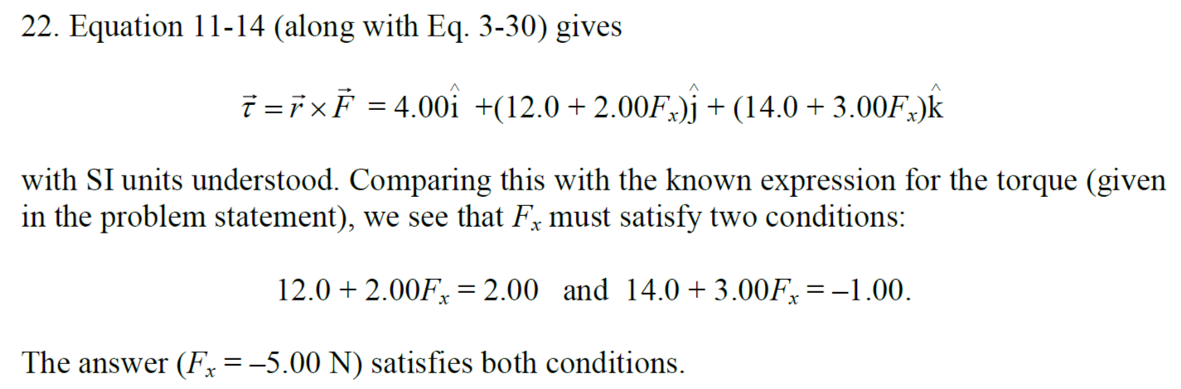

Slide 8
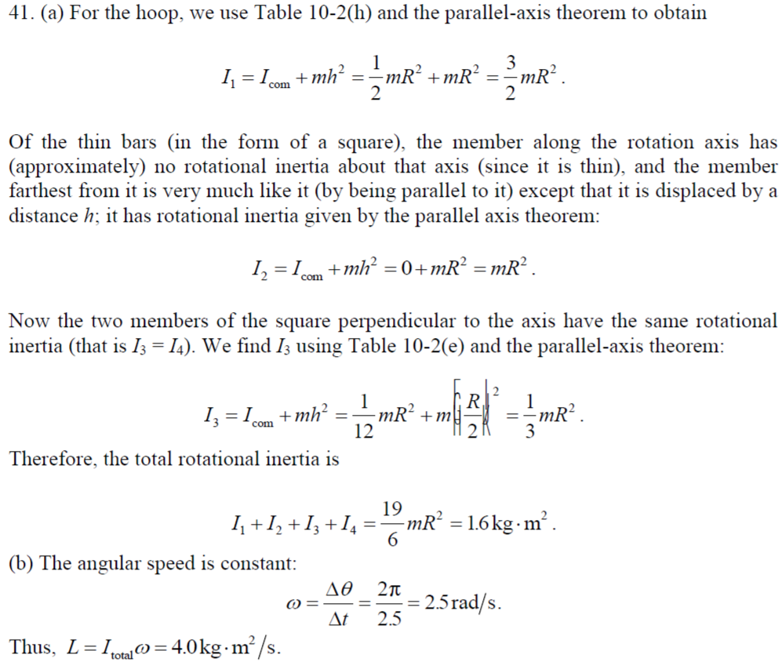

Slide 10
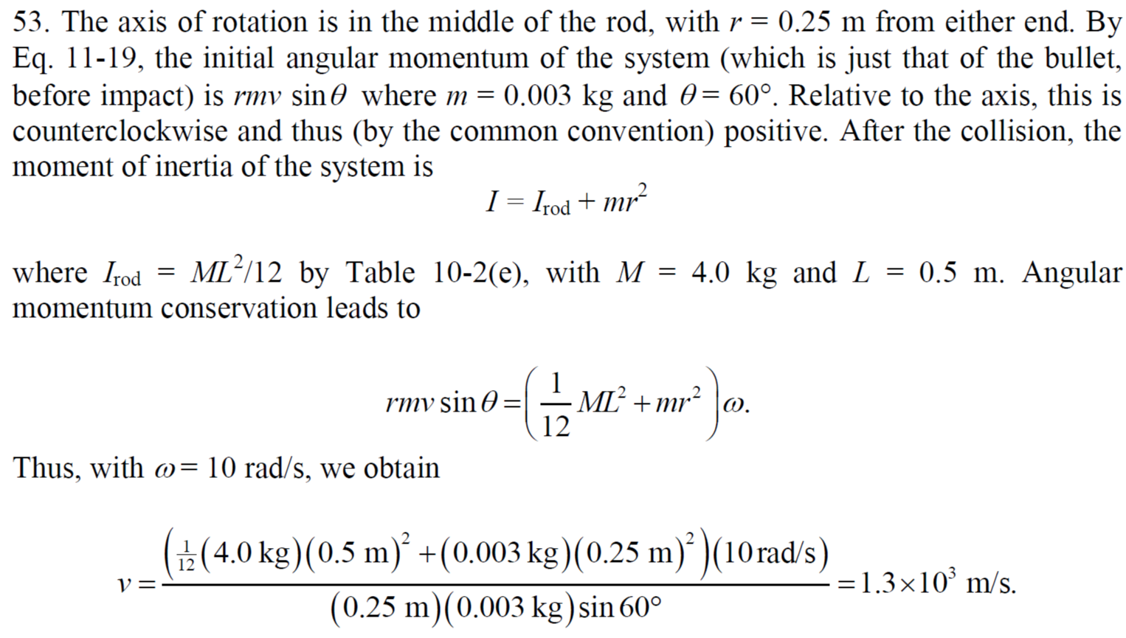

Slide 14
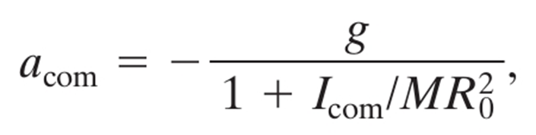

Slide 16
The figure gives the speed v versus time t for a 0.500 kg object of radius 6.00 cm that rolls smoothly down a 30° ramp. The scale on the velocity axis is set by v_{s} = 4.0 m/s. What is the rotational inertia of the object?

Slide 17
A solid brass ball of mass 0.280 g will roll smoothly along a loop-the-loop track when released from rest along the straight section. The circular loop has radius R = 14.0 cm, and the ball has radius r << R. (a) What is h if the ball is on the verge of leaving the track when it reaches the top of the loop?

