Slide 1
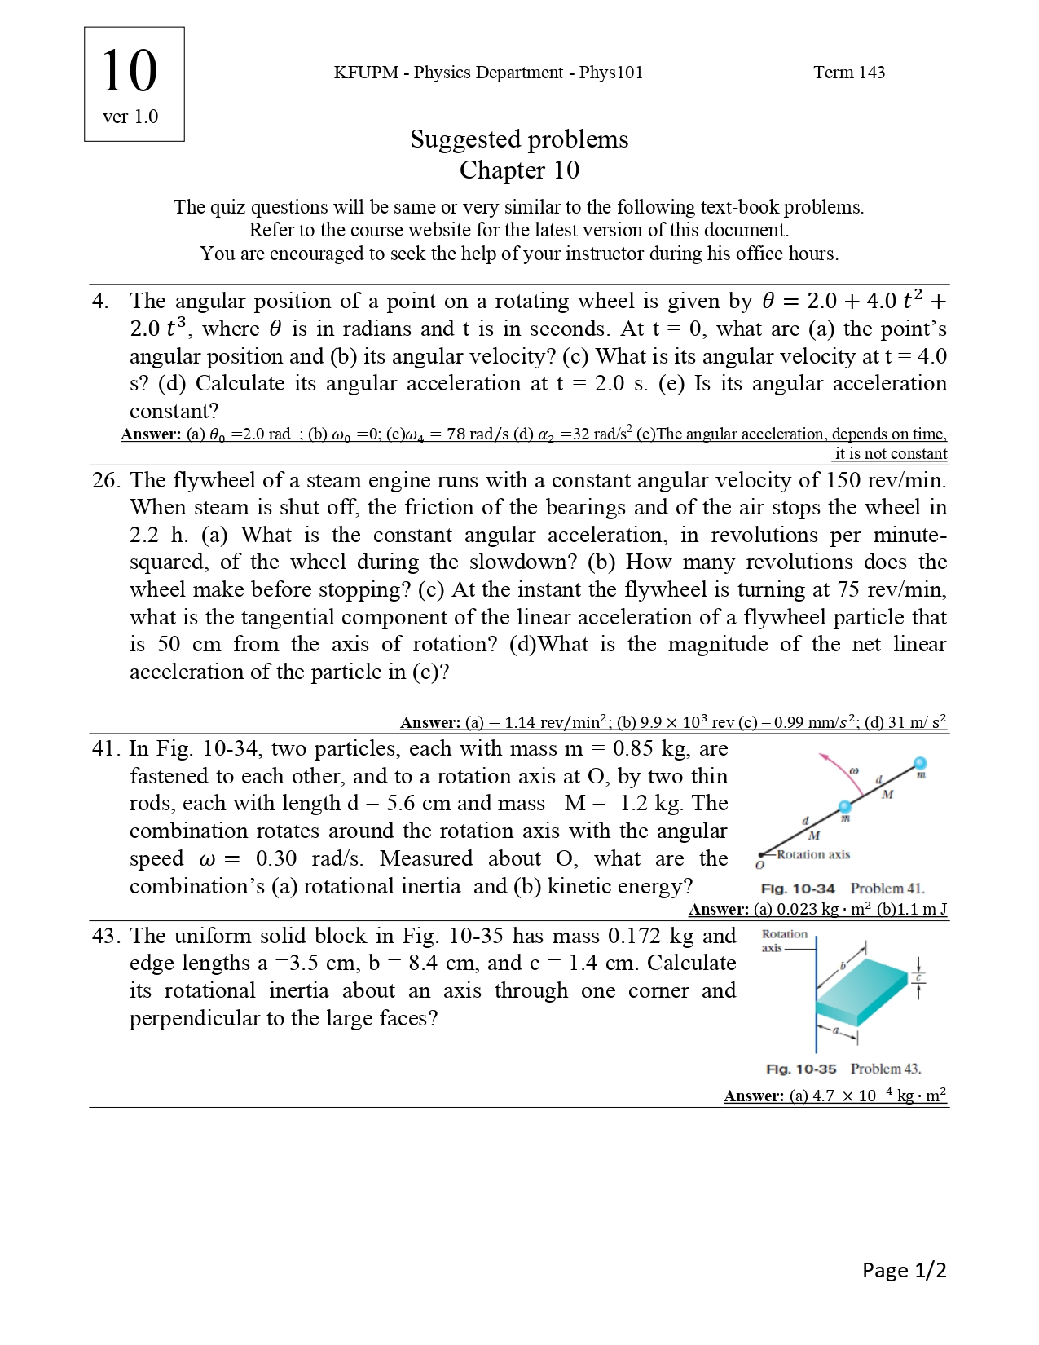

Slide 2
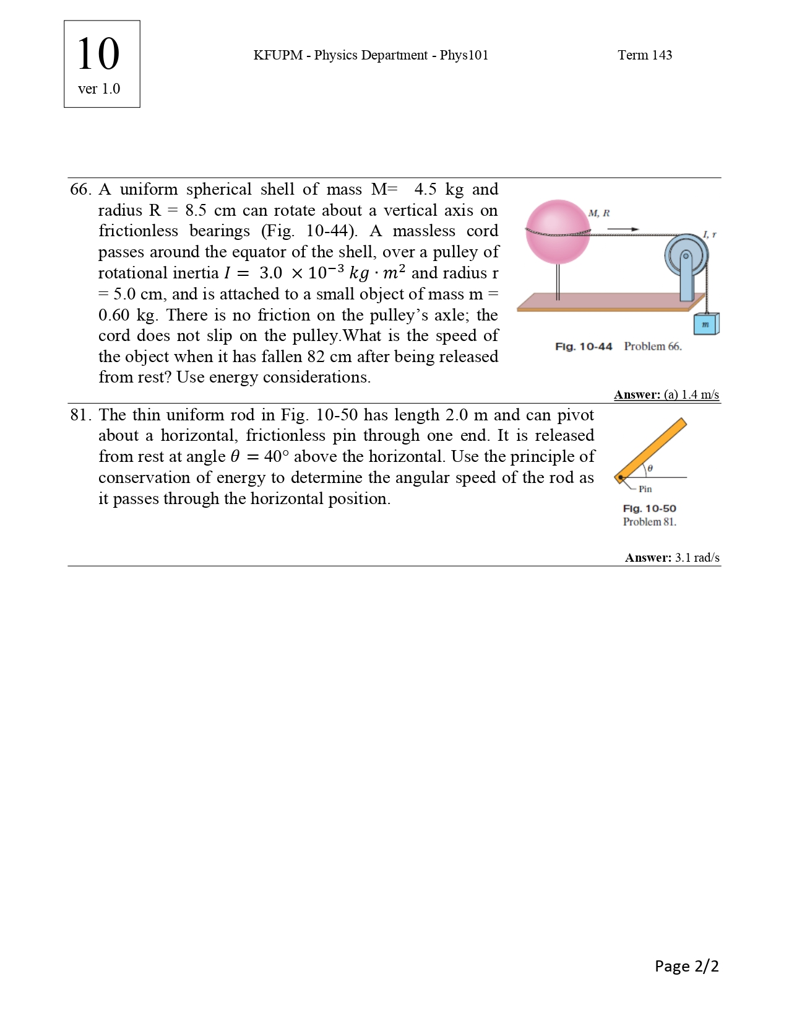

Slide 4
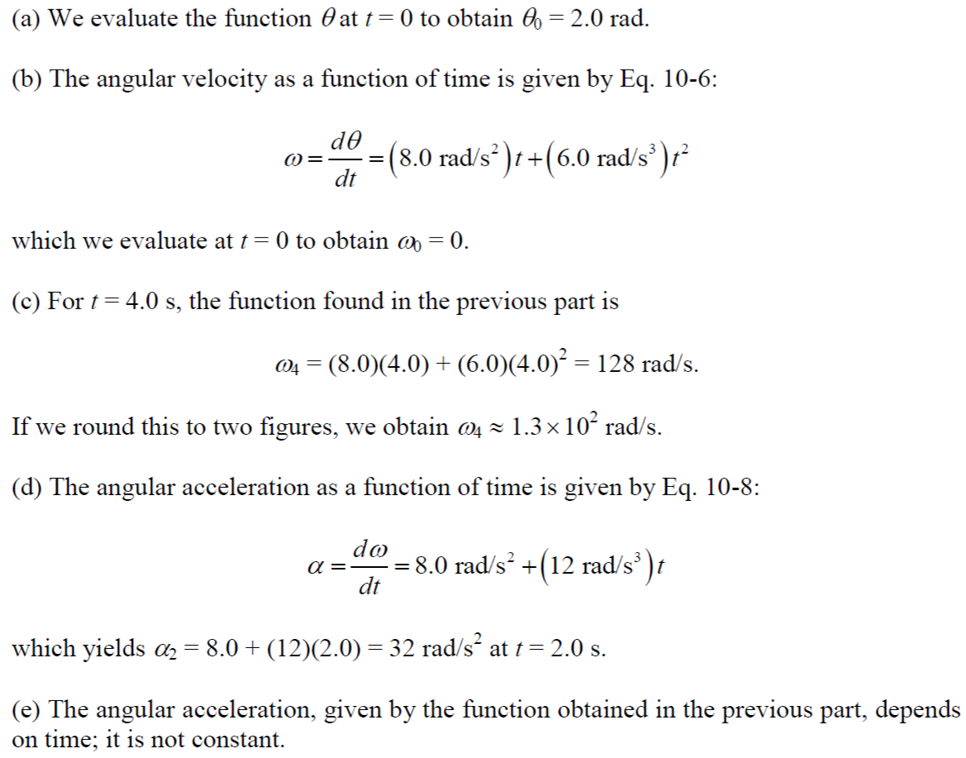

Slide 6
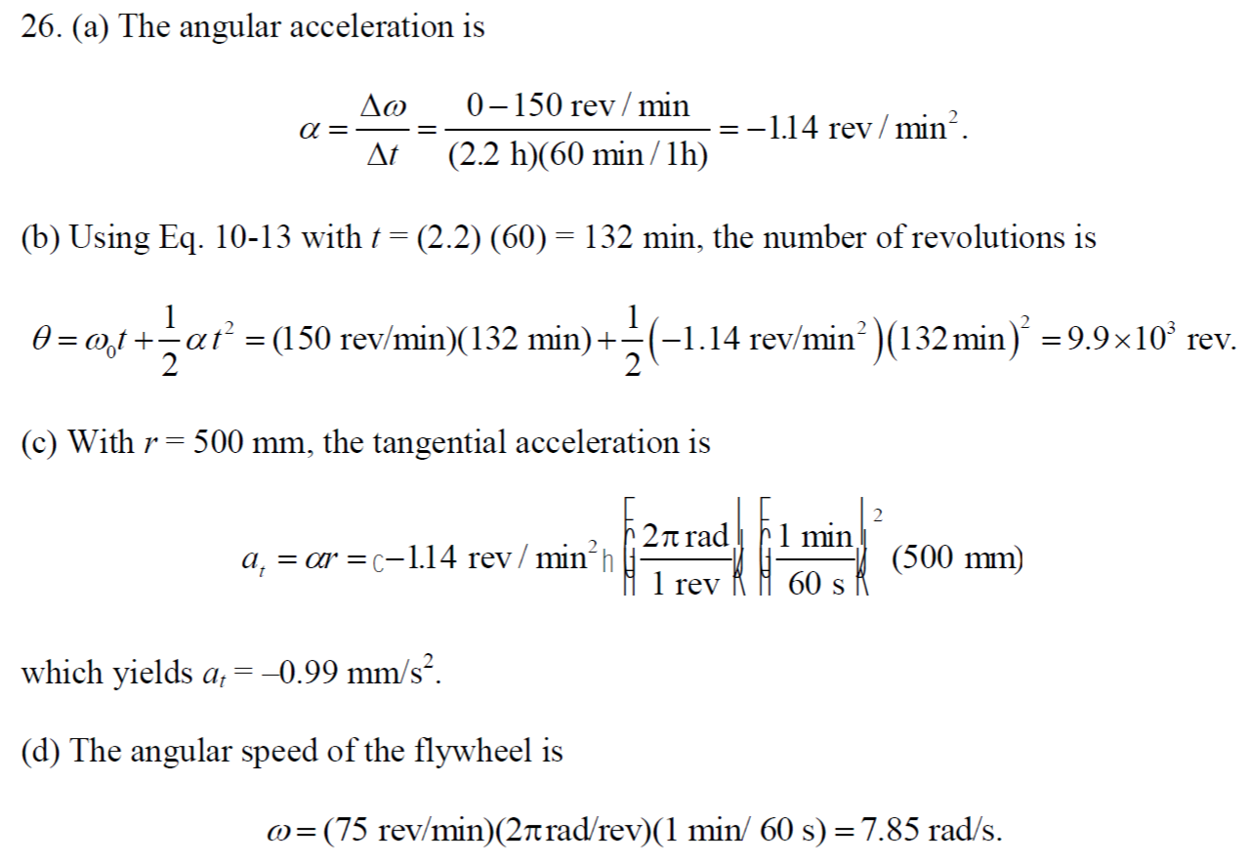

Slide 7
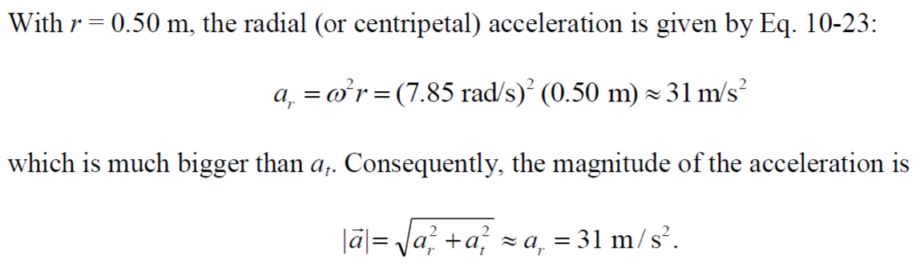

Slide 8
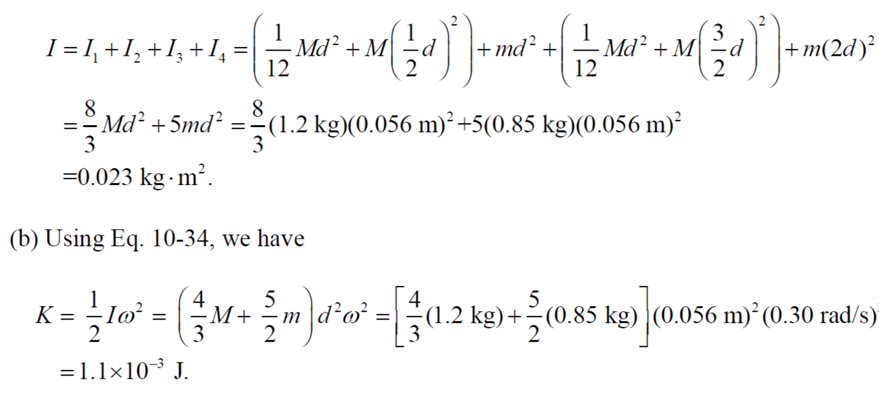

Slide 9
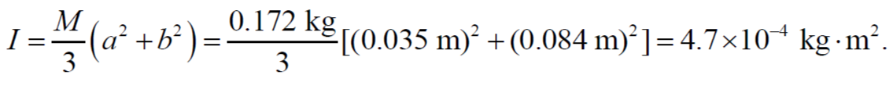

Slide 11
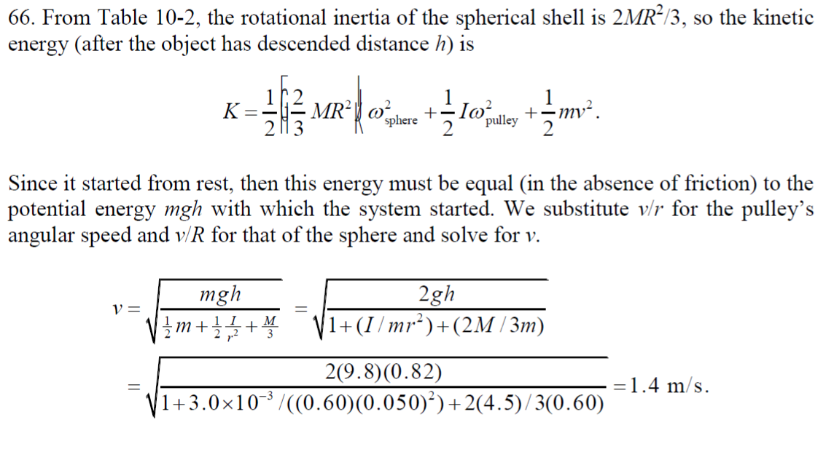

Slide 13
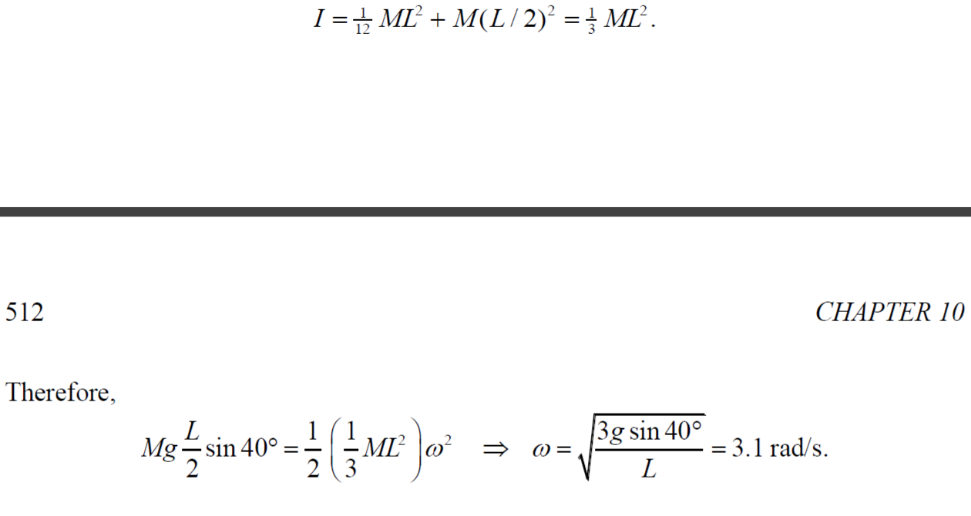

Slide 21
A thin rod of length 0.75 m and mass 0.42 kg is suspended freely from one end. It is pulled to one side and then allowed to swing like a pendulum, passing through its lowest position with angular speed 4.0 rad/s. Neglecting friction and air resistance, find (a) the rod’s kinetic energy at its lowest position and (b) how far above that position the center of mass rises.

