Slide 1
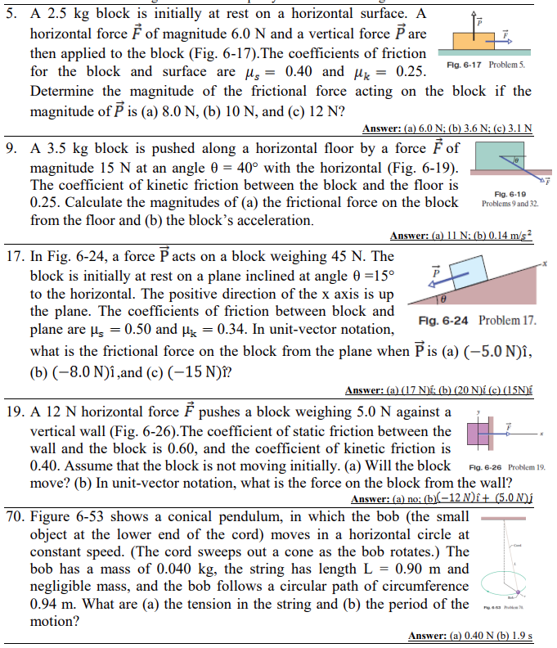

Slide 3
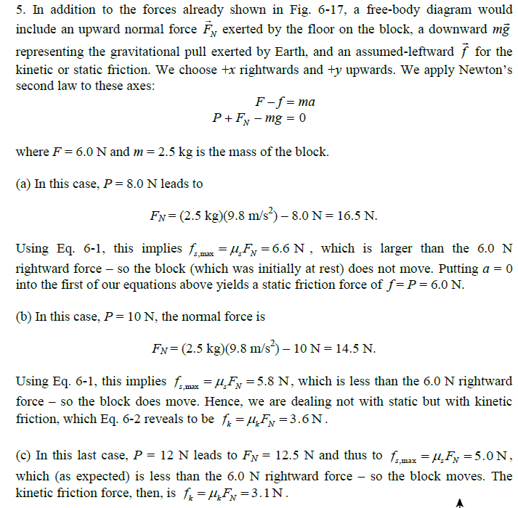

Slide 4
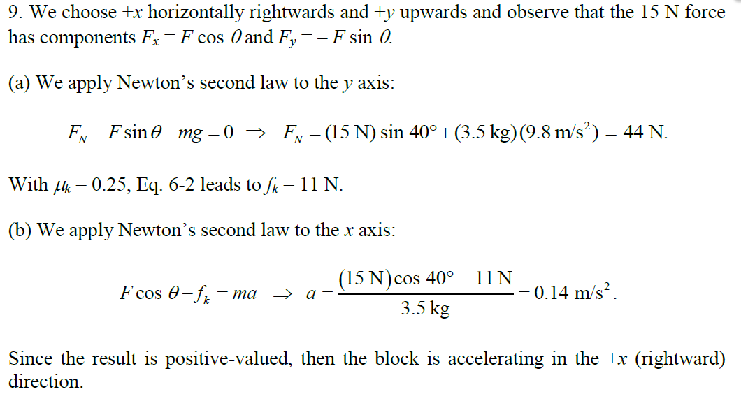

Slide 6
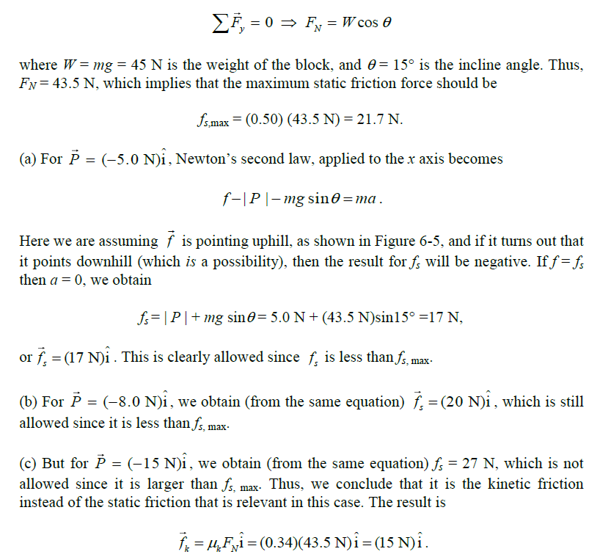

Slide 8
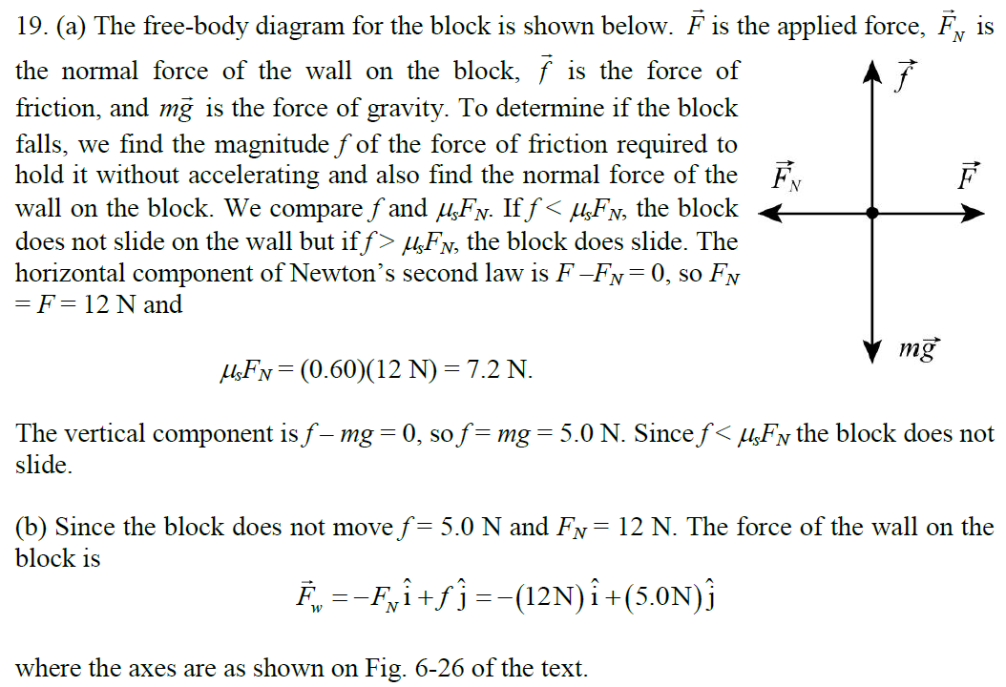

Slide 10
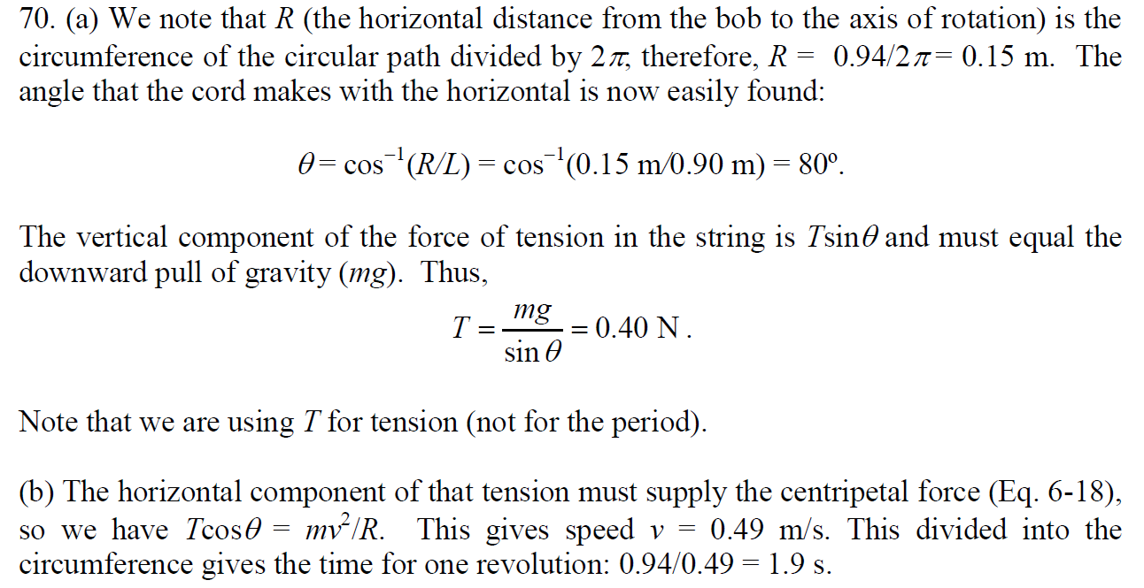

Slide 11
A light string can support a stationary hanging load of 25.0 kg before breaking. An object of mass m = 3.00 kg attached to the string rotates on a frictionless, horizontal table in a circle of radius r = 0.800 m, and the other end of the string is held fixed. What range of speeds can the object have before the string breaks?

Slide 12
A car initially traveling eastward turns north by traveling in a circular path at uniform speed. The length of the arc ABC is 235 m, and the car completes the turn in 36.0 s. (a) What is the acceleration when the car is at B located at an angle of 35.0º? Express your answer in unit vectors notations. Determine (b) the car’s average acceleration during the 36.0-s interval.

Slide 13
A 40.0-kg child swings in a swing supported by two chains, each 3.00 m long. The tension in each chain at the lowest point is 350 N. Find the child’s speed at the lowest point.

Slide 14
A roller-coaster car has a mass of 500 kg when fully loaded with passengers. The path of the coaster from its initial point shown in the figure to point B involves only up-and-down motion, with no motion to the left or right. (a) If the vehicle has a speed of 20.0 m/s at point A, what is the force exerted by the track on the car at this point? (b) What is the maximum speed the vehicle can have at point B and still remain on the track? Use: r₁ = 10.0 m and r₂ = 15.0 m, respectively.

Slide 15
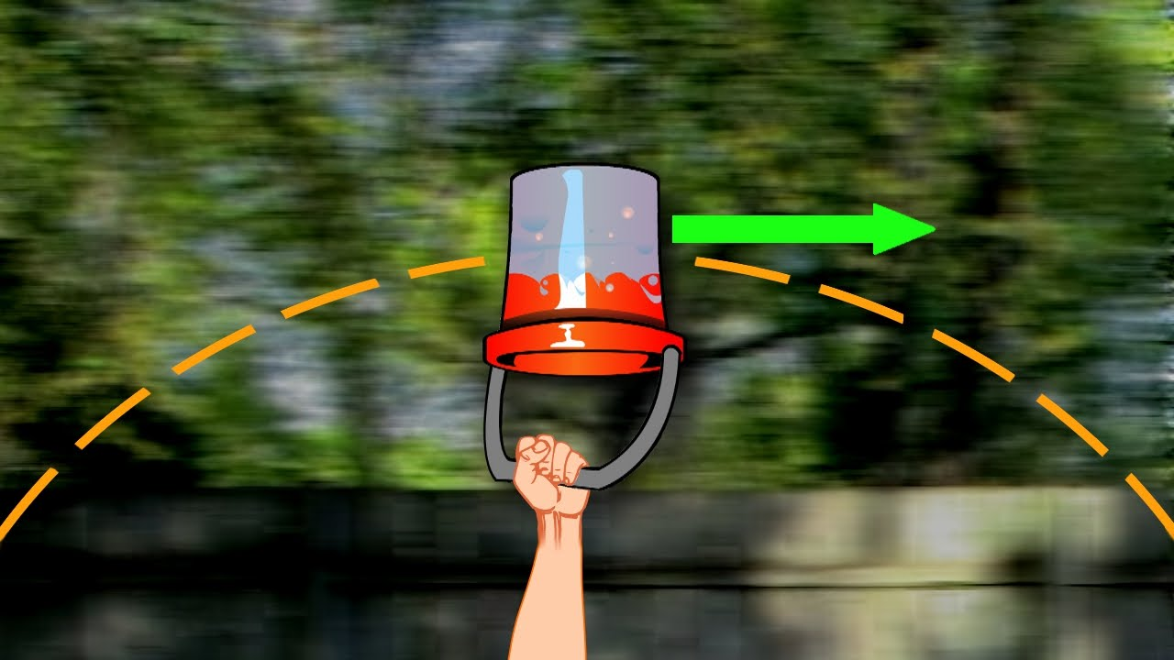
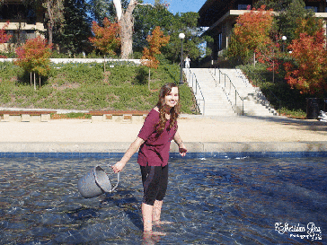
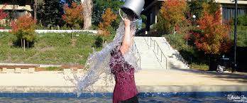
A pail of water is rotated in a vertical circle of radius 1.00 m. (a) What two external forces act on the water in the pail? (b) Which of the two forces is most important in causing the water to move in a circle? (c) What is the pail’s minimum speed at the top of the circle if no water is to spill out?

Slide 16
A small sphere of mass m is attached to the end of a cord of length R and set into motion in a vertical circle about a fixed point O. Determine the tangential acceleration of the sphere and the tension in the cord at any instant when the speed of the sphere is v and the cord makes an angle u with the vertical.
https://www.youtube.com/watch?v=9s1IRJbL2Co

Slide 17
One end of a cord is fixed and a small 0.500-kg object is attached to the other end, where it swings in a section of a vertical circle of radius 2.00 m. When θ = 20.0º, the speed of the object is 8.00 m/s. At this instant, find (a) the tension in the string, (b) the tangential and radial components of acceleration, and (c) the total acceleration. (d) Is your answer changed if the object is swinging down toward its lowest point instead of swinging up?

Slide 18
A man (m = 85.0 kg) tries to cross a river by swinging from a vine. The vine is 10.0 m long, and his speed at the bottom of the swing is 8.00 m/s. The man doesn’t know that the vine has a breaking strength of 1 000 N. Does he make it across the river without falling in?

