Slide 1
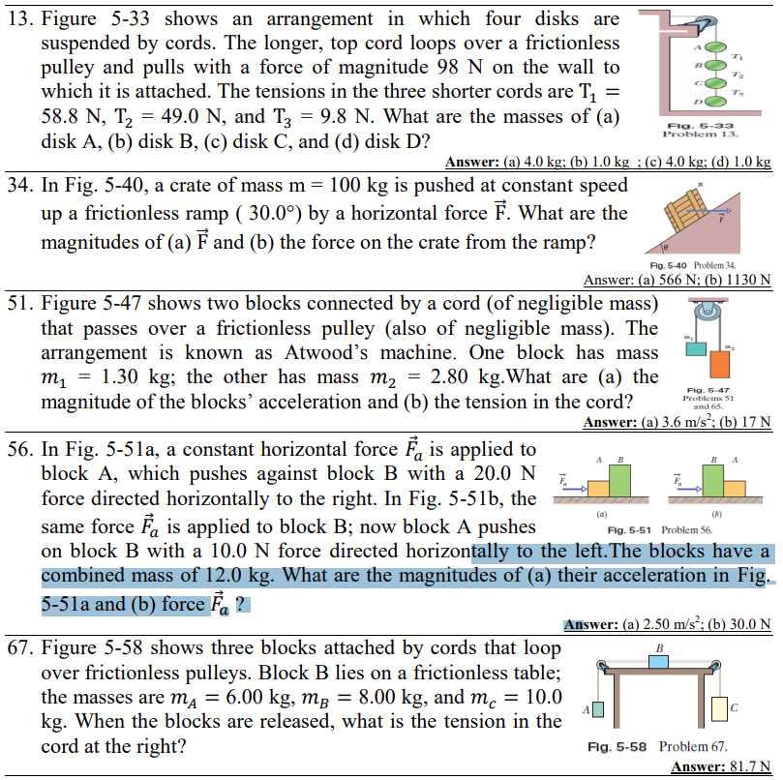

Slide 2
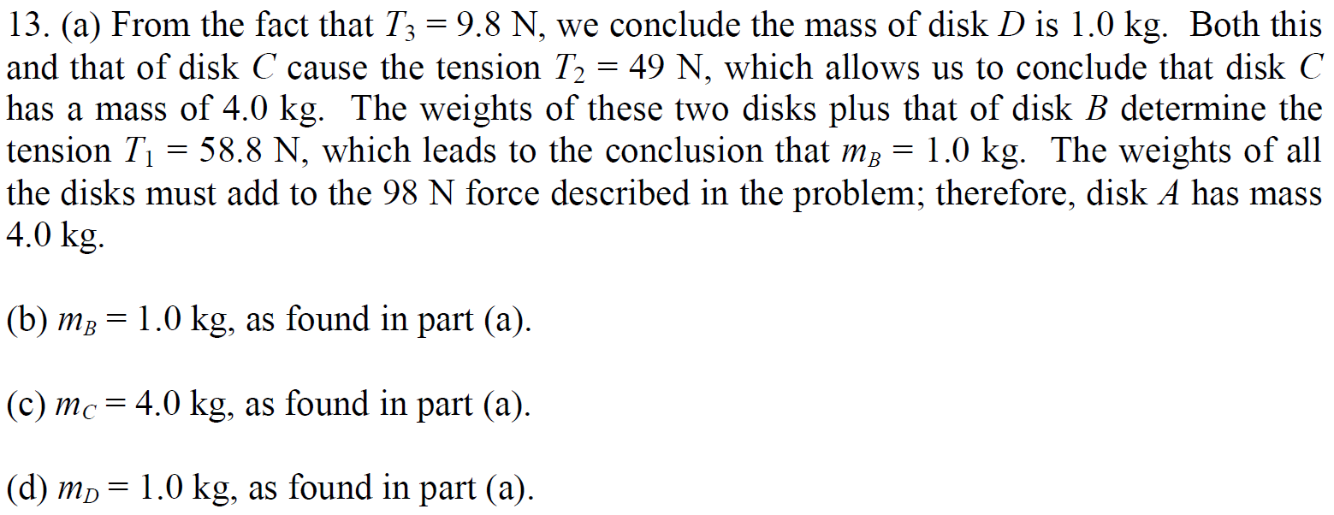

Slide 3
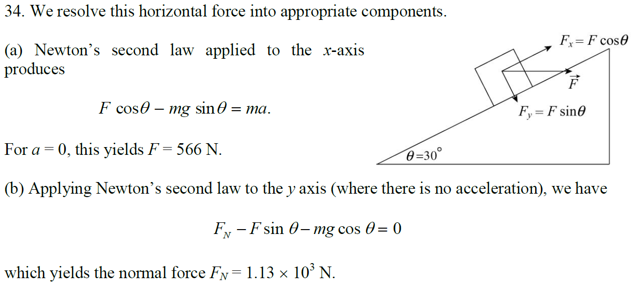

Slide 4
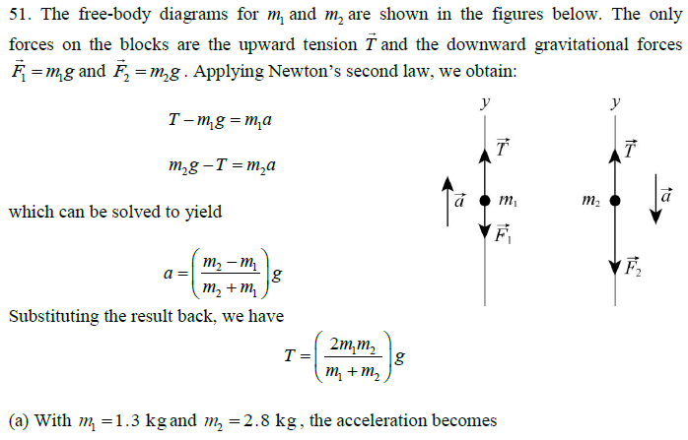

Slide 5
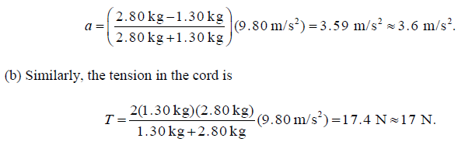

Slide 6
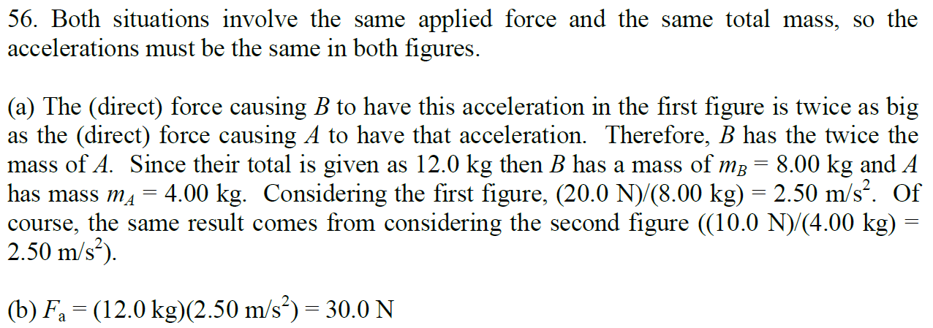

Slide 7
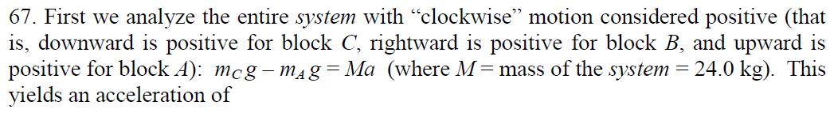
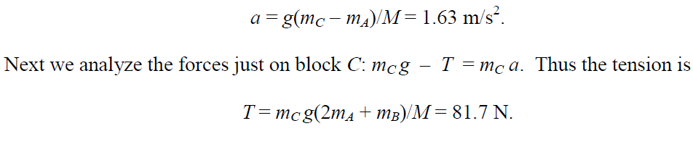

Slide 10
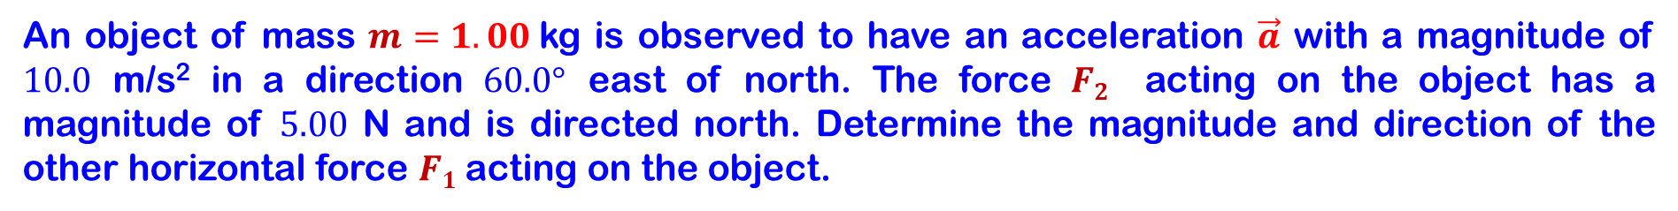
An object of mass $m=1.00$kg is observed to have an acceleration $\vec{a}$ with a magnitude of $10.0$ m/s² in a direction $60.0°$ east of north. The force $F2$ acting on the object has a magnitude of $5.00$ N and is directed north. Determine the magnitude and direction of the other horizontal force $F1$ acting on the object.

Slide 11
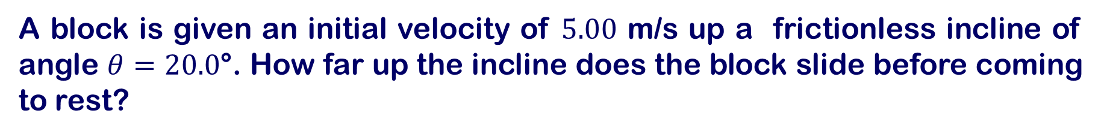
A block is given an initial velocity of $5.00$ m/s up a frictionless incline of angle $θ=20.0$°. How far up the incline does the block slide before coming to rest?

Slide 12
Two blocks of mass 3.50 kg and 8.00 kg are connected by a massless string that passes over a frictionless pulley. The inclines are frictionless. Find (a) the magnitude of the acceleration of each block and (b) the tension in the string.

Slide 13
Two blocks, each of mass m = 3.50 kg, are hung from the ceiling of an elevator. (a) If the elevator moves with an upward acceleration a of magnitude 1.60 m/s², find the tensions T₁ and T₂ in the upper and lower strings. (b) If the strings can withstand a maximum tension of 85.0 N, what maximum acceleration can the elevator have before a string breaks?

Slide 17
A tin antioxidants (m₁ = 1.0 kg) on a frictionless inclined surface is connected to a tin of corned beef (m₂ = 2.0 kg). The pulley is massless and frictionless. An upward force of magnitude F = 6.0 N acts on the corned beef tin, which has a downward acceleration of 5.5 m/s². What are (a) the tension in the connecting cord and (b) angle β?

