Slide 1
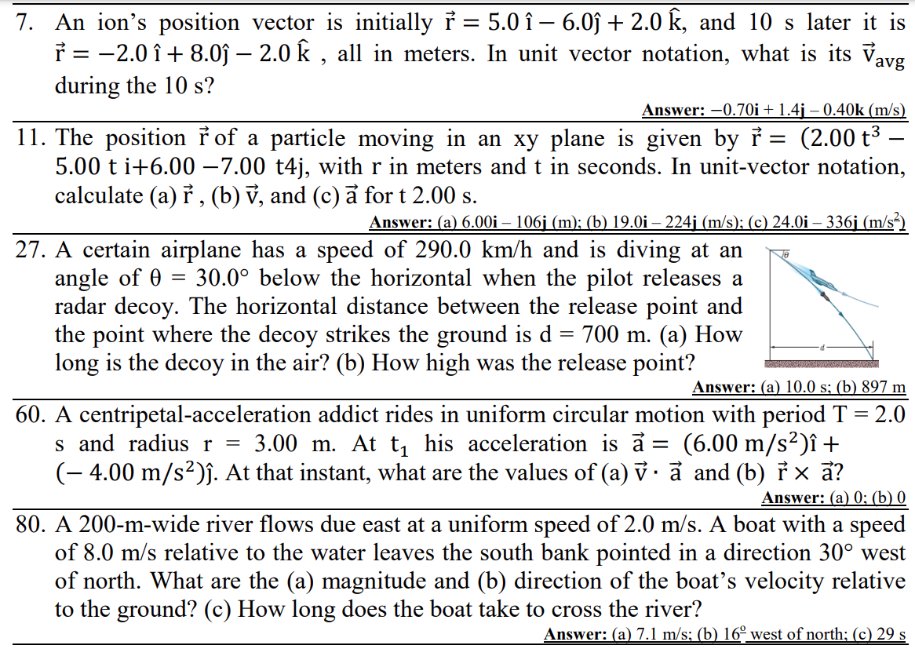

Slide 2
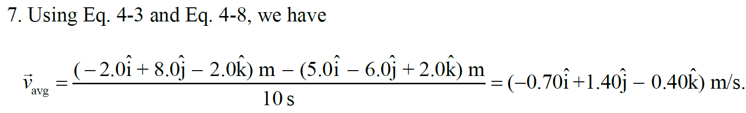

Slide 3
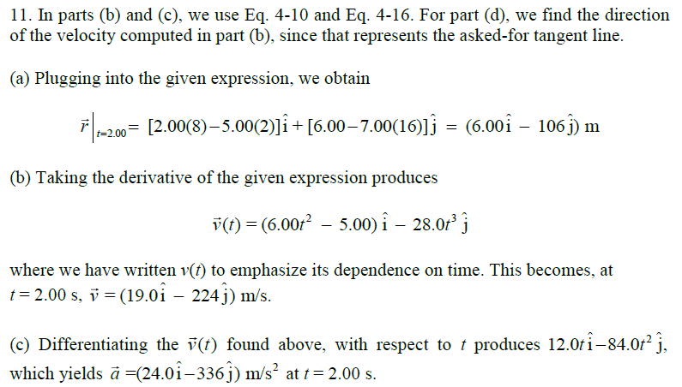

Slide 4
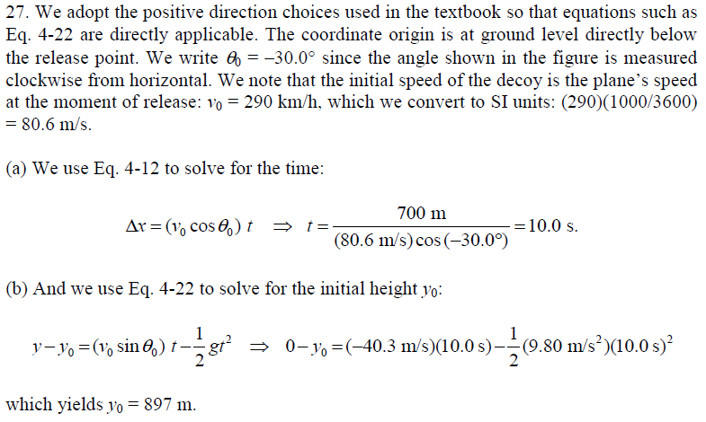

Slide 5
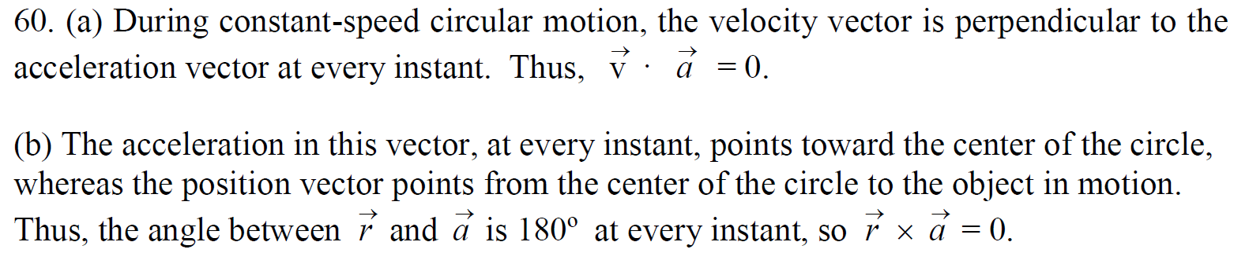

Slide 8
A rotating fan completes 1200 revolutions every minute. Consider the tip of a blade, at a radius of 0.15 m. (a) Through what distance does the tip move in one revolution? What are (b) the tip’s speed and (c) the magnitude of its acceleration?

Slide 9
A boy whirls a stone in a horizontal circle of radius 1.5 m and at height 2.0 m above level ground. The string breaks, and the stone flies off horizontally and strikes the ground after traveling a horizontal distance of 10 m. What is the magnitude of the centripetal acceleration of the stone during the circular motion?

