Slide 1
Chapter 30
Induction

Slide 2
Few things to be remembered!
From preceding chapters!

Slide 3
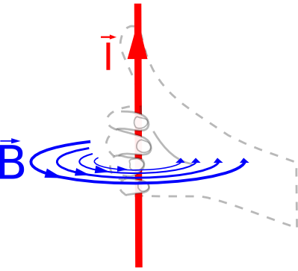
Magnet-from current (ch 28)
B
Anticlockwise current
N
N
I
S
S

Slide 4
Magnet from current (ch 28)
B
clockwise current
S
I
N

Slide 5
Electric Flux (ch 23)
Do you remember?
Electric flux
A
E
θ
E

Slide 6
Magnetic Flux
Similarly
Magnetic flux
A
E
θ
B
T83-28: In Dhahran, the total magnetic field of the Earth has been measured to be 0.54 x 10⁻⁴ T and it points downward at an angle of 53⁰ below the horizontal. What is the magnetic flux through 1.0 m² of ground in Dhahran due to the Earth magnetic field?
A) 0.43 x 10⁻⁴ Wb

Slide 7
Electromagnetic Induction
N
Magnetic filed “B” passes through the coil of area “A”
S
Cupper coil
Magnet
Flux is constant: Coil and magnet are at rest

Slide 8
Electromagnetic Induction
N
S
Cupper coil
Flux Changing: If flux changes then the current gets generated in the coil
Anyhow flux must change for the current
This is principle of generating electricity

Slide 9
Faraday’s law
N
S
Faradays law: The rate of change of flux through a coil is equal to the emf generated in the coilc
Emf generated in the coil
If the coil have N turns

Slide 10
Lentz’s law
N
S
Lentz’s law: An induced current has a direction such that the magnetic field due to the current opposes the change in magnetic flux that induces the current.
Emf generated in the coil
-ve sign is due to Lentz’s law

Slide 11
Lentz’s law
N
S
Flux Increasing: More Field lines are passing through the coil.
Coils induced current will generate a magnetic field that will try to oppose it. i.e. try to decrease the flux
B
B_{i}

Slide 12
Lentz’s law
N
S
Flux Decreasing: Less Field lines are passing through the coil.
Coils induced current will generate a magnetic field that will try to oppose it. i.e. try to increase the flux
B
B_{i}

Slide 13
What will you do to create electricity?

Slide 14
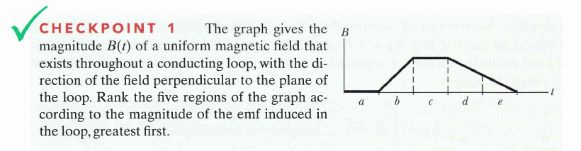
Checkpoints
b, d &e tie, a and c (zero)

Slide 15
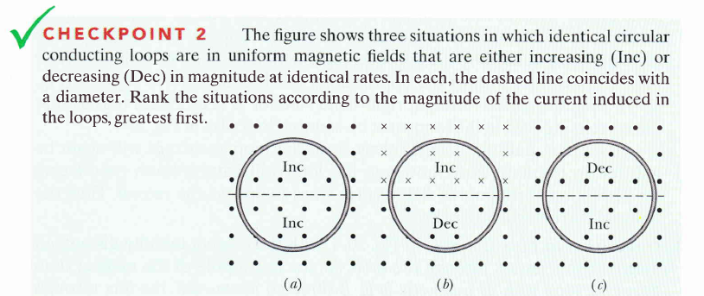
Checkpoints
a & b tie, c (zero)

Slide 16
T072: Q#28:
A circular loop of radius R = 10 cm is placed so that its plane is perpendicular to a magnetic field that is increasing at a constant rate of 50 mT/s. What is the magnitude of the induced emf in the loop?
(Ans: 1.6 mV)

Slide 17
Q14.: A long straight wire is in the plane of two circular conducting loops. The straight wire carries a constant current I in the direction shown in Fig 9. The circular loop 1 is moved to the right while the loop 2 is moved to the left with the same speed, v. The induced current directions in the circular loops 1 and 2 are respectively:
(Ans: Clockwise , counterclockwise)

Slide 18
Q:The plane of a circular coil of radius 0.01 m is initially in yz plane and initially perpendicular to the uniform magnetic field 10 T i. The coil has 100 turns. Find the emf produced in the coil (in V) when the coil is flipped 30º about the y-axis passing through its center in 0.5 s .

Slide 19
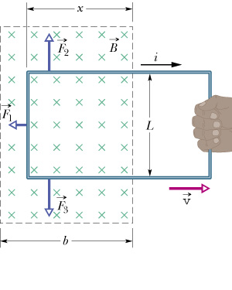
Induction and Energy Transfer
Magnitude of Emf generated
Opposing Force on the coil (F₁)
Power generated

Slide 20
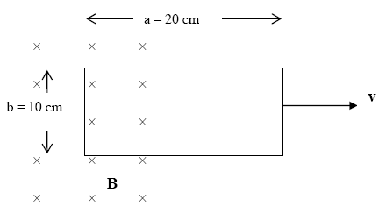
Ch30 Summary
T72Q29.
Consider a rectangular conducting loop of length a = 20 cm and width b = 10 cm and resistance R = 10 Ω as shown in Fig. 1. The loop is moving out of a uniform magnetic field region, at a constant speed of 5.0 m/s. The magnetic field B is into the page and has a magnitude of 0.50 T. What is the magnitude and direction of the induced current?
(Ans: 25 mA clockwise)

Slide 21
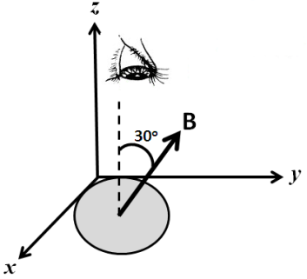
T111-Q30.
A circular loop of wire of radius 14 cm is placed in the xy plane in a magnetic field that makes an angle of 30º with the normal to the plane of the loop, as shown in Figure 15. The magnitude of this field increases at constant rate from 30 mT to 60 mT in 15 ms. If the loop has a resistance of 5.0 Ω, what is the current induced in the loop, looking from the top?
A) 21 mA, clockwise

Slide 22
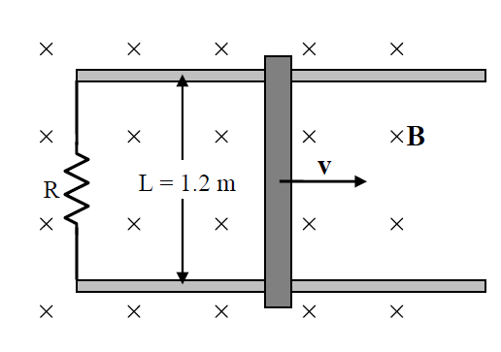
T103-Q30.
Figure 9 shows a bar being moved to the right on two parallel rails at a constant speed of 3.0 m/s in a uniform magnetic field of 0.50 T directed into the page. If the induced current is 2.5 A, find the power dissipated in the resistor? (Neglect the mass of the bar, friction, and the resistance of the bar and rails).
A) 4.5 W.

Slide 23
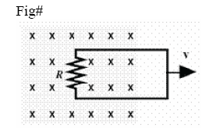
T81-Q15.
A circuit is pulled to the right at constant speed in a uniform magnetic field with a 16 N force as shown in Fig 10. As the circuit moves, a 6.0 A current flows through the 4.0 Ω resistor. With what speed does the circuit move?
(Ans: 9.0 m/s)

Slide 24
T-041 Q#1:
A circular wire loop, of an area 0.10 m², is initially oriented so that its plane is perpendicular to a 0.40 T magnetic field. When the loop is rotated so that its plane is parallel to the field, a 25 V average potential difference is induced across the loop. The time (in seconds) required to make this rotation of the loop is
(Ans: 1.6x10⁻³).)

Slide 25
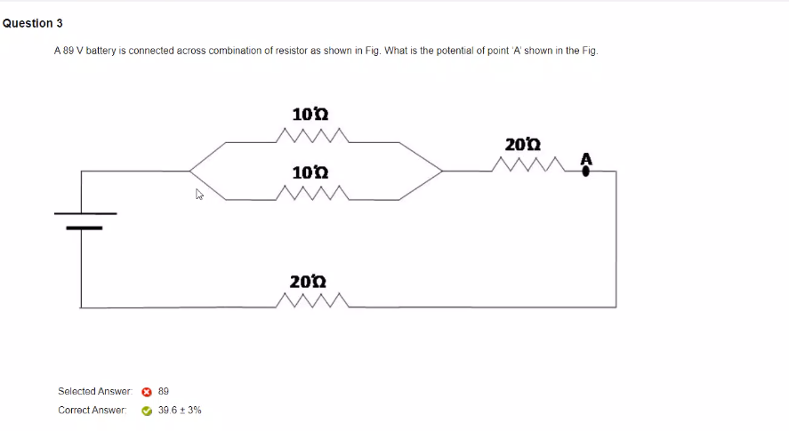

Slide 26
T81-Q16.:
A 2.0 m long copper wire, with resistance 5.0 Ω, is shaped into a square loop and placed perpendicular to a uniform magnetic field that is increasing at the constant rate of 1.0 ×10⁻² T/s. At what rate is thermal energy generated in the loop?
(Ans: 1.3 x10⁻⁶ W.)

Slide 27
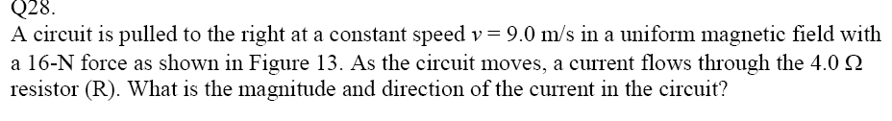
T82
T61- Q#30.
A constant magnetic flux of 4.0×10⁻⁵ Wb is maintained through a coil for 0.5 s. What emf is induced in the coil by this flux during that period?
(Ans: Zero)
A circular loop of radius R = 10 cm is placed so that its plane is perpendicular to a magnetic field that is increasing at a constant rate of 50 mT/s. What is the magnitude of the induced emf in the loop? (Ans: 1.6 mV)

Slide 28
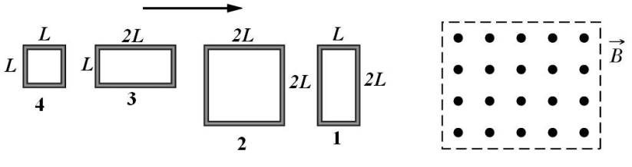
T111-Q28
Figure 14 shows four wire loops, with edge lengths of either L or 2L. All four wires move toward a region of uniform magnetic field B (directed out the page) at the same constant velocity. As they enter the magnetic field, in which loop(s) is the greatest induced emf?
A) 1 and 2
T111-Q29.
A square loop of wire is held in a uniform 0.24 T magnetic field directed perpendicular to the plane of the loop. The length of each side of the loop is decreasing at a constant rate of 5.0 cm/s. What is the emf induced in the loop at the instant the length is 12 cm?
A) 2.9 mV

Slide 29
T111-Q30.
A circular loop of wire of radius 14 cm is placed in the xy plane in a magnetic field that makes an angle of 30º with the normal to the plane of the loop, as shown in Figure 15. The magnitude of this field increases at constant rate from 30 mT to 60 mT in 15 ms. If the loop has a resistance of 5.0 Ω, what is the current induced in the loop, looking from the top?
A) 21 mA, clockwise

Slide 30
T103-Q28.
The normal to a certain plane with an area of 1.0-m2 makes an angle of 60° with a uniform magnetic field. The magnetic flux through this plane is the same as the flux through a second plane whose area is perpendicular to the magnetic field. The area of the second plane is:
A) 0.50 m2
T103-Q29.
A wire loop of radius 10 cm has resistance 2.0 Ω. The plane of the loop is perpendicular to a uniform magnetic field that is increasing at a rate of 0.10 T/s. Find the magnitude of the induced current in the loop.
A) 1.6 mA
T103-Q30.
Figure 9 shows a bar being moved to the right on two parallel rails at a constant speed of 3.0 m/s in a uniform magnetic field of 0.50 T directed into the page. If the induced current is 2.5 A, find the power dissipated in the resistor? (Neglect the mass of the bar, friction, and the resistance of the bar and rails).
A) 4.5 W.

Slide 31
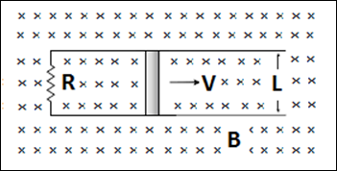
T102-Q28.
A solenoid is designed to produce a magnetic field of 0.0250 T at its center. It has 1.20 cm radius and 30.0 cm length and the solenoid wire can carry a maximum current of 9.947 A. The total length of the wire required to make the solenoid is:
A) 45.2 m
T102-Q29. A 5-turn square coil (10 cm along a side, resistance = 4.0 Ω) is placed in a magnetic field that makes an angle of 30o with the plane of the coil. The magnitude of this field varies with time according to B = 0.50t², where t is measured in s and B in T. What is the induced current in the coil at t = 4.0 s?
A) 25 mA
T102-Q30. A bar of length L = 80 cm moves with velocity V on two frictionless rails, as shown in Figure 9, in a region where the magnetic field is uniform (B = 0.30 T) and into the paper. If V = 50 cm/s and R = 60 mΩ, what is the magnetic force on the moving bar?

Slide 32
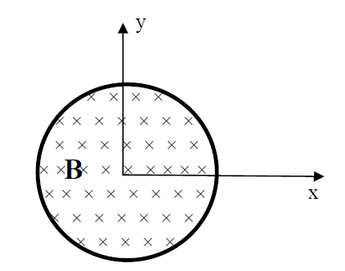
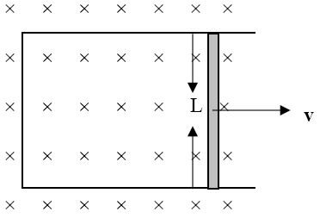
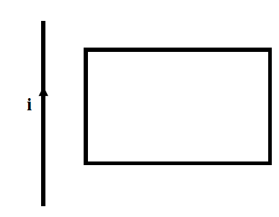
T101-Q28. A conducting loop with an area of 12 cm2 and a resistance of 0.010 Ω lies in the xy plane as shown in Figure 15. The loop is in a region of uniform magnetic field that is directed in the negative z direction. The magnitude of the magnetic field decreases from 0.80 to 0.50 T in 1.5 s. The current induced in the loop is
A) 24 mA, clockwise
T101-Q29. Figure 16 shows a bar of length L = 35 cm moving to the right on two parallel rails at a constant speed of 5.0 m/s in a uniform magnetic field B = 0.40 T. If the induced current in the circuit is 1.2 A, the power dissipated in the circuit is
A) 0.84 W
T101-Q30. A long straight wire carries a current i and is in the plane of a rectangular conducting loop, as shown in Figure 17. Which of the following will induce a clockwise current in the
loop?
A) Moving the loop to the right away from the wire, keeping the current in the wire constant

Slide 33
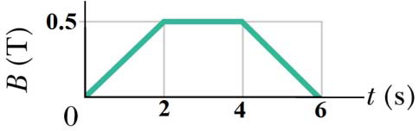
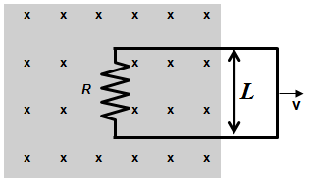
T92-Q28. Suppose this page is perpendicular to a uniform magnetic field and the magnetic flux through it is 5.0 Wb. If the page is turned by 30° around an edge the flux through it will be:
A) 4.3 Wb
T92-Q29. A circular wire loop of radius 15.0 cm is located in a uniform magnetic field that changes in magnitude as shown in Figure 12. The plane of the loop is perpendicular to the magnetic field. What is the magnitude of the emf induced in the loop during the time interval
t = 0 to t = 2.00 s?
A) 17.7 mV
T92-Q30. A circuit, with side length L = 1.0 m, is pulled toward the right at a constant speed v = 3.0 m/s. At the instant shown in Figure 13, the loop is partially in a magnetic field of magnitude B = 5.0 mT that is directed into the page. As the circuit moves, an induced current
flows through a resistor R = 5.0 Ω. What are the magnitude and direction of the induced
current?
A) 3.0 mA, clockwise

Slide 34
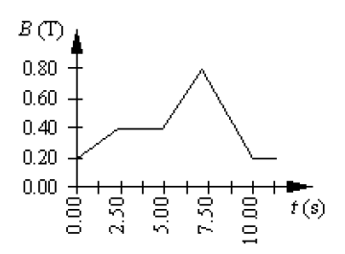
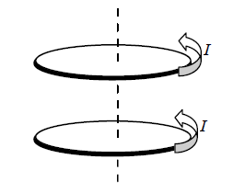
T92-Q29.
A circular coil of wire has 25 turns and has a radius of 0.075 m. The coil is located in a variable magnetic field whose behavior is shown on the graph of Figure 13. At all times, the magnetic field is directed perpendicular to the plane of a loop. What is the magnitude of the emf induced in the coil in the time interval from t = 5.0 s to 7.5 s?
A) 71 mV
T92-Q30.
Two conducting loops carry equal currents I in the same direction as shown in Figure 14. If the current in the upper loop drops to zero, what will happen to the current in the lower loop?
A) The current will increase.
B) The current will not change.
C) The current will drop to zero.
D) The current will reverse its direction.
E) The current will decrease

Slide 35
T83-28: In Dhahran, the total magnetic field of the Earth has been measured to be 0.54 x 10⁻⁴ T and it points downward at an angle of 53⁰ below the horizontal. What is the magnetic flux through 1.0 m² of ground in Dhahran due to the Earth magnetic field?
A) 0.43 x 10⁻⁴ Wb
T83-Q29.
A rod (length L=10 cm) moves on two horizontal frictionless conducting rails , as shown in Fig. 10. The magnetic field in the region is directed perpendicular to the plane of the rails and is uniform and constant. If a constant force of 0.60 N moves the bar at a constant velocity of 2.0 m/s, what is the current through the 12 ohm resistor?
A) 0.32 A
T83-Q30.
A circular loop of radius 45 cm is moved with a speed of 10 m/s inside a region containing a constant magnetic field of magnitude 0.50 T. If the direction of the magnetic field is perpendicular to plane of the circular loop, what is the magnitude of the induced emf in the circular loop?
A) Zero

Slide 36
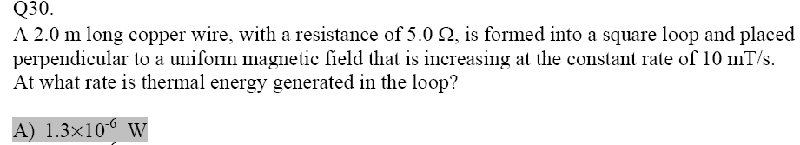
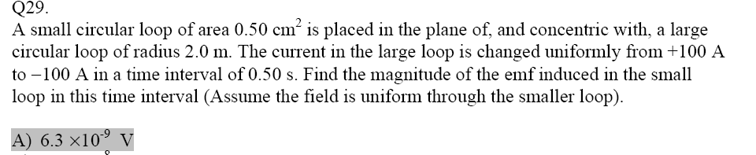
Q29. In the Fig. 2 the magnetic field decreases from 1.0 T to 0.40 T in 1.2 s. A 3.0 cm radius conducting loop with a resistance of 0.010 Ω is perpendicular to B. What are the size and the direction of the current induced in the loop?
(Ans: 140 mA and current is clockwise.)
Q#8. A flat circular coil has 80 turns of diameter 20 cm with a total resistance of 40 Ω. The plane of the coil is perpendicular to a uniform magnetic field. At what rate should the magnetic field change for the power dissipated in the coil to be 2 W? (Ans: 3.6 T/s)

