Slide 1
Chapter 28
Magnetic field

Slide 2
Lecture 01

Slide 3
28-2: Magnet
Every magnet has north and south poles.
Like poles repulse and unlike poles attracts.
1N
1N
N
Magnetic filed line is the path followed by unit north pole. Though there is no single north pole exist in nature
S

Slide 4
28-3: Magnetic field “B”
The force acting on unit north pole is called magnetic field strength or simply magnetic field. It is denoted by “B”.
Q
P
magnetic field lines
SI unit of B = Tesla (T)
The direction of “B” at a point is given by a tangent at the point in a filed line.
Its cgs unit = Gauss (G)
1G = 10⁻⁴ T
The field due to small bar magnet is about 100G

Slide 5
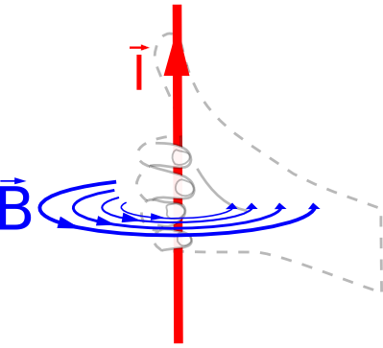
Magnet-from current
B
Anticlockwise current
N
N
I
S
Current in a circular loop generate magnetic field. The direction of axial magnetic field is given by right hand thumb rule.
S

Slide 6
Magnet from current
B
clockwise current
S
I
N
Clockwise current generates downward magnetic field in the axis of the coil.

Slide 7
Current from Magnetic field
clockwise Field
B
Anticlockwise field
I
Circular current gives vertical magnetic current.
Circular field gives vertical magnetic field.
“B” generates “I” and “I” generates “B”

Slide 8
Conceptual-1
28.2.1. Which one of the following choices is not a possible way to produce a magnetic field?
a) Set up a current in a long, straight wire.
b) Uniformly distribute charges over the surface of a conductor.
c) Make an object out of materials that have an intrinsic magnetic field.
d) Pass a current through a coil of wire.

Slide 9
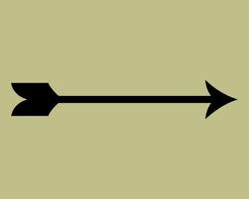
3 Dimensional vector direction
j
X
.
Out of the page (k)
Into the page (-k)
i

Slide 10
Incase you need ☺

Slide 11
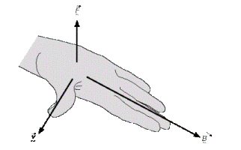
28-6: A circulating Charged particle
When a particle moves in the magnetic field “B” with velocity “v”, it experience a force “F_{B}”
-q
q
At top
At Bottom
B
Left Side
Right Side
F
F
v
Right hand rule of +ve charge
v
B
+q

Slide 12
+ve Charged particle in magnetic field
X = Right, Y = Front (counterclockwise move), Z = Up
v(f)
B(f)
B (r)
x
F(u)
V(r)
F(d)

Slide 13
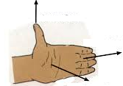
-ve Charged particle in magnetic field
B
v
-q
When a –ve charged particle moves in the magnetic field “B” with velocity “v”, it experience a force “F_{B}”
The force will act along “k” direction which will be into the page denoted by “ʘ”
V
For –ve The left hand rule is being used
B
F

Slide 14
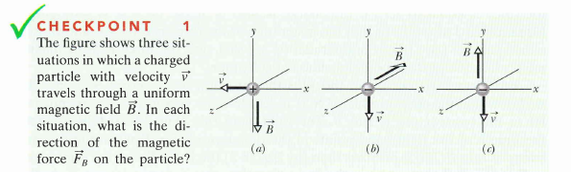
-ve Charged particle in magnetic field
θ
The force will act along “k” direction which will be into the page denoted by “ʘ”
+z
-x
0

Slide 15
T072: Q#18:
A 2.0 C charge moves in a uniform magnetic field with a velocity of (2.0 i + 4.0 j) m/s and experience a magnetic force of 12 N along the +z-axis. The x component of the magnetic field is equal to zero. Determine the y component of the magnetic field?
(Ans: +3.0 T)
T71-Q21.
An electron with a velocity of v = (4.0×10⁴ i + 3.0×10⁶ j) m/s enters a region of magnetic field B = (0.40 i) T. The magnetic force on the electron is:
(A 1.9×10⁻¹³ k N)
T081-Q5.
A particle (mass = 6.0 mg) moves with a speed of 4.0 km/s in a direction that makes an angle of 37° above the positive x axis in the x-y plane. At the instant it enters a magnetic field of (5.0 x 10⁻³ i ) T, it experiences an acceleration of (8.0 k ) m/s². What is the charge of the particle?
(Ans: – 4.0 μC)
T111-Q19.
At one instant, a charged particle is moving with velocity v = 2i+3j (m/s) in a uniform external magnetic field B = -3j (T). At that instant, the magnetic field produces a force F = 5.8 x 10⁻³k(N) on the particle. What is the charge of the particle?
A) –9.7 × 10⁻⁴C

Slide 16
T072: Q#18:
A 2.0 C charge moves in a uniform magnetic field with a velocity of (2.0 i + 4.0 j) m/s and experience a magnetic force of 12 N along the +z-axis. The x component of the magnetic field is equal to zero. Determine the y component of the magnetic field?
(Ans: +3.0 T)

Slide 17
T111-Q19.
At one instant, a charged particle is moving with velocity v = 2i+3j (m/s) in a uniform external magnetic field B = -3j (T). At that instant, the magnetic field produces a force F = 5.8 x 10⁻³k(N) on the particle. What is the charge of the particle?
A) –9.7 × 10⁻⁴C

Slide 18
28-4: Crossed fields
L
+ + + + + + + + + + +
y
-q
x
-q
-q
B
E
- - - - - - - - - - - - - - - -
To apply force along – y axis
B must be applied in -z direction
(into the page)

Slide 19
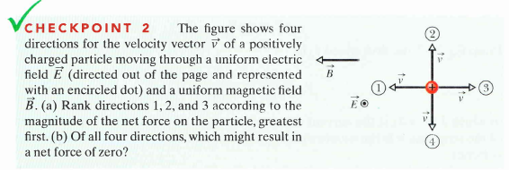
Checkpoint-2
2, 1 and 3 tie
4

Slide 20
T81-Q9.
An ion with a charge of +4.8×10⁻¹⁹ C is in a region where a uniform electric field of 6.0×10⁴ V/m is perpendicular to a uniform magnetic field of 1.8 T. If its acceleration is zero then its speed must be:
(Ans: 3.3 × 10⁴ m/s)

Slide 21
T72-Q21.
What is the kinetic energy of an electron that passes in a straight line through perpendicular electric and magnetic fields if E= 4.0 kV/m and B= 8.0 mT ?
(Ans: 0.71 eV)

Slide 22
Lecture 02

Slide 23
28-6: A circulating Charged particle
-q
q
Time period (T)
+q

Slide 24
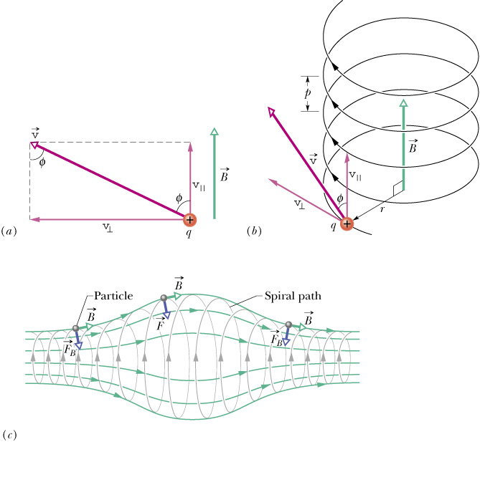
Helical path
The charged particle will move in helical path if v and B are not exactly 90⁰
The velocity will have vertical component which will take the particle up with constant velocity (no acceleration).

Slide 25
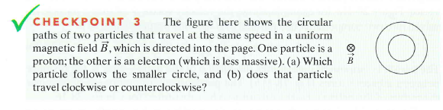
Checkpoint-3
Electron – clockwise
Proton – anti-clockwise

Slide 26
T72-Q20.
A charged particle has a kinetic energy of 10⁻⁷ joules and moves in a circular path in a uniform magnetic field. If the magnitude of the magnetic force on the particle is 1.5 x 10⁻⁴ N, what is the radius of the circular motion?
(Ans: 1.3 mm)
T62-Q19.
An electron moving perpendicular to a 50 µT magnetic field goes through a circular trajectory. What is the time required to complete one revolution?
(7.15 x 10⁻⁷ s )
T32-Q#5:
Which one of the following statements is FALSE (NOT TRUE). A uniform magnetic field
(Ans: changes the kinetic energy of a charge.)
T71-Q20.
A potential difference of 600 V is applied to accelerate an electron from rest. This accelerated electron enters a uniform magnetic field and completes one revolution in 9 nano seconds. Determine the radius of the electron orbit?
(Ans: 0.021 m)

Slide 27
T72-Q20.
A charged particle has a kinetic energy of 10⁻⁷ joules and moves in a circular path in a uniform magnetic field. If the magnitude of the magnetic force on the particle is 1.5 x 10⁻⁴ N, what is the radius of the circular motion?
(Ans: 1.3 mm)

Slide 28
T32-Q#5:
Which one of the following statements is FALSE (NOT TRUE). A uniform magnetic field
(Ans: changes the kinetic energy of a charge.)
T71-Q20.
A potential difference of 600 V is applied to accelerate an electron from rest. This accelerated electron enters a uniform magnetic field and completes one revolution in 9 nano seconds. Determine the radius of the electron orbit?
(Ans: 0.021 m)

Slide 29
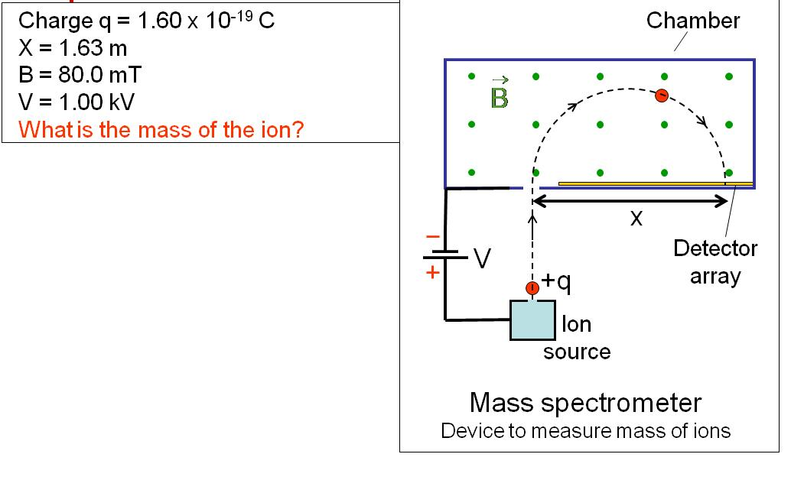
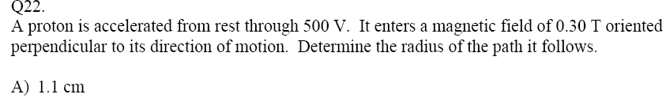
A circulating Charged particle
T83

Slide 30
28-8: Force on a conductor
-e
-e
-e
-e
-e
-e
-e
-e
-e
-e
-e
-e
-e
-e
-e
-e
L
-e
-e
-e
-e
F_{B}
-e
-e
-e
-e
-e
-e
-e
-e
i
-e
-e
-e
-e
-e
-e
-e
-e
-e
-e
-e
-e
-e
-e
-e
-e
-e
-e
-e
-e
B
F
Length is a vector quantity. Its direction is taken in the direction of current.
L

Slide 31
Force on a conductor
For electron
-e
-e
-e
-e
-e
-e
-e
-e
-e
-e
-e
-e
-e
-e
-e
-e
F_{B}
L
-e
-e
-e
-e
-e
-e
-e
-e
-e
-e
-e
-e
i
For Current
-e
-e
-e
-e
-e
-e
-e
-e
-e
-e
-e
-e
-e
-e
-e
-e
-e
-e
-e
-e

Slide 32
Current Generates Magnetic field
clockwise Field
B
Anticlockwise field
I
A straight current carrying wire generates circular magnetic field
The direction of the field at a point is given by the tangent at a point

Slide 33
Two thin conductors with opposite current
x
F
F
x
i₁
i₂
Two thin conductors with opposite current will repeal each other

Slide 34
Two thin conductors with current in same direction
x
F
F
x
i₁
i₂
Two thin conductors with current in the same direction will attract each other

Slide 35
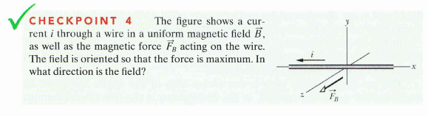
Checkpoint-4
B(-j)

Slide 36
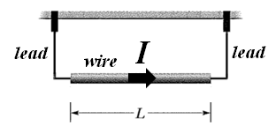
Checkpoint-4
T111-Q20.
A 10 g wire of length L = 70 cm is suspended by a pair of flexible leads, as shown Figure 9. The wire carries a current of 0.7 A that flows to the right. What is the minimum magnetic field needed to have zero tension in the leads?
A) 0.2 T, into the page

Slide 37
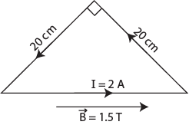
T62-Q21:
The following Fig. 1 shows a straight horizontal length of copper wire of mass m = 50 g and length L = 1.0 m lies in a uniform magnetic field B = 0.5 T directed out of the page. What is the magnitude and direction of the current in the wire to balance the gravitational force?
(Ans: 0.98 A, to the left)
L = 1.0 m
T51-Q#25.
A straight wire of linear mass density 100 g/m is located perpendicular to a magnetic field of 0.5 T as shown in the figure 2. What current in the wire is needed to balance the gravitational force on the wire?
( Ans: 2.0 A to the right)
T81- Q8.
Fig 5 shows a loop of wire carrying a current of 2.0 A. The loop has the shape of a right angled triangle with two equal sides, each 20 cm long. A 1.5 T uniform magnetic field is parallel to the hypotenuse. The resultant magnetic force on the two equal sides has a magnitude of:
(Ans: 0 N)

Slide 38
T62-Q21:
The following Fig. 1 shows a straight horizontal length of copper wire of mass m = 50 g and length L = 1.0 m lies in a uniform magnetic field B = 0.5 T directed out of the page. What is the magnitude and direction of the current in the wire to balance the gravitational force?
(Ans: 0.98 A, to the left)
L = 1.0 m

Slide 39
Lecture 03

Slide 40
Rectangular coil in a magnetic field
RS
PQ
QR and SP
Q
R
Pull up!
Push down!
N
x
S
P
S
F_{b} down
F_{b} up
The equal and opposite forces on the rectangular coil will make it to rotate.
This is the principle of electric motor

Slide 41
28-9: Torque on a Loop
N
L
x
“i” will always be normal to “B”
S
b
“For N number of turns
Area (A) = Lb
The direction of A is given by right hand thump rule
A
A
x
A
A

Slide 42
28-10: The magnetic dipole moment
N
L
x
S
b
Magnetic moment
The direction of “μ” is same as the direction of A
In Electric Field
In Magnetic Field

Slide 43
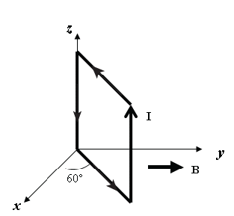
T72- Q19. A current loop is oriented in three different positions relative to a uniform magnetic field. In position 1 the plane of the loop is perpendicular to the field lines. In position 2 and 3 the plane of the loop is parallel to the field lines as shown in Fig. 1. The torque is maximum in:
(Ans: positions 2 and 3)
T81-Q#25. Q6. A square loop of side 0.20 m consists of 50 closely wrapped turns, each carrying a current of 0.50 A. As shown in Fig 4, the loop is oriented in a uniform magnetic field of 0.40 T directed in the positive y direction. What is the magnitude of the torque on the loop?
(Ans: 0.35 N.m)
T111-Q21. A 26-turn rectangular coil of wire carrying a current of 0.25 A is placed in a uniform magnetic field of magnitude 0.050 T. The coil is 2.5 cm long and has width w. The torque acting on the coil is 2.3 × 10⁻⁴ N.m. If the angle between the magnetic field and the plane of the coil is 55º, then the width w of the coil is:
A) 4.9 cm
T103-Q22. A loop of current-carrying wire has a magnetic dipole moment of 5.0 × 10⁻⁴ A·m2. The magnetic moment initially is aligned with a 0.50-T magnetic field. Calculate the work done by an external agent to rotate the loop so its dipole moment is perpendicular to the field and hold it in that orientation.
A) 2.5 × 10⁻⁴ J

Slide 44
T72- Q19. A current loop is oriented in three different positions relative to a uniform magnetic field. In position 1 the plane of the loop is perpendicular to the field lines. In position 2 and 3 the plane of the loop is parallel to the field lines as shown in Fig. 1. The torque is maximum in:
(Ans: positions 2 and 3)

Slide 45
T81-Q#25. Q6. A square loop of side 0.20 m consists of 50 closely wrapped turns, each carrying a current of 0.50 A. As shown in Fig 4, the loop is oriented in a uniform magnetic field of 0.40 T directed in the positive y direction. What is the magnitude of the torque on the loop?
(Ans: 0.35 N.m)

Slide 46
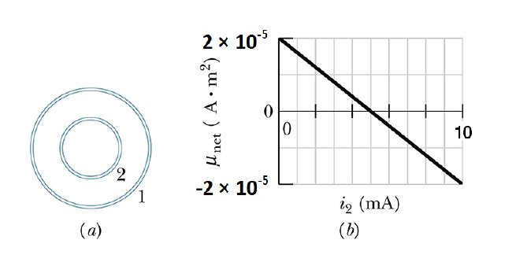
T102-Q24. Figure 6a shows two concentric coils, lying in the same plane, carry currents in opposite directions. The current in the larger coil 1 is fixed. Current i₂ in coil 2 can be varied. Figure 6b gives the net magnetic moment of the two-coil system as a function of i₂. If the current in coil 2 is then reversed, what is the magnitude of the net magnetic moment (in A.m²) of the two-coil system when i₂ = 8.0 mA?
A) 5.2×10⁻⁵

Slide 47
Summary
For positive charge
Magnetic Dipole
For negative charge
Magnetic moment
For current
Direction of L is the direction of current
i
i
k
k
j
j
Positive
negative

Slide 48
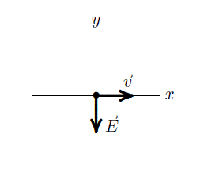
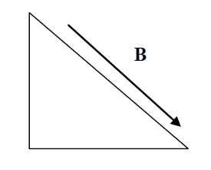
T103
T103-Q19.
At one instant an electron is moving in the xy plane, the components of its velocity being v_{x} = 5.0 × 10⁵ m/s and v_{y} = 3.0 × 10⁵ m/s. A magnetic field of 0.80 T is in the positive x direction. At that instant the magnetic force on the electron is
A) 3.8 × 10⁻¹⁴ N along the positive z direction
T103-Q20.
An electron is traveling in the positive x direction. A uniform electric field E is in the negative y direction as shown in Figure 5. The magnetic field that will make the electron move in a straight line has a direction
A) into the page
T103-Q21.
A loop of wire carrying a current of 2.0 A is in the shape of a right angled triangle with two equal sides, each 15 cm long as shown in Figure 6. A 0.70 T uniform magnetic field is parallel to the hypotenuse. The magnitude of the net magnetic force on the loop is:
A) zero

Slide 49
T103-Q22.
A loop of current-carrying wire has a magnetic dipole moment of 5.0 × 10⁻⁴ A·m2. The magnetic moment initially is aligned with a 0.50-T magnetic field. Calculate the work done by an external agent to rotate the loop so its dipole moment is perpendicular to the field and hold it in that orientation.
A) 2.5 × 10⁻⁴ J
T103-Q23.
An electron moves along a horizontal circle in a region of uniform magnetic field of magnitude 4.0 mT that is directed out of the page. It experiences a magnetic force of magnitude 3.2 x 10⁻¹⁵ N. Calculate the radius of the circular path.
A) 7.1 mm

Slide 50
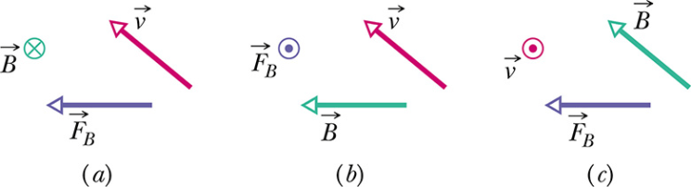
T102-Q21.
Figure 5 shows three situations in which an electron moves at velocity v through a uniform magnetic field Band experiences a magnetic force F_{B} . Determine which situation(s) are physically reasonable for the orientations of the vectors.
A) None of the them
T102-Q23.
A 50 cm long wire carries a 0.50 A current along the positive x-axis through a magnetic field B = (6i+8k) mT. What is the magnitude of the magnetic force on the wire?
A) 2.5 mN
T102-Q24. Figure 6a shows two concentric coils, lying in the same plane, carry currents in opposite directions. The current in the larger coil 1 is fixed. Current i2 in coil 2 can be varied. Figure 6b gives the net magnetic moment of the two-coil system as a function of i2. If the current in coil 2 is then reversed, what is the magnitude of the net magnetic moment (in A.m2) of the two-coil system when i2 = 8.0 mA?
A) 5.2×10-5

Slide 51
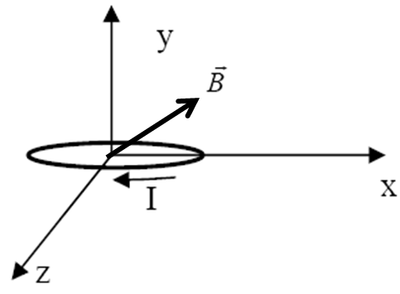
T101-Q20.
A uniform magnetic field of magnitude 2.0 T, directed along the positive y axis, crosses an electric field E. What is magnitude and direction of the electric field needed to guide an electron with a speed of 30 m/s along a straight line in the positive x axis direction?
A) 60 V/m along the negative z direction
T101-Q21. A wire of length 2.0 m carries a current of 2.0 A in the direction of the positive y axis. The wire is placed in a uniform magnetic field. To produce a maximum magnetic force of 1.0 N directed along the positive x axis, the magnetic field must be
A) 0.25 T along the positive z direction
T101-Q22. A 20-turn coil, with an area of 1.5 m2, lies in the xz plane and carries a current I = 0.20 A in the direction indicated in Figure 11. The coil is placed in a uniform magnetic field that lies in the xy plane and makes an angle of 30o with the + x-axis, and has a magnitude of 0.50
T. What is the torque on the coil?
A) 2.6 N.m along the positive z direction

Slide 52
T101-Q23. A charged particle enters a region of uniform magnetic field with its velocity perpendicular to the field, which of the following quantities is independent of the speed of the
particle?
A) Period of revolution
B) Kinetic energy
C) Magnetic force
D) Radius of the orbit
E) Linear momentum

Slide 53
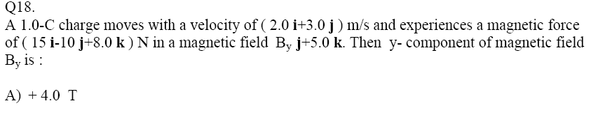
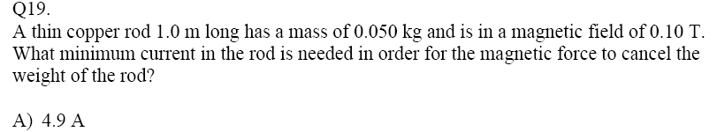
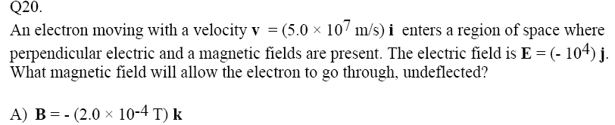
T83
T83
T83

Slide 54
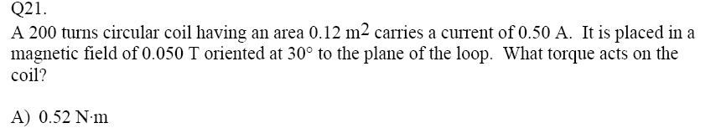
T83
T83

