Slide 1
Chapter 27
circuits

Slide 2
Lecture 01

Slide 3
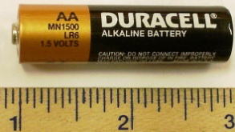
Circuit Diagram
Real Diagram
Resistor
i
-e
-e
A
Circuit Diagram
-e
-e
-e
-e
-e
i
R
-e
-e
-e
-e
V
0
-e
-e
-e
conductor
V
0
V
0
Conductor
Battery
Battery

Slide 4
Current by Capacitor
2V
1V
0V
4V
3V
5V
+
-
+
-
+
-
-e
-e
-e
-e
-e
+
-
+
-
R
The current can not be constant!

Slide 5
27-2 Emf(E )
V
+
-
-
Emf (E ) is work done on unit +ve charge to take it from lower to higher potential
+
+
-
-
+
+1C
+
-
-
+
-
-e
-e
-e
+
-e
+
-
-e
+
-
+
-
E
R
Circuit Diagram
i
R
V
0
conductor
E
b
Emf of an ideal battery is always equal to the potential difference
Battery

Slide 6
Potential Drop
i
R
V
0
R
conductor
b
E
b
E
b
potential
Battery
Whatever potential rises inside the battery, it drops in the resistor

Slide 7
Checkpoint-1

Slide 8
Kirchhoff’s Current Law
At a junction:
Total current inflow = total current outflow
junction
Or
The sum of the current at a junction is always zero
Current flow is similar to water flow!

Slide 9
Kirchhoff’s Voltage Law
i
1. Choose a loop (box) and choose the direction of current in the loop: Either clockwise or counterclockwise
V= iR
0
E
2. Choose a direction to explore emfs (E ) and voltages (iR) : Either clockwise or counter clockwise
3. Start from a point (let's say from low potential terminal of the battery).
4. Emf is positive if you move from lower to higher terminal
i
V= iR
0
5. iR is positive if you move against the current
6. The sum of the all E and iR must be zero
E

Slide 10
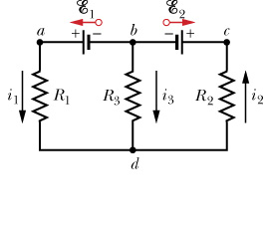
Kirchhoff’s Law: Multiple loop
1. Determine the direction of current in each junction. (you can choose any direction but remember total incoming current = total outgoing current)
2. Choose a loop and write the equation
3. Choose the next loop and write the equation
Loop -abda
4. Solve the equations to find the unknown
Loop -bcdb
Write an equation for outer loop

Slide 12
Real Battery and Terminal Potential
+
E
-
R
+
-
i
b
+
-
a
-e
-e
-e
-e
-e
b
a
+
r
-
V
0
+
-
conductor
E
R
r
Real Battery
Emf (E ) a real battery is always greater than the terminal potential (V)
The potential rises inside the battery, and it drops in the resistors

Slide 13
Potential Drop (Positive as Zero)

Slide 14
Power
i
R
E
R
r
b
V
0
b
conductor
0
V
E
potential
a
r
b
Battery
In ideal Battery
P_{r} = 0
P_{b} = Power generated in battery
P_{R} = Power lost in R
P_{r} = Power lost in r

Slide 15
Potential Between two points
R₂
d
i
c
i
R
V
0
conductor
R₃
R₁
E
a
r
b
a
r
b
Battery
Battery

Slide 16
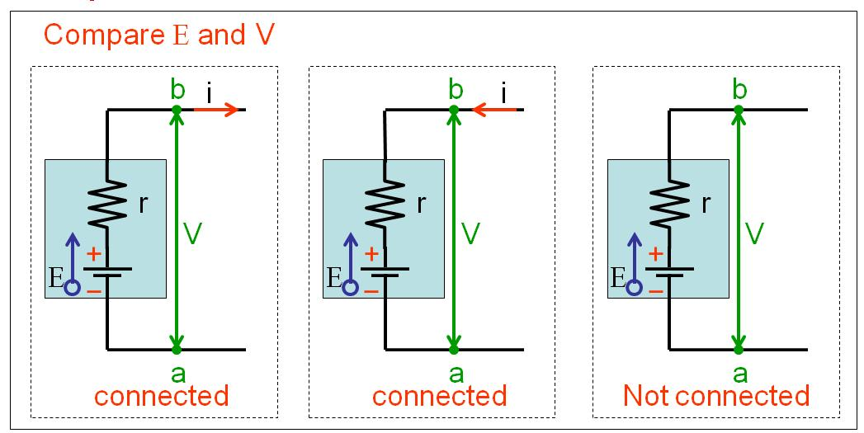
Checkpoint-3
V_{b} +ir-E = V_{a}
V_{b} -ir-E = V_{a}
V_{b} +0-E = V_{a}
V_{b}-V_{a} = E-ir
V_{b} -V_{a} = E+ir
V_{b} -V_{a} = E
V = E-ir
V = E+ir
V = E

Slide 17
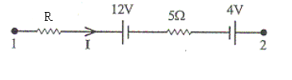
T072Q#13 The Fig. 1 shows two resistors, each of the resistance R, connected to two ideal batteries of emf ε₁ and ε₂ (ε₁> ε₂). The potential difference V_{a} – V_{b} is equal to ε₁/5. What is the ratio ε₂/ε₁?
( Ans: 3/5)
T071-Q13. A single loop circuit contains two external resistors and two emf sources as shown in the figure 1. Assume the emf sources are ideal, what is the power dissipation across resistor R₁.
(Ans: 0.9 W)
T51-Q#7. In the figure 2 shown, the potential difference between point 1 and 2, (V₂-V₁), is -40 V, and the current is equal to 4.0 A, then, the value of the resistance R is [ Ans: 3Ω]
T72-Q14.
Three resistors and two batteries are connected as shown in Fig. 2. What is the potential difference Va – Vb?
(Ans: 15 V)

Slide 18
T072Q#13 The Fig. 1 shows two resistors, each of the resistance R, connected to two ideal batteries of emf ε₁ and ε₂ (ε₁> ε₂). The potential difference V_{a} – V_{b} is equal to ε₁/5. What is the ratio ε₂/ε₁?
( Ans: 3/5)

Slide 19
T51-Q#7. In the figure 2 shown, the potential difference between point 1 and 2, (V₂-V₁), is -40 V, and the current is equal to 4.0 A, then, the value of the resistance R is [ Ans: 3Ω]

Slide 20
T72-Q14.
Three resistors and two batteries are connected as shown in Fig. 2. What is the potential difference Va – Vb?
(Ans: 15 V)

Slide 21
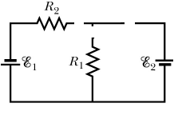
T111-Q14.
In the circuit shown in Figure 4, E₁ = 6.0 V, E₂ = 12 V, R₁ = 200 Ω, and R₂ = 100 Ω. Determine the current passing through R₂ .
180 mA to the left

Slide 22
Lecture 02

Slide 23
Resistors in Series
R₂
R₃
i
R₁
E

Slide 24
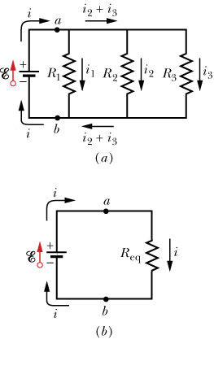
Resistances in parallel

Slide 25
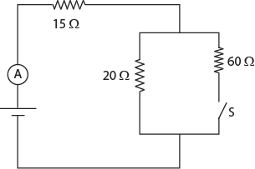
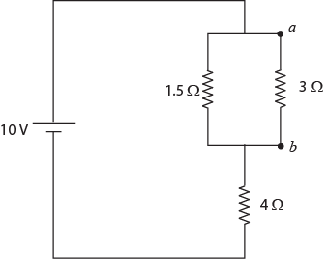
T72- Q15. Determine the power dissipated by the 4.0 Ω resistor in the circuit shown in Fig. 3.
(Ans: 16 W)
T81-Q3.: When switch S is open, the ammeter in the circuit shown in Fig 2 reads 2.0 A. When S is closed, the ammeter reading:
(Ans: increases)
T81-Q1.
Fig 1 shows two resistors 3.0 Ω and 1.5 Ω connected in parallel and the combination is connected in series to a 4.0 Ω resistor and a 10 V emf device. The potential difference V_{a} - V_{b} is:
(Ans: 2.0 V)

Slide 27
T72- Q15. Determine the power dissipated by the 4.0 Ω resistor in the circuit shown in Fig. 3.
(Ans: 16 W)

Slide 28
T81-Q3.: When switch S is open, the ammeter in the circuit shown in Fig 2 reads 2.0 A. When S is closed, the ammeter reading:
(Ans: increases)

Slide 29
T81-Q1.
Fig 1 shows two resistors 3.0 Ω and 1.5 Ω connected in parallel and the combination is connected in series to a 4.0 Ω resistor and a 10 V emf device. The potential difference V_{a} - V_{b} is:
(Ans: 2.0 V)

Slide 30
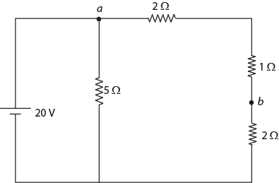
T81-Q4.
In Fig 3, what is the potential difference V_{a}-V_{b}? (Ans: 12 V)
Ch27-26: Fig 27-39 shows five 5 Ω resistors. Find the equivalent resistance between points (a) F and H and (b) F and G (Hint: for each pair of points, imagine that a battery is connected across the pair)
Answers: (a) 2.5 Ω (b)3.13 Ω
Ch27-39: In the circuit of Fig 27-50, E = 12V, R₁ =2000 Ω, R₂ =3000 Ω, R₃ = 4000Ω. what are potential differences
V_{A} - V_{B},
V_{B} - V_{C}
V_{C} – V_{D}
(d) V_{A} - V_{C}?
Answers: (a) 5.25 V (b)1.5V (c) 5.25V (d) 6.75 V

Slide 31
Ch27-26: Fig 27-39 shows five 5 Ω resistors. Find the equivalent resistance between points (a) F and H and (b) F and G (Hint: for each pair of points, imagine that a battery is connected across the pair)
Answers: (a) 2.5 Ω (b)3.13 Ω

Slide 32
Ch27-39: In the circuit of Fig 27-50, E = 12V, R₁ =2000 Ω, R₂ =3000 Ω, R₃ = 4000Ω. what are potential differences
V_{A} - V_{B},
V_{B} - V_{C}
V_{C} – V_{D}
(d) V_{A} - V_{C}?
Answers: (a) 5.25 V (b)1.5V (c) 5.25V (d) 6.75 V

Slide 33
Three identical 46m long wires passes through the vertices of an equilateral triangle in x-y plane and have equal out-of-the-page current 7.3 A passing thorugh each of them. If the co-ordinates in x-y plane of two of the wires is (-0.8, 0) and (0.8, 0) and the third wire is in the positive y-axis, find the magnitude and direction of the force (in N) on the third wire. (Assume it as an isolated system)
Provide your answer in three significant figures.
Note: provide directions in terms of i, j, k and ni, nj, nk. where n stands for negative. Put your direction in the unit

Slide 34
The plane of a circular coil of radius 0.08 m is initially in yz plane and initially perpendicular to the uniform magnetic field 24 T i .The coil has 271 turns and current 5 A passes through it. Find the energy (J) required to flip the coil about the y-axis passing through its center by 43 degree from its original position

Slide 35
Ch27-37: In Fig. 27-48, the resistances R1 = 1 ohm and R2 = 2 Ohm. And the ideal battries have emfs E₁ = 2V an E₂ = E₃ = 4V. What are
size and (b) direction (up or down) of the current in battery 1,
(c) The size and (d) direction (up or down) of the current in battery 2, the
(e) size and (f) direction (up or down) of the current in battery 3?
What is the potential difference V_{a} – V_{b}?

Slide 36

Voltmeter
Extremely high resistor usually in kV
V
i
R
V
0
Maximum current passes through the circuit and negligibly small current passes through the voltmeter.
Voltmeter is always measured in parallel.
conductor
V
0
Battery
$$Req=\frac{R ×R_{V}}{R+R_{V}}≈R_{V}$$

Slide 37
Ammeter
i
R
Extremely low resistor usually in mA
V
0
conductor
A
V
0
The current that passes through the circuit does not change due to very small resistor of ammeter in series.
Ammeter is always connected in series
Battery
$$Req=R+R_{A}≈R$$

Slide 38
Charging a parallel plate Capacitor
+
V
-
+
-
+
-
-e
-
-e
-e
-e
-e
+
+
-
d
-e
-e
-e
-e
-e

Slide 39
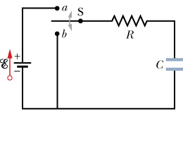
Charging a capacitor
i
+
-
Solution of this first order differential equation is:
q₀ = C E = max charge
At t = 0, q = 0, No charge
At t → ∞, q = q₀, fully charged
At t = 0, V_{c} = 0, No charge
At t -> ∞ V_{c} = E , fully charged

Slide 40
Discharging Capacitor
2V
1V
0V
4V
3V
5V
+
-
+
-
+
-
-e
-e
-e
-e
-e
Insert capacitor to a resistor
+
-
+
-
R
The current can not be constant!

Slide 41
Discharging a capacitor
i
+
-
Solution of this differential equation is:
At t = 0, q = q₀, fully charged
At t → ∞, q = 0, fully discharged
At t = 0, i = i₀ = q₀/RC, max current
At t → ∞, i = 0, fully discharged

Slide 42
Charging a capacitor
At t = 0, i = i₀ = q₀/RC, max current
At t → ∞, i = 0, fully discharged

Slide 43
Discharging a capacitor
q

Slide 44
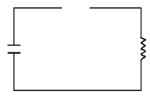
Charging of Capacitor
Discharging of Capacitor
Fully charged battery
t = 0
i = i₀
Dead battery
t = ∞
i = 0
Close Switch
t = 0
i = i₀
Open Switch
t = ∞
i = 0
S
S
T72- Q16. Consider a series RC circuit as shown in the following figure 4, where , R = 10⁶ ohm, C = 5.0 μF and E = 30 V. If the switch is closed at t =0, what is the current in resistance R at time 10 s after the switch is closed? (Ans: )
E
C
T111-Q15.
A 1.0 µF capacitor with an initial stored energy of 0.50 J is discharged through a 1.0 M Ω resistor. Find the current through the resistor when the discharge starts. A) 1.0 mA
R
S

Slide 45
T72- Q16. Consider a series RC circuit as shown in the following figure 4, where , R = 10⁶ ohm, C = 5.0 μF and E = 30 V. If the switch is closed at t =0, what is the current in resistance R at time 10 s after the switch is closed? (Ans: )
E
C
R
S

Slide 46
T111-Q15.
A 1.0 µF capacitor with an initial stored energy of 0.50 J is discharged through a 1.0 M Ω resistor. Find the current through the resistor when the discharge starts. A) 1.0 mA

Slide 47
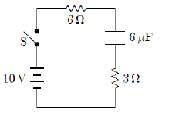
Time Constant
Charging of Capacitor
Discharging of Capacitor
For t = RC is called time constant (τ)
For t = RC is called time constant (τ)
63% of capacitor gets charged at time τ
63% of capacitor gets discharge at time τ
T103-Q18.
In the circuit shown in Figure, the capacitor is initially uncharged. At time t = 0, switch S is closed. If τ denotes the time constant, the approximate current through the 3 Ω resistor when t = τ /10 is:
A) 1.0 A

Slide 48
T103-Q18.
In the circuit shown in Figure, the capacitor is initially uncharged. At time t = 0, switch S is closed. If τ denotes the time constant, the approximate current through the 3 Ω resistor when t = τ /10 is:
A) 1.0 A

Slide 49
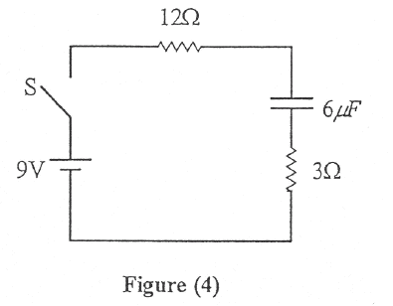
T72- Q16. A capacitor of capacitance C takes 2 s to reach 63 % of its maximum charge when connected in series to a resistance R and a battery of emf ε. How long does it take for this capacitor to reach 95 % of its maximum charge (from zero initial charge)? (Ans: 6s)
T-011 Q#1: In the circuit shown in figure (4), the capacitor is initially uncharged. At t = 0, switch S is closed. If T denotes the time constant, then the current passing through the 3.0 Ohm resistor at t = T/100 is: (Ans: 0.5 A.)
T001-Q#4: A 4.00 micro-F capacitor is charged to 24.0 V. Find the charge on the capacitor 4.00 milli-seconds after it is connected across a 200-Ohm resistor.
(Ans: 0.647 micro-C)

Slide 50
T72- Q16. A capacitor of capacitance C takes 2 s to reach 63 % of its maximum charge when connected in series to a resistance R and a battery of emf ε. How long does it take for this capacitor to reach 95 % of its maximum charge (from zero initial charge)? (Ans: 6s)

Slide 51
T-011 Q#1: In the circuit shown in figure (4), the capacitor is initially uncharged. At t = 0, switch S is closed. If T denotes the time constant, then the current passing through the 3.0 Ohm resistor at t = T/100 is: (Ans: 0.5 A.)

Slide 52
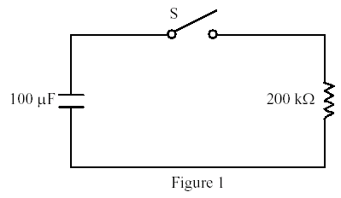
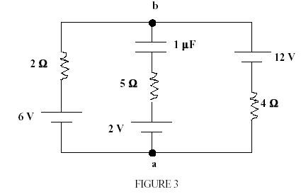
T002: Q#1: The capacitor in figure (1) is initially charged to 50 V and then the switch is closed. What charge flows out of the capacitor during the first minute after the switch was closed?
(Ans: 4.8 mC.)
T71- Q14. A capacitor of capacitance 5.0x10⁻⁶ F is discharging through a 4.0 M Ω resistor. At what time will the energy stored in the capacitor be half of its initial value? (Ans: 7 s)
T001-Q#3: The circuit in Figure 3 has been connected for a long time. Find the potential difference Vb - Va.
(Ans: 8 V)
T111-Q15.
A 1.0 µF capacitor with an initial stored energy of 0.50 J is discharged through a
1.0 M Ω resistor. Find the current through the resistor when the discharge starts.
A) 1.0 mA tau

Slide 53
Ch27-65:
In the circuit of Fig 27-64, E = 1.2kV, C = 6.5 μF, R₁ = R₂ = R₃ = 0.73 MΩ. With C completely uncharged, switch S is suddenly closed (at t = 0). At t =0, what are:
(a) current i₁ in resistor 1,
(b) current i₂ in resistor 2
(c) current i₃ in the resistor 3?
At t = ∞, what are (d) i₁,
(e) i₂
(f) i₃?
What is the potential difference across resistor 2 at
(g) t = 0 and
(h) t = ∞
R₁
R₃
E
R₂
Answers: (a) 1.1 mA, (b) 0.55mA (c)0.55mA (d) 0.82mA (e)0.82mA (f)0 mA (g) 400V (h) 600V

Slide 54
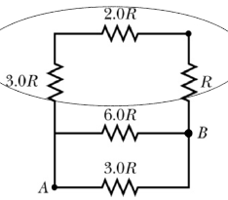
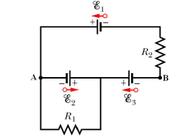
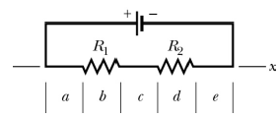
T111-Q16. Consider the five resistors connected as shown in Figure 6. Find the equivalent resistance between the points A and B. A) 3R/2
T111-Q17.
In the circuit shown in Figure 7, R¹ = 100 Ω, R² = 50 Ω, and the ideal batteries have emfs E¹ = 6.0 V, E² = 5.0 V, and E³ = 4.0 V. Find the potential difference V^{B} – V^{A} .
A) +1.0 V
T111-Q18.
In the circuit shown in Figure 8, an ideal battery is connected to two resistors (R¹ > R² ). The section lying along an x axis is divided into five segments of equal length. Rank the segments according to the magnitude of the electric field in them, greatest first.
A) b, then d, then a and c and e tie

Slide 55
T103-Q14.
The resistance of resistor 1 is twice the resistance of resistor 2. The two are connected in series and a potential difference is maintained across the combination. Then:
A) the potential difference across resistor 1 is twice that across resistor 2
B) the current in resistor 1 is twice that in resistor 2
C) the potential difference across resistor 1 is half that across resistor 2
D) the current in resistor 1 is half that in resistor 2
E) the potential difference across resistor 1 is 4 times that across resistor 2
T103-Q15.
A battery with an emf of 24 V is connected to a 6.0 Ω resistor. As a result, a current of 3.0 A flows through the resistor. What is the potential difference that appears at the terminals of the battery:
A) 18 V

Slide 56
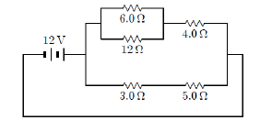

T103-Q16.
The current in the 4.0 Ω resistor in the circuit shown in Figure 2 is :
A) 1.5 A
T103-Q17.
Each of the resistors in the diagram of Figure 3 has a resistance of 12 Ω. The potential difference between points a and b is 10 V. What is the power dissipated in the entire circuit?
A) 4.0 W
T103-Q18.
In the circuit shown in Figure 4, the capacitor is initially uncharged. At time t = 0, switch S is closed. If τ denotes the time constant, the approximate current through the 3 Ω resistor when t = τ/10 is:
A) 1.0 A

Slide 57
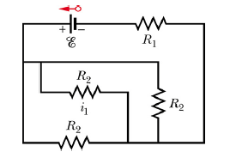
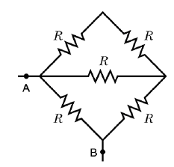
T102-Q17.
Consider the circuit shown in Figure 3. The resistances R1 = 10 Ω, R2 = 20 Ω and the ideal battery has emf ε = 12 V. What are the magnitude and direction (left or right) of the current i1?
A) 0.24 A to the right
T102-Q18.
Consider the five 10 Ω resistors connected as shown in Figure 4. Find the equivalent resistance (in Ohms) between the points A and B.
A) 6.3
T102-Q19.
A capacitor in a series RC circuit is charged to 60% of its maximum value in 1.0 s. The time constant of the circuit is: A) 1.1 s

Slide 58
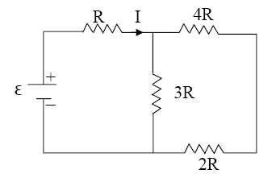
T102-Q20.
Initially a single resistor R1 is connected to a battery. Then another resistor R2 (different from R1) is added in parallel. Which one of the following is ALWAYS TRUE?
The current through R1 now is the same as that before R2 is added.
The current through R1 now is less than that before R2 is added.
The current through R1 now is more than that before R2 is added.
The total current through R1 and R2 is the same as that through R1 before R2 is added.
The total current through R1 and R2 is twice as that through R1 before R2 is added.
T101-Q16.
Determine R when I = 0.20 A and ε = 18 V in the circuit shown in Figure 8.
A) 30 Ω

Slide 59
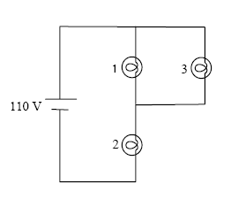
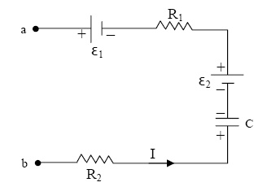
T101-Q17.
The circuit shown in Figure 9 has three 100-Ω light bulbs connected to a 110 V battery. Which light bulb(s) is(are) brightest?
A) 2
T101-Q18.
In Figure 10, ε 1 = 4.0 V, ε 2 = 12 V, R1 = 4.0 Ω, R2 = 12 Ω, C = 3.0 µF, Q = 18 µC, and I = 2.5 A. What is the potential difference Va – Vb?
A) –30 V
T101-Q19.
In an RC circuit, how much time (in terms of the time constant τ) does it require an initially uncharged capacitor to reach 80 % of its maximum potential difference?
A) 1.6 τ

Slide 60
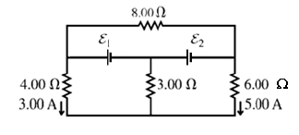
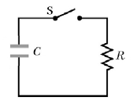
T92-Q13.
Four 20-Ω resistors are connected in parallel and the combination is connected to a 20-V emf device. The current in the device is:
A) 4.0 A
T92-Q14.
Resistor 1 has twice the resistance of resistor 2. They are connected in parallel to a battery. If the power dissipated in R1 is P1 and the power dissipated in R2 is P2, then P1/P2 is:
A) 0.50
T92-Q15.
Find the current in 8.00-Ω resistor in the circuit shown in Figure 4?
A) 2.25 A toward the left
T92-Q16. The capacitor shown in Figure 14 is initially charged. Switch S is closed at time t = 0. At the end of 10.0 ms, the charge on the capacitor is one third the initial value. The time constant of this circuit is:
A) 9.10 ms

Slide 61
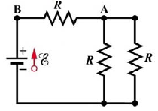
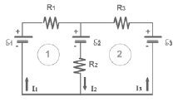
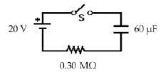
T92-Q17.
In the circuit of Figure 5: E = 30 V, and the resistance of each resistor is 10 Ω. What is the potential difference VA – VB?
A) – 20 V
T91-Q13.
For the circuit shown in Figure 4, which equation is correct for loop 2?
A) E2 + R3I3 - E3 + R2I2 = 0
T91-Q14.
Initially, for the circuit shown in Figure 5, the switch S is open and the capacitor is
uncharged. The switch S is closed at time t = 0. At what time will the current be half its initial
value?
A) 12.5 s

Slide 62
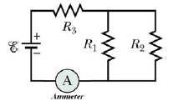
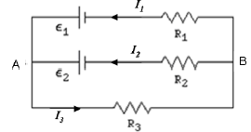
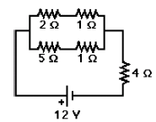
T91-Q15.
The circuit in Figure 6 shows three identical resistors connected to a battery and an ammeter. The current measured by the ammeter is I_{o}. If resistor R2 is removed, the current measured by the ammeter will be
A) 3I_{o} /4.
T91-Q16.
In the circuit shown in Figure 7, ε1 = 28 V, ε2 = 42 V, R1 = 2.0 Ω, R2 = 5.0 Ω, R3 = 1.0 Ω, and I1 = 7.5 A. Calculate the potential difference VA – VB.
A) + 13 V
T91-Q17.
In the circuit shown in Figure 8, what power is dissipated in the 4-Ω resistor?
A) 16 W

