Slide 1
Chapter 17
Sound waves

Slide 2
Lecture -01

Slide 3
17-2 Sound Wave: Animation
ray
ray
ray
Wave front
compression
Wave front
rarefaction
Wave front
Wave front
ray
Wave front
Wave front
ray
ray
ray
Wavefronts: Surfaces over which the oscillations have the same value.
Rays : lines representing the direction of sound wave. Rays are ⊥ to wavefronts

Slide 4
Longitudinal Wave: Sound Wave
Longitudinal Waves: Particles displacement parallel to wave direction
Rarefaction
(low pressure)
Compression
(high pressure)
λ
λ

Slide 5
17.3: Speed of sound (v)
τ
τ
One dimensional motion: rope
(String) Wave Velocity,
Three dimensional motion: air
(Sound)Wave Velocity,
Bulk Modulus
Density of medium
Velocity of sound wave for one medium is always fixed. For the air the average velocity is: 343m/s

Slide 6
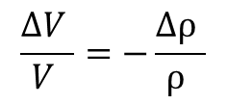
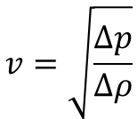

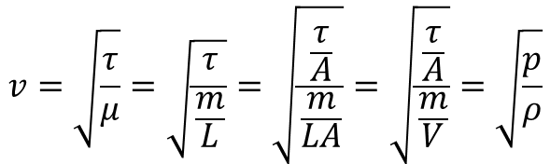





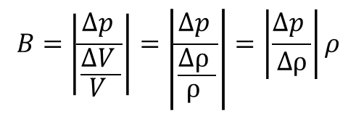
Speed of Sound
$$v=\sqrt{\frac{τ}{μ}}=\sqrt{\frac{τ}{\frac{m}{L}}}=\sqrt{\frac{\frac{τ}{A}}{\frac{m}{LA}}}=\sqrt{\frac{\frac{τ}{A}}{\frac{m}{V}}}=\sqrt{\frac{p}{ρ}}$$
But in media there is change in pressure and change in density happen regularly
$$v=\sqrt{\frac{∆p}{∆ρ}}$$
$$∆p =v^{2}∆ρ$$
Wherever is more density there is more pressure.
$$m=constant$$
$$B=\left|\frac{∆p }{\frac{∆V }{V }}\right|=\left|\frac{∆p }{\frac{∆ρ }{ρ }}\right|=\left|\frac{∆p }{∆ρ}\right|ρ$$
$$ρV=constant$$
Differentiating
$$ρ∆V+V∆ρ=0$$
$$B=v^{2}ρ$$
$$\frac{∆V }{V }=−\frac{∆ρ }{ρ }$$
$$v=\sqrt{\frac{B}{ρ}}$$
Negative sign indicates decreasing volume creates increasing density

Slide 8
17-4: Traveling Sound Wave: Animation
s_{m}
Displacement of particle (S): Simple harmonic motion
s
s_{m}
t
Change in pressure (Δp): pressure also changes simple harmonically
p
p_{m}
t

Slide 9
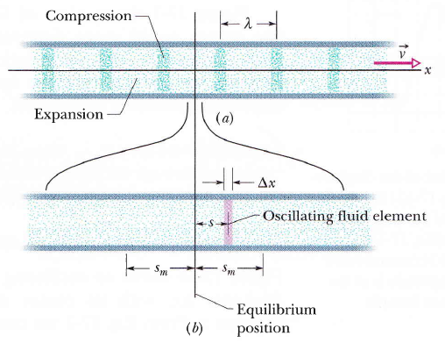

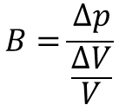

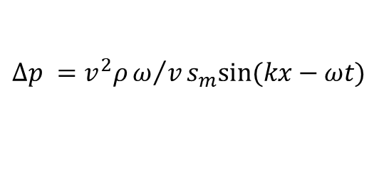









Speed of Sound
$$s_{2}$$
$$s_{3}$$
$${∆p}_{1}$$
$${∆p}_{2}$$
$${∆p}_{3}$$
Pressure ($p$) becomes minimum as displacement (s) becomes maximum
Figure 17-5
$$∆p =Bks_{m}sin⁡(kx−ωt)$$
The volume of oscillating element of width Δx
$$∆p =v^{2}ρω/vs_{m}sin⁡(kx−ωt)$$
$$V=A∆x$$
$$∆p =(vρωs_{m})sin⁡(kx−ωt)$$
The change in volume while displacement is Δs
$$∆V=A∆s$$
$$B=\frac{∆p}{\frac{∆V}{V}}$$
$$∆p =B\frac{∆V}{V}=B\frac{ds}{dx}$$

Slide 10
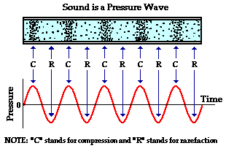
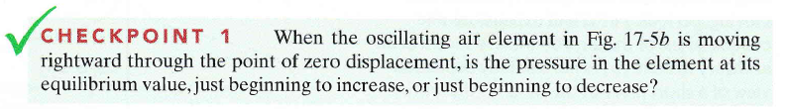
Figure 17-5
Decrease: displacement is increasing, so pressure should be decreasing
http://www.acs.psu.edu/drussell/demos/waves-intro/waves-intro.html

Slide 11
T51-Q#6. The maximum pressure amplitude ΔPm that the human ear can tolerate is about 30 N/m². If the maximum displacement Sm is 1.3x10⁻⁵ m, find the frequency of the corresponding sound. (ρ =1.2 kg/m³, the speed of sound =340 m/s).
(Ans: 900 Hz)

Slide 12
Sample Problem 17-2:
The maximum pressure amplitude Δp_{m} that the human ear can tolerate is about 28 Pa (which is very much less than the normal air pressure of about 10⁵ Pa). What is the displacement amplitude s_{m} for such a sound in air of density 1.21 Kg/m³, at a frequency of 1000 Hz and a speed of 343 m/s

Slide 13
Interference: Sources in same side
When two identical sound waves travel along the same direction they interferes constructively and destructively.
L₁
P
The relationship between phase
difference and path difference is
A
min
L₂
max
B
Constructive interference = Highest Amplitude= Highest Power = Highest intensity
n (2л), n = 0, 1, 2, ………
Destructive interference = lowest Amplitude = lowest power = lowest intensity
(n+1/2) 2л, n = 0, 1, 2, ………

Slide 14
Maxima
Minima
n= 2, 3rd Max, ΔL=2λ
n= 1, 2nd min, ΔL= 3λ/2
n= 1, 2nd Max, ΔL=λ
L₁
n= 0, 1st min, ΔL= λ/2
L₁
n= 0, 1st Max, ΔL=0
L₁
L₂
n= 0, 1st min, ΔL= λ/2
L₂
n= 1, 2nd Max, ΔL=λ
n= 1, 2nd min, ΔL= 3λ/2
L₂
n= 2, 3rd Max, ΔL=2λ

Slide 15
Interference: Sources in opposite side
When two identical sound waves travel along the same direction they interferes constructively and destructively.
A
B
λ/2
Constructive interference
Destructive interference

Slide 16
T72: Q6.Two speakers S1 and S2 are placed on the y-axis as shown in figure 1. The speakers are in phase and emit identical sound waves with a given frequency. An observer, standing at point A, hears a sound of maximum intensity. As the observer moves along a straight line parallel to the y-axis and reaches point B, he hears first minimum of sound intensity. The frequency of sound emitted by the speakers is? (speed of sound in air = 343 m/s).
(Ans: 121 Hz)

Slide 17

Interference
T103-Q7. Two speakers, separated by 2.00 m, face each other as shown in Figure 1 . They are driven by the same generator, and emit sound waves with a frequency of 170 Hz, that are initially in phase. A listener is initially at point A, which is at the midpoint between the two speakers. What is the shortest distance he should move to find a point of destructive interference? [Take the speed of sound to be 340 m/s]
A) 0.500 m

Slide 18
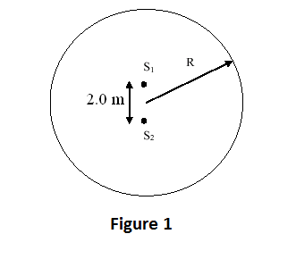
Interference
T103-Q7. Two speakers, separated by 2.00 m, face each other as shown in Figure 1 . They are driven by the same generator, and emit sound waves with a frequency of 170 Hz, that are initially in phase. A listener is initially at point A, which is at the midpoint between the two speakers. What is the shortest distance he should move to find a point of destructive interference? [Take the speed of sound to be 340 m/s]
A) 0.500 m
T102-Q5. The sound from a single source can reach point O by two different paths. One path has a length 20.0 m and the second path has a length 21.0 m. The sound destructively interferes at point O. What is the minimum frequency of the source if the speed of sound is 340 m/s? A) 170 Hz
T101-Q8. At a location that is 3.00 m from sound source A and 4.20 m from sound source B, constructive interference occurs. Source A and source B are in phase. What is the lowest frequency of the waves? The speed of sound in air is 343 m/s. A) 286 Hz
T111-Q5. Two transmitters, S1 and S2, shown in Figure 1, emit identical sound waves at a frequency of 680 Hz. The transmitters are separated by a distance of 2.0 m. Consider a big circle of radius R with its center halfway between these transmitters. How many interference minima are there on this big circle? Take the speed of sound in air to be 340 m/s. A) 16

Slide 19
T111-Q5. Two transmitters, S1 and S2, shown in Figure 1, emit identical sound waves at a frequency of 680 Hz. The transmitters are separated by a distance of 2.0 m. Consider a big circle of radius R with its center halfway between these transmitters. How many interference minima are there on this big circle? Take the speed of sound in air to be 340 m/s. A) 16

Slide 20
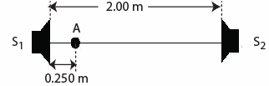
T82-Q7. Two sound sources, separated by a distance of 2.00 m, are in phase and both emit sound waves with a frequency of 500 Hz. Point A is 0.250 m from S1 (see Figure 1). What is the phase difference between the two sound waves at point A? (vsound = 343 m/s)
A) 13.7 rad

Slide 21
At a location that is [x] m from sound source A and [y] m from sound source B, constructive interference occurs. Source A and source B are in phase. What is the lowest frequency of the waves? The speed of sound in air is [v] m/s

Slide 22
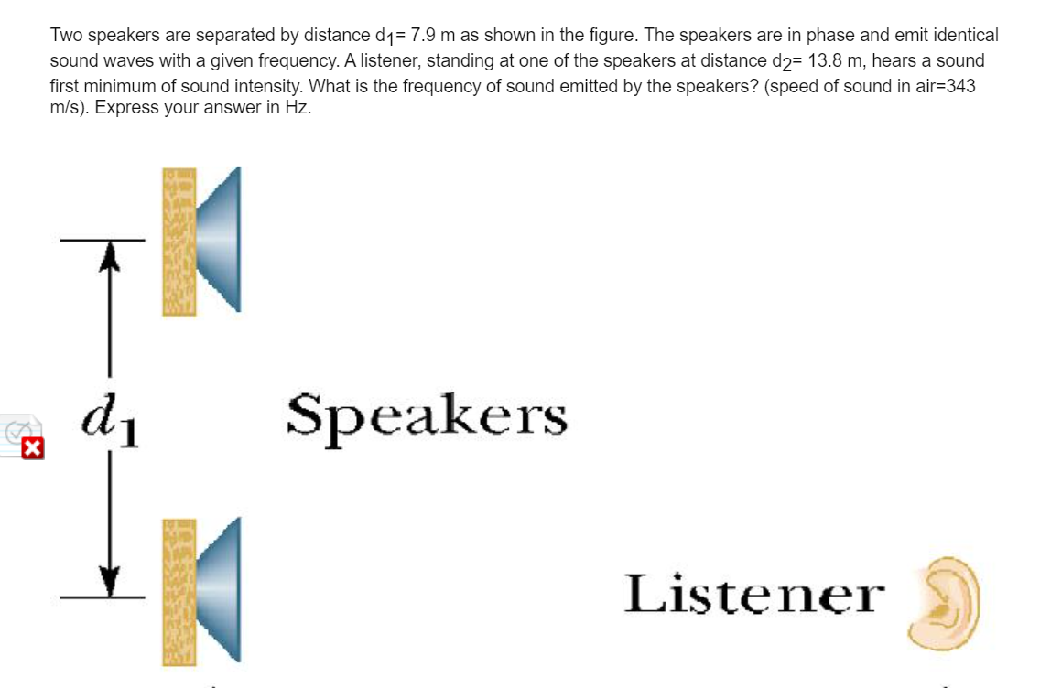

Slide 23
T72: Q6.Two speakers S1 and S2 are placed on the y-axis as shown in figure 1. The speakers are in phase and emit identical sound waves with a given frequency. An observer, standing at point A, hears a sound of maximum intensity. As the observer moves along a straight line parallel to the y-axis and reaches point B, he hears first minimum of sound intensity. The frequency of sound emitted by the speakers is? (speed of sound in air = 343 m/s).
(Ans: 121 Hz)
T82-Q7. Two sound sources, separated by a distance of 2.00 m, are in phase and both emit sound waves with a frequency of 500 Hz. Point A is 0.250 m from S1 (see Figure 1). What is the phase difference between the two sound waves at point A? (vsound = 343 m/s)
A) 13.7 rad

Slide 24
Lecture -02

Slide 25
Power (P)
4πR²
4πR²
4πR²
4πR²
Average Power depends on the surface area formed by wave fronts and it varies with distance from the source.

Slide 26
Intensity (I)
4πR²
4πR²
4πR²
4πR²

Slide 27
Sample Problem 17-3:
An electric spark jumps along a straight line of the length 10m, emitting a pulse of sound that travels radially outward from the spark. (The spark is said to be a line source of sound.) The power of the emission is 1.6x10⁴ W. What is the intensity I of sound when it reaches a distance 12 m from the spark.
(Ans: 21.2 W/m²)

Slide 28
Sound level(β)
Faintest
loudest
Sound amplitude (s_{m} )
10⁻⁵ m
10⁻¹¹ m
Large range of intensity variation can be handled by expressing in logarithm
Sound level
Decibel
Where I₀ =10⁻¹² W/m² , is reference intensity

Slide 29
Difference in Sound level(β₂ – β₁)

Slide 30
Intensity and sound level
T111-Q6. During a typical workday of eight hours, the average sound intensity arriving at a human ear is 1.8 × 10⁻⁵ W/m². If the area of the human ear through which the sound passes is 2.1 cm², what is the total energy entering each ear during the workday? A) 1.1 × 10^{–4} J
T102- Q6. Which one of the following statements is TRUE?
If two sound waves have the same intensity level (in decibels), they must have the same intensity.
T101-Q5. The intensity of a certain sound wave is 6.0 μW/cm2. If its sound level is raised by 10 decibels, the new intensity (in μW/cm2) is:
A) 60
T81-Q6.The intensity of sound emitted by a source is doubled. What is the change in intensity level of the sound? (Ans: 3.0 dB)
T82-Q6. A point sound source emits sound with an average power of 0.78 W. At what distance from the source is the sound level equal to 98 dB? A) 3.1 m
T62-Q8. A person is listening to sounds from two different sources simultaneously. One source has sound level of 80 dB, while the other has 90 dB. What combined sound level will the person hear? (Ans: 90.4 dB)

Slide 31
T82-Q6. A point sound source emits sound with an average power of 0.78 W. At what distance from the source is the sound level equal to 98 dB?
A) 3.1 m

Slide 32
T62-Q8. A person is listening to sounds from two different sources simultaneously. One source has sound level of 80 dB, while the other has 90 dB. What combined sound level will the person hear? (Ans: 90.4 dB)

Slide 33
Ch17-Q27.
Suppose that the sound level of a conversation is initially at an angry 70dB and then drops to soothing 50dB. Assuming that the frequency of the sound is 500 Hz, determine the (a) initial and (b) final sound intensities and the (c) initial and (d) final sound amplitudes
Answers: (a) 10μW/m² (a) 0.1 μW/m² (c) 70 nm (d) 7 nm
T111-Q6. During a typical workday of eight hours, the average sound intensity arriving at a human ear is 1.8 × 10⁻⁵ W/m². If the area of the human ear through which the sound passes is 2.1 cm², what is the total energy entering each ear during the workday?
A) 1.1 × 10^{–4} J
T71-Q#7. The average output power of a speaker is 550 watts. The sound level that reaches to a detector is 105 dB, how far is the detector from the source? (Take I_{o}=10⁻¹² W/m²)
(Ans: 37 m)
T61-Q7. The intensity of a sound wave is 10⁻⁷ W/m² at a distance of 30.0 m from a speaker emitting sound waves at a the frequency of . What is the sound level at a distance of 50.0 m from the speaker? (Ans: 46 dB)
Q#4. The sound level of a certain sound source is increased by 40 dB. By what factor is the displacement amplitude increased? (Ans: 100)

Slide 34
Q#4. The sound level of a certain sound source is increased by 40 dB. By what factor is the displacement amplitude increased? (Ans: 100)

Slide 35
Ch17-Q27.
Suppose that the sound level of a conversation is initially at an angry 70dB and then drops to soothing 50dB. Assuming that the frequency of the sound is 500 Hz, determine the
initial sound intensity
final sound intensities
initial amplitude
final sound amplitudes
(Air density = 1.4 m/s, v = 343 m/s)
Answers: (a) 10μW/m² (a) 0.1 μW/m² (c) 70 nm (d) 7 nm

Slide 36
T62-Q8. A person is listening to sounds from two different sources simultaneously. One source has sound level of 80 dB, while the other has 90 dB. What combined sound level will the person hear? (Ans: 90.4 dB)

Slide 37


Standing wave in sound: Pipe with both ends open
Wave reflects back and forth from open ends (Soft boundary) and if the reflected wave travel 2L distance in nT time resonance will take place.
n = number of harmonics, which represents different possible frequencies or wavelengths at which resonances take place.
Click for Animation
L
Free
medium
Guided medium
Free
medium
Soft interface molecules will oscillate with highest amplitude: Antinode
$$λ_{n}=\frac{2L}{n}$$
$$f_{n}=\frac{nv}{2L}$$
n = 1, 2, 3, 4, ---
Click for real life Examples
Both end Open pipe is same as resonating string

Slide 38
















L
$$=\frac{λ1}{2}$$
L
$$=\frac{λ2}{2}+\frac{λ2}{2}=λ$$
AN
$$\frac{1}{2}loop$$
$$\frac{1}{2}loop$$
AN
$$extra loop$$
Soft interface molecules will oscillate with highest amplitude: Antinode
$$λ_{2}=\frac{2L}{2}$$
$$=L$$
$$Each lool is \frac{λ}{2}$$
Second harmonics = Second resonance
$$λ_{n}=\frac{2L}{n}$$
$$f_{n}=\frac{nv}{2L}$$
L
$$=2\frac{λ3}{2}+\frac{λ3}{2}=3\frac{λ3}{2}$$
$$λ_{1}=\frac{2L}{1}$$
$$f_{1}=\frac{v}{2L}$$
$$=2L$$
$$extra loop$$
$$extra loop$$
First harmonics = First resonance
Third harmonics = Third resonance
$$λ_{3}=\frac{2L}{3}$$

Slide 39
Standing wave in sound: Pipe with one end open
Open end - antinodes
Closed end - node
L
First harmonic = 1st resonance will takes place if
N
AN
Close
open
Third harmonic = 2nd Resonance will takes place if
No Phase change takes place at open end but 180º phase change takes place in one close end.
Therefore the reflected wave has to travel 4L distance to produce no phase difference with the original wave.
So, 2L distance has to be travelled in nT/2.
n^{th} harmonic, will takes place if
Remember this for close pipe
n = 1, 3, 5, 7, ---
Only odd harmonics will presence in one end close pipe

Slide 40


















L
$$=\frac{λ1}{4}$$
$$Five \frac{1}{2}loops$$
$$\frac{1}{2}loop$$
L
$$=5\frac{λ5}{4}$$
Close
open
Close
open
First harmonics = First resonance
5th harmonics = Third resonance
$$λ_{n}=\frac{4L}{n}$$
$$f_{n}=\frac{nv}{4L}$$
$$λ_{5}=\frac{4L}{5}$$
$$f_{5}=\frac{5v}{4L}$$
$$λ_{1}=\frac{4L}{1}$$
$$f_{1}=\frac{v}{4L}$$
$$=4L$$
T101-Q6. A pipe, with one end open and the other closed, is operating at one of its resonant frequencies. The open and closed ends are respectively:
pressure minimum, displacement minimum
L
$$=3\frac{λ3}{4}$$
Close
$$\frac{1}{2}loop$$
$$\frac{1}{2}loop$$
$$\frac{1}{2}loop$$
open
$$extra loop$$
3rd harmonics = Second resonance
$$λ_{3}=\frac{4L}{3}$$
$$f_{3}=\frac{3v}{4L}$$

Slide 41
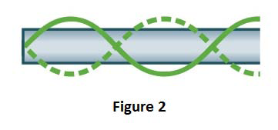
Resonance
T111-Q7. A tube closed at one end resonates in the standing wave pattern shown in Figure 2. If the length of the tube is 0.500 m, and the speed of sound in air is 343 m/s, what is the frequency of the emitted sound?
A) 858 Hz
T103-Q8. A tube open at both ends has length L_{A}. A tube open only at one end has length L_{B}. If the two tubes have the same fundamental frequency, then
A) L_{A} = 2L_{B}
T102-Q7. A pipe, open at both ends, resonates in its second harmonic with a frequency of 1200 Hz. In this situation, the distance between two consecutive antinodes, in cm, is (Take the speed of sound = 343 m/s)
A) 14.3 cm
T101-Q6. A pipe, with one end open and the other closed, is operating at one of its resonant frequencies. The open and closed ends are respectively:
pressure minimum, displacement minimum

Slide 42
T111-Q7. A tube closed at one end resonates in the standing wave pattern shown in Figure 2. If the length of the tube is 0.500 m, and the speed of sound in air is 343 m/s, what is the frequency of the emitted sound?
A) 858 Hz

Slide 43
T103-Q8. A tube open at both ends has length L_{A}. A tube open only at one end has length L_{B}. If the two tubes have the same fundamental frequency, then
A) L_{A} = 2L_{B}

Slide 44
T72-#6.
A standing wave is set up in an air-filled tube that is closed at one end. The standing wave has two nodes and the frequency of oscillation is 230 Hz. What is the length of the tube? Take the speed of sound to be 343 m/s.
(Ans: 1.1 m)
T062: Q6.
A 2.5 m long tube, open at both ends, is filled with a gas. The frequency of a certain harmonic is 500 Hz and the frequency of the next harmonic is 600 Hz. What is the speed of sound in the tube?
(Ans: 500 m/s)
T81-Q5.
A pipe has two consecutive resonance frequencies of 600 Hz and 1000 Hz. One end of the pipe is closed. What is the fundamental frequency of the pipe?
(Ans: 200 Hz)

Slide 45
Ch17: Book’s Question.
A tube 1.2m long is closed at one end. A stretched wire is placed near the open end. The wire is 0.33m long and has a mass of 9.6g. It is fixed at both the ends and oscillates in its fundamental modes. By resonance, it sets the air column in the tube into oscillation at that column’s fundamental frequency. Find(a) that frequency and (b) the tension in the wire. Ans: (a) 71.5 Hz (b) 64.8N
Ch17:Book’s Question.
A well with vertical sides and water at the bottom at the bottom resonates at 7Hz and at no lower frequency. The air in the well has a density 1.1 kg/m3 and a bulk modulus of 1.33 x 10⁵ Pa. How far down in the well is the water surface? Answers: 12.4m
Ch17:Book’s Question.
Pipe A which is 1.2m long and open at Both ends oscillate at its third lowest harmonic frequency. It is filled with air for which speed of sound is 343 m/s. Pipe B, which is closed at one end, oscillate at its second lowest harmonic frequency. This frequency of B happens to match the frequency A. An x-axis extends along the interior of A, with x =0 at one end. (a) How many nodes are long that axis? What are the (b) smallest and (c) second smallest values of x locating those nodes?
Answers: (a) 3 nodes (b) 0.2 m (c) 0.6m

Slide 46
Lecture -03

Slide 47
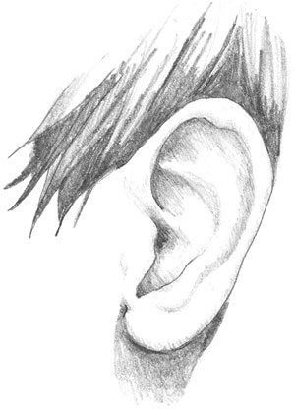
Doppler’s Effect: Detector Moving
Detector is moving
away from source
Detector is moving
towards the source
Wave fronts are passing him slower than to a stationary person
v
Wave fronts are passing faster than to a stationary person
v_{D}
v_{D}
λ
λ

Slide 48
Doppler’s Effect: Source Moving
Source is moving
Towards the detector
Source is moving
away from detector
v
λ
λ
λ’
λ’

Slide 49
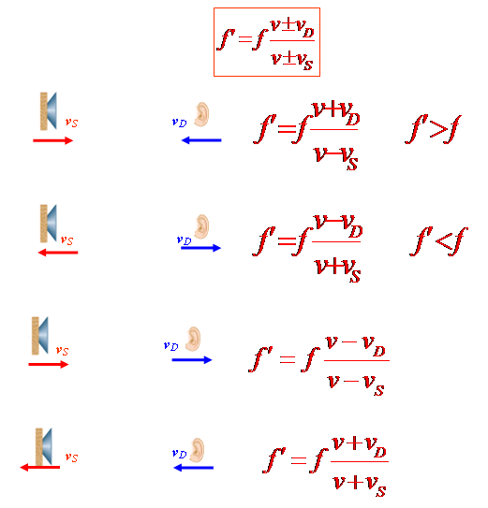
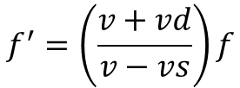
Doppler’s Effect: Summary
more
less
more
$$f^{′}=\left(\frac{v+vd}{v−vs}\right)f$$
more

Slide 50

Supersonic speed and, shock waves
vt
θ
v_{s}t
Mach cone angle
Mach Number
$$=\frac{v}{vs}$$
Speed of a plane 3 Mach = it is flying 3 times faster than sound

Slide 51
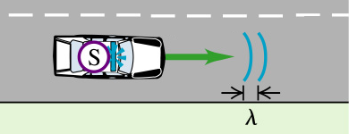
Doppler's Effect
T111-Q8: Two cars are traveling in opposite directions at the same speed when one of the drivers sounds the horn of his car, which has a frequency of 544 Hz. The other driver hears the frequency as 563 Hz. If the speed of sound in air is 344 m/s, what is the speed of the cars?
A) 5.90 m/s
T103-Q9. A police car, moving at 20.0 m/s, emits a sound wave with a frequency of 300 Hz. Find the wavelength of the sound wave in front of the car, as shown in Figure 2. [Take the speed of sound in air to be 340 m/s]
A) 1.07 m
T102-Q8. As you stand by the side of the road, a car approaches you at a constant speed, sounding its horn, and you hear a frequency of 80.0 Hz. After the car passes you, you hear a frequency of 60.0 Hz. What is the speed of the car? Assume that the speed of sound in air is 343 m/s.
A) 49.0 m/s
T101-Q7. A train moving at constant speed is passing a stationary observer. The whistle of the train emits sound with a frequency of 440 Hz. The observer hears the sound with a frequency of415 Hz. The speed of sound in air is 343 m/s. Which of the following is correct? The train
has a speed of
A) 20.7 m/s, and is moving away from the observer.

Slide 52
T102-Q8. As you stand by the side of the road, a car approaches you at a constant speed, sounding its horn, and you hear a frequency of 80.0 Hz. After the car passes you, you hear a frequency of 60.0 Hz. What is the speed of the car? Assume that the speed of sound in air is 343 m/s.
A) 49.0 m/s

Slide 53

T81-Q8.If it were possible for a man to move with the speed of sound directly toward a stationary whistle emitting a sound of frequency f, he would hear (Ans: a sound of frequency 2f)
T71-Q7. A stationary train passenger hears a frequency of 520 Hz as a train approaches a bell on a trackside safety gate. After the train passes the gate the passenger hears a frequency of 480 Hz for the bell sound. The speed of the train is : ( speed of sound in air = 343 m/s) (Ans: 13.7 m/s)
Q#8. A stationary policeman sends a sound wave of frequency 550 Hz towards a car approaching him. The reflected frequency detected by the policeman is 620 Hz. What is the speed of the car? (Ans: 20 m/s)
Q8. Figure 2 shows four situations in which a moving source of sound S and a detector D either moving or stationary. The arrows indicate the directions of motion. The speeds v of the source and the detector are the same. Detector 3 is stationary. Rank the situations accordingto the frequency at the detector, highest to lowest.
A) 4, 3, 2, 1

Slide 54
Q#8. A stationary policeman sends a sound wave of frequency 550 Hz towards a car approaching him. The reflected frequency detected by the policeman is 620 Hz. What is the speed of the car?
(Ans: 20 m/s)

Slide 55

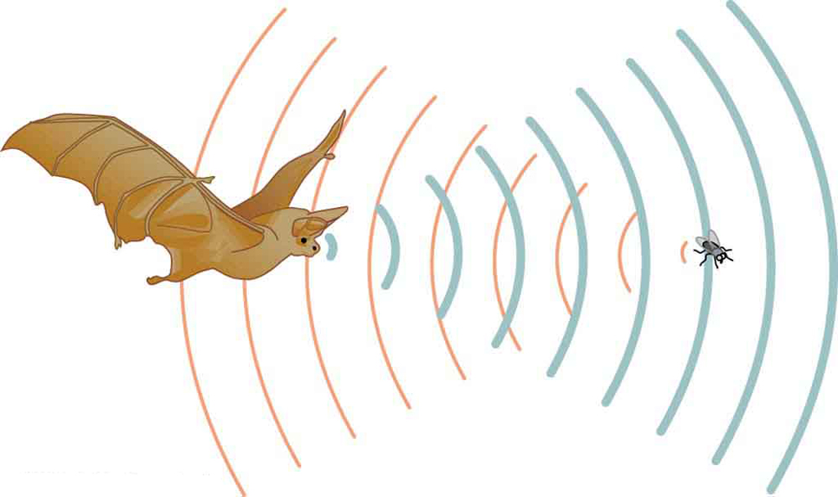
Sample Question:
A stationary policeman sends a sound wave of frequency 550 Hz towards a car approaching him. The reflected frequency detected by the policeman is 620Hz.
(a)What is the speed of the car?
(b) What frequency the police would detect if the police car with speed 10m/s is chasing another car in the same direction?
(c) What frequency the police would detect if the police car is moving with 10m/s and send the wave to a nearby tree?
Sample Question:
A bat flying at 10 m/s sends a sound wave of frequency 100 Hz. If it receives the reflected frequency of 80 Hz from an insect what would be the speed of the insect

Slide 56
Sample Question:
A bat flying at 10 m/s sends a sound wave of frequency 100 Hz. If it receives the reflected frequency of 80 Hz from an insect what would be the speed of the insect
A train approaches a mountain at a speed of 24.2 m/s. The train engineer sounds a whistle that emits a frequency of 420 Hz. What will be the sound frequency that the engineer hears reflected off the mountain? ( speed of sound =340 m/s)

Slide 57
Sample Question:
A stationary policeman sends a sound wave of frequency 550 Hz towards a car approaching him. The reflected frequency detected by the policeman is 620Hz.
(a)What is the speed of the car?
(b) What frequency the police would detect if the police car with speed 10m/s is chasing another car in the same direction?
(c) What frequency the police would detect if the police car is moving with 10m/s and send the wave to a nearby tree?

Slide 58
Ch17-Book’s Problem .
A sound source A and a reflecting source B move directly towards each other. Relative to the air, the speed of source A is 29.9 m/s, the speed of surface B is 65.8m/s and the speed of the sound is 329m/s. The source emits wave at frequency 1200 Hz as measured in the source frame. In the reflector frame, what are the (a) frequency and (b) wavelength of the arriving sound waves?In the source frame, what are the (c) frequency and (d) wavelength of the sound waves relfected back to the source? Answers: (a)1580 Hz, (b) 0.2m (c) 2160 Hz (d)0.15m
Ch17-Book’s Problem:
A girl is sitting near the open window of a train that is moving at a velocity of 10m/s to the east. The girl’s uncle stands near the tracks and watches the train move away. The locomotive whistle emits sound at frequency 500 Hz. The air is still. (a) What frequency does the uncle hear? (b) What frequency does the girl hear? A wind begins to blow from the east at 10 m/s. (c) What frequency does the uncle hear? (d) What frequency does the girl hear? Answer: (a) 485.8 Hz (b) 500 Hz (c) 486.2 Hz (d) 500 Hz

Slide 59
T-111-Ch17
Q5. Two transmitters, S1 and S2, shown in Figure 1, emit identical sound waves at a frequency of 680 Hz. The transmitters are separated by a distance of 2.0 m. Consider a big circle of radius R with its center halfway between these transmitters. How many interference minima are there on this big circle? Take the speed of sound in air to be 340 m/s.
A) 16
Q6. During a typical workday of eight hours, the average sound intensity arriving at a human ear is 1.8 × 10⁻⁵ W/m². If the area of the human ear through which the sound passes is 2.1 cm², what is the total energy entering each ear during the workday?
A) 1.1 × 10^{–4} J
Q7. A tube closed at one end resonates in the standing wave pattern shown in Figure 2. If the length of the tube is 0.500 m, and the speed of sound in air is 343 m/s, what is the frequency of the emitted sound?
A) 858 Hz
Q7: Two cars are traveling in opposite directions at the same speed when one of the drivers sounds the horn of his car, which has a frequency of 544 Hz. The other driver hears the frequency as 563 Hz. If the speed of sound in air is 344 m/s, what is the speed of the cars?
A) 5.90 m/s

Slide 60
T-103-Ch17
Q7. Two speakers, separated by 2.00 m, face each other as shown in Figure 1 . They are driven by the same generator, and emit sound waves with a frequency of 170 Hz, that are initially in phase. A listener is initially at point A, which is at the midpoint between the two speakers. What is the shortest distance he should move to find a point of destructive interference? [Take the speed of sound to be 340 m/s]
A) 0.500 m
Q8.
A tube open at both ends has length LA. A tube open only at one end has length LB. If the two tubes have the same fundamental frequency, then
A) LA = 2LB
Q9. A police car, moving at 20.0 m/s, emits a sound wave with a frequency of 300 Hz. Find the wavelength of the sound wave in front of the car, as shown in Figure 2. [Take the speed of sound in air to be 340 m/s]
A) 1.07 m

Slide 61
T-102-Ch17
Q5. The sound from a single source can reach point O by two different paths. One path has a length 20.0 m and the second path has a length 21.0 m. The sound destructively interferes at point O. What is the minimum frequency of the source if the speed of sound is 340 m/s?
A) 170 Hz
Q6. Which one of the following statements is TRUE?
  A) If two sound waves have the same intensity level (in decibels), they must have the same intensity.
  B) If two different sound waves have the same displacement amplitude, then they must have the same intensity level (in decibels).
  C) If the intensity level (in decibels) of sound A is twice the intensity level of sound B, then the intensity of A is twice the intensity of B.
  D) If two different sound waves have the same displacement amplitude, then they must have the same intensity.
  E) If the intensity of sound A is twice the intensity of sound B, then the intensity level (in decibels) of A is twice the intensity level of B.
Q7. A pipe, open at both ends, resonates in its second harmonic with a frequency of 1200 Hz. In this situation, the distance between two consecutive antinodes, in cm, is (Take the speed of sound = 343 m/s)
A) 14.3 cm
Q8. As you stand by the side of the road, a car approaches you at a constant speed, sounding its horn, and you hear a frequency of 80.0 Hz. After the car passes you, you hear a frequency of 60.0 Hz. What is the speed of the car? Assume that the speed of sound in air is 343 m/s.
A) 49.0 m/s

Slide 62
T-101-Ch17
Q5. The intensity of a certain sound wave is 6.0 μW/cm2. If its sound level is raised by 10 decibels, the new intensity (in μW/cm2) is:
A) 60
Q6. A pipe, with one end open and the other closed, is operating at one of its resonant frequencies. The open and closed ends are respectively:
A) pressure minimum, displacement minimum
B) pressure minimum, pressure minimum
C) displacement maximum, pressure minimum
D) displacement minimum, displacement minimum
E) pressure maximum, pressure maximum
Q7. A train moving at constant speed is passing a stationary observer. The whistle of the train emits sound with a frequency of 440 Hz. The observer hears the sound with a frequency of415 Hz. The speed of sound in air is 343 m/s. Which of the following is correct?
The train has a speed of
A) 20.7 m/s, and is moving away from the observer.
Q8. At a location that is 3.00 m from sound source A and 4.20 m from sound source B, constructive interference occurs. Source A and source B are in phase. What is the lowest frequency of the waves? The speed of sound in air is 343 m/s.
A) 286 Hz

Slide 63
T-92-Ch17
Q7. The displacement of a sound wave in air is given by:
s (x,t) = (7.00 ×10-6) [cos(5.23x – 1800 t)],
where x and s are in meters and t is in seconds. What is the pressure amplitude of this wave? [The density of air is 1.21 kg/m3]
A) 5.25 Pa
Q8. Two sound sources are driven by the same generator and emit sound waves with frequency 688 Hz. An observer is at a point on the line joining the two sources, and is at a point of destructive interference. What is the shortest distance the observer should walk on the line joining the sources to move to a point of constructive interference?[The speed of sound in air is 343 m/s]
A) 0.125 m
Q9. An observer is 50 m from a sound source. If he moves to a distance of 100 m from the source, the change in sound level (in dB) is:
A) − 6.0
Q10: A tube of length L is open at both ends. The second harmonic frequency of this tube is F. The tube is then closed at one end, and its length is adjusted so that its fundamental frequency is equal to F. What is the new length?
A) L/4
Q11. A stationary source emits a sound wave of frequency f. A man travels toward the source at half the speed of sound. The frequency as detected by the man is:
A) 3f/2

Slide 64
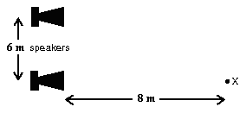
T-91-Ch17
Q6. Two small identical speakers are connected (in phase) to the same source. The speakers are 6 m apart and are at ear level. An observer stands at X=8 m in front of one speaker as shown in Fig. 1. The sound he hears will be least intense if the wavelength is:
A) 4 m
Q7. The intensity of sound wave A is 100 times that of sound wave B. By how many decibels is the sound level of A higher than that of B?
A) 20 dB
Q8. A tuning fork with a frequency of 510 Hz is placed at the open end of an air column that is closed at the other end. What is the shortest length of the air column that will resonate with the tuning fork? The speed of sound in air is 345 m/s.
A) 17 cm
Q9. A source emits sound with a frequency of 1000 Hz. The source and an observer are moving toward each other, each with a speed of 100 m/s. If the speed of sound is 340 m/s, the observer hears sound with a frequency of:
A) 1833 Hz

Slide 65
T-82-Ch17
Q5. A tube open at both ends has a fundamental frequency of 76.0 Hz. What is the third harmonic frequency of this tube if one end is closed?
A) 114 Hz
Q6. A point sound source emits sound with an average power of 0.78 W. At what distance from the source is the sound level equal to 98 dB?
A) 3.1 m
Q7. Two sound sources, separated by a distance of 2.00 m, are in phase and both emit sound waveswith a frequency of 500 Hz. Point A is 0.250 m from S1 (see Figure 1). What is the phase difference between the two sound waves at point A? (vsound = 343 m/s)
A) 13.7 rad
Q8. Figure 2 shows four situations in which a moving source of sound S and a detector D either moving or stationary. The arrows indicate the directions of motion. The speeds v of the source and the detector are the same. Detector 3 is stationary. Rank the situations accordingto the frequency at the detector, highest to lowest.
A) 4, 3, 2, 1

Slide 66
T-81-Ch16
Q5.
A pipe has two consecutive resonance frequencies of 600 Hz and 1000 Hz. One end of the pipe is closed. What is the fundamental frequency of the pipe?
(Ans: 200 Hz)
Q6.
The intensity of sound emitted by a source is doubled. What is the change in intensity level of the sound?
(Ans: 3.0 dB)
Q7.
Two identical loudspeakers, facing each other, are in phase and each has a frequency of 85 Hz. A man at the midpoint between the two loudspeakers moves slowly toward one of them until he hears the first minimum in sound. How far did he move? (The speed of sound in air = 340 m/s)
(Ans: 1.0 m)
Q8.
If it were possible for a man to move with the speed of sound directly toward a stationary whistle emitting a sound of frequency f, he would hear
(Ans: a sound of frequency 2f)

Slide 67
T-72-Ch16
Q6.Two speakers S1 and S2 are placed on the y-axis as shown in figure 1. The speakers are in phase and emit identical sound waves with a given frequency. An observer, standing at point A, hears a sound of maximum intensity. As the observer moves along a straight line parallel to the y-axis and reaches point B, he hears first minimum of sound intensity. The frequency of sound emitted by the speakers is? (speed of sound in air = 343 m/s).
(Ans: 121 Hz)
Q7. A stationary train passenger hears a frequency of 520 Hz as a train approaches a bell on a trackside safety gate. After the train passes the gate the passenger hears a frequency of 480 Hz for the bell sound. The speed of the train is : ( speed of sound in air = 343 m/s)
(Ans: 13.7 m/s)
Q8: The intensity of a certain sound wave is 6 mW/cm2. If its sound level is raised by 10 decibels, the new intensity (in mW/cm2) is:
(Ans: 60)
Q9. If the speed of sound is 340 m/s, the two lowest resonance frequencies of a 0.5 m organ pipe, closed at one end, are approximately: (Ans: 170 and 510 Hz)

Slide 68
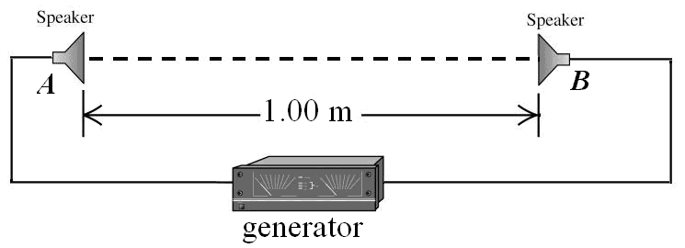
T-71-Ch17
Q#5. In the figure below, two speakers are driven by the same generator and are a distance of 1.0 m apart. The speakers emit sound waves at a frequency of 686 Hz that are in phase. A listener starts at A and moves toward B. What will be the distance from A of the first point at which he will observe constructive interference? The speed of sound in air is 343 m/s. (Ans: 0.25 m)
Q#6. A standing wave is set up in an air-filled tube that is closed at one end. The standing wave has two nodes and the frequency of oscillation is 230 Hz. What is the length of the tube? Take the speed of sound to be 343 m/s.
(Ans: 1.1 m)
Q#7. The average output power of a speaker is 550 watts. The sound level that reaches to a detector is 105 dB, how far is the detector from the source? (Take I_{o}=10⁻¹² W/m²)
(Ans: 37 m)
Q#8. A stationary policeman sends a sound wave of frequency 550 Hz towards a car approaching him. The reflected frequency detected by the policeman is 620 Hz. What is the speed of the car? (Ans: 20 m)

Slide 69
T-62-Ch17
Q6. A 2.5 m long tube, open at both ends, is filled with a gas. The frequency of a certain harmonic is 500 Hz and the frequency of the next harmonic is 600 Hz. What is the speed of sound in the tube?
(Ans: 500 m/s)
Q7. The intensity of a sound wave of frequency 360 Hz is 1.6×10⁻⁶ W/m². .If the speed of sound in air is 343 m/s, what is the displacement amplitude of the air molecules oscillation caused by this wave? (ρ_{air}=1.21 kg.m³).
(Ans: 3.88×10⁻⁸ m )
Q8. A person is listening to sounds from two different sources simultaneously. One source has sound level of 80 dB, while the other has 90 dB. What combined sound level will the person hear?
(Ans: 90.4 dB)
Q9. Two trucks are heading straight toward each other with the same speed "U". The horn of one, with frequency , is blowing, and is heard to have a frequency of 3200 Hz by the people in the other truck. Find "U" if the speed of sound is 340 m/s.
(Ans: 11 m/s)

Slide 70
T-61-Ch16
Q#5. Sound waves of frequency 340 Hz are sent into the top of a vertical tube containing water, as shown in the figure 1. If standing waves are produced, as shown, what is the height level of the water?. [Speed of sound in air = 340 m/s] (Ans: 35 m)
Q#6. A man strikes one end of a long steel pipe of length L, filled with water, by a hammer. A detector attached to the other end of the pipe receives two sounds signals, one from the wave that travels through the pipe and the other from the wave that travels through the water. If the time difference between the two wave signals is 0.02 s, what is the length of the pipe? (Speeds of sound in steel and water are V_{s} = 5940 m/s and V_{w} = 1480 m/s, respectively). (Ans:39 m)
Q7. The intensity of a sound wave is 10⁻⁷ W/m² at a distance of 30.0 m from a speaker emitting sound waves at a the frequency of . What is the sound level at a distance of 50.0 m from the speaker? (Ans: 46 dB)
Q8. A truck emits sound with a frequency of 620 Hz. A person is riding a bike that moves at a speed of 3.0 m/s and is following the truck. If the person hears a frequency of 560 Hz, how fast is the truck moving? (Take the speed of sound in air as 343 m/s). (Ans: 40 m/s)

Slide 71
T-52-Ch16
Q#1. A pipe open at both ends has a fundamental frequency of 400 Hz. What will be the fundamental frequency if the pipe is closed at one end? (speed of sound is 340 m/s) (Ans: 200 Hz.)
Q#4. The sound level of a certain sound source is increased by 40 dB. By what factor is the displacement amplitude increased? (Ans: 100)
Q#13. A stationary person hears a frequency of 800 Hz of an ambulance siren moving at a speed of 60 m/s towards him. What frequency will he hear when the ambulance is moving away from him with the same speed. [speed of sound in air is 340 m/s]. (Ans: 560 Hz).
Q#11. Two speakers are separated by a distance of 3.6 m. A listener is standing in front of one speaker at a distance of 6 m, as shown in Fig. 1. The transmitted sound waves by both speakers are in phase and are in the audible range. What is lowest frequency at which a listener will hear a minimum intensity (speed of sound in air is 340 m/sec)? (Ans: 170 Hz )

Slide 72
T-51-Ch16
Q#5. The sound level at a distance of 5.0 m from a point source is 117 dB. The power output of the source is:
(Ans: 157 W)
Q#6. The maximum pressure amplitude ΔPm that the human ear can tolerate is about 30 N/m². If the maximum displacement Sm is 1.3*10⁻⁵ m, find the frequency of the corresponding sound. (ρ =1.2 kg/m³, the speed of sound =340 m/s).
(Ans: 900 Hz)
Q#7. Two identical speakers are connected in phase to the same source, as shown in Fig. 1. The speakers are 0.22 m apart and at ear level. An observer stands at distance of 1.2 m in front one speaker as shown in the figure. If the will hears maximum sound if the wavelength is:
(Ans: 2.0 cm)
Q#8. A police car is moving at speed of 30 m/s. Its siren emits a sound at frequency of 600 Hz. As the car approaches a large wall, what is the frequency of the sound heard by the driver of the police car?
(Ans: 716 Hz)

