Slide 1
Chapter 25
Capacitors

Slide 2
Book’s Problems
Ch 25 Problems:
4, 5, 8, 12, 17, 19, 27, 36, 41, 44, 48, 49, 50.

Slide 3
Capacitance (C)
+
-
+
-
+
-
+
-
+
-
V₊
0
V
C is capacitance = Ability to store the charges
Unit of Capacitance

Slide 4
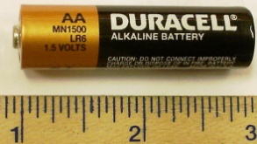
Charging a parallel plate Capacitor
+
V
-
+
-
+
E
-
-e
-
-e
-e
-e
-e
+
+
-
d
-e
-e
-e
-e
-e

Slide 5
Cylindrical Capacitor
-
-
-
+
r
+
+
+
-
a
+
+
-
+
+
-
-
b
-

Slide 6
Spherical a Capacitor
-
-
-
+
r
+
+
+
-
a
+
+
-
+
+
-
-
b
-

Slide 7
Isolated Spherical a Capacitor
-
-
-
+
r
+
+
+
-
a
+
+
-
+
+
-
∞
-
b
-
For the Sphere of radius R

Slide 9
T072: Q# 14: The magnitude of the charge on each plate of a parallel plate capacitor is 2.5 μC. If the capacitor has a plate area of 0.25 m2 and a plate separation of 0.1 mm, what is the electric field between its plates?
(Ans: 1.1×10⁶ V/m)
T051:Q#14. A parallel-plate capacitor has an area of 16 cm² . The plates are separated by 0.5 mm and are connected across a 60 V battery. Find the magnitude of the charge on each plate.
(Ans: 1.7 nC)
T-041-Q#1 A parallel-plate capacitor (with plates A and B) has circular shape of radius 6.0 cm separated by 2.0 mm. Find the total charges on both plates (A and B) when a 12 V battery is connected.
(Ans: zero)
T061:Q#15. A parallel plate capacitor has square shaped plates with an area = 4.1×10⁻³ m² and 1.6×10⁻³ m separation. What charge will appear on the plates of such capacitor if a potential difference of 80 V is applied?
(Ans: 1.8×10⁻⁹ C)

Slide 10
T103-Q18.
Which of the following statements is TRUE?
A) The capacitance depends on the geometry of the capacitor.
B) The capacitance does not depend on the material separating the charged conductors.
C) The energy stored in a capacitor does not change by changing its potential.
D) Capacitors do not store energy.
E) The capacitance of a capacitor doubles when the voltage across it is doubled.
T102-Q14. A parallel-plate capacitor has a plate area of 0.20 m² and a plate separation of 0.10 mm. To obtain an electric field of 2.0 x 10⁶ N/C between the plates, the magnitude of the charge on each plate should be:
A) 3.5 x 10⁻⁶ C
T91-Q14.
The capacitance of a parallel-plate capacitor is
A) proportional to the plate area.

Slide 11
T061:Q#15. A parallel plate capacitor has square shaped plates with an area = 4.1×10⁻³ m² and 1.6×10⁻³ m separation. What charge will appear on the plates of such capacitor if a potential difference of 80 V is applied?
(Ans: 1.8×10⁻⁹ C)

Slide 12
T072: Q# 14: The magnitude of the charge on each plate of a parallel plate capacitor is 2.5 μC. If the capacitor has a plate area of 0.25 m2 and a plate separation of 0.1 mm, what is the electric field between its plates?
(Ans: 1.1×10⁶ V/m)

Slide 13
Capacitors in Series
+q
-q
+q
-q
+q
-q
V₁
V₂
V₃
V
+q
-q
Series: Charge is common

Slide 14
Capacitors in Parallel
+q₁
-q₁
V
+q₂
-q₂
V
+q₃
-q₃
V
+q_{eq}
-q_{eq}
V
Parallel: Potential is common

Slide 15
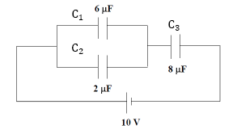
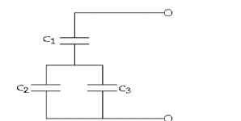
T111-Q18. Determine the equivalent capacitance of the circuit shown in Figure 7.
A) 4.0 µF
T92-Q18.
Three capacitors are arranged as shown in Figure 5. C1 has a capacitance of 5.00 pF, C2 has a capacitance of 10.0 pF, and C3 has a capacitance of 15.0 pF. Find the charge stored in capacitor C1 if the voltage drop across C2 is 311 V.
A) 7.78 nC

Slide 16
T92-Q18.
Three capacitors are arranged as shown in Figure 5. C1 has a capacitance of 5.00 pF, C2 has a capacitance of 10.0 pF, and C3 has a capacitance of 15.0 pF. Find the charge stored in capacitor C1 if the voltage drop across C2 is 311 V.
A) 7.78 nC

Slide 17
T111-Q18. Determine the equivalent capacitance of the circuit shown in Figure 7.
A) 4.0 µF

Slide 18
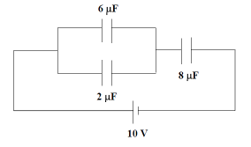
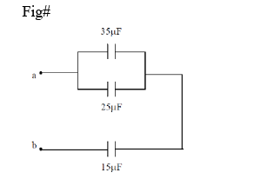
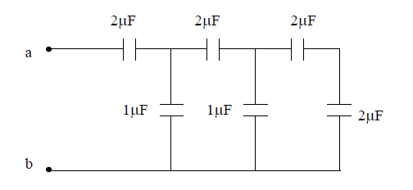
T111-Q19. What is the charge on each plate on the 2-µF capacitor in Figure 7?
A) 10 µC
T111-Q16.
If V_{ab} is equal to 100 V, find the charge stored and the potential difference across the 35 µF capacitor shown in Figure 4.
A) 700 µC and 20 V.
T101-Q16.
The equivalent capacitance between points a and b in the combination of capacitors connected as shown in Figure 5 is:
A) 1.0 μF

Slide 19
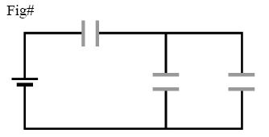
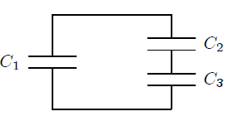
T91-Q16.
Three identical capacitors, each with a capacitance of 6.0 µF, are connected to a 50-V battery
as shown in Figure 6. What is the charge stored by the system?
A) 200 µC
T101-Q18.
Capacitor C1 is connected to a battery and charged to 4.0 × 10−8 C. It is then disconnected from the battery and connected to two capacitors C2 and C3, as shown in Figure 6. The charge on the positive plate of C1 is 1.0 × 10−8 C. The charges on the positive plates of C2 and C3 are, respectively:
A) q2 = 3.0 × 10−8C and q3 = 3.0 × 10−8C

Slide 20
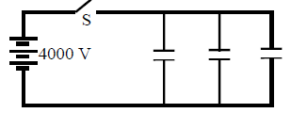

T101-Q17.
A 2-μF and a 1-μF capacitor are connected in series and a potential difference is applied across the combination. The 2-μF capacitor has:
A) half the potential difference of the 1-μF capacitor
T92-Q19.
Each of the three 25-μF capacitors shown in Figure 6 is initially uncharged. How much charge is stored in the combination after the switch S is closed?
A) 0.30 C
T92-Q20.
In Figure 7, two capacitors, C1= 2.00 μF and C2 = 5.00 μF, are separately charged by a 100-volt battery and then connected, with opposite polarity, by closing switches S1 and S2. What will be the potential difference across C1 after the switches are closed?
A) 42.9 V

Slide 21
T92-Q20.
In Figure 7, two capacitors, C1= 2.00 μF and C2 = 5.00 μF, are separately charged by a 100-volt battery and then connected, with opposite polarity, by closing switches S1 and S2. What will be the potential difference across C1 after the switches are closed?
A) 42.9 V

Slide 22
Lecture 2

Slide 23
Energy Stored in the Capacitor
+
V
-
+
-
+
q’
-
-e
-
-e
-e
-e
-e
+
+
-
d
-e
-e
-e
-e
-e
V

Slide 24
Energy Density
A
d
V

Slide 25
T103-Q17.
Two capacitors, C₁ = 16 μF and C₂ = 4.0 μF are connected in parallel and charged with a 50 V power supply. What potential difference would be required across the same capacitors connected in series so that the combination stores the same energy as when connected in parallel?
A) 125 V
T91-Q15.
A capacitor is charged using a battery, and the energy stored in it is U_{i}. The battery is disconnected and then the charged capacitor is connected to an identical uncharged capacitor. The energy stored by the two capacitors is U_{f}. Which of the following is CORRECT?
A) U_{f} = U_{i}/2
Book’s problem-
Two parallel plate capacitors 6 μF each are connected in parallel to a 10 V battery. One of the capacitors is then squeezed so that its plate separation is halved. Because of the squeezing,
how much additional charge is transferred to the capacitors by the battery?
Find the increase in the total charge stored on the capacitors.
What is the change in energy stored in the capacitor?
Ans: (a) 60 μC (b) ?

Slide 26
T103-Q17.
Two capacitors, C₁ = 16 μF and C₂ = 4.0 μF are connected in parallel and charged with a 50 V power supply. What potential difference would be required across the same capacitors connected in series so that the combination stores the same energy as when connected in parallel?
A) 125 V

Slide 27
Book’s problem-
Two parallel plate capacitors 6 μF each are connected in parallel to a 10 V battery. One of the capacitors is then squeezed so that its plate separation is halved. Because of the squeezing,
how much additional charge is transferred to the capacitors by the battery?
Find the increase in the total charge stored on the capacitors.
What is the change in energy stored in the capacitor?
Ans: (a) 60 μC (b) ?

Slide 28
Dielectric medium
V’
V
+
+
-
-
-
+
-
+
-
+
-
-
+
+
-
+
-
+
-
+
-
-
+
+
-e
-
+
-
+
-
+
-
-
-e
-e
-e
-e
-e
-e
-e
-e
-e
+
+
+
-
-
-
-
+
+
-
+
+
d
The dielectric increases the capacity of charge storage and it is measured by dielectric constant “k”
-e
-e
-e
-e
-e
-e
-e
-e
-e
-e
It will be able to store “kq” charge with voltage V.
When dielectric is introduced volume will decrease and capacitance will increase.

Slide 29
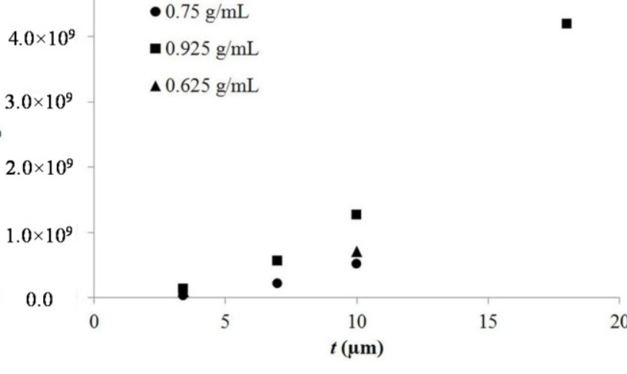
Material | k
vacuum | 1
air | 1.00054
Paper | 3.5
oil | 4.5
water | 80.4
Titania Ceremic | 130
Strontium Titanate | 310
Dielectric constant k
Capacitors using TiO₂ based Titanium Oxide based Second Generation Dielectric materials (TSDM) can reach up to billion. (~4 x 10⁹)
https://www.ncbi.nlm.nih.gov/pmc/articles/PMC5512908/

Slide 30
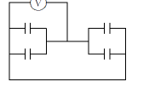
T111-Q20.
A 10 pF parallel plate capacitor is charged with a 4.0 V battery. While the capacitor is still connected to the battery, a dielectric slab (κ = 5.0) is inserted between the plates to completely fill the gap. How much electric potential energy is stored in the capacitor after inserting the dielectric?
A) 4.0 × 10-¹⁰J
T102-Q15. Figure 8 shows an arrangement of four capacitors, 500 µF each with air between the plates. When the space between the plates of each capacitor is filled with a material of dielectric constant 2.50, the voltmeter reads 1000 V. The magnitude of the charge, in Coulombs, on each capacitor plate is: Fig#8
A) 1.25
T102-Q17.
An air filled parallel-plate capacitor has a capacitance of 3.0 pF. The plate separation is then increased three times and a dielectric material is inserted, completely filling the space between the plates. As a result, the capacitance becomes 5.0 pF. The dielectric constant of the material is:
A) 5.0

Slide 31
T111-Q20.
A 10 pF parallel plate capacitor is charged with a 4.0 V battery. While the capacitor is still connected to the battery, a dielectric slab (κ = 5.0) is inserted between the plates to completely fill the gap. How much electric potential energy is stored in the capacitor after inserting the dielectric?
A) 4.0 × 10-¹⁰J

Slide 32
T111-Q20.
A 10 pF parallel plate capacitor is charged with a 4.0 V battery. Then the capacitor is disconnected from the battery and a dielectric slab (κ = 5.0) is inserted between the plates to completely fill the gap. How much electric potential energy is stored in the capacitor after inserting the dielectric?
A)

Slide 33
T102-Q15. Figure 8 shows an arrangement of four capacitors, 500 µF each with air between the plates. When the space between the plates of each capacitor is filled with a material of dielectric constant 2.50, the voltmeter reads 1000 V. The magnitude of the charge, in Coulombs, on each capacitor plate is: Fig#8
A) 1.25

Slide 34
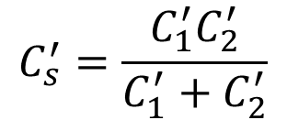
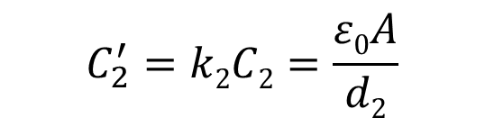
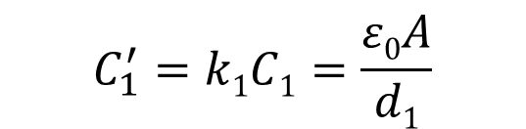
Two different dielectrics: Series
+
+
+
+
+
+
+
+
+
-
-
-
-
-
-
-
-
-
+
+
+
+
+
+
+
+
+
-
-
-
-
-
-
-
-
-
-
-
-
-
-
-
-
-
-
+
+
+
+
+
+
+
+
+
k2
k1
C’₁
C’₂
V
$$C_{s}^{′}=\frac{C_{1}^{′}C_{2}^{′}}{C_{1}^{′}+C_{2}^{′}}$$
d₂
d₁
$$C_{1}^{′}=k1C1=\frac{ε0A}{d1}$$
V
$$C_{2}^{′}=k2C2=\frac{ε0A}{d2}$$

Slide 35


Two different dielectrics: Parallel
+
+
+
+
+
+
+
+
+
-
-
-
-
+
+
+
+
-
-
-
-
-
-
-
-
-
-
-
-
-
-
-
-
-
-
-
-
-
-
-
-
-
-
+
+
+
+
+
+
+
+
+
+
+
+
+
-
-
-
-
+
+
+
+
k₁
+
+
+
C’₁
k2
-
-
-
-
-
+
+
+
+
+
C’₂
V
V
$$C1=\frac{ε0A1}{d}$$
$$C2=\frac{ε0A2}{d}$$

Slide 36


$$C_{1}^{′}=k1C1=k1\frac{ε0A}{\frac{d}{2}}$$
C’₁
C’₂
$$C_{2}^{′}=k2C2=k2\frac{ε0A}{\frac{d}{2}}$$

Slide 37


C’₂
$$C_{1}^{′}=k1C1=k1\frac{ε0A/2}{d}$$
C’₁
$$C_{2}^{′}=k2C2=k2\frac{A/2}{d}$$

Slide 38
C₂’
C₁’
C₃’
Ans: 45.5 pF

Slide 39
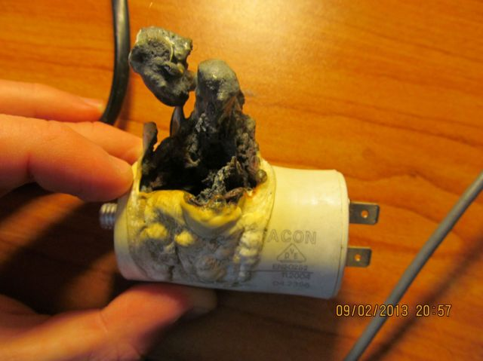


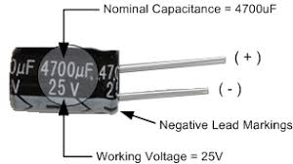

Breakdown voltage (V_{max})
There is a limit to store the charge. If you try to push too much charge, the corona discharge would take place of breakdown of dielectric would take place.
-
+
-
+
-
+
Dielectric Strength (E_{max}): Maximum Electric Filed strength that dielectric can hold.
-
+
-
+
-
+
-
+
-
+
-
+
-
+
-
+
-
+
$$\left|Vmax\right|=\left|Emax\right|d$$

Slide 40
T173-Q18. A parallel plate capacitor filled with dielectric material between its plates has a capacitance of 50 pF. If the plate separation is 0.20 mm, find the maximum operating potential difference. (For the dielectric: dielectric constant = 6.0, dielectric strength = 150×10⁶ V/m)
A) 30 kV

Slide 41
T102-Q16. Two parallel-plate capacitors with the same capacitance but different plate separation are connected in series to a battery. Both capacitors are filled with air. The quantity that is NOT the same for both capacitors when they are fully charged is:
A) The electric field between the plates
B) The stored energy
C) The potential difference
D) The charge on the positive plate
E) The dielectric constant
T91-Q17.
A 9.0 pF air-filled capacitor is required to store an energy of 7.4 µJ with a potential
difference of 650 V. To do that, a dielectric should be inserted between the plates of the capacitor. What is the dielectric constant?
A) 3.9
T101-Q20.
A parallel-plate capacitor, of capacitance 1.0 × 10−9 F, with air between the plates, is charged by a battery to a potential difference of 12 V. The battery is then disconnected and a dielectric material with dielectric constant = 4.0 fills the space between the plates. The resulting potential difference, in volts, between the plates is:
A) 3.0

Slide 42
Summary
Parallel Plate Capacitor
Cylindrical Capacitor
Spherical Capacitor
Capacitance of a single sphere
Capacitors in Parallel
Capacitors in Series

Slide 43
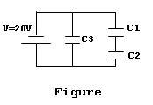
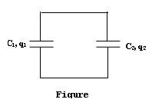
T081: Q15.: You are to connect capacitors C₁= C and C₂ = 2C to the same battery, first individually, then in series and then in parallel. In which of the following cases, the charge stored is the smallest?
(Ans: C1 and C2 in series)
T051:Q#17. Two capacitors, C1= 2 µF and C2 = 6 µF, are connected in parallel with a 60 V battery, as shown in Figure 2. The battery is removed and plates of opposite sign are connected. Find the final potential difference for each capacitor. (Ans: 30 V, 30 V)
T042: Q#18: Three capacitors C1=5 micro-F, C2=10 micro-F and C3= 3 micro-F are connected to a 20 V battery as shown in Figure 8. Find the stored electric energy in C2.
(Ans: 2.2*10**(-4) J.)
T042:Q#16: Consider two separate capacitors: c₁=30 μF carries a charge of q₁=6.0x10² μ C and c₂=50 μ F, carries a charge of q₂=1.0x10³ μ C. If the opposite polarity terminals of the two capacitors are connected together as shown in figure 10, find the new voltage across c₁.
(Ans: 5.0 Volts.)

Slide 44
T042: Q#18: Three capacitors C₁=5 μ F, C₂=10 μ F and C₃= 3 μ F are connected to a 20 V battery as shown in Figure 8. Find the stored electric energy in C₂.
(Ans: 2.2x10⁻⁴ J.)
Book’s problem-
Two parallel plate capacitors 6 μF each are connected in parallel to a 10 V battery. One of the capacitors is then squeezed so that its plate separation is halved. Because of the squeezing, (a) how much additional charge is transferred to the capacitors by the battery and (b) what is the increase in the total charge stored on the capacitors? Ans: (a) 60 μC (b) ?
T081: Q18.: Two capacitors each of capacitance 250 F are connected in parallel across a battery of 120V. How much energy is produced after both capacitors are completely discharged?
(Ans: 3.6 J)
T042: Q#18: Three capacitors C1=5 micro-F, C2=10 micro-F and C3= 3 micro-F are connected to a 20 V battery as shown in Figure 8. Find the stored electric energy in C2.
(Ans: 2.2*10**(-4) J.)

Slide 45
T092: Q19Each of the three 25-μF capacitors shown in Figure 6 is initially uncharged. How (a) charge (b) energy is stored in the combination after the switch S is closed?
S
4000 V
T071: Q2. When the potential difference across a 5 μF capacitor is increased by 2 V, the energy stored increases by 10 %. What was the original potential difference?
(Ans: 40 V).
T052: Q#3: A parallel-plate capacitor has a plate area of 0.2 m² and a plate separation of 0.1mm. The electric field between the plates is 2.0 × 10⁶ V/m. The energy stored in the capacitor is:
(Ans: 0.35 mJ)
T072: Q17.: An air-filled parallel-plate capacitor is connected across a 24 V battery. When the battery is disconnected and then a dielectric slab is inserted into and fills the region between the plates, the voltage across the capacitor drops to 8 V. What is the dielectric constant of the slab?
(Ans: 3.0)

Slide 46
T081: Q16.: Given a 9.4 pF air-filled capacitor, you are asked to convert it to a capacitor that can store 9.4 μJ, with a potential of 877 V. What is the dielectric constant of the material that you must insert between the plates of the capacitor? (Ans: 2.6)
T071: Q4. A parallel-plate capacitor is completely filled with a dielectric of dielectric constant 6, has a capacitance of 50 pF. If the plate separation is 0.1 mm, find the plate area.
(Ans: 0.94 cm²)
Book’s Problem-
In figure the battery has a potential difference of V = 10.0 V and the five capacitors each have a capacitance of 10μF. What is the charge and energy on (a) capacitor 1 and (b) capacitor 2?
c₂
c₁
V

