Slide 1
Chapter 23
Gauss’ theorem

Slide 2
Flux and surface direction
A
A
A
A
A
A
A
A
A
0
t
The flux depends on the orientation (direction) of the surface. The direction of the surface is taken normal to the surface and pointing away from the body.
θ =180⁰, flux is -ve
θ = 0⁰, flux is +ve
A
A
A
A
A
A
A
A
A
A
Total Flux
If θ varies point to point in the surface we have to divide the surface into small elements dA.
If ΔA is very small
A
Flux in the close surface

Slide 3




Flux of an electric field
+q
Many filed lines pass through area A
Few filed lines pass through area A
Number of field lines

Slide 4
Flux of an electric field
Electric Flux
Average electric flux
N
θ
E
The electric flux is the scalar product of Electric field and the area through which field lines passes.
T061: Q#6. When a piece of paper is held with its face perpendicular to a uniform electric field the flux through it is 25.0 N·m²/C. When the paper is turned 25.0º with respect to the field the flux through it is:
(Ans: 22.7 N·m²/C )

Slide 5
T061: Q#6. When a piece of paper is held with its face perpendicular to a uniform electric field the flux through it is 25.0 N·m²/C. When the paper is turned 25.0º with respect to the field the flux through it is:
(Ans: 22.7 N·m²/C )

Slide 6
Electric flux through a close surface
2
E
1
3
dA
Such an imaginary surface is called Gaussian surface
θ =180⁰
θ =90⁰
θ =0⁰
Net electric flux in a chargeless close surface is zero
For a chargeless close surface: flux in = flux out
The electric flux φ through a Gaussian surface is proportional to the net number of electric field lines passing through the surface

Slide 7
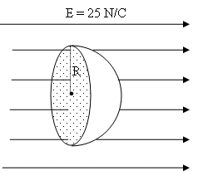
T81-Q7. If the constant electric field in Fig 2 has a magnitude E = 25 N/C, calculate the electric flux through the curved surface of the hemisphere (half a sphere of radius R = 5.0 cm). (Knowing that the electric field is perpendicular to the flat surface and that the hemisphere encloses no electric charges.)
(Ans: 0.20 N·m²/C)
T103-Q9. The flux (in N.m2/C) of the electric field E=(24 N/C)ˆi + (30 N/C)ˆj + (16 N/C)ˆk through a 1.5 m² portion of the yz plane is:
A) 36
T111-Q7. A uniform electric field is given by: E = 2i +4j -5k (N/C). A square plate, of side 10 cm, lies in the xy plane. What is the value of the electric flux through the plate?
A) 0.05 N.m² /C
T71-Q5. When a piece of paper is held with its face perpendicular to a uniform electric field the flux through it is 30.0 N·m /C. When the paper is turned at certain angle with respect to the field the flux through it is 24.6 N·m²/C. What is the angle? (Ans: 35º)

Slide 8
T111-Q7. A uniform electric field is given by: E = 2i +4j -5k (N/C). A square plate, of side 10 cm, lies in the xy plane. What is the value of the electric flux through the plate?
A) 0.05 N.m² /C

Slide 9
T81-Q7. If the constant electric field in Fig 2 has a magnitude E = 25 N/C, calculate the electric flux through the curved surface of the hemisphere (half a sphere of radius R = 5.0 cm). (Knowing that the electric field is perpendicular to the flat surface and that the hemisphere encloses no electric charges.)
(Ans: 0.20 N·m²/C)

Slide 10
T101Q5. A charge of 0.80 × 10⁻⁹ C is placed at the center of a cube that measures 4.0 m along each edge. What is the electric flux through any two faces of the cube?
A) 30 N ⋅ m²/C
T83-Q5.
The flux of an electric field E = (24N/C) i + (30N/C) j + (16N/C) k through a 2.0 m² portion of the yz plane is:
A) 48 N.m2 /C

Slide 11
Gauses Theorem: charges inside a close surface
+q
1
2
3
dA
θ = 0⁰ in many spots. Hence there will be net flux.
Such an imaginary surface is called Gaussian surface
Net flux in a closed charged surface is not zero but it is given by
Enclosed charge
Permeability of vacuum
This is Gauss’ law

Slide 12
Gausses Theorem
For any imaginary surface enclosing charge q
q
Purpose of Gauss theorem is to find the electric field due to different shaped charge objects.
Imaginary surface
(Gaussian Surface)

Slide 13
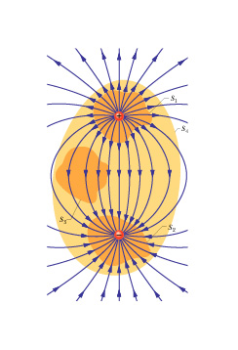
Gauss law: Illustration-1
1. What is the flux through S₁ ?
2. What is the flux through S₂ ?
Charge is negative, electric field is negative
3. What is the flux through S₃ ?
No charge enclosed
4. What is the flux through S₄ ?
Net charge enclosed is zero

Slide 14
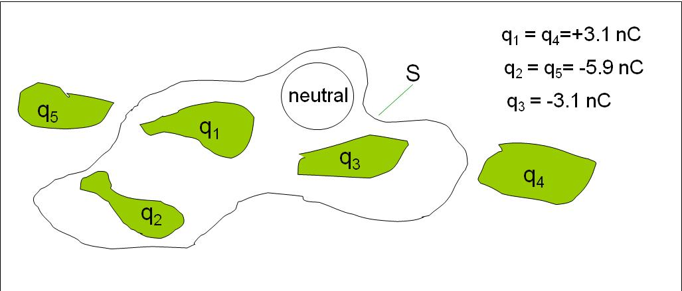
Gauss law: Illustration-2
What is the net electric flux through the gaussian surface S ?
Ans: -670 Nm²/C

Slide 15
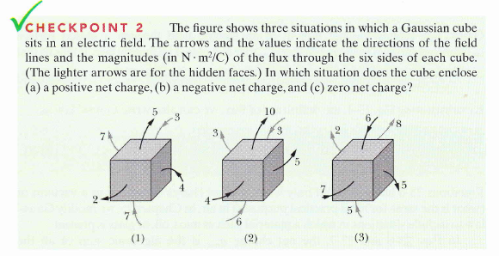
Gauss law: Checkpoint-2
a) 2 b) 3 c) 1

Slide 16
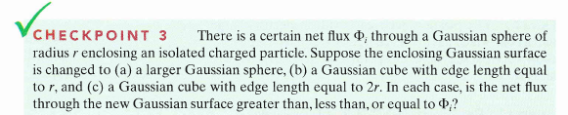
Gauss law: Checkpoint-3
Ans: Same for all surfaces
T62-Q6. A point charge of 12 μC is placed at the center of a spherical shell of radius 12 cm. Find the ratio of the total electric flux through the entire surface of the shell to that of a concentric spherical surface of radius 6.0 cm.
(Ans:1)

Slide 17
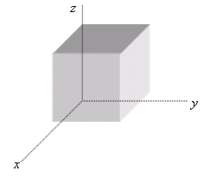
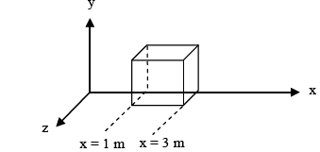
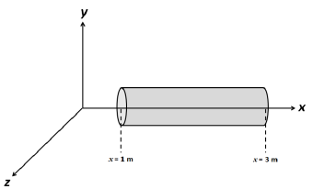
72-Q7.For the electric field: E = (10 i + 20y j) N/C, what is the electric flux through a 2.0 m² portion of the xy-plane? (Ans: Zero.)
T81-Q6. Fig. 1 shows a Gaussian surface in the shape of a cube with edge 2.0 m. This cube lies in a region where the electric field vector is given by:
Find the net charge contained in the cube.
(Ans: 0 )
T102-Q5. Figure 1 shows a Gaussian cube in region where the electric field is along the y-axis. E = -30.0 j N/C on the top face and E = +20.0 j N/C on the bottom face of the cube. Determine the net charge contained within the cube.
Fig# 1 A) –1.77 × 10⁻⁹ C
T92-Q9. A non-uniform electric field given by E = 3.0 xiˆ + 4.0 jˆ pierces the Gaussian surface that is in the form of a cylinder of radius 1.0 m (see Figure 2). What is the net charge inside
the cylinder?
A) 6πεο

Slide 18
T102-Q5. Figure 1 shows a Gaussian cube in region where the electric field is along the y-axis. E = -30.0 j N/C on the top face and E = +20.0 j N/C on the bottom face of the cube. Determine the net charge contained within the cube.
Fig# 1 A) –1.77 × 10⁻⁹ C

Slide 19
T92-Q9. A non-uniform electric field given by E = 3.0 xiˆ + 4.0 jˆ pierces the Gaussian surface that is in the form of a cylinder of radius 1.0 m (see Figure 2). What is the net charge inside
the cylinder?
A) 6πεο

Slide 20
Lecture 2

Slide 21
Electric Field Point Charge
E
+1C
r
+q

Slide 22

Gauss law and Coulomb’s law
Gauss’ law
dA
E
r
But
+q
This is Coulomb’s law

Slide 23
Charges on the conductor
-
-
-
-
E = 0 inside the conductor
-
-
-
-
When you put an excess charge in a conductor it will always float outside the surface. No extra charge will remain inside the metal.
-
-
-
-
-
-
-
-
-
-
-
-
-
-
-
-
-
-
-
-
The net electric field (flux) must be zero inside a conductor. If there is net electric field inside the conductor it will generates net force (qE) on the charge that force will move the charge giving rise to a be a net current.
-
-
-
Gaussian Surface
Hence, if we draw a Gaussian surface just inside the metallic surface the electric flux through Gaussian surface must be zero.
The extra charge in a conductor always remain uniformly distributed in the surface outside the Gaussian surface but not inside the body

Slide 24
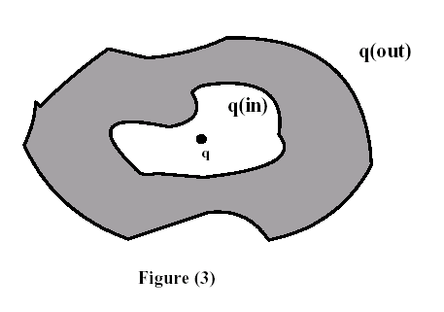
Charges on the conductor
E=0
E =0 means q = 0
No net charge inside the conductor
No net flux through the Gaussian surface: No net charge inside the cavity
T011: Q#3: An isolated conductor of arbitrary shape has a net charge of -15x10⁻⁶ C. Inside the conductor is a cavity within which is a point charge q=- -5x10⁻⁶ C. What is the charge on the cavity-wall, q_{in}, and what is the charge on the outer surface of the conductor, q_{out}?
Ans: q_{in} = 5.0x10x⁻⁶ C; q_{out} = - 20x10⁻⁶ C

Slide 25
Roll A conducting sheet to Cylinder
Metal Sheet
Opposite face
+2Q
+Q
All charge in the outer face
+Q
This face
When we roll out the sheet in the form of cylinder (cavity, hollow inside) the charge will only reside the outer surface not in the inner surface
Will have charge equally distributed both faces

Slide 26
Charge densities
+ + + + + + + + + +
Liner charge density (λ)
L
+ + + + + + +
+ + + + + + + +
+ + + + + + + + + + + + + +
Surface charge density (σ)
A
+ + + + +
+ + + + +
+ + + + +
+ + +
V
Volume charge density (ρ)
+ + + + +
+ + + + +

Slide 27
Spherical Symmetry
A Spherical Symmetry will converse to a Point

Slide 28
Applying gauss’s law: Spherical Symmetry: Conducting Sphere
Finding electric field inside the metallic sphere
Finding electric field on the surface of the conducting sphere
+
+
+
1. Draw the Gaussian surface of spherical symmetry with radius r.
1. Draw the Gaussian surface of spherical symmetry with radius r = R.
+
+
+q
+
+
P
P
+
r
+
r
+
2. Find total charge enclosed inside the Gaussian surface. In this case Total charge q is enclosed inside.
R
+
R
2. Find total charge enclosed inside the Gaussian surface. In this case charge enclosed is zero.
+
+
+
q_{enc}=0
E = 0
+
+
+
+
+
q
+
+
3. Use Gausses Law to find electric field
3. Use Gausses Law to find electric field
Same as the Point charge at the center of the Gaussian sphere

Slide 29
Applying gauss’s law: Spherical Symmetry: Conducting Sphere
To find electric field outside E, we need to draw gaussion surface of radius r_{o} > R. It encloses the all chagre
+q
P
r_{o}
R
According to Gaussian theorem
Same as the Point charge at the center of the Gaussian sphere

Slide 30
Shell: Spherical Symmetry
Conducting Shell
Conducting Shell
+
+
+
+
-
-
+
-
+
-
-
+
-
+
-
+
+
-
-
+q
-
+q
+
-
+
+
-
-
+
+
-
+
-
-
-
-
-
+
-
+
+
+
+q charge at the center of the cell induces –q charge inside and +q charge outside surface.
If the +q charge inside the cell is offset it will change the distribution of –q charges but the +q charges on the surface will remain uniformly distributed
Charges in a surface of a conductor are always uniformly distributed

Slide 31
Shell: Spherical Symmetry
E - in the surface or the outside the conductor
E - inside the hollow region
E - inside the conductor
+
+
+
+
+
P
+
-
P
+
-
-
+
-
-
+
-
-
+
-
+
-
P
+
r
r
+
-
+
-
+
r_{in}
-
-
-
-
+q
+q
+q
+
-
+
+
-
+
+
-
+
-
-
-
+
-
+
-
+
-
-
-
-
-
+
-
+
-
+
+
+
+
Gaussian Surface
Gaussian Surface
Gaussian Surface
Point charge
Point charge
or
Inside metal

Slide 32
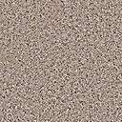
Spherical Symmetry: Insulating Sphere
Insulating= Non conducting
Volume charge density:
Q = total charge
From gausses Theorem
R
o
r_{in}
P
If Point P is in the surface, (r = R ) it behaves like a point charge at the center of the sphere: Same as in the case of metal
If Point P is outside the surface, (r > R ) it behaves like a point charge at the center of the sphere: Same as in the case of metal

Slide 33
Insulating shell
P
r
If Point P is outside or in the surface: (r = R or r > R)
R_{in}
R_{out}

Slide 34
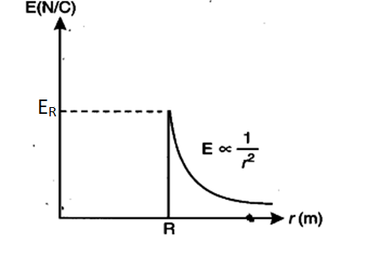
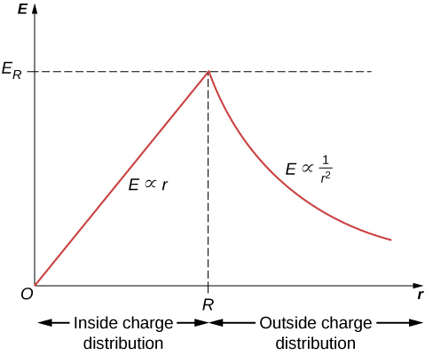
Conducting Sphere
Insulating Sphere
For r < R, inside
For r < R, inside
For r = R, in the surface
For r = R, in the surface
For r > R, outside
For r > R, outside

Slide 35
Summary of applying Gausses law
Find what symmetry is it?
Draw Gaussian surface of the symmetry starting from the point at which electric field has to be found.
Find the charge enclose inside the Gaussian surface.
If the symmetry is spherical, the enclosed charge will behave like a point charge at the center of the sphere.
If the symmetry is cylindrical, the enclosed charge will behave like the line charge.

Slide 36
Conducting Spherical Shell
T081 Q5. A spherical conducting shell has charge Q. A particle with charge q is placed at the center of the spherical shell. The charge on the inner surface of the shell and the charge on the outer surface of the shell, respectively, are: (Ans: −q, (Q + q))
T52-Q#15. A conducting spherical shell with a net charge q_{o} has an outer radius R. A point charge q_{o} is placed at a distance R/3 from the center of the shell. What is the surface charge density on the outer surface of the shell? (Ans: 2q_{o} / 4π R²)
T82-Q5.Consider a conducting neutral spherical shell having an inner radius of 3.70 cm and an outer radius of 4.50 cm. A positive point charge q is placed at the center of the shell. The magnitude of the electric field a distance 5.00 cm from the center of the shell is 2500 N/C. Calculate the magnitude of the charge density on the outer surface of the shell. A) 2.73×10−8 C/m²
T91-Q7. A point charge q = + 4.00 µC is placed at the center of a conducting spherical shell. The net electric flux outside the shell is – 1.00 × 10⁶ N.m²/C. What is the net charge of the shell? A) −12.9 µC
T103-Q8. Consider a spherical shell of radius R and charge Q distributed uniformly on its surface. Find the radial distance where the electric field due to the shell is half its maximum value. A)√2R

Slide 37
Conducting Spherical Shell
T081 Q5. A spherical conducting shell has charge Q. A particle with charge q is placed at the center of the spherical shell. The charge on the inner surface of the shell and the charge on the outer surface of the shell, respectively, are: (Ans: −q, (Q + q))
T103-Q8. Consider a spherical shell of radius R and charge Q distributed uniformly on its surface. Find the radial distance where the electric field due to the shell is half its maximum value. A)√2R

Slide 38
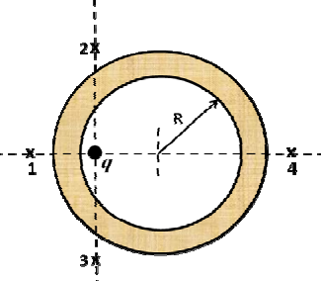
T103-Q10. The electric field just outside the surface of a hollow conducting sphere of radius 20 cm is 500 N/C and directed radially outward. An unknown charge Q is placed at the center of the sphere and it is noted that the electric field at the same location is still directed radially outward, but has decreased to 100 N/C. What is the magnitude of the charge Q? A) 1.8 nC
T103-Q11. A point charge of 10.0 nC is placed at the center of a hollow spherical conductor of inner radius 5.00 cm and outer radius 6.00 cm. The spherical conductor has a net charge of −5.00 nC. Determine the surface charge density on the inner surface of the conductor.
A) −318 nC/m²
T111-Q6. The electric field at point P just outside the outer surface of a hollow spherical conductor of inner radius 10 cm and outer radius 20 cm has magnitude 450 N/C and is directed outward. When an unknown point charge Q is placed at the center of the sphere, the electric field at point P is still pointing outward but is now 180 N/C. What is the value of charge Q? A) –1.2 nC
92-Q11. Figure 3 shows a cross section of a neutral spherical metal shell of inner radius R. A point charge q = 5.0 μC is located at a distance 4R/5 from the center of the shell. Points 1, 2, 3, and 4 are all the same distance from the center of the spherical shell. At which point is the magnitude of the electric field the largest?
A) The electric field is the same at points 1, 2, 3 and 4

Slide 39
T103-Q10. The electric field just outside the surface of a hollow conducting sphere of radius 20 cm is 500 N/C and directed radially outward. An unknown charge Q is placed at the center of the sphere and it is noted that the electric field at the same location is still directed radially outward, but has decreased to 100 N/C. What is the magnitude of the charge Q? A) 1.8 nC

Slide 40
92-Q11. Figure 3 shows a cross section of a neutral spherical metal shell of inner radius R. A point charge q = 5.0 μC is located at a distance 4R/5 from the center of the shell. Points 1, 2, 3, and 4 are all the same distance from the center of the spherical shell. At which point is the magnitude of the electric field the largest?
A) The electric field is the same at points 1, 2, 3 and 4

Slide 41
T102-Q8. Which of the following statements is NOT TRUE?
A) If a charged particle is placed inside a spherical shell of uniform charge density, there is a non-zero electrostatic force on the particle from the shell.
B) The electric field is zero everywhere inside a conductor in electrostatic equilibrium.
C) Any excess charge placed on an isolated conductor in electrostatic equilibrium resides on its surface.
D) The electric field just outside a charged conductor in electrostatic equilibrium is perpendicular to its surface.
E) The net electric flux through any closed surface is proportional to the net charge inside the surface.
T111-Q9. A solid isolated charged conductor is in electrostatic equilibrium. Choose the TRUE statement:
Any excess charge is confined to the surface of the conductor.
Excess charge is distributed throughout the volume
There of the conductor. is an electric field inside
There is the conductor. no electric field at the surface
Electric flux through a Gaussian surface of the conductor. inside the conductor is non-zero.
T101-Q6. A positive charge Q = +5.0 × 10⁻⁹ C is placed on a conducting spherical shell with inner radius R₁ = 5.0 mm and outer radius R₂ = 6.0 mm. A point charge q = +1.0 × 10⁻⁹ C is placed at the center of the shell. The surface charge density on the outer surface of the conducting shell is:
A) +1.3 × 10⁻⁵ C/m²

Slide 42
Insulating (Dielectric, non-conducting) sphere, shell, cylinder
T52-Q#8. A large insulating solid sphere has a charge density of 5 nC/m³. Calculate the electric field inside the sphere at a distance of 10 cm from its center. (Ans: 18.8 N/C )
T032: Q#14: A total charge of 5.00x10⁻⁶ C is uniformly distributed inside an irregularly shaped insulator. The volume of the insulator is 3.0 m³. Now, imagine a cube of volume 0.50 m³ inside the insulator. What is the total electric flux through the surfaces of the cube? (Ans: 9.4x10⁴ Nm²/C.)
T61-Q#7. Charge Q is distributed uniformly throughout a spherical insulating shell. The net electric flux in N·m²/C through the inner surface of the shell is: (Ans: 0 )
T72-Q8. A solid nonconducting sphere, of radius 4.0 m, has a uniform charge density. What is the ratio of the magnitude of the electric field at a distance 2.0 m from the center to the magnitude of the electric field at the surface of the sphere? (Ans: 0.5)
T71-Q8. An insulating spherical shell of radius 15 cm has a total charge of 10 μC uniformly distributed on its surface. Calculate the electric field intensity at a distance of 14 cm from the center of the shell. (Ans: 0)

Slide 43
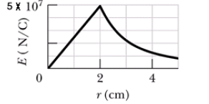
T102-Q7. Figure 3 shows the magnitude of the electric field due to a sphere with a positive charge distributed uniformly throughout its volume. What is the value of the charge on the sphere?
A) 2 µC
T101-Q9. A non-conducting sphere of radius R = 7.0 cm carries a charge Q = 5.0 × 10−3 C distributed uniformly throughout its volume. At what distance within the sphere, measured from the center of the sphere does the electric field reach a value equal to half its maximum value? A) 3.5 cm
T91-Q5. Positive charge q is distributed uniformly throughout an insulating sphere of radius R, centered at the origin. A particle with a positive charge q is placed at x = 2R on the x axis. The magnitude of the electric field at x = R/2 on the x axis is:
A) q/72πε_{o}R²
T83-Q7. A non-conducting sphere of radius R = 10 cm carries a charge density
ρ= 10-9 C/m3 distributed uniformly throughout its volume. At what distance within the sphere, measured from the center of the sphere, the magnitude of the electric field is E = 1.32 N/m?
A) 3.50 cm

Slide 44
T102-Q7. Figure 3 shows the magnitude of the electric field due to a sphere with a positive charge distributed uniformly throughout its volume. What is the value of the charge on the sphere?
A) 2 µC

Slide 45
Cylindrical Symmetry
A cylindrical Symmetry will converse to a line

Slide 46
Cylindrical Symmetry: Charged rod/Cylinder
Infinitely large Charged Rod
1
+
+
+
+
+
+
+
+
+
+
+
+
+
2
r
P
θ = 90⁰
θ = 0⁰
θ = 90⁰
3
Gaussian surface

Slide 47
Insulating Cylinder
Conducting Cylinder
Charge enclosed inside the Gaussian surface
R
+
+
+
+
+
+
+
+
+
+
+
+
+
+
+
+
+
+
+
+
+
+
+
+
+
+
For r < R
P
r
P
r
If the point P is in the surface or outside the surface: (r > R or r = R)
For, (r > R or r = R)

Slide 48
Charged Conducting Rod/cylindrical symmetry
T081 -Q8. A charge is distributed uniformly along a long straight wire. If the electric field 4.0 cm from the wire is 40 N/C, then the electric field 8.0 cm from the wire is: (Ans: 20 N/C)
T061: Q#8. A long wire, of linear charge density λ_{l} , runs along the cylindrical axis, of a cylindrical conducting shell, which carries a net linear charge density of λ_{c}. The charge per unit length on the inner and outer surfaces of the shell, respectively are: [Note: linear charge density charge per unit length] ≡ (Ans: −λ_{l} and λ_{c} + λ_{l} )
T052: Q#20. Consider a long wire of linear charge density λ. Now imagine a closed cylindrical Gaussian surface of radius r and length L with the wire as the axis. What is the electric flux through the cylinder surface? (Ans: λL/ε_{o})
T071: Q6. An infinitely long uniformly charged rod is coaxial with an infinitely long uniformly charged cylindrical shell of radius 5.0 cm. The linear density of the rod is + 15 × 10⁻⁹ C/m and that of the cylindrical shell is – 20 × 10⁻⁹ C/m. What is the magnitude of the electric field at a distance of 10 cm from the axis? (Ans: 900 N/C)

Slide 49
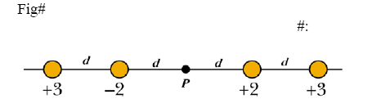
T072: Q6. The Fig. 2 shows short sections of two very long parallel wires carrying uniform linear charge densities + 6.0 μC/m and – 2.0 μC/m. Find the magnitude and direction of the net electric field at point P.
T042: Q#6 A very long uniform line of charge having a linear charge density of 6.8 micro-C/m lies along x-axis. A second line of charge has a linear charge density of -3.40 micro-C/m and is parallel to x-axis at y = 0.5 m. What is the net electric field at point where y= 0.25 m on y-axis?
(Ans: 7.3x10⁵ N/C along +y-axis.)
T91-Q6.Figure 2 shows the cross sections of four very long rods that extend into and out of the page. The value below each rod is the uniform linear charge density λ in units of µC/m, and the distance d = 1.0 cm. What is the net electric field at point P?
A) − 7.2 × 10⁶ i (N/C)

Slide 50
T072: Q6. The Fig. 2 shows short sections of two very long parallel wires carrying uniform linear charge densities + 6.0 μC/m and – 2.0 μC/m. Find the magnitude and direction of the net electric field at point P.

Slide 51
T91-Q6.Figure 2 shows the cross sections of four very long rods that extend into and out of the page. The value below each rod is the uniform linear charge density λ in units of µC/m, and the distance d = 1.0 cm. What is the net electric field at point P?
A) − 7.2 × 10⁶ i (N/C)

Slide 52
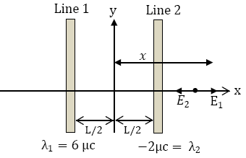
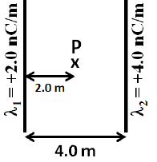
T102-Q6.
Figure 2 shows short sections of two very long parallel lines of charge, fixed in place and separated by L = 10 cm. The uniform linear charge densities are +6.0 µC/m for Line 1 and –2.0 µC/m for Line 2. Find the x-coordinate of the point along the x-axis at which the net electric field due to the two line charges is zero.
A) +10 cm
T111-Q10. Two infinitely long lines of charge are shown in Figure 5. What is the electric field at P?
A) 18 (N/C), to the left
T62-Q8. The electric field, at a distance of 40 cm, from a very long uniform wire of charge is 840 N/C. How much charge is contained in a 2.0 cm long of the wire?
(Ans: 0.37)
T101-Q7.A long conducting solid cylinder, with radius R = 10 cm, has a uniform charge density λ = 7.0 × 10⁻⁹ C/m. Determine the magnitude of the electric field at a distance r = 12 cm from the axis of the cylinder.
A) 1.1 × 10³ N/C

Slide 53
Insulating (Dielectric, non-conducting) Cylinder
T83-Q8. An infinitely long non-conducting cylinder of radius R = 2.00 cm carries a uniform charge density ρ = 18.0 μC/ m3. Calculate the electric field at distance r = 1.00 cm from the axis of the cylinder? A) 1.02 ×104 N/C
T92-Q12. A very long non -conducting cylinder of radius 4.0 cm has a uniform volume charge density of 25 μC/m³. What is the magnitude of the electric field at r = 2.0 cm, where r is the distance from the axis of the cylinder?
A) 2.8 × 10⁴ N/C

Slide 54
Planner Symmetry: Insulating Sheet
Infinitely large insulating Charge Sheet with charge in one face
Surface Charge density
+ + + + + + + + + + + +
+ + + + + + + + + + + + + +
+ + + + + + + + + + + + + + + + + + + + +
+ + + + + + + + + + + +
+ + + + + +
1
E
A
2
A
A
θ =0⁰
θ =90⁰
θ =0⁰
3
E
Gaussian Surface

Slide 55
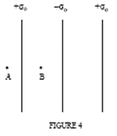
Insulating (Dielectric, non-conducting) Sheet
T71-Q5. The Fig. 1 shows two large, parallel, non-conducting sheets with identical negative uniform charge density of magnitude σ. A negative point charge q is placed between the two sheets. Rank the four numbered points according to the magnitude of the net electric field there, greatest first. (Ans: 1,2,3 tie, then 4)
T052: Q#14. Three large insulating sheets of charge with the given charge densities are shown in figure 4. The magnitudes of electric field at points A and B are respectively
(Ans: σ_{o} / 2ε_{o} , σ_{o} / 2ε_{o})
T32-Q#12 Figure 7 shows portions of two large, parallel, nonconducting sheets, A and B. The surface charge densities are: sigma 1 = -4.5 micro-C/m² and sigma 2 = -6.5 micro-C/m². Find the electric field at any point between the two sheets.
(Ans: 1.1x10⁵ N/C towards B.)

Slide 56
Insulating (Dielectric, non-conducting) Sheet
T71-Q5. The Fig. 1 shows two large, parallel, non-conducting sheets with identical negative uniform charge density of magnitude σ. A negative point charge q is placed between the two sheets. Rank the four numbered points according to the magnitude of the net electric field there, greatest first. (Ans: 1,2,3 tie, then 4)

Slide 57
T052: Q#14. Three large insulating sheets of charge with the given charge densities are shown in figure 4. The magnitudes of electric field at points A and B are respectively
(Ans: σ_{o} / 2ε_{o} , σ_{o} / 2ε_{o})

Slide 58
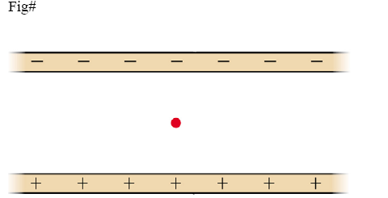
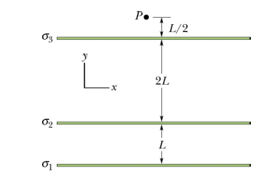
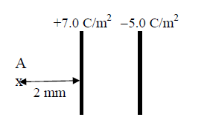
T91-Q8. Two infinite insulating sheets carry equal but opposite surface charge densities. A particle (q = + 1.0 nC, m = 3.5 × 10⁻⁶ kg) is at rest in the middle between the two plates (see Figure 3).What is the uniform surface charge density of each plate?
A) 3.0 × 10-7 C/m²
T111-Q8. Figure 9 shows, in cross section, three infinitely large parallel and flat non-conducting sheets on which charge is uniformly distributed. The surface charge densities are σ₁ = +2.00 µC/m², σ₂ = + 5.00 µC/m², and σ₃ = –3.00 µC/m² , and distance L = 1.50 cm. In units of N/C, what is the net electric field at point P?
A) +2.26 × 10⁵j
T101-Q8. Consider two non-conducting large parallel plates as shown in Figure 2. What is the magnitude of net electric field at point A?
A) 1.1 ×10¹¹ N/C

Slide 59
Planner Symmetry: Conducting Sheet
Infinitely large thin Conducting Charge Sheet
Charge will redistribute to both faces so total charge will be 2q.
+ + + + + + + + + + + +
+ + + + + + + + + + + + + +
+ + + + + + + + + + + + + + + + + + + + +
+ + + + + + + + + + + +
+ + + + + +
E
Gaussian Theorem
+
+
+
+
+
+
+
+
+
+
+
+
+
+
+
+
+
+
A
A
A
E
Therefore, at each side the electric filed
Cross-sectional view
Gaussian Surface

Slide 60
Insulator: Electric Field
What will be the Electric field between the plates of equal charges?
-
+
-
+
+1C
+1C
-
+
+1C
-
+
-
+
Total Electric field inside
Electric Field to the left and to the right is zero

Slide 61


A
B
T32-Q#12 Figure shows portions of two large, parallel, nonconducting sheets, A and B. The surface charge densities are: σ₁ = -4.5 μ-C/m² and σ₂ = -6.5 μ-C/m².
a) Find the electric field at any point between the two sheets.
(Ans: 1.1x10⁵ N/C towards B.)
b) Find the magnitude and direction of electric field to the left of A.
c) Find the magnitude and direction of electric field to the right of B
$$σ_{1}$$
$$σ_{2}$$

Slide 62
Conductor: Electric Field
σ₁
Electric field Conductor or metal
σ₁
σ₁
+
+
-
-
+1C
+
+
-
-
+
+
-
-
+1C
+1C
+
+
-
-
+
+
-
-
Metals or conductors have charges on both the sides

Slide 63

Insulator and Conductor: Electric Field
+
+
+
+
+
+
-
-
-
-
-
-
-
+
+
-
+
+
+
+
+
+
-
-
-
-
-
-
-
+
+
-
+
+
+
+
+
+
-
-
-
-
-
-
+
+
+1C
-
-
+
+
+
+
+
+
-
-
-
-
-
-
+
+
-
-
+
+
+
+
+
+
-
-
-
-
-
-
+
+
-
-
$$σ=\frac{Q}{A}$$
Electric Field between two plates with opposite Charges

Slide 64

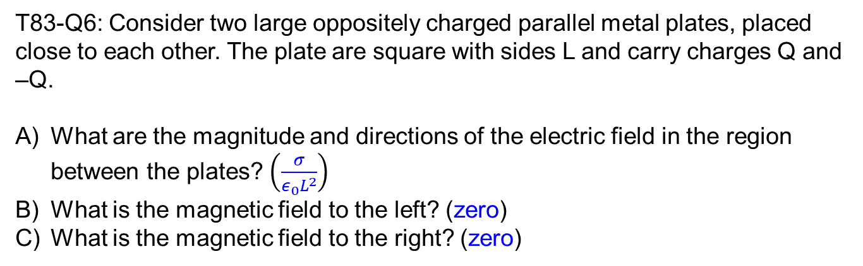
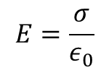
T83-Q6: Consider two large oppositely charged parallel metal plates, placed close to each other. The plate are square with sides L and carry charges Q and –Q.
What are the magnitude and directions of the electric field in the region between the plates? $\left(\frac{σ}{ε_{0}L^{2}}\right)$
What is the magnetic field to the left? (zero)
What is the magnetic field to the right? (zero)
+
+
+
+
+
+
+
+
-
-
-
-
-
-
-
-
Solution:
Charge is only one face.
E₊
E₊
E₊
+1
+1
E₋
+1
E₋
E₋
$$σ=\frac{Q}{L^{2}} and E_{+}(E_{−})=\frac{σ}{2ε_{0}}$$
Charge between the plates
$$E=\frac{σ}{ε_{0}}$$

Slide 65
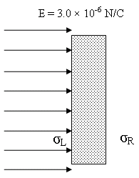
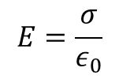
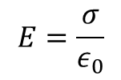
T81-Q11: Fig. 3 shows a 3.0x10⁵ N/C uniform electric field pointing perpendicularly to the left face of a large neutral vertical conducting plate. The surface charge density of the left (σ_{L}) and right (σ_{R}) faces of the plate, respectively, are: (Ans: -2.7 x 10⁻⁶ C/m² ; +2.7 x 10⁻⁶ C/m²)
+
+
+
+
+
+
+
+
+
+
+
+
+
+
+
+
+
+
+
+
_
_
_
_
_
_
_
_
_
_
_
_
_
_
_
_
_
_
_
_
$$E=\frac{σ}{ε_{0}}$$
$$E=\frac{σ}{ε_{0}}$$
Between two sheets
Between two sheets

Slide 66
T32-Q#15: A 40 N/C uniform electric field points perpendicularly toward a large neutral conducting sheet, as shown in figure 8. The surface charge densities (in C/m²) on the right, (σ_{R} ) and left, *(σ_{L}) respectively are
(Ans: - 3.5x10⁻¹⁰ + 3.5x10⁻¹⁰

Slide 67
T92-Q10. Three parallel positively-charged non-conducting sheets are separated by a distance d between adjacent sheets. The surface charge density on each of the sheets is σ. The electric field in the regions between adjacent sheets has magnitude:
A) σ/2εo

