Slide 1
Chapter 5
Newton’s laws
Free Body Diagrams

Slide 2
Lecture 1

Slide 3
Newton’s First Law of Motion
If there is no force against a moving body will never stop
m
If there is no force acting against a moving body it will continue to move with constant velocity

Slide 4
Newton’s First Law of Motion
Force is required to change the magnitude or direction of motion
m
F
F
m
m
F

Slide 5
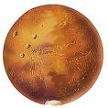


Newton’s First Law of Motion
If you want to go to mars, you can switch off your engine after you escape from the earth until you reach the mars why?
There are many manmade objects that crossed the solar system and they don’t have fuel at all. How is it possible?
Manmade Objects Escaping Solar System

Slide 6
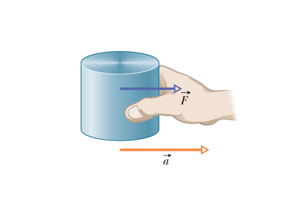
Newton’s Second Law of Motion
The magnitude of the force can be calculated as:
Pull
If body is not moving (v =0) or moving with constant velocity, there is no force (F =0 )
Unit of Force: N
Push
How much is 1N force?
F
a

Slide 7
Free Body Diagram
F
F
F
a
1. The body is represented by a point.
2. Force is represented by an arrow

Slide 8
Free Body Diagram
F₂
F₁
ma
F₂
F₁
The net force F on the body is:
Write Separate Equations for i and j
X-Direction (i)
Y-Direction (j)
Equation along x-direction

Slide 9

Free Body Diagram
Write Free body diagram
F
Fsin(θ)
θ
Fcos(θ)
Write Separate Equations for i and j
X-Direction (i)
Y-Direction (j)

Slide 10
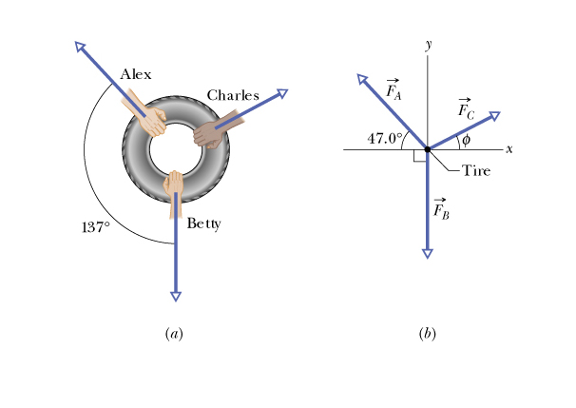
Draw: Free Body Diagram
Write the Force Equations for i and j
X-direction
y-direction

Slide 11
Sample Problems
Ch5-Q6:
While two forces acts on it, a particle is to move at the constant velocity v = (3m/s )i-(4m/s)j. One of the forces is F1 = (2N)i + (-6N)j. What is the other force?
Q1. Two forces act on a 2 kg object to produce an acceleration a=(2m/s)i+(-1m/s)j+0k . One of the forces is F₁=(2N)i+(3N)j+(-1N)k
What is the other force?
A) F₂=(2N)i+(-5N)j+(1N)k
Q2. Only two forces act upon a 5.0 kg box. One of the forces is (6 i +8 j) N . If the box moves at a constant velocity of (1.6 i +1.2 j) m/s , what is the magnitude of the second force?( Ans: 10. N)

Slide 12
Different Type of Forces
1. Normal Force (F_{N})
2. Gravitational Force (F_{g})
3. Tension (T)
4. Friction (f) (Chapter 6)
5. Centripetal Force (Chapter 6)

Slide 13
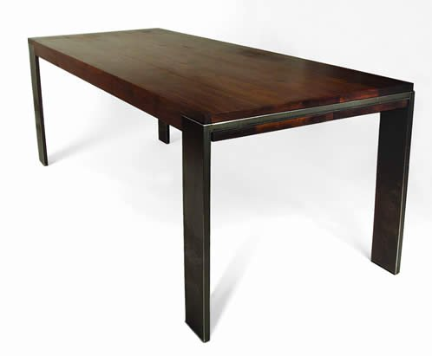
Normal Force(F_{N})
A reaction from the contact surface that is always perpendicular to the body is called normal force
Normal force on Red block by the table
F_{N}
Block

Slide 14

Normal Force(F_{N})
Normal Force is always Normal (Perpendicular) to the body from the contact surface.
Wall
F_{N}
F_{N}
F_{N}
F_{N}
body
Free body diagram for Normal force
Free body diagram for Normal force

Slide 15
Gravitational Force (F_{g})
Any body in or above the surface of the earth is subject to the gravitational force.
Or
mg
mg

Slide 16
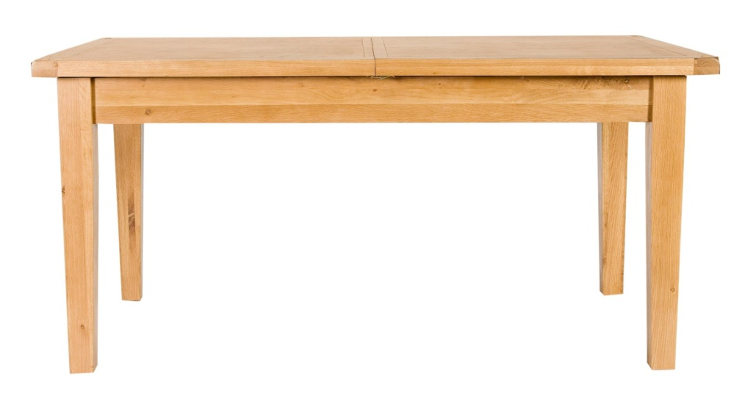
Force On The Block
F_{N}
F_{N}
F₁
mg
mg
mg
y - direction
Free Body Diagram
Since the body is not moving, a = 0

Slide 17
Normal Force and gravitational Force
The block not only has normal force but also has gravitational force
Wall
F_{N}
F_{N}
mg
mg
F_{N}
F_{N}
mg
mg
Free body diagram
Free body diagram

Slide 18
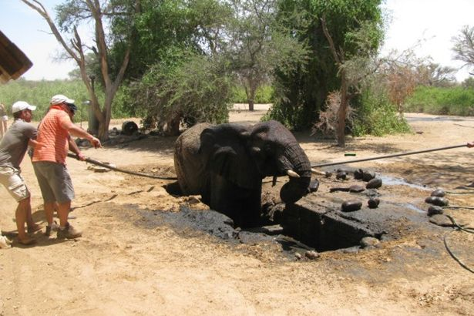

Tension (T)
When a body is pulled by a rope, cable, cord or other such objects, the force on the body is called tension
T’
T
T’
T
Free body diagram
Tension is directed always away from the body

Slide 19
Example1: Block moving on ideal Frictionless surface
F_{N}
F_{N}
T
T
Frictionless surface
mg
mg
Write Separate Equations for i and j
Free Body Diagram
X-Direction
Y-Direction

Slide 20
Example 2: Frictionless surface
F₁
a) Force F₁ acts on a block at an angle θ to slide it on the frictionless table with an acceleration “a”
θ
F_{N}
Ideal frictionless table
F₁
θ
Write Separate Equations for i and j
mg
x-Direction
Y-Direction
Free Body Diagram

Slide 21
Example 3 : Frictionless surface
F₁
b) Force F₁ and F₂ act on a block at an angle θ and φ respectively to slide it on a frictionless table with an acceleration “a” as shown in figure.
F₂
φ
θ
F_{N}
Ideal frictionless table
F₁
θ
φ
F₂
Write Separate Equations for i and j
mg
x-Direction
Y-Direction
Free Body Diagram

Slide 22
Example 4: Vertical forces
c) A body of mass “m” tied to a rope with tension “T” is lowered with an acceleration “a”
T
ma
mg
d) A body of mass “m” tied to a rope with tension “T” is pulled up with an acceleration “a”
Q5.: A 5.0 kg block is lowered with a downward acceleration of 2.8m/s² by means of a rope. The force of the block on the rope is:(Ans:35 N, down)
T
ma
mg

Slide 23
Example 4: Frictionless surface, tension and gravity
Rope
Rope
Wall
T
F_{N}
T
F_{N}
mg
mg
F_{N}
T
F_{N}
T
mg
Free body diagram
mg
Free body diagram
Write the equation in i and j directions

Slide 24
Example 6: Frictionless incline surface
Rope
F_{N}
F_{N}
T
mgsin(θ)
mgsin(θ)
mgcos(θ)
mg
θ
mg
θ
θ
mgcos(θ)
x-direction
x-direction
F_{N}
F_{N}
T
mgsin(θ)
mgsin(θ)
θ
θ
mg
mgcos(θ)
F_{g}
mgcos(θ)
y-direction
y-direction

Slide 25
Example 7: horizontal and vertical force together
y-direction
F_{AN}
F_{AN}
T_{A}
T_{A}
A
x-direction
T_{B}
m_{A}g
F_{Ag}
y-direction
Since the rope is same and the pulley is massless and frictionless
T_{B}
m_{B}g
B
Both bodies are moving together
m_{B}g

Slide 26
Example 8: Frictionless and massless pulley with two hanging bodies
Since the rope is same and pulley is ideal (massless and frictionless) both bodies will have common tension (T)
Since both bodies are moving together they will have common acceleration (a)
T
T
m₁
a
m₂
a
m₂
m₂ g
m₁
m₁ g
m₁>m₂

Slide 27
Example 9: Frictionless incline plane and pulley
F_{N}
T
F_{N}
T
T
T
A
B
B
A
mg Sin(Θ)
mg Cos(Θ)
mg Sin(Θ)
mg Cos(Θ)
Θ
Θ
Θ
m_{B}g
m_{B}g
m_{A}g
m_{A}g

Slide 28
Newton’s Third Law

Slide 29

Action and Reaction
To every action there is equal and opposite reaction
When we are on scale the gravity pull us down as an action but the scale surface push us up as an reaction.
A
F_{BA}
B
F_{AB}
Our weight is a Reaction against gravity!
W
W – mg = 0
F_{AB} = Force on A due to B
F_{BA} = Force on B due to A
W = mg
mg
Our weight is a normal force from the scale surface

Slide 30
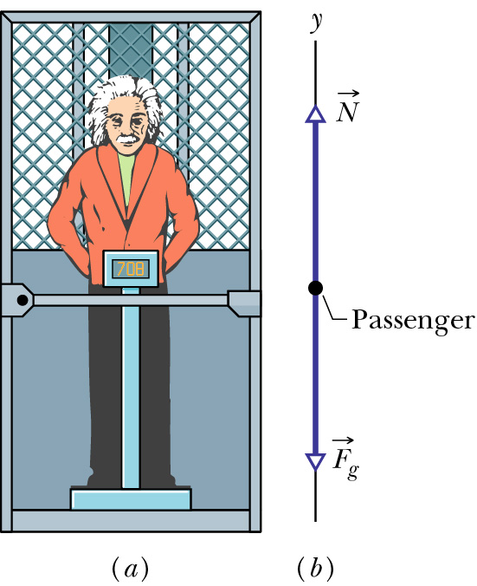
Example 10: Elevator problem
Accelerating Up
F_{N}
Accelerating Down
mg
Moving with Constant Velocity
Q15: You stand on a spring scale on the floor of an elevator. The scale shows the highest reading when the elevator:
(Ans: moves downward with decreasing speed)

Slide 31
Example 11: Elevator problem extended
T
T
m
M
mg
Mg
If something is hanged on the floor of the elevator with is accelerating up (or down) with acceleration “a”
Elevator (with everything inside) of mass “M” is hanged on a rope accelerate up (or down) with acceleration “a”.

Slide 32
Problems
Summary
1. ΣF = ma
Acceleration is same for whole system moving together
Rules of solving Problems
Draw the Force diagram.
Write the equations of the forces in different directions
Solve the equations
2. F₁₂ =-F₂₁
Don’t forget to apply Newton’s 3rd low of motion if two or more bodies are involved
3. Tension in a rope
Tension in a single segment of rope is same
Tension is always away from the body
4. Incline Plane
Always resolve the gravity into two components
5. Lift (Elevator)
Lift problem is a fight between Weight (Normal force ) and gravity (mg)

Slide 33
Elevator (Lift)
Q1: You stand on a spring scale on the floor of an elevator. The scale shows the highest reading when the elevator: (Ans: moves downward with decreasing speed)
Q2. A 70 kg man stands in an elevator that is moving downward at constant acceleration of 2.0 m/s². The force exerted by the man on the elevator floor is (Ans: 546 N down)
Q3. With what force will the feet of a person of mass 60.0 kg press downward on an elevator floor when the elevator has an upward acceleration of 1.20 m/s²?
A) 660 N
Q4. An elevator cab with a total mass of 2000 kg is pulled upward by a cable. If the elevator accelerates at 2.00 m/s² upward, find the tension in the cable. (Ans: 2.36 ×10⁴ N)
Q5. An elevator of mass 480 kg is designed to carry a maximum load of 3000 N. What is the tension in the elevator cable at maximum load when the elevator moves down accelerating at 9.8 m/s²? (Ans: 0)

Slide 34
Example 1:
Q1: Two blocks are in contact in a frictionless table. A horizontal force is applied to the larger block as shown in figure if m₁ = 2.3 kg, m₂ = 1.2 kg and F = 3.2 N,
find the magnitude of the force between two blocks.
find the magnitude of the force between two blocks if F is applied to m₂ .
Find the acceleration of m₁
Find acceleration of m₂
F
m₁
F_{1N}
F_{2N}
m₂
F₁₂
m₁
F
m₂
F₂₁
m₁ g
m₂ g
F₁₂ = force on 1 due to 2
F₂₁ = force on 2 due to 1
(Answer (a)1.1N (b) 2.1 N)
Newton’s Third Law
F₁₂ = F₂₁

Slide 35
Example 2:
Book Question:
In figure 1.1 a constant horizontal force F_{a} is applied to block A which pushes against block B with a 20N force directed horizontally to the right. In Fig 1.2, the same force F_{a} is applied to block B. Now block A pushes on Block B with a 10 N force directly horizontally to the left. The blocks have a combined mass of 12 kg.
What are the magnitude of:
their acceleration in fig 5.5 (a) and 5.5 (b)
force F_{a}?
B
F_{a}
B
F_{a}
A
A
1
2
N
N
F_{BA}
B
N
F_{a}
AB
F_{AB}
B
m_{B}g
(m_{A}+m_{B})g
F_{AB} = m_{B}a
m_{B}g
F_{a} = (m_{A}+m_{B})a
F_{AB} = m_{B}a
(Ans: a) 2.5 m/s² (b) 30 N

Slide 36
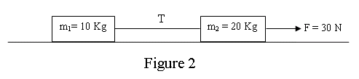
More Examples:
Q2. Two masses m₁ = 10 kg and m₂ = 20 kg are connected by a light string and pulled across a frictionless surface by a horizontal force F = 30 N as shown in Figure . Find the tension in the string. (Ans: 10 N)
Q3. In figure 4 Kg block A and 6 Kg block B are connected by a string of negligible Mass. Force F_{A} = (12N) i acts on block A, force F_{B} = (24N) i acts on block B. What is the tension on the string? (Ans: 2.4N)
F_{A}
F_{B}
A
T
B

Slide 37
Q4: A 70 N block A and a 35 N block B are connected by a string, as shown in figure. If the pulley is massless and the surface is frictionless, the magnitude of the acceleration of the 35 N block is: A) 3.3 m/s2

Slide 38
Q15.: Two blocks of masses m₁ = 4.00 kg and m₂ = 2.00 kg are connected by a string passing over a massless and frictionless pulley and placed on a frictionless horizontal table as shown in Fig. 3. A force of F = 10.0 N at an angle of 60.0° with the horizontal is applied to m₁. The magnitude of acceleration of the system is: (Ans: 2.43 m/s² )
Q19. Two boxes, one of mass m = 5.00 kg and the other with an unknown mass M are connected with a string passing over a massless frictionless pulley and are placed on frictionless planes as shown in Fig. 5.What must be the mass M, if it goes down the plane with an acceleration of a = 2.45 m/s²? (Ans: 19.1 kg )

Slide 39
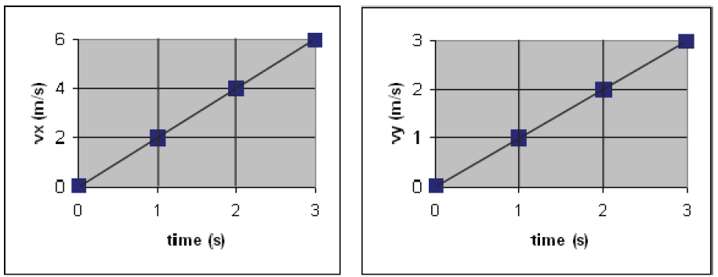
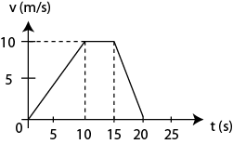
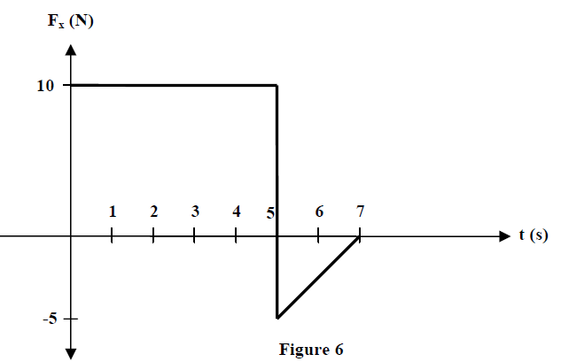
Graph
Q1. A constant force in the xy-plane pushes a 2.0 kg object across a horizontal frictionless floor on which an x-y coordinate system is drawn. The x and y components of the velocity of the object as a function of time are shown in Figure 4. The magnitude of the force is: A) 4.5 N
Q2.: A car of mass 1000 kg is initially at rest. It moves along a straight road for 20 s and then comes to rest again. The velocity – time graph for the movement is given in Fig.6. The magnitude of the net force that acts on the car while it is slowing down to stop from t = 15 s to t = 20 s is: (Ans: 2000N)
Q3. Figure 6 shows the force versus time graph of a force F_{x} acting on a 5.0 kg object moving in the x-direction along a frictionless one-dimensional track. At t = 0 the object is moving in the negative direction of the x-axis with a speed of 2.0 m/s. What are the speed and direction of the object at t = 7.0 s?
A) 7.0 m/s in the positive x-direction

Slide 40
Books problem: Figure 5-5.59 gives a function of time t, the force component Fx that acts on a 3 Kg ice block that can move only along the x axis. At t = 0, the block is moving in the positive direction of the axis, with a speed of 3 m/s.
What are its (a) speed (b) direction of the travel at t = 11s
6
F_{x} (N)
Area = 15
2
4
6
8
10
-4
t (s)

Slide 41
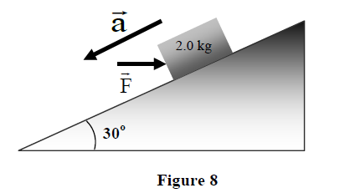
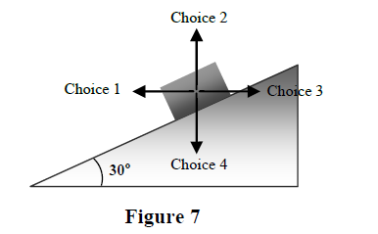
Incline Plane
Q1. A block of mass 2.0 kg is being pushed by a force F parallel to the ground as shown in Figure 8. The block is observed to have an acceleration of 1.0 m/s² down the incline. Assume the incline is frictionless. Calculate the magnitude of the force F.
A) 9.0 N
Q2. A 4.0 kg block is pushed upward a 30° inclined frictionless plane with a constant horizontal force F (Fig 4). If the block moves with a constant speed find the magnitude of the force F. A: 23 N )
Q3. Figure 7 shows four possible choices for the direction of ONE force of magnitude F to be applied to a block on an inclined plane of angle 30◦. The directions are either horizontal or vertical. (for all choices, we assume that the block remains on the inclined plane). Rank the choices according to the magnitude of the normal force on the block from the plane, greatest first.
A) choice 4, choice 3, choice 1, choice 2

Slide 42
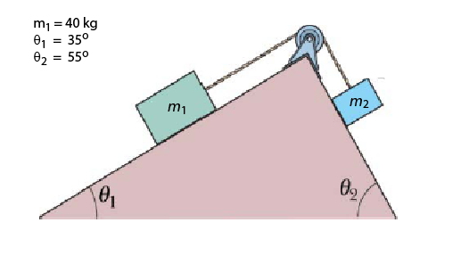
Q1. A block of mass 2.0 Kg attains acceleration, a =3.0i +2.5j + 1.5k as a result of two forces F1 and F2. If F1 = 2.0 i + 3.0 k, the magnitude and direction of F2 is:
Q2. What weight a 55 Kg person will feel while going down in an elevator with acceleration 2.4 m/s²
v_{x} (m/s)
Q3. A 20 kg ball is travelling in a frictionless track along positive x-direction and its v-t graph is shown in figure. The force experienced by the ball at 17th second is:
-40 N
Q4: Two masses rest on opposite sides of a frictionless inclined plane as shown in figure. If m1 moves down with a constant velocity 4.5 m/s what will be the angle θ₂?
M₁ = 100 kg
M₂ = 50 kg
Θ₁ = 20⁰

Slide 43
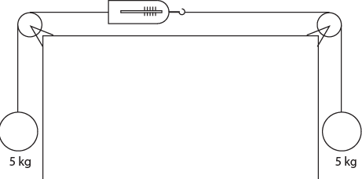
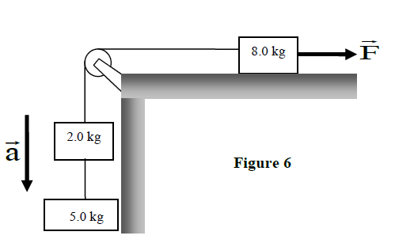
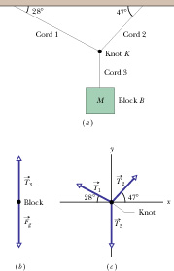
Tension
Q1. The system shown in Figure 6 is in equilibrium. If the spring scale is calibrated in N, what does it read?
A) 49N
Q2. In the system shown in Figure 6, a horizontal force F acts on the 8.0-kg object. The horizontal surface is frictionless. What is the magnitude of F if the 5.0-kg object has a downward acceleration of 1.0 m/s2?
A) 54 N
Q3: Find the tensions on chord 1 and chord 2 in the diagram in the right if the mass of the block B is 10 kg. Answer: T1 = 69.3 N and T2 = 89.7 N

Slide 44
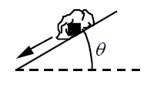
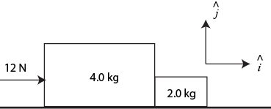
T-102-Ch5
Q14. As shown in Figure 3, a 2.0-N rock slides down on a frictionless inclined plane. Which one of the following statements is TRUE concerning the magnitude of the normal force that the plane exerts on the rock?
The normal force is less than 2.0 N.
Q15. As shown in Figure 4, a 4.0-kg block and a 2.0-kg block move on a horizontal frictionless surface while being accelerated by a 12-N force. In unit vector notation, determine the force that the 2.0-kg block exerts on the 4.0-kg block. (A) – 4 i N
Q16. With what force will the feet of a person of mass 60.0 kg press downward on an elevator floor when the elevator has an upward acceleration of 1.20 m/s2?
A) 660 N
Q17.As shown in Figure 5, two masses rest on opposite sides of a frictionless pulley on frictionless inclines. What is the mass m₂ if the system remains at rest?
A) 28

Slide 45

T-101-Ch5
Q14. A constant force in the xy-plane pushes a 2.0 kg object across a horizontal frictionless floor on which an x-y coordinate system is drawn. The x and y components of the velocity of the object as a function of time are shown in Figure 4. The magnitude of the force is:
A) 4.5 N
Q15. A large block of mass 4.6 kg and a small block of mass 2.4 kg are in contact on a frictionless table as shown in Figure 5. A horizontal force of 7.0 N is applied to the larger block. What is the magnitude of the force between the two blocks?
A) 2.4 N
Q16.
The system shown in Figure 6 is in equilibrium. If the spring scale is calibrated in N, what does it read?
A) 49N

Slide 46
T-92-Ch5
Q15. In the system shown in Figure 6, a horizontal force F acts on the 8.0-kg object. The horizontal surface is frictionless. What is the magnitude of F if the 5.0-kg object has a downward acceleration of 1.0 m/s2?
A) 54 N
Q17. Figure 7 shows four possible choices for the direction of ONE force of magnitude F to be applied to a block on an inclined plane of angle 30◦. The directions are either horizontal or vertical. (for all choices, we assume that the block remains on the inclined plane). Rank the choices according to the magnitude of the normal force on the block from the plane, greatest first.
A) choice 4, choice 3, choice 1, choice 2
Q18. A block of mass 2.0 kg is being pushed by a force F parallel to the ground as shown in Figure 8. The block is observed to have an acceleration of 1.0 m/s2 down the incline. Assume the incline is frictionless. Calculate the magnitude of the force F.
A) 9.0 N

Slide 47
T-91-Ch5
Q15. Two forces act on a 2 kg object to produce an acceleration a=(2m/s)i+(-1m/s)j+0k . One of the forces is F₁=(2N)i+(3N)j+(-1N)k
What is the other force?
A) F₂=(2N)i+(-5N)j+(1N)k
Q16. Figure 6 shows the force versus time graph of a force F_{x} acting on a 5.0 kg object moving in the x-direction along a frictionless one-dimensional track. At t = 0 the object is moving in the negative direction of the x-axis with a speed of 2.0 m/s. What are the speed and direction of the object at t = 7.0 s?
A) 7.0 m/s in the positive x-direction
Q20. An object is being accelerated in the absence of friction by a 100-N force. A second force of 100-N is then applied to the object in a direction opposite to the direction of motion. The object with these two forces acting on it will
A) Move at a constant velocity
B) Slow down
C) Move in a circle
D) Stop rapidly
E) Move backward

Slide 48
T-82-Ch5
Q15: You stand on a spring scale on the floor of an elevator. The scale shows the highest reading when the elevator: (Ans: moves downward with decreasing speed)
Q16. A 70 N block A and a 35 N block B are connected by a string, as shown in Fig 3. If the pulley is massless and the surface is frictionless, the magnitude of the acceleration of the 35 N block is: A) 3.3 m/s2
Q17. When a 25.0 kg crate is pushed across a frictionless horizontal floor with a force of 200 N, directed 20◦ below the horizontal, the magnitude of the normal force of the floor on the crate is: A) 313 N

Slide 49
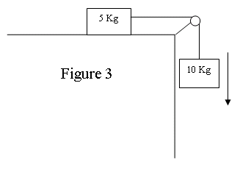
T-81-Ch5
Q15. Two masses m₁ = 10 kg and m₂ = 20 kg are connected by a light string and pulled across a frictionless surface by a horizontal force F = 30 N as shown in Figure 2. Find the tension in the string. (Ans: 10 N)
Q16. A 5.0-kg block and a 10-kg block are connected by a light string as shown in Figure 3. If the pulley is massless and the surface is frictionless, the magnitude of the acceleration of the 5.0 kg block is (Ans: 6.5 m/s²
Q17. A 70 kg man stands in an elevator that is moving downward at constant acceleration of 2.0 m/s². The force exerted by the man on the elevator floor is (Ans: 546 N down)

Slide 50
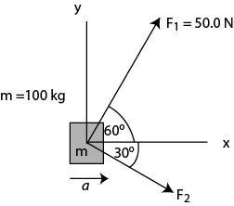
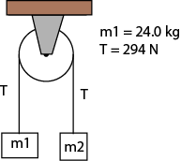
T-72-Ch5
Q13.Two blocks of mass m₁= 24.0 kg and m₂, respectively, are connected by a light string that passes over a massless pulley as shown in Fig. 2. If the tension in the string is T = 294 N. Find the value of m₂. (Ignore friction) (Ans: 40.0 kg)
Fig 2
Fig 3
Q14.Two horizontal forces of equal magnitudes are acting on a box sliding on a smooth horizontal table. The direction of one force is the north direction; the other is in the west direction. What is the direction of the acceleration of the box?(Ans:45° west of north)
Q16.: A 5.0 kg block is lowered with a downward acceleration of 2.8m/s² by means of a rope. The force of the block on the rope is:(Ans:35 N, down)
Q17.:Two students are dragging a box (m=100 kg) across a horizontal frozen lake. The first student pulls with force F₁=50.0 N, while the second pulls with force F₂. The box is moving in the x-direction with acceleration a (see Fig. 3). Assuming that friction is negligible, what is F₂?

Slide 51
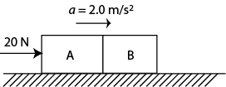
T-71-Ch5
Q13. A constant force F of magnitude 20 N is applied to block A of mass m = 4.0 kg, which pushes block B as shown in Fig. 5. The block slides over a frictionless flat surface with an acceleration of 2.0 m/s². What is the net force on block B? (Ans:12 N)
Fig 2
Fig 3
Q14. Only two forces act upon a 5.0 kg box. One of the forces is (6 i +8 j) N . If the box moves at a constant velocity of (1.6 i +1.2 j) m/s , what is the magnitude of the second force?( Ans: 10. N)
Q15. An elevator of mass 480 kg is designed to carry a maximum load of 3000 N. What is the tension in the elevator cable at maximum load when the elevator moves down accelerating at 9.8 m/s²? (Ans: 0)
Q16.: A car of mass 1000 kg is initially at rest. It moves along a straight road for 20 s and then comes to rest again. The velocity – time graph for the movement is given in Fig.6. The magnitude of the net force that acts on the car while it is slowing down to stop from t = 15 s to t = 20 s is: (Ans: 2000N)

Slide 52
T-62-Ch5
Q15.: Two blocks of masses m₁ = 4.00 kg and m₂ = 2.00 kg are connected by a string passing over a massless and frictionless pulley and placed on a frictionless horizontal table as shown in Fig. 3. A force of F = 10.0 N at an angle of 60.0° with the horizontal is applied to m₁. The magnitude of acceleration of the system is: (Ans: 2.43 m/s² )
Q#18. Two boxes A and B (m_{A} = 3.0 kg and m_{B} =1.0 kg) are in contact on a horizontal frictionless surface and move along the x-axis (see Fig. 4). A horizontal force F = 10 i N is applied on Box A. The net force acting on A is F₁ and on B is F₂. Which one of the following statements is correct? A) F₁ = 7.5 I N and F₂ = 2.5iN
Q19. Two boxes, one of mass m = 5.00 kg and the other with an unknown mass M are connected with a string passing over a massless frictionless pulley and are placed on frictionless planes as shown in Fig. 5.What must be the mass M, if it goes down the plane with an acceleration of a = 2.45 m/s²? (Ans: 19.1 kg )
Q#20: A 2.00-kg mass is hanging from the ceiling of an elevator accelerating upward at a = 2.50 m/s² (see Fig. 6). What is the tension T in the string? (Ans: 24.6 N)

Slide 53
T-61-Ch5
Q13. A 4.0 kg block is pushed upward a 30° inclined frictionless plane with a constant horizontal force F (Fig 4). If the block moves with a constant speed find the magnitude of the force F. ( A: 23 N )
Q14. An elevator cab with a total mass of 2000 kg is pulled upward by a cable. If the elevator accelerates at 2.00 m/s² upward, find the tension in the cable. (Ans: 2.36 ×10⁴ N)
Q16. A 7.0 kg block and a 3.0 kg block are connected by a string as shown in Fig 5. If the pulley is massless and the surface is frictionless, the magnitude of the acceleration of the 3.0 kg block is: (Ans: 2.9 m/s² )

Slide 54
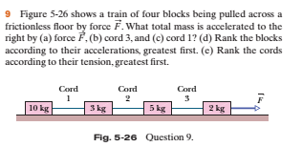

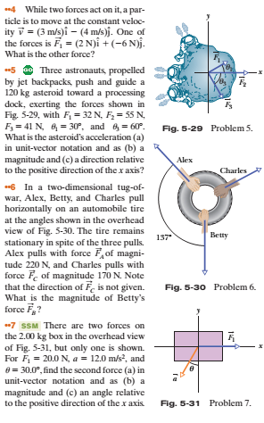

Slide 55
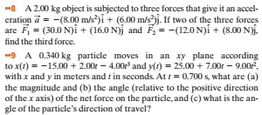
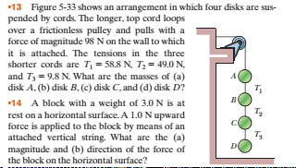

Slide 56
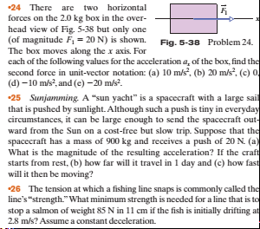
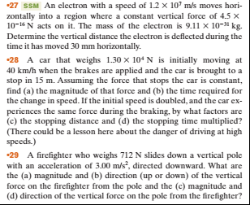

Slide 57
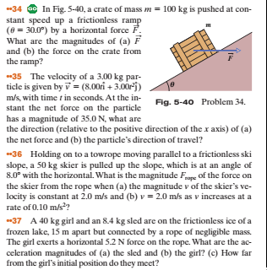
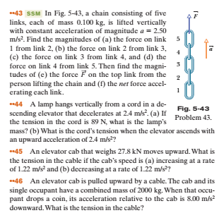

Slide 58
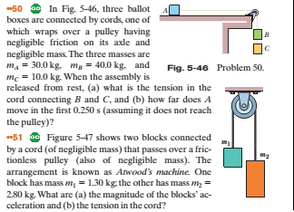
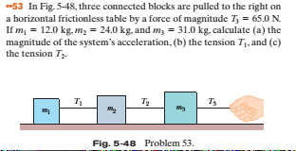

Slide 59
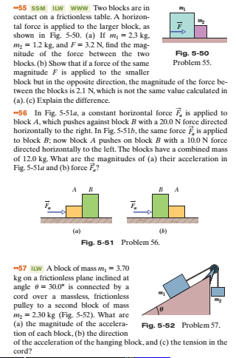

Slide 60
