Slide 1
Chapter 14
Fluids(liquid, gas)
Something that can flow is fluid

Slide 2
Density
Density ρ of a fluid (liquid and gas) having a mass m and a volume V is given by
Material | Density (Kg/m³) | State
Water (fresh) | 1000 | At STP
Water (salt) | 1030
Plastics | 850 − 1400
Magnesium | 1740 | At STP
Beryllium | 1850 | At STP
Glycerol^{[8]} | 1261
Silicon | 2330 | At STP
Aluminium | 2700 | At STP
Diamond | 3500 | At STP
Titanium | 4540 | At STP
Selenium | 4800 | At STP
The Earth | 5515.3
Density Units: kg/m³
Density measures the heaviness of the material
liquid
gas

Slide 3
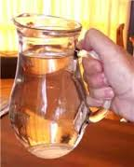
Specific gravity (S.G)
Do you know mass of 1 cm³ (cc) water = 1 g?
1 liter (1000 cc) water
1 Kg of water
Specific gravity measures the heaviness of any material compare to water
prove
Weight
Table salt has a specific gravity of 2.17, so it is 2.17 times as dense as water.
Aluminum has a specific gravity of 2.7, so it is 2.7 times as dense as water.
Iron has a specific gravity of 7.87, so it is 7.87 times as dense as water.
Lead has a specific gravity of 11.35, so it is 11.35 times as dense as water.
Mercury has a specific gravity of 13.56, so it is 13.56 times as dense as water.
Gold has a specific gravity of 19.3, so it is 19.3 times as dense as water.
Osmium, the densest naturally occurring chemical element, has a specific gravity of 22.59, so it is 22.59 times as dense as water.

Slide 4
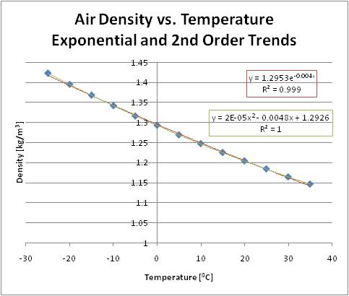
Pressure
F
F
A
A
liquid
gas
IF YOU CHANGE PRESSURE DENSITY CHANGES
Pressure on the fluid
Pressure changes temperature and temperature changes density
Pressure Units: N/m² (Pascal)

Slide 5
Fluid at rest
A = Area
F_{b}
F_{t}
F_{t}
h
F_{b}
mg
mg
absolute pressure
Consider an imaginary fluid body which is in equilibrium
If P_{t} = P₀ and P_{b} = P
atmospheric pressure
Gauge pressure (P_{g}) = P–P₀
Example1:
If 1 atmospheric pressure is 1.01 x 10⁵ Pa find the pressure at 1 Km above the earth surface.
(density of air is 1.2Kg/m³)

Slide 6
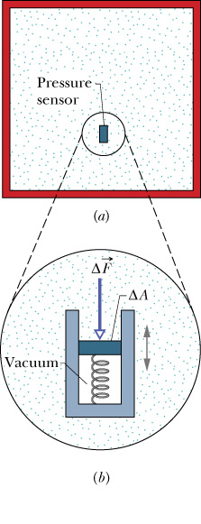
Pressure Measurement
t
Pressure gauge which is used to measure the fluid pressure inside:
Fluid compresses the spring which is translated in terms of pressure
h
b
Mercury
Example2: If 1 atmospheric pressure is 760 mm of Hg find it in Pascal.
(density of mercury is 13.6 g/cc)

Slide 7
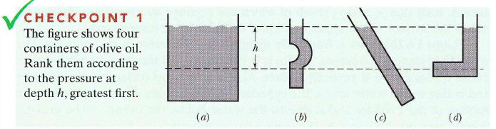
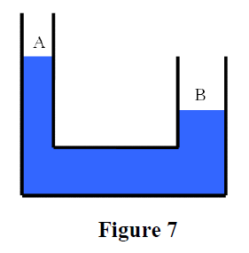
Examples
Ans: All Tie (height is same)
T92-Q26.
Figure 7 shows a snapshot of a fluid within a U-shaped tube that has both sides open at the top. Is this fluid in static equilibrium at this instant?
A) No, because the fluid level in both sides should be at the same height.
B) No, because the fluid level in side A should be lower than that in side B.
C) No, because the cross-sectional area of side A is less than that of side B.
D) Yes, the fluid is in static equilibrium.
E) The answer may be yes or no, depending on the density of the fluid.

Slide 8
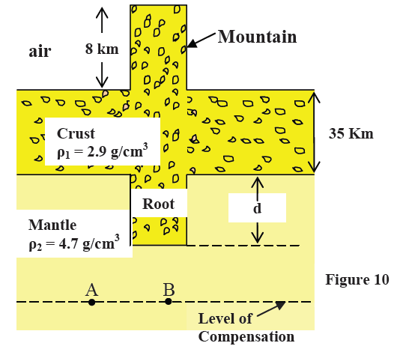
T71-Q8.
The pressure of a gas in a tank is measured with a mercury manometer (Fig. 5). The mercury is 36.2 cm higher in the outside arm than in the arm connected to the gas cell. Find the gauge pressure of the gas cell. (Density of mercury is 13.6 g/cm³)
Ans: 4.82 × 10⁴ Pa
T101-Q22.
The pressure on a submarine is 1.00 x 10⁶ Pa. Assume that the density of seawater is 1.20 x 10³ kg/m³. The depth of the submarine below the surface of seawater is:
A) 76.4 m
T81-Q25.
A vertical cross section of a simple geological model of the earth that requires mountains to have roots is shown in Figure 10. At some horizontal level in the fluid mantle (called the level of compensation), the pressure has a constant value (the pressures at points A and B in the figure are equal). How deep must the root (d) of the mountain approximately be?
A) 13 km

Slide 9
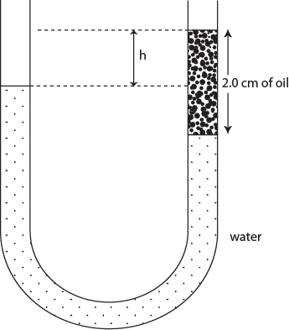
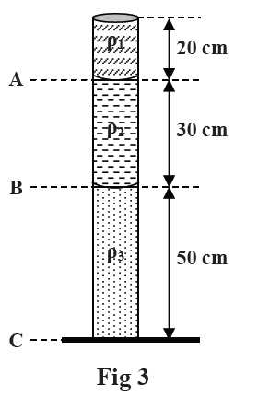
T62-Q9.
A U-tube of constant cross sectional area, open to the atmosphere, is partially filled with Hg (ρ_{Hg}=13.6 g/cm³). Water (ρ_{w}=1.00 g/cm³) is then poured into both arms. If the equilibrium configuration of the tube is as shown in the Fig. 5 with h₃= 1.00 cm, determine the value of h₁. (Note that h₁, h₂ and h₃ are not drawn to scale).
A) 12.6 cm
Fig-5
T102-Q22.
A U-shaped tube open at both ends contains water and a quantity of oil occupying a 2.0 cm length of the tube, as shown in Figure 10. If the density of oil is 82% of the density of water, what is the height difference h?
A) 0.36 cm
T82-Q11.
The open vertical tube in Fig. 3 contains three fluids of densities
ρ1 = 300 kg/m3, ρ2 = 400 kg/m3 and ρ3 = 500 kg/m3, which do not mix. Find the pressure
at point B.
A) 1.03 x 10⁵ Pa

Slide 10
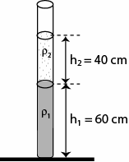
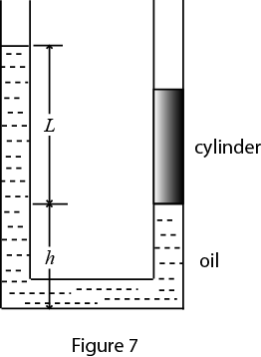
T81-Q24.
On a standard day (atmospheric pressure), a pressure gauge instrument below the surface of the ocean (Specific Gravity = 1.025) reads an absolute pressure of 1.4 x 10⁶ Pa. How deep underwater is this instrument?
A) 129 m
T61-Q23.
The open vertical tube in Fig. 13 contains two liquids of densities ρ₁ = 1000 kg/m³ and ρ₂ = 800 kg/m³, which do not mix. Find the gauge pressure (pressure due to the liquids only) at the bottom of the tube.
(A: 9000 Pa )
Fig-13
T51-Q#24:
Fig. 7 shows a U-tube with cross-sectional area A and partially filled with oil of density ρ. A solid cylinder, which fits the tube tightly but can slide without friction, is placed in the right arm. The system is in equilibrium. The weight of the cylinder is:
(Ans: ALρg)

Slide 11
Pascal’s law
Definition:
A change in pressure applied to an enclosed incompressible fluid is transmitted to every portion of the fluid and to the walls of its container.
inlet
F_{in}
A_{out}
outlet
A_{in}
d_{out}
d_{in}
F_{out}
Inlet pressure = Outlet pressure
Should energy be conserved?
Using (1) and (2) you can prove
Volume of displaced fluid must conserve
Yes! Energy does conserve.

Slide 12
Ch14-Q9:
A piston of cross-sectional area a is used in a hydraulic press to exert a small force of magnitude f on the enclosed liquid. A connecting pipe leads to a larger piston of cross-sectional area A (see figure). (a) What force magnitude F will the larger piston sustain without moving? (b) If the piston diameters are 3.8 cm and 53 cm, what force magnitude on the small piston will balance a 20 kN force on the large piston?
a) fA/a (b) 103 N
f
F
a
A

Slide 13
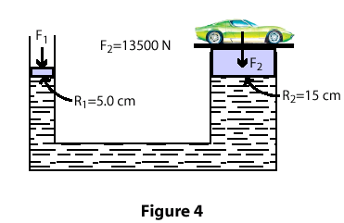
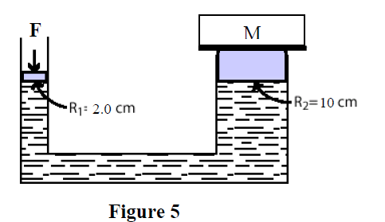
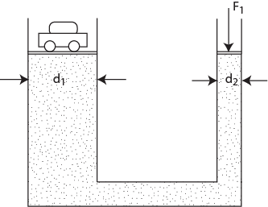
T42-Q11
A piston of radius R1= 5.0 cm is used in a hydraulic press to exert a force F1 on the enclosed liquid to raise a car of weight F2=13,500 N (see Fig 4). If the radius of the larger piston is R2 = 15 cm, Find F1.
(Ans: 1.5x10³ N)
T92-Q23.
The hydraulic jack shown in Figure 5 is used to raise the mass M through a height of 5.0 mm by performing 500 J of work on the small piston. The diameter of the large piston is 10 cm while that of the small piston is 2.0 cm. The mass M is:
A) 1.0 x 10⁴ kg
T102-Q21.
In the hydraulic lift of Figure 9, a large piston of diameter d1 = 120 cm supports a car of mass 3.20 × 10³ kg. What is the magnitude of the vertically downward force F1 that must be applied to the smaller piston of diameter d2 = 15.0 cm to balance the car?
A) 4.90 ×10² N

Slide 14
Lecture 2

Slide 15
Submerging (Immerging)
Partly submerged
Fully submerged
Displaced liquid
Displaced liquid
Volume of the body inside the liquid
Volume of the displaced liquid
Mass of the displaced liquid = ρ_{l}V
Weight of the displaced liquid = ρ_{l}Vg

Slide 16
Buoyant Force (F_{b})
mg
F_{B}
When the body is inside the liquid it will experience the upward force called Buoyant force (F_{B}).
Displaced liquid
F_{B}
When will the body Float?
When will the body sink?
F_{B} – mg = 0
F_{B} – mg < 0
mg
or
F_{B} - mg > 0

Slide 17
Apparent weight (W_{a})
mg
F_{B}
Apparent weight (W_{a}) = Real weight (mg) - Buoyant Force (F_{B})
Displaced liquid
-W_{a} = F_{B} -mg
F_{B}
W_{a}
F_{B} = mg- W_{a}
When will the body sink?
When will the body Float?
W_{a} < 0
mg
W_{a} = 0
F_{B} =mg
or
W_{a} < 0
F_{B} >mg

Slide 18
Archimedes’ principle
F_{B}
mg
F_{B}
mg
m_{l}g
Displaced liquid
Archimedes Found that
Buoyant Force = Weight of the displaced liquid

Slide 19
Principle of Floating
W_{a}
A body will float if the weight of the displaced fluid is equal to the weight of the body
F_{b}
m_{f}g
If the body is completely submerged
Reduced Weight = mg - W_{a}
Reduced Weight = F_{b}
Reduced Weight = m_{l}g
A body will float inside the liquid if the density of the displaced fluid is equal to the density of the body

Slide 20
T81-Q27.
Consider a fresh-water ice cube floating in a glass of fresh water. When the ice cube melts, which of the following statements is TRUE?
A) The water level remains the same because the ice cube displaces a mass of water equal to its own mass.
B) The water level rises because ice is less dense than water.
C) The water level falls because ice is less dense than water.
D) The water level rises because the ice cube displaces a mass of water equal to its own mass.
E) The water level falls because the ice cube displaces a mass of water equal to its own mass.
T82Q9.
A penguin (bird) floats first in a fluid of density ρ1 = 1.0 ρ, then in a fluid of density ρ2 =0.95 ρ, and then in a fluid of density ρ3 = 1.1 ρ. Rank the densities of the fluids
according to the amount of fluid displaced by the penguin, GREATEST first.
A) ρ2, ρ1, ρ3
T91Q26.
A balloon filled with helium gas that occupies a volume of 0.0500 m³ is attached by a light rope to the ground. What is the tension in the rope?
(Density of helium gas = 0.1786 kg/m³, density of air = 1.293 kg/m³)
A) 0.5460 N

Slide 21
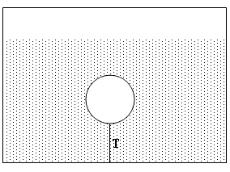
T41-Q24. An Aluminum block of density 2.70 g/cm³ has a weight W in air and has a weight W_{app} in water when completely submerged. If (W- W_{app}) is equal to 196 N, the volume of the block is:
A) 0.020 m³
T92-Q24. A solid cube of wood 30.0 cm on each edge is totally submerged in water when pushed downward with a vertical force of 54.0 N holding it in equilibrium. The density of wood is approximately:
A) 800 kg/m³
Book’s problem-Q31: An iron anchor of density 7870 Kg/m³ appears 200 N lighter in water than in air. (a) What is the volume of the anchor? (b) How much does it weigh in air?
Ans: (a)2.04x10⁻² m³ (b)1.57x10³ N
T101-Q21. An aluminum ball of volume 4.0 cm³ is dropped in water. Assume the density of water to be 1.0 g/cm³ and the density of aluminum to be 2.7 g/cm³. Find the acceleration with which the ball sinks in the water (ignore viscosity).
A) 6.2 m/s²
T72-Q25. A 10 kg spherical object with a volume of 0.10 m³ is held in static equilibrium under water by a cable fixed to the bottom of a water tank. What is the tension T in the cable? (See Fig. 7)
Ans: 880 N

Slide 22
T91-Q24. A person floats in the ocean with 90% of his body below the water surface. The density of the ocean water is 1025 kg/m³. What is the person’s average density in kg/m³?
A) 922.5
T102-Q23. The average density of a typical iceberg is 0.86 that of sea water. What fraction of the volume of the iceberg is outside the water?
A) 0.14
T101-Q20. An iceberg floats on the sea. Its volume above the seawater is 8.0 ×10² m³. Assume the density of ice to be 9.0 × 10² kg/m³ and the density of seawater to be 1.2 × 10³ kg/m³. The total mass of the iceberg is:
A) 2.9 × 10⁶ kg
T82-Q9 : A plastic sphere floats in water with 0.50 of its volume submerged. This same sphere floats in oil with 0.40 of its volume submerged. Determine the density of the oil.
Ans: 1.25 x 10³ kg/m³
T81-Q23. A uniform block of wood floats in water with two-thirds of its volume submerged. What is the density of the wood?
A) 0.67 g/cm³

Slide 23
A cork floats in water in a bucket resting on the floor of an elevator. The elevator then accelerates upward. During the acceleration:
A. the cork is immersed more
B. the cork is immersed less
C. the cork is immersed the same amount
D. at first the cork is immersed less but as the elevator speeds up it is immersed more
E. At first the cork is immersed more but as the elevator speeds up it is immersed less
An object hangs from a spring balance. The balance indicates 30N in air and 20N when the object is submerged in water. What does the balance indicate when the object is submersed in a liquid with a density that is half that of water? (25 N)

Slide 24
All tie
Volume α 1/density

Slide 25
Lecture 3

Slide 26
Fluid in Motion
Steady Flow (Laminar flow): The velocity of the moving fluid at any point is constant.
v
v
v
Incompressible flow: The density of fluid is constant.
Non-viscous flow: Flow without resistance. Viscosity is friction in liquid. Non-viscous means no liquid friction.
Irrigational Flow: The flow in which body will not rotate about its centre of mass.

Slide 27
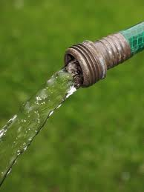
Flow of Mass or Volume
Volume and mass of the flow is not fixed.
It depends on time.
Area of cross-section
Volume flow rate:
Mass flow rate:
T72Q23.: Water is pumped out of a swimming pool at a speed of 5.0 m/s through a uniform hose of radius 1.0 cm. Find the mass of water pumped out of the pool in one minute. (Density of water = 1000 kg/m³).
(Ans: 94 kg)
T71:Q10. The open end of a cylindrical pipe has a radius of 1.5 cm. Water (density = 1.0×10³ kg/m³) flows steadily out of this end at a speed of 7.0 m/s. The rate at which mass is leaving the pipe is:
A) 4.9 kg/s
T71Q10. A garden hose has an inner diameter of 16 mm. The hose can fill a 10 liter bucket in 20 s. Find the speed of the water at the end of the hose (1 Liter = 10⁻³ m³).
(Ans: 2.5 m/s)

Slide 28
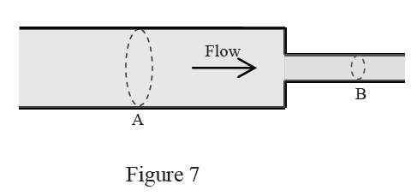
Continuity Equation
Mass/volume of a fluid in a closed system should conserve.
V₁
V₂
d₂
Δt
d₂
Rate of volume flow is conserved
T91-Q27.
Oil is flowing through a horizontal tube that has two different cross-sectional areas as shown in Figure 7. At position A where the radius of the tube is 7.00 cm, the mass flow rate of the oil is 0.025 kg/s. What is the mass flow rate at position B where the radius of the tube is 3.50 cm?
A) 0.025 kg/s
Δt

Slide 29
Bernoulli’s Equation
d₂
V₁
V₂
h₂
d₂
h₁

Slide 30
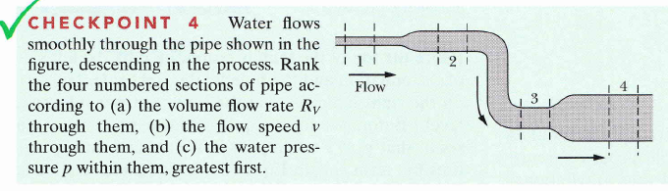
13 outward
4. (a) all tie; (b) 1, then 2 and 3 tie, 4 (wider means slower);
(c) 4, 3, 2, 1 (wider and lower mean more pressure)

Slide 31
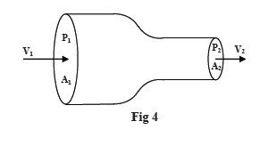
T61-Q25.
Water is pumped through a hose of uniform cross-section as shown in Fig. 14, from the lower level (1) to the upper level (2). Which of the following expresses the correct relationship between velocity and pressure at the two levels?
A) v₁ = v₂ and p₂ < p₁
T62-Q26.
Water flows through a horizontal tube from point 1 (cross sectional area A₁) to point 2 (cross sectional area A₂), as shown in Fig. 15. If A₁ = 2A₂ and v₁ = 10 m/s, the change in the kinetic energy (ΔK) of 1.0 m³ of water in moving from point 1 to point 2 is:
A) 1.5 x 10⁵ J )
T82-Q12.
Fig. 4 shows an ideal fluid flowing in a horizontal tube. The pressure, velocity, and tube cross section area at point 1 and 2 are (P₁, v₁, A₁) and (P₂, v₁, A₁), respectively. If P₁=8.0 x 10⁴ Pa, A₁= 4A₂, P₂ = 6.0 x10⁴ Pa and A₂= 2.0 x 10⁻³ m², at what volume rate does water flow through point 2?
[Take density of water to be 1000 kg/m³]
A) 0.013 m³/s

Slide 32
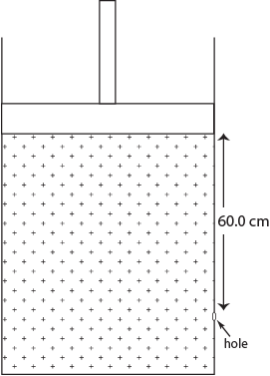
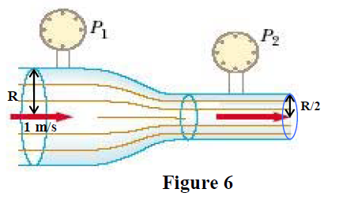
T102-Q24.
Water flows through a horizontal pipe of varying cross-section. The pressure is 1.5 × 10⁴ Pa at a point where the speed is 2.0 m/s and the area of cross section is A. Find the speed and pressure at a point where the area is A/2.
A) 4.0 m/s and 0.90 ×10⁴ Pa
T102-Q25.
A large tank is filled with water. A tightly fitting piston rests on top of the water (Figure 11). The combined pressure from the piston and atmosphere on the top surface of water is 1.02 × 10⁵ Pa. A very small circular hole is opened at a depth of 60.0 cm below the initial water level of the tank. What is the initial speed of water coming out of the hole?
A) 3.71 m/s
T92-Q25.
A tube of radius R is connected horizontally in series with another tube of radius R/2 as shown in Figure 6. Water enters the wider tube with speed v1 = 1 m/s. The water pressures in the tubes are P1 and P2, respectively such that P1+P2 = 10000 Pa. Choose the correct values for P1 and P2 (in Pa).
A) P1= 8750 and P2= 1250

Slide 33
Books Problem-Q65:
Figure 14-53 shows a stream of water flowing through a hole at depth h = 10 cm in a tank holding water to height H = 40 cm. (a) What distance x does the stream strike the floor? (b) At what depth should s second hole be made to give the same value of x? (c) at what depth should a hole be made to maximize x?
A) (a) 35 cm; (b) 30 cm; (c) 20 cm
T71-Q11.
Water flows through a pipe as shown in Fig. 7. At the lower elevation, the water’s speed (v_{A}) is 5.0 m/s and the gauge pressure (P_{A}) is 7.5 × 10⁴ Pa. Find the gauge pressure at the higher elevation (P_{B}). (Diameter at A = 6.0 cm, diameter at B = 4.0 cm and the elevation of B relative to A is 2.0 m)
(Ans: 4.60 kPa)

Slide 34
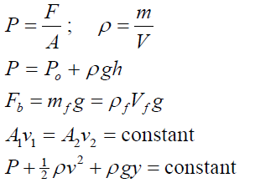
Formula

Slide 35
T-102-Ch14
Q21.
In the hydraulic lift of Figure 9, a large piston of diameter d1 = 120 cm supports a car of mass 3.20 × 10³ kg. What is the magnitude of the vertically downward force F1 that must be applied to the smaller piston of diameter d2 = 15.0 cm to balance the car?
A) 4.90 ×10² N
Q22.
A U-shaped tube open at both ends contains water and a quantity of oil occupying a 2.0 cm length of the tube, as shown in Figure 10. If the density of oil is 82% of the density of water, what is the height difference h?
A) 0.36 cm

Slide 36
T-102-Ch14
Q23.
The average density of a typical iceberg is 0.86 that of sea water. What fraction of the volume of the iceberg is outside the water?
A) 0.14
Q24.
Water flows through a horizontal pipe of varying cross-section. The pressure is 1.5 × 10⁴ Pa at a point where the speed is 2.0 m/s and the area of cross section is A. Find the speed and pressure at a point where the area is A/2.
A) 4.0 m/s and 0.90 ×10⁴ Pa
Q25.
A large tank is filled with water. A tightly fitting piston rests on top of the water (Figure 11). The combined pressure from the piston and atmosphere on the top surface of water is 1.02 × 105 Pa. A very small circular hole is opened at a depth of 60.0 cm below the initial water level of the tank. What is the initial speed of water coming out of the hole?
A) 3.71 m/s

Slide 37
T-101-Ch14
Q20.
An iceberg floats on the sea. Its volume above the seawater is 8.0 ×10² m³. Assume the density of ice to be 9.0 × 10² kg/m³ and the density of seawater to be 1.2 × 10³ kg/m³. The total mass of the iceberg is:
A) 2.9 × 10⁶ kg
Q21.
An aluminum ball of volume 4.0 cm³ is dropped in water. Assume the density of water to be 1.0 g/cm³ and the density of aluminum to be 2.7 g/cm³. Find the acceleration with which the ball sinks in the water (ignore viscosity).
A) 6.2 m/s2
Q22.
The pressure on a submarine is 1.00 x 10⁶ Pa. Assume that the density of seawater is 1.20 x 10³ kg/m³. The depth of the submarine below the surface of seawater is:
A) 76.4 m

Slide 38
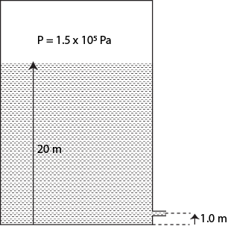
T-101-Ch14
Q23.
A pipe 16 cm in diameter is connected to the top of a water storage tank of volume 1.0 x 10⁴ liters. If the tank is filled at a constant rate in 10 minutes, what is the entry speed of water from the pipe into the tank?
(1 liter = 10⁻³ m³)
A) 50 m/min
Q24.
Figure 5 shows a very large, closed, cylindrical oil tank. There is a small hole in its side at a height of 1.0 m from the bottom of the tank. The oil vapor pressure in the tank is maintained at 1.5 × 10⁵ Pa. Find the speed with which the oil leaves the tank through the hole when the oil level is 20 m from the bottom of the tank. The density of oil is 8.5 × 10² kg/m3.
A) 22 m/s

Slide 39
T-92-Ch14
Q23.
The hydraulic jack shown in Figure 5 is used to raise the mass M through a height of 5.0 mm by performing 500 J of work on the small piston. The diameter of the large piston is 10 cm while that of the small piston is 2.0 cm. The mass M is:
A) 1.0 x 10⁴ kg
Q24.
A solid cube of wood 30.0 cm on each edge is totally submerged in water when pushed downward with a vertical force of 54.0 N holding it in equilibrium. The density of wood is approximately:
A) 800 kg/m³

Slide 40
T-92-Ch14
Q25.
A tube of radius R is connected horizontally in series with another tube of radius R/2 as shown in Figure 6. Water enters the wider tube with speed v1 = 1 m/s. The water pressures in the tubes are P1 and P2, respectively such that P1+P2 = 10000 Pa. Choose the correct values for P1 and P2 (in Pa).
A) P1= 8750 and P2= 1250
Q26.
Figure 7 shows a snapshot of a fluid within a U-shaped tube that has both sides open at the top. Is this fluid in static equilibrium at this instant?
A) No, because the fluid level in both sides should be at the same height.
B) No, because the fluid level in side A should be lower than that in side B.
C) No, because the cross-sectional area of side A is less than that of side B.
D) Yes, the fluid is in static equilibrium.
E) The answer may be yes or no, depending on the density of the fluid.

Slide 41
T-91-Ch14
Q24.
A person floats in the ocean with 90% of his body below the water surface. The density of the ocean water is 1025 kg/m3. What is the person’s average density in kg/m3?
A) 922.5
Q25.
A large tank, open to the atmosphere, is filled with water to a height of 16 m. A small hole is opened at a height of 6.0 m above the bottom of the tank. What is the speed (in m/s) of the water through the hole?
A) 14

Slide 42
T-91-Ch14
Q26.
A balloon filled with helium gas that occupies a volume of 0.0500 m³ is attached by a light rope to the ground. What is the tension in the rope?
(Density of helium gas = 0.1786 kg/m³, density of air = 1.293 kg/m³)
A) 0.5460 N
Q27.
Oil is flowing through a horizontal tube that has two different cross-sectional areas as shown in Figure 7. At position A where the radius of the tube is 7.00 cm, the mass flow rate of the oil is 0.025 kg/s. What is the mass flow rate at position B where the radius of the tube is 3.50 cm?
A) 0.025 kg/s

Slide 43
T-82-Ch14
Q9.
A penguin (bird) floats first in a fluid of density ρ1 = 1.0 ρ, then in a fluid of density ρ2 =0.95 ρ, and then in a fluid of density ρ3 = 1.1 ρ. Rank the densities of the fluids
according to the amount of fluid displaced by the penguin, GREATEST first.
A) ρ2, ρ1, ρ3
Q10.
A plastic sphere floats in water with 0.50 of its volume submerged. This same sphere
floats in oil with 0.40 of its volume submerged. Determine the density of the oil.
A) 1.25 x 10³ kg/m³

Slide 44
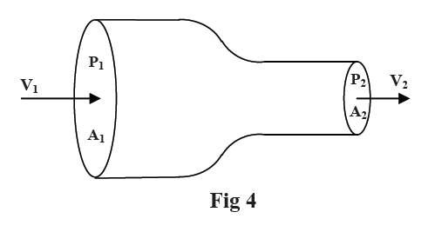
T-82-Ch14
Q11.
The open vertical tube in Fig. 3 contains three fluids of densities ρ1 = 300 kg/m3, ρ2 = 400 kg/m3 and ρ3 = 500 kg/m3, which do not mix. Find the pressure
at point B.
A) 1.03 x 10⁵ Pa
Q12.
Fig. 4 shows an ideal fluid flowing in a horizontal tube. The pressure, velocity, and tube cross section area at point 1 and 2 are (P1, v1, A1) and (P2, v2, A2) respectively. If P1 = 8.0 x 10⁴ Pa. A1 =4A2, P2 = 6.0 x10⁴ Pa and A2= 2.0 x 10⁻³ m², at what volume rate does water flow through point 2?
[Take density of water to be 1000 kg/m3]
A) 0.013 m3/s

Slide 45
T-81-Ch14
Q23.
A uniform block of wood floats in water with two-thirds of its volume submerged. What is the density of the wood?
A) 0.67 g/cm³
Q24.
On a standard day (atmospheric pressure), a pressure gauge instrument below the surface of the ocean (Specific Gravity = 1.025) reads an absolute pressure of 1.4 x 10⁶ Pa. How deep underwater is this instrument?
A) 129 m
Q25.
A vertical cross section of a simple geological model of the earth that requires mountains to have roots is shown in Figure 10. At some horizontal level in the fluid mantle (called the level of compensation), the pressure has a constant value (the pressures at points A and B in the figure are equal). How deep must the root (d) of the mountain approximately be?
A) 13 km

Slide 46
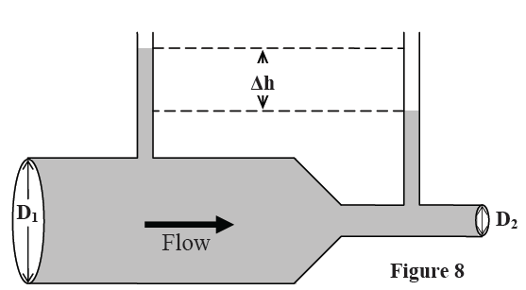
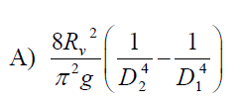
T-81-Ch15
Q26.
A Venturi meter is installed in a water main line, as shown in Figure 8. The pipe has a circular cross-section, with diameter D₁ in the first segment and D₂ in the second segment, with D₂ < D₁. The density of water is ρ. The volume flow rate of the water in the pipe is R_{v} (measured in m³/s). What is the difference in the water level Δh in the two tubes?
Q27.
Consider a fresh-water ice cube floating in a glass of fresh water. When the ice cube melts, which of the following statements is TRUE?
A) The water level remains the same because the ice cube displaces a mass of water equal to its own mass.
B) The water level rises because ice is less dense than water.
C) The water level falls because ice is less dense than water.
D) The water level rises because the ice cube displaces a mass of water equal to its own mass.
E) The water level falls because the ice cube displaces a mass of water equal to its own mass.

Slide 47
T81-Q26.
A Venturi meter is installed in a water main line, as shown in Figure 8. The pipe has a circular cross-section, with diameter D₁ in the first segment and D₂ in the second segment, with D₂ < D₁. The density of water is ρ. The volume flow rate of the water in the pipe is R_{v} (measured in m³/s). What is the difference in the water level Δh in the two tubes?
T52-Q#25: A water line enters a house 2.0 m below ground. A smaller diameter pipe carries water to a faucet 5.0 m above ground, on the second floor. Water flows at 2.0 m/s in the main line and at 7.0 m/s on the second floor. If the pressure in the main line is 3.0 x 10⁵ Pa, then the pressure on the second floor is: (Take the density of water to be 1.0 x 10³ kg/m³) (Ans: 2.1 x 10⁵ P)

Slide 48
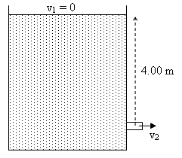
T-72-Ch14
Q23.: Water is pumped out of a swimming pool at a speed of 5.0 m/s through a uniform hose of radius 1.0 cm. Find the mass of water pumped out of the pool in one minute. (Density of water = 1000 kg/m³).(Ans: 94 kg)
Q24. A large tank open to atmosphere is filled with water. Fig 6 shows this tank with a stream of water flowing through a hole (open to atmosphere) at a depth of 4.00 m. The speed of water, v₂, leaving the hole is: ( Ans: 8.85 m/s)
Q25.A 10 kg spherical object with a volume of 0.10 m³ is held in static equilibrium under water by a cable fixed to the bottom of a water tank. What is the tension T in the cable? (See Fig. 7) (Ans: 880 N)
Fig-6
Fig-7

Slide 49
T-71-Ch14
Q8.The pressure of a gas in a tank is measured with a mercury manometer (Fig. 5). The mercury is 36.2 cm higher in the outside arm than in the arm connected to the gas cell. Find the gauge pressure of the gas cell. (Density of mercury is 13.6 g/cm3) (Ans: 4.82 × 10⁴ Pa)
Q9.: A cube of wood of side = 10 cm has a density of 700 kg/m3. As shown in Fig. 6, the cube is held in equilibrium under water by a string tied to the BOTTOM of a container. Find the tension in the string. (Ans: 2.94 N)
Q10. A garden hose has an inner diameter of 16 mm. The hose can fill a 10 liter bucket in 20 s. Find the speed of the water at the end of the hose (1 Liter = 10-3 m3).(Ans: 2.5 m/s)
Q11.Water flows through a pipe as shown in Fig. 7. At the lower elevation, the water’s speed (v_{A}) is 5.0 m/s and the gauge pressure (P_{A}) is 7.5 × 104 Pa. Find the gauge pressure at the higher elevation (P_{B}). (Diameter at A = 6.0 cm, diameter at B = 4.0 cm and the elevation of B relative to A is 2.0 m) (Ans: 4.60 kPa)
Fig-5
Fig-7
Fig-6

Slide 50
T-62-Ch14
Q7. Fig. 4 shows an ideal fluid flow in a horizontal tube. The pressure, velocity, and cross sectional area of fluid at point 1 and 2 are (P₁, v₁, A₁) and (P₂, v₂, A₂) respectively with A₁>A₂. Which one of the following statements is correct? A) v₁ < v₂ & P₁> P₂
Q8. A wooden box has been found to floats in three different fluids of densities: ρ₁ (fluid 1) = 0.9 g/cm³, ρ₂ (fluid 2) = 1.0 g/cm³, ρ₃ (fluid 3) = 1.1 g/cm³. Which one of the following statements is true? (A) the three fluids exert the same buoyant force
Q9.A U-tube of constant cross sectional area, open to the atmosphere, is partially filled with Hg (ρ_{Hg}=13.6 g/cm³). Water (ρ_{w}=1.00 g/cm³) is then poured into both arms. If the equilibrium configuration of the tube is as shown in the Fig. 5 with h₃= 1.00 cm, determine the value of h₁. (Note that h₁, h₂ and h₃ are not drawn to scale). A) 12.6 cm
Q10. The open end of a cylindrical pipe has a radius of 1.5 cm. Water (density = 1.0×10³ kg/m³) flows steadily out of this end at a speed of 7.0 m/s. The rate at which mass is leaving the pipe is: A) 4.9 kg/s
Fig-4
Fig-5

Slide 51
T-61-Ch14
Q23. The open vertical tube in Fig. 13 contains two liquids of densities ρ₁ = 1000 kg/m³ and ρ₂ = 800 kg/m³, which do not mix. Find the gauge pressure (pressure due to the liquids only) at the bottom of the tube. (A: 9000 Pa )
Q24. An Aluminum block of density 2.70 g/cm³ has a weight W in air and has a weight W_{app} in water when completely submerged. If (W- W_{app}) is equal to 196 N, the volume of the block is: A) 0.020 m³
Q25. Water is pumped through a hose of uniform cross-section as shown in Fig. 14, from the lower level (1) to the upper level (2). Which of the following expresses the correct relationship between velocity and pressure at the two levels? A) v₁ = v₂ and p₂ < p₁
Q26. Water flows through a horizontal tube from point 1 (cross sectional area A₁) to point 2 (cross sectional area A₂), as shown in Fig. 15. If A₁ = 2A₂ and v₁ = 10 m/s, the change in the kinetic energy (ΔK) of 1.0 m³ of water in moving from point 1 to point 2 is: A) 1.5 x 10⁵ J )
Fig-13
Fig-14
Fig-15

Slide 52
T-52-Ch14
Q#23: A uniform U-tube is partially filled with water. Oil, of density 0.75 g/cm³, is poured into the right arm until the water level in the left arm rises 3.0 cm (see Fig 8). The length of the oil column (h) is then: (Ans: 4.0 cm)
Q#24: The dimensions of a boat (ρ_{boat}= 150 kg/m³) is 3.00 m x 3.00 m x 1.00 m. What maximum load can it carry in sea water (ρ_{sea water}= 1020 kg/m³) without sinking? (Ans: 7830 kg)
Q#25: A water line enters a house 2.0 m below ground. A smaller diameter pipe carries water to a faucet 5.0 m above ground, on the second floor. Water flows at 2.0 m/s in the main line and at 7.0 m/s on the second floor. If the pressure in the main line is 3.0 x 10⁵ Pa, then the pressure on the second floor is: (Take the density of water to be 1.0 x 10³ kg/m³) (Ans: 2.1 x 10⁵ P)
Q#26: The rate of flow of water through a horizontal pipe is 2.00 m³/min. Calculate the speed of flow at a point where the diameter of the pipe is 10.0 cm. (Ans: 4.24 m/s).

Slide 53
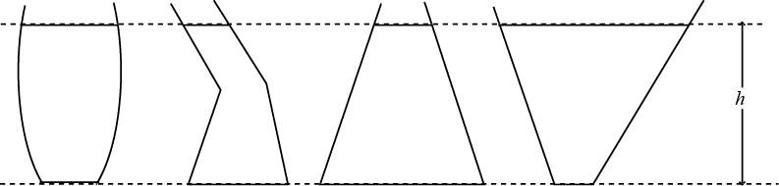
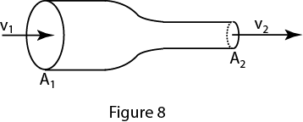
T-51-Ch14
Q#23: Several cans of different sizes and shapes are all filled with the same liquid to the same height h (See Fig. 6). Then: (Ans: the pressure on the bottom of each can is the same)
Q#24: Fig. 7 shows a U-tube with cross-sectional area A and partially filled with oil of density ρ. A solid cylinder, which fits the tube tightly but can slide without friction, is placed in the right arm. The system is in equilibrium. The weight of the cylinder is: (Ans: ALρg)
Q#25: An object hangs from a spring balance The balance indicates 30N in air and 20N when the object is submerged in water. What does the balance indicate when the object is submersed in a liquid with a density that is half that of water? (Ans:25N)
Q#26: An incompressible liquid flows along the pipe as shown in Fig. 8 with A₁=2A₂. The ratio of the mass flow rate R₂/R₁ is: (show v₁ and v₂ in fig) (Ans: 1)
Fig-6

Slide 54
T-42-Ch14
Q8 A water hose of 1.00 cm radius is used to fill a container of volume 20.0*10**3 cm**3. It takes 60 s to fill the container. What is the speed at which the water leaves the hose? (Ans: 106 cm/s)
Q9 Water enters a house through a pipe with a velocity of 4.0 m/s at a pressure of 4*10**5 Pa. The water in a narrower pipe at the second floor bathroom 5.0 m above has a velocity of 16 m/s.What is the pressure of water in the bathroom? (Density of water = 1.0*10**3 kg/m**3) (Ans 2.3*10**5 Pa)
Q10 A block of metal has mass of 0.50 kg and density of 8.0*10**3 kg/m**3. It is suspended from a string and completely submerged in water. Find the tension in the string. (Density of water = 1.0*10**3 kg/m**3) (Ans: 4.3 N)
Q11 A piston of radius R1= 5.0 cm is used in a hydraulic press to exert a force F1 on the enclosed liquid to raise a car of weight F2=13,500 N (see Fig 4). If the radius of the larger piston is R2 = 15 cm, Find F1. (Ans: 1.5*10**3 N)

Slide 55
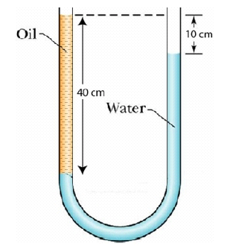
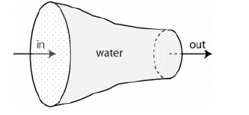
T-41-Ch14
Q8 A solid sphere of mass 5.0 kg is floating in water with half of its volume submerged. The density of water is 1000 kg/m**3. The buoyant force on the sphere is (Ans: 49 N)
Q9 Fig 5 shows a very large, closed, oil tank with a hole at a height of 1.0 m from the bottom of the tank. The oil vapor pressure in the tank is maintained at 1.5*10**5 Pa. Find the speed at which oil leaves the hole, when the oil level is 20 m from the bottom of the tank. The density of oil is 850 kg/m**3. (Ans: 22 m/s )
Q10 A U-tube of uniform cross-section, open at both ends, is filled with water (density 1000 kg/m**3) and oil as shown in Fig 2. Water and oil do not mix. Find the density of oil. (Ans: 750 kg/m**3)
Q11 Water flows through a horizontal pipe. The diameter of the pipe is reduced gradually as shown in Fig 3. Assume water is an ideal fluid. Which of the following statements is true? (Ans: The water flow rate is constant everywhere.)
Fig-2
Fig-3

