Slide 1
Chapter 6
Friction Circular motion

Slide 2
Lecture 1

Slide 3
Friction Force(f)
Friction:
The force that always opposes the applied force
The force that always opposes the motion.
The force which appears when two surfaces are in contact
F_{N}
Friction force
Applied force
F
f
mg
If we zoom into a surface the smooth looking surface can also be found rough
F
F_{N}
Roughness of the surface is the cause of friction
f
The roughness is measured by a constant: μ
μ = 0 for ideally smooth surface
μ = 1 for ideally rough surface
0 < μ < 1 for real surfaces
mg
μ = coefficient of friction

Slide 4
Friction Force(f)
Static Friction (f_{s}): Friction while body is not moving
Dynamic Friction (f_{k}): Friction during the motion
F_{N}
F_{N}
F
f_{s}
F_{N}
3F
f_{k}
mg
mg
f_{s} =0, because F = 0
f_{s} =F
F_{N}
F_{N}
mg
When the applied force is equal to the friction force: body is moving with constant velocity
2F
f_{s}
3F
f_{s}
F_{N}
mg
mg
f_{s} =2F
f_{s} =3F, maximum static, just before move
5F
f_{k}
mg
And if the applied force is higher than friction force body is accelerating
Coefficient of static friction
Coefficient of Dynamic friction

Slide 5
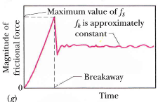
F_{s} > F_{k}
Because of the property of inertia the static friction is always greater than the dynamic friction.

Slide 6
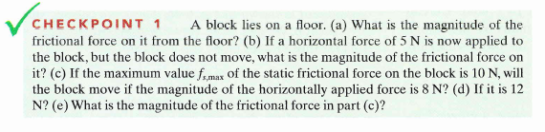
Checkpoint 1
Answers:
zero (no force applied)
5 N
No
Yes
8N

Slide 7
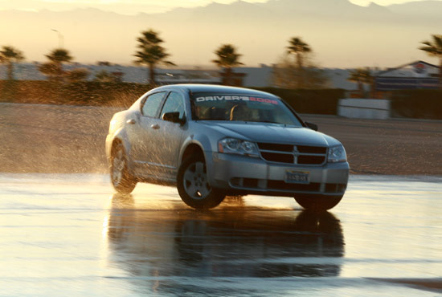
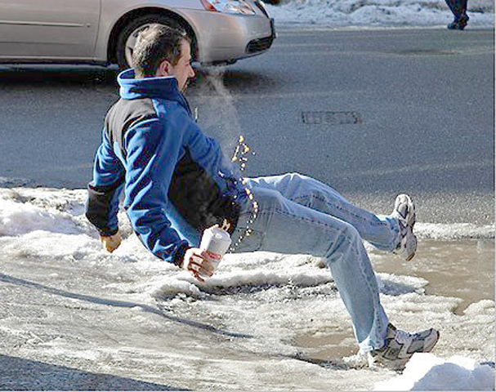
Sliding/slipping
While walking or running which friction do car/you have?
kinetic
Which friction stops car/you from sliding or slipping?
static

Slide 8
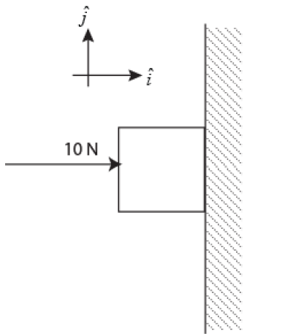
Examples
T101-Q18. As shown in Figure 7, a block weighing 5.0 N is held at rest against a vertical wall by a horizontal force of magnitude 10 N. The coefficient of static friction between the wall and the block is 0.60, and the coefficient of kinetic friction is 0.40. In unit vector notation, find the force on the block from the wall.
A) −10 i+ 5.0 j
T101-Q19. A 20.0 kg block is initially at rest on a rough, horizontal surface. A horizontal force of 75.0 N is required to set the block in motion. After it is in motion, a horizontal force of 60.0 N is required to keep the block moving with constant speed. Find the coefficients of static and kinetic friction.
A) 0.383; 0.306
T102-Q18. A box rests on the flatbed of a truck that is initially traveling at 15 m/s on a level road. The driver applies the brakes and the truck is brought to a stop in a distance of 38 m. If the deceleration of the truck is constant, what is the minimum coefficient of static friction between the box and the flatbed of the truck that is required to keep the box from sliding?
A) 0.30

Slide 9
Example 1: Block moving on real surface
F_{N}
F_{N}
f
T
f
T
Real surface
mg
mg
Free Body Diagram
X-Direction
Y-Direction

Slide 10
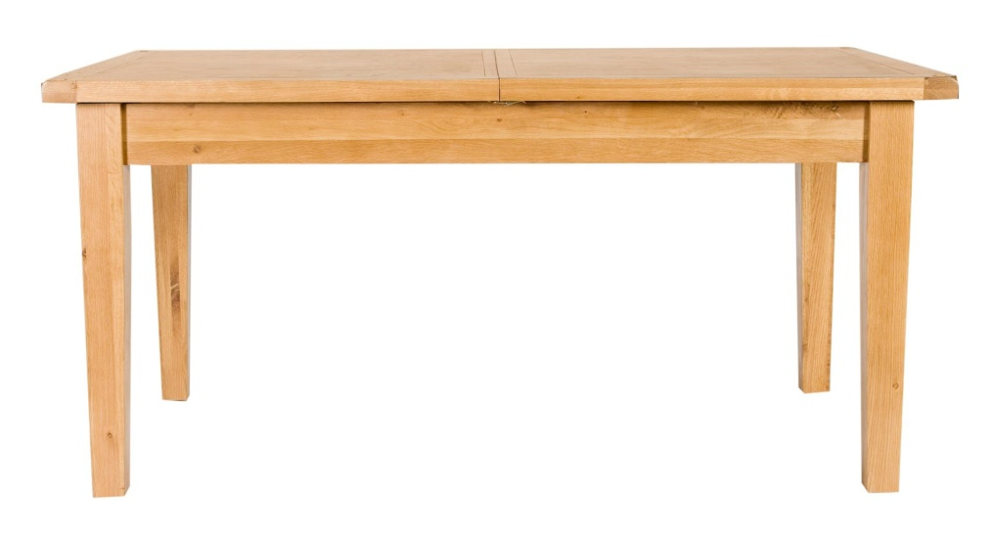
Example2:
F₁
Force F₁ acts on a block at an angle θ to slide it on a table with an acceleration “a”
θ
f
F_{N}
Real Table
F₁
θ
f
Write Separate Equations for i and j
Free Body Diagram
mg
x-Direction (i)
Y-Direction (j)

Slide 11
Example3:
Force F₁ acts on a block at an angle θ to slide it on a table with an acceleration “a”
F₁
θ
f
Free Body Diagram
F_{N}
Real Table
f
F₁ cos(θ)
θ
F₁ sin(θ)
F₁
Write Separate Equations for i and j
mg
x-Direction (i)
Y-Direction (j)

Slide 12

Example 4: Rough surface: Force Equation
Moving Down
Moving Up
Rope
F_{N}
f
F_{N}
T
f
mgsin(θ)
mgsin(θ)
mgcos(θ)
mg
θ
mg
θ
θ
mgcos(θ)

Slide 13
Example 7: Rough incline plane - acceleration
N
T
(a) Body A is moving up and body B moving down
T
A
B
f
mg Sin(Θ)
mg Cos(Θ)
Θ
Θ
m_{B}g
(a) Body A is moving down and body B moving up
m_{A}g
Massless and frictionless pulley

Slide 14
Example6: Incline Plane- No acceleration
F_{N}
f
constant velocity
mgsin(θ)
mgcos(θ)
mg
θ
θ
Divide equation (2) by (1)
The friction is angle dependent
Q17.: A 5.0 kg block is moving with constant velocity down a rough incline plane. The coefficients of static and kinetic friction between the block and the incline are 0.25 and 0.20, respectively. What is the inclination angle of the incline plane? (Ans: 11°)

Slide 15
Example 8: Real table with ideal pulley
F_{AN}
F_{AN}
T_{A}
f
T_{A}
f
A
T_{B}
F_{Ag}
F_{Ag}
T_{B}
Since the rope is same:
F_{Bg}
B
Both bodies are moving together
F_{Bg}

Slide 16
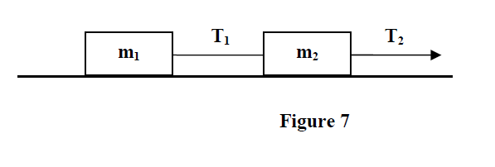
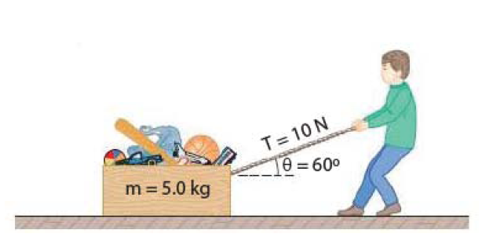
Examples
T91-Q17. Figure 7 shows two connected blocks that are pulled to the right on a rough table by a force T₂ = 120 N. If m₁ = 10.0 kg, m₂ = 20.0 kg , and μ_{k} = 0.2, calculate the tensions T₁
T102-Q19. As shown in Figure 6, a boy pulls a box of total mass m = 5.0 kg with a rope that makes an angle of 60° with the horizontal. The boy pulls on the rope with a force of 10 N; and the box moves with constant velocity. What is the coefficient of kinetic friction between the box and the surface? A) 0.12
Why do you feel easier to pull travel bag than to push?

Slide 17
T102-Q19.
Two boxes, one of mass m = 5.00 kg and the other with an unknown mass M are connected with a string passing over a massless frictionless pulley and are placed on frictionless planes as shown in Fig. 5.What must be the mass M, if it goes down the plane with an acceleration of a = 2.45 m/s²? (Ans: 19.1 kg )
Chapter 5
T102-Q19.
Two boxes, one of mass m = 5.00 kg and the other with an unknown mass M are connected with a string passing over a massless frictionless pulley and are placed on planes with coefficients of friction 0.1 and 0.2 respectively as shown in Fig. 5. What must be the mass M, if it goes down the plane with an acceleration of a = 2.45 m/s²? (Ans: )
Chapter 6

Slide 18
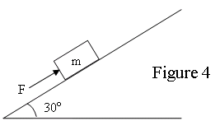
T81-Q20: A block of mass m = 10 kg is pushed up a rough 30º inclined plane by a force F parallel to the incline as shown in Figure 4. The coefficient of kinetic friction between the block and the plane is 0.4. Find the magnitude of the force F when the block is moving up at constant velocity. (Ans: 83 N)
Twisted: A block of mass m = 10 kg is pushed up a rough 30º inclined plane by a force F parallel to the incline as shown in Figure 4. The coefficient of kinetic friction between the block and the plane is 0.4. Find the magnitude of the force F when the block is moving up with constant acceleration ±1.0 m/s²

Slide 19
Circular motion

Slide 20
Circular Motion
The acceleration of the particle in a circular path is always towards the center of the circle.
0
The Force will also be towards the centre.
Hence it is called a centripetal force
Centripetal force is not an original force: It should be caused by some original forces

Slide 21
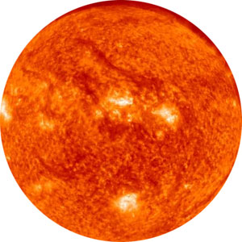

Centripetal Force on the Earth is caused by Gravity
Centripetal force not an original force. It is always generated by some other forces.
Centripetal force on Earth is caused by Gravitational Force

Slide 22
Example 1:Tension on String- Circular motion in horizontal plane
The centripetal force is caused by the tension
At every Point in the Circle
0

Slide 23
Example 2:Tension on String- Circular Motion in vertical plane
In vertical plane the centripetal force is caused by the tension and gravitational force
At the top
At the bottom
0
T
F_{c}
F_{c}
At the central line

Slide 24
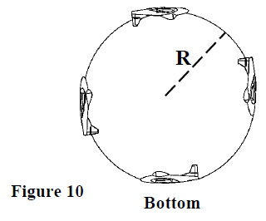
T102-Q20. A 0.250-kg ball attached to a string is rotating in a vertical circle of radius 0.500 m. Find the magnitude of the tension in the string at the bottom of the circle where its speed is 4.00 m/s.
A) 10.4 N
T92-Q20. A pilot of mass 75.0 kg in a jet aircraft executes a loop-the-loop, as shown in Figure 10. In this maneuver, the aircraft moves in a vertical circle of radius R = 3.00 km at a constant speed of 250 m/s. Determine the magnitude of the force exerted by the seat on the pilot at the bottom of the loop. A) 2.30 ×10³ N
Q19. A 0.10 kg stone is tied to the end of a 1.0-m long rope. The stone is moved in a circle in the vertical plane. What is the tension in the rope when the stone is at its lowest position and has a speed of 5.0 m/s?
A) 3.5 N

Slide 25

Checkpoint 2
F_{N}
F_{C}
F_{C}
F_{N}
Answers:
a downwards F_{N} upwards
Both upwards

Slide 26
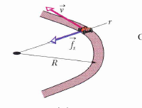
Example 3: Centripetal force and friction-Driving in Circular Road
C
T101-Q18. A car rounds a flat curved road (radius = 92 m) at a speed of 26 m/s and is on the verge of sliding at this speed. What is the coefficient of static friction between the tires of the car and the road?
(Ans: 0.75)

Slide 27
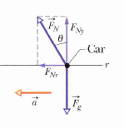
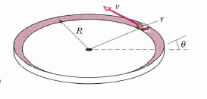
Example 4: No Friction- Driving in inclined Circular Road
C
Dividing equation (1) by equation (2)
Q19.At what angle should the circular roadway of 50 m radius, be banked to allow cars to round the curve without slipping at 12 m/s? (Ignore friction)(Ans: 16°)

Slide 28
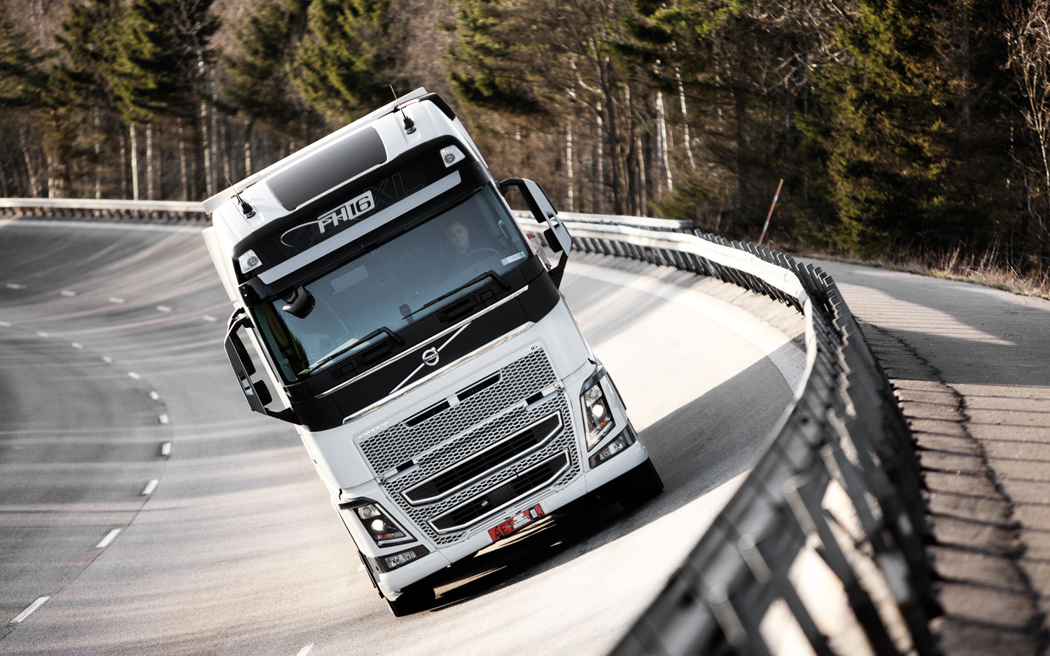
Most of the circular roads are banked those who are not banked need ?????

Slide 29
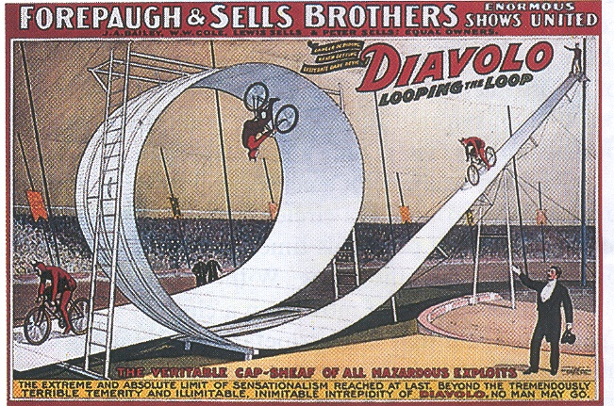
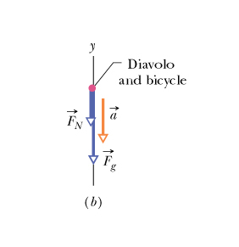
Example 5: Circus Cyclist-Minimum Velocity at the top
At the top
For minimum velocity (v_{min}) at the top: F_{N} = 0
y
C

Slide 30
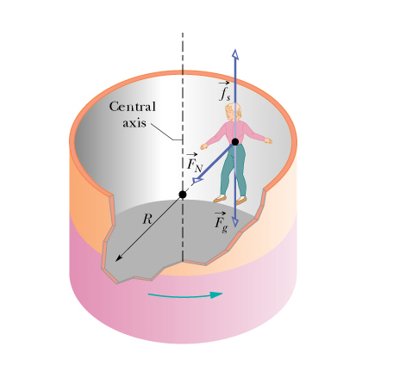
Example 6: The principle of artificial gravity
Q: What is the minimum speed of the cylinder of radius 2.1m for the woman not to fall. Provided the coefficient of static friction between her shirt and the cylinder is 0.4? Ans:7.2 m/s
y
x
C
f_{s}
F_{c}
C
F_{N}
F_{g}

Slide 31
Problems

Slide 32
T-91-Ch6
Q# A car is rounding a flat curve of radius R=220 m with speed v= 94 km/h. What is the magnitude of the force exerted by the seat on the passenger whose mass m is 85 kg.
( Ans: 263 N)
Horizontal Force
To get the right answer you have to apply the following formula. But the question has inappropriate language. They should have asked for horizontal force.

Slide 33
T-102-Ch6
Q18. A box rests on the flatbed of a truck that is initially traveling at 15 m/s on a level road. The driver applies the brakes and the truck is brought to a stop in a distance of 38 m. If the deceleration of the truck is constant, what is the minimum coefficient of static friction between the box and the flatbed of the truck that is required to keep the box from sliding?
A) 0.30
Q19. As shown in Figure 6, a boy pulls a box of total mass m = 5.0 kg with a rope that makes an angle of 60° with the horizontal. The boy pulls on the rope with a force of 10 N; and the box moves with constant velocity. What is the coefficient of kinetic friction between the box and the surface? A) 0.12
Q20. A 0.250-kg ball attached to a string is rotating in a vertical circle of radius 0.500 m. Find the magnitude of the tension in the string at the bottom of the circle where its speed is 4.00 m/s.
A) 10.4 N

Slide 34
T-101-Ch6
Q18. As shown in Figure 7, a block weighing 5.0 N is held at rest against a vertical wall by a horizontal force of magnitude 10 N. The coefficient of static friction between the wall and the block is 0.60, and the coefficient of kinetic friction is 0.40. In unit vector notation, find the force on the block from the wall.
A) −10 i+ 5.0 j
Q19. A 20.0 kg block is initially at rest on a rough, horizontal surface. A horizontal force of 75.0 N is required to set the block in motion. After it is in motion, a horizontal force of 60.0 N is required to keep the block moving with constant speed. Find the coefficients of static and kinetic friction.
A) 0.383; 0.306
Q20. A car rounds a flat curved road (radius = 100 m) at a speed of 25.0 m/s and is about to slide at this speed. What is the coefficient of static friction between the tires of the car and the road?
A) 0.638

Slide 35
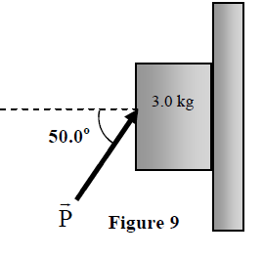
T-92-Ch6
Q16. The coefficient of kinetic friction:
A) is a dimensionless quantity
B) is greater than the coefficient of static friction
C) is the ratio of force to area
D) can have units of Newtons
E) is in the direction of the frictional force
Q19. A block of mass 3.0 kg is pushed against a rough wall (coefficient of kinetic friction is 0.20) by a force P = 30 N that makes an angle of 50° with the horizontal as shown in Figure 9. Assuming the block is sliding down, find the magnitude of its acceleration. A) 0.85 m/s2
Q20. A pilot of mass 75.0 kg in a jet aircraft executes a loop-the-loop, as shown in Figure 10. In this maneuver, the aircraft moves in a vertical circle of radius R = 3.00 km at a constant speed of 250 m/s. Determine the magnitude of the force exerted by the seat on the pilot at the bottom of the loop. A) 2.30 ×103 N

Slide 36
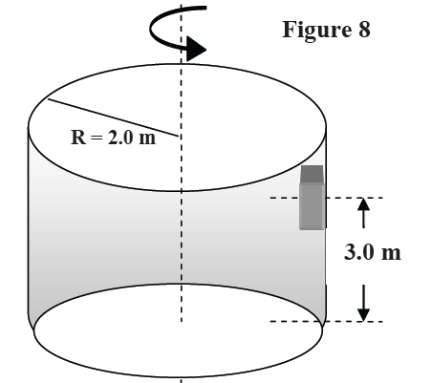
T-91-Ch6
Q17. Figure 7 shows two connected blocks that are pulled to the right on a rough table by a force T₂ = 120 N. If m₁ = 10.0 kg, m₂ = 20.0 kg , and μ_{k} = 0.2, calculate the tensions T₁
Q18. A block is 3.0 m up above the ground and is in contact with the inner side of a rotating cylinder of 2.0 m radius as shown in Figure 8. If the coefficient of static friction between the block and the cylinder is 0.50, what is the minimum speed the cylinder must have in order for the block not to fall down? A) 6.3m/s
Q19. A 0.10 kg stone is tied to the end of a 1.0-m long rope. The stone is moved in a circle in the vertical plane. What is the tension in the rope when the stone is at its lowest position and has a speed of 5.0 m/s?
A) 3.5 N

Slide 37
T-82-Ch6
Q#18: A 5 kg block is placed on top of a 10 kg block which is lying on a frictionless horizontal surface, as shown in Fig. 4. A horizontal force F of 60 N is applied to the 10 kg block. Find the static frictional force on 5 kg block from the 10 kg block such that the 5 kg block does not slip. A) 20 N to the right
Q19. A crate is sliding down an incline that is 35º above the horizontal. If the coefficient of kinetic friction is 0.4 the acceleration of the crate is: A) 2.4 m/s2
Q20. An automobile moves on a level horizontal road in a circle of radius 30 m. The coefficient of static friction between tires and road is 0.5 . The maximum speed with which this car can travel round this curve without sliding is: A) 12 m/s

Slide 38
T-81-Ch6
18. A block slides down an incline plane at constant velocity. Which of the following statements are true?
A frictional force must be acting on it
The net downward force along the plane is acting on it
A net upward force is acting on it
Its acceleration is increasing
Its acceleration is decreasing
Q19.: A 1.0 kg block, attached to the end of a string of length 2.0 m, swings in a vertical circle. When the block is at its highest point, its speed is 5.0 m/s. What is the magnitude of the tension in the string at that point? A) 2.7 N
Q20: A block of mass m = 10 kg is pushed up a rough 30º inclined plane by a force F parallel to the incline as shown in Figure 4. The coefficient of kinetic friction between the block and the plane is 0.4. Find the magnitude of the force F when the block is moving up at constant velocity. (Ans: 83 N)

Slide 39
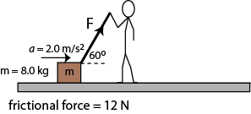
T-72-Ch6
Q18.In Fig. 4, a boy is dragging a box (mass =8.0 kg) attached to a string. The box is moving horizontally with an acceleration a = 2.0 m/s². If the frictional force is 12 N, calculate the applied force F at an angle θ=60° (Ans: 56 N)
Q19.At what angle should the circular roadway of 50 m radius, be banked to allow cars to round the curve without slipping at 12 m/s? (Ignore friction)(Ans: 16°)
Q20. A 1000 kg airplane moves in straight horizontal flight at constant speed. The force of air resistance is 1800 N. The net force on the plane is: (Ans: zero)

Slide 40
T-71-Ch6
Q17.: A 5.0 kg block is moving with constant velocity down a rough incline plane. The coefficients of static and kinetic friction between the block and the incline are 0.25 and 0.20, respectively. What is the inclination angle of the incline plane? (Ans: 11°)
Q18. A car rounds a flat curved road (radius = 92 m) at a speed of 26 m/s and is on the verge of sliding at this speed. What is the coefficient of static friction between the tires of the car and the road? (Ans: 0.75)
Q19.: A box of mass 40.0 kg is pushed across a rough flat floor at the constant speed of 1.50 m/s. When the force is removed, the box slides a further distance of 1.20 m before coming to rest. Calculate the friction force acting on the box when it slides.(Ans: 37.5 N)
Q20.A 10.0 kg box is pushed up an incline (θ= 30.0°) by a horizontal force of 298 N. The box then moves at a constant velocity as shown in Fig. 7. What is the frictional force on the box? ( Ans: 209 N)

Slide 41
T-71-Ch6
Q17.: A 5.0 kg block is moving with constant velocity down a rough incline plane. The coefficients of static and kinetic friction between the block and the incline are 0.25 and 0.20, respectively. What is the inclination angle of the incline plane? (Ans: 11°)
Q18. A car rounds a flat curved road (radius = 92 m) at a speed of 26 m/s and is on the verge of sliding at this speed. What is the coefficient of static friction between the tires of the car and the road? (Ans: 0.75)
Q19.: A box of mass 40.0 kg is pushed across a rough flat floor at the constant speed of 1.50 m/s. When the force is removed, the box slides a further distance of 1.20 m before coming to rest. Calculate the friction force acting on the box when it slides.(Ans: 37.5 N)
Q20.A 10.0 kg box is pushed up an incline (θ= 30.0°) by a horizontal force of 298 N. The box then moves at a constant velocity as shown in Fig. 7. What is the frictional force on the box? ( Ans: 209 N)

Slide 42
T-71-Ch6
Q17.: A 5.0 kg block is moving with constant velocity down a rough incline plane. The coefficients of static and kinetic friction between the block and the incline are 0.25 and 0.20, respectively. What is the inclination angle of the incline plane? (Ans: 11°)
Q18. A car rounds a flat curved road (radius = 92 m) at a speed of 26 m/s and is on the verge of sliding at this speed. What is the coefficient of static friction between the tires of the car and the road? (Ans: 0.75)
Q19.: A box of mass 40.0 kg is pushed across a rough flat floor at the constant speed of 1.50 m/s. When the force is removed, the box slides a further distance of 1.20 m before coming to rest. Calculate the friction force acting on the box when it slides.(Ans: 37.5 N)
Q20.A 10.0 kg box is pushed up an incline (θ= 30.0°) by a horizontal force of 298 N. The box then moves at a constant velocity as shown in Fig. 7. What is the frictional force on the box? ( Ans: 209 N)

Slide 43
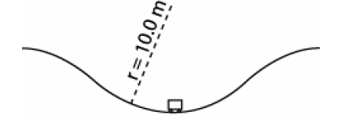
T-62-Ch6
Q14.
A 500 kg car moves in a vertical roller coaster of radius 10.0 m at a constant speed of 18.0 m/s (see Fig. 2). The magnitude of the force exerted by the track on the car at the bottom of the circle is:
A) 2.11 x 10⁴ N
Q16.
A car takes a round turn on a flat circular track at a speed of 8.00 m/s. The coefficient of static friction between its tires and the track is 0.300. If the car is at the verge of slipping out of the track at this speed, the radius of the track is:
A) 21.8 m
Q17.
A box of mass M is placed on a 30° inclined plane. The box is sliding with an acceleration equals g/2 (g is the free fall acceleration). What is the magnitude of the force of friction between the box and the plane?
A) zero

Slide 44
T-61-Ch6
Q17. A box with a weight of 50 N rests on a horizontal surface with μ_{s}= 0.40. A person pulls horizontally on it with a force of F₂=10 N and it does not move. To start it moving, a second person pulls vertically upward on the box with a force F₁ (see Fig 6). What is the smallest vertical force (F₁) for which the box starts moving? (Ans: 25 N )
Q18. : An 8.0 kg block is pushed against a vertical wall by a horizontal force F as shown in Fig 7. If the coefficients of friction between the block and the wall are μ_{s} = 0.60 and μ_{k} = 0.30 then the minimum value for (F) that will prevent the block from slipping is: (Ans: 130 N)
Q#19: A 2.0 kg block is released from rest the top of a ramp (point A) as shown in Fig 8. The coefficient of kinetic friction between the block and the inclined surface is 0.20. The speed by which the block hits the bottom (point B) is: (Ans: 6.6 m/s)
Q20. A 1000 kg car moves on a level horizontal circular road of radius 50 m. The coefficient of static friction between the tires and the road is 0.50. The maximum speed with which this car can round this curve without slipping is: (Ans: 16 m/s )

Slide 45
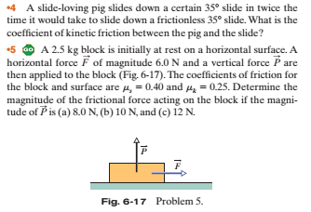

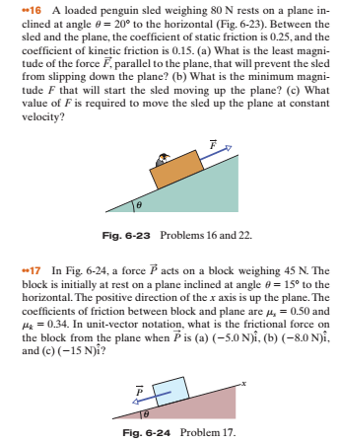
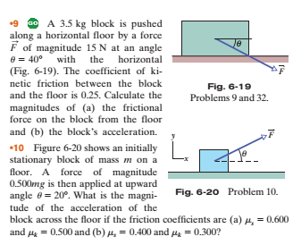

Slide 46
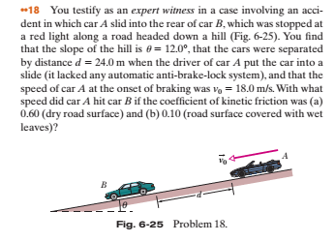
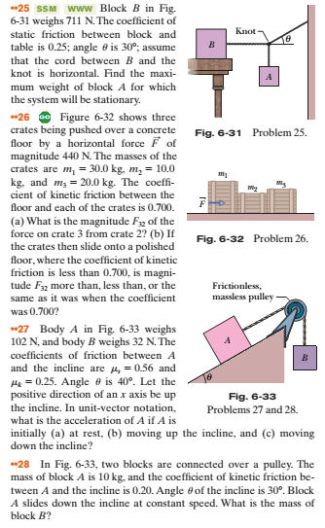
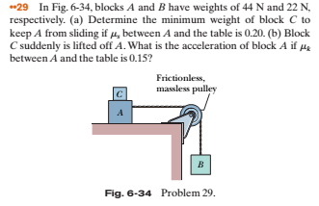

Slide 47

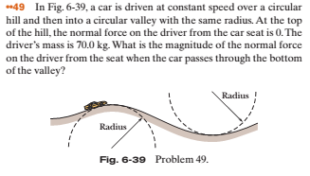
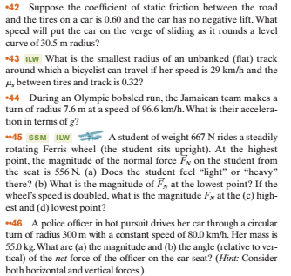
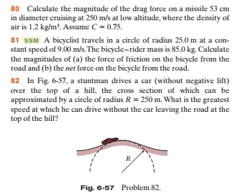

Slide 48
