Slide 1
Chapter 4
Motion in 2 and 3 dimension
Projectile,
Circular motion
Relative velocity

Slide 2
Lecture 1

Slide 3

Position Vector
Position is always measured from the origin
Position Vector can be resolved into x- and y- components
Position Vector
0
For Three dimension:
Position vector can be written as:

Slide 4
Average Velocity
Vector Addition
Change is position
∆r can be resolved into three components
0
Velocity
acceleration

Slide 5
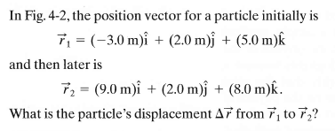
Solved Problem 4.1: Page 60
(a) Find the velocity if the position is changed in t = 3s
(b) Find the magnitude of velocity
(d) Find the direction of velocity

Slide 6
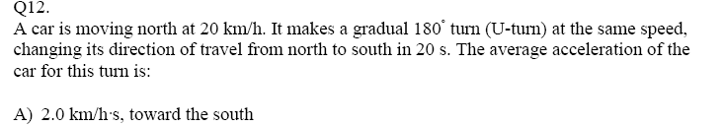
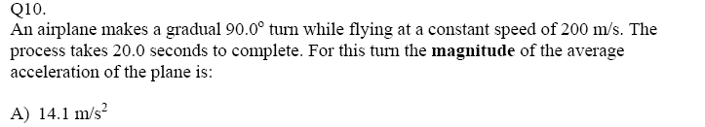

Slide 7
Instantaneous Velocity
Vector Addition
Change in position is very small
∆r can be resolved into three components
0
Velocity
acceleration

Slide 8
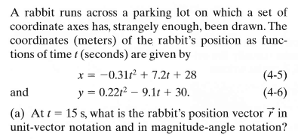

Instantaneous: Solved Problem 4.2: Page 60
(b) Find the velocity of the rabbit
(c) Find the acceleration of the rabbit
(d) Find the magnitude and direction of: r, v and a

Slide 9
Average: sample problem
(a) Find the average displacement from t = 1s to t =15s
(c) Find the average velocity from t =1s to t = 15 s
(d) Find the average acceleration from t =1s to t = 15 s

Slide 10
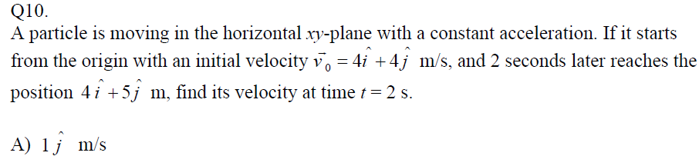
2D-Problems: Solve two directions separately (never mix apple and oranges)
T-102
T-101

Slide 11
Velocity Direction
Any position can be resolved into two or three direction
v
v
v
v
0
v
v
Velocity direction is always tangent to the path (trajectory).
v

Slide 12
Circular Motion
1. The magnitude of velocity (speed) of a particle in a circular motion is always constant (v)
2. The direction of the velocity is given by a tangent on the path
2r
3. The acceleration of the particle in a circular path is always towards the center of the circle.
0
4. Time Period (T): Total time taken to complete the circle

Slide 13
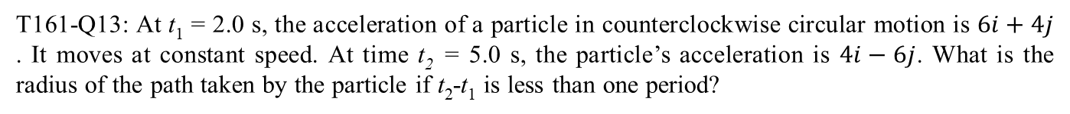
T161-Q13: At t₁ = 2.0 s, the acceleration of a particle in counterclockwise circular motion is $6i+4j$ . It moves at constant speed. At time t₂ = 5.0 s, the particle’s acceleration is $4i−6j$. What is the radius of the path taken by the particle if t₂-t₁ is less than one period?
(x, y)
Acceleration is always along the radial victor but in opposite direction.
a_{x}
a_{Y}
0
You can calculate angle made by acceleration with x or y-axis.

Slide 14
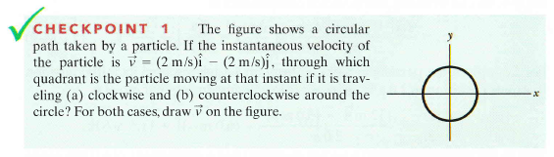
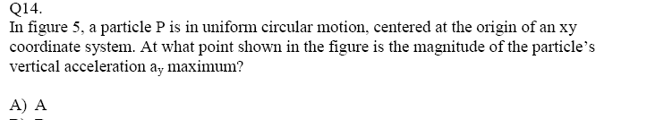
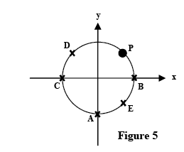
Checkpoint-1
I Quadrant
III Quadrant

Slide 15
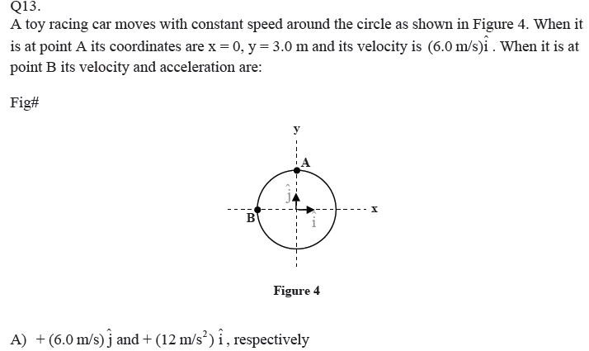

Slide 16
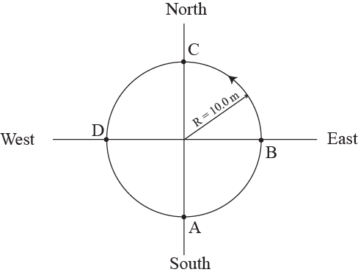
New Slide
T211-Q6.
An object is in a uniform circular motion in a horizontal circle of radius 10.0 m. If it completes 2.50 rotations in 10.0 s, starting at point A (Figure 2),
find its average velocity
find average speed
find acceleration
Solution:
a) Velocity cares only about initial and final positions. If the object starts from A, in 2.5 rotation it will be at C. So the displacement between A and C is “2R”
Towards North because net displacement has direction from south (A) to north (C)
b) Speed is total distance traveled by the object by total time. In each rotation it will cover 2πR distance.
c) Acceleration will always be towards the center -> south
Here “v” is the speed not the velocity

Slide 17
Lecture 2

Slide 18
Projectile
v_{x} i
T = time of flight
X = Horizontal range
H = Maximum Height
v_{y} j
v_{y} = 0
v_{x} i
v_{x} i
v_{y}(- j)
H
v_{y}=v ₀ SinΘ j
v₀
Θ
T/2
T/2
v_{x} i
v_{x} = v₀ CosΘ i
X
v_{y}(- j)
The horizontal velocity is always constant: v_{x} = v₀ CosΘ i Which means no acceleration in horizontal direction
2. The vertical velocity changes. It is zero at maximum height
3. Only common quantity between x and y motion is the TIME

Slide 19
Projectile
v_{y} = 0
v_{x} i
T = time of flight
R = Horizontal range
H = Maximum Height
v_{y} j
Horizontal Motion
v_{x} i
v_{x} i
v_{y}(- j)
v₀
H
v_{y}=v ₀ SinΘ j
Θ
T/2
T/2
v_{x} i
v_{x} = v₀ CosΘ i
v_{y}(- j)
R
X- motion
Y- motion
Time “t” is common between x and y motion
Only one equation
All three equations

Slide 20
Separate two different motions as:
Vertical Motion
f
Horizontal Motion
Δy
i
f
Δx
i
Time “t” is common between x and y motion
speed
What will be the minimum speed?

Slide 21

Checkpoint-3
Yes! (Find where the vector is)

Slide 22
Projectile
v_{y} = 0
v_{x} i
T = time of flight
R = Horizontal range
H = Maximum Height
v_{y} j
v_{x} i
v_{x} i
v_{y}(- j)
v₀
H
v_{y}=v ₀ SinΘ j
Θ
T/2
T/2
v_{x} i
v_{x} = v₀ CosΘ i
v_{y}(- j)
R
Combined Equation
Combined Equation
These formulae are the mixture of x and y motion.

Slide 23
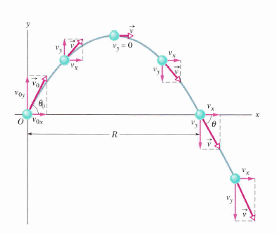
Maximum Horizontal Range
If θ = 45, R is maximum

Slide 24
Projectile: Horizontally thrown
v_{y0} = 0, v_{x} =v₀
Thrown horizontally
V CosΘ i
Θ
v
V SinΘ(- j)
V₀CosΘ i
Θ
V SinΘ(- j)
v

Slide 25
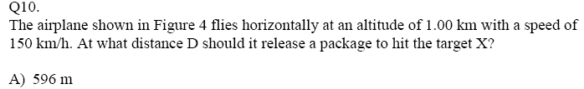
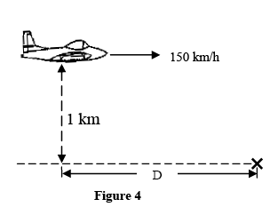
T-92-Ch4

Slide 26
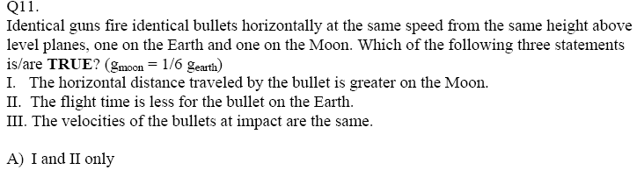
T-91-Ch4

Slide 27
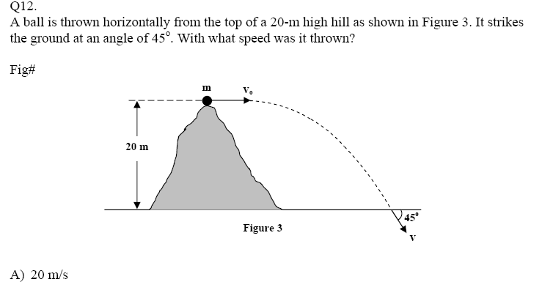
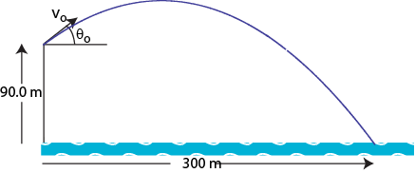
Q13.
A ball is thrown from the top of a cliff as shown in Figure 2. The ball lands 10.0 seconds later in water 300 m from the base of the cliff. The height of the cliff is 90.0 m. Neglect the air resistance and find the initial speed v_{o} of the ball.
50.0 m/s

Slide 28
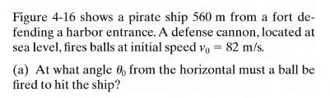
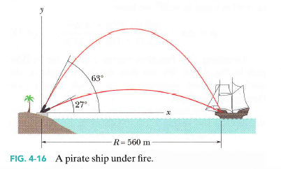

Solved Problem 4.6: Page 69
a)27 and 63
b) 690 m

Slide 29
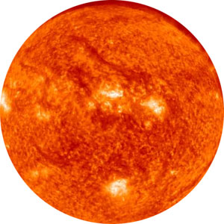

Relative Motion
Imagine there are two parallel earths rotating round the sun with same velocity (v). You are in one earth and your friend is in another facing each other and seeing each other through a telecope.
How fast do you see your friend is moving if you look him through a powerful telescope?
Answer: He is not moving ( v_{R} = 0)
Now how fast will you see your friend moving?
Answer: with double of his velocity ( v_{R} = v+v = 2v)

Slide 30

Relative Motion
Imagine you are in one car and your friend is in another. Both of you are driving with same speed. How fast do you see your friend is moving?
Answer: with zero velocity
Imagine you are in one car and your friend is in another. Both of you are driving with same speed. How fast do you see your friend is moving?
Answer: double of his speed

Slide 31
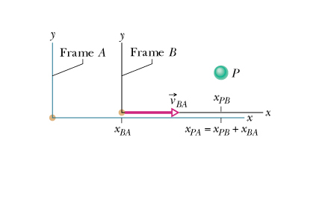
Relative Motion-1D
B
A
x_{BA} = position of B wrt A
x_{PA} = position of P wrt A
x_{PB} = position of P wrt B
v_{BA} = velocity of B wrt A
v_{PA} = velocity of P wrt A
v_{PB} = velocity of P wrt B

Slide 32
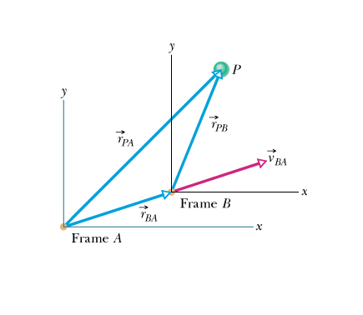
Relative Motion-2D
r_{BA} = position of B wrt A
r_{PA} = position of P wrt A
r_{PB} = position of P wrt B
Vector Addition
Differentiating wrt time
v_{BA} = velocity of B wrt A
v_{PA} = velocity of P wrt A
v_{PB} = velocity of P wrt B

Slide 33
Relative Motion
You are driving in a highway in a car A and your friend is driving in the next lane in car B with same speed. How fast do you see your friend moving?
A
B
Answer: with zero velocity
E = with respect to earth
You are driving in a highway in a car A and your friend is driving in the next lane in car B with same speed. How fast do your friend see you moving?
B
A
Answer: double of his speed

Slide 34

Exercise 1: A boat is heading due north as it crosses a wider river with a velocity of 10 km/h
relative to the water. The river has a uniform velocity of 5.00 km/h due east .
Determine the velocity of the boat wrt an observer on the riverbank.
Determine the angle the boat will make with north direction.
11.2 Km/hr, 26⁰
N
v_{RE}
v_{BR}
Θ
v_{BE}

Slide 35
Exercise 2: A boat is heading due north as it crosses a 100-m wide river with a velocity of 10 km/h relative to the water, but wants to travel due north. The river has a uniform velocity
of 5.00 km/h due east.
Which direction should it head?
How long will it take to cross the river?
N
v_{RE}
v_{BR}
v_{BE}
Θ

Slide 36

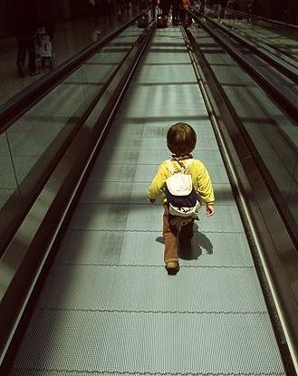

Identify which is normal and which is appear
v_{RE}
v_{BR}
v_{RE}
v_{BE}
v_{BR}
v_{BE}
Airport walkway
Airport walkway
v_{BR} = Normal
v_{WE}
v_{WE}
v_{BW} = Normal
v_{BE}
v_{BE}
v_{BW}
v_{BW}

Slide 37
Ch4-79: Two highways intersect as shown in figure. At the instant shown, a police car P is distance d_{p} = 800 m. From the intersection and moving at the speed v_{p} = 80Km/h. Motorist M is distance d_{m} = 600 m from the interaction and moving at speed v_{m} = 60Km/hr
in unit-vector notation, what is the velocity of the motorist wrt the police car.
What is the magnitude and direction.
V_{m} = 60Km/hr
r_{mp}
r_{mE}
V_{p} = 80Km/hr
E
r_{pE}
d_{p} = 800

Slide 38
4- ideas in this chapter
1. Position vector, velocity and acceleration
2. Circular Motion (speed constant)
3. Projectile
Treat x and y motion differently.
X motion is constant velocity.
Y –motion is freely falling under gravity
4. Relative velocity
v_{AB} = Velocity of A with respect to B.
v_{AE} = Veolcity of A with respect to earth (rest).

Slide 39
T-102-Ch4
Q10.
A particle moves in a circular path of radius 0.400 m with constant speed. If the particle makes five revolutions in each second of its motion, find the magnitude of its acceleration.
395 m/s²

Slide 40
T-102-Ch4
Q12.
Car A is moving with a speed of 70.0 km/hr in a direction making an angle of 45.0° with the positive x-axis. Car B is moving with a speed of 70.0 km/hr in a direction making an angle of 135° with the positive x-axis. Find the velocity of Car A with respect to Car B in unit vector notation. (All angles are measured counterclockwise with respect to positive x-axis).
A. 99.0 i Km/hr
Q13.
A ball is thrown from the top of a cliff as shown in Figure 2. The ball lands 10.0 seconds later in water 300 m from the base of the cliff. The height of the cliff is 90.0 m. Neglect the air resistance and find the initial speed v_{o} of the ball.
50.0 m/s

Slide 41
T-101-Ch4
Q11.
A straight river has a steady speed of 0.5 m/s. A boy swims upstream a distance of 500 m and swims back to the starting point. If the boy can swim at a speed of 1.5 m/s in still water, calculate the total time taken for his round trip?
A) 750 s

Slide 42
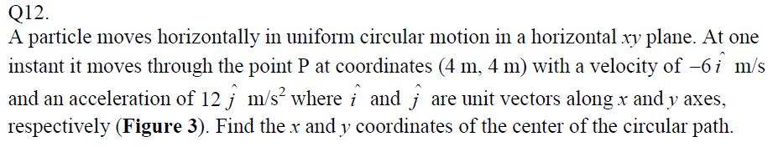
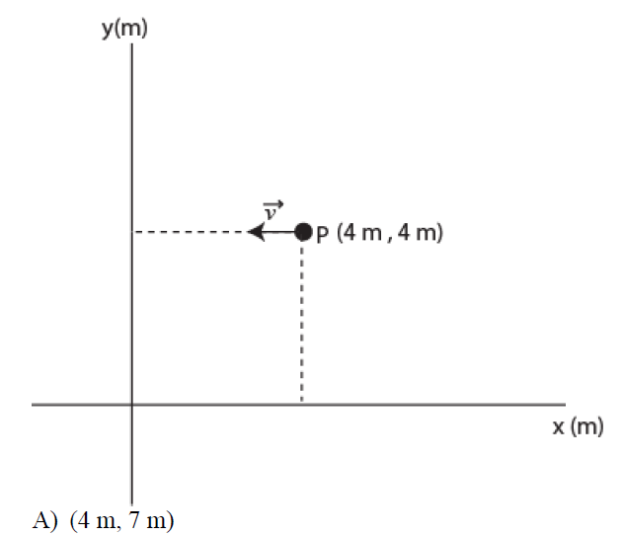
T-101-Ch4
Q13.
While flying horizontally at a constant velocity a plane drops a package through a trap door in its floor. The plane continues at the same velocity. At the instant the package strikes the ground, neglecting air friction, the plane will be (Choose the CORRECT answer):
A) Directly over the package.
B) Far behind the package.
C) In front of the package.
D) Just behind the package.
E) At a relative position which depends on the plane’s speed.

Slide 43
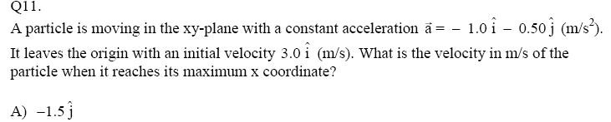
T-92-Ch4

Slide 44
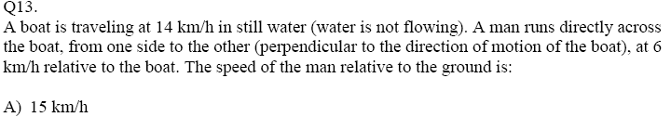
T-92-Ch4

Slide 45
T-91-Ch4

Slide 46
T-91-Ch4

Slide 47
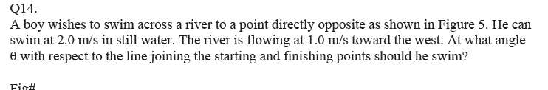
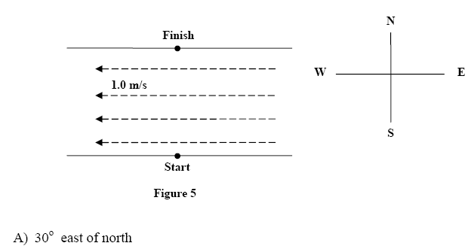
T-91-Ch4

Slide 48
T-82-Ch4
Q10. The airport terminal in Dammam has a 100 m “moving sidewalk” that moves at a constant speed of 1.00 m/s. A boy boards the moving sidewalk and walks on it with a speed of 2.00 m/s to make a round trip. How long does it take this boy to make the round trip on the moving sidewalk? (Ans: 133 s)
Q11. Fig. 2 shows a circular path taken by a particle. If the instantaneous velocity of the particle is v = - (4.0 m/s) i + (4.0 m/s) j, through which quadrant is the particle moving at that instant if it is traveling counterclockwise? (Ans: First quadrant)
Q12. A particle leaves the origin with an initial velocity v = (3.00 i+ 4.00 j) m/s and has a constant acceleration a = (-1.00 i - 0.400 j) m/s2. What is its position vector when it reaches its maximum x coordinate? (Ans: 4.50 i + 10.2 j) m

Slide 49
T-82-Ch4
Q13. A plane, diving with constant speed at an angle of 37.0 degrees with the vertical, releases a package at a height of 950 m. The package hits the ground 6.00 s after release. Find the speed of the plane. (Ans: 161 m/s)
Q14. : A meter stick is rotating about one end and completes 500 revolutions every minute. Find the speed and acceleration of its tip (the other end). (Ans: 52.4 m/s; 2.74 x 10³ m/s2)

Slide 50
T-81-Ch4
Q10.: A ball, thrown vertically down, hits a horizontal floor with a speed of 10 m/s and bounces back with the same speed. The change in its velocity is (Ans: 20 m/s up)
Q11.: A ball is thrown horizontally with a speed of 10 m/s from a height of 490 m above ground. Find the horizontal distance traveled by the ball when it hits the ground. (Ans: 100 m)
Q12.: Rain is falling vertically at a constant speed of 7 m/s relative to an observer on the ground. At what angle to the vertical do the rain drops appear to be falling as viewed by the driver of a car traveling on a straight horizontal road at a speed of 20 m/s? (Ans: 70.7º)
Q13.: At t = 0, a particle is moving in the xy-plane with a velocity of 4 j m/s and a constant acceleration of (2i+4j) m/s². Find the velocity of the particle at t = 3 s. (Ans: (6i +16j) m/s)

Slide 51
T-72-Ch4
Q9: A projectile is fired over a flat horizontal land. It takes 10 s to reach its range of 100 m. What is the speed of the projectile at the highest point of its trajectory? (Ans: 10 m/s.)
Q10.: A particle is moving counterclockwise in x-y plane in a uniform circular motion. The circle is centered at the origin and has a radius of 2.0 m. When the velocity of the particle is 4 i m/s, then its acceleration is (Ans: 8 j m/s² )
Q11.: A river is flowing 0.20 m/s east. A boat in this river has a speed of 0.40 m/s directed 60° south of east relative to the earth. Find the velocity of the boat relative to the river.( Ans: 0.35 m/s, south)
Q12.: A particle has its position vector defined by .
At what time is its speed equal to zero? (Ans: 1.0 s)

