Slide 1
Chapter 2
Motion Along a Straight Line
Speed and Acceleration
average and instantaneous velocity
Equation of motion in 1D
Graphical study

Slide 2
Lecture 1
Speed and Acceleration
average and instantaneous velocity
Equation of motion in 1D

Slide 3

Position, Distance and Displacement
Position is measured from a starting point called origin (start).
Negative Direction (left)
Positive Direction (Right)
-5
-4
-3
-2
-1
0
1
2
3
4
5
start
Distance:
-Total length of the path is distance.
Displacement:
-Length between final and initial position is called displacement
0
2cm
5 cm
3 cm
Displacement = (8 cm- 0 cm) = 8cm
SI Unit: m
Distance = 5cm+ 3cm = 8cm

Slide 4
Distance and Displacement
Distance doesn’t care about direction of motion (scalar).
Displacement cares about the direction of motion (vector).
0
2 cm
8 cm
Displacement = (2cm -0 cm )= 2cm
Distance = 5cm+ 3cm+6 cm = 14 cm

Slide 5

Average Speed
Total Distance (x)
100 m
Average Speed (v) =
=
= 20m/s
Total Time (t)
5s
SI Unit: m/s
t = 0
t = 5
100 m

Slide 6
Average Velocity (v_{av})
Change in Displacement
x_{f} - x_{i}
Δx
Average velocity (v_{av} ) =
=
=
Change in Time
t_{f} –t_{i}
Δt
SI Unit: m/s
t_{i} = 0
t_{f} = 5
x_{i} = 0
x_{f} = 100

Slide 7
Average Velocity (v_{av})
Distance (m) | Time (s) | Velocity (m/s)
0 (start) | 0
20 | 1 | 20
40 | 2 | 20
60 | 3 | 20
80 | 4 | 20
100 | 5 | 20
Final velocity
inital velocity
Prove this from the data!
t_{i} = 1
t_{i} = 2
t_{i} = 3
t_{i} = 4
t_{f} = 5
t_{i} = 0
x_{i} = 20
x_{i} = 40
x_{i} = 60
x_{i} =80
x_{f} =100
x_{i} = 0

Slide 8
Instantaneous velocity
Very small change in Displacement
Instantaneous velocity (v ) =
Very small change in Time
t_{i} = 0.5
t_{i} = 1
t_{i} = 1.5
t_{i} = 2
t_{i} = 2.5
t_{i} = 3
t_{i} = 3.5
t_{i} = 4
t_{f} = 5
t_{i} = 0
t_{i} = 4.5
2.5s
3s
50m
60m
x_{i} =90
x_{i} = 10
x_{i} = 20
x_{i} = 30
x_{i} = 40
x_{i} = 50
x_{i} = 60
x_{i} = 70
x_{i} =80
x_{f} =100
x_{i} = 0

Slide 9
0s
0.0625s
0.125s
0.1875s
0.25s
0.3125s
0.375s
0.4375s
0.5s
Δt→0
Δx
0m
1.25m
2.5m
3.75m
5m
7.5m
7.5m
7.5m
10m

Slide 10
Average Velocity: Data Analysis
Distance (m) | Time (s) | Velocity (m/s)
0 (start) | 0
10 | 1 | 10
30 | 2 | 20
60 | 3 | 30
t_{i} = 0
t = 1
t = 2
t = 3s
x_{i} = 0
x = 10 m
x = 30 m
x = 60 m

Slide 11
Average Velocity: Data Analysis
Distance (m) | Time (s) | Velocity (m/s)
0 (start) | 0
10 | 1 | 10
30 | 2 | 20
60 | 3 | 30
80 | 4 | 20
90 | 5 | 10
Common Definition
This formula is only for continuous change only!

Slide 12
Acceleration (a)
Distance (m) | Time (s) | Velocity (m/s) | Acceleration (m/s²)
0 (start) | 0
5 | 1 | 5 | 5
15 | 2 | 10 | 5
30 | 3 | 15 | 5
50 | 4 | 20 | 5
75 | 5 | 25 | 5
Average velocity change per unit time
Distance (m) | Time (s) | Velocity (m/s)
0 (start) | 0
5 | 1 | 5
15 | 2 | 10
30 | 3 | 15
50 | 4 | 20
75 | 5 | 25
Distance (m) | Time (s)
0 (start) | 0
5 | 1
15 | 2
30 | 3
50 | 4
75 | 5
Change in velocity
v_{f} -v_{i}
v –v₀
Acceleration (a) =
=
=
= 5m/s²
Change in Time
t_{f} -t_{i}
t –t₀
SI Unit: m/s²
If the velocity change is instantaneous:
t_{i} = 0
t = 1
t = 2
t = 3
t = 3
t = 5s
x_{i} = 0
x = 5
x = 15 m
x = 30 m
x = 50 m
x = 75 m

Slide 13
Lecture 2
Graphical study

Slide 14
Basic formulae for the motion
Conclusion
Conclusion
t
t₀
Take starting point t₀ = 0
a
x, v
x₀ , v₀

Slide 15
Problem Solving strategy
Read the questions carefully and underline the given parameters.
Draw picture if possible.
Figure out what you need to find.
Draw a diagram and write down the given quantities.
Write the formula.
Solve for the unknown.
Example: A car starts from rest and accelerates at a rate of 2.0 m/s² in a straight line until it reaches a speed of 20 m/s. The car then slows down at a constant rate of 1.0 m/s² until it stops. How much time elapses (total time) from start to stop? (Ans: 30 s)
v₀ =20 m/s
a = 2.0 m/s²
a = -1.0 m/s²
v = 0 m/s
v₀ = 0 m/s
v = 20 m/s
Three quantities must be given:
Choose first equation.
Find two times for two motions
Add them up to get answer
Things to remember:
Starts from rest means: v₀ = 0 m/s
Stopped means: v = 0 m/s
Acceleration is negative if final velocity is less and it is called retardation or decelleration
Choose one equation to find “t”

Slide 16
Example-1:
A car starts from rest and accelerates at a rate of 2.0 m/s² in a straight line until it reaches a speed of 20 m/s. The car then slows down at a constant rate of 1.0 m/s² until it stops.
(a) How much time elapses (total time) from start to stop? (Ans: 30 s)
v₀ =20 m/s
a = 2.0 m/s²
a = -1.0 m/s²
v = 0 m/s
v₀ = 0 m/s
v = 20 m/s
(b) Find the total distance covered.
(c) Find the average speed during the entire motion
Choose one equation to find “t”
Example 1-1:
A body moves in a straight line with 10 m/s for first 6 seconds. Then it accelerates with 4 m/s² for next 6 seconds. What is the average velocity?

Slide 17
Example 2:
The position of a particle x(t) as a function of time (t) is described by equation
x(t) = 2.0 + 3.0 t – t³
where x is in m and t is in s.
(a) At what time the particle reach to maximum positive position? (Ans: 1s)
(b) What is the maximum positive position of the particle on the x axis? (Ans: 4.0 m)
(c) What is the particle’s speed at t = 0.5s ?
(d) What is the average speed of the particle from the starting point to the maximum positive position?
(e) What is the acceleration of the motion at t = 0.5s ?
(f) What is the average acceleration for the entire motion?
Example 3-1: A car travels up a hill at a constant speed of 30 km/h and down the same hill at a constant speed of 50 km/h. Calculate the average speed of the car for the round trip (up and down the hill, the same distance).
A) 38 km/h
Example 3-2: Two automobiles, 150 kilometers apart, are traveling toward each other. One automobile is moving at 60km/h and the other is moving at 40 km/h. In how many hours will they meet? (A: 1.5)

Slide 18
Vertical motion (free fall)
v = 0
v₀ = 0
g =- 9.8 m/s²
g =- 9.8 m/s²
Most of the time treat up and down motion separately!
-y
y
For vertical motion:
UP = Positive
Down = Negative
x = y
a = g =- 9.8 m/s²
Dropped (v₀ = 0)
Maximum Height:
(v = 0) upward
(v₀ = 0) downward
v₀
-v

Slide 19
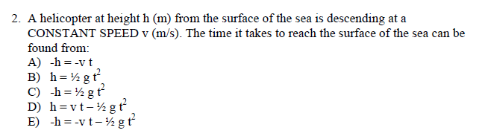
Example:
Descending
-h
Velocity = -ve
Constant Speed = acceleration = 0

Slide 20
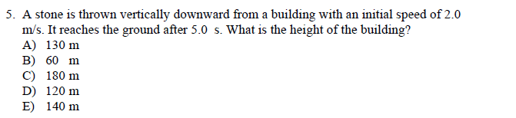
Example:
v₀ = -2m/s
v
a = g = -9.8 m/s²
t = 5s
Δy = h = ?
You have 3 quantities given and you can find rest two unknown quantities

Slide 21
Example 4: An object is thrown vertically upward with an initial speed of 25 m/s from the ground. What is the height of the object 1.0 s before it touches ground?(Ans:20 m)
Example 5: A ball is dropped from a height of 100 m at t = 0. Later, at t = 1.00 s, a second ball is thrown downward with a speed of 19.8 m/s. At what time will the two balls be at the same height? (Neglect air resistance). (Ans. 1.49 s)
Example 6.: Stone A is thrown vertically upward from the ground with an initial speed of 9.8 m/s. After 1 second, stone B is thrown with the same speed vertically upward from the same position. Find the time (in seconds) at which they will be at the same height simultaneously. A) 1.5

Slide 22
Average Velocity (v_{av}): slope of x-t line
100
Distance (m) | Time (s)
0 (start) | 0
20 | 1
40 | 2
60 | 3
80 | 4
100 | 5
80
Δx
60
Δt
x (m)
40
20
0
1
2
3
4
5
t (s)
t_{i} = 1
t_{i} = 2
t_{i} = 3
t_{i} = 4
t_{f} = 5
t_{i} = 0
x_{i} = 20
x_{i} = 40
x_{i} = 60
x_{i} =80
x_{f} =100
x_{i} = 0

Slide 23
Displacement (x) = Area of x-t
Calculate area under the curve and find, x = 100
100
Distance (m) | Time (s) | Velocity (m/s)
0 (start) | 0
20 | 1 | 20
40 | 2 | 20
60 | 3 | 20
80 | 4 | 20
100 | 5 | 20
80
60
v(m/s)
40
20
0
1
2
3
4
5
t (s)
This looks like
x = area under the v–t curve

Slide 24
What if you don’t have straight line?
Distance (m) | Time (s) | Velocity (m/s)
0 (start) | 0 | 0
5 | 1 | 5
15 | 2 | 10
30 | 3 | 15
50 | 4 | 20
75 | 5 | 25
Distance (m) | Time (s)
0 (start) | 0
5 | 1
15 | 2
30 | 3
50 | 4
75 | 5
75
60
45
X (m)
30
15
0
1
2
3
4
5
t (s)
Calculate velocities at each point
Integration = area under the curve
Tangent in the curve at a point gives the direction of velocity at the point and the slope of that tangent gives the magnitude of the velocity at that point.
= area under the v–t curve

Slide 25
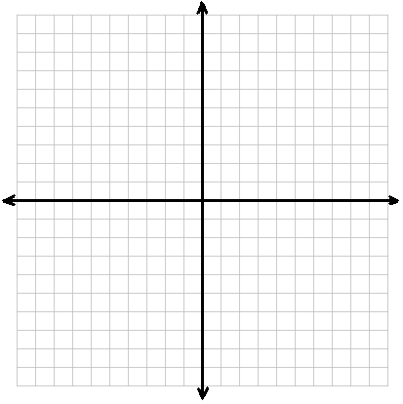
Find the velocities in the following diagram
v = 2 m/s
x (m)
Δx =6
v = 0 m/s
Δt =3
v = 1.3m/s
Δx =4
Δt =3
t(s)

Slide 26
Acceleration = slope of v-t curve
Distance (m) | Time (s) | Velocity (m/s) | Acceleration (m/s²)
0 (start) | 0
5 | 1 | 5 | 5
15 | 2 | 10 | 5
30 | 3 | 15 | 5
50 | 4 | 20 | 5
75 | 5 | 25 | 5
25
Distance (m) | Time (s) | Velocity (m/s)
0 (start) | 0
5 | 1 | 5
15 | 2 | 10
30 | 3 | 15
50 | 4 | 20
75 | 5 | 25
20
15
v(m/s)
10
5
0
1
2
3
4
5
t (s)
Calculate acceleration from the slope of the curve

Slide 27
velocity = area under a-t curve
Distance (m) | Time (s) | Velocity (m/s) | Acceleration (m/s²)
0 (start) | 0
5 | 1 | 5 | 5
15 | 2 | 10 | 5
30 | 3 | 15 | 5
50 | 4 | 20 | 5
75 | 5 | 25 | 5
25
20
15
a(m/s²)
10
5
0
1
2
3
4
5
t (s)
Calculate the final velocity
v = 25 m/s
Integration = area under the curve
= area under the v–t curve

Slide 28
A body start to move from origin in positive x-direction, find the acceleration at different segments.
v(m/s)
Each unit = 1s
Each unit = 10 m/s
0 m/s²
10 m/s²
-10 m/s²
20 m/s²
t = 0 s
t(s)
From which time period the body moves in positive x direction?
At what time body start to slow down?
At what time body changed its direction?
For which time period body moves in negative x-direction?
Which direction particle is moving in last 2 second?
Find the average displacement.

Slide 29

Vertical motion (free fall) in graph
y
t
v
t
a
t
-9.8 m/s²

Slide 30
Conclusion of a graph
Whatever is in the right side of the formula should be given in the graph!
v is the slope of x - t curve
x is the area under the v - t curve
a is the slope of v - t curve
v is the area under the a - t curve
Positive
Be careful about Negative and Positive
Negative
Positive
Negative

Slide 31
Checkpoint:
If initial velocity is zero what is final velocity?
a (m/s²)
t(s)
Final velocity (v) = 26 m/s

Slide 32
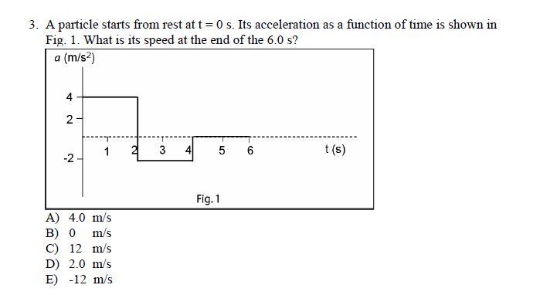
Example:
You need to find v

Slide 33
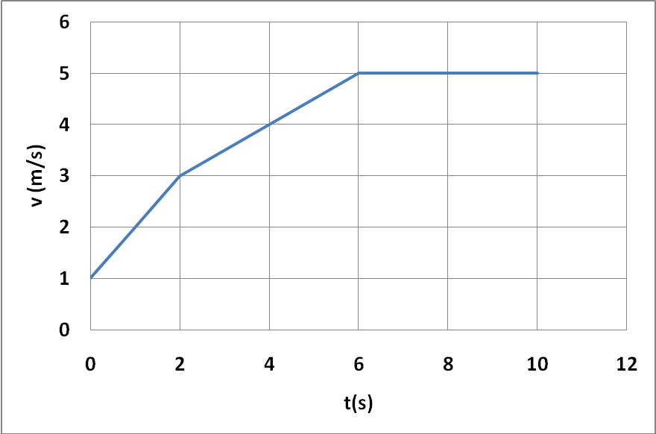
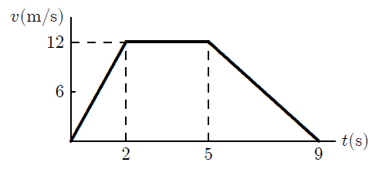
Example 7-1:
The velocity-time graph of an object moving in a straight line is shown in Figure.
(a) Find the total distance covered by the object
(b) Find the total distance covered in the first 6.0 s
(c) Find the position of the object at t =6 s if it start from 2.0 m from origin.
(d)What is the average speed of the object for the first 6.0 s? Ans: 3.3 m/s
(e) What is the acceleration of the motion at 4.2 s?
(f) Find the average acceleration of the motion.
Example 7-2:
The graph represents the straight line motion of a car. How far does the car travel between
t = 2 s and t = 5 s?
Ans: 36 m

Slide 34
Problems

Slide 35
4- ideas in this chapter
1. Average Velocity/Speed and Acceleration
2. Instantaneous Velocity and Acceleration
Need to know the rules of calculus!
3. Equation of motion
You will always need these equations!
4. Reading graph (Slope or Area under the Curve)

Slide 36
T102-Ch2
Q3.
A ball is dropped from a height of 100 m at t = 0. Later, at t = 1.00 s, a second ball is thrown downward with a speed of 19.8 m/s. At what time will the two balls be at the same height? (Neglect air resistance).
A. 1.49 s
3
Q4.
A car starts from rest and accelerates at a constant rate of 2.0 m/s² in a straight line until it reaches a speed of 30 m/s. The car then slows down at a constant rate of 1.0 m/s² until it stops. How much time elapses (total time) from start to stop?
A. 45 s
1, 3

Slide 37
T102-Ch2
Q5.
Which one of the following statements is always FALSE?
A body has constant velocity and variable acceleration.
B) A body has velocity eastward and acceleration eastward.
C) A body has velocity eastward and acceleration westward.
D) A body has zero instantaneous velocity but non-zero acceleration.
E) A body has constant acceleration and variable velocity.
1
Q6.
The velocity-time graph of an object moving in a straight line is shown in Figure 1. What is the average speed of the object for the first 6.0 s?
Fig#
3.3 m/s
4

Slide 38
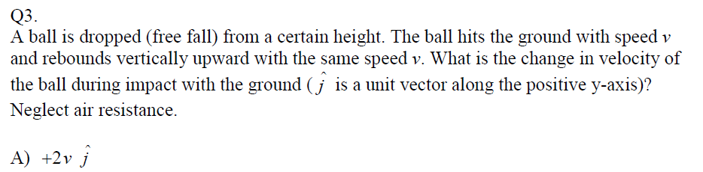
T101-Ch2
3
Q4.
A particle moves along the x-axis. Its position x as a function of time t is given by:
x = 12t – 2t²
where x is in meters and t is in seconds. At what time (in seconds) does the particle change its direction of motion?
A) 3
2

Slide 39
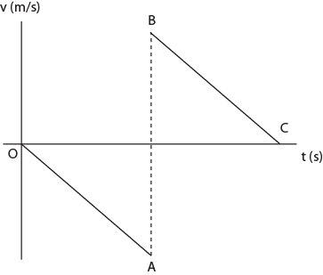
T101-Ch2
Q5.
A ball is dropped from a certain height and bounces back vertically upward after hitting the ground. Figure 1 shows the velocity-time sketch of the ball. Line OA shows the downward motion of the ball and line BC shows the upward motion of the ball (after rebound). The slopes of lines OA and BC must be equal because:
A) the acceleration due to gravity remains constant
B) the velocity remains the same before and after impact with the ground
C) the rebound height is equal to the height from where the ball was dropped
D) the speed before and after impact with the ground is not the same
E) the velocity changes its direction during impact.
4
Q6.
Stone A is thrown vertically upward from the ground with an initial speed of 9.8 m/s. After 1 second, stone B is thrown with the same speed vertically upward from the same position. Find the time (in seconds) at which they will be at the same height simultaneously.
A) 1.5
3

Slide 40
T92-Ch2
Q3.
An airplane must reach a speed of 400 km/h on a runway for takeoff. What is the lowest constant acceleration (in m/s²) for takeoff from a 2.00 km runway assuming the plane starts from rest?
A) 3.09
1,3
Q4.
A stone is thrown vertically up from the edge of the top of a 100-m high building. It reaches the ground (at the bottom of the building) after 10.0 s. What is the initial speed of the stone?
A) 39.0 m/s
3

Slide 41
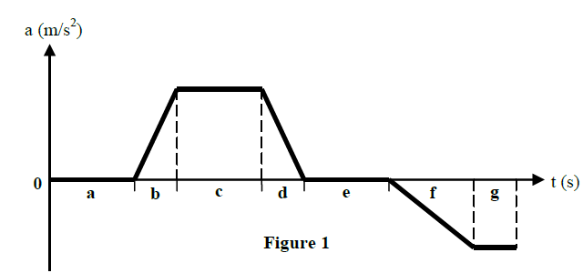
T92-Ch2
Q5.
A car travels up a hill at a constant speed of 30 km/h and down the same hill at a constant speed of 50 km/h. Calculate the average speed of the car for the round trip (up and down the hill, the same distance).
A) 38 km/h
1,3
Q6.
Figure 1 shows the acceleration-time graph of a particle moving along an axis. In which of the time intervals indicated in the figure, does the particle move at constant speed?
A) a and e
4,3

Slide 42
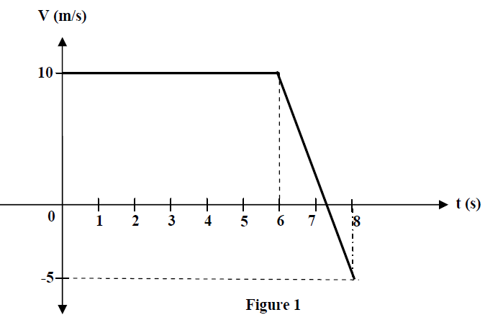
T91-Ch2
Q3.
A hot air balloon carrying a 10.0 kg block is descending vertically at a constant speed of 10.0 m/s. When the balloon is 100 m above the ground, the block is released. How long does it take the block to reach the ground? (Neglect air resistance)
A) 3.61 s
3
Q4.
Figure 1 shows the velocity-time graph of a particle moving along the x-axis. What is the average acceleration of the particle during the time interval t = 1.0 s to t = 8.0 s?
A) -2.1 m/s²
4,3

Slide 43
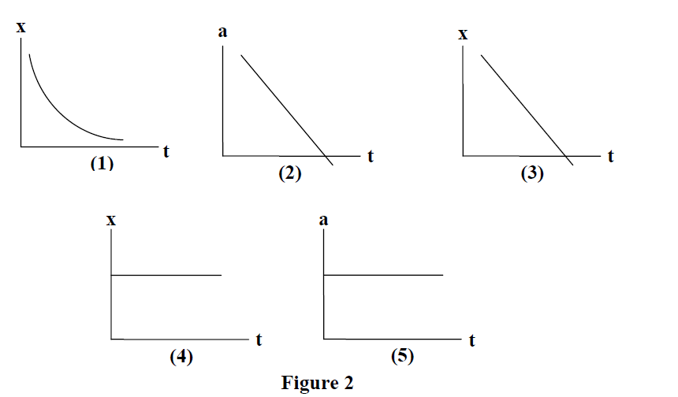
T91-Ch2
Q5.
Which of the graphs shown in Figure 2 represents an object moving with a negative constant velocity?
A) 3
1,4
Q6.
A car moving along the positive x-axis with constant acceleration covered the distance between two points 60 m apart in 6.0 s. Its velocity as it passes the second point was 15 m/s. What was its velocity at the first point?
A) 5.0 m/s
1,3

Slide 44
T82-Ch2
Q3.Two cars A and B travel on a straight line. The displacement of car A is given by x_{A} (t) =2.60 t+1.20 t², where t is in seconds and x_{A} in m. The displacement of car B is given by x_{B} (t) =2.80 t²- 0.20 t³. At what time the two cars will have the same acceleration? (A 2.67 s)
2
Q4. A ball is thrown from ground straight upward with a velocity of 26 m/s. How long does it take the ball to strike the ground? (Ans: 5.3 s)
3
Q5.Two automobiles, 150 kilometers apart, are traveling toward each other. One automobile is moving at 60km/h and the other is moving at 40 km/h. In how many hours will they meet? (A: 1.5)
1
Q6. The graph shown in Fig.1 represents the straight-line motion of a car. Find its acceleration at t = 6 s. ( A) –3.00 m/s²
4,3

Slide 45
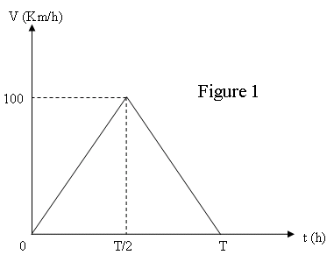
T81-Ch2
Q3.The velocity-time graph of a train traveling in a straight line from station A to station B, 10 km away, is shown in Figure 1. The train starts from A at t = 0 and arrives at B at t = T hours later. Find the acceleration of the train during the first half of the trip. (Ans:1000 km/h²)
4
Q4.: A person throws down a stone into a well with an initial speed of 10 m/s. It takes the stone 3 s to reach the surface of the water in the well. What is the distance traveled by the stone to reach the surface of the water? (Ans: 74.1 m)
3
Q5: The displacement of a car is given by x = 5t² – 20t + 10, where x is in meters and t is in seconds. The car was initially moving towards the East. At what time does it change direction and move towards the West? (Ans: 2 s)
2
Q6.: A man leaves his home driving his car for one hour at an average speed of 90 km/h before running out of gas. He then gets out of his car and walks a distance of 10 km in 3 hours before reaching a gas station. The average speed of the man during the whole trip between his home and the gas station is (A) 25 km/h
1

Slide 46
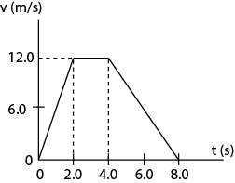
T-72-Ch2
Q2. The position of an object is given as a function of time by x = 4.0t² –3 t³ , where x is in meters and t is in seconds. Its average acceleration during the interval from t = 1.0 s to t = 2.0 s is: (Ans: −19 m/s²)
2 and 1
Q3.: A car starts from rest and undergoes a constant acceleration. It travels 5.0 m in the time interval from t = 0 to t = 1.0 s. Find the displacement of the car during the time interval from t = 1.0 s to t = 2.0 s.( Ans: 15 m)
3
Q4. Fig. 1 represents the velocity of a car (v) moving on a straight line as a function of time (t). Find the acceleration of the car at 6.0 s. (A ns: -3.0 m/s²)
4

Slide 47
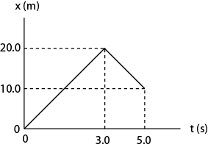
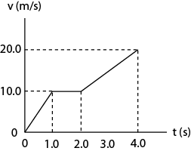
T71-Ch2
Q3.Fig 1 shows the position-time graph of an object. What is the average velocity of the object between t=0.0 s and t= 5.0 s? (Ans: 2.0 m/s)
1 and 4
Q4. Fig 2 shows a velocity-time graph of a runner. If the runner starts from the origin, find his position at t = 4.0 s.( Ans: 45 m)
4
Q5.An object is thrown vertically upward with an initial speed of 25 m/s from the ground. What is the height of the object 1.0 s before it touches ground?(Ans:20 m)
3
Q6.: A car starts from rest and accelerates at a rate of 2.0 m/s² in a straight line until it reaches a speed of 20 m/s. The car then slows down at a constant rate of 1.0 m/s² until it stops. How much time elapses (total time) from start to stop? (Ans: 30 s)
1

