Slide 1
Chapter 13
Gravity

Slide 2
Lecture 1

Slide 3
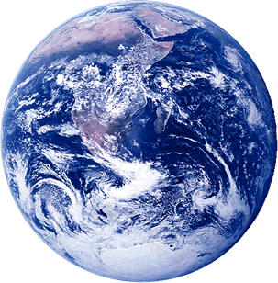
Law of Gravity
m
Force between them
body
Gravitational constant : G = 6.67x10⁻¹¹ Nm²/Kg²
F_{Eb}
r
M
F_{bE}
Force on the body by earth is towards the earth (F_{bE} )
Force on the earth is towards the body (F_{Eb} )
Earth
F_{bE} = -F_{Eb}

Slide 4
Gravitation and law of superposition
Force on the body 1 due to body 2 and 3
will be the vector sum of the two forces
m₂
m₁
F₁₂
F₁₃
If there are many bodies
m₃

Slide 5
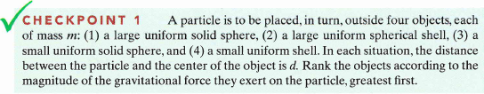
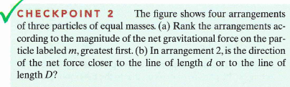
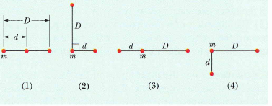
All tie
(a) 1, 2 and 4 tie, then 3;
(b) line d

Slide 6
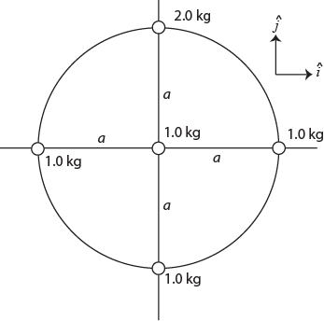
T61-Q20. Two uniform concentric spherical shells each of mass M are shown in Fig. 11. The magnitude of the gravitational force exerted by the shells on a point particle of mass m located a distance d from the center, outside the inner shell and inside the outer shell, is:
A) GMm/d²
Fig. 11
T61-Q21.
Fig. 12 shows five configurations of three particles, two of which have mass m and the other one has mass M. The configuration with the least (minimum) gravitational force on M, due to the other two particles is:
A) 2
Fig. 12
T102Q16.
Five masses are put together as shown in Figure 8. What is the net force on the 1.0-kg mass placed in the center of the circle? G is the gravitational constant.
A)() G/a² (+j)

Slide 7
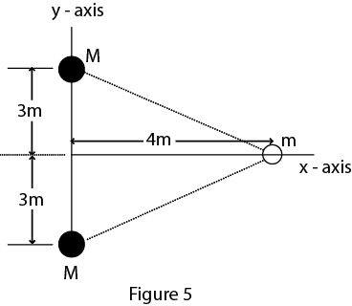
T72-Q19:
A spaceship is going from the Earth (mass = M_{e}) to the Moon (mass = M_{m}) along the line joining their centers. At what distance from the centre of the Earth will the net gravitational force on the spaceship be zero? (Assume that M_{e} = 81 M_{m} and the distance from the centre of the Earth to the center of the Moon is 3.8 × 10⁵ km). (Ans: 3.4 × 10⁵ km)
T62Q27.
Eight balls of different masses are placed along a circle as shown in Fig. 8 The net force on a ninth ball of mass m in the center of the circle is in the direction of:
A) NE
T52Q#19:
Calculate the magnitude and direction of net gravitational force on particle of mass m due to two particles each of mass M, where m =1000 kg and M =10000 kg and are arranged as shown in the Fig. 5.
Ans: 4.3 x 10⁻⁵ N directed towards negative x-axis

Slide 8
Acceleration Due to gravity (a_{g})
a_{g} = g = 9.8 m/s² at the surface of the earth

Slide 9
a_{g} at different height above the surface
Lets consider the earth as a perfect sphere
Earth pulls the ball with force
Earth pulls the ball with force
m
From equation (i) and (ii)
h
h (Km) | a_{g} (m/s² ) | Altitude example
0 | 9.83 | Mean Earth Surface
8.8 | 9.80 | Mt. Everest
36.6 | 9.71 | Highest crewed bellon
400 | 8.7 | NASA
3500 | 0.225 | Communication satellite
r_{E}
M
The acceleration due to gravity depends on the distance from the center of the earth

Slide 10
But Earth is not a perfect sphere ….!
Its bulged in the equator
r_{equator} > r_{pole}
r_{pole}
r_{equator}
M
More Accurately
a_{g-equator} < a_{g-pole}

Slide 11
T32Q21 :
The gravitational acceleration at the surface of Earth = 9.8 m/s². Find the gravitational acceleration at an altitude equal to 3 times the radius of earth.
Ans: 0.6 m/s²
T72Q21:
At what altitude above the Earth’s surface would the gravitational acceleration be a_{g}/4 ? (where a_{g} is the acceleration due to gravitational force at the surface of Earth and R_{e} is the radius of the Earth).
(Ans: R_{e})
T92Q22.
What would be the weight of a 100-kg man on Jupiter? The mass of Jupiter is equal to 318 times the mass of Earth and the radius is 11 times that of Earth.
A) 2.6 x 103 N
T101Q15.
Find the acceleration due to gravity on a planet whose mass is four times the mass of Earth and whose radius is half the radius of Earth (g is the acceleration due to gravity on Earth).
A) 16 g

Slide 12
It spins as well…………!
F_{N}
Gravitational force
F_{c}
Centripetal force
F_{g}
m
weight
Free fall acceleration
Gravitational acceleration
Centripetal acceleration
=
-
r_{E}
M

Slide 13
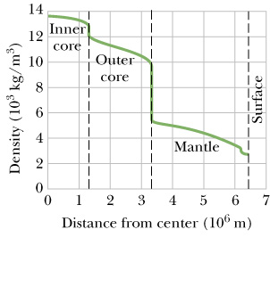
Mass is also not uniformly distributed in the earth
Mantle
Outer core
core

Slide 14
Gravitation inside the Earth
r
if
M
Like a spring or Pendulum

Slide 15
Lecture 2

Slide 16
Gravitational Potential

Slide 17

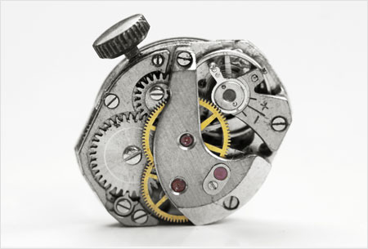
Work and Potential Energy
The net work and potential energy are related by,
You can always store energy in the form of potential energy. But for that you need to apply force (F_{a}) to do work against natural forces such as gravity (F_{g}) and spring force (F_{s}).
F_{a}
F_{a}
F_{g}
F_{s}
h
Energy is capacity to do work. They are interchangeable

Slide 18
Gravitational Potential Energy (U)
At r = ∞, U = 0 (reference point)
m
Work done by gravity while moving a mass m from distance r to infinity
dr
negative
F
Taking body from distance r to infinity
r_{E}
U = 0 at infinity
M
In general, Potential at distance “r” from the center of the earth

Slide 19
Gravitational Potential Energy (U)
PE of many bodies
Gravitational Force (F)
&
Potential Energy (U)
m₁
r₁₂
m₂
r₁₃
r₂₃
m₃
Potential is a scalar quantity so simply add all the potentials
Can you prove this?
If there are more than one body, the total PE is sum of the PE of all possible pairs

Slide 20
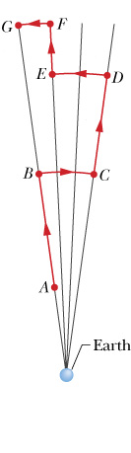
Work done by gravity (W)
Near earth a baseball moved from point A to G. Find the work done by gravity during the motion.

Slide 21
Do you remember?
When the change in KE is zero
W_{c} = -W_{a}
Work done by conservative forces
W_{g} + W_{s} = -W_{a}

Slide 22
Work done by External agent (W_{a})
Near earth a baseball moved from point A to G. Find the work done by and external agent to take it from point A to G.

Slide 23

T101-Q17.
Three masses m1 = 2.0 kg, m2 = 5.0 kg, and m3 = 20 kg are placed at the corners of an equilateral triangle of sides 0.50 m. Find the gravitational potential energy of the system of these three particles.
A) − 2.0 × 10⁻⁸ J
T82:
Each of the four corners of a square with side a is occupied by a point mass m. There is a fifth mass, also m, at the center of the square. To remove the mass from the center to a point very far away the work that must be done by an external agent is given by:
A) +4√2Gm²/a
T81-Q19:
Three point masses m₂ = 1.0 kg, m₁ = m₃ = 2.0 kg, are aligned on a straight line as shown in Figure 6. Take L = 15 cm and d = 5.0 cm. What is the work needed to move m₂ from its original position to a final position a distance d from m₃?
A) 0

Slide 24
Energy Conservation: Comes back to Earth
A body is thrown with initial velocity v_{i} reaches maximum height and falls down
0
0
f
h
m
i
r_{E}
M
K = 0 at because it stops at maximum height

Slide 25
Escape Velocity: Just reach to infinity and stops
∞
It is the minimum speed required to escape from the gravity of the planet
h₂
h₁
m
K = 0 at ∞ because it stops there and a infinity U = 0
Solving equation (i)
But
r_{E}
M

Slide 26
Energy Conservation:
Body moves with final velocity at infinity
(after escaping gravity)
f
∞
m
i
r_{E}
M
U = 0 at infinity

Slide 27
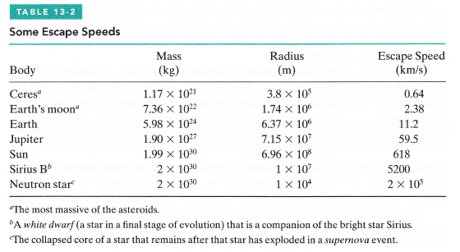
Escape velocity of any plant is:
Conservation of energy equation for escape velocity is:
a_{s} = acceleration at the surface of the planet
r_{p} = radius of the planet
Master equation

Slide 28
Escape Velocity
T71-Q22:
The gravitational acceleration on the surface of a planet, whose radius is 5000 km, is 4.0 m/s². The escape speed from the surface of this planet is:
(Ans: 6.3 km/s)
T81-Q18:
The escape velocity of a rocket from the surface of the earth is v₁. What is the escape velocity of the same rocket from the surface of a planet whose radius and acceleration due to gravity are each 5 times as those of the earth?
A) 5v₁
T61-Q28. :
The escape velocity of an object of mass 200 kg on a certain planet is 60 km/s. When the object is on the surface of the planet, the gravitational potential energy of the object-planet system is:
A) −3.6 x 10¹¹ J
T82-Q6:
What is the mass of a planet, in units of Earth’s mass M_{E}, whose radius is twice the radius of Earth and whose escape speed is twice that of the Earth?
A) 8M_{E}
T102-Q18.
If we assume that a black hole is a planet where the escape velocity is equal to the speed of light (3.00 ×10⁸ m/s), find the radius of a black hole with a mass equal to that of Earth.
A) 8.86 × 10⁻³ m

Slide 29
Conservation of Energy
T101-Q16.
Find the speed in m/s that an object must have on the surface of Earth in order to escape from the gravitational field (pull) of Earth with a speed of 2.00 × 10⁴ m/s.
A) 2.29 × 10⁴
T92-Q20.
A rocket is fired vertically from Earth’s surface with an initial speed of 2.0 x 10⁴ m/s. Neglecting air resistance, calculate its speed when it is very far from Earth.
A) 1.7 x 10⁴ m/s
T52-Q#22:
A 100-kg rock from outer space is heading directly toward Earth. When the rock is at a distance of (9R_{E}) from the Earth's surface, its speed is 12 km/s. Neglecting the effects of the Earth's atmosphere on the rock, find the speed of the rock just before it hits the surface of Earth.
(Ans: 16 km/s)
T71Q6:
A rocket is launched from the surface of a planet of mass M=1.90 × 10²⁷ kg and radius R = 7.15 × 10⁷ m. What minimum initial speed is required if the rocket is to rise to a height of 6R above the surface of the planet? (Neglect the effects of the atmosphere).
Ans: 5.51 × 10⁴ m/s

Slide 30
Lecture 3

Slide 31

Orbits and Energy
Centripetal Force = Gravitational Force
Mechanical Energy

Slide 32

Time Period (T)
r

Slide 33
Circular orbit
T102-Q20.
What speed on the surface of Earth should be given to a satellite to put it in an orbit of radius R = 3R_{E} around the Earth (where R_{E} is the radius of Earth)?
A) Sqrt(10GM_{E}/6R_{E})
T101-Q19.
The potential energy of a satellite-planet system is −3.2 × 10⁶ J. What is the kinetic energy of the satellite in its orbit?
A) +1.6 × 10⁶ J
T92-Q20.
A 1000 kg satellite is in a circular orbit of radius = 3Re about the Earth. How much energy is required to transfer this satellite to an orbit of radius = 6Re?
A) 5.220 x 10 ⁹ J
T72-Q20:
A 1000 kg satellite is in a circular orbit of radius = 2R_{e} about the Earth. How much energy is required to transfer the satellite to an orbit of radius = 4R_{e}? (R_{e} = radius of Earth = 6.37 × 10⁶ m, mass of the Earth = 5.98 × 10²⁴ kg)
Ans: 7.8 × 10⁹ J.

Slide 34
Circular orbit: Time Period
T101-Q18.
A satellite of mass 125 kg is in a circular orbit of radius 7.00 × 10⁶ m around a certain planet. If the period of revolution of the satellite is 8.05 × 10³ s, what is its mechanical energy?
A) −1.87 × 10⁹ J
T92-Q21.
A satellite of mass m moves around a planet (of mass M) in a circular orbit of radius R = 9.400 x 10³ km with a period of 2.754 x 10⁴ s. Find the mass M of the planet.
A) 6.500 × 10²³ kg
T81-Q8.
A planet is in a circular orbit around the Sun. Its distance from the Sun is four times the
average distance of Earth from the Sun. The period of this planet, in Earth years, is:
A) 8
T51-Q20:
One of the moons of planet Mars completes one revolution around Mars in 1.26 days. If the distance between Mars and the moon is 23460 km, calculate the mass of Mars. Ans: 6.45 x 1023 kg

Slide 35
Kepler’s 3-Laws of planets
Kepler’s I Law: (Law of Orbit)
All planets move in elliptical
orbits, with the sun at one focus.
b
-a
a
F
F’
ea
b
a = Semi major axis
b = semi minor axis
e = eccentricity ,
ea = distance of one of the focal point from the center of the ellipse

Slide 36
Kepler’s 3-Laws of planets
Kepler’s II Law: (Law of Areas)
A line that connects a planet to the sun sweeps out equal areas in the plane of the planet’s orbit in equal time intervals; that is the rate dA/dt at which it sweeps out area A is constant
t
θr
θ
r
t
t
rθ
θ
r

Slide 37
Kepler’s 3-Laws of planets
Kepler’s III Law: (Law of Periods)
The square of period of any planet is proportional to the cube of the semi major axis of the orbit
r
Circle
a
Elipse
Mechanical Energy: Circle
Mechanical Energy : Ellipse

Slide 38
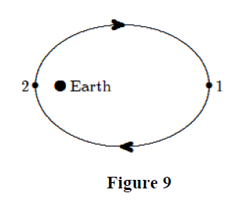
Kepler’s laws
T102-Q19.
The law of areas due to Kepler is equivalent to the law of
A) Conservation of angular momentum.
B) Conservation of mass.
C) Conservation of energy.
D) Conservation of linear momentum.
E) None of the others.
T92-Q19.
A small satellite is in an elliptical orbit around Earth as shown in Figure 9. L1 and L2 denote the magnitudes of its angular momentum and K1 and K2 denote its kinetic energy at positions 1 and 2, respectively. Which of the following statements is CORRECT?
A) L2 = L1 and K2 > K1
T71-Q 7:
Fig. shows a planet traveling in a counterclockwise direction on an elliptical path around a star S located at one focus of the ellipse. The speed of the planet at a point A is v_{A} and at B is v_{B}. The distance AS = rA while the distance BS = r_{B}. The ratio vA/vB is:
Ans: (r_{B}/r_{A})

Slide 39
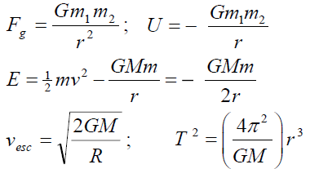
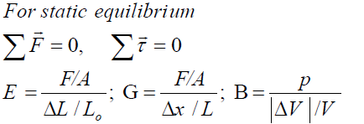
Formula

Slide 40
T-102-ch13
Q16.
Five masses are put together as shown in Figure 8. What is the net force on the 1.0-kg mass placed in the center of the circle? G is the gravitational constant.
A)() G/a² (+j)
Q17.
If, instead of being distributed over the volume of the Earth, the mass of the Earth is distributed inside a thin shell, what would be the radial dependence of the gravitational force on an object outside the Earth? Take r to be the distance to the object from the center of the Earth.
A)1/r ²
Q18.
If we assume that a black hole is a planet where the escape velocity is equal to the speed of light (3.00 ×10⁸ m/s), find the radius of a black hole with a mass equal to that of Earth.
A) 8.86 × 10⁻³ m

Slide 41
T-102-ch13
Q19.
The law of areas due to Kepler is equivalent to the law of
A) Conservation of angular momentum.
B) Conservation of mass.
C) Conservation of energy.
D) Conservation of linear momentum.
E) None of the others.
Q20.
What speed on the surface of Earth should be given to a satellite to put it in an orbit of radius R = 3R_{E} around the Earth (where R_{E} is the radius of Earth)?
Sqrt(10GM_{E}/6R_{E})

Slide 42
T-101-ch13
Q15.
Find the acceleration due to gravity on a planet whose mass is four times the mass of Earth and whose radius is half the radius of Earth (g is the acceleration due to gravity on Earth).
A) 16 g
Q16.
Find the speed in m/s that an object must have on the surface of Earth in order to escape from the gravitational field (pull) of Earth with a speed of 2.00 × 10⁴ m/s.
A) 2.29 × 10⁴
Q17.
Three masses m1 = 2.0 kg, m2 = 5.0 kg, and m3 = 20 kg are placed at the corners of an equilateral triangle of sides 0.50 m. Find the gravitational potential energy of the system of these three particles.
A) − 2.0 × 10⁻⁸ J

Slide 43
T-101-ch13
Q18.
A satellite of mass 125 kg is in a circular orbit of radius 7.00 × 10⁶ m around a certain planet. If the period of revolution of the satellite is 8.05 × 10³ s, what is its mechanical energy?
A) −1.87 × 10⁹ J
Q19.
The potential energy of a satellite-planet system is −3.2 × 10⁶ J. What is the kinetic energy of the satellite in its orbit?
A) +1.6 × 10⁶ J

Slide 44
T-92-ch13
Q19.
A small satellite is in an elliptical orbit around Earth as shown in Figure 9. L1 and L2 denote the magnitudes of its angular momentum and K1 and K2 denote its kinetic energy at positions 1 and 2, respectively. Which of the following statements is CORRECT?
A) L2 = L1 and K2 > K1
Q20.
A rocket is fired vertically from Earth’s surface with an initial speed of 2.0 x 10⁴ m/s. Neglecting air resistance, calculate its speed when it is very far from Earth.
A) 1.7 x 10⁴ m/s

Slide 45
T-92-ch13
Q21.
Two moons orbit the same planet in circular orbits. Moon A has orbital radius R, and moon B has orbital radius 4R. Moon A takes 20 days to complete one orbit. How long does it take moon B to complete its orbit?
A) 160 days
Q22.
What would be the weight of a 100-kg man on Jupiter? The mass of Jupiter is equal to 318 times the mass of Earth and the radius is 11 times that of Earth.
A) 2.6 x 103 N

Slide 46
T-91-ch13
Q19
An astronaut weighs 140 N on the moon’s surface. He is in a circular orbit of radius 2R_{m} around the moon, where R_{m} = 1.74 ×10³ km is the radius of the moon. Find the gravitational force of the moon on the astronaut on this orbit?
A) 35.0 N towards the moon.
Q20.
A 1000 kg satellite is in a circular orbit of radius = 3Re about the Earth. How much energy is required to transfer this satellite to an orbit of radius = 6Re?
A) 5.220 x 10 ⁹ J
Q21.
A satellite of mass m moves around a planet (of mass M) in a circular orbit of radius R = 9.400 x 10³ km with a period of 2.754 x 10⁴ s. Find the mass M of the planet.
A) 6.500 × 10²³ kg

Slide 47
T-91-ch13
Q22.
A rocket of mass m is launched from the surface of a planet of mass M = 5.93 × 10²⁷ kg and radius R = 6.75 × 10³ km. What minimum initial speed is required if the rocket is to rise to a height of 4R above the surface of the planet? (Neglect the effects of the atmosphere).
A) 3.10 × 10⁵ m/s
Q23.
Two particles A and B of masses mA = 5.2 kg and mB = 2.4 kg are placed on a horizontal frictionless surface a distance d = 4.0 m apart. How much work is required by an external agent to triple (three times) the separation between the particles?
A) 1.4 × 10⁻¹⁰ J

Slide 48
T-82-ch13
Q5.
Each of the four corners of a square with side a is occupied by a point mass m. There is a fifth mass, also m, at the center of the square. To remove the mass from the center to a point very far away the work that must be done by an external agent is given by:
A) +4√2Gm²/a
Q6.
What is the mass of a planet, in units of Earth’s mass M_{E}, whose radius is twice the radius of Earth and whose escape speed is twice that of the Earth?
A) 8 M_{E}
Q7.
A spherical shell has inner radius R₁, outer radius R₂, and mass M, distributed uniformly
throughout the shell. The magnitude of the gravitational force exerted on the shell by a
point particle of mass m, located a distance d from the center (d < R₁) is:
A) 0
Q8.
A planet is in a circular orbit around the Sun. Its distance from the Sun is four times the
average distance of Earth from the Sun. The period of this planet, in Earth years, is:
A) 8

Slide 49
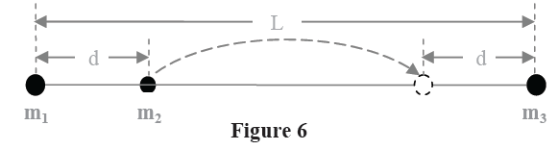
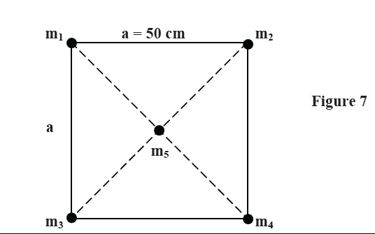
T-81-ch13
Q18.
The escape velocity of a rocket from the surface of the earth is v₁. What is the escape velocity of the same rocket from the surface of a planet whose radius and acceleration due to gravity are each 5 times as those of the earth?
A) 5 v₁
Q19.
Three point masses m₂ = 1.0 kg, m₁ = m₃ = 2.0 kg, are aligned on a straight line as shown in Figure 6. Take L = 15 cm and d = 5.0 cm. What is the work needed to move m₂ from its original position to a final position a distance d from m₃?
A) 0
Q20.
What is the net gravitational force, in Newtons, on mass m₅ = 500 kg located at the center of the square as shown in Figure 7. The masses on the corners are m₁ = m₄ = 200 kg, m₂ = 300 kg and m₃ = 100 kg.
A) 5.34 x 10⁻⁵ towards m₂

Slide 50
T-81-ch13
Q21.
Two satellites are revolving around the earth. The first satellite has a mass m₁ = 2M and potential energy U₁ = U, while the second one has a mass m₂ = 3M and potential energy U₂ = 3 U. The ratio of their orbital radii R₁/R₂ is
A) 2.0
Q22.
In 1957 the Russians put the first satellite in orbit. The Americans were able to measure the period and orbital speed of the satellite but could not determine its mass and, therefore, were not able to know the power of the Russian rocket that put the satellite in orbit. The power of the rocket is a measure of the military power of a country because powerful rockets can be used to carry massive bombs. The Americans were not able to determine the mass of the orbiting Russian satellite because:
A) The period of revolution of a satellite is independent of its mass.
B) The Americans did not have the technology to find the mass of the satellite.
C) The Russians put a device in the satellite that prevented others from finding its mass.
D) The Russian satellite was sending signals that interfered with the measurements.
E) The mass of the satellite was too small to be measured from far away.

Slide 51
T-72-Ch13
Q19: A spaceship is going from the Earth (mass = M_{e}) to the Moon (mass = M_{m}) along the line joining their centers. At what distance from the centre of the Earth will the net gravitational force on the spaceship be zero? (Assume that M_{e} = 81 M_{m} and the distance from the centre of the Earth to the center of the Moon is 3.8 × 10⁵ km). (Ans: 3.4 × 10⁵ km)
Q20: A 1000 kg satellite is in a circular orbit of radius = 2R_{e} about the Earth. How much energy is required to transfer the satellite to an orbit of radius = 4R_{e}? (R_{e} = radius of Earth = 6.37 × 10⁶ m, mass of the Earth = 5.98 × 10²⁴ kg) (Ans: 7.8 × 10⁹ J.)
Q21: At what altitude above the Earth’s surface would the gravitational acceleration be a_{g}/4 ? (where a_{g} is the acceleration due to gravitational force at the surface of Earth and R_{e} is the radius of the Earth).(Ans: R_{e})
Q22: The gravitational acceleration on the surface of a planet, whose radius is 5000 km, is 4.0 m/s². The escape speed from the surface of this planet is: (Ans: 6.3 km/s)

Slide 52
T-71-Ch13
Q4: At what distance above the surface of Earth (radius = R) is the magnitude of the gravitational acceleration equal to g/16? (Where g = gravitational acceleration at the surface of Earth). (Ans: 3 R)
Q5: A satellite moves around a planet (of mass M) in a circular orbit of radius = 9.4 x 106 m with a period of 2.754 x 10⁴ s. Find M. (Ans: 6.5 × 10²³ kg)
Q6: A rocket is launched from the surface of a planet of mass M=1.90 × 10²⁷ kg and radius R = 7.15 × 10⁷ m. What minimum initial speed is required if the rocket is to rise to a height of 6R above the surface of the planet? (Neglect the effects of the atmosphere). (Ans: 5.51 × 10⁴ m/s)
Q #7: Fig. shows a planet traveling in a counterclockwise direction on an elliptical path around a star S located at one focus of the ellipse. The speed of the planet at a point A is v_{A} and at B is v_{B}. The distance AS = rA while the distance BS = r_{B}. The ratio vA/vB is: (Ans: (r_{B}/r_{A})

Slide 53
T-62-Ch13
Q27. Eight balls of different masses are placed along a circle as shown in Fig. The net force on a ninth ball of mass m in the center of the circle is in the direction of: A) NE
Q28. :The escape velocity of an object of mass 200 kg on a certain planet is 60 km/s. When the object is on the surface of the planet, the gravitational potential energy of the object-planet system is: A) −3.6 x 10¹¹ J
Q29. : A planet has two moons of masses m₁ = m and m₂ = 2m and orbit radii r₁= r and r₂= 2r, respectively. The ratio of their periods T₁/T₂ is: A) 0.35
Q30.: A satellite in a circular orbit around Earth has a kinetic energy of 1.0 x 10⁸ J. The mechanical energy of the stellite-Earth system is: A) −1.0 x 10⁸ J

Slide 54
T-61-Ch13
Q19.: Three identical particles each of mass m are placed on a straight line separated by a distance d as shown in Fig. 10. To remove the particle at the center to a point far away (where U = 0), the work that must be done by an external agent is given by: A) 2Gm²/d
Q20. Two uniform concentric spherical shells each of mass M are shown in Fig. 11. The magnitude of the gravitational force exerted by the shells on a point particle of mass m located a distance d from the center, outside the inner shell and inside the outer shell, is: A) GMm/d²
Q21. Fig. 12 shows five configurations of three particles, two of which have mass m and the other one has mass M. The configuration with the least (minimum) gravitational force on M, due to the other two particles is: A) 2
Q22.: A satellite of mass m and kinetic energy K is in a circular orbit around a planet of mass M. The gravitational potential energy of this satellite-planet system is: A) –2K
Fig. 10
Fig. 11
Fig. 12

Slide 55
T-52-Ch13
Q#19: Three identical particles each of mass m are distributed along the circumference of a circle of radius R as shown in Fig 7. The gravitational force of m₂ on m₁ is 1.0 x 10⁻⁶ N. The magnitude of the net gravitational force on m₁ due to m₂, m₃ is (Ans: 1.4 x 10⁻⁶ N)
Q#20: Calculate the mass of the Sun using the fact that Earth is rotating around the Sun in a circular orbit of radius 1.496 x 10¹¹m with a period of one year (1 year =3.156 x 10⁷s).(Ans: 1.99 x 10³⁰ kg).
Q#21: Calculate the work require to move an Earth satellite of mass m from a circular orbit of radius 2R_{E} to one of radius 3R_{E}. (Consider M_{E} = mass of Earth, R_{E} = radius of Earth, G = universal Gravitational constant) (Ans: G M_{E} m /(12 R_{E})).
Q#22: A 100-kg rock from outer space is heading directly toward Earth. When the rock is at a distance of (9R_{E}) from the Earth's surface, its speed is 12 km/s. Neglecting the effects of the Earth's atmosphere on the rock, find the speed of the rock just before it hits the surface of Earth.(Ans: 16 km/s)

Slide 56
T-51-Ch13
Q#19: Calculate the magnitude and direction of net gravitational force on particle of mass m due to two particles each of mass M, where m =1000 kg and M =10000 kg and are arranged as shown in the Fig. 5.(Ans: 4.3 x 10⁻⁵ N directed towards negative x-axis)
Q#20: One of the moons of planet Mars completes one revolution around Mars in 1.26 days. If the distance between Mars and the moon is 23460 km, calculate the mass of Mars.( Ans: 6.45 x 1023 kg)
Q#21: A satellite of is in a circular orbit around a planet. If the kinetic energy of the satellite is 1.87 x 10⁹ J, what is the mechanical energy of the satellite? (Ans: - 1.87 x 10⁹ J)
Q#22: A projectile was fired straight upward from Earth's surface with an initial speed v_{i} such that it reaches a maximum height of 2R_{E} above the Earth surface (take g = 9.80 m/s² and R_{E} = 6.37 x 10⁶ m). The initial speed v_{i} is (Ans: 10.5 km/s)

Slide 57
T-42-Ch13
Q4: Four point masses are at the corners of a square whose side is 20 cm long (see Fig 3). What is the magnitude of the net gravitational force on a point mass m5 = 2.5 kg located at the center of the square? (Ans:1 3.3*10**(-8) N)
Q5: An object is fired vertically upward from the surface of the Earth (Radius = R) with an initial speed of (Vesc)/2, where (Vesc = escape speed). Neglecting air resistance, how far above the surface of Earth will it reach? (Ans: R/3)
Q6: What is the escape speed on a spherical planet whose radius is 3200 km and whose gravitational acceleration at the surface is 4.00 m/s**2? (Ans: 5.06 km/s)
Q7 : A planet requires 300 (Earth) days to complete its circular orbit about its sun (mass M = 6.0*10**30 kg). The orbital speed of the planet is: (Ans: 4.6*10**4 m/s)

Slide 58
Review

Slide 59
Circular orbit
Force and Acceleration
Master equation
Potential Energy
Escape Velocity
Kepplar’s law

Slide 60
Force Problems
T72-Q19:
A spaceship is going from the Earth (mass = M_{e}) to the Moon (mass = M_{m}) along the line joining their centers. At what distance from the centre of the Earth will the net gravitational force on the spaceship be zero? (Assume that M_{e} = 81 M_{m} and the distance from the centre of the Earth to the center of the Moon is 3.8 × 10⁵ km).
(Ans: 3.4 × 10⁵ km)
T52Q#19:
Calculate the magnitude and direction of net gravitational force on particle of mass m due to two particles each of mass M, where m =1000 kg and M =10000 kg and are arranged as shown in the Fig. 5.
Ans: 4.3 x 10⁻⁵ N directed towards negative x-axis

Slide 61
Acceleration Problems
T101Q15.
Find the acceleration due to gravity on a planet whose mass is four times the mass of Earth and whose radius is half the radius of Earth (g is the acceleration due to gravity on Earth).
A) 16 g
*29: The mean diameters of Mars and Earth are 6.9 x10³ km and 1.3 x 10⁴ km, respectively. The mass of Mars is 0.11- times Earth's mass.
(a) What is the ratio of the mean density (mass per unit volume) of Mars to that of Earth?
(b) What is the value of the gravitational acceleration on Mars?
(c) What is the escape speed on Mars?
A) a. 0.74 b. 3.8 m/s² c. 5.0 x 10³ m/s
**23: Certain neutron stars (extremely dense stars) are believed to be rotating at about 1 rev/s. If such a star has a radius of 20 km, what must be its minimum mass so that material on its surface remains in place during the rapid rotation
A) 5 x10²⁴ kg

Slide 62
Potential Energy Problems
T91Q23.
Two particles A and B of masses mA = 5.2 kg and mB = 2.4 kg are placed on a horizontal frictionless surface a distance d = 4.0 m apart. How much work is required by an external agent to triple (three times) the separation between the particles?
A) 1.4 × 10⁻¹⁰ J
T82:
Each of the four corners of a square with side a is occupied by a point mass m. There is a fifth mass, also m, at the center of the square. To remove the mass from the center to a point very far away the work that must be done by an external agent is given by:
A) +4√2Gm²/a
*1&30 (a) What must the separation be between a 5.2 kg particle and a 2.4 kg particle for their gravitational attraction to have a magnitude of 2.3 x 10⁻¹² N?
(b) What is the gravitational potential energy of the two-particle system? If you triple the separation between the particles, how much work is done
(c) by the gravitational force between the particles and
(d) by you?
A) a. 19 m b. -4.4x10⁻¹¹J c. -2.9x10⁻¹¹J d. 2.9x10⁻¹¹J

Slide 63
Conservation of Energy
T92-Q20.
A rocket is fired vertically from Earth’s surface with an initial speed of 2.0 x 10⁴ m/s. Neglecting air resistance, calculate its speed when it is very far from Earth.
A) 1.7 x 10⁴ m/s
T52-Q#22:
A 100-kg rock from outer space is heading directly toward Earth. When the rock is at a distance of (9R_{E}) from the Earth's surface, its speed is 12 km/s. Neglecting the effects of the Earth's atmosphere on the rock, find the speed of the rock just before it hits the surface of Earth.
(Ans: 16 km/s)
T71Q6:
A rocket is launched from the surface of a planet of mass M=1.90 × 10²⁷ kg and radius R = 7.15 × 10⁷ m. What minimum initial speed is required if the rocket is to rise to a height of 6R above the surface of the planet? (Neglect the effects of the atmosphere).
Ans: 5.51 × 10⁴ m/s

Slide 64
Escape Velocity
T61-Q28. :
The escape velocity of an object of mass 200 kg on a certain planet is 60 km/s. When the object is on the surface of the planet, the gravitational potential energy of the object-planet system is:
A) −3.6 x 10¹¹ J
T82-Q6:
What is the mass of a planet, in units of Earth’s mass M_{E}, whose radius is twice the radius of Earth and whose escape speed is twice that of the Earth?
A) 8M_{E}
T102-Q18.
If we assume that a black hole is a planet where the escape velocity is equal to the speed of light (3.00 ×10⁸ m/s), find the radius of a black hole with a mass equal to that of Earth.
A) 8.86 × 10⁻³ m
**37 (a) What is the escape speed on a spherical asteroid whose radius is 500 km and whose gravitational acceleration at the surface is 3.0 m/s? (b) How far from the surface will a particle go if it leaves the asteroid's surface with a radral speed of 1000 m/s? (c) With what speed will an object hit the asteroid if it is dropped from 1000 km above the surface?
A) a. 1.3 x10⁷ m/s b. 2.2 x10⁷ J c. 6.9 x10⁷ J

Slide 65
Circular orbit
T92-Q20.
A 1000 kg satellite is in a circular orbit of radius = 3Re about the Earth. How much energy is required to transfer this satellite to an orbit of radius = 6Re?
A) 5.220 x 10 ⁹ J
T72-Q20:
A 1000 kg satellite is in a circular orbit of radius = 2R_{e} about the Earth. How much energy is required to transfer the satellite to an orbit of radius = 4R_{e}? (R_{e} = radius of Earth = 6.37 × 10⁶ m, mass of the Earth = 5.98 × 10²⁴ kg)
Ans: 7.8 × 10⁹ J.

Slide 66
Circular orbit: Time Period
T101-Q18.
A satellite of mass 125 kg is in a circular orbit of radius 7.00 × 10⁶ m around a certain planet. If the period of revolution of the satellite is 8.05 × 10³ s, what is its mechanical energy?
A) −1.87 × 10⁹ J
T92-Q21.
A satellite of mass m moves around a planet (of mass M) in a circular orbit of radius R = 9.400 x 10³ km with a period of 2.754 x 10⁴ s. Find the mass M of the planet.
A) 6.500 × 10²³ kg
T81-Q8.
A planet is in a circular orbit around the Sun. Its distance from the Sun is four times the
average distance of Earth from the Sun. The period of this planet, in Earth years, is:
A) 8
T51-Q20:
One of the moons of planet Mars completes one revolution around Mars in 1.26 days. If the distance between Mars and the moon is 23460 km, calculate the mass of Mars. Ans: 6.45 x 1023 kg

Slide 67
Kepler’s laws
T102-Q19.
The law of areas due to Kepler is equivalent to the law of
A) Conservation of angular momentum.
B) Conservation of mass.
C) Conservation of energy.
D) Conservation of linear momentum.
E) None of the others.
T92-Q19.
A small satellite is in an elliptical orbit around Earth as shown in Figure 9. L1 and L2 denote the magnitudes of its angular momentum and K1 and K2 denote its kinetic energy at positions 1 and 2, respectively. Which of the following statements is CORRECT?
A) L2 = L1 and K2 > K1
T71-Q 7:
Fig. shows a planet traveling in a counterclockwise direction on an elliptical path around a star S located at one focus of the ellipse. The speed of the planet at a point A is v_{A} and at B is v_{B}. The distance AS = rA while the distance BS = r_{B}. The ratio vA/vB is:
Ans: (r_{B}/r_{A})

Slide 68
Book’s Problem:
**94: A 150.0 kg rocket moving radially outward from Earth has a speed of 3.70 km/s when its engine shuts off 200 km above Earth's surface. (a) Assuming negligible air drag, find the rocket's kinetic energy when the rocket is 1000 km above Earth's surface. (b) What maximum height above the surface is reached by the rocket?
A) a. 2.2 x10⁷ J b. 1.03 x10³ Km
**65: A satellite is in a circular Earth orbit of radius r. The area A enclosed by the orbit depends on r² because A = πr² . Determine how the following properties of the satellite depend on r: (a) period, (b) kinetic energy, (c) angular momentum, and (d) speed.
A) a. r^{3/2} b. 1/r c. r^{1/2} d. r^{1/2}
**77 &78: Four uniform spheres, with masses mA = 40 kg, mB = 35 kg, mC = 200 kg, and mD = 50 kg, have (x, y) coordinates of (0, 50 cm), (0, 0), (-80 cm, 0), and (40 cm, 0), respectively.
In unit-vector notation, what is the net gravitational force on sphere B due to the other spheres?
remove sphere -4 and calculate the gravitational potential energy of the remaining three-particle system.
lf A is then put back in place, is the potential energy of the four-particle system more or less than that of the system in (a)?
In (a), is the work done by you to remove A positive or negative?
In (b), is the work done by you to replace A positive or negative?
A) a. 3.7 x10⁻⁵ N j b. -1.3 x10⁻⁴ J c. make result more negative d. positive work e. negative

