Slide 1
Chapter 9
Center of Mass

Slide 2
Lecture 1
Center of Mass

Slide 3
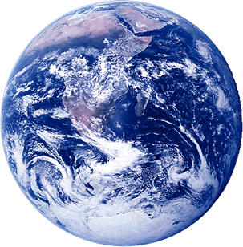
Mass of the earth = 5.9742 × 10²⁴ kg
Center of mass (com)
Mass of the earth is concentrated at the center of the earth.

Slide 4
Center of Mass motion

Slide 5
Center of Mass Motion
m₁
m₂
Center of Mass = Total Mass of the system = m₁+m₂
Centre of mass is the equivalent point mass of the system

Slide 6
Center of Mass calculation from origin
m₁
m₂
0
X-axis
x₁
x_{com}
x₂

Slide 7
Center of Mass calculation
If origin is not given you can choose as per your convenience
d
m₁
Choose the origin such that the unknown quantity will not show up in the equation
m₂
x₂
x_{com}
x_{com}
x₁
Origin
Origin
Origin

Slide 8
Where is the Centre of Mass?
Plastic sphere
You cut it
Filled it with gold

Slide 9

Check Point-1
(a) origin;
(b) 3rd quadrant;
(c) on y axis below origin;
(d) origin;
(e) 4th quadrant;
(f) origin
The figure shows a uniform square plate from which four identical squares at the corners will be removed
a) where is com of plate originally?
b) where it is after removal of square 1
c) after removal of square 1 and 2
d) after removal of square 1 and 3
e) after removal of square 1, 2 and 3
f) All four square
Answers in term of Quadrant, axes or points

Slide 10
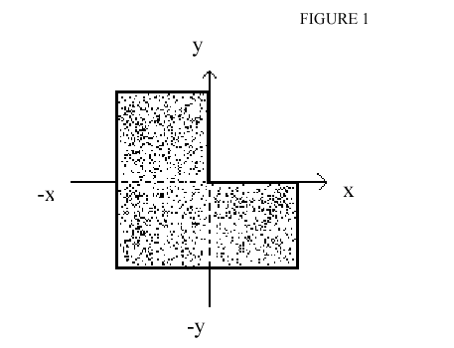
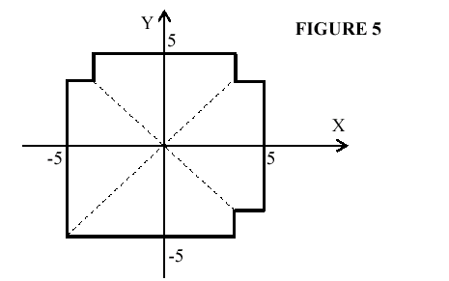
Where is the Centre of Mass?
3rd Quadrant

Slide 11
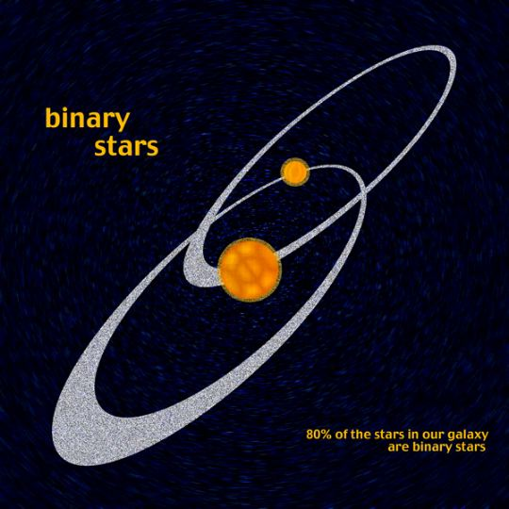
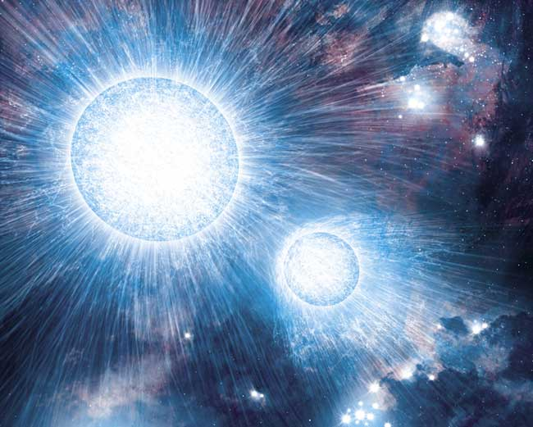
Real Life binary objects

Slide 12
Center of Mass calculation of three bodies
m₁
m₂
m₃
0
X-axis
x₁
x_{com}
x_{com}
x₂
x₃

Slide 13
Center of Mass: three bodies
m₃
x₃
x₁
m₁
y₃
y₁
X-axis
0
y₂
x₂
m₂

Slide 14
Center of Mass: 2-dimension
m₃
r₃
m₁
r₁
X-axis
0
r₂
m₂

Slide 15
Center of Mass: 3D
m₃
r₃
m₁
r₁
X-axis
0
r₂
m₂

Slide 16
Velocity, Acceleration and force on CoM
Differentiation both sides with respect to time
Again differentiation both sides with respect to time

Slide 17
Velocity, acceleration and force on com
Y-axis
Z-axis

Slide 18
Velocity, acceleration and force on com

Slide 19
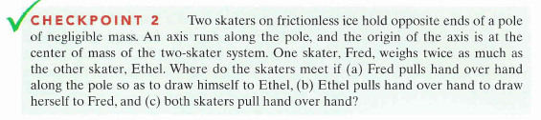
Check Point-2
There is no external force applied, hence the COM will not change in all three cases
They will always meet at center of mass (COM)

Slide 20
T042: Q8: Four masses, m₁ = 1.0 kg, m₂ = 2.0 kg, m₃ = 3.0 kg and m₄ = 4.0 kg are placed at the corners of a square of side a = 1.0 m, as shown in Fig 3. The x and y coordinates of their center of mass are: (Ans: (0.5 m, 0.7 m))

Slide 21
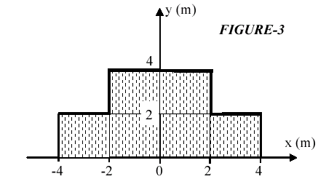
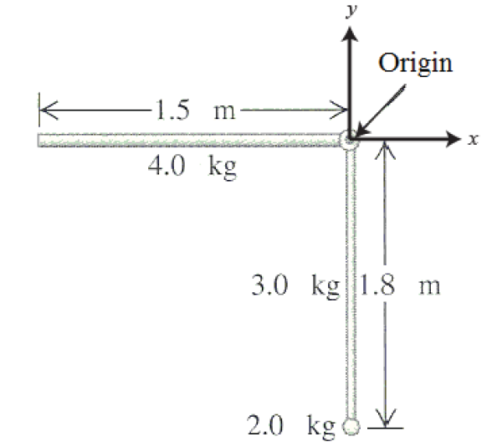
Q# 9.
A uniform plate is shaped as in Fig(3). Find the coordinates of the center of mass of the plate? (A1 (0,1.67) m)
T102-Q8.
An object consists of a uniform 4.0-kg rod of length 1.5 m which is hinged perpendicular to another uniform rod of length 1.8 m and mass 3.0 kg (see Figure 3). The longer rod has a 2.0-kg ball at one end. What are the coordinates of the center of mass of the system? Treat the ball as a point particle.
A. (-0.33 m, 0.7 m)

Slide 22
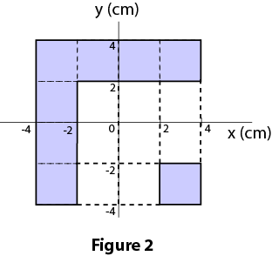
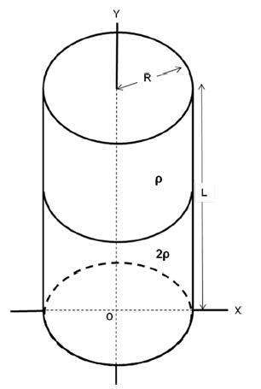
Q10:
The two pieces of uniform sheets made of the same metal are placed in the x-y plane as shown in the Figure 2. The center of mass (x_{com}, y_{com}) of this arrangement is(Ans: (-0.75, 0.75) cm)
Q9.
A cylindrical can is filled with two liquids of equal volume with density ρ and 2ρ as shown in Figure 5. L is the length and R is the radius of the cylindrical can. The center of the circular base is at the origin of coordinate axis. Find the coordinates of center of mass (x, y) of the can filled with the two liquids, in terms of R and L.
Ignore the mass of the cylindrical can and assume that the two liquids do not mix with each other.
A. (0,5/12L)

Slide 23
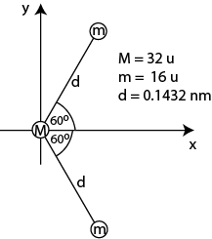
Q#9: A sulfur dioxide molecule SO₂ consists of a Sulfur atom (M = 32 u) located at the origin with two Oxygen atoms each of mass (m = 16 u) bound to it as in Fig 4. The angle between the two bonds is 120°. If each bond is 0.1432 nm long, what is the location of the center of mass of the molecule (x,y)? (Ans: (0.0358, 0) nm)

Slide 24
Q7 A 1.0 kg particle is moving with a velocity of 16 m/s along the positive x direction while a 3.0 kg particle is moving with a velocity of 4.0 m/s along the positive y direction. Find the magnitude of their center of mass velocity. (Ans 5.0 m/s )
Q10. A 2.00-kg particle has a velocity of 4.00 m/s in the positive x direction and a 3.00-kg particle has a velocity of 5.00 m/s in the positive y direction. What is the speed of their center of mass?
A) 3.40 m/s

Slide 25
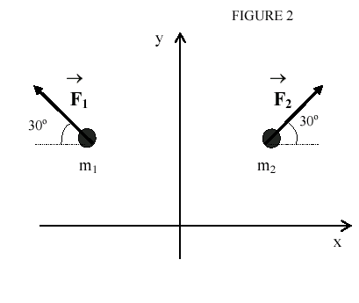
Q9 Two particles m₁ and m₂, 5.0-kg each, are initially at rest. External forces F₁ and F₂, 12 N each, are acting on these particles as shown in Fig. The acceleration of the center of mass of the two particles system is (Answer: 1.2 j m/s² )

Slide 26
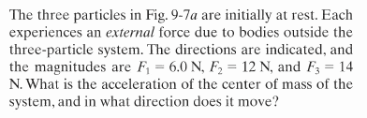
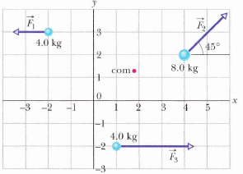
Solved Problem from Book

Slide 27
Momentum (p)

Slide 28
Linear momentum of a system
Similarly,
Net momentum
Net force

Slide 29
Collision and Impulse (J)
The average value of J can also be calculated as
Impulse (J) =
J = Area under the F and t curve
If the time of collision is brief (very short) the change in momentum in called impulse

Slide 30
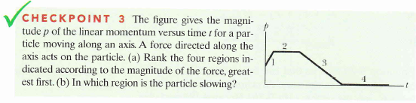
Check Point-3
a) 1, 3, 2&4 tie
b) 3

Slide 31
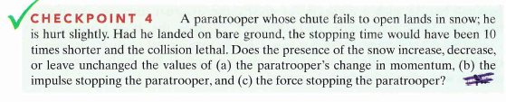
Check Point-4
a) Unchanged: Δp = mv – 0 in both situation
b) Unchanged: J = Δp
c) decreases: F = J/Δt, Δt increases

Slide 32
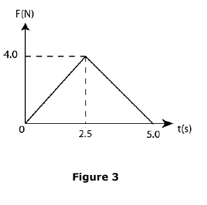
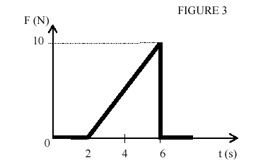
Q9. An impulsive force F as a function of time is shown in the Fig. as applied to an object (m = 5.0 kg) at rest. What will be its final speed? A) 2.0 m/s.

Slide 34
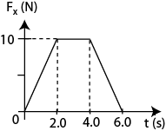
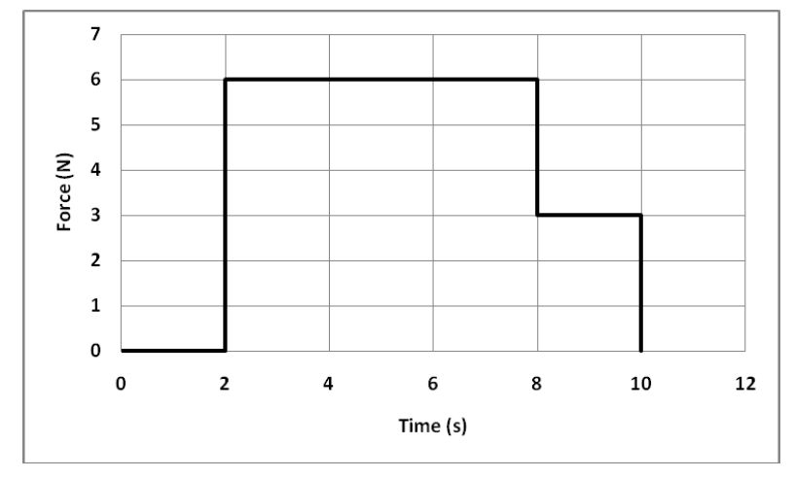
Q10.
A 10.0 kg toy car is moving along the x axis. The only force F_{x} acting on the car is shown in Fig. 5 as a function of time (t). At time t = 0 s the car has a speed of 4.0 m/s. What is its speed at time t = 6.0 s? (Ans: 8.0 m/s )
Q9.
At time t = 0, a 3.0-kg block slides along a frictionless surface with a constant speed of 5.0 m/s in the positive x-direction. A horizontal, time dependent force is applied along the positive x-direction to the block as shown in Figure 4. What is the speed of the block at t = 10 seconds?
A. 19 m/s

Slide 35

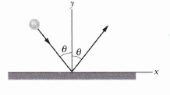
Check Point-5
a) 0
b) positive
c) j
Q10. A 0.55 kg ball falls directly down onto concrete hitting it with a speed of 4.0 m/s and rebouncing directly upward with the same speed of 4.0 m/s. What is the impulse on the ball? ( j is the unit vector in the upward positive y-direction)
A) (+4.4 N.s) j
Q12. A 1.0-kg ball moving with a speed of 2.0 m/s perpendicular to a wall rebounds from the wall (opposite to its original direction) with a speed of 2.0 m/s .The change in the momentum of the ball is:
A) 4.0 N · s away from the wall

Slide 36
Lecture 2
Collision

Slide 37
Isolated system = No external force
Initial momentum = final momentum
In every collision of an isolated system the total momentum of the system remains constant (doesn’t change)
What will happen to com of the system?
It will not change!

Slide 38
There are two types of collisons
Elastic Collision
Momentum conserved
Kinetic Energy also conserved
Inelastic Collision
Momentum conserved
Kinetic Energy doesn’t conserved

Slide 39
1D: Elastic Collision
v_{2i}
v_{1f}
v_{2f}
v_{1i}
m₂
m₁
m₂
m₁
Solving both equations
This is the formula for collision

Slide 40
1D: Elastic Collision
v_{1f}
v_{2f}
v_{1i}
v_{2i}
m₁
m₂
m₁
m₂
Don’t forget the –ve and +ve sign of the direction
Example 1.
Sphere A has mass m and is moving with velocity v. It makes a head-on elastic collision with a stationary sphere B of mass 2m. After the collision their speeds v_{A} and v_{B} are, respectively:
A) −v/3, 2v/3
Example 2
Block 1 of mass 1.00 kg is moving with an initial speed of 4.00 m/s on a frictionless horizontal surface. It makes an elastic head on collision with a stationary block 2 of mass 12.0 kg. What is the kinetic energy of block 2 after collision?
A) 2.27 J

Slide 41
2D- Elastic Collision
v_{1f} sinΘ₁
v_{2i}
v_{1f}
v_{2f}
v_{1i}
Θ₁
v_{1f} cosΘ₁
m₂
m₁
m₂
m₁
v_{2f} cosΘ₂
Θ₂
v_{2f} sinΘ₂

Slide 42
Inelastic Collision

Slide 43
1D: Complete Inelastic Collision
Note:
The total energy of a system (elastic or inelastic) always conserves.
But

Slide 44
2D-Inelastic Explosion
When a single body breaks into two bodies
v_{1f} sinΘ₁
v_{1i}
v_{1f}
v_{2f}
Θ₁
v_{1f} cosΘ₁
m₂
M
m₁
v_{2f} cosΘ₂
Θ₂
v_{2f} sinΘ₂
But

Slide 45
2D-Complete Inelastic Collision
When two body combines to one body and moves together after collision

Slide 46
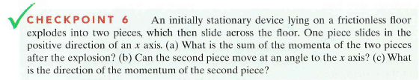
Check Point-6
a) 0
b) No
c) Negative x
T102-Q10.
An object is at rest at the origin. It explodes into three equal pieces. One piece moves to the west. What are the possible directions of motion of the other two pieces?
north, south-east
north, north-east
south, south-east
south, south-west
east, north
Q11.
A projectile has a range R. At its highest point the projectile explodes into two equal parts. One part falls vertically down. How far from the firing point will the other part land?
A) 3R/2

Slide 47

Check Point-7
a) 10 Kg.m/s
b) 14 Kg.m/s
c) 6 Kg.m/s
Q10. A 3.0-kg and a 2.0-kg carts approach each other on a horizontal air track. They collide and stick together. After the collision their total kinetic energy is 0.40 x10² J. The initial speed of their center of mass was:
A) 4.0 m/s
Q11. Two objects with the same mass move along the same line in opposite directions. The first object is moving with speed v to the right. The two objects collide in a perfectly inelastic collision and move with speed 0.40 v to the right, just after the collision. What was the speed of the second object before the collision?
A) 0.20 v

Slide 48
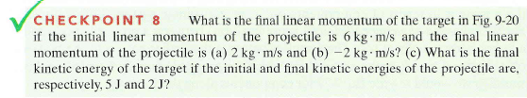
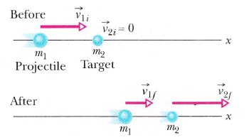
Check Point-8
a) 4 Kg.m/s
b) 8 Kg.m/s
c) 3 J
Figure9- 20

Slide 49

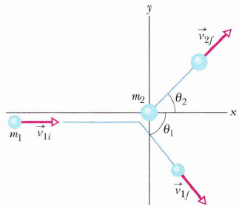
Check Point 9
target
a) 2 Kg.m/s b) 3 Kg.m/s
Figure9- 23

Slide 50
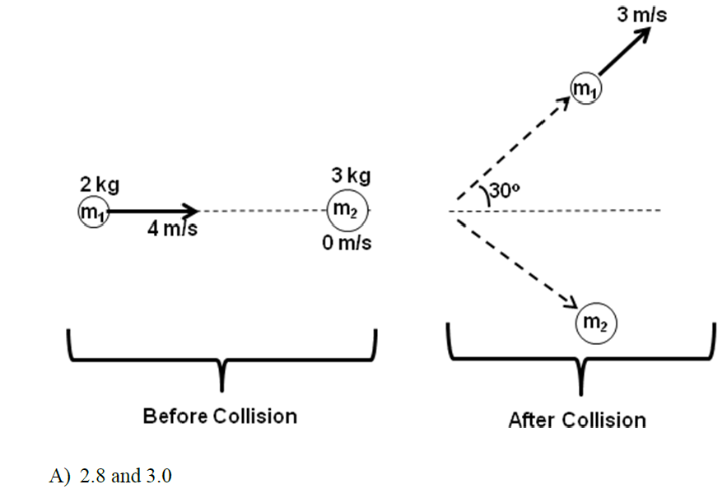
Examples Elastic
Q12.
An object of mass m1 = 2.0 kg is moving with a velocity of 4.0 m/s along the x-axis on a frictionless horizontal surface and collides with another object of mass m2 = 3.0 kg initially at rest. After collision both masses continue to move on the frictionless surface as shown in Figure 7. If m1 moves with a velocity of 3.0 m/s at an angle of 30º with respect to the x-axis, what will be the magnitude of the x- and y-components of the momentum of mass m2 (in kg·m/s)?
A) 2.8 and 3.0
Find the energy lost in the system.

Slide 51
Examples:
50 kg man stationary man with skating shoe on a surface of negligible friction shoves a stone away from himself, giving it a speed of 10 m/s. If the speed of the man after the shove is 0.002 m/s in the backward direction then what is the mass of the stone?
2. A 50 kg man in a destroyer boat of mass 100 kg was heading towards west with 10 m/s. He saw a target in his screen towards the east and lunched a rocket of mass 10 kg straight towards the target. If the the speed of the rocket is 100 m/s find the magnitude and direction of boat just after the lunch.

Slide 52
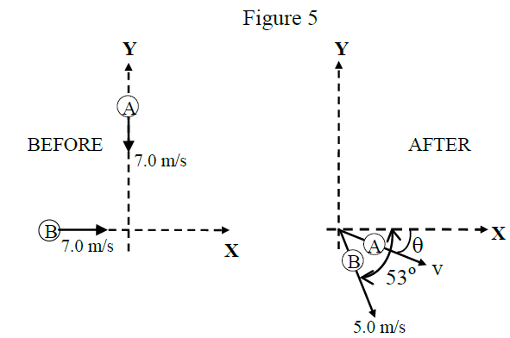
T123-Q11.
Two objects A and B, with the same mass collide on ice with negligible friction. Figure 5 gives speeds and directions of the objects BEFORE and AFTER the collision. Find the speed v and angle θ for object A after the collision.
T123-Q10:
A car with a mass of 1.2 x10³ kg is travelling to the right at a speed of 15 m/s when it collides head-on with a truck of mass 2.0 x10³ kg travelling at a speed of 15 m/s to the left. The vehicles lock together when they collide. Find the average force (both magnitude and direction) exerted on the car if the collision lasts for 0.20 s.
A) 1.1 x 10⁵ N to the left

Slide 53
T122-Q11:
A 900 kg car traveling with velocity + 15.0 i (m/s) collides with a 750 kg car moving with velocity + 20.0 j(m/s). After the collision, the two cars stick together. Just after the collision, what is the speed of the combined object and the direction of its velocity with respect to positive x-axis?
A) 12.2 m/s , 48.0°
T121-Q9
Consider a one dimensional collision between two identical balls. One is originally at rest and the other has a velocity of 4m/s i . If 3/8 of the initial kinetic energy is lost during the collision, find the velocities of the balls after the collision.
A) 1 m/s i and 3 m/s i

Slide 54
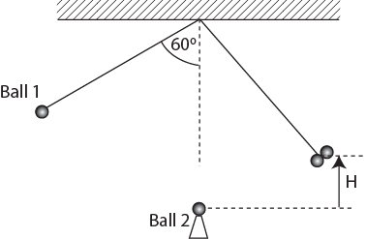
T121 Q10:
A ball of mass m, suspended by a light string of length 100 cm is released from a position where the string makes an angle θ = 60.0º with the vertical (see Figure 5). The ball collides with a second identical ball kept at rest on a smooth wedge at the bottom of its swing and the two balls stick together after collision. Determine the maximum vertical height H to which the balls rise after the collision.
A) 12.5 cm
T121-Q11.
Ball A, moving with velocity 8m/s i, collides with stationary Ball B. Masses of balls A and B are the same. After the collision, if B moves with velocity 6 m/s j, what is the velocity of A?
A) 8m/s i – 6m/s j

Slide 55
Examples:
Q3.
A 10 g bullet moving at high speed strikes a 1.0 kg wooden block that rests on a frictionless surface.
The bullet emerges, traveling in the same direction with its speed reduced to 100 m/s and the block as a result moves in the same direction at a speed of 1.0 m/s. What is the initial speed of the bullet?
If the bullet is buried in the block and the block starts to move with 10 m/s what was the initial speed of the bullet?
Q4.
A spring gun of mass 1.0 kg is pointing towards positive x direction over a frictionless table at a height of 1.0 m. The spring of the gun is compressed 10 cm by a bullet of mass 10 g and is fired.
Find the magnitude and direction of recoiled velocity of the bullet.
If the bullet hits a pendulum of mass 500 g next to it and embedded on it how high the pendulum will go?

Slide 56
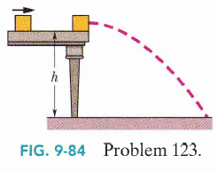
Q129: In Fig. 9-84, a 3.2 kg box of running shoes slides on a horizontal frictionless table and collides with a 2.0 kg box of ballet slippers initially at rest on the edge of the table, at
height h - 0.40 m. The speed of the 3 .2kg box is 3.0 m/s just before the collision. If the two boxes stick together because of packing tape on their sides, what is their kinetic energy just before they strike the floor? Ans: 29 J
Q109: A collision occurs between a 2.00 kg particle traveling with velocity v1 = (-4.00 m/s)i + (-5.00 m/s)j and a 4.00 kg particle traveling with velocity v2= (6.00 m/s)i +(-2.00m/s)j. The collision connects the two particles. What then is their velocity in (a) unit-vector notation and as a (b) magnitude and (c) angle?
a) 2.67i -3j b) 4.01 m/s c) 48.4⁰

Slide 57
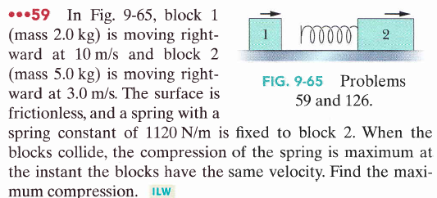
94 A spacecraft is separated into two parts by detonating the explosive bolts that hold them together. The masses of the parts are 1200 kg and 1800 kg; the magnitude of the impulse on each part from the bolts is 300 N' s. With what relative speed do the two parts separate because of the detonation?
Ans: 25 cm

Slide 58
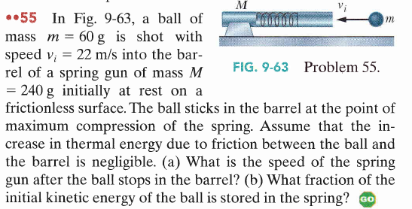
a) 4.4 m/s b) 0.8

Slide 59
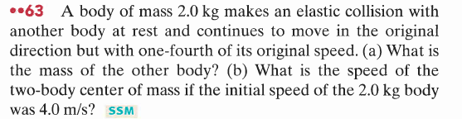
a) 1.2 kg b) 1.2 m/s

Slide 60
Summary
Center of mass (com)
Momentum (p) impulse (J) and force (F)
Differentiation both sides with respect to time
F = slope of p/t curve
Impulse (J) =
Again differentiation both sides with respect to time
J = Area under the F/t curve
Same formulae for y and z directions
Conservation of momentum: Collision
Elastic Collision
Elastic Collision
and
but
Examples of perfect inelastic:
Stick together, exploded

Slide 61
Problems

Slide 62
T-102
Q8.
An object consists of a uniform 4.0-kg rod of length 1.5 m which is hinged perpendicular to another uniform rod of length 1.8 m and mass 3.0 kg (see Figure 3). The longer rod has a 2.0-kg ball at one end. What are the coordinates of the center of mass of the system? Treat the ball as a point particle.
A. (-0.33 m, 0.7 m)
Q9.
At time t = 0, a 3.0-kg block slides along a frictionless surface with a constant speed of 5.0 m/s in the positive x-direction. A horizontal, time dependent force is applied along the positive x-direction to the block as shown in Figure 4. What is the speed of the block at t = 10 seconds?
A. 19 m/s

Slide 63
T-102
Q10.
An object is at rest at the origin. It explodes into three equal pieces. One piece moves to the west. What are the possible directions of motion of the other two pieces?
north, south-east
north, north-east
south, south-east
south, south-west
east, north
Q11.
Two objects with the same mass move along the same line in opposite directions. The first object is moving with speed v to the right. The two objects collide in a perfectly inelastic collision and move with speed 0.40 v to the right, just after the collision. What was the speed of the second object before the collision?
A) 0.20 v

Slide 64
T-101
Q9.
A cylindrical can is filled with two liquids of equal volume with density ρ and 2ρ as shown in Figure 5. L is the length and R is the radius of the cylindrical can. The center of the circular base is at the origin of coordinate axis. Find the coordinates of center of mass (x, y) of the can filled with the two liquids, in terms of R and L.
Ignore the mass of the cylindrical can and assume that the two liquids do not mix with each other.
A. (0,5/ 12L)
Q10.
An object of mass m is moving with constant velocity of 4 i m/s on a frictionless horizontal surface in the xy-plane. The object explodes (due to internal forces) into three pieces with masses m/4, m/4, and m/2. If the two pieces of mass m/4 each move with velocities -2 i + 2j and -2i – 2j m/s, find the velocity (in m/s) of the center mass of these three pieces after explosion.
A. 4 i

Slide 65
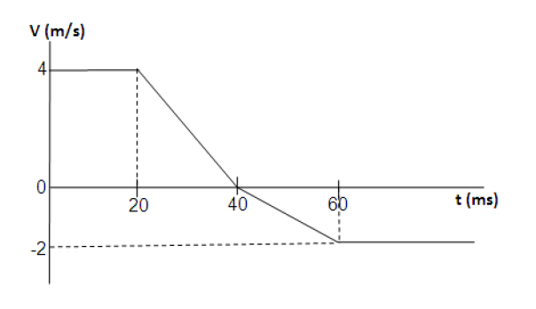
T-101
Q11. Figure 6 shows the velocity versus time graph of a particle of mass 1.0 kg moving along the x-axis towards a wall. The particle was in contact with the wall during time interval between t = 20 ms and t = 60 ms. Find the magnitude of the average force (in N) exerted by the wall on the ball during contact.
A) 1.5 ×10+2
Q12.
An object of mass m1 = 2.0 kg is moving with a velocity of 4.0 m/s along the x-axis on a frictionless horizontal surface and collides with another object of mass m2 = 3.0 kg initially at rest. After collision both masses continue to move on the frictionless surface as shown in Figure 7. If m1 moves with a velocity of 3.0 m/s at an angle of 30o with respect to the x-axis, what will be the magnitude of the x- and y-components of the momentum of mass m2 (in kg·m/s)?
A) 2.8 and 3.0

Slide 66
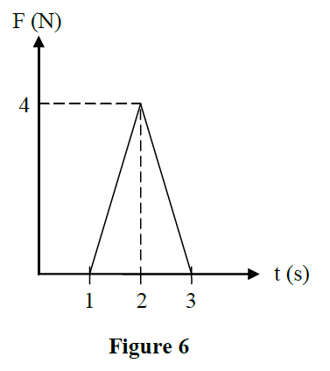
T-92
Q8. A 5-kg object is subjected to a force F . The variation of the force F as a function of time t is shown in Figure 6. Calculate the change in the velocity of the object during the time interval the force is applied.
A) 0.8 m/s
Q9. A 5.0-kg object moving with a speed of 5.0 m/s in the positive x-direction collides and sticks to a 1.0-kg object originally moving with a speed of 4.0 m/s in the negative x-direction. What is the final speed of the two masses?
A) 3.5 m/s
Q10. A 2.00-kg particle has a velocity of 4.00 m/s in the positive x direction and a 3.00-kg particle has a velocity of 5.00 m/s in the positive y direction. What is the speed of their center of mass?
A) 3.40 m/s
Q11. Three particles are placed in the xy plane. A 5-gram particle is located at (3, 4) m, and a 7-gram particle is located at (−1,−6) m. Where a 2-gram particle must be placed so that the center of mass of this three-particle system is located at the origin?
A) (−4 , 11) m

Slide 67
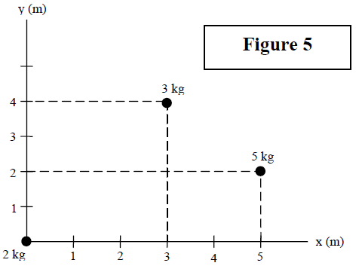
T-91
Q8.
Consider the system of particles shown in Figure 5. Where should a 4th particle of mass 4.0 kg be placed so that the center of mass of the four particles system is located at (4 m, 4 m)?
A) (5.5 m, 8.5 m)
Q9.
Two boys, with masses of 40 kg and 60 kg, respectively, stand on a horizontal frictionless surface holding the ends of a 10 m long massless rod. The boys pull themselves toward each other along the rod. When they meet, what distance will the 60 kg boy have covered?
A) 4.0 m

Slide 68
T-91
Q10.
A 0.55 kg ball falls directly down onto concrete hitting it with a speed of 4.0 m/s and rebouncing directly upward with the same speed of 4.0 m/s. What is the impulse on the ball? ( j is the unit vector in the upward positive y-direction)
A) (+4.4 N.s) j
Q11.
A collision between two objects is completely inelastic. Which one of the following statements concerning this collision is TRUE?
The total kinetic energy of the objects after the collision is less than it was before collision
B) The vector sum of the velocities of the two objects must be zero after the collision
C) The total momentum of the two objects after the collision is less than it was before the collision
D) The objects bounce away from each other after the collision
E) The total kinetic energy of the objects must be zero after collision

Slide 69
T-82
Q9. Sphere A has mass m and is moving with velocity v. It makes a head-on elastic collision with a stationary sphere B of mass 2m. After the collision their speeds v_{A} and v_{B} are, respectively:
A) −v/3, 2v/3
Q10. A 3.0-kg and a 2.0-kg carts approach each other on a horizontal air track. They collide and stick together. After the collision their total kinetic energy is 0.40 x10² J. The initial speed of their center of mass was:
A) 4.0 m/s
Q11. A projectile has a range R. At its highest point the projectile explodes into two equal parts. One part falls vertically down. How far from the firing point will the other part land?
A) 3R/2
Q12. A 1.0-kg ball moving with a speed of 2.0 m/s perpendicular to a wall rebounds from the wall (opposite to its original direction) with a speed of 2.0 m/s .The change in the momentum of the ball is:
A) 4.0 N · s away from the wall

Slide 70
T-72-Ch9
Q#9: A sulfur dioxide molecule SO₂ consists of a Sulfur atom (M = 32 u) located at the origin with two Oxygen atoms each of mass (m = 16 u) bound to it as in Fig 4. The angle between the two bonds is 120°. If each bond is 0.1432 nm long, what is the location of the center of mass of the molecule (x,y)? (Ans: (0.0358, 0) nm)
Q10. A 10.0 kg toy car is moving along the x axis. The only force F_{x} acting on the car is shown in Fig. 5 as a function of time (t). At time t = 0 s the car has a speed of 4.0 m/s. What is its speed at time t = 6.0 s? (Ans: 8.0 m/s )
Q11. An object of mass M moving on a frictionless frozen lake with speed V explodes into two equal pieces, one moving at 6.0 m/s due north, and the other at 8.0 m/s due west. Determine V. (Ans: 5.0 m/s)
Q12. A 4.0 kg block with a velocity of 2i m/s makes an elastic collision with a 2.0 kg block moving with a velocity of ( 2i+j ) m/s. What is the total kinetic energy of the two blocks after the collision? (Ans: 13 J)

Slide 71
T-71-Ch9
Q8. Two velocities of the three-particle system are shown in the Fig. 1. If the velocity of the center of mass is zero, find the velocity v of the 4.0 kg mass. (Ans: (5i-3j) m/s)
Q9. A 4.0 kg object moving with velocity (9.0) i m/s explodes into two pieces, one with mass 1.0 kg and velocity (6.0 j) m/s and the other with mass 3.0 kg and velocity v . Determine v. (Ans: (12i-2.0 j) m/s )
Q10. A 5 kg object moving along the x axis is subjected to a force F_{x} in the positive x direction. A graph of F_{x} as a function of time t is shown in Fig. 2. Find the magnitude of the change in the velocity of the object during the time the force is being applied. (Ans: 0.8 m/s)
Q11. A block of mass m = 500 g moving on a frictionless track at an initial speed of 3.20 m/s undergoes an elastic collision with an initially stationary block of mass M. After collision, the first block moves opposite to its original direction at 0.500 m/s. The mass M is: (Ans: 685 g)
Q12. Two bodies , A and B each of mass 2.0 kg moving with velocities v_{A} = (2.0i+5.0 j) m/s and v_{B} = (1.0i-5.0j) m/s collide and stick together after collision. After the collision, the velocity of the composite object is: (Ans: 1.5 i m/s )
Fig 1
Fig 2

Slide 72
T-62-Ch9
Q9. An impulsive force Fx as a function of time (in ms) is shown in the Fig. 3 as applied to an object (m = 5.0 kg) at rest. What will be its final speed? A) 2.0 m/s.
Q10. Each object in Fig. 4 has a mass of 2.0 kg. The mass m₁ is at rest, m₂ has a speed of 3.0 m/s in the direction of +ve x-axis and m₃ has a speed of 6.0 m/s in the direction of +ve y-axis. The momentum of the center of mass of the system is: (Ans: 6i+12j)
Q11. A 0.20 kg steel ball, travels along the x-axis at 10 m/s, undergoes an elastic collision with a 0.50 kg steel ball traveling along the y-axis at 4.0 m/s. The total kinetic energy of the two balls after collision is: (Ans: 14 J.)
Q12. If the masses of m₁ and m₃ in Fig. 5 are 1.0 kg each and m₂ is 2.0 kg, what are the coordinates of the center of mass? (Ans: (1.00, 0.50) m )
Fig 4
Fig 5

Slide 73
T-61-Ch9
Q10. A small object with linear momentum 5.0 kg·m/s makes a head-on collision with a large object at rest. The small object bounces straight back with a momentum of magnitude 4.0 kg·m/s. What is the magnitude of the change in momentum of the large object? (Ans: 9.0 kg·m/s )
Q11. A 1500 kg car traveling at 90.0 km/h east collides with a 3000 kg car traveling at 60.0 km/h south. The two cars stick together after the collision (see Fig 2). What is the speed of the cars after collision? A) 13.9 m/s
Q12. A 3.0 kg mass is positioned at (0, 8.0) m, and a 1.0 kg mass is positioned at (12, 0) m. What are the coordinates of a 4.0 kg mass which will result in the center of mass of the system of three masses being located at the origin (0, 0)? (Ans: (-3.0, -6.0) m )
Fig 2

Slide 74
T-52-Ch9
Q#9: The location of two thin flat objects of masses m₁= 4.0 kg and m₂ = 2.0 kg are shown in Fig. 3, where the units are in m. The x and y coordinates of the center of mass of this system are: (Ans:1.0 m, 0.33m).
Q#10: The impulse which will change the velocity of a 2.0-kg object from v₁ =+30jm/ s to v₂== −30 i m/s is : (-60i-60j)N.s.
Q#11: A 2.00 kg pistol is loaded with a bullet of mass 3.00 g. The pistol fires the bullet at a speed of 400 m/s. The recoil speed of the pistol when the bullet was fired is: (Ans: 0.600 m/s)
Q#12: Sphere A has mass 3m and is moving with velocity v in the positive the x direction. Sphere B has a mass m and is moving with velocity v in the negative x direction. The two spheres make a head-on elastic collision. After the collision the velocity of A (v_{A}) is: (Ans:zero)
Fig 3

Slide 75
T-51-Ch9
Q9: Sphere A has a mass M and is moving with speed 10 m/s. It makes a head-on elastic collision with a stationary sphere B of mass 3M. After the collision the speed of B is: (Ans: 5.0 m/s )
Q10: The two pieces of uniform sheets made of the same metal are placed in the x-y plane as shown in the Figure 2. The center of mass (x_{com}, y_{com}) of this arrangement is(Ans: (-0.75, 0.75) cm)
Q#11: A 0.50 kg ball moving at 2.0 m/s perpendicular to a wall rebounds from the wall at 1.4 m/s. The impulse on the ball is: (Ans: 1.7 N · s away from wall)
Q#12: An object of 12.0 kg at rest explodes into two pieces of masses 4.00 kg and 8.00 kg. The velocity of the 8.00 kg mass is 6.00 m/s in the +ve x-direction. The change in the kinetic is: (Ans: 432 J)

Slide 76
T-42-Ch9
Q8: Four masses, m1 = 1.0 kg, m2 = 2.0 kg, m3 = 3.0 kg and m4 = 4.0 kg are placed at the corners of a square of side a = 1.0 m, as shown in Fig 3. The x and y coordinates of their center of mass are: (Ans (0.5 m, 0.7 m)
Q9: A 1.0 kg ball strikes a vertical wall at an angle of 30 degrees with a speed of 3.0 m/s and bounces off at the same angle with the same speed, as shown in Fig 4. The change in momentum of the ball is : (Ans 3 kg*m/s to the left)
Q10: A 6.0 kg body moving with velocity v breaks up (explodes) into two equal masses. One mass travels east at 3.0 m/s and the other mass travels north at 2.0 m/s. The speed v of the 6.0 kg mass is: (Ans 1.8 m/s)
Q11: In an inelastic collision between two objects with no external forces, (Ans: momentum is conserved but kinetic energy is not conserved)
Q12: A 1.0 kg ball falling vertically hits a floor with a velocity of 3.0 m/s and bounces vertically up with a velocity of 2.0 m/s . If the ball is in contact with the floor for 0.10 s, the average force on the floor by the ball is: (Ans 50 N down)
Q13 A 2.0 kg block with a speed of 4.0 m/s undergoes a head on ELASTIC collision with a 4.0 kg block initially at rest. After the collision, the 4.0 kg block has 14.2 J of kinetic energy . The speed of the 2.0 kg block after the collision is: (Ans 1.3 m/s)

Slide 77
y
What are the (a) x coordinate (b) the y coordinate of the center of mass for the uniform plate shown in figure, if L = 5 cm.
4L
2L
L
3L
x
4L
2L

Slide 78
y
Figure gives an overhead view of the path taken by a 0.165 Cue ball as it bounces from a rail of a pool table. The Ball’s initial speed is 2.00m/s, and the angle Θ₁ is 30⁰. The bounce reverse the y component of the ball’s velocity but doesn’t alter the x component. What (a) angle and (b) the change in the ball’s liner momentum in unit-vector notation? (the fact that the ball rolls is irrelevant to the problem.
Θ₁
Θ₂
x

Slide 79
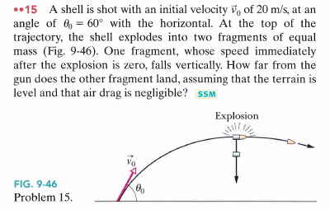
Book’s Problem Chapter 9

