Slide 1
Chapter 7 and 8
Energy and Work

Slide 2
Lecture 1

Slide 3
Work, Energy and Power
Work
Kinetic Energy
Where d is displacement vector and F is force.
Where m is mass and v is speed of the body
Gravitational Potential Energy
Spring Potential Energy
Gravitational Potential energy of body of mass m at height h.
Spring potential energy of spring with spring constant k and displacement x.

Slide 4
Example1: Positive work done by a force
Work is the scalar product of force (F) and displacement vector (d)
F
d
F
d
Displacement and Force are always in the same direction for positive work
Q: What happen to KE?
Ans: Kinetic Energy increases from zero to ½ mv²
The body gains Kinetic Energy (ΔK positive) during positive work.
Force transfer energy to body during positive work.

Slide 5
Example 2: Negative Work done on the body
When force (F) is applied against a moving body and it stopped after displacement “d”
F
d
F
d
Displacement and Force are always in opposite direction for negative work
Q: The velocity of the body goes from v to zero. What happen to KE?
Answer: Kinetic Energy decreases from ½ mv² to zero
The body loose Kinetic Energy (ΔK negative) during negative work.
Force transfer energy out from body during negative work.

Slide 6
Work Energy Principle
How the net work and Kinetic Energy related?
Here W is the net work done. Net work is translated into Kinetic Energy
We can prove this easily
Energy is capacity to do work. They are interchangeable

Slide 7
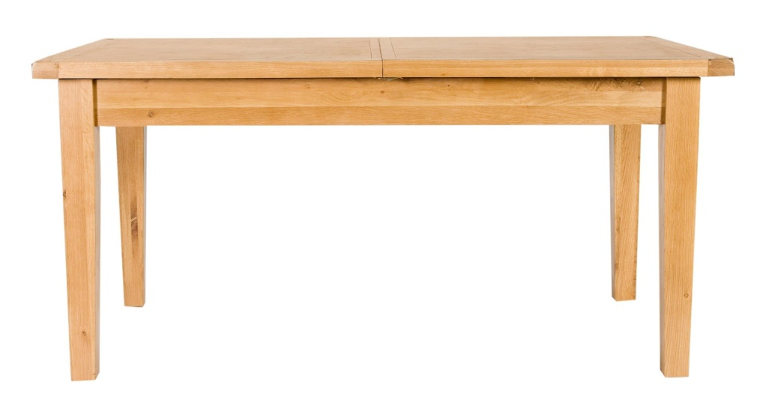
Example 3: block moves distance “d” on the frictionless floor
T
F_{N}
θ
T
θ
Ideal frictionless table
d
d
mg
Work done by Tension T
Free Body Diagram
Work done by Normal force
The total (net) work done
Work done by gravitational force

Slide 8
Example 4 : Work done and Net work done
F_{N}
F₁
F₂
F₁
F₂
φ
θ
φ
θ
d
Free Body Diagram
Ideal frictionless table
mg
d
Net work done
F₁
Work is scalar quantity
Work done by force F₁
θ
Alternative way
Net work done from net force
d
F₂cos(φ)
F₁cos(θ)
Work done by force F₂
d
180-φ
F₂
W = {F₁cos(θ)- F₂cos(φ)}d
d

Slide 9
Example 5: Work done by centripetal Force
Centripetal Force at any point is towards the centre: Along the radius
Direction of displacement is always along the tangent in the circular path
Δx
Angle between F_{c} and Δx is always 90º
0
Hence the work done by centripetal force is always zero
Q1. A stone of mass 1.0 kg, tied to a rope of length 2.0 m, is rotating in a horizontal circle on a frictionless table top with a speed of 1.0 m/s. Find the work done by the force of tension in the rope when the stone has completed one revolution.
A) 0 J
Q2. How much work is done by the tension force at any time interval and why?
A) Zero because force is always perpendicular to the displacement

Slide 10
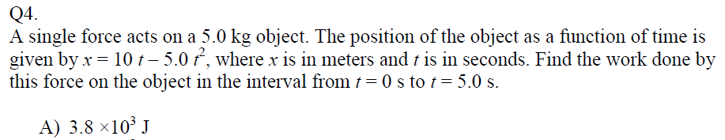
Examples
Q4. At time t = 0 a single force F acts on a 2.0 kg particle and changes its velocity from v_{i} = (4.0i -3.0 j) m/s at t =0 s to v_{f} = (4.0i +3.0 j) m/s at t = 3.0 s. During this time the work done by F on the particle is: (Ans: 0)

Slide 11
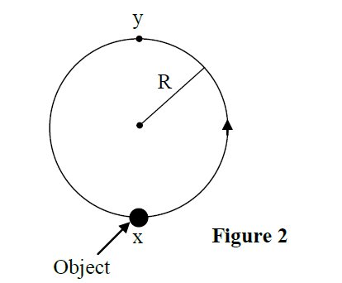
Examples: Work done by gravitational force
Q2: A man moves the 10-kg object shown in Figure 2 in a vertical plane from position X to position Y along a circular track of radius R = 20 m. The work done by the force of gravity during this motion is
A) − 3920 J
Q3. A body of mass M = 2.00 kg, tied to a string, rotates in a vertical circle of radius R = 1.00 m. Find the work done by the force of gravity on the body during one full revolution. A) zero

Slide 12
Power (P)
Power: Rate of doing work
Power: Rate of energy transfer
Average Power
Average Power
Instantaneous Power
Instantaneous Power
Instantaneous Power

Slide 13
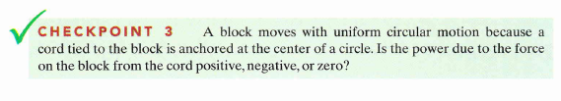
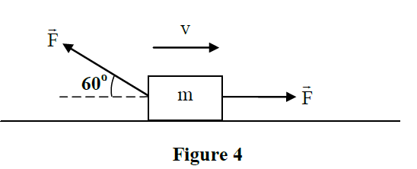
Examples of Power
Q3. A particle is acted on by a constant force F= (2.0 N) i– (5.0 N) j and is displaced from an initial position of d_{i}= (0.50 m)i+ (0.80 m)j at time t = 0 s to a final position of d_{f}= (3.5 m)i+ (9.8 m)j at time t = 10 s. Find the average power (in Watts) on the particle due to this force in this time interval. A) –3.9
Q4. Figure 4 shows two equal forces of magnitude F = 10 N acting on a box as the box slides to the right across a frictionless floor. The speed of the box at a certain instant is 4.0 m/s. Calculate the net power due to these two forces at that instant? A) 20 W
Q5. A 3.0-kg mass has an initial velocity v_{o} = (6.0 i – 2.0 j) m/s. A single force F is applied for 5.0 s which changes its velocity to v = (8.0 i + 4.0 j) m/s. Find the average power delivered by the force in this interval. (Ans: 12 W)
Q6.: A 60-kg boy runs from the 1st floor to the 2nd floor, using the stairs, in 12 s. The stairs are made up of 30 steps, each 10 cm high. Calculate the average power required by the boy.(Ans: 147 W)

Slide 14
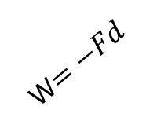


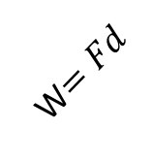
Always make displacement and force along the same line
d
F
d
F
W$=Fd$
d
d
F
F
W$=−Fd$
W$=−Fd$
d
W$=Fd$
d
F
F

Slide 15
Summary
F
Θ
d
F
Power
W= d.F = Fd Cos(Θ)
If Θ = 0,
W= Fd
maximum (positive) work
If Θ = 180⁰
W = - Fd
Maximum (Negative) work
If Θ = 90
W=0
dcos(Θ)
d
F
F
d
Net work done
F
90⁰
d

Slide 16
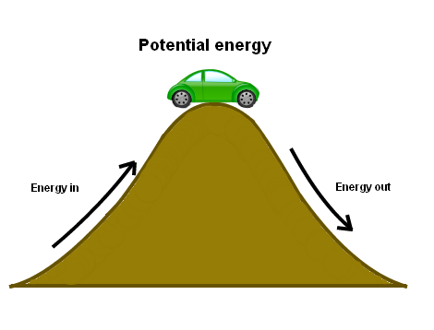
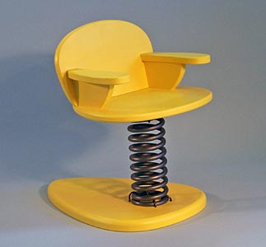
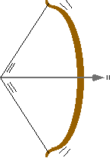
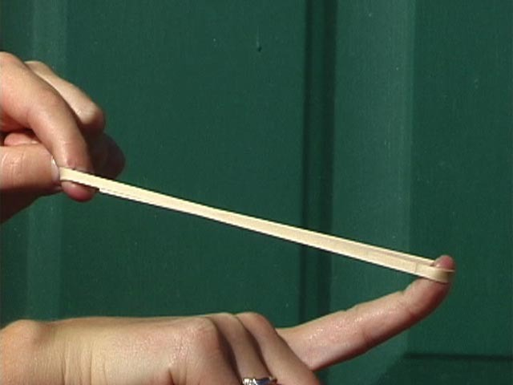
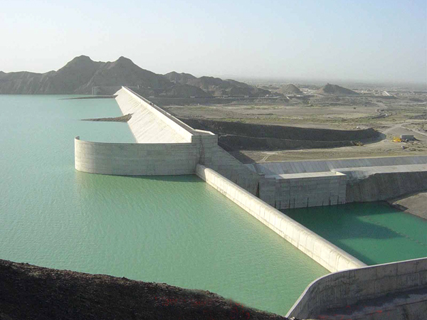
Potential Energy and conservative force
Potential energy (U) is the energy by the virtue of the position of body
Lot of potential energy
No potential Energy
Lot of potential energy
When the body gets displaced from the equilibrium position it gains U.
Usually the equilibrium position is referenced as U = 0.
Sometime you can choose reference point as per your convenience
Lot of potential energy
Lot of potential energy
Energy is stored in the form of Potential Energy

Slide 17
Gravitational Potential Energy
The Energy of a body by virtue of its position under gravity
displaced state
h
relexed state
ground
The cause of gravitational potential energy is the gravitational force: F = mg

Slide 18
Example 6: Potential Energy increases:
Work is done against the Gravitational Force (W_{g})
h
F_{g} (-j)
mg
or
h j
Here potential energy (U_{g}) increases as a result of decreasing energy (K)
True for isolated system:
Only in the presence of one force mg

Slide 19
Example 7: Potential Energy Decrease:
Work Done by Gravitational Force (W_{g})
F_{g} (-j)
or
h
mg
h(- j)
Here the K increases as U_{g} decreases
True for isolated system.
Only in the presence of gravitational for mg

Slide 20
For isolated system: Only under gravity
Net work,
If only gravitational force is present
Therefore for a body under the influence of gravitational force only

Slide 21
Work Done in Lifting and lowering an Object
When you lift and lower a body U_{g} changes but not the K
v = 0
Work Energy Principle, the net work
F_{g}
F_{g}
Since the ΔK = 0
h
F_{a}
But
F_{a}
v₀ = 0
F_{a} is reaction force

Slide 22
For isolated system: Only under gravity

Slide 23

Work done in incline Plane under gravity only
Moves Down
i
j
F_{N}
d
mgsin(θ)
mg
θ
F_{g}cos(θ)
h
mg
h
θ
mgsin(θ)
We can get the same work done differently
d
The reference is taken at the lowest point where the final U =0
d
θ
Path doesn’t matter, only height matter
Only vertical displacement matter.

Slide 24
Gravity: Path doesn’t matter only height matter
i
j
The work done by gravity while body moves up!
h
mg
The work done by gravity while body moves down like this!
i
j
h
h
mg
U = 0 (relaxed position)

Slide 25
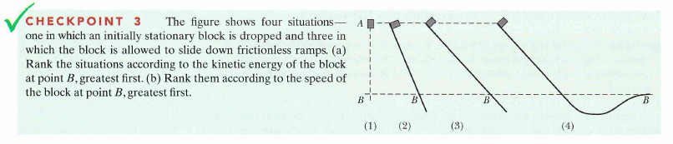
Examples
All tie (b) all tie
Height is same for all situation
Q2: A man moves the 10-kg object shown in Figure 2 in a vertical plane from position X to position Y along a circular track of radius R = 20 m. The work done by the force of gravity during this motion is
A) − 3920 J
Q6.: A 60-kg boy runs from the 1st floor to the 2nd floor, using the stairs, in 12 s. The stairs are made up of 30 steps, each 10 cm high. Calculate the average power required by the boy. (Ans: 147 W)

Slide 26
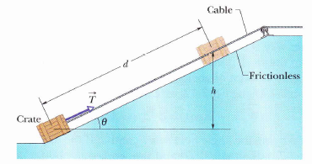
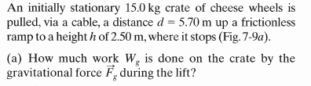

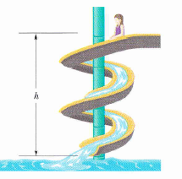
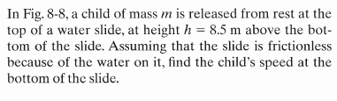
Gravity: Work done by conservative force
Answer: (a) -368 J, (b) 368 J

Slide 27
Work Done by Spring Force

Slide 28
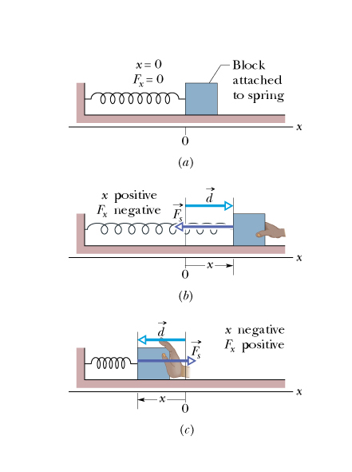
Spring Force
Within the elastic limit the spring force is always opposite to the applied force or displacement.
What will happen if you stretch (or compress) the spring?
Spring constant
displacement
Always opposes displacement
This law is called the Hooks Law
If you start with zero position
It will oppose the applied force

Slide 29
Spring Potential Energy
The Energy of a spring by virtue of its position under the spring force
Relaxed state
displaced state
The cause of gravitational potential energy is the gravitational force: F = -kx

Slide 30
Conservative force: spring force
Extended
Work done by spring force while spring is extended
f
x
i
Relaxed position, U_{0s}= 0
Work done by spring force while spring is extended
Released
i
x
f
Relaxed position, U_{s}= 0

Slide 31
Work done by Spring Force
The work done by spring force is always negative no matter whether you extend or compress it.
During Extension
During Compression
work done by the spring force
work done by the spring force
x
F_{s}
x
F_{s}
work done by the applied force
work done by the applied force
x
x
F_{a}
F_{a}

Slide 32
Summary
There are two types of potential Energies
Spring Potential Energy
Gravitational Potential Energy

Slide 33
Mechanical Energy
Conservative and non-conservative forces

Slide 34
Mechanical Energy
If a system is under both gravity and spring force
The total work done:
Mechanical Energy
Change in Mechanical Energy
The mechanical energy of any body under spring force and gravitational force doesn’t change.
The mechanical energy of a body under spring force and gravitational force conserves
The principle of conservation of mechanical energy states that in an isolated system that is only subject to conservative forces the mechanical energy is constant.
What are the conservation forces?
Answer: Spring force (-kx) and gravitational force (mg)

Slide 35
Conservative force
The force which follows the following three criteria:
1. There is no energy loss (ΔE =0) in the path while the conservative force is doing work
2. The work done by the conservative force doesn’t depend on the path.
It just depend on initial and final positions.
3. The net work done by the conservative force in a round trip is always zero.
Examples of conservative force: Spring force (-kx) and gravitational force (mg)

Slide 36
Remember: Gravitational and Spring Potential Energies
Spring Potential Energy (U_{s})
Gravitational Potential Energy (U_{s})
Relaxed position, U_{0s}= 0
U_{g} = mgh
x
h
Relaxed position, U_{0g}= 0
Potential Energy will appear only if you change the position of the object from equilibrium (relaxed) state
Note: U is mostly taken (referenced) as zero at relaxed state or you choose as per your convenience.

Slide 37
Gravitational force (F_{g} = mg): Conservative force
The work done by gravity while body moves up!
The work done by gravity while body moves down!
mg (-j)
The work doesn’t depend on the path it just depend on initial and final positions
h(- j)
h j
The net work done in a round trip is always zero
There is no energy loss in the path
Hence gravitational force (mg) is a conservative force
U = 0 (relaxed position)

Slide 38
Conservative force: spring force (F_{s} = -kx)
Extended
Work done by spring force while spring is extended
f
x
i
Relaxed position, U_{0s}= 0
Work done by spring force while spring is extended
Released
i
Net work done in the round trip
x
f
Relaxed position, U_{s}= 0
Therefore, spring force is conservative force

Slide 39
Non-conservative force: Friction
1. There is energy loss in the path while force is doing work. When friction does the work the energy is transformed into heat .
d
Rough Surface
2. The net work done by the force in a round trip is not zero.
3. The work done by the force depend on the path.

Slide 40
Conservative and non-conservative forces
Conservative force:
The net work done by conservative force in a closed path is zero
Non-conservative force:
The net work done by conservative force in a closed path path is not zero
Example:
Gravitational force (mg)
Spring force (-kx)
Example:
Friction Force
h
h
Rough Surface
Energy doesn’t get lost
Energy gets lost in the form of heat
Work depends on the initial and final positions only not in the path followed by the particle
Work depends on the path followed by the particle. Longer the path more energy gets lost

Slide 41
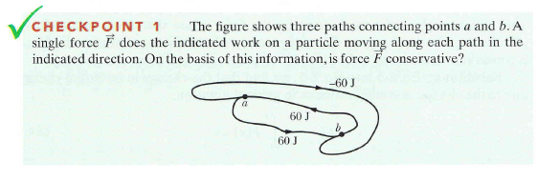
W_{ab}= -60 J
W_{ba}= 60 J
W_{ab}= 60 J
No: because the energy depends on the path followed by the particle

Slide 42
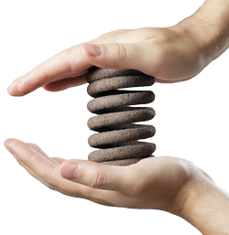
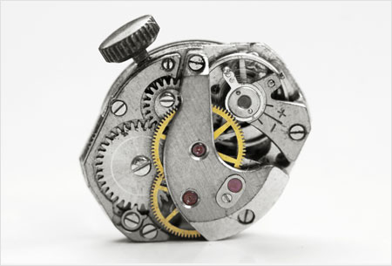
Work and Potential Energy
The net work and potential energy are related by,
You can always store energy in the form of potential energy. But for that you need to apply force (F_{a}) to do work against natural forces such as gravity (F_{g}) and spring force (F_{s}).
F_{a}
F_{a}
F_{g}
F_{s}
h
Energy is capacity to do work. They are interchangeable

Slide 43
Frictionless incline plane: Work done under external applied force
Moves up
Work done by applied (external) force
F
The net work, W on the block
Work done on the block by gravity
If spring also presents, the work done by spring force
If there is an external force the total mechanical energy doesn’t conserve.

Slide 44
Rough incline plane: Work done under external applied force
Moves up
F
Work done by applied (external) force
The net work, W on the block
f
Work done on the block by gravitational force
Work done on the block by spring force
Expand this equation!
Work done on the block by friction force
Always negative
Can be positive or negative

Slide 45
Example 1: Simple Pendulum
0
0
0
L
θ
y
mg sin(θ)
h
Goes from center to highest point
θ
x_{m}
mg cos(θ)
mg
Goes back from highest point to center
From Geometry

Slide 46
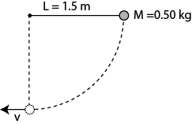
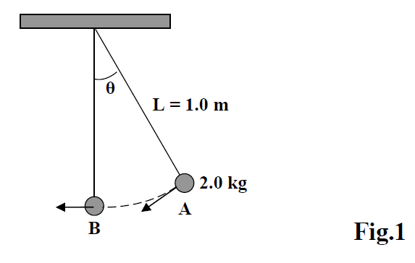
Mechanical Energy Conservation: Pendulum
Q1.Fig 1 shows a simple pendulum, consisting of a ball of mass M = 0.50 kg, attached to one end of a massless string of length L = 1.5 m. The other end is fixed. If the ball is initially released from rest with the string horizontal, then its speed at the lowest point is: ( Ans: 5.4 m/s)
Q2. An object of mass m, attached to a light cord of length L, is held horizontally from a fixed support as shown in Fig 1. The object is then released from rest. What is the tension force in the cord when the object is at the lowest point of its swing? (Ans: 3 mg)
Q3. A simple pendulum consists of a 2.00 kg mass attached to a 1.00 m long light string. It is given an initial speed of 0.500 m/s at A where the pendulum makes an angle θ with the vertical as shown in Fig.1. If its speed at the lowest point B is 1.70 m/s, find the value of the angle θ.
(A: 30.1 degrees)

Slide 47
Find following things here
F_{AN}
Lets say Body B moved “h” height down body A moves h distance in to the right.
T
h
Find the work done by tension on body A
Net Work on body A
Find the work done by tension on B
Net work on B?
Find the work done by gravity?
What is the net work done?
What is the net work done from Kinetic Energy?
T
h
F_{Ag}
mg

Slide 48

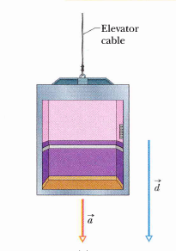
Sample Problem
a. During the fall through a distance d = 12 m, what is the work W_{g} done on the cab by the gravitational force?
b. During the 12 m fall, what is the work W_{T} done on the cab by the upward pull T of the elevator cable?
c. What is the net work done on the cab during the fall ?
d. What is the cab’s Kinetic Energy at the end of the 12 m fall?

Slide 49
More Mechanical Energy Conservation
Q1. An object moves in a circle at constant speed. The work done by the centripetal
force is zero because:
A) the change in kinetic energy of the object is not zero.
B) the centripetal force is perpendicular to the velocity.
C) the centripetal force is parallel to the velocity.
D) the object is moving with constant velocity.
E) the centripetal force does not change velocity.
Answer: B
Q1. A 4.0-kg cart starts up a frictionless incline plane with a speed of 3.0 m/s and comes to rest 2.0 m up the incline. The net work done on the cart is: (Ans: –18 J)
Checkpoint:
A ball of mass m, attached at one end of a massless string of length L, rotates in a vertical circle fast enough to prevent the string from going loose at the top of the circle. Neglecting air resistance, during this motion, which ONE of the following statements is WRONG:
A) Gravitational potential energy is not conserved.
B) The speed of the ball at the bottom of the circle is maximum.
C) The work done by the tension is zero.
D) Kinetic energy is not conserved.
E) Change in mechanical energy is not zero.
Answer: E

Slide 50
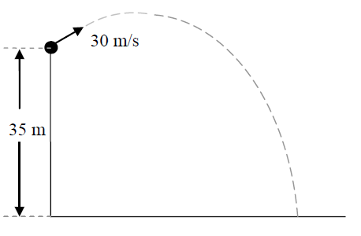
Projectile
Q2. A projectile of mass m = 0.200 kg is fired at an angle of 60.0 degrees above the horizontal with a speed of 20.0 m/s. Find the work done on the projectile by the gravitational force during its flight from its firing point to the highest point on its trajectory. (A: –30.0 J)
Q3. An 800 kg car is traveling at velocity 12 i m/s. When the brakes are applied, the car changes its velocity to 12 j m/s in 4.0 s. What is the change in kinetic energy of the car in this time period? (Ans: 0 J )
Q4. A certain force F is acting on a body of mass m = 3.0 kg and changes its velocity from an initial value v₀ = 6.0 m/s i – 2 m/s j to a final value v₀ = 8.0 m/s i + 4.0 m/s j. Find the work done by F is: A) 60 J
Q5. A projectile of mass m = 0.200 kg is fired at an angle of 60.0 degrees above the horizontal with a speed of 20.0 m/s. Find the work done on the projectile by the gravitational force during its flight from its firing point to the highest point on its trajectory.
(A: –30.0 J)
Q6. A 4.0-kg cart starts up an incline with a speed of 3.0 m/s and comes to rest 2.0 m up the incline. The net work done on the cart is: (Ans: –18 J)
Q7. A projectile is fired from a height of 35 m with a speed of 30 m/s as shown in Figure 2. Find its speed when it hits the ground. Ignore air resistance. A) 40 m/s

Slide 51
Spring: Mechanical energy conservation
5. A 50 Kg stone drops straight down from a height of 2.0 m onto a springboard with a force constant of 8 x 10³ N/m.
By what velocity did it hit the first plate?
By what maximum distance does it compress the spring?
find the total time taken by the stone to come to rest.
2m
x

Slide 52
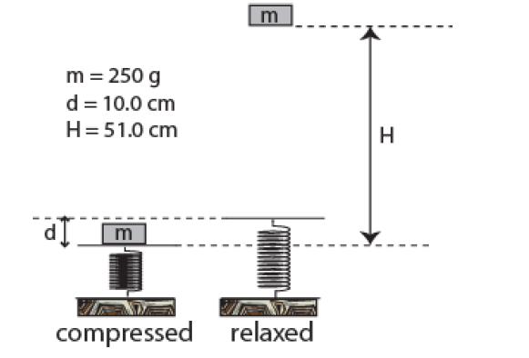
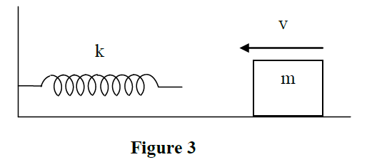
Q6. As shown in Figure 1, a 250 g mass is fired vertically upward using a spring. The spring must be compressed d =10.0 cm from its relaxed position if the mass is to just reach a maximum height H = 51.0 cm above the mass’s initial position on the compressed spring. Find the spring constant of the spring.
A) 250 N/m
Q3. In Figure 3, a 2.0 kg object slides on a frictionless horizontal surface toward a spring. The speed of the object just before it hits the spring is 6.0 m/s and its speed when the spring is compressed 15 cm is 3.7 m/s. Find the spring constant of the spring.
A) 2.0 ×10³ N/m

Slide 53
Practice Graph Problems

Slide 54
F (N)
Q1:
Figure 1 shows the Force-displacement graph of a particle of mass 0.5 kg moving along the x-axis.
What is the work done on the particle during the interval x = 1.0 m to x= 6.0 m?
What is the work done on the particle during the interval x = 1.0 m to t = 7.0 m?
10
0
x (m)
1
2
3
4
5
6
7
8
-5
Figure 1
Q2:
Figure 1 shows the Force-velocity graph of a particle of mass 5.0 kg moving along the
x-axis.
What is the average Power on the particle during the time interval v = 1.0 m/s to v = 8.0 m/s?
What is the instantaneous power at v = 3 m/s
F (N)
10
0
v (m/s)
1
2
3
4
5
6
7
8
-5
Figure 1

Slide 55
W (J)
10
Q3:
Figure 1 shows the Work-time graph of a particle of mass 0.5 kg moving along the x-axis.
What is the power at t = 6.2 s
What is the power at t = 3 s
0
t (s)
1
2
3
4
5
6
7
8
-5
Figure 1
P (W)
Q4:
Figure 1 shows the Power-time graph of a particle of mass 5.0 kg moving along the
x-axis.
What is the work done on the particle during the time interval t = 1.0 s to t = 8.0 s?
10
0
t (s)
1
2
3
4
5
6
7
8
-5
Figure 1

Slide 56
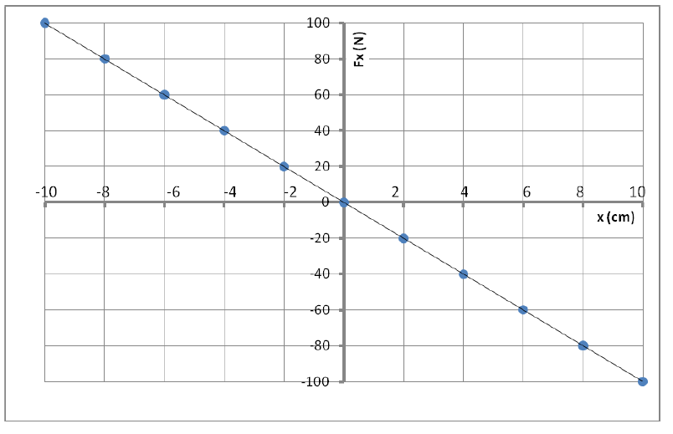
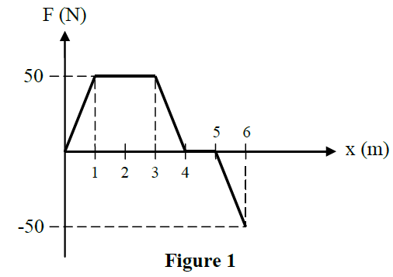
Example Problems:
Q1: Figure 1 shows the spring force as a function of position x for a spring-block system resting on a frictionless table. The block is released at F_{x} = + 10 cm. How much work (in Joules) does the spring do on the block when the block moves from x_{i} = + 8.0 cm to x_{f} = -4 cm? A) +2.4
Q1. A 5.0 kg object moving along the x-axis has a velocity of 5.0 m/s at x = 1.0 m. If the only force acting on this object is shown in Figure 1, what is the speed of the object at x = 6.0 m? A) 8.1 m/s

Slide 57
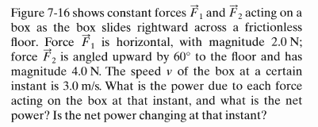
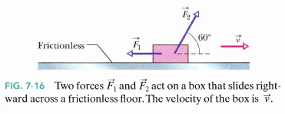
Few more problems
Q1. A man pulls a box up a rough inclined plane at constant speed. Which one of the following statements is FALSE?
a. The work done on the box by the normal force of the plane is zero.
b. The gravitational potential energy of the box increases.
c. The net work done by all the forces acting on the box is zero.
d. The work done on the box by the gravitational force is zero
e. The man does positive work in pulling the box up the incline.
Q1. A 2000 kg elevator moves 20 m upward in 4.9 sec at a constant speed. At what average rate does the force from the cable do the work on the elevator?
(Ans: 80000 W)
P₁ = -6 W, P₂ = 0, P_{net} = 0

Slide 58
Few examples: Non-conservative force
Q1. A particle moves from point A to point B under the influence of only two forces. One force is conservative and does 50 J of work. The other is non-conservative and does 20 J of work. What is the change in kinetic energy of the particle? A) 70 J
Sample problem 1: A 10³ Kg elevator carries a maximum load 8 x 10² Kg. A constant frictional force of 4 x 10³ N retards its motion upward . What minimum power in KW and in HPw must the motor deliver to left the fully loaded elevator at a constant speed of 3 m/s?
Answer: 64.8kW, 86.9 hp.
1 hpw = 746 W
Sample problem 2. A 2.2 kg block starts from rest on a rough inclined plane that makes an angle of 30° above the horizontal. The coefficient of kinetic friction is 0.25. As the block moves 3.0 m down the plane, the change in the mechanical energy of the block is: (Ans: –14 J)

Slide 59
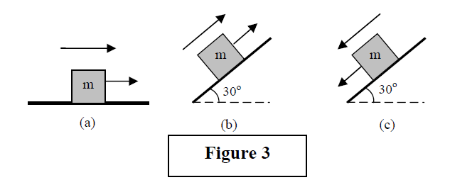
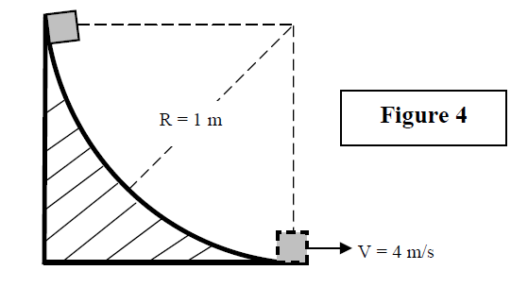
More Examples: Non-conservative force
Q1. Figure 3 shows three identical blocks that are moving on three identical rough surfaces having the same coefficient of kinetic friction. They all move the same distance parallel to the surface. Rank the 3 situations according to the magnitude of the work done by the force of friction, greatest first.
A) a then b and c tie
Q2. A block of mass 0.75 kg is free to move on a horizontal surface where μ_{k} = 0.25. The block is placed against a spring with a spring constant k = 83 N/m. The spring is compressed 0.10 m and then the block is released from rest. Find the speed of the block just as it leaves the spring.
A) 0.79 m/s
Q3. A block of mass 2.00 kg is released from rest and slides down a rough track of radius R = 1.00 m as shown in Figure 4. If the speed of the block at the bottom of the track is 4.00 m/s, what is the work done by the frictional force acting on the block?
A) − 3.60 J

Slide 60
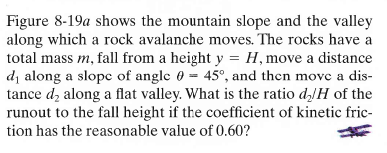
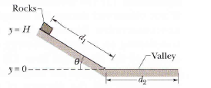
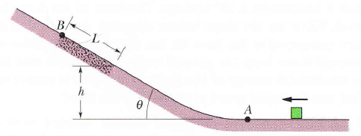
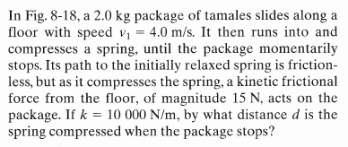
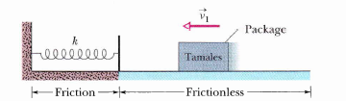
Problems from book’s example: Non-Conservative Forces
In Fig. 8-58, a block slides along a path that is without friction until the block reaches the section of length L =0.75 m, which begins at height h = 2.0 m on a ramp of angle 30º. In that section, the co-efflcient of kinetic friction is 0.40. The block passes through point A with a speed of 8.0 m/s. If the block can reach point B (where the friction ends), what is its speed there, and if it cannot, what is its greatest height above A?

Slide 61
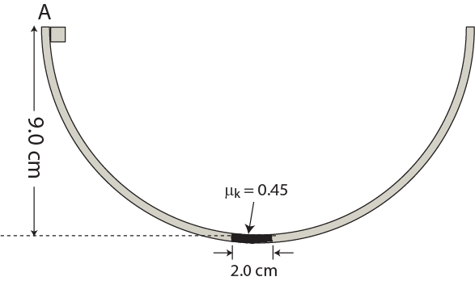
T111-Q7. A block slides back and forth in a hemispherical bowl, starting from rest at the top point A, as shown in Figure 5. The bowl is frictionless except for a 2.0 cm-wide rough flat surface at the bottom, where coefficient of kinetic friction is μ_{k}= 0.45. How many times does the block cross the rough region before coming to rest?

Slide 62
Some Important Problems

Slide 63
Q1: A ball of mass 2.0 kg is thrown horizontally from the top of a 20-m
high hill as shown in Figure 3. It strikes the ground at an angle of 45º.
with what speed was it thrown?
how much work is done to reach the ground?
which force did the work?
what is the power when did it hit the ground?
after striking the ground if the body comes in rest how much heat did it generate in the ground?
If the body bounced back with one third of its final velocity how much work is done by the friction?
m
v_{o}
20 m
Figure 3
45º
v
a. 19.8 m/s, b. 392 J, c. gravitational, d. 388 W e. 392 J f. 697

Slide 64
Q3: In figure, a small block of mass m = 0.032Kg can slide along the frictionless loop-the-loop, with loop radius R = 12 cm. The block is released at Point P, at height h = 5.0R above the bottom of the loop. How much work does the gravitational force do on the block as the block travels from point P to (a) point Q (b) the top of the loop ? Answers: (a) 0.15J, (b) 0.11J
P
If the gravitational potential energy of the block-earth system is taken to be zero at the bottom of the loop what is the potential energy at point (c) P, (d) at point Q, and (e) at the top of the loop? Answers (c) 0.19J (d) 0.038J (e) 0.075 J
h
R
Q
If instead of merely being released , a block is given some initial speed downward along the track, do the answers to (a) through (e) decrease, increase or remains the same.
R
Answer: Remains the same

Slide 65
Q2: In Figure a horizontal force F_{a} of magnitude 20.0 N is applied to 3.00 Kg Psychology book as the book slides a distance d = 0.500 m up a frictionless ramp at an angle Θ = 30⁰. During the displacement what is the work done on the book by
(a) the net force,
(b) the gravitational force
(c) the normal force?
If the book has zero kinetic energy at the start of the displacement what is the
(d) speed
(e) potential energy
(f) power at the end of the displacement?
d
F_{a}
psychology
Θ
a. 13.1 J, b. -73.5 J c. zero d. 2.9 m/s, e. 73.5 f. 7.7 W

Slide 66
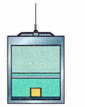
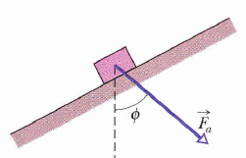
***Q25: In Fig. 7-35, a 0.250 kg block of cheese lies on the floor of a 900 kg elevator cab that is being pulled upward by a cable through distance d₁= 2.40 m and then through distance d₂= 10.5 m. (a) Through d₁, if the normal force on the block from the floor has constant magnitude F_{N} =3.00 N, how much work is done on the cab by the force from the cable? (b) Through d₂,if the work done on the cab by the (constant force from the cable is 92.61. kJ, what is the magnitude of F_{N}?
**Q20: In Fig. 7-32, a constant force F_{a} magnitude 82.0 N is applied to a 3.00 kg shoe box at angle φ=53º, causing the box to move up a frictionless ramp at constant speed. How much work is done on the box by F_{a} when the box has moved through vertical distance h = 0.150 m?

Slide 67
Q4. A worker does 500 J of work in moving a 20 kg box a distance 2.0 m on a rough horizontal floor. The box starts from rest and its final velocity after moving 2.0 m is 4.0 m/s.
Find :
(a)work done by the friction between the box and the floor in moving 2.0 m distance
(b) Coefficient of kinetic friction between the box and the floor
(c) Net force on the box
(d) time taken to reach the distance 2m
(e) Energy lost during the process
(f) amount of heat generated during the process.

Slide 68
Q6: A 5kg block rests on horizontal frictionless surface. The block is pressed back against the spring having a constant of k = 625 N/m, compressing the spring by 10 cm. Then the block is released.
find the maximum distance d the block travels up the frictionless incline plane of angle 30⁰.
(b) how fast is the block going when halfway to its maximum height?
Ans: d = 1.28 m, v = 2.5 m/s
d
5kg
h
h/2
30⁰
10 cm
0

Slide 69
Q7: A block of mass m = 2.5 kg slide head on into a spring of spring constant k = 320 N/m. When the block stops it has compressed the spring by 7.5 cm. The coefficient of kinetic friction between the block and the floor is 0.25. While the block is in contact with the spring and being brought to the rest , what are
the work done by the spring force
the increase in thermal energy of the block-floor system?
what is the block’s speed just as it reaches the spring?
Answers: (a) 0.9 J (b) 0.46 J
2.5kg

Slide 70
Graph: Work/Power
F
= Area under the curve
x
F
= Area under the curve
v
E
= Slope
t

Slide 71
Old Exams

Slide 72
T-102-ch7 and 8
Q1. A 15.0-kg block is pulled over a rough, horizontal surface by a constant force of 70.0 N acting at an angle of 20.0° above the horizontal. The block is displaced 5.00 m, and the coefficient of kinetic friction between the block and the horizontal surface μ_{k} = 0.200. Find the work done by the force of friction. A) − 123 J
Q2. An elevator is designed to carry a load of 20.0 × 103 N from the ground to a height of 87.5 m in a time of 18.0 seconds. What is the average power that must be supplied by the motor of the elevator to lift this load? A) 97.2 × 103 W
Q3. A certain force F is acting on a body of mass m = 3.0 kg and changes its velocity from an initial value v₀ = 6.0 m/s i – 2 m/s j to a final value v₀ = 8.0 m/s i + 4.0 m/s j. Find the work done by F is: A) 60 J
Q4. A man pulls a box up a rough inclined plane at constant speed. Which one of the following statements is FALSE?
a. The work done on the box by the gravitational force is zero.
b. The gravitational potential energy of the box increases.
c. The net work done by all the forces acting on the box is zero.
d. The work done on the box by the normal force of the plane is zero.
e. The man does positive work in pulling the box up the incline.

Slide 73
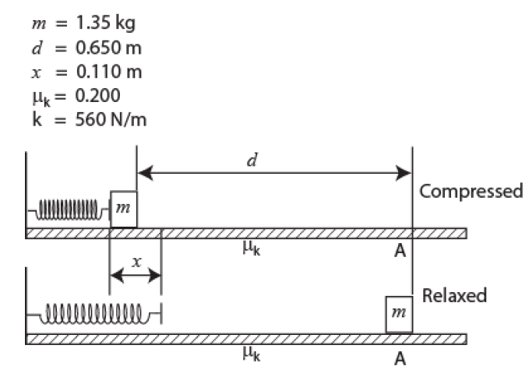
T-102-ch7 and 8
Q5. A small mass suspended from a string of length 0.20 m is pulled sideways until the string makes an angle φ= 60º with the vertical. It is then released from rest. Find the speed of the mass when it passes through the lowest point of its path during its motion.
A) 1.4 m/s
Q6. As shown in Figure 1, a 250 g mass is fired vertically upward using a spring. The spring must be compressed d =10.0 cm from its relaxed position if the mass is to just reach a maximum height H = 51.0 cm above the mass’s initial position on the compressed spring. Find the spring constant of the spring.
A) 250 N/m
Q7. As shown in Figure 2, a block of mass m = 1.35 kg is held against a compressed spring of spring constant k = 560 N/m. The spring is compressed by x = 0.110 m. The block is released and slides a distance d = 0.650 m to point A. Find the speed of the block at point A if the coefficient of kinetic friction between the block and the surface is μ_{k} = 0.200.
A) 1.57 m/s

Slide 74
T-101-ch7 and 8
Q1. A stone of mass 1.0 kg, tied to a rope of length 2.0 m, is rotating in a horizontal circle on a frictionless table top with a speed of 1.0 m/s. Find the work done by the force of tension in the rope when the stone has completed one revolution. A) 0 J
Q2: Figure 1 shows the spring force as a function of position x for a spring-block system resting on a frictionless table. The block is released at F_{x} = + 10 cm. How much work (in Joules) does the spring do on the block when the block moves from x_{i} = + 8.0 cm to x_{f} = -4 cm? A) +2.4
Q3. A particle is acted on by a constant force F= (2.0 N) i– (5.0 N) j and is displaced from an initial position of d_{i}= (0.50 m)i+ (0.80 m)j at time t = 0 s to a final position of d_{f}= (3.5 m)i+ (9.8 m)j at time t = 10 s. Find the average power (in Watts) on the particle due to this force in this time interval. A) –3.9
Q4. A single force acts on a 5.0 kg object. The position of the object as a function of time is given by x = 10 t – 5.0 t², where x is in meters and t is in seconds. Find the work done by this force on the object in the interval from t = 0 s to t = 5.0 s.
A) 3.8 ×10³ J

Slide 75
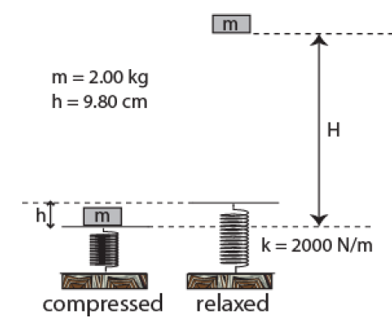
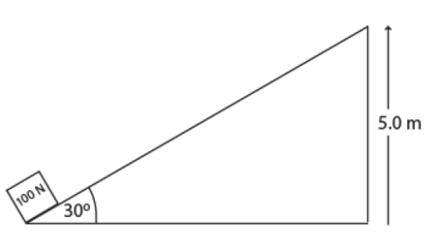
T-101-ch7 and 8
Q5. An object of mass 1.0 kg is moving in a straight line over a rough horizontal surface. The coefficient of kinetic friction between the object and the floor is 0.20. What is the power that must be supplied to the object in order to keep it moving at a constant speed of 2.0 m/s? A) 3.9 W
Q6. A projectile is fired from a height of 35 m with a speed of 30 m/s as shown in Figure 2. Find its speed when it hits the ground. Ignore air resistance. A) 40 m/s
Fig 2
Q7. A spring is compressed a distance of h = 9.80 cm from its relaxed position and a 2.00 kg block is put on top of it (Figure 3). What is the maximum height, H, that the block will reach when the spring is released? The spring constant is k = 2.00 ×103 N/m. A) 49.0 cm
Fig 3
Q8. A man pulls a 100-N crate up a frictionless 30.0° - incline to a height 5.00 m, as shown in Figure 4. Assuming that the crate moves at a constant speed, the work done on the crate by the man is: A) +500 J

Slide 76
T-92-ch7 and 8
Q1. A 5.0 kg object moving along the x-axis has a velocity of 5.0 m/s at x = 1.0 m. If the only force acting on this object is shown in Figure 1, what is the speed of the object at x = 6.0 m? A) 8.1 m/s
Q2: A man moves the 10-kg object shown in Figure 2 in a vertical plane from position X to position Y along a circular track of radius R = 20 m. The work done by the force of gravity during this motion is
A) − 3920 J
Q3. In Figure 3, a 2.0 kg object slides on a frictionless horizontal surface toward a spring. The speed of the object just before it hits the spring is 6.0 m/s and its speed when the spring is compressed 15 cm is 3.7 m/s. Find the spring constant of the spring.
A) 2.0 ×10³ N/m

Slide 77
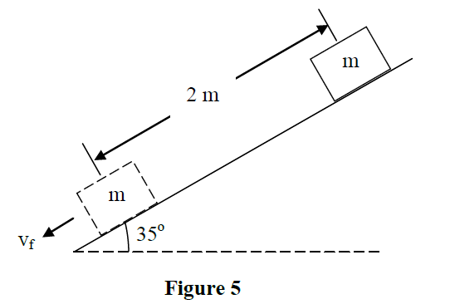
T-92-ch7 and 8
Q4. Figure 4 shows two equal forces of magnitude F = 10 N acting on a box as the box slides to the right across a frictionless floor. The speed of the box at a certain instant is 4.0 m/s. Calculate the net power due to these two forces at that instant? A) 20 W
Q5. A 3.0 kg block starts from rest on a rough inclined plane that makes an angle of 35o with the horizontal as shown in Figure 5. As the block moves 2.0 m down the incline, its speed is 4.0 m/s. Find the value of the coefficient of kinetic friction between the block and the incline. A) 0.2
Q6. A particle moves from point A to point B under the influence of only two forces. One force is conservative and does 50 J of work. The other is non-conservative and does 20 J of work. What is the change in kinetic energy of the particle?
A) 70 J
Q7. A 2.0 kg object is thrown vertically upward with an initial speed of 30 m/s. After moving a vertical distance of 25 m, its speed is 5.0 m/s. How much work is done by the air resistance on the object during this upward motion?
A) − 385 J

Slide 78
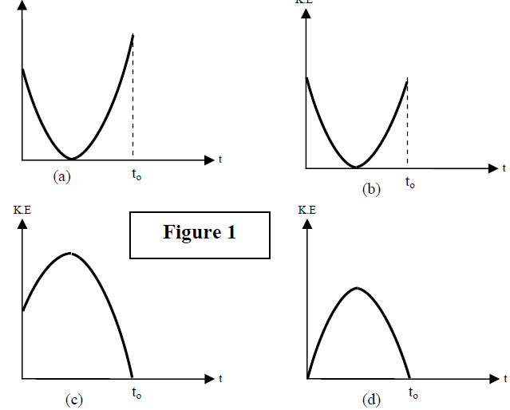
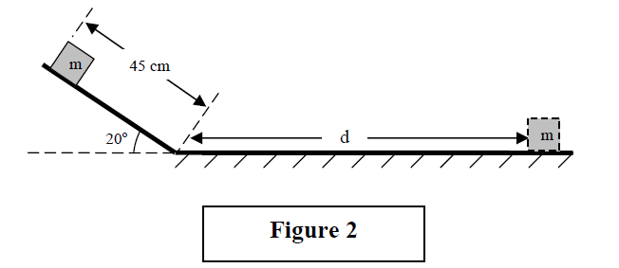
T-91-ch7 and 8
Q1. A stone is thrown upward from the top of a building. It takes a time to for the stone to reach the ground. Which one of the plots shown in Figure 1 best represents the change of the kinetic energy of the stone with time?
A) (a)
Q2. A body of mass M = 2.00 kg, tied to a string, rotates in a vertical circle of radius R = 1.00 m. Find the work done by the force of gravity on the body during one full revolution. A) zero
Q3. Two constant forces and F₁ = (-5.0 i +3.0 j) N and F₂ = (3.0 i-3.0 j) N act on a box as it slides across a frictionless (xy)-horizontal floor. What is the power due to the two forces at the instant when the velocity of the box is 2.3 m/s along the positive x-axis? A) − 4.6 W
Q4. Figure 2 shows an object of mass m = 1.00 kg starting from rest. It first slides a distance 45.0 cm down a frictionless inclined surface and then slides across a rough horizontal surface whose coefficient of kinetic friction is 0.150. What is the maximum distance d travelled by the object across the horizontal surface? A) 103 cm

Slide 79
T-91-ch7 and 8
Q5. Figure 3 shows three identical blocks that are moving on three identical rough surfaces having the same coefficient of kinetic friction. They all move the same distance parallel to the surface. Rank the 3 situations according to the magnitude of the work done by the force of friction, greatest first.
A) a then b and c tie
Q6. A block of mass 0.75 kg is free to move on a horizontal surface where μ_{k} = 0.25. The block is placed against a spring with a spring constant k = 83 N/m. The spring is compressed 0.10 m and then the block is released from rest. Find the speed of the block just as it leaves the spring.
A) 0.79 m/s
Q7.
A block of mass 2.00 kg is released from rest and slides down a rough track of radius R = 1.00 m as shown in Figure 4. If the speed of the block at the bottom of the track is 4.00 m/s, what is the work done by the frictional force acting on the block?
A) − 3.60 J

Slide 80
T-82-Ch7
Q1. An object moves in a circle at constant speed. The work done by the centripetal
force is zero because:
A) the centripetal force is perpendicular to the velocity.
B) the change in kinetic energy of the object is not zero.
C) the centripetal force is parallel to the velocity.
D) the object is moving with constant velocity.
E) the centripetal force does not change velocity.
Q2. A 4.0-kg cart starts up an incline with a speed of 3.0 m/s and comes to rest 2.0 m up the incline. The net work done on the cart is: (Ans: –18 J)
Q3. A block of mass 1.6 kg, resting on a horizontal frictionless surface, is attached to a horizontal spring fixed at one end. The spring, having a spring constant of 1.0 x 10³ N/m, is compressed to x = -2.0 cm (x = 0.0 is the equilibrium position) and the block is released from rest. The speed of the block as it passes through the position x = - 1.0 cm is: (A 0.43 m/s

Slide 81
T-82-Ch8
Q4. A 3.0-kg mass has an initial velocity v_{o} = (6.0 i – 2.0 j) m/s. A single force F is applied for 5.0 s which changes its velocity to v = (8.0 i + 4.0 j) m/s. Find the average power delivered by the force in this interval. (Ans: 12 W)
Q5. A projectile of mass m = 0.200 kg is fired at an angle of 60.0 degrees above the horizontal with a speed of 20.0 m/s. Find the work done on the projectile by the gravitational force during its flight from its firing point to the highest point on its trajectory.
(A: –30.0 J)
Q6. A 0.500-kg block is pushed against a horizontal spring fixed at one end (the block is NOT attached to the spring), compressing the spring 10.0 cm. The spring has a spring constant of 1.00 x 10² N/m. The block lies on a horizontal floor having a coefficient of kinetic friction μ_{k} = 0.200. Find the total distance traveled by the block after being released from rest.
(A: 51.0 cm)

Slide 82
T-82-Ch8
Q8. A ball of mass m, attached at one end of a massless string of length L, rotates in a vertical circle fast enough to prevent the string from going loose at the top of the circle. Neglecting air resistance, during this motion, which ONE of the following statements is WRONG:
A) Change in mechanical energy is not zero.
B) The speed of the ball at the bottom of the circle is maximum.
C) The work done by the tension is zero.
D) Kinetic energy is not conserved.
E) Gravitational potential energy is not conserved.
Q7.A simple pendulum consists of a 2.00 kg mass attached to a 1.00 m long light string. It is given an initial speed of 0.500 m/s at A where the pendulum makes an angle θ with the vertical as shown in Fig.1. If its speed at the lowest point B is 1.70 m/s, find the value of the angle θ.
(A: 30.1 degrees)

Slide 83
T-81-Ch7
Q1.: Figure 1 shows the acceleration of a 2 kg particle as a single force acts on it along the x-axis, from x = 0 to x = 6 m. Find the work done by the force on the particle. (Ans: 48 J)
Q2.: A 0.2-kg stone tied to a string is rotated in a horizontal circle of radius 0.5 m. The speed of the stone is kept constant at 1.0 m/s. Find the work done by the tension of the string on the stone in one rotation.( Ans:0.0 J)
Q3.: A 60-kg boy runs from the 1st floor to the 2nd floor, using the stairs, in 12 s. The stairs are made up of 30 steps, each 10 cm high. Calculate the average power required by the boy.(Ans: 147 W)
Q4.: A 2-kg block slides across a horizontal frictionless floor with a speed of 2.0 m/s. It then runs into and compresses a spring of spring constant k = 800 N/m. The block comes momentarily to rest after compressing the spring a distance d. Find the distance d. (Ans:10 cm)

Slide 84
T-81-Ch8
Q5.: A 2-kg object is dropped vertically from rest. After falling a distance of 50 m, it has a speed of 25 m/s. Calculate the work done by the air resistance on the object during this fall.( Ans: -355 J)
Q6.: A spring with spring constant k = 106 N/m is attached to the top of a frictionless 30⁰ incline as shown in Figure 2. The distance between the lower end of the incline and the relaxed end of the spring is 1 m. A 1-kg block is pushed against the spring until the spring is compressed by 0.2 m and released from rest. Find the speed of the block when it reaches the lower end of the incline. (ignore the size of the block). (Ans: 4.0 m/s)
Q7. A projectile is fired from a height of 25 m with a speed of 20 m/s as shown in Figure 3. Find its speed when it hits the ground. Ignore air resistance. (Ans: 30 m/s)
Q8.: As an object moves from point A to point B, only two forces act on it: one force is conservative and does 10 J of work, the other is non conservative and does –20 J of work. What happens to the energy of the object between points A and B? (Ans: Kinetic energy decreases, mechanical energy decreases.)

Slide 85
T-72-Ch7
Q1.Fig 1 shows a simple pendulum, consisting of a ball of mass M = 0.50 kg, attached to one end of a massless string of length L = 1.5 m. The other end is fixed. If the ball is initially released from rest with the string horizontal, then its speed at the lowest point is: ( Ans: 5.4 m/s)
Q3. A person pushes horizontally a 10 kg box at a constant velocity 1.5 m/s. The coefficient of kinetic friction between the box and the horizontal floor is 0.30. What is the rate of work that the person does in pushing the box? (Ans: 44W)
T61:Q7. An object of mass m, attached to a light cord of length L, is held horizontally from a fixed support as shown in Fig 1. The object is then released from rest. What is the tension force in the cord when the object is at the lowest point of its swing? (Ans: 3 mg)

Slide 86
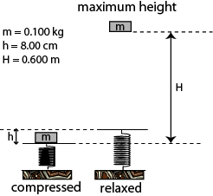
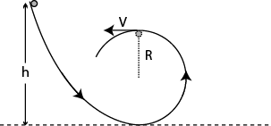
T-72-Ch8
Q2.: A ball slides without friction around a loop-the-loop (see Fig 2). A ball is released, from rest, at a height h from the left side of the loop of radius R. What is the ratio (h/R) so that the ball has a speed v=√Rg at the highest point of the loop? (g = acceleration due to gravity) (Ans:5/2)
Q4. A worker does 500 J of work in moving a 20 kg box a distance D on a rough horizontal floor. The box starts from rest and its final velocity after moving the distance D is 4.0 m/s. Find the work done by the friction between the box and the floor in moving the distance D.( Ans: –340 J)
Q5. A 2.0 kg block is released from rest 60 m above the ground. Take the gravitational potential energy of the block to be zero at the ground. At what height above the ground is the kinetic energy of the block equal to half its gravitational potential energy? (Ignore air resistance).( Ans: 40 m)
Q6. A 2.2 kg block starts from rest on a rough inclined plane that makes an angle of 30° above the horizontal. The coefficient of kinetic friction is 0.25. As the block moves 3.0 m down the plane, the change in the mechanical energy of the block is: (Ans: –14 J)
Q7. A 0.50 kg block attached to an ideal spring with a spring constant of 80 N/m oscillates on a horizontal frictionless surface. The speed of the block is 0.50 m/s, when the spring is stretched by 4.0 cm. The maximum speed the block can have is: (Ans: 0.71 m/s)
Q8.A block (mass = 0.100 kg) is pushed against a vertical spring compressing the spring a distance of h = 8.00 cm (see Fig 3). The block is not attached to the spring. When released from rest, the block rises to a maximum height of H = 0.600 m. Calculate the spring constant.
Fig 2
Fig3

Slide 87
T-71-Ch7
Q1. An 800 kg car is traveling at velocity 12 i m/s. When the brakes are applied, the car changes its velocity to 12 j m/s in 4.0 s. What is the change in kinetic energy of the car in this time period? (Ans: 0 J )
Q2. An ideal spring is hung vertically from the ceiling. When a 2.0 kg mass hangs at rest from it, the spring is extended 6.0 cm from its relaxed length. A downward external force is now applied to the mass to extend the spring an additional 10 cm. While the spring is being extended by the external force, the work done by the spring is: (Ans: −3.6 J )
Q3. A single force acts on a 5.0 kg object in such a way that the position of the object as a function of time is given by x=10.0 t -5.0 t² with x is in meters and t is in seconds. Find the work done on the object from t = 0 to t = 4.0 s. (Ans: 2000 J)
Q4. A 2000 kg elevator moves 20 m upward in 4.9 sec at a constant speed. At what average rate does the force from the cable do the work on the elevator? (Ans: 80000 W)

Slide 88
T-71-Ch8
Q5. A 10.0 kg block is released from rest 100 m above the ground. When it has fallen 50 m, its kinetic energy is: (Ans: 4900 J )
Q6. A 4.0 kg block is initially moving to the right on a horizontal frictionless surface at a speed of 5.0 m/s. It then compresses a horizontal spring of spring constant 200 N/m. At the instant when the kinetic energy of the block is equal to the potential energy of the spring, the mechanical energy of the block-spring system is: (Ans: 50 J)
Q7. A 5.0 kg block starts up a 30° incline with 198 J of kinetic energy. The block slides up the incline and stops after traveling 4.0 m. The work done by the force of friction between the block and the incline is: (Ans: -100 J)

Slide 89
T-62-Ch7
Q1. A 10.0 kg box slides with a constant speed a distance of 5.00 m downward along a rough slope that makes an angle of 30.0° with the horizontal. The work done by the force of gravity is: (Ans: 245 J)
Q2. A block is attached to the end of an ideal spring and moved from coordinate x_{i} to coordinate x_{f} . The relaxed position is at x = 0. For which values of x_{i} and x_{f} that are given below, the work done by spring is positive? (Ans: x_{i} = -4 cm and x_{f} = -2 cm)
Q3. Fig. 1 gives the only force F_{x} that can act on a particle. If the particle has a kinetic energy of 10 J at x = 0, find the kinetic energy of the particle when it is at x = 8.0 m. (Ans: 30 J)

Slide 90
T-62-Ch8
Q4: A 200 kg box is pulled along a horizontal surface by an engine. The coefficient of friction between the box and the surface is 0.400. The power the engine delivers to move the box at constant speed of 5.00 m/s is: (Ans: 3920 W)
Q5. A 2.0 kg object is connected to one end of an unstretched spring which is attached to the ceiling by the other end and then the object is allowed to drop. The spring constant of the spring is 196 N/m. How far does it drop before coming to rest momentarily? (Ans: 0.20 m)
Q6. A 2.0 kg block is thrown upward from the ground. At what height above the ground will the gravitational potential energy of the Earth-block system have increased by 490 J? (Ans: 25 m)
Q7. An ideal spring (compressed by 7.00 cm and initially at rest,) fires a 15.0 g block horizontally across a frictionless table top. The spring has a spring constant of 20.0 N/m. The speed of the block as it leaves the spring is: (Ans:2.56 m/s )
Q8 : A small object of mass m on the end of a massless rod of length L is held vertically, initially. The rod is pivoted at the other end O. The object is then released from rest and allowed to A small object of mass m on the end of a massless rod of length L is held vertically, initially. The rod is pivoted at the other end O. The object is then released from rest and allowed to swing down in a circular path as shown in Fig. 2. What is the speed (v) of the object at the lowest point of its swing? (Assume no friction at the pivot) (Ans: 4gL)
Fig 2

Slide 91
T-61-Ch7
Q1. A 16 kg crate falls from rest from a height of 1.0 m onto a spring scale with a spring constant of 2.74 × 10³ N/m. Find the maximum distance the spring is compressed. (Ans: 40 cm)
Q2. A 4.0 kg cart starts up an incline with a speed of 3.0 m/s and comes to rest 2.0 m up the incline. The net work done on the cart is: (Ans: -18 J )
Q3. A net horizontal force of 50 N is acting on a 2.0 kg crate that starts from rest on a horizontal frictionless surface. At the instant the object has traveled 2.0 m, the rate at which this net force doing work is: (Ans: 500 W)
Q4. At time t = 0 a single force F acts on a 2.0 kg particle and changes its velocity from v_{i} = (4.0i -3.0 j) m/s at t =0 s to v_{f} = (4.0i +3.0 j) m/s at t = 3.0 s. During this time the work done by F on the particle is: (Ans: 0)

Slide 92
T-61-Ch8
Q5. A 2.2 kg block starts from rest on a rough inclined plane that makes an angle of 25° with the horizontal. The coefficient of kinetic friction is 0.25. As the block slides 2.0 m down the plane, the mechanical energy of the Earth-block system changes by: (Ans: −9.8 J)
Q6. An ideal spring with a 20 N/m spring constant is compressed by a 10 N force. The potential energy stored in the spring is: (Ans: 2.5 J)
Q7. An object of mass m, attached to a light cord of length L, is held horizontally from a fixed support as shown in Fig 1. The object is then released from rest. What is the tension force in the cord when the object is at the lowest point of its swing? (Ans: 3 mg)
Q8. A block of mass 2.0 kg is initially moving to the right on a horizontal frictionless surface at a speed 5.0 m/s. It then compresses a spring of spring constant 100 N/m. At the instant when the kinetic energy of the block is equal to the potential energy of the spring, the spring is compressed a distance of: (Ans: 0.50 m )

