Slide 1
Chapter 3
(Vectors)
Addition of vectors
Resolution of vector
Multiplication of vector (Scalar and vector Products)

Slide 2
Lecture 1
Addition of vectors
Resolution of vector

Slide 3
Right Angle Triangle Property
Do you remember?
Out of 4 (a, x, y, θ) if you know 2 you can get other two
a
y =?
a = ?
y = a sin(θ)
y
θ
θ
x = a cos(θ)
x =?
x
If you know x and y, you can get ‘a’ and θ
If you know ‘a’ and ‘θ’, you can get ‘a’

Slide 4
Vector: One Dimension (x)
Negative Direction (left)
Positive Direction (Right)
-5
-4
-3
-2
-1
0
1
2
3
4
5
start
X-direction is represented by unit vector ‘ i ’ or
Direction
Magnitude
Vector notation:
Vector notation:
Magnitude:
Magnitude:
Unit vector:

Slide 5
Add or Subtract: One Dimension
Resultant vector:
Rule 1: Put the head of vector A to the tail of vector B
Magnitude:
Rule 2: The resultant vector will be the line joining the tail of A to the head of B
Resultant vector:
Magnitude:
Magnitude:

Slide 6

Example:
Position is measured from a starting point called origin (start).
-5
-4
-3
-2
-1
0
1
2
3
4
5
start
Rule 1: Put the head of vector 1 to the tail of vector 2
0
2cm
5 cm
3 cm
5 cm i 3 cm i
Rule 2: The resultant vector will be the line joining the tail of 1 to the head of 2
Resultant displacement = 5cm i + 3 cm i = 8 cm i
Magnitude:

Slide 7
Vector: One Dimension (y)
y-direction is represented by unit vector ‘ j ’ or
Positive y-direction (j)
Magnitude
Magnitude
0
Direction
Direction
5
4
3
2
1
-1
-2
-3
-4
-5
negative y-direction (-j)
Vector notation:
Vector notation:
Magnitude:
Magnitude:
Unit vector:
Rule of addition and subtraction are same as x-direction.

Slide 8
Example:
Rule 1: Put the head of vector 1 to the tail of vector 2
4 cm (-j)
Rule 2: The resultant vector will be the line joining the tail of 1 to the head of 2
8 cm j
4 cm j
Resultant displacement = 8 cm j - 4 cm j = 4 cm j
Magnitude:
0

Slide 9
3D: Unit Vectors
i , j, k or are unit vectors representing x- y and z-directions respectively
5
4
3
2
1
0
-1
-2
-3
-4
-5
-5
-4
-3
-2
-1
1
2
3
4
5

Slide 10
Triangle Law of Vector: Vector addition
Rule 1: Put the head of vector 1 to the tail of vector 2
Rule 2: The resultant vector will be the line joining the tail of 1 to the head of 2
Note: You are free to move vector without changing its direction (angle)
B
θ
C
A
Resultant vector:
Magnitude(Length) of AC:
Magnitude(Length) of BC:
Magnitude:
Magnitude(Length) of AB:

Slide 11

Example:
j
This means the ant moved 5-steps along x-direction and 4-steps along y-direction
B
5i+ 4j
4j
AB=5i+ 4j
0
i
A
5i
There are two ways for the ant to reach from point A to B
Magnitude of x component
Magnitude of y component
Magnitude (length) of AB =

Slide 12
Example 2:
j
B
5i +4j
5i
0
i
A
3i-3j
8i-3j
C

Slide 13
Checkpoint:
j
B
5i +4j
?
0
i
A
8i-3j
C
1. In the vector diagram which one is resultant?
Answers:
1. AB
2. -3i+7j
3. AC
4. 3i-7j
2. Find the vector vector CB !
3. In the vector diagram which one is resultant ?
4. Find the vector BC !

Slide 14
Is it True?
j
CB =-3i+7j
AB is Resultant
B
5i +4j
0
i
A
8i-3j
You can move any vector without changing its direction and magnitude.
You can put all the vectors with their tail at origin.
The resultant vector is always in between the two vectors which make it.
C

Slide 15
Is it True?
j
AC is Resultant
B
5i +4j
0
i
A
8i-3j
You can move any vector without changing its direction and magnitude.
You can put any vector with its tail at origin.
The resultant vector is always in between the two vectors which make it.
C
BC =3i-7j

Slide 16
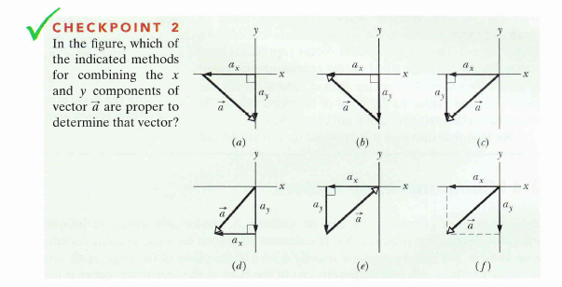
Checkpoints
Answers:
c, d, f

Slide 17
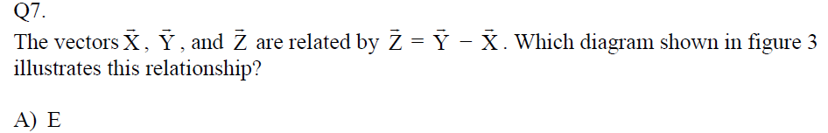
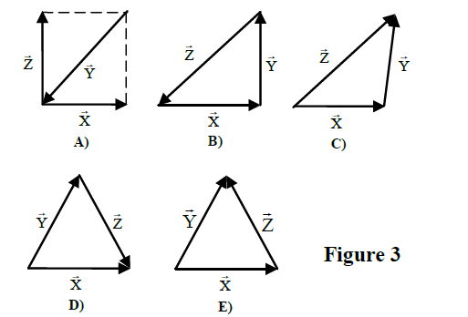

Slide 18
Vector Resolution: Breaking one vector into two
j
What is x component?
What is y-component?
What is angle with x-axis?
5i +4j
4j
8 (-i)
0
5i
i
9 (-j)
8(-i)+9(-j)

Slide 19
Vector Resolution: Breaking one vector into two
Resolution is just opposite of vector addition
Resultant vector:
Magnitude of x -component:
Magnitude of x -component:
Magnitude:
Magnitude of a:

Slide 20
Vector Resolution: Angular components
We can break one vector into two or more perpendicular vector components
θ
θ
Resultant vector:
Cos: goes with the side where angle is formed
Sin: goes to the opposite side of the angle
Prove that:
Magnitude:

Slide 21
Resolution of vector
d_{y} j
d_{y} j
d
d
-d_{x} i
-d_{x} i
d_{x} i
d_{x} i
d
-d_{y} j
d
-d_{y} j

Slide 22
Vector Properties
1. You can extend the vector along its direction.
2. The angle has to be measured from arrow to arrow.
3. You can rotate all vectors together to align one vector in the horizontal direction if horizontal direction is not defined.
B
θ
A
y
4. Resolve other vectors into x and y directions.
B sin(θ)
B
x
y
θ
x
A
B cos(θ)

Slide 23
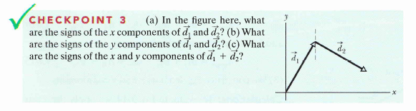
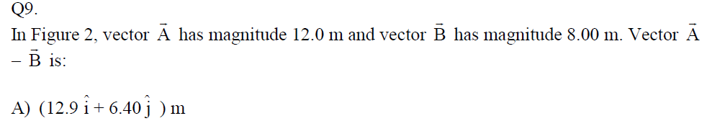
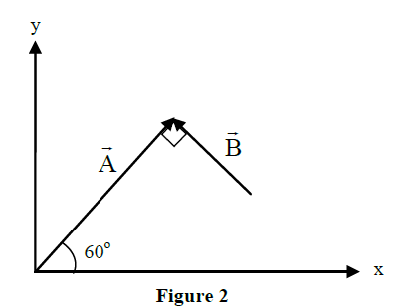
Checkpoints
i and j
i and –j
i and j
d₁+d₂
d_{1x} j
d₁
(d_{1x} +d_{2x} )j
d_{2x} i
d_{1x} i
(d_{1x} +d_{2x})i
d₁
d_{2x} (-j)

Slide 24
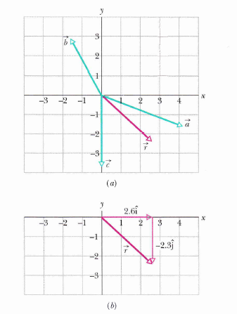
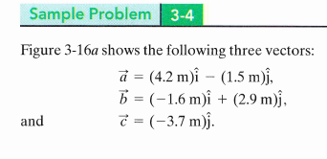

Sample Problmem: Page 45
a) What is the magnitude of r?
b) What is the direction of r?
Answers:
a) 3.5 m
b) -41º

Slide 25
Lecture 2
Multiplication of vector (Scalar and vector Products)

Slide 26
Multiplication of vectors
There are two types of vector Multiplication:
Scalar Product (Multiplication)
Vector Product (Multiplication)
a SinΘ
Θ
a CosΘ
Scalar Product: Dot Product
Vector Product: Cross Product
Result is always a scalar
Result is vector and its direction is perpendicular (normal) to the both original vectors

Slide 27
Multiplication of vectors
b_{y}
a_{y}
b_{x}
a_{x}
Vector Product: Cross Product
Scalar Product: Dot Product
b_{y}
a_{y}
a_{y}
b_{x}
x
b_{y}
a_{x}
a_{x}
b_{x}

Slide 28
Multiplication of vectors
b_{y}
a_{y}
b_{x}
a_{x}
Vector Product: Cross Product
Scalar Product: Dot Product
b_{y}
a_{y}
a_{y}
b_{x}
x
b_{y}
a_{x}
a_{x}
b_{x}

Slide 29
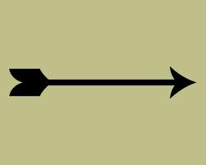
3 Dimensional vector direction
j
X
.
Out of the page (k)
Into the page (-k)
i

Slide 30
Scalar Product
Scalar products of unit vectors
The result of scalar multiplication between vectors a and b is:
Prove this!
Final result is scalar
This is also called dot product

Slide 31
Scalar Multiplication: Dot product
Any vector can be written in its components
0
0
0
0
0
0
Final result is scalar

Slide 32
Vector Product
vector products of unit vectors
Proof
The result of vector multiplication between vectors a and b is:
This is also called cross product
n cap represents the direction of a x b which is normal to a as well as b
Learn this rule!
Clockwise + ve
Anticlockwise - ve

Slide 33
Vector Multiplication: Cross product
Any vector can be written in its components
Clockwise + ve
Anticlockwise - ve
0
0
Final result is vector

Slide 34

Checkpoints
Answers:
90º
0º
180º

Slide 35
Problems

Slide 36
3- ideas in this chapter
1. Vector addition ( getting resulting vector)
a+b
b
a
2. Resolution of vector (Breaking vector into its components)
a
a_{y}j
a
asin(θ)j
θ
acos(θ)i
a_{x}i
3. Multiplication of vectors
You can get mixed concepts as well

Slide 37
Problem Solving strategy
Read the questions carefully and underline the given quantities and clue points.
Figure out what you need to find.
Draw a diagram and write down the given quantities.
Solve for the unknown.
Q8. Consider two vectors A = (3 i + 4 j) cm and B = (- 4 i + 3 j) cm. Find the angle between these two vectors. (Ans: 90 degrees)
Alternative method
?
3j
4j
-4i
3i
Find these angles

Slide 38
Sample Question
Exmaple 2:
A vector A is defined as A = 1.5i +1.5j. Find a vector B that makes an angle of 60⁰ with A in the counterclockwise direction and has magnitude of 4 units.
Ans: -1.04 i +3.86 j

Slide 39
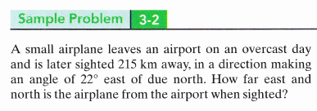
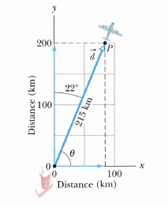
Sample Problem (Page 42)
N
West of North
East of North
W
E
Answers:
d_{x} =81 Km
d_{y} = 199 Km
West of South
East of South
Always make angle with last direction.
Example:
22º East of North, make angle with North
22º North of East, make angle with East
S

Slide 40
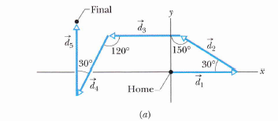
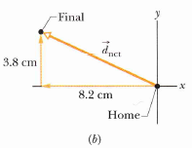
Sample Question: Page 46
An ants make 5 moves as shown in figure,
Draw the diagram of resultant vector
If each move is 6.0 cm what is the net displacement vector
What is the magnitude of net displacement?
What is the angle of the net displacement?
Answers:
b) - 8.2 cm i + 3.8 cm j
c) 9.0 cm
d) -24.8º

Slide 41
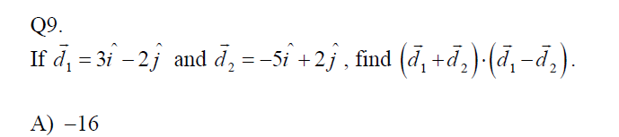
Find: d₁ x d₂

Slide 42
T102-Ch3
Q7.
A man leaves his house and makes three successive displacements. The first displacement is D1 (10.0 km, 60.0°), the second displacement D2 is unknown, and the third displacement D3 is (10.0 km, 240°). Find the second displacement D2 if his resultant displacement is (20.0 km, 90.0°). All angles are measured counter clockwise with respect to the positive x-axis.
(20.0 km, 90.0°)
1 and 2
1
3

Slide 43
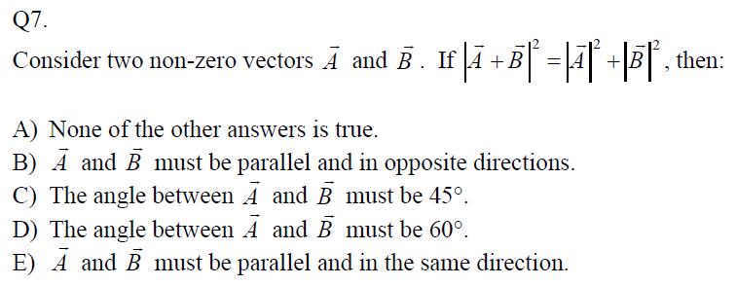
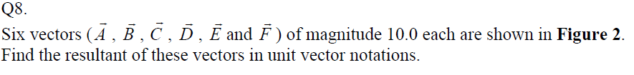
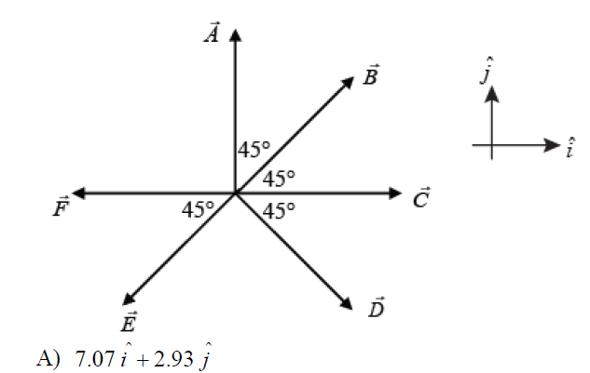
T101-Ch3
1 and 2
1
3

Slide 44
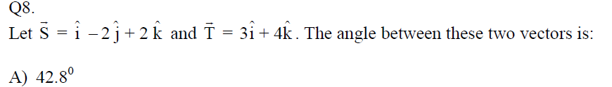
T92-Ch3
1 and 2
3
1 and 2

Slide 45
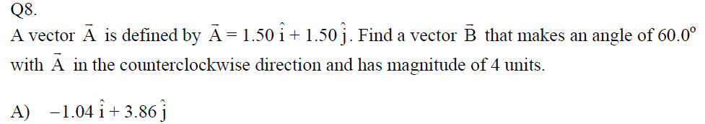
T91-Ch3
Q7.
A car travels 30 km due south and then D km in an unknown direction. The magnitude of the resultant displacement is 50 km and its direction is 53º west of south. Find the magnitude and direction of the unknown displacement D.
A) 40 km due west
1 and 2
1 and 2
Q9.
Which one of the following statements concerning vectors and scalars is FALSE?
A) A vector that has zero magnitude may have components other that zero.
B) A vector that has a negative component, has a positive magnitude.
C) A scalar component may be either positive or negative.
D) Two vectors are equal only if they have the same magnitude and same direction.
E) In calculations, the vector components of a vector may be used in place of the vector itself.
1 and 2

Slide 46
Examples: T82-Ch3
Q7. Vector A has a magnitude of 40.0 cm and is directed 60.0 degrees above the negative x-axis. Vector B has magnitude of 20.0 cm and is directed along the positive x-axis. Find the resultant vector (i and j are unit vectors along positive x and y axes, respectively). (Ans: 34.6 j cm)
1 and 2
Q8. Consider two vectors A = (3 i + 4 j) cm and B = (- 4 i + 3 j) cm. Find the angle between these two vectors. (Ans: 90 degrees)
1 and 3
Q9. If vector A is added to vector B, the result is (6 i + 1j) m. If A is subtracted from B, the result is (- 4 i + 7 j) m. Find the magnitude of B. (Ans. 4 m.)
1 and 2

Slide 47
T81-Ch3
Q7. A boat travels a distance of 27.0 km 20.0º North of East. It then travels 53.0 km in a direction 30.0º East of North. What is the total distance traveled by the boat in the East direction? ( Ans: 51.9 km)
1 and 2
Q8. Consider two vectors A and B with magnitudes 5 cm and 8 cm, respectively. Vector A is along the positive x-axis and vector B is along the positive y-axis. Find A. (B+A): (Ans: 25 cm²)
1 ,2 and 3
Q9. Consider the following three vectors , , and Find the magnitude of the vector D = A – B + 2C. (Ans: 17.7)
1

Slide 48
T-72-Ch3
Q5.Vectors , a , b and c are related through equations a + b = c and a – b = 5.0 c . If c = 3 i + 4 j , what is the magnitude of vector a ? (Ans: 15)
1
3

Slide 49
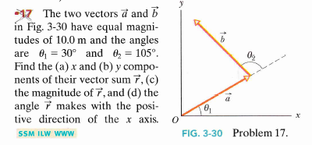
Books’ Problems

Slide 50
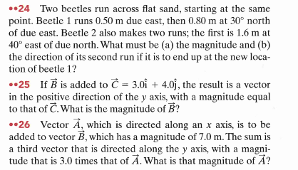
Book’s Problems

Slide 51
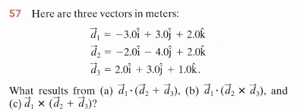
Book’s Problems

