Slide 1
Chapter 12
Equilibrium and Elasticity

Slide 2
Lecture 1
Equilibrium

Slide 3
Center of Gravity
mg
mg
The point at which effective gravitational force F_{g} acts on is called the center of gravity (cog) of the body
If g is same for all elements center of mass (com) and center of gravity (cog) are consistent

Slide 4
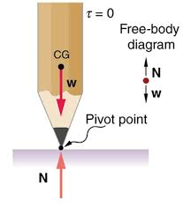
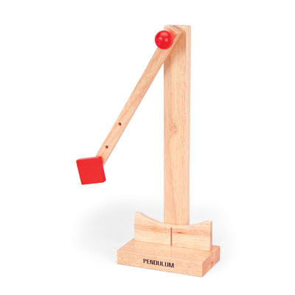
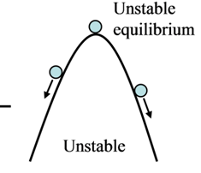
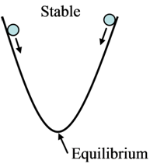
Equilibrium System
Unstable Equilibrium
Stable Equilibrium
If a small perturbation away from equilibrium is applied, the system will move farther away from its equilibrium state.
Example: a pencil balanced on it's end.
If a small perturbation away from equilibrium is applied, the system will return itself to the equilibrium state. Example: Pendulum Rod

Slide 5
Static Equilibrium System
N
F_{L}
F_{R}
mg
Two conditions for equilibrium
Net Force = 0
Net Torque = 0
Translational equilibrium
Rotational equilibrium

Slide 6
Equilibrium System = Not moving and not rotating system
N₁
N₂
mg
Total upward force = total downward Force
Total clockwise torque = Total anticlockwise torque
Total right force = total left Force

Slide 7
Axis of Rotation at “mg” to eliminate it from the torque equation
N₁
N₂
Axis of rotation
Anti-clockwise torque
Clockwise torque
L/2
L/2
mg
Net force in vertical direction is zero
Net Torque = 0

Slide 8
Axis of Rotation at “N₂” to eliminate it from the torque equation
N₁
N₂
Clockwise torque
Axis of rotation
L
L/2
mg
Net force in vertical direction is zero
Anti-clockwise torque
Net Torque = 0

Slide 9
Axis of Rotation at “N₁” to eliminate it from the torque equation
N₁
N₂
Axis of rotation
L
L/2
Anti-clockwise torque
mg
Clockwise torque
Net force in vertical direction is zero
Net Torque = 0

Slide 10
1. c, e, f

Slide 11
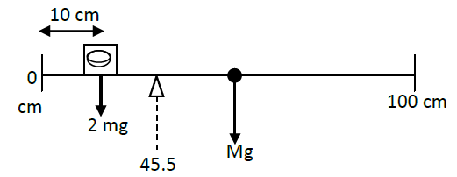
2. (a) no; (b) at site of , perpendicular to plane of figure; (c) 45 N
Example 0
A meter stick balances horizontally on a knife-edge at the 50.0 cm mark. With two 5.00 g coins stacked over the 10.0 cm mark, the stick is found to balance at the 45.5 cm mark. What is the mass of the meter stick?
A) 78.9 × 10⁻³m

Slide 12
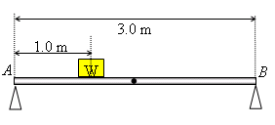
Example 1
A uniform steel bar of length 3.0 m and weight 20 N rests on two supports (A and B) at its ends. A block of weight W = 30 N is placed at a distance 1.0 m from A (see Fig. 4). The forces on the supports A and B respectively are: (Ans:30 N and 20 N)
Example 2
Forces F₁, F₂ and F₃ acts on the structure of Fig 12-30, shown in the overhead view. We wish to put the structure in equilibrium by applying a forth force at a point such as P. The forth force has vector components F_{h} and F_{v}.
We are given a = 2m, b = 3m, c = 1 m, F₁ = 20N, F₂ = 10N and F₃ = 5N.
Find (a) F_{h}, (b) F_{v}, and (c) d.

Slide 13
3. d

Slide 14
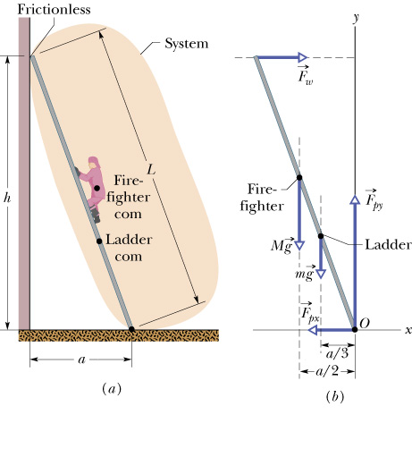
Example 3
Provided : m = 45 kg, L = 12m, M = 72Kg, h = 9.3m, Com of ladder = L/3, Firefighter = L/2.
Find N₁ and N₂
Ans: (a) N₂ = 410 N (b) N₁ = 1100 N
N₂
N₂
Mg
N₁
Mg
mg
N₁
F_{f}
mg
F_{f}
a/3
a/2

Slide 15
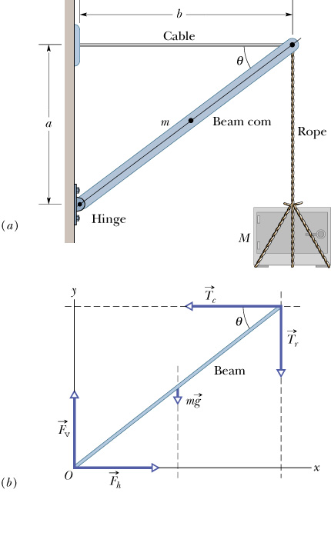
Example 4
m = 85 kg, M = 430 kg, a = 1.9 m and b = 2.5 m Ans: (a) T_{c} = 6100 N (b) Fv = 5047 N
T_{c}
F_{v}
mg
T_{r}
T_{c}
F_{h}
Mg
Mg
T_{r}
F_{v}
mg
Mg
F_{h}

Slide 16
Example 5
Example 6: Given: Mass of the block (M) = 225 Kg, Mass of the rod (m) = 45 Kg, φ = 30⁰ , θ = 45⁰
To find: (a) T = ?
(b) F_{h} = ?
(b) F_{v} = ?
T₁
Mg
T_{x}
Tcos(φ)
T₁
T_{y}
Tsin(φ)+Mg
T
F_{v}
mg
F_{v}
mg
Mg
φ
θ
F_{h}
F_{h}

Slide 17
Example 6
In Fig., one end of a uniform beam of weight 222 N is hinged to a wall; the other end is supported by a wire that makes angles θ= 30.0° with both wall and beam. Find
the tension in the wire and the
horizontal and
vertical components of the force of the hinge on the beam.
F_{hy}
F_{hx}
F_{hy}
T
F_{hx}
Tsin(θ)
Tsin(θ)
Tcos(θ)
mg
Tcos(θ)
mg

Slide 18
Book’s Problems
In Fig., a uniform beam of weight 500 N and length 3.0 m is suspended horizontally. On the left it is hinged to a wall; on the right it is supported by a cable bolted to the wall at distance D above the beam. The least tension that will snap the
cable is 1200 N.
What value of D corresponds to that tension?
To prevent the cable from snapping, should D be increased or decreased from that value?
In Fig., one end of a uniform beam of weight 222 N is hinged to a wall; the other end is supported by a wire that makes angles θ= 30.0° with both wall and beam. Find
the tension in the wire and the
horizontal and
vertical components of the force of the hinge on the beam.
The system in Fig. is in equilibrium. A concrete block of mass 225 kg hangs from the end of the uniform strut of mass 45.0 kg. For angles φ= 30.0° and θ= 45.0°, find
the tension T in the cable and the
horizontal and
vertical components of the force on the strut from the hinge.

Slide 19
Example 7
Fig. 1 shows a three boxes of masses m₁, m₂ and m₃ hanging from a ceiling. The crossbars are horizontal and have negligible mass and same length L. If m₃ = 1.0 kg, then m₁ is equal to:(Ans: 12 kg )
T₂
T₁
l/2
3l/2
l/2
3l/2
m₁
T₁
m₂
m₃

Slide 20
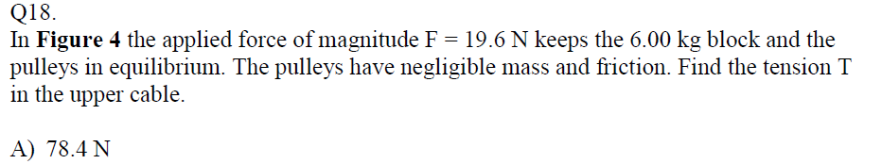
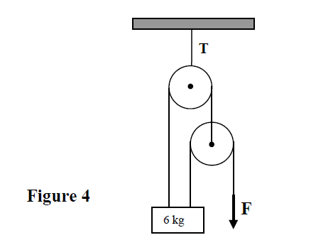
T-92-ch12
T’
T₂
T₁
T
P₁
P₂
T’
P₂
6g
T₁
F
P₁
T₂
T’
T₂
T₁

Slide 21
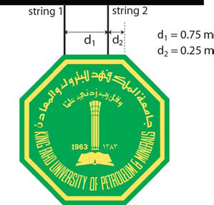
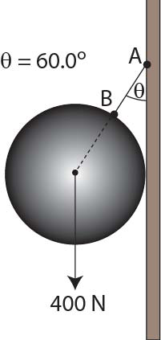
T122-Q14.
A uniform and symmetric sign board is supported by two strings as shown in Figure 4. Find the ratio of the tension in string 1 to the weight of the sign board.
A) 0.33
T₁
T₂
d₁
d₂
mg
T121-Q16.
Figure 6 shows a uniform solid sphere of weight 400 N suspended by string AB and resting against a frictionless vertical wall. The string makes an angle of 60.0° with the wall. Find the magnitude of the force exerted by the wall on the sphere.
A) 693 N
Tsin(θ)
F_{N}
Tcos(θ)
mg

Slide 22
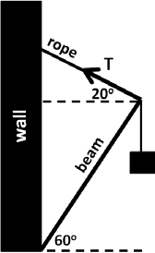
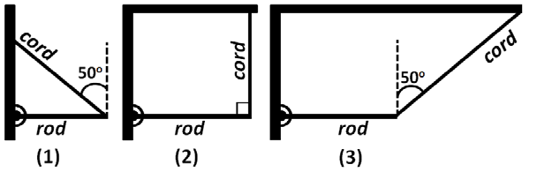
T122-Q13.
A block with a weight τ of 10.0`kN is supported by a massless rope attached to a 4.00`m massless beam that can pivot at the base, as shown in Figure 3. Find the magnitude of the tension (T) in the rope.
A) 5.08 kN
T122-Q14: Figure 11 shows three situations in which a horizontal rod is supported by a hinge on a wall at one end and a cord at the other end. Rank the situations according to the magnitude of the force on the rod from the cord, greatest first.
A) (1 and 3 tie) then 2

Slide 23
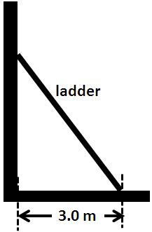
T122-Q15.
A 5.0`m long, 10`kg ladder is leaning against a frictionless vertical wall, while the bottom of the ladder rests 3.0`m away from the wall on a horizontal rough floor, as shown in Figure 4. What is the magnitude of the force of static friction between the floor and the ladder?
A) 37 N

Slide 24
Lecture 2
Elasticity

Slide 25
Hookes Law
Δx
Δx
Hooks Law
F = -kΔx
Compression or elongation
Force
Spring Constant
Hooks Law is valid within an elastic limit

Slide 26
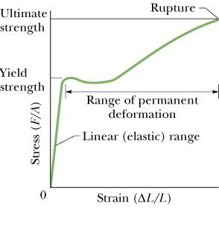
Elastic Limit
Elastic limit
If you pull the string too hard it will rapture

Slide 27
Stress, strain and Yong’s modulus
F
ΔL
elongation
A
A
compression
ΔL
Stress = Force/Area of crossection
Stress = F/A
L
L
strain = elongation or compression/length
Strain =ΔL /L
Young's Modulus

Slide 28
Share and Bulk Modulus
F
F
Δx
F
ΔV
F
F
L
F
F
F
F
V
Share Modulus
Bulk Modulus

Slide 29
T72Q18.: A horizontal steel rod of length 81 cm and radius 9.5 mm is fixed at one end. It stretches by 0.90 mm when a horizontal force of magnitude F is applied to its free end. Find the magnitude of F (Young modulus of steel is 20 × 10¹⁰ N/m²). (Ans: 63 kN)
T71Q3. Fig. 3 shows a uniform block of mass m = 100 kg, which is held in a horizontal position by two vertical steel rods at its ends. Each of the rods has length, L = 1.0 m, cross sectional area = 1.0 × 10⁻³ m2 and young’s modulus, E =2.0×10¹¹ N/m² . The increase in the length of any one the rods (ΔL), is: (Ans: 2.5×10⁻⁶ m)
T52Q#17:A shearing force F = 50 N is applied to an aluminum rod with a length of L =10 m, a cross-sectional area A=1.0 × 10^{–5} m², and a shear modulus G = 2.5 × 10¹⁰ N/m². As a result the rod is sheared through a distance (Δx) of: (Ans: 0.20 cm)
T61Q16. The volume of a solid Aluminum sphere at the sea level is V = 1.0 m³. This sphere is placed at a depth of about 700 m in the sea where the absolute pressure is p = 7.0 x 10⁶ N/m². The change in the volume (ΔV) of the sphere is: (the bulk modulus of Aluminum, B = 70 x10⁹ N/m²). A) 1.0 x 10⁻⁴ m³
T62Q3. A solid copper sphere has a diameter of 85.5 cm. How much stress must be applied to the sphere to reduce its diameter to 85.0 cm? The bulk modulus of copper is 1.4 x 10¹¹ N/m² (Ans: 2.4 × 10⁹ N/m² )

Slide 30
T123 Q16:
A small sphere is made of a material with a bulk modulus of 1.90 x 109 Pa. The volume of the sphere shrinks by 0.20 % when submerged in a fluid at a depth of 400 m. What is the density of this fluid? Assume the pressure on the sphere at this depth is the same from all directions.
A) 970 kg/m3
T122 Q13:
When water freezes, it expands by about 9.0 %. What would be the pressure increase inside the radiator of your car if the water in it freezes? The bulk modulus of ice is 2.0×10⁹ N/m².
A) 1.8×10⁸Pa.
T122-Q16.
A certain wire stretches 0.90 cm when an outward force with magnitude F is applied perpendicular to the cross section of each end. The same forces are applied to a wire of the same material but with three times the diameter and three times the length. The second wire stretches:
A) 0.30 cm

Slide 31
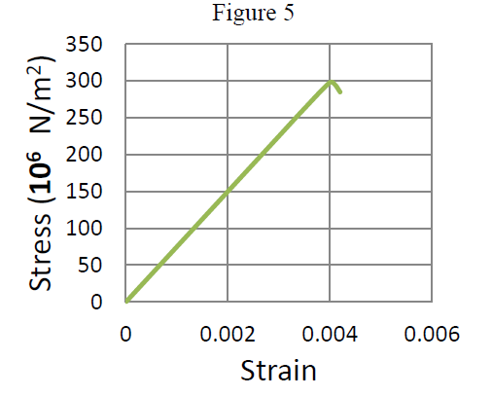
T122-Q15.
Figure 5 shows the stress-strain curve for a material. What is Young’s modulus of this material? A) 7.50 × 10¹⁰ N/m²
T113-Q14.
A certain wire stretches 1.00 cm when a force F is applied to it. The same force is applied to a second wire of the same material with equal length but with twice the diameter. The second wire stretches:
A) 0.25 cm
T113-Q15.
A cube of volume 1.0 m³ is made of material with a bulk modulus of 2.0 × 10⁹ N/m². When it is subjected to a pressure of 2.0 × 10⁵ Pa, the magnitude of the change in its volume is:
A) 1.0 × 10⁻⁴ m

Slide 32
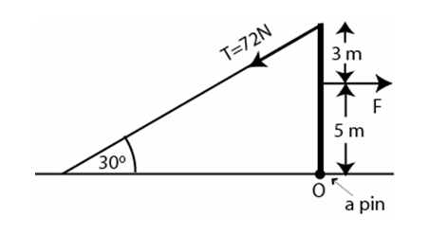
T113-Q11.
A uniform beam is held in a vertical position by a pin at its lower end and a cable at its upper end (see Figure 2). The tension in the cable is 72.0 N. Find the horizontal force F acting on this beam.
A) 99.8 N
T113-Q12:
A meter stick balances horizontally on a knife-edge at the 50.0 cm mark. With two 5.00 g coins stacked over the 10.0 cm mark, the stick is found to balance at the 45.5 cm mark. What is the mass of the meter stick?
A) 78.9 × 10⁻³m

Slide 33
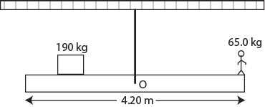
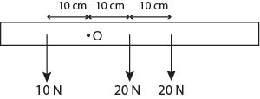
T-102-ch12
Q13.
As shown in Figure 6, a uniform beam of length 4.20 m is suspended by a cable from its center point O. A 65.0-kg man stands at one end of the beam. Where should a 190-kg block be placed on the beam so that the beam is in static equilibrium (Distances are measured from the center point O of the beam)?
A) 0.718 m
Q14.
What increase in pressure is necessary to decrease the volume of a sphere by 0.150 % (Take the bulk modulus of the sphere B = 2.80 × 1010 N/m2)?
A) 4.20 × 107 N/m2
Q15.
Three parallel forces of magnitudes 10.0 N, 20.0 N, and 20.0 N, respectively, act on a body (Figure 7). The perpendicular distances from a given point O to their lines of action are shown. The single force which can replace these forces is:
A) 50.0 N, 10.0 cm to the right of point O.

Slide 34
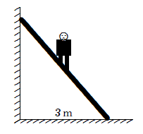
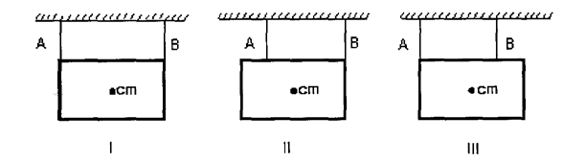
T112-Q1. An 800-N man stands halfway up a 5.0-m long ladder of negligible weight. The base of the ladder is 3.0m from the wall as shown in Figure 1. Assuming that the wall-ladder contact is frictionless, then the magnitude of normal force of the wall on the ladder is:
A) 300 N
T112-Q2.
A cube with edges exactly 2.0 m long is made of material with a bulk modulus of 3.5 ×10⁹ N/m². When it is subjected to a pressure of 7.0 × 10⁵ Pa its change in the volume is:
A) −1.6 × 10⁻³ m³
Q4. A picture is to be hung from the ceiling by means of two wires as shown in Figure 3. Order the following arrangements of the wires according to the tension in wire B, from least to greatest.

Slide 35
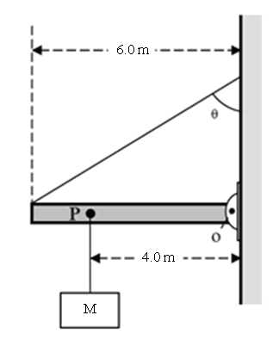
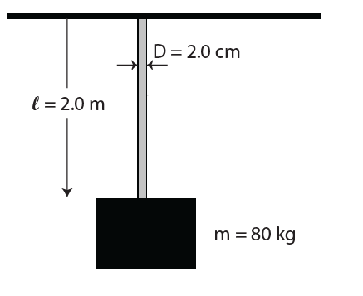
T112-Q3.
A uniform beam of length 6.0 m and mass 150 kg is pivoted to a vertical wall at point O and is suspended horizontally by a rope of negligible mass making an angle θ = 60° with the wall as shown in Figure 2. An unknown mass M is hanged at point P, 4.0 m away from the pivot point O. If the system is in equilibrium as shown with the tension in the rope equal to 2.15x10³ N, what is the value of mass M?
A) 52 kg
T111-Q1.
Figure 1 shows a solid cylindrical steel rod of length l = 2.0 m and diameter D = 2.0 cm. What will be increase in its length when m = 80 kg block is attached to its bottom end? (Young's modulus of steel = 1.9 × 10¹¹ Pa)
A) 2.6 x 10⁻⁵ m

Slide 36
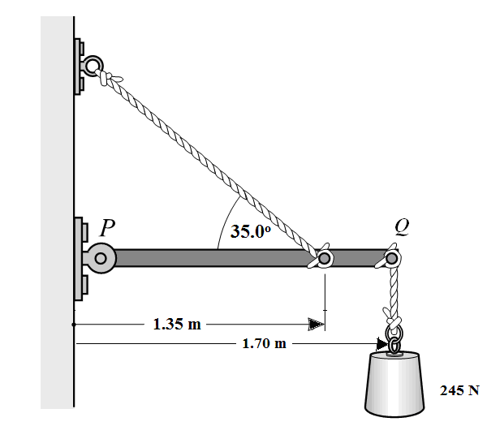
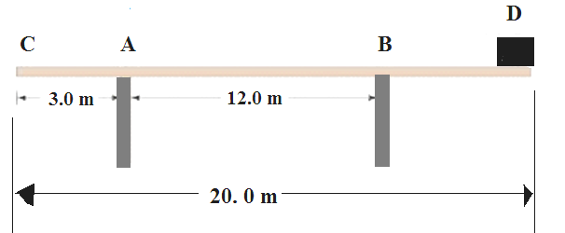
T111-Q2.
In Fig. 2, PQ is a horizontal uniform beam weighing 155 N. It is supported by a string and a hinge at point P. A 245 N block is hanging from point Q at the end of the beam. Find the horizontal component of net force on the beam from the hinge.
A) 580 N
T111-Q3.
A 20.0 m long uniform beam weighing 550 N rests on supports “A” and “B”, as shown in Figure 3. Find the magnitude of the force that the support “A” exerts on the beam when the block of weight 200 N is placed at D.

Slide 37
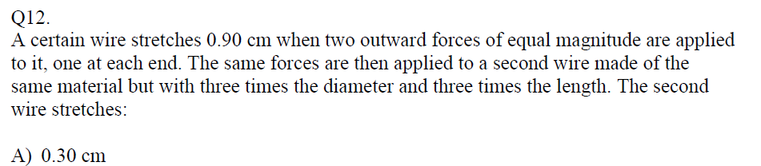
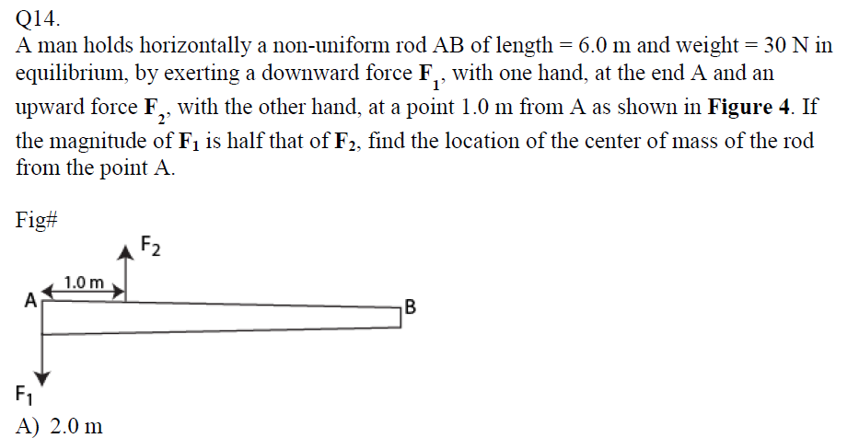
T-101-ch12

Slide 38
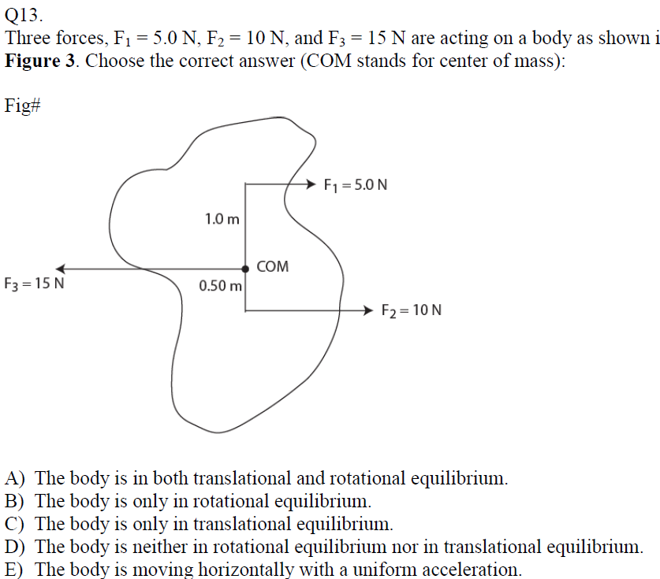
T-101-ch12

Slide 39
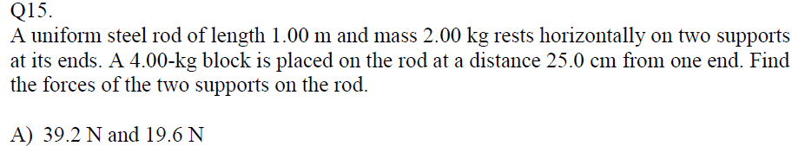
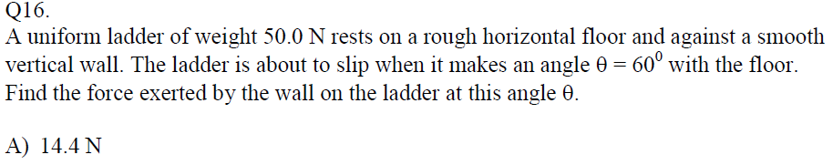
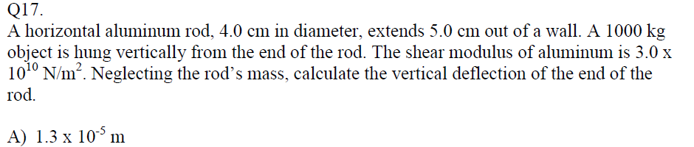
T-92-ch12

Slide 40
T-92-ch12
T’
T₂
T₁
T
P₁
P₂
T
P₂
6g
T₁
F
P₁
T₂
T’
T₂
T₁

Slide 41
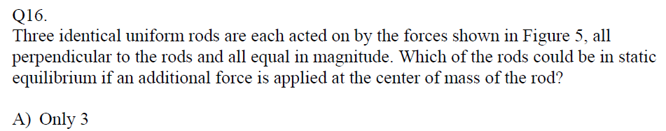
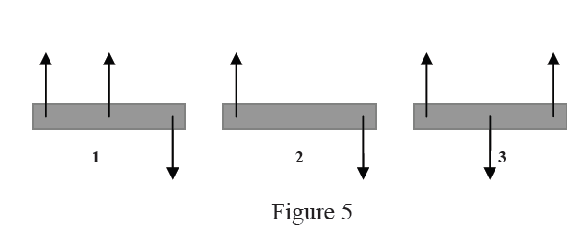
T-91-ch12

Slide 42
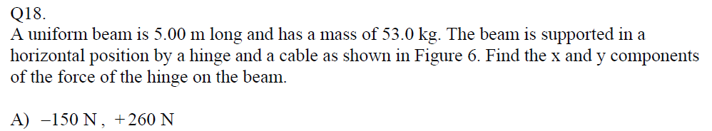
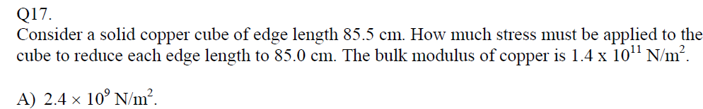
T-91-ch12

Slide 43
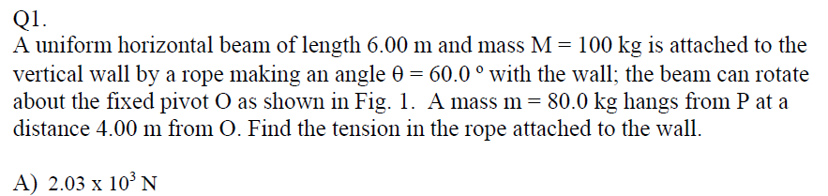
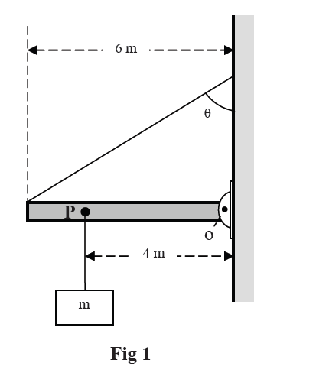
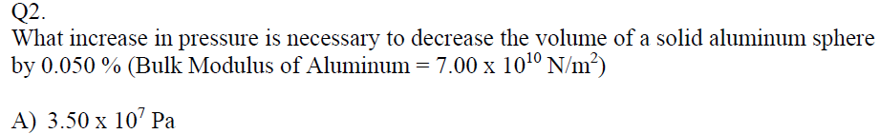
T-82-ch12

Slide 44
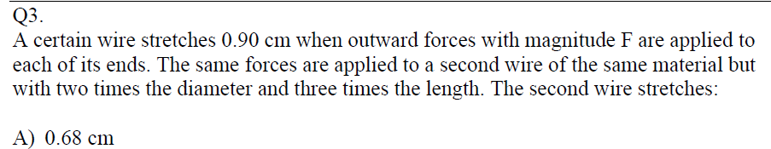
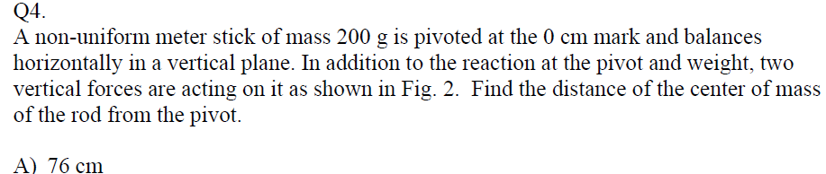
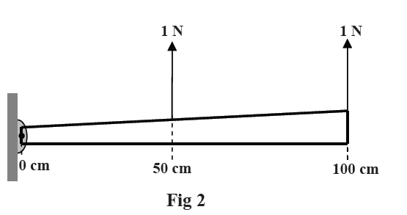
T-82-ch12

Slide 45
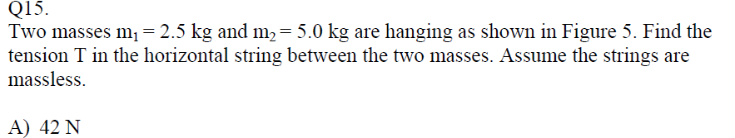
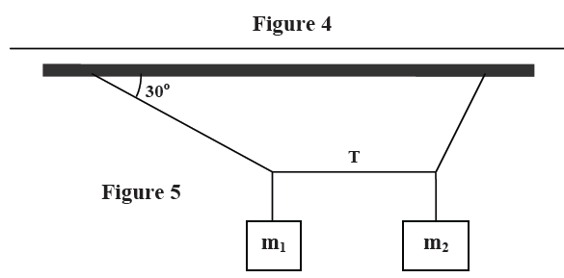
T-81-ch12

Slide 46
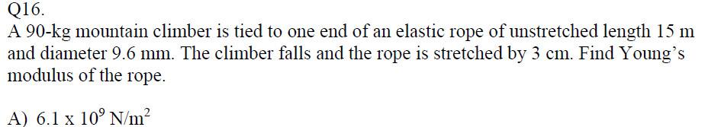
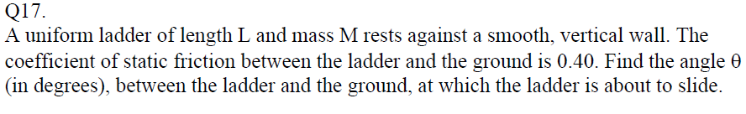
T-81-ch12
A: 51.3

Slide 47
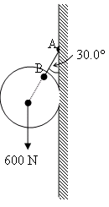
T-72-Ch12
Q16. A uniform steel bar of length 3.0 m and weight 20 N rests on two supports (A and B) at its ends. A block of weight W = 30 N is placed at a distance 1.0 m from A (see Fig. 4). The forces on the supports A and B respectively are: (Ans:30 N and 20 N)
Q17. Fig. 5 shows a uniform ball of 600 N weight suspended by a string AB and rests against a frictionless vertical wall. The string makes an angle of 30.0° with the wall. The magnitude of the tension in the string is: ( Ans: 693 N)
Q18.: A horizontal steel rod of length 81 cm and radius 9.5 mm is fixed at one end. It stretches by 0.90 mm when a horizontal force of magnitude F is applied to its free end. Find the magnitude of F (Young modulus of steel is 20 × 10¹⁰ N/m²). (Ans: 63 kN)
Figure 5
Figure 4

Slide 48
T-71-Ch12
Q1.: A uniform meter stick has mass M = 1.25 kg. As shown in Fig. 1, this meter stick is supported by two vertical strings, one at each end, in such a manner that it makes an angle of 20° with the horizontal. Find the tension in each string.( A) T1 = 6.1 N, T2 = 6.1 N)
Q2.: A thin right angled rod is made of a uniform material. The shorter end is half the length of the longer end. It is hanging by a string attached at point O (Fig. 2). At equilibrium, the angle α between the shorter rod and the vertical is: ( Ans: 76°)
Q3. Fig. 3 shows a uniform block of mass m = 100 kg, which is held in a horizontal position by two vertical steel rods at its ends. Each of the rods has length, L = 1.0 m, cross sectional area = 1.0 × 10-3 m2 and young’s modulus, E =2.0×1011 N/m2 . The increase in the length of any one the rods (ΔL), is: (Ans: 2.5×10⁻⁶ m)
Figure 1
Figure 2
Figure 3

Slide 49
T-62-Ch12
Q1. Fig. 1 shows a three boxes of masses m₁, m₂ and m₃ hanging from a ceiling. The crossbars are horizontal and have negligible mass and same length L. If m₃ = 1.0 kg, then m₁ is equal to:(Ans: 12 kg )
Q2. Fig. 2 shows a uniform beam with a weight of 60.0 N and length of 3.20 m is hinged at its lower end and a horizontal force F of magnitude 50.0 N acts at its upper end. The beam is held vertical by a cable that makes an angle θ = 30.0° with the ground and is attached to the beam at a height h = 1.60 m. The tension (T) in the cable is: (A: 115 N)
Q3. A solid copper sphere has a diameter of 85.5 cm. How much stress must be applied to the sphere to reduce its diameter to 85.0 cm? The bulk modulus of copper is 1.4 x 10¹¹ N/m² (Ans: 2.4 × 10⁹ N/m² )
Fig. 1
Fig. 2

Slide 50
T-61-Ch12
Q16. The volume of a solid Aluminum sphere at the sea level is V = 1.0 m³. This sphere is placed at a depth of about 700 m in the sea where the absolute pressure is p = 7.0 x 10⁶ N/m². The change in the volume (ΔV of the sphere is: (the bulk modulus of Aluminum, B = 70 x10⁹ N/m²). A) 1.0 x 10⁻⁴ m³
Q17. : A uniform meter stick of mass M is balanced on a knife edge at the 40 cm mark by hanging a 0.50 kg mass at the 20 cm mark (see Fig. 8). Find M (A) 1.0 kg)
Q18. : A 5.0 m long uniform ladder (with mass m = 12.0 kg ) leans against a wall at a point 4.0 m above a horizontal floor as shown in Fig 9. Assuming the wall is frictionless (but the floor is not), determine the normal force exerted on the ladder by the wall. (A) 44 N )
Fig. 8
Fig. 9

Slide 51
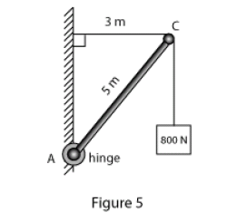
T-52-Ch12
Q#16:A 5.0-m weightless rod (AC), hinged to a wall at A, is used to support an 800-N block as shown in Fig 5.The horizontal and vertical components of the force (F_{H}, F_{V}) of the hinge on the rod are: (Ans: F_{H} = 600 N, F_{V} = 800N )
Q#17:A shearing force F = 50 N is applied to an aluminum rod with a length of L =10 m, a cross-sectional area A=1.0 × 10^{–5} m², and a shear modulus G = 2.5 × 10¹⁰ N/m². As a result the rod is sheared through a distance (Δx) of: (Ans: 0.20 cm)
Q#18: A man holds a rod AB of length = 6.0 m and weight = 30 N in equilibrium, by exerting an upward force F₁, with one hand, and a downward force F₂, with the other hand as shown in Fig 6. What are the magnitude of the forces F₁ and F₂? (Ans: F₁ = 90 N, F₂ = 60 N)

Slide 52
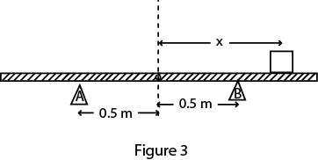
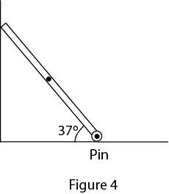
T-51-Ch12
Q: 16 . A cube of volume 8.0 cm³ is made of material with a bulk modulus of 3.5×109 N/m². When it is subjected to a pressure of 3.0 × 10⁵ Pa, the change in its volume (ΔV) is(Ans: 6.9 x 10⁻⁴ cm³)
Q: 17. A uniform rigid rod having a mass of 50 kg and a length of 2.0 m rests on two supports A and B as shown in the Fig. 3. When a block of mass 60 kg is kept at point C at a distance of x from the center, the rod is about to be lifted from A The value of x is: (Ans: 0.92 m )
Q: 18. A uniform beam having a mass of 60 kg and a length of 2.8 m is held in place at its lower end by a pin (P). Its upper end leans against a vertical frictionless wall as shown in the Fig. 4. What is the magnitude of the force by the pin on the beam? (Ans: 706 N)

