Slide 1
Chapter 10
Rotation (Angular Motion)

Slide 2
Body Rotates about a axis
The axis about which the body rotates is called axis of rotation
body = center of mass
Body rotates about narrow end
Axis of rotation
Body rotates about its center

Slide 3
Angular Motion (Θ)
one complete rotation =360⁰ = 2л radian
n complete rotation =n x 360⁰ = n (2л) radian
“Θ” must be measured in radian not in degree

Slide 4
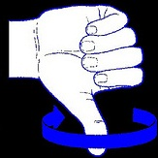
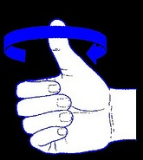
Angular Velocity (ω)
like
Θ
t
Clockwise: Negative
Anti-Clockwise: Positive
It is a vector quantity and its direction either be clockwise (-) or anticlockwise (+) and is given by right hand thumb rule.

Slide 5
Angular Velocity (ω)
like
Θ -- t
Θ₀ -- t₀
Clockwise: Negative
Anti-Clockwise: Positive

Slide 6
Angular Acceleration (α)
like
fast
faster
fastest
Clockwise: Negative
Anti-Clockwise: Positive

Slide 7
Rotation with Constant Angular Acceleration- Equations of Motion
Linear Motion (x,t,v,a)
v = v_{o}+at
v₀² = v₀²+2aΔx
Δx =v₀t+at²/2
Rotational Motion (θ,t,ω, α)
ω= ω₀+αt
ω²= ω₀²+2αΔθ
Δθ= ω₀t+ αt²/2

Slide 8
Linear – Angular motion relationship
s
Θ
r
Transverse acceleration
Radial acceleration

Slide 9
Transverse (a_{t}) and Radial(a_{r}) linear accelerations
v
a_{t}
a_{r}
v₀
Transverse acceleration (a_{t}):
It is rate of change of magnitude of velocity of a particle moving in a circular path. It applies when body rotates faster and faster (not with constant speed). It is always in the direction of tangent.
a_{r}
Radial acceleration (a_{r}):
It is due to the change in direction of velocity. It is always along the radius.
Since it is towards the center it is also called centripetal acceleration

Slide 10
Example 1: The angular position of a point on the rim of a rotating wheel is given by Θ= 4.0t -3.0t² + t³, where Θ is in radians and t is in seconds. What is the average angular acceleration for the time interval that begins at t = 0 s and ends at t = 1.0 s? (Ans: -3.0 rad/s²) .
Example 2: Assume that a disk starts from rest and rotates with an angular acceleration of 2.00 rad/s². The time it takes to rotate through the first three revolutions is: (Ans: 4.34 s)
Example 3: At t=0, a disk has an angular velocity of 360 rev/min, and constant angular acceleration of -0.50 rad/s². How many rotations does the disk make before coming to rest? (Ans: 226)

Slide 11
Example 1: A turntable rotating at 33 revolutions per minute is switched off. It comes to rest in 2.0 minutes with constant angular acceleration. Find the radial acceleration of a point 10 cm from the axis of rotation at time t = 1.0 minute.
A) 0.30 m/s²
Example 2: A horizontal disk with a radius of 0.10 m rotates about a vertical axis through its center. The disk starts from rest at t = 0.0 s and has a constant angular acceleration of 2.1 rad/s². At what value of t will the radial and tangential components of the linear acceleration of a point on the rim of the disk be equal in magnitude?
A) 0.69 s
Example 3: A rigid body is initially at rest. At time t = 0, it is given a constant angular acceleration of 0.060 rad/s2. Find the magnitude of the centripetal acceleration of a point that is a distance of 2.5 m from the axis of rotation at t = 8.0 s.
A) 0.58 m/s2

Slide 12
Chapter 10
Rotation (Angular Motion)
Lecture 2

Slide 13
Rotational KE
Distance between com and axis of rotation
Constant
mass
β depends on the shape
and axis of rotation of the object
β = 1, for a rotating point mass
I = Moment of Inertia = βmr²

Slide 14
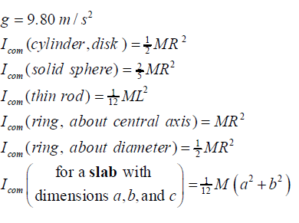
Few important shapes
com
Axis of rotation
L = length of the rod
m = mass of the rod
R = Radius of the disc (wheel)
m = mass of the disc (wheel)
Axis of rotation (com)

Slide 15
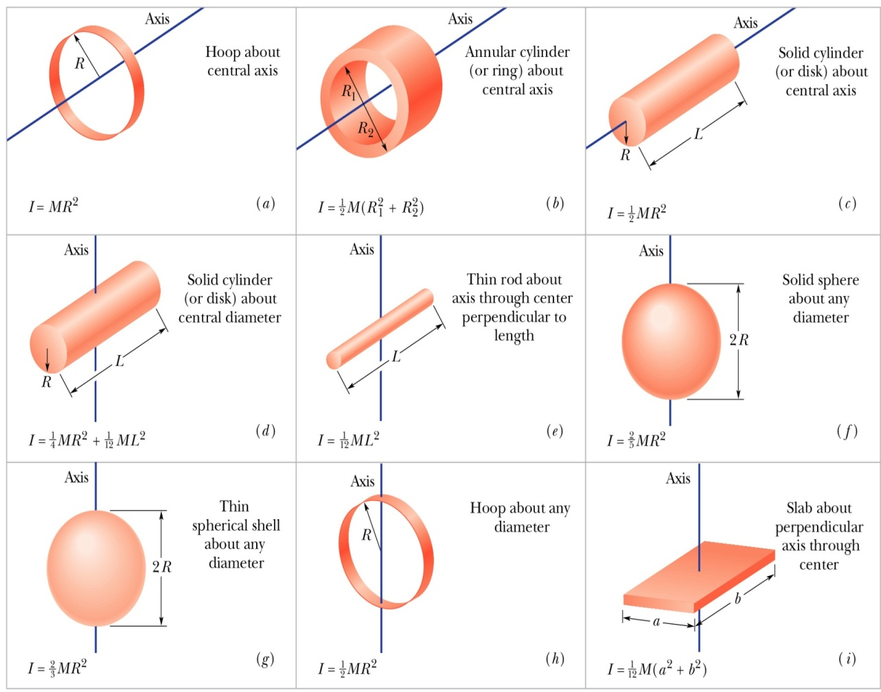
Moment of inertia of different shapes about different axes
Example:
The moment of inertia of an object does not depend on:
its mass.
its size and shape.
the location of the axis of rotation.
its angular velocity.
E) the distribution of its mass.
Ans: D

Slide 16
Moment of inertia
Moment of inertia in rotational motion behaves as the mass of the body in the translational motion
Linear Motion
Angular Motion
?
?

Slide 17
Parallel Axis theorem
h
com
Axis of rotation
For a rod, I_{c} = 1/12 mL²

Slide 18
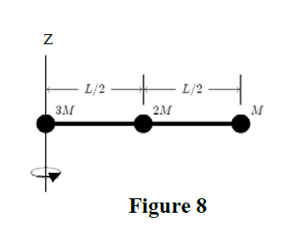
Example 1: In figure two particles each with mass m = 0.85Kg, are fastened to each other and to a rotation axis at O, by two thin rods each with length d = 5.6 cm and mass M = 1.2Kg. The combination rotates around the rotation axis with angular speed 0.3 rad/s. Measured about O, what are the combination’s
(a) rotational inertia and (b) Kinetic energy?
Ans (a) 0.023 kg.m² (b) 1.1x10⁻³ J
m
ω
d
M
d
m
M
O
Rotational axis
Example 2: The rotational inertia of a solid sphere (mass M and radius R₁) about an axis parallel to its central axis but at a distance of 2R₁ from it is equal to I₁. The rotational inertia of a cylinder (same mass M but radius R₂) about its central axis is equal to I₂. If I₁=I₂, the radius of the cylinder R₂ must then be: (Ans: 3.0 R₁)
Example3: Three point masses M, 2M and 3M, are attached to a rod of mass M and length L as shown in Figure 8. Take M = 1.00 kg and L = 1.00 m. The rotational kinetic energy of the system when rotating about the vertical z-axis through the mass 3M with a speed of 4.00 rad/s is: A) 14.7 J

Slide 19
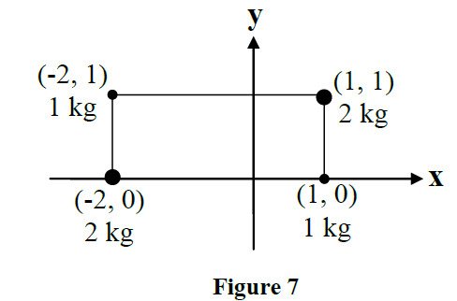
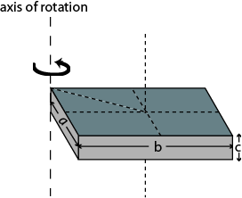
Example 4:
A rigid body consists of two particles attached to a rod of negligible mass. The rotational inertia of the system about the axis shown in Fig. is 10 kg m². What is x₁? (Ans: 1.4 m )
Example 5.
The four particles shown in Figure 7 are connected by rigid rods of negligible mass. Calculate the moment of inertia of this system about the x-axis.
A) 3 kg.m²
Example6.
A uniform slab of dimensions: a = 60 cm, b = 80 cm, and c = 2.0 cm (see Fig. 6) has a mass of 6.0 kg. Its rotational inertia about an axis perpendicular to the larger face and passing through one corner of the slab is:
(Ans: 2.0 kg.m² )

Slide 20
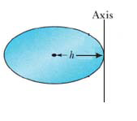
Example 7
Figure shows a disk that can rotate about an axis perpendicular to its plane with constant angular velocity ω. By what factor will the rotational kinetic energy of the disk change if the axis of rotation of the disk is shifted from the center to the edge of the disk, keeping ω constant. (Ans: 3)
Example 8:
Three point masses m_{A}, m_{B} and m_{C} Fare located in the x-y plane at points A, B and C as shown in Figure 5. They are connected together by massless rods. Find the kinetic energy of the system if it rotates with an angular speed of 4.0 rad/s about the z-axis passing through point A.
A) 0.46 J
If mass of the each rod is = m????
The third rod of length l = 0.3 behaves as a point mass at its center of mass

Slide 21
Chapter 10 &11
Torque and Newton’s Law in Rotation, Work and Power

Slide 22
Torque (τ)
F
Δr = distance from the axis of rotation to the force
Δr
Torque is rotational force
It’s a vector quantity
Its unit is Nm

Slide 23
Torque (τ)
F
r
Θ is angle between r and F
and n is the direction normal to r and F
If Δr =r and Θ = 90⁰

Slide 24
Torque direction:
Clockwise: Negative
Counter-clockwise: positive
Positive torque
Negative torque
F
F
r
r
com
com
F
F
r
F
F
r
Anticlockwise: Positive
Clockwise: Negative

Slide 25
Only perpendicular components survive in cross product
F
r
o
r
θ
F
θ
Fcos(θ)
rsin(θ)
Distance component “rsin(θ)” is perpendicular to Force “F”
Distance “r” is perpendicular to force component – “Fcos(θ)”
r
rsin(θ)
F
Fcos(θ)
Anticlockwise: Positive
Clockwise: Negative

Slide 26
Examples
Example1: A constant torque of 10.0 N·m accelerates an object from rest to an angular speed of 10.0 rad/s after a rotation of π/2 radians. What is the moment of inertia of the object about the rotational axis? A) 0.314 kg.m²
Example 2. At an instant, a particle of mass 2.0 kg has a position of r = (9i +15j) m and acceleration of a = -3 i m/s² . What is the net torque on the particle at this instant about the point having the position vector r₀ = 9i m: ? (Ans: 90 k Nm)
Example 3. Force F = (-8.0 N) i+ (6.0 N) j acts on a particle with position vector r = (3.0 m) i+ (4.0 m)j. What is the torque on the particle about the point P = (0, 4.0 m)? (Ans: 18k N.m)
Example4: A 4.0 kg particle moves in an x-y plane. At the instant when the particle’s position relative to the origin is , r’ = 2.0 i its acceleration is , a = 2.0 i +3j where r ’ is in meters and a is in m/s². Find the torque acting on the particle about the point P (0, 2.0) m. A) +40kN.m
Example 5: A single force acts on a particle situated on the positive x axis. The torque about the origin is in the negative z direction. The force might be:
A) in the negative y direction

Slide 27
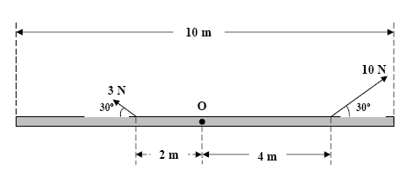
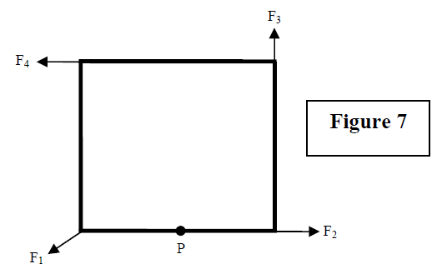
Examples
Example1:
A uniform rod of length L = 10.0 m and mass M = 2.00 kg is pivoted about its center of mass O. Two forces of 10.0 and 3.00 N are applied to the rod, as shown in Fig.3. What is the magnitude of the angular acceleration of the rod about O .
Ans: ) 1.02 rad/s²
Example 2.
Four forces of the same magnitude act on a square frame that can rotate about the middle point P as shown in Figure 7. Rank the forces acting on it according to the magnitude of the torque they produce about point P, greatest first. (assume all forces in the plane of the square)
A) F4, F3, F1, F2

Slide 28
Work and Power: Rotational Motion

Slide 29
Work
Power
If θ between s and F =0
Example from ch7:
A 0.50-kg object moves on a horizontal circular track with a radius of 2.5 m. An external force of 3.0N, always tangent to the track, causes the object to speed up as it goes around.
Find the work done by the force for a complete revolution.
If it starts from rest its speed at the end of one revolution is?
(Ans: 14 m/s)

Slide 30
Example 1: A disk of rotational inertia 5.0 kg m² starts rotating from rest and accelerates with a constant angular acceleration of 1.0 rad/s². During the first 4.0 s, the work done on the disk is: (Ans: 40 J)
Example 2. A disk starts from rest at t = 0, and rotates about a fixed axis (moment of inertia = 0.030 kg·m²) with an angular acceleration of 7.5 rad/s². What is the rate at which work is being done on the disk when its angular velocity is 32 rad/s? (Ans: 7.2 W)
Example3. A 32.0 kg thin hoop (ring) with radius 1.20 m, is rotating at 280 rev/min about its axis. What is the required average power of the net force that brings the hoop to a full stop in 15.0 s?
A) 1.32 × 10³ W
Example 4. The engine delivers 1.20 ×10⁵ W to a plane propeller at ω = 2400 rev/min. How much work does the engine do in one revolution? A) 3000 J
Example 5: A disk has a rotational inertia of 4.0 kg·m² and a constant angular acceleration of 2.0 rad/s². If it starts from rest the work done during the first 5.0 s by the net torque acting on it is: (Ans: 200 J)
Example6: The average power needed to spin ( rotate about its axis) a uniform, solid disk of mass 5.0 kg and radius 0.50 m from rest to a final angular velocity ω_{f} in 3.0 s is 2.6 W. The final angular speed is:
A) 5.0 rad/s

Slide 31
Newton’s Laws in Rotational Motion

Slide 32
Pulley (disc) has mass M
Disc
Block
T
m
R
ma
The Kinetic Energy of block
mg
T
The Kinetic Energy of pulley
Example 1: A 5.00 kg block hangs from a cord which is wrapped around the rim of a frictionless pulley of mass 40Kg and radius 0.1 m as shown in Fig. 4. What is the acceleration, a, of the block as it moves down? (Ans: 1.96 m/s² )

Slide 33
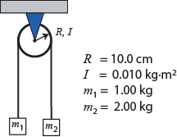
Examples
Example:
Two objects of masses m1 = 1.00 kg and m2 = 2.00 kg hang at the ends of a massless string that passes over a pulley of radius R = 10.0 cm and moment of inertia I = 0.010 kg.m2, as shown in Figure 5. What is the linear acceleration of the masses?
A) 2.45 m/s²
Net acceleration anticlockwise
R
R
T₁
τ₁
-τ₂
T₂
Solve this
Mass that cause anticlockwise motion
Mass that cause clockwise motion

Slide 34

Example 1: A 5.00 kg block hangs from a cord which is wrapped around the rim of a frictionless pulley of mass 40Kg and radius 0.1 m as shown in Fig. 4. What is the acceleration, a, of the block as it moves down? (Ans: 1.96 m/s² )
Example 2: A rope pulls a 1.0-kg box on a frictionless surface through a pulley as shown in Fig 4. The pulley has a rotational inertia of 0.040 kg.m² and radius of 20 cm. If the force F is 10 N, then the acceleration of the box is: (Ans: 5.0 m/s²)
Example 3: A 8.0-cm radius disk with a rotational inertia of 0.12 kg . m² is free to rotate on a horizontal axis. A string is fastened to the surface of the disk and a 10-kg mass hangs from the other end. The mass is raised by using a crank to apply a 9.0-N.m torque to the disk. The acceleration of the mass is: Ans: 0.50m/s²
Example 4: Two objects of masses m1 = 1.00 kg and m2 = 2.00 kg hang at the ends of a massless string that passes over a pulley of radius R = 10.0 cm and moment of inertia I = 0.010 kg.m2, as shown in Figure 5. What is the linear acceleration of the masses? A) 2.45 m/s²
Example 5: A rope is wound around the rim of a wheel (radius = 2.0 m, and moment of inertia about the rotation axis, I = 5.0 kg.m2). A constant force F = 40 N is applied (Figure ) to one end of the rope for 1.0 s causing the wheel to rotate starting from rest. Find the length of the rope unwound during this period of time. A) 16 m

Slide 35
Energy Conversation in Rotational Motion

Slide 36
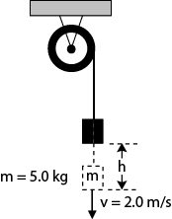
Example 1: A wheel of radius R = 0.20 m is mounted on a fixed frictionless horizontal axis. The rotational inertia I of the wheel about this axis is 0.50 kg.m². A massless cord wrapped around the circumference of the wheel is attached to a m = 5.0 kg box (Fig. ). The box is then released from rest. When the box has a speed of v = 2.0 m/s, the distance (h) through which the box has fallen is: (Ans: 0.71 m)
h
m

Slide 37
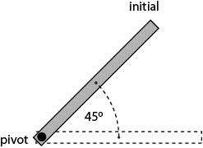
Example 2. A thin rod of mass 0.50 kg and length 2.0 m is pivoted at one end and can rotate in a vertical plane about this horizontal frictionless pivot (axis). It is released from rest when the rod makes an angle of 45° above the horizontal (Fig.). Find the angular speed of the rod as it passes through the horizontal position.
(Ans: 3.2 rad/s)
Example 3. Fig. 5 shows a 1.0 m thin uniform rod of mass 2.0 kg, which is free to rotate about a frictionless pin passing through one end O. The rod is released from rest in the horizontal position. As the rod swings through its lowest position, its angular speed is
(Ans: 5.4 rad/s)

Slide 38
Example 4:
A uniform spherical shell of mass M = 4.5 kg and radius R = 8.5cm can rotate about a vertical axis on frictionless bearing. A massless cord passes around the equator of the shell over a pulley of rotational inertia I = 3.0x 10⁻³ kg.m² and radius r =5 cm. and it is attached to a small object of mass m = 0.6 kg. There is no friction on the pulleys axle the cord doesn’t slip on the pulleys. What is the speed of the object after it has fallen 82 cm after being released? (Ans: 1.4 m/s)
M, R
I, r
m

Slide 39
Example 5
In figure, a solid brass ball of mass 0.28g will roll smoothly along a loop-the-loop track when released from the rest along the straight section. The circular loop has radius R = 14 cm, and the ball has radius r << R. (a) What is h if the ball on the verge of leaving the track when it reaches the top of the loop? If the ball is released at height h = 6R m what are the (b) magnitude and (c) direction of the horizontal force component acting on the ball at point Q?
(Ans a. 37.8 cm, b.1.96x10⁻² N, c. towards the center of the loop)
P
h
R
Q
R

Slide 40
b and c
(a) yes; (b) no; (c) yes; (d) yes
all tie

Slide 41
1, 2, 4, 3
1 and 3 tie, 4, then 2 and 5 tie (zero)

Slide 42
downward in the figure ;
less

Slide 43
Chapter 10 &11
Rotation (Angular Motion)
Lecture 4

Slide 44
a) ±z, (b) y (c)-x

Slide 45
Angular Momentum (L)
r
r
r
p
mv
v

Slide 46
Proof: L = Iω
Θ is angle between r and p
and n is the direction normal to r and p
r₀=0, If Θ = 90⁰
r
r
r
p
mv
v

Slide 47
Angular momentum:
p
L/2sin(θ)
p
psinΘ
Θ
Θ
com
com
L/2
p
L/2
p
p
psin(θ)
L/2sin(θ)
r
Clockwise: Negative
clockwise: Negative

Slide 48
Angular Momentum: Direction
mv
r
r
mv
Clockwise: Negative
Anti-Clockwise: Positive

Slide 49
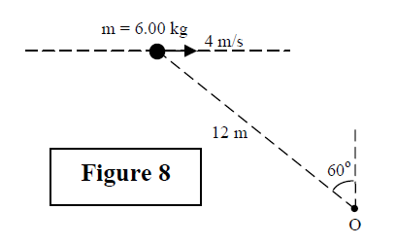
Examples: Angular momentum
Example1:
A 2.0-kg particle has a velocity v = (2.0 i + 4.0 j) m/s at the point (2.0, -2.0) m. Find its angular momentum relative to the point (- 2.0, - 2.0) m at this moment.
A) + 32 k
Example 2: In the instant of two particles move in xy plane. Particle P₁ has mass 6.5kg and speed and v₁ = 2.2 m/s, and it is at distance d₁ = 1.5m from point O. Particle P₂ has mass 3.1Kg and speed v₂ = 3.6m/s, and it is at distance d₂ = 2.8 m from point O. What are the (a) magnitude and (b) direction of the net angular momentum of the two particles about O?
(a. 21.4kgm²/s, b. +z)
v₁
P₁
d₁
v₂
O
d₂
P₂
Example 3:
A 6.00 kg particle moves to the right at 4.00 m/s as shown in Figure 8. Its angular momentum about the point O is:
A) 144 kg m²/s into the page

Slide 50
1 and 3 tie; then 2 and 4 tie, then 5 (zero);
2 and 3
VVIP Question:
A 2.0-kg particle has a time dependent position vector r = (2.0 t² i + 2.0 j) m. Find its angular momentum and torque relative to the point (- 2.0, - 2.0) m at time t = 2.0s.

Slide 51
Angular Momentum (L) & Torque (τ)
Example: The angular momentum of an object about the origin is given as functions of time as follows: L=(2t-1)i kg.m².s where t is in s. The torque about the origin at t = 2.0 s is:.
Ans: (2.0 i) N.m)

Slide 52
(a) 3, 1; then 2 and 4 tie (zero)

Slide 53
6. (a) all tie (L = RFt );
(b) sphere, disk, hoop

Slide 54
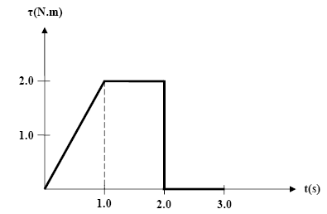
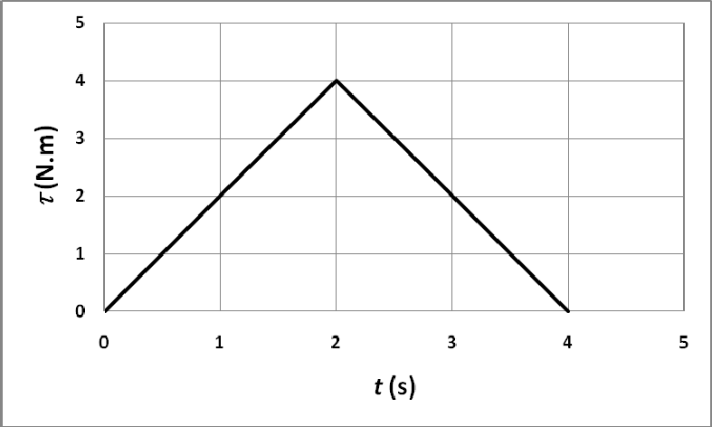
Examples
Example 1:
An object whose moment of inertia is 4.0 kg.m² experiences the net torque shown in Fig.2. What is the angular speed of the object at t = 3.0 s if it starts from rest?
A) 0.75 rad
Example 2
: Figure 7 shows a graph of a torque applied to a rotating body as a function of time. What is the angular momentum of the rotating body at t = 4.0 s, assuming it was initially at rest?
A) 8.0 kg·m²/s

Slide 55
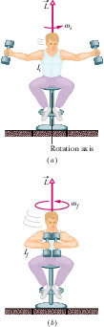
Conservation of angular momentum (L_{i} = L_{f})
(a) decreases; (b) same (tnet 0, so L is conserved); (c) increases

Slide 56
Example’s: Conservation of angular momentum
Example1: A student holding two weights close to his chest is sitting on a frictionless chair; the student and chair are rotating with an angular speed of 10 rad/s. The moment of inertia of Student + Weights + Chair system about the axis of rotation is 20 kg.m2. Now the student extends his arms horizontally to increase the moment of inertia by 10 %. Find the new angular speed of the system?
A) 9.1 rad/s
Example2: A boy of mass m = 30.0 kg stands at the center of a platform which rotates about a frictionless axle making one revolution in 6.00 seconds. The platform is a uniform circular disk with mass M = 100 kg and radius R = 2.00 m. If the boy walks radially to a position 1.00 m from the platform center, find the angular speed of the boy-platform system after the boy has reached this position.
A) 9.11 × 10⁻¹ rad/s
Example 3: A man of mass 80 kg, holding a stone of mass 2.0 kg, stands at the rim of a turntable of radius 4.0 m and mounted on a frictionless shaft through its center. The rotational inertia of the turntable is 2.0 ×103 kg.m2. The whole system is initially at rest. Now, the man throws the stone tangentially out with a speed of 2.0 m/s relative to the ground. Calculate the angular speed of the man-turntable system. You may consider the man as a point mass.
A) 4.9 × 10–3 rad/s

Slide 57
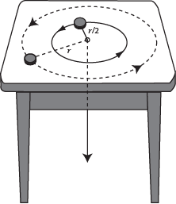
More Example
Example.
A small disk, tied to one end of a light string, moves with speed v in a circular path of radius r, on a horizontal, frictionless table. The string passes through a hole in the center of the table as shown in Figure 6. If the string is slowly pulled down, thereby reducing the radius of the path of the disk to half its initial value, the new speed of the disk is:
A) 2v
Example.
A merry-go-round of radius R = 2.0 m has a rotational inertia I = 200 kg.m² and is rotating at 10 rev/min, about a frictionless vertical axle. A 50 kg boy jumps onto the edge of the merry-go-round and sits down on the edge. Considering the boy to be a point mass, the new angular speed of the merry-go-round is: (Ans: 5.0 rev/min)

Slide 58
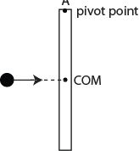
Book’s problem: A uniform thin rod of length 0.5m and mass 4kg can rotate in a horizontal plane can rotate in a horizontal plane about a vertical axis through its center. The rod is at rest when a 3g bullet traveling in the rotation plane is fired into one end of the rod. As viewed from above, the bullet’s path makes Θ = 60⁰ with the rod. If the bullet lodges in the rod and the angular velocity of the rod is 10 rad/s immediately after the collision, what is the speed of the bullet just before the impact? (Ans:1.3x10³ m/s)
axis
Θ
Example5.
A uniform thin rod of mass M = 50 g and length L = 1.0 m hangs from a pivot at point A at the edge (Figure 10). A ball of clay of mass m = 10 g moving with a horizontal velocity v = 25 m/s strikes the rod at its center of mass (COM) at right angle and remains stuck to the rod. Find the angular speed of the clay–rod system just after the collision.
A) 6.5 rad/s

Slide 59
Chapter 11
Rolling
Lecture 4

Slide 60
Rotational and Translational Motion
com
x, t

Slide 61
Angular Motion
T
v=v_{com}
The wheel rotates about its COM with the speed v_{com}
com
v=v_{com}
P
Linear Motion
Every particle in the wile movers forward with speed v_{com}
T
v=v_{com}
v_{com}
com
P
v=v_{com}

Slide 62
Combine both motions together
v_{com}
v_{com}
T
At the top: rotates about B
At the COM: rotates about B
v_{com}
com
At the Bottom: rotates about B
B
When an object experiences rolling motion the point of contact is momentarily at rest and is an instantaneous axis of rotation about which com moves with velocity v_{com}
T
-v_{com}
v_{com}
Rolling
cm
B
Example: A wheel of 0.25-m radius is rolling without sliding at a constant angular speed of 10 rad/s. What is the linear speed of a point at the top of the wheel?
A) 5.0 m/s

Slide 63
Total KE = ?
Total KE = Translational KE + Rotational KE
cm
Example : A sphere of mass 1.40 x10² kg rolls on a horizontal floor so that its center of mass has a speed of 0.150 m/s. How much work must be done on the sphere to stop it?
A) -2.21 J

Slide 64
When the rolling wheel is accelerating
This is in case of rotational acceleration caused by torque
a_{com}
com
Here the applied torque need to be clockwise to have net acceleration forward. The friction force will oppose the torque by creating counterclockwise torque
Tendency to fall
f_{s}
Example 1.
When the speed of a rear-drive car is increasing on a horizontal road the direction of the frictional force on the tires is:
A. forward for all tires
B. backward for all tires
C. forward for the front tires and backward for the rear tires
D. backward for the front tires and forward for the rear tires
E. zero

Slide 65
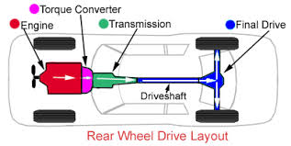
Friction in Rare Drive car
Rotational Motion
Rear wheels have angular motion due to torque created by engine. Hence the friction force has to be forward to oppose the torque.
Translational Motion
Front wheels are pushed forward by a force created by engine. So the friction has to be in the backward direction to oppose the force.
F
f_{s}
F
f_{s}

Slide 66
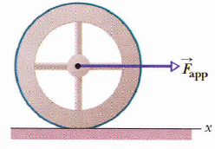
a) same b) less
Example:
In Fig. , a constant horizontal force F_{app}, of magnitude 10 N is applied to a wheel of mass 10 kg and radius 0.30 m. The wheel rolls smoothly on the horizontal surface, and the acceleration of its center of mass has magnitude 0.60 m/s².
In unit-vector notation, what is the frictional force on the wheel?
What is the rotational inertia of the wheel about the rotation axis through its center of mass?
f_{s}
a) -4N i b) 0.6 kgm²

Slide 67
Rolling in incline plane
N
There is a net force forward hence the static friction is backward which creates rotational motion.
mg sinΘ
cm
r
Θ
f_{s}
mg cosΘ
mg
Θ

Slide 68
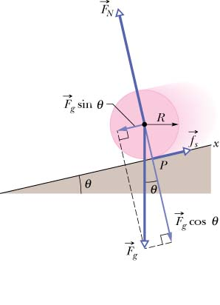
If you role a cylinder, hoop and a sphere in an incline plane simultaneously which one will reach to the bottom first?
a_{com}
Cylinder
Hoop
Sphere
Second
Third
First

Slide 69
Rolling: Energy Conservation
W_{f} = 0, because it doesn’t slip. The friction is static friction
cm
h
Θ
Example : A uniform hoop (ring) is smoothly rolling from the top of a 30° inclined plane of height 5.0 m, starting from rest. Find the speed of its center of mass when it reaches the bottom of the incline. (Ans: 7.0 m/s)

Slide 70
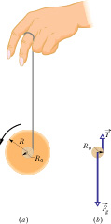
Yo-Yo
Energy Conservation
1. Instead of rolling down a ramp at angle θ with the horizontal, the yo-yo rolls down a string at angle θ= 90° with the horizontal.
2. Instead of rolling on its outer surface at radius R, the yo-yo rolls on an axle of radius R₀.
3. Instead of being slowed by frictional force f_{s}, the yo-yo is slowed by the tension force T on it from the string

Slide 71
less
Example :
A thin hoop of mass M and radius R rolls without slipping down an inclined plane. The ratio of its rotational kinetic energy to its total kinetic energy is:
A) 1/2

Slide 72
Examples
Example1:
Two cylinders made of the same material roll down a plane inclined at an angle θ with the horizontal. Each travels the same distance. The radius of cylinder B is twice the radius of cylinder A. If they start from rest at the same height, in what order do they reach the bottom.
A) They both reach the bottom at the same time, because each has the same linear acceleration.
Example2:
A solid cylinder rolls without sliding along the floor. The ratio of its translational kinetic energy to its rotational kinetic energy (about an axis through its center of mass and along its length) is:
A) 2
Example3.
A thin hoop rolls without sliding along the floor. The ratio of its translational kinetic energy of the center of mass to its rotational kinetic energy about an axis through its center of mass is: (Ans: 1 )

Slide 73
Example 2:
When we apply the energy conservation principle to a cylinder rolling down an incline without sliding, the work done by friction is zero because:
the coefficient of kinetic friction is zero
the angular velocity of the center of mass about the point of contact is zero
C) the linear velocity of the point of contact between the cylinder and the plane is zero
D) there is no friction present
E) the coefficients of static and kinetic friction are equal
Ans: C

Slide 74
Old Exams

Slide 75
T-102-ch10
Q12.
A uniform disk is rotating about an axis perpendicular to its plane and passing through a point on its edge. Find the ratio of its moment of inertia about this axis of rotation to its moment of inertia about a parallel axis passing through its center of mass.
A) 3
Q13.
Two objects of masses m1 = 1.00 kg and m2 = 2.00 kg hang at the ends of a massless string that passes over a pulley of radius R = 10.0 cm and moment of inertia I = 0.010 kg.m2, as shown in Figure 5. What is the linear acceleration of the masses?
A) 2.45 m/s²
Q14.
A constant torque of 10.0 N·m accelerates an object from rest to an angular speed of 10.0 rad/s after a rotation of π/2 radians. What is the moment of inertia of the object about the rotational axis?
A) 0.314 kg.m²

Slide 76
T-102-ch10
Q15.
The angular position of a rotating disk is given by, where θ (t) =t² -10t +2 is in radians and t is in seconds. Find the time at which the disk reverses its rotational direction.
A) 5 s
Q16. A small disk, tied to one end of a light string, moves with speed v in a circular path of radius r, on a horizontal, frictionless table. The string passes through a hole in the center of the table as shown in Figure 6. If the string is slowly pulled down, thereby reducing the radius of the path of the disk to half its initial value, the new speed of the disk is:
A) 2v
Q17.
A wheel of 0.25-m radius is rolling without sliding at a constant angular speed of 10 rad/s. What is the linear speed of a point at the top of the wheel?
A) 5.0 m/s

Slide 77
T-102-ch10
Q18.
Figure 7 shows a graph of a torque applied to a rotating body as a function of time. What is the angular momentum of the rotating body at t = 4.0 s, assuming it was initially at rest?
A) 8.0 kg·m²/s
Q20.
A rigid body is initially at rest. At time t = 0, it is given a constant angular acceleration of 0.060 rad/s2. Find the magnitude of the centripetal acceleration of a point that is a distance of 2.5 m from the axis of rotation at t = 8.0 s.
A) 0.58 m/s2

Slide 78

T-101-ch10
Q13.
The moment of inertia of an object does not depend on
its angular velocity.
its mass.
its size and shape.
the location of the axis of rotation.
E) the distribution of its mass.
Q14. A turntable rotating at 33 revolutions per minute is switched off. It comes to rest in 2.0 minutes with constant angular acceleration. Find the radial acceleration of a point 10 cm from the axis of rotation at time t = 1.0 minute.
A) 0.30 m/s²
Q15. In the Figure , two particles, each with mass m = 1.0 kg, are fastened to each other, and to a rotation axis at point O, by two thin rigid rods. Each rod has length d = 1.0 m and mass M = 1.0 kg. Find the moment of inertia of the system about a perpendicular axis through point O as shown in the Figure.
A) 7.7 kg·m²

Slide 79
T-101-ch10 &11
Q16.
A rope is wound around the rim of a wheel (radius = 2.0 m, and moment of inertia about the rotation axis, I = 5.0 kg.m2). A constant force F = 40 N is applied (Figure ) to one end of the rope for 1.0 s causing the wheel to rotate starting from rest. Find the length of the rope unwound during this period of time.
A) 16 m
Q17.
A thin hoop of mass M and radius R rolls without slipping down an inclined plane. The ratio of its rotational kinetic energy to its total kinetic energy is:
A) 1/2
Q18.
A 4.0 kg particle moves in an x-y plane. At the instant when the particle’s position relative to the origin is , r’ = 2.0 i its acceleration is , a = 2.0 i +3j where r ’ is in meters and a is in m/s². Find the torque acting on the particle about the point P (0, 2.0) m.
A) +40kN.m

Slide 80
T-101-ch11
Q19.
A boy of mass m = 30.0 kg stands at the center of a platform which rotates about a frictionless axle making one revolution in 6.00 seconds. The platform is a uniform circular disk with mass M = 100 kg and radius R = 2.00 m. If the boy walks radially to a position 1.00 m from the platform center, find the angular speed of the boy-platform system after the boy has reached this position.
A) 9.11 × 10⁻¹ rad/s
Q20.
A uniform thin rod of mass M = 50 g and length L = 1.0 m hangs from a pivot at point A at the edge (Figure 10). A ball of clay of mass m = 10 g moving with a horizontal velocity v = 25 m/s strikes the rod at its center of mass (COM) at right angle and remains stuck to the rod. Find the angular speed of the clay–rod system just after the collision.
A) 6.5 rad/s

Slide 81
T-92-ch10
Q12. The four particles shown in Figure 7 are connected by rigid rods of negligible mass. Calculate the moment of inertia of this system about the x-axis.
A) 3 kg.m²
Q13. An average torque of 1.0 N·m about the fixed axis of rotation of a pulley increases its angular speed from 5.0 rad/s to ωf in 3.0 s. The moment of inertia of the pulley about its axis of rotation is 0.2 kg.m2. Find ωf.
A) 20 rad/s
Q14. Assume that a disk starts from rest and rotates with an angular acceleration of 4.00 rad/s2. The time it takes to rotate through the first five revolutions is:
A) 3.96 s
Q15. Three point masses M, 2M and 3M, are attached to a rod of mass M and length L as shown in Figure 8. Take M = 1.00 kg and L = 1.00 m. The rotational kinetic energy of the system when rotating about the vertical z-axis through the mass 3M with a speed of 4.00 rad/s is:
A) 14.7 J

Slide 82
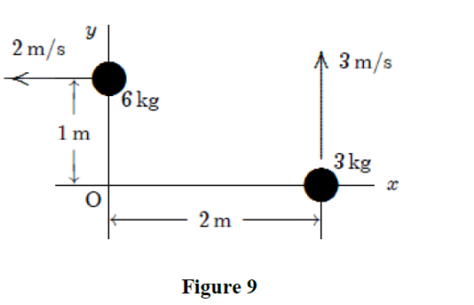
T-92-ch10
Q16.
A solid cylinder rolls without sliding along the floor. The ratio of its translational kinetic energy to its rotational kinetic energy (about an axis through its center of mass and along its length) is:
A) 2
Q17.
When we apply the energy conservation principle to a cylinder rolling down an incline without sliding, the work done by friction is zero because:
A) the linear velocity of the point of contact between the cylinder and the plane is zero
B) the angular velocity of the center of mass about the point of contact is zero
C) the coefficient of kinetic friction is zero
D) there is no friction present
E) the coefficients of static and kinetic friction are equal
Q18.
Two objects moving in the xy plane are shown at a certain instant in Figure 9. The magnitude of the total angular momentum (about the origin O) at this instant is:
A) 30 kg · m2/s

Slide 83
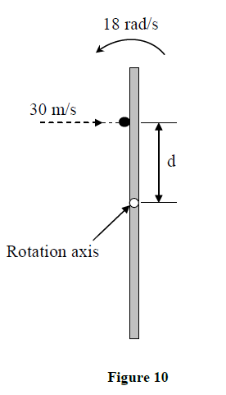
T-92-ch10 &11
Q19.
A 3.0-kg block is located on the x-axis 2.0 m from the origin and is acted upon by a force = 8.0 N. Find the net torque acting on the block relative to the origin. F = 8N i
A) Zero
Q20.
Figure 10 is an overhead view of a uniform thin rod (of length 1 m and mass 2 kg) rotating horizontally at 18 rad/s counter-clockwise about a vertical axis through its center. A particle of mass 0.2 kg traveling horizontally at 30 m/s hits the rod and stick to it at a distance d from the axis of rotation. At the time of collision with the rod, the particle was traveling perpendicular to the rod. Right after the collision, the (rod + particle) system comes to rest. Find the value of d.
A) 0.5 m

Slide 84
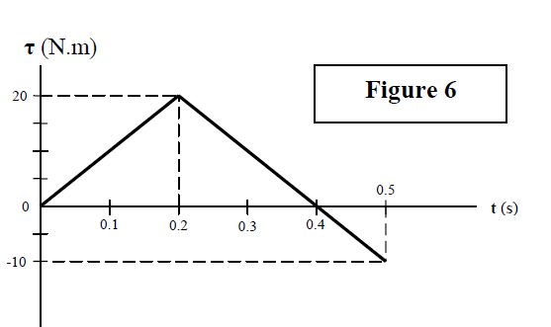
T-91-ch10
Q12. A turntable is initially rotating at 33 rev/min. When the power to the turntable is switched off, the turntable slows down at a constant rate of 0.20 rad/s2. How many revolutions will the turntable make before coming to a full stop?
A) 4.7
Q13. Figure 6 shows the time variation of a torque applied tangentially to the edge of a 10.0 kg uniform disk rotating about its central axis. If the initial angular velocity of the disk is −50 rad/s, what is its angular velocity after 0.500 seconds? The disk has a radius of 10 cm.
A) 20 rad/s
Q14. A 32.0 kg thin hoop (ring) with radius 1.20 m, is rotating at 280 rev/min about its axis. What is the required average power of the net force that brings the hoop to a full stop in 15.0 s?
A) 1.32 × 10³ W
Q15. Four forces of the same magnitude act on a square frame that can rotate about the middle point P as shown in Figure 7. Rank the forces acting on it according to the magnitude of the torque they produce about point P, greatest first. (assume all forces in the plane of the square)
A) F4, F3, F1, F2

Slide 85
T-91-ch10
Q16.
A wheel of radius R = 0.500 m rolls smoothly (without sliding) on a horizontal surface. Starting from rest, the wheel moves with a constant angular acceleration of 6.00 rad/s2. The distance traveled by the center of the wheel between t = 0 and t = 3.00 s is:
A) 13.5 m
Q17.
A solid cylinder of mass M = 1.0 kg and radius R = 10 cm rolls smoothly (without sliding) down a 300 rough incline. Find the force of static friction acting along the incline at the point of contact between the incline and the cylinder.
A) 1.6 N
Q18. A single force acts on a particle situated on the positive x axis. The torque about the origin is in the negative z direction. The force might be:
A) in the negative y direction
B) in the positive y direction
C) in the positive x direction
D) in the negative x direction
E) in the positive z direction

Slide 86
T-91-ch10
Q19.
A 6.00 kg particle moves to the right at 4.00 m/s as shown in Figure 8. Its angular momentum about the point O is:
A) 144 kg m2/s into the page
Q20.
A man of mass 80 kg, holding a stone of mass 2.0 kg, stands at the rim of a turntable of radius 4.0 m and mounted on a frictionless shaft through its center. The rotational inertia of the turntable is 2.0 ×103 kg.m2. The whole system is initially at rest. Now, the man throws the stone tangentially out with a speed of 2.0 m/s relative to the ground. Calculate the angular speed of the man-turntable system. You may consider the man as a point mass.
A) 4.9 × 10–3 rad/s

Slide 87
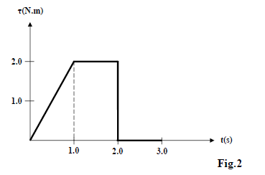
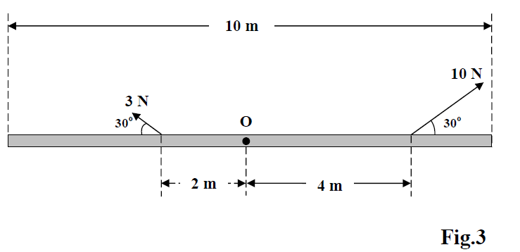
T-82-Ch10
Q13. An object whose moment of inertia is 4.0 kg.m2 experiences the net torque shown in Fig.2. What is the angular speed of the object at t = 3.0 s if it starts from rest?
A) 0.75 rad/s
Q14. A uniform rod of length L = 10.0 m and mass M = 2.00 kg is pivoted about its center of mass O. Two forces of 10.0 and 3.00 N are applied to the rod, as shown in Fig.3. The magnitude of the angular acceleration of the rod about O is
A) 1.02 rad/s2
Q15. A horizontal disk with a radius of 0.10 m rotates about a vertical axis through its center. The disk starts from rest at t = 0.0 s and has a constant angular acceleration of 2.1 rad/s2. At what value of t will the radial and tangential components of the linear acceleration of a point on the rim of the disk be equal in magnitude?
A) 0.69 s

Slide 88
T-82-ch11
Q16. The average power needed to spin ( rotate about its axis) a uniform, solid disk of mass 5.0 kg and radius 0.50 m from rest to a final angular velocity ωf in 3.0 s is 2.6 W. The final angular speed is:
A) 5.0 rad/s
Q17. A sphere of mass 1.40 x10² kg rolls on a horizontal floor so that its center of mass has a speed of 0.150 m/s. How much work must be done on the sphere to stop it?
A) – 2.21 J
Q18. Two cylinders made of the same material roll down a plane inclined at an angle θ with the horizontal. Each travels the same distance. The radius of cylinder B is twice the radius of cylinder A. If they start from rest at the same height, in what order do they reach the bottom.
A) They both reach the bottom at the same time, because each has the same linear acceleration.
B) A reaches the bottom first because it has a greater acceleration.
C) A reaches the bottom first because it has a smaller moment of inertia.
D) B reaches the bottom first because it experiences a larger torque.
E) B reaches the bottom first because it travels a larger distance in one rotation.

Slide 89
T-82-ch11
Q19.
A 2.0-kg particle has a velocity v = (2.0 i + 4.0 j) m/s at the point (2.0, -2.0) m. Find its angular momentum relative to the point (- 2.0, - 2.0) m at this moment.
A) + 32 k
Q20.
A student holding two weights close to his chest is sitting on a frictionless chair; the student and chair are rotating with an angular speed of 10 rad/s. The moment of inertia of Student + Weights + Chair system about the axis of rotation is 20 kg.m2. Now the student extends his arms horizontally to increase the moment of inertia by 10 %. Find the new angular speed of the system?
A) 9.1 rad/s

Slide 90
T-72-Ch10
Q13. Assume that a disk starts from rest and rotates with an angular acceleration of 2.00 rad/s². The time it takes to rotate through the first three revolutions is:
(Ans: 4.34 s)
Q14. A uniform slab of dimensions: a = 60 cm, b = 80 cm, and c = 2.0 cm (see Fig. 6) has a mass of 6.0 kg. Its rotational inertia about an axis perpendicular to the larger face and passing through one corner of the slab is:
(Ans: 2.0 kg.m² )
Fig. 6
Q15. A thin rod of mass 0.50 kg and length 2.0 m is pivoted at one end and can rotate in a vertical plane about this horizontal frictionless pivot (axis). It is released from rest when the rod makes an angle of 45° above the horizontal (Fig. 7). Find the angular speed of the rod as it passes through the horizontal position.
(Ans: 3.2 rad/s)
Fig. 7

Slide 91
T-72-Ch10
Q#16: A wheel of radius R = 0.20 m is mounted on a fixed frictionless horizontal axis. The rotational inertia I of the wheel about this axis is 0.50 kg.m². A massless cord wrapped around the circumference of the wheel is attached to a m = 5.0 kg box (Fig. 8). The box is then released from rest. When the box has a speed of v = 2.0 m/s, the distance (h) through which the box has fallen is: (Ans: 0.71 m)
Fig. 8
Q17. A force F = 2.0 i + 3.0 j is applied to an object that is pivoted about a fixed axis aligned along the z-axis. If the force is applied at the point of coordinates (4.0, 5.0, 0.0) m, what is the applied torque (in N.m) about the z axis?
(Ans: 2k )

Slide 92
T-72-Ch11
Q18: A uniform solid disk of mass 3.0 kg and radius 0.20 m rotates about a fixed axis perpendicular to its face. The axis passes through a point midway between the center and the edge of the disk. The angular speed of rotation is 6.0 rad/s. What is the magnitude of the angular momentum (in kg.m²/s) of the disk about this axis? ( Ans: 0.54)
Q19. A merry-go-round of radius R = 2.0 m has a rotational inertia I = 200 kg.m² and is rotating at 10 rev/min, about a frictionless vertical axle. A 50 kg boy jumps onto the edge of the merry-go-round and sits down on the edge. Considering the boy to be a point mass, the new angular speed of the merry-go-round is: (Ans: 5.0 rev/min)
Q20. A uniform hoop (ring) is smoothly rolling from the top of a 30° inclined plane of height 5.0 m, starting from rest. Find the speed of its center of mass when it reaches the bottom of the incline. (Ans: 7.0 m/s)

Slide 93
T-71-Ch10
Q14. A rigid body consists of two particles attached to a rod of negligible mass. The rotational inertia of the system about the axis shown in Fig. 3 is 10 kg m². What is x₁? (Ans: 1.4 m )
Q15. A 5.00 kg block hangs from a cord which is wrapped around the rim of a frictionless pulley as shown in Fig. 4. What is the acceleration, a, of the block as it moves down? (The rotational inertia of the pulley is 0.200 kg·m² and its radius is 0.100 m.) (Ans: 1.96 m/s² )
Q16. Fig. 5 shows a 1.0 m thin uniform rod of mass 2.0 kg, which is free to rotate about a frictionless pin passing through one end O. The rod is released from rest in the horizontal position. As the rod swings through its lowest position, its kinetic energy is: (Ans: 9.8 J )
Fig. 4
Fig. 5
Fig. 3

Slide 94
T-71-Ch11
Q17. A uniform ball, of mass M = 80.0 kg and radius R = 0.250 m, rolls smoothly from rest down a 30° incline. The ball descends a vertical height h to reach the bottom of the incline with a speed of 9.80 m/s. Find the value of h. (Ans: 6.86 m)
Q18. A horizontal disk has a radius of 3.0 m and a rotational inertia of 600 kg·m² about its axis. It is initially spinning at 0.80 rad/s when a 20 kg child is at the center of the disk. The child then walks to the rim (edge) of the disk. When the child reaches the rim, the angular velocity of the disk is (Treat the child as a point mass): (Ans: 0.62 rad/s )
Q19. At an instant, a particle of mass 2.0 kg has a position of r = (9i +15j) m and acceleration of a = -3 i m/s² . What is the net torque on the particle at this instant about the point having the position vector r₀ = 9i m: ? (Ans: 90 k Nm)
Q20. A thin rod of mass M = 2.0 kg and length L = 1.0 m is rotating about an axis O located a 25 cm from one end. Find the angular momentum of the rod about O, if its angular velocity is 120 rev/min. (Ans: 3.7 kg·m²/s )

Slide 95
T-62-Ch10
Q13. : A torque of 0.80 N·m applied to a pulley increases its angular speed from 45.0 rev/min to 180 rev/min in 3.00 s. Find the moment of inertia of the pulley. (Ans: 0.17 kg·m² ⁾
Q14. : A thin rod of mass 0.23 kg and length 1.00 m is rotated in a horizontal circle about a fixed axis passing through a point 20.0 cm from one of the edges of the rod. If it has a constant angular acceleration of 3.0 rad/s², find the net torque acting on the rod? (Ans: 0.12 N·m)
Q15. A disk starts from rest at t = 0, and rotates about a fixed axis (moment of inertia = 0.030 kg·m²) with an angular acceleration of 7.5 rad/s². What is the rate at which work is being done on the disk when its angular velocity is 32 rad/s? (Ans: 7.2 W)
Q16: A disk has a rotational inertia of 4.0 kg·m² and a constant angular acceleration of 2.0 rad/s². If it starts from rest the work done during the first 5.0 s by the net torque acting on it is: (Ans: 200 J)

Slide 96
T-62-Ch11
Q17. A mass, m₁ = 5.0 kg, hangs from a string and descends with an acceleration = a. The other end is attached to a mass m₂ = 4.0 kg which slides on a frictionless horizontal table. The string goes over a pulley (a uniform disk) of mass M = 2.0 kg and radius R = 5.0 cm (see Fig. 6). The value of a is: (Ans: 4.9 m/s²)
Fig. 6
Q18. Fig. 7 shows an overhead view of a thin rod of mass M (=2.0 kg) and length L = 2.0 m which can rotate horizontally about a vertical axis through the end A. A particle of mass m = 2.0 kg traveling horizontally with a velocity v_{i} =10.0 j m/s strikes the rod (which was initially at rest) at point B. The particle rebounds with a velocity v_{i} = - 6.0 j m/s Find the angular speed (ω_{f} ) of the rod just after collision. ( Ans: 24 rad/s )
Fig. 7
Fig. 8
Q19. A string is wrapped around a solid disk of mass m, radius R. The string is stretched in the vertical direction and the disk is released as shown in Fig. 8. Find the tension (T) in the string.
(Ans: 1/3 mg
Q20. The engine delivers 1.20 ×10⁵ W to a plane propeller at ω = 2400 rev/min. How much work does the engine do in one revolution? A) 3000 J

Slide 97
T-61-Ch10
Q13. : A string (one end attached to the ceiling) is wound around a uniform solid cylinder of mass M = 2.0 kg and radius R = 10 cm (see Fig 3). The cylinder starts falling from rest as the string unwinds. The linear acceleration of the cylinder is: (Ans: 6.5 m/s²)
Q14. : A 16 kg block is attached to a cord that is wound around the rim of a flywheel of radius 0.20 m and hangs vertically, as shown in Fig 4. The rotational inertia of the flywheel is 0.50 kg·m². When the block is released and the cord unwinds, the acceleration of the block is: (Ans: 5.5 m/s² )
Q15. : A particle of mass 0.50 kg is attached to one end of a 1.0 m long rod of mass 3.0 kg (Fig 5). The rod and the particle are rotating around the other pivoted end of the rod with 2.0 rad/s. The kinetic energy of the system about the pivot is: (Ans: 3.0 J)
Q16. A disk starts from rest and rotates around a fixed axis, subject to a constant net torque. The work done by the torque during the time interval from t = 0 to 2 s is W₁ and the work done during the time interval from t = 0 to 6 s is W₂. The ratioW₂/W₁ = (Ans: 9)
Fig. 3
Fig. 4
Fig. 5

Slide 98
T-61-Ch11
Q17. A particle, held by a string whose other end is attached to a fixed point C, moves in a circle on a horizontal frictionless surface. If the string is cut, the angular momentum of the particle about the point C: (Ans: does not change )
Q18. What is the net torque about the origin on an object located at (0, -5.0, 5.0) m when forces and F₁= -3.0 k N and F₂= 2.0 j N act on the object? (Ans: 5i N.m)
Q19. : A thin uniform rod of mass M = 3.0 kg and length L = 2.0 m is suspended vertically from a frictionless pivot at its upper end. An object of mass m = 500 g, traveling horizontally with a speed v = 45 m/s strikes the rod at its center of mass and sticks there (See Fig 6). What is the angular velocity of the system just after the collision? (Ans: 5.0 rad/s )
Q20. A thin hoop rolls without sliding along the floor. The ratio of its translational kinetic energy of the center of mass to its rotational kinetic energy about an axis through its center of mass is: (Ans: 1 )
Fig. 6

Slide 99
T-52-Ch10
Q#13: The angular position of a particle is given as θ = 2 + t – t³ where θ is in rad and t is in s. The angular acceleration when the particle is momentarily at rest is (Ans: 3.5 rad/s² clockwise)
Q#14: A disk of rotational inertia 5.0 kg m² starts rotating from rest and accelerates with a constant angular acceleration of 1.0 rad/s². During the first 4.0 s, the work done on the disk is: (Ans: 40 J)
Q#15: The rotational inertia of a solid sphere (mass M and radius R₁) about an axis parallel to its central axis but at a distance of 2R₁ from it is equal to I₁. The rotational inertia of a cylinder (same mass M but radius R₂) about its central axis is equal to I₂. If I₁=I₂, the radius of the cylinder R₂ must then be: (Ans: 3.0 R₁)
Q#16: A rope pulls a 1.0-kg box on a frictionless surface through a pulley as shown in Fig 4. The pulley has a rotational inertia of 0.040 kg.m² and radius of 20 cm. If the force F is 10 N, then the acceleration of the box is: (Ans: 5.0 m/s²)
Fig. 4

Slide 100
T-52-Ch11
Q#17: A ring is given an initial speed of 7.0 m/s at its center of mass (see Fig 5). It then rolls smoothly up the incline. At the height 5.0 m the speed of the center of mass of the ring is: (Ans: 0 m/s)
Q#18: The angular momentum of an object about the origin is given as functions of time as follows: L=(2t-1)i kg.m².s where t is in s. The torque about the origin at t = 2.0 s is:.(Ans: (2.0 i) N.m)
Q#19: Two identical thin rods of mass M and length d are attached together in the form of a plus sign “+” (see Fig 6). The whole structure is rotating counterclockwise with angular velocity of ω about the z axis (which is at the point of attachment). The angular momentum about the z axis is: (Ans: (1/6) M ω d2 counterclockwise )
Q#20: A solid sphere of mass M=1.0 kg and radius R=10 cm rotates about a frictionless axis at 4.0 rad/s (see Fig 7). A hoop of mass m=0.10 kg and radius R =10 cm falls onto the ball and sticks to it in the middle exactly. The angular speed of the whole system about the axis just after the hoop sticks to the sphere is: (Ans: 3.2 rad/s )

Slide 101
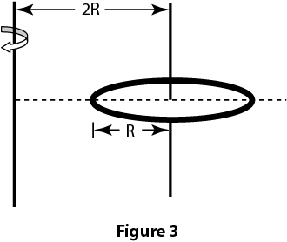
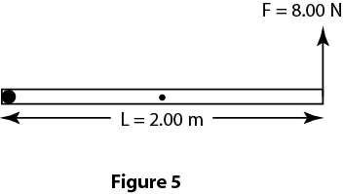
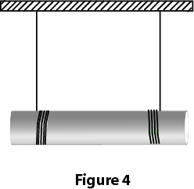
T-51-Ch10
Q#13. A car engine is idling at ω₀= 500 rev/min at a traffic light. When the light turns green, the crankshaft rotation speeds up at a constant rate to ω= 2500 rev/min over an interval of 3.0 s. The number of revolutions the crankshaft makes during these 3.0 s is: (Ans: 75)
Q#14: Find the moment of inertia of a uniform ring of radius R and mass M about an axis 2R from the center of the ring as shown in the Figure 3. (Ans: 5M R²)
Q#15: A uniform 2.0 kg cylinder of radius 0.15 m is suspended by two strings wrapped around it, as shown in Figure 4. The cylinder remains horizontal while descending. The acceleration of the center of mass of the cylinder is: (Ans: 6.5 m/s²)
Q#16. A uniform thin rod of mass M = 3.00 kg and length L = 2.00 m is pivoted at one end O and acted upon by a force F = 8.00 N at the other end as shown in Figure 5. The angular acceleration of the rod at the moment the rod is in the horizontal position as shown in this figure is: (Ans: 3.35 rad/s² clockwise)
Q#19. Force F = (-8.0 N) i+ (6.0 N) j acts on a particle with position vector r = (3.0 m) i+ (4.0 m)j. What is the torque on the particle about the point P = (0, 4.0 m)? (Ans: 18k N.m)
Fig. 3
Fig. 4
Fig. 5

Slide 102
T-51-Ch11
Q#17. A wheel is 60 cm in diameter and rolls without slipping on a horizontal floor. The speed of the center of mass of the wheel is 20 m/s. The speed of a point at the top edge of the wheel is: (Ans: 40 m/s)
Q#18: A stone attached to a string is whirled at 3.0 rev/s around a horizontal circle of radius 0.75 m. The mass of the stone is 0.15 kg. The magnitude of the angular momentum of the stone relative to the center of the circle is: (Ans: 1.6 kg.m²/s )
Q#20. A monkey of mass = M stands on the rim of a horizontal disk. The disk has a mass of 4 M and a radius R=2.0 m and is free to rotate about a frictionless vertical axle through its center. Initially the monkey and the disk are at rest. Then the monkey starts running around the rim clockwise at a constant speed of 4.0 m/s relative to the ground. The angular velocity of the disk becomes: (Ans: 1.0 rad/s counterclockwise)

Slide 103
T-42-Ch10
Q14: A wheel initially has an angular velocity of 18 rad/s but it is slowing at a constant rate of 2.0 rad/s**2. The time it takes to stop is (Ans: 9.0 s)
Q15: Two wheels A and B are identical. Wheel B is rotating with twice the angular velocity of wheel A. The ratio of the radial acceleration of a point on the rim of B (a2) to the radial acceleration of a point on the rim of A (a1) is (a2/a1 : (Ans: 4)
Q16: Four identical particles, each with mass m, are arranged in the x, y plane as shown in Fig 5. They are connected by light sticks of negligible mass to form a rigid body. If m = 2.0 kg and a = 1.0 m, the rotational inertia of this system about the y-axis is: (Ans: 12 kg*m**2)
Q17: Fig 6 shows a pulley (R=3.0 cm and Io= 0.0045 kg*m**2 ) suspended from the ceiling. A rope passes over it with a 2.0 kg block attached to one end and a 4.0 kg block attached to the other. When the speed of the heavier block is 2.0 m/s the total kinetic energy of the pulley and blocks is : (Ans: 22 J)
Fig. 5
Fig. 6

Slide 104
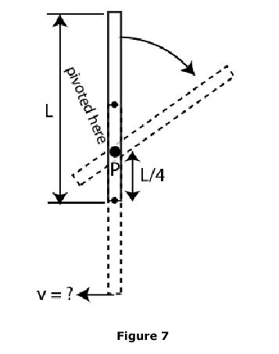
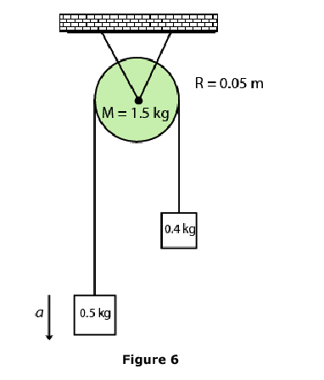
T-41-Ch10
Q14: A uniform rod (M = 2.0 kg, L = 2.0 m) is held vertical about a pivot at point P, a distance L/4 from one end (see Fig 7). The rotational inertia of the rod about P is 1.17 kg*m**2. If it starts rotating from rest, what is the linear speed of the lowest point of the rod as it passes again through the vertical position (v)? (Ans: 8.7 m/s).
Q16: At t=0, a disk has an angular velocity of 360 rev/min, and constant angular acceleration of -0.50 rad/s**2. How many rotations does the disk make before coming to rest? (Ans: 226)
Q17: In Fig 6, m1 = 0.50 kg, m2 = 0.40 kg and the pulley has a disk shape of radius 0.05 m and mass M = 1.5 kg. What is the linear acceleration of the block of mass m2? (Ans: 0.59 m/s**2)
Fig. 7
Fig. 6

Slide 105
