Slide 1
Information entropies for Two-electron systems
Ibraheem Nasser
Department of Physics, KFUPM, Dhahran 31261, Saudi Arabia

Slide 2
Abstract: In atomic systems, the Schrödinger equation for two electrons, for example the He-like atoms, could be solved approximately using the variational method incorporated with trial functions. Depend on the form of the trial functions, the eigenvalues could be calculated using the solution of the Schrödinger equation in spherical or Hylleraas coordinates. The solution gives the optimum wavefunctions, that one can used to calculate the information entropies (Shannon, Fisher, Rényi, Tsallis, etc.). The information entropy is a trigger for providing the information about the localization, extent, spread, shape and uncertainty of the electronic density distribution of states in r- or p- spaces. In this seminar, we will give an overview about our latest work regarding Rényi entropy for He-like atoms.

Slide 4
Schrödinger Equation for the Helium-like Atoms

Slide 12
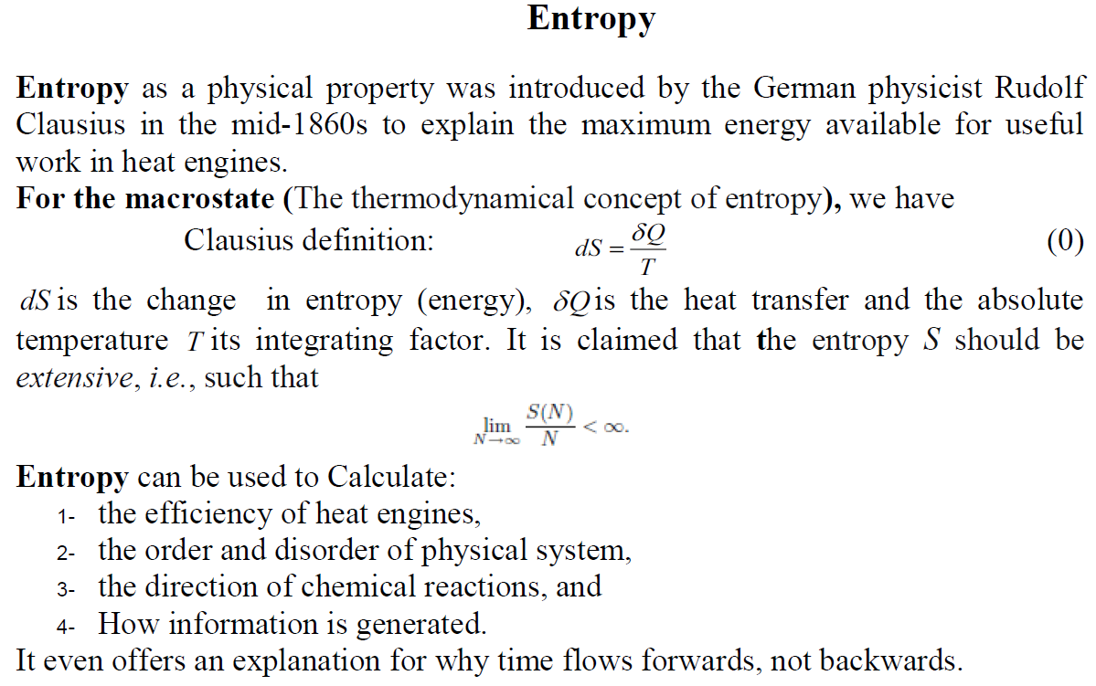

Slide 13
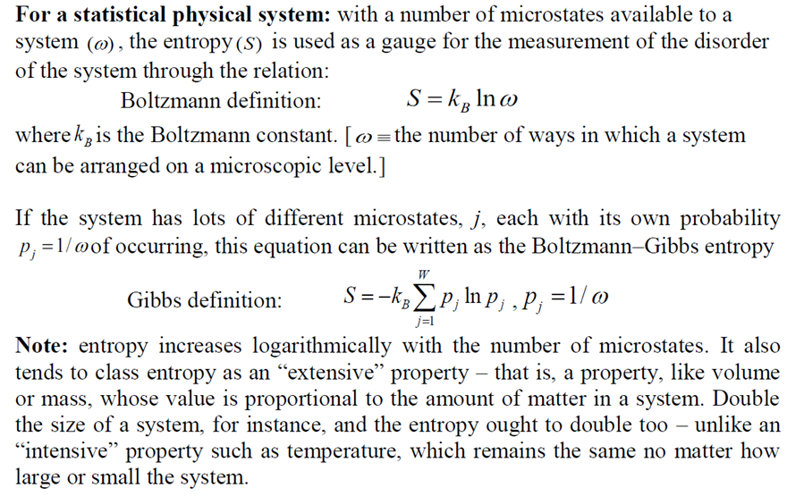

Slide 14
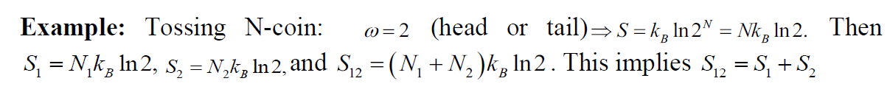

Slide 15


Slide 16
In atomic physics
It is known that entropy is a gauge for providing the information about the localization, extent, spread, shape and uncertainty of the electronic density distribution of states in the respective spaces.

Slide 17
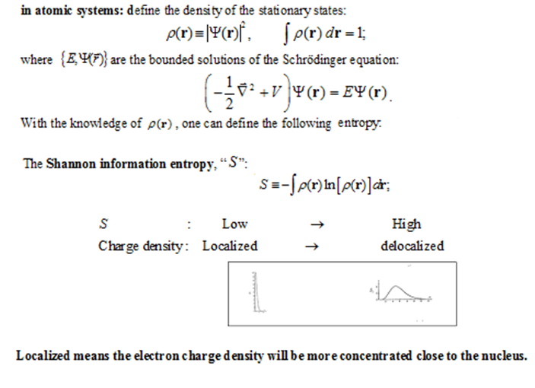

Slide 19
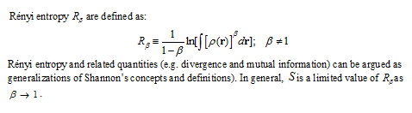

Slide 20
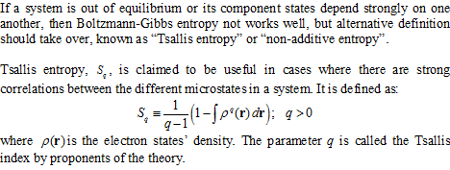

Slide 22
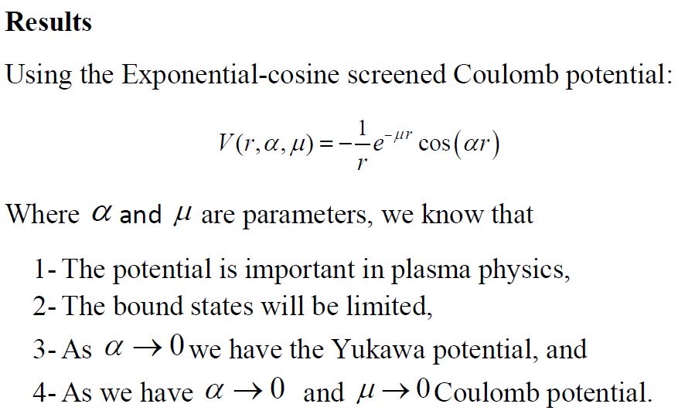

Slide 23
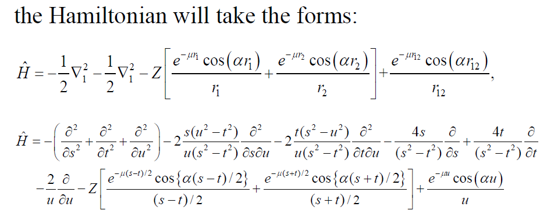

Slide 24
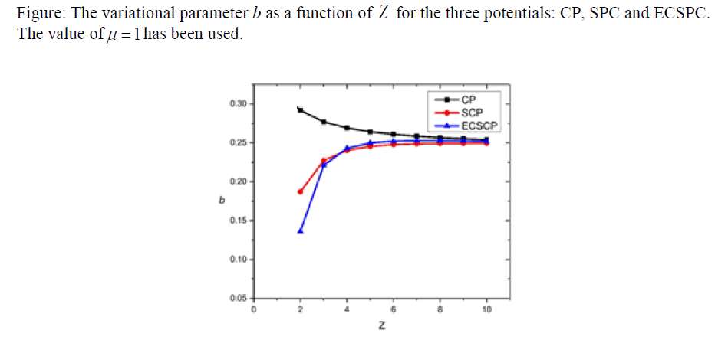

Slide 25
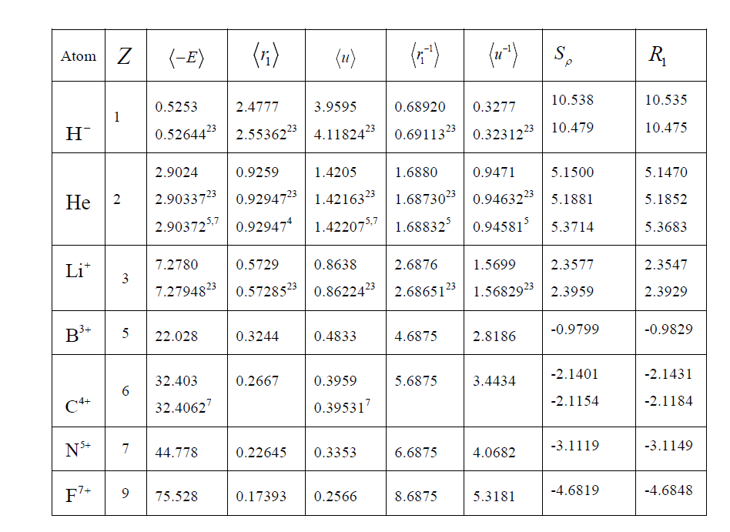

Slide 27
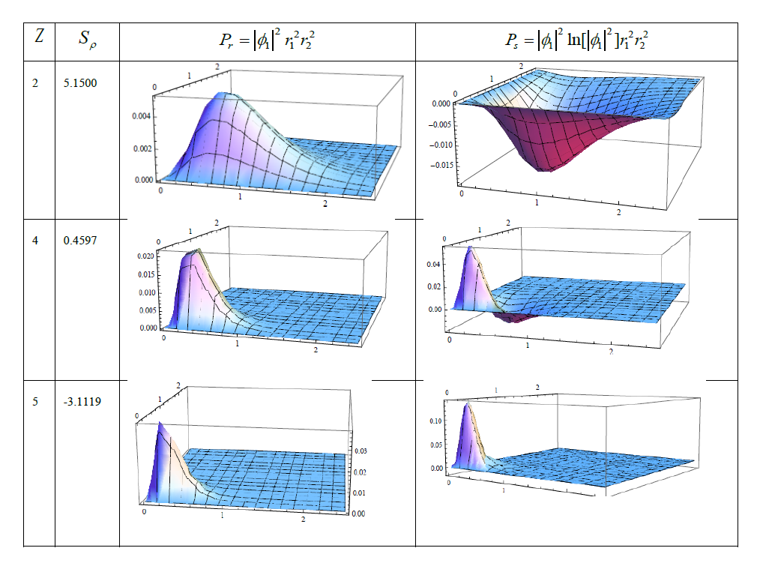

Slide 28
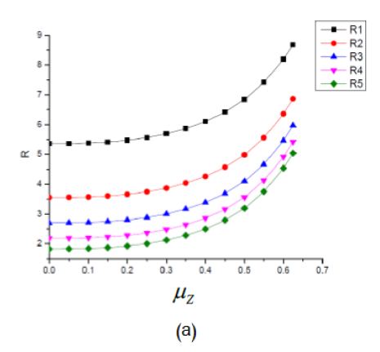

Slide 29
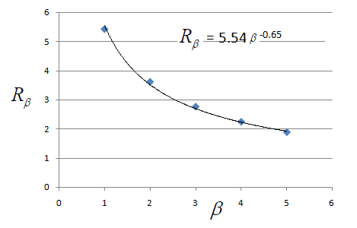

Slide 30
Future work
Applied different effective potentials.
Study another definitions of entropy.

Slide 31
Thank you

