Slide 1
Ch-6-1-2017 RADIOACTIVE DECAY

Slide 3
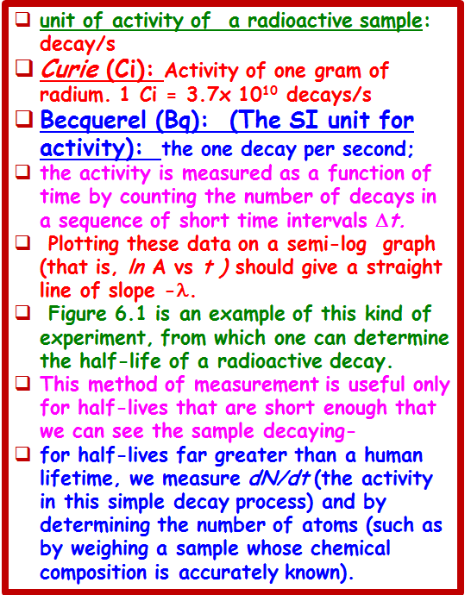

Slide 4
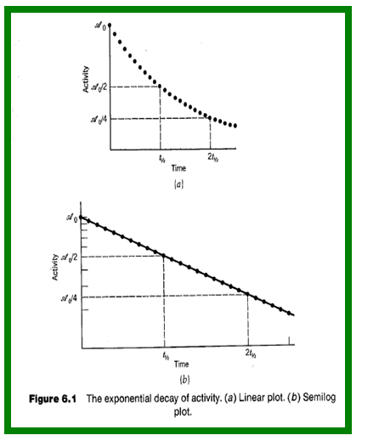

Slide 11
We assumed the decay probability λ to be (1) small and (2) constant in time.
If V‘ is independent of time, then λ calculated according to Equation 6.15 will also be independent of time. Under such a condition, the effect of V' on the stationary states a and b of V is .
and the system formerly in the state a has a probability proportional to IV_{ba}l² to be
found in the state b. We observe this as a "decay" from a to b.
To apply Fermi's Golden Rule, the probability for decay must also be small, so that the amplitude of in the above expression is small. It is this requirement that gives us a decay process.
If the decay probability were large, then there would be enough radiation present to induce the reverse transition b → a through the process of resonant absorption. The system would then oscillate between the states a and b, in analogy with a classical system of two coupled oscillators.
The final connection between the effective decay probability for an ensemble of a large number of nuclei and the microscopic decay probability computed from the quantum mechanics of a single nucleus requires the assumption that each nucleus of the ensemble emits its radiation independently of all the others. We assume that the decay of a given nucleus is independent of the decay of its neighbors.
This assumption then permits us to have confidence that the decay constant we measure in the laboratory can be compared with the result of our quantum mechanical calculation.

Slide 15
