Slide 1
Electric Potential
Chapter 24

Slide 2
24-1 Electric Potential
Learning Objectives
24.01 Identify that the electric force is conservative and thus has an associated potential energy.
24.02 Identify that at every point in a charged object’s electric field, the object sets up an electric potential V, which is a scalar quantity that can be positive or negative depending on the sign of the object’s charge.
24.03 For a charged particle placed at a point in an object’s electric field, apply the
relationship between the object’s electric potential V at that point, the particle’s charge q, and the potential energy U of the particle–object system.
24.04 Convert energies between units of joules and electron-volts.
24.05 If a charged particle moves from an initial point to a final point in an electric field, apply the relationships between the change ΔV in the potential, the particle’s charge q, the change ΔU in the potential energy, and the work W done by the electric force.

Slide 3
24-1 Electric Potential
Learning Objectives
24.06 If a charged particle moves between two given points in the electric field of a charged object, identify that the amount of work done by the electric force is path independent.
24.07 If a charged particle moves through a change ΔV in electric potential without an applied force acting on it, relate ΔV and the change ΔK in the particle’s kinetic energy.
24.08 If a charged particle moves through a change ΔV in electric potential while an applied force acts on it, relate ΔV, the change ΔK in the particle’s kinetic energy, and the work W_{app} done by the applied force.

Slide 4
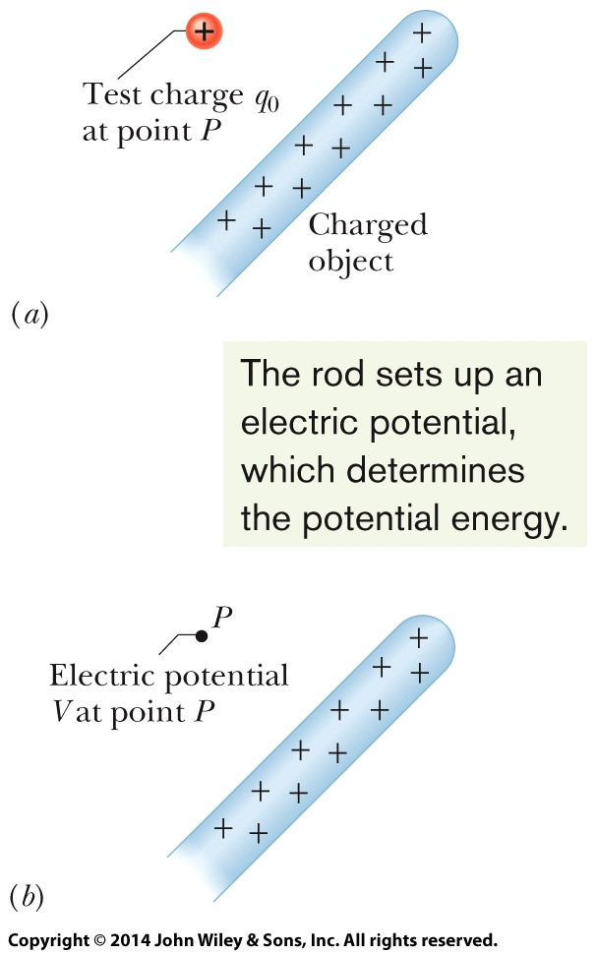
24-1 Electric Potential
The electric potential V at a point P in the electric field of a charged object is
where W∞ is the work that would be done by the electric force on a positive test charge q₀ were it brought from an infinite distance to P, and U is the electric potential energy that would then be stored in the test charge–object system.
If a particle with charge q is placed at a point where the electric potential of a charged object is V, the electric potential energy U of the particle–object system is
A test charge has been brought in from infinity to point P in the electric field of the rod.
We define an electric potential V at P based on the potential energy of the configuration in (a).

Slide 5
24-1 Electric Potential
Change in Electric Potential. If the particle moves through a potential difference ΔV, the change in the electric potential energy is
Work by the Field. The work W done by the electric force as the particle moves from i to f:
Conservation of Energy. If a particle moves through a change ΔV in electric potential without an applied force acting on it, applying the conservation of mechanical energy gives the change in kinetic energy as
Work by an Applied Force. If some force in addition to the electric force acts on the particle, we account for that work

Slide 6
24-2 Equipotential Surfaces and the Electric Field
Learning Objectives
24.09 Identify an equipotential surface and describe how it is related to the direction of the associated electric field.
24.10 Given an electric field as a function of position, calculate the change in potential ΔV from an initial point to a final point by choosing a path between the points and integrating the dot product of the field E and a length element ds along the path.
24.11 For a uniform electric field, relate the field magnitude E and the separation Δx and potential difference ΔV between adjacent equipotential lines.
24.12 Given a graph of electric field E versus position along an axis, calculate the change in potential ΔV from an initial point to a final point by graphical integration.
24.13 Explain the use of a zero-potential location.

Slide 7
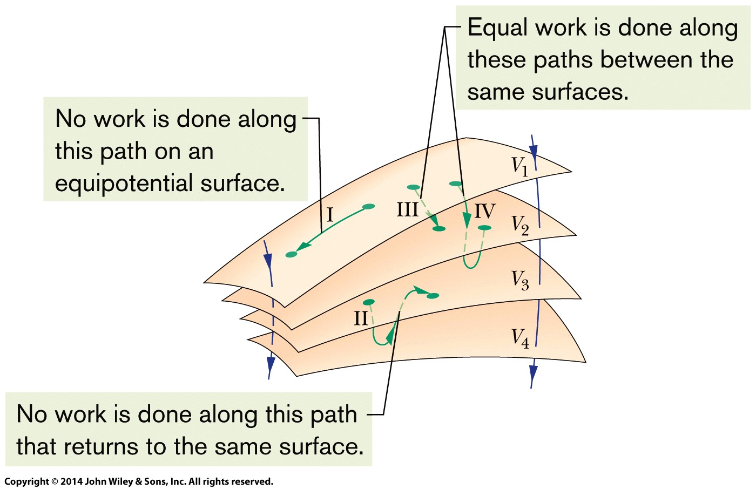
24-2 Equipotential Surfaces and the Electric Field
Adjacent points that have the same electric potential form an equipotential surface, which can be either an imaginary surface or a real, physical surface.
Figure shows a family of equipotential surfaces associated with the electric field due to some distribution of charges. The work done by the electric field on a charged particle as the particle moves from one end to the other of paths I and II is zero because each of these paths begins and ends on the same equipotential surface and thus there is no net change in potential. The work done as the
charged particle moves from one end to the other of paths III and IV is not
zero but has the same value for both these paths because the initial and final potentials are identical for the two paths; that is, paths III and IV connect the same pair of equipotential surfaces.

Slide 8
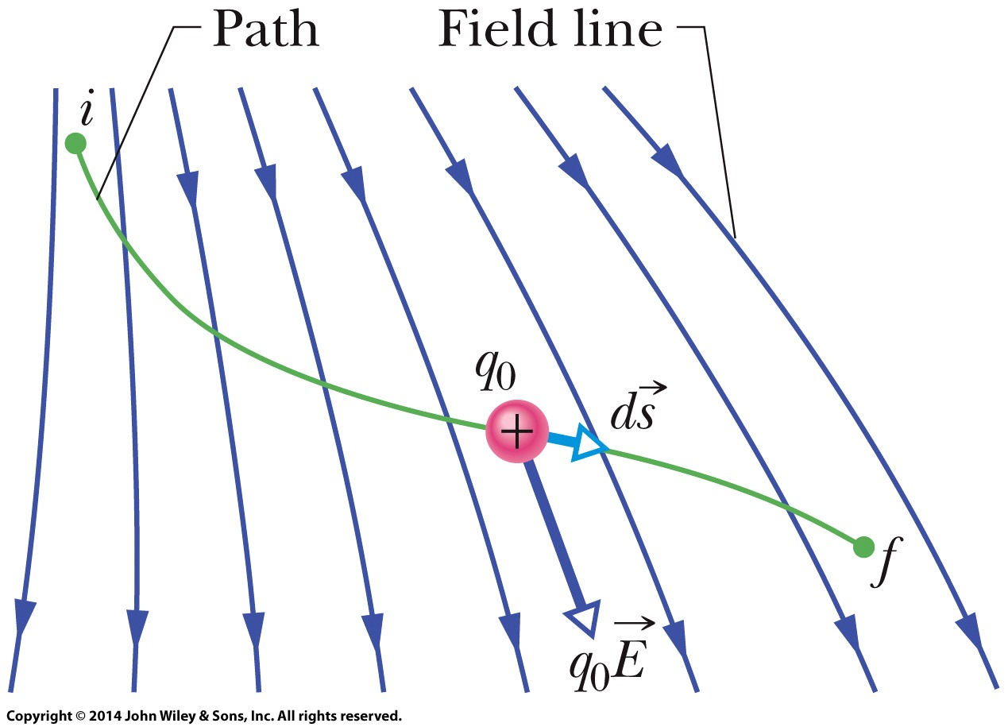
24-2 Equipotential Surfaces and the Electric Field
The electric potential difference between two points i and f is
where the integral is taken over any path connecting the points. If the integration is difficult along any particular path, we can choose a different path along which the integration might be easier.
If we choose V_{i} = 0, we have, for the potential at a particular point,
In a uniform field of magnitude E, the change in potential from a higher equipotential surface to a lower one, separated by distance Δx, is
A test charge q₀ moves from point i to point f along the path shown in a non-uniform electric field. During a displacement ds, an electric force q₀ E acts on the test charge. This force points in the direction of the field line at the location of the test charge.

Slide 9
24-3 Potential due to a Charged Particle
Learning Objectives
24.14 For a given point in the electric field of a charged particle, apply the relationship between the electric potential V, the charge of the particle q, and the distance r from the particle.
24.15 Identify the correlation between the algebraic signs of the potential set up by a particle and the charge of the particle.
24.16 For points outside or on the surface of a spherically
symmetric charge distribution, calculate the electric potential as if all the charge is concentrated as a particle at the center of the sphere.
24.17 Calculate the net potential at any given point due to several charged particles, identifying that algebraic addition is used, not vector addition.
24.18 Draw equipotential lines for a charged particle.

Slide 10
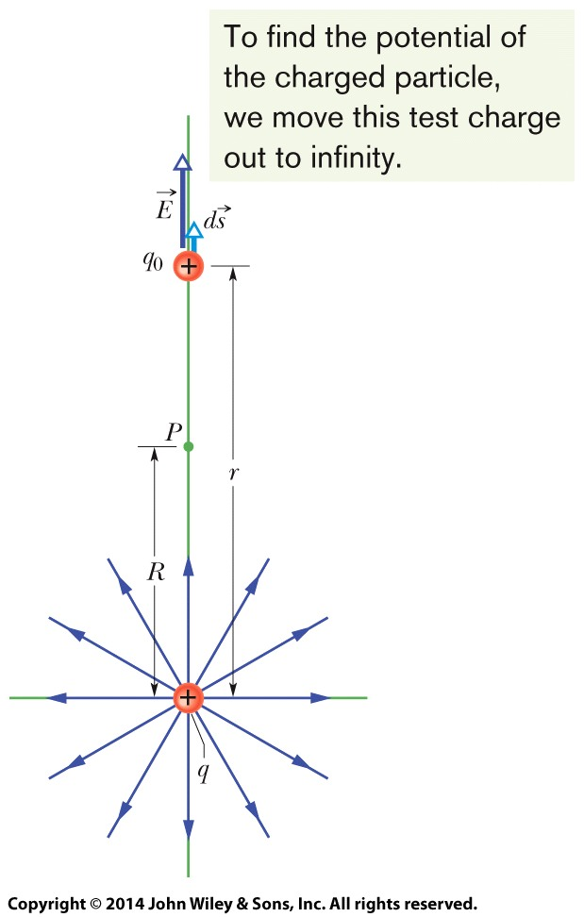
24-3 Potential due to a Charged Particle
We know that the electric potential difference between two points i and f is
In this figure the particle with positive charge q produces an electric field E and an electric potential V at point P. We find the potential by moving a test charge q₀ from P to infinity. The test charge is shown at distance r from the particle, during differential displacement ds.
For radial path
The magnitude of the electric field at the site of the test charge
We set V_{f} =0 (at ∞) and V_{i} =V (at R)
Solving for V and switching R to r, we get
as the electric potential V due to a particle of charge q at any radial distance r from the particle.

Slide 11
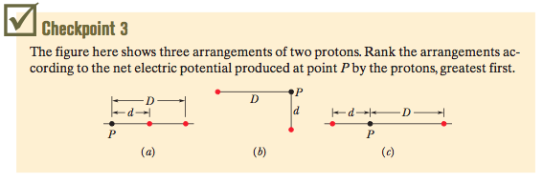
24-3 Potential due to a Charged Particle
Potential due to a group of Charged Particles
The potential due to a collection of charged particles is
Thus, the potential is the algebraic sum of the individual potentials, with no consideration of directions.
Answer: Same net potential (a)=(b)=(c)

Slide 12
24-4 Potential due to a Electric Dipole
Learning Objectives
24.19 Calculate the potential V at any given point due to an electric dipole, in terms of the magnitude p of the dipole moment or the product of the charge separation d and the magnitude q of either charge.
24.20 For an electric dipole, identify the locations of positive potential, negative potential, and zero potential.
24.21 Compare the decrease in potential with increasing distance for a single charged particle and an electric dipole.

Slide 13
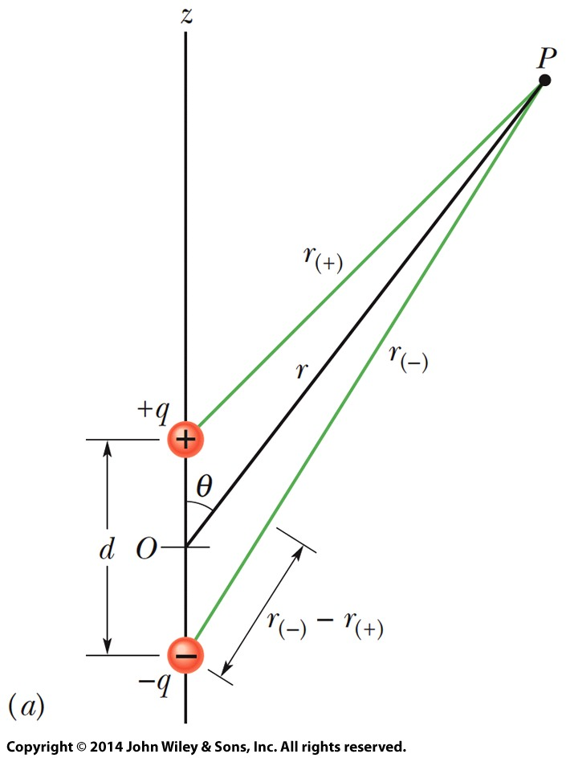
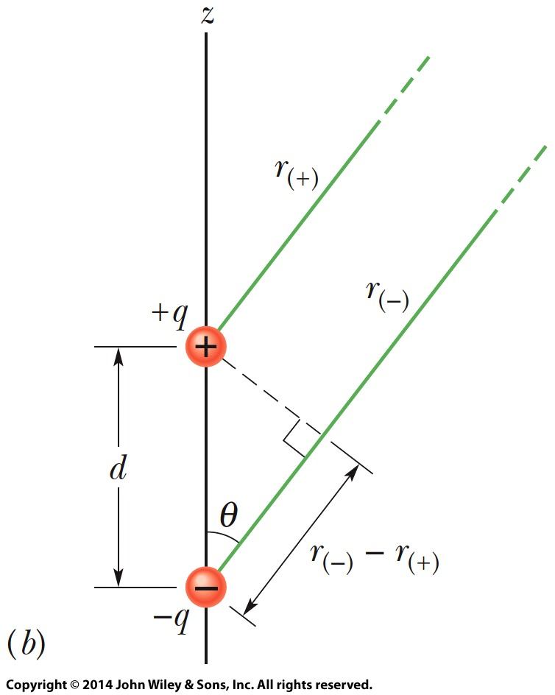
24-4 Potential due to a Electric Dipole
The net potential at P is given by
We can approximate the two lines to P as being parallel and their length difference as being the leg of a right triangle with hypotenuse d (Fig. b). Also, that difference is so small that the product of the lengths is approximately r ².
Point P is a distance r from the midpoint O of a dipole. The line OP makes an angle θ with the dipole axis.
If P is far from the dipole, the lines of lengths r₍₊₎ and r₍₋₎ are approximately parallel to the line of length r, and the dashed black line is approximately perpendicular to the line of length r₍₋₎.
We can approximate V to be
where θ is measured from the dipole axis as shown in Fig. a. And since p=qd, we have

Slide 14
24-5 Potential due to a Continuous Charge Distribution
Learning Objectives
24.22 For charge that is distributed uniformly along a line or over a surface, find the net potential at a given point by splitting the distribution up into charge elements and summing (by integration) the potential due to each one.

Slide 15
24-5 Potential due to a Continuous Charge Distribution
For a continuous distribution of charge (over an extended object), the potential is found by
dividing the distribution into charge elements dq that can be treated as particles and then
summing the potential due to each element by integrating over the full distribution:
We now examine two continuous charge distributions, a line and a disk.

Slide 16
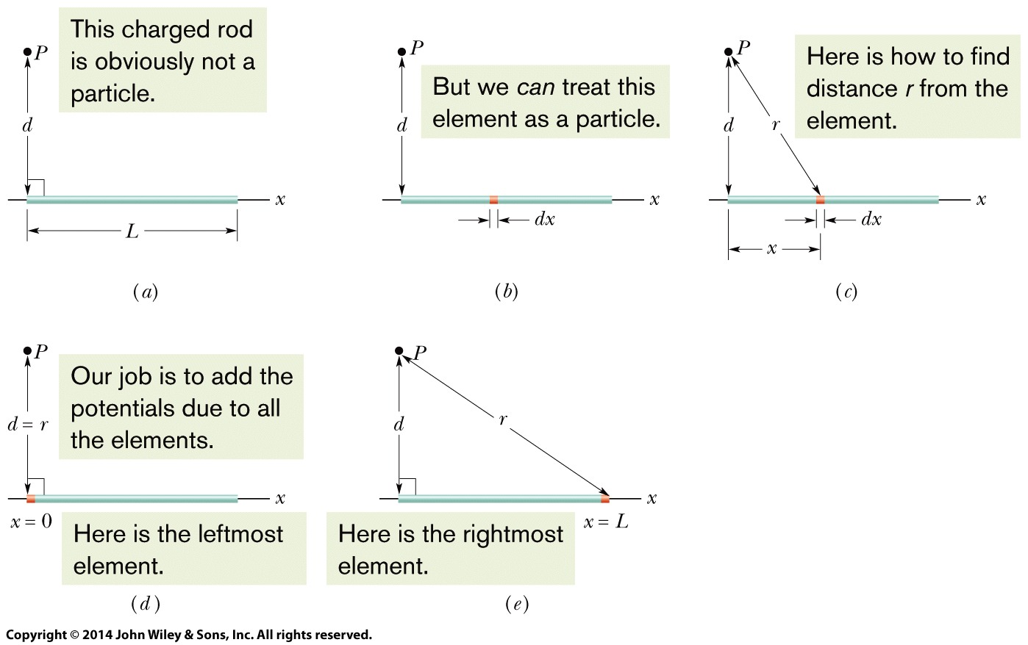
24-5 Potential due to a Continuous Charge Distribution
Line of Charge
Fig. a has a thin conducting rod of length L. As shown in fig. b the element of the rod has a differential charge of
This element produces an electric potential dV at point P (fig c) given by
We now find the total potential V produced by the rod at point P by integrating dV along the length of the rod, from x = 0 to x = L (Figs.d and e)
Simplified to,

Slide 17
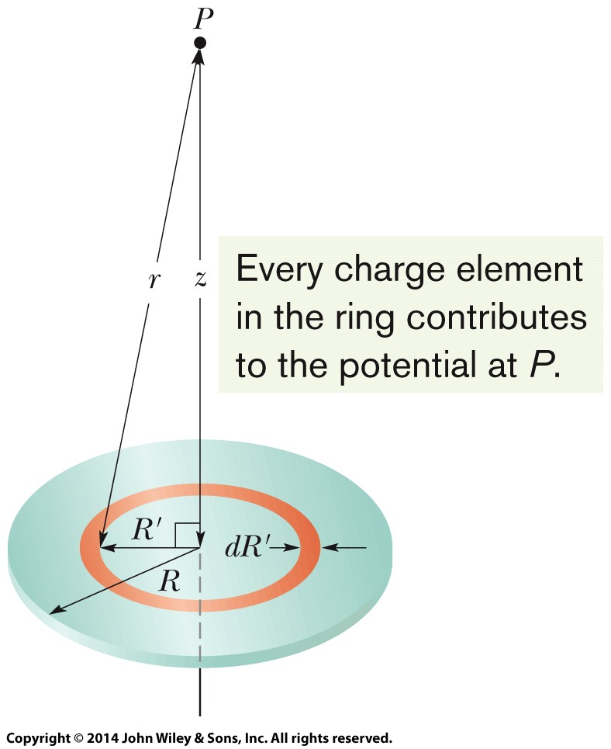
24-5 Potential due to a Continuous Charge Distribution
Charged Disk
In figure, consider a differential element consisting of a flat ring of radius R’ and radial width dR’. Its charge has magnitude
in which (2πR’)(dR’) is the upper surface area of the ring. The contribution of this ring to the electric potential at P is
We find the net potential at P by adding (via integration) the contributions of all the rings from R’=0 to R’=R:
A plastic disk of radius R, charged on its top surface to a uniform surface charge density σ. We wish to find the potential V at point P on the central axis of the disk.
Note that the variable in the second integral is R’ and not z

Slide 18
24-6 Calculating the Field from the Potential
Learning Objectives
24.23 Given an electric potential as a function of position along an axis, find the electric field along that axis.
24.24 Given a graph of electric potential versus position along an axis, determine the electric field along the axis.
24.25 For a uniform electric field, relate the field magnitude E. and the separation Δx and potential difference ΔV between adjacent equipotential lines.
24.26 Relate the direction of the electric field and the directions in which the potential decreases and increases.

Slide 19
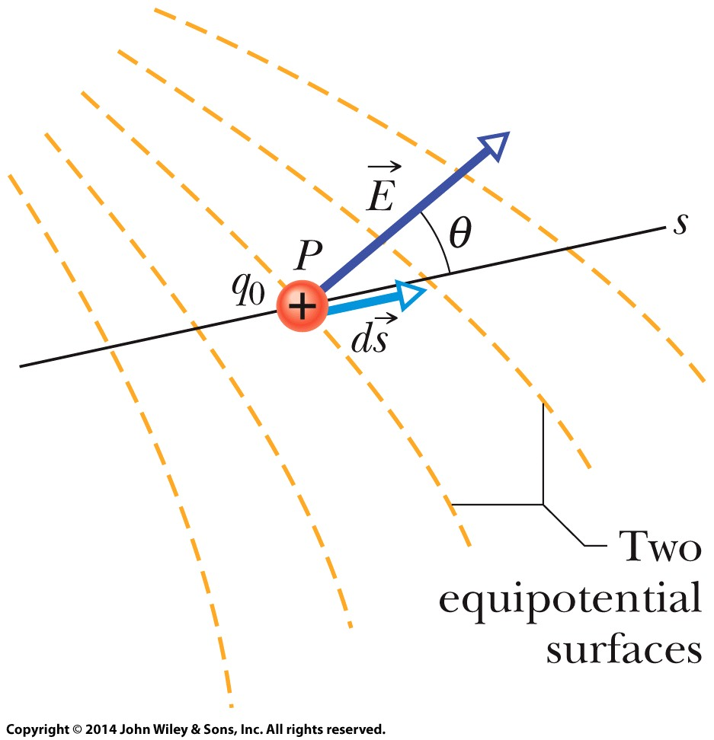
24-6 Calculating the Field from the Potential
Suppose that a positive test charge q₀ moves through a displacement ds from one equipotential surface to the adjacent surface. The work the electric field does on the test charge during the move is – q₀dV. On the other hand the work done by the electric field may also be written as the scalar product (q₀E)•ds. Equating these two expressions for the work yields
or,
Since E cosθ is the component of E in the direction of ds, we get,
A test charge q₀ moves a distance ds from one equipotential surface to another. (The separation between the surfaces has been exaggerated for clarity.) The displacement ds makes an angle θ with the direction of the electric field E.

Slide 20
24-7 Electric Potential Energy of a System of Charged Particles
Learning Objectives
24.27 Identify that the total potential energy of a system of charged particles is equal to the work an applied force must do to assemble the system, starting with the particles infinitely far apart.
24.28 Calculate the potential energy of a pair of charged particles.
24.29 Identify that if a system has more than two charged particles, then the system’s
total potential energy is equal to the sum of the potential energies of every pair of the particles.
24.30 Apply the principle of the conservation of mechanical energy to a system of charged particles.
24.31 Calculate the escape speed of a charged particle from a system of charged particles (the minimum initial speed required to move infinitely far from the system).

Slide 21
24-7 Electric Potential Energy of a System of Charged Particles
The electric potential energy of a system of charged particles is equal to the work needed to assemble the system with the particles initially at rest and infinitely distant from each other. For two particles at separation r,
Two charges held a fixed distance r apart.
Three charges are fixed at the vertices of an equilateral triangle. What is the electric potential energy of the system?

Slide 22
24-8 Potential of a Charged Isolated Conductor
Learning Objectives
24.32 Identify that an excess charge placed on an isolated conductor (or connected isolated conductors) will distribute itself on the surface of the conductor so that all points of the conductor come to the same potential.
24.33 For an isolated spherical conducting shell, sketch graphs of the potential and the electric field magnitude versus distance from the center, both inside and outside the shell.
24.34 For an isolated spherical conducting shell, identify that internally the electric field is zero and the electric potential has the same value as the surface and that externally the electric field and the electric potential have values as though all of the shell’s charge is concentrated as a particle at its center.

Slide 23
24-8 Potential of a Charged Isolated Conductor
Learning Objectives (Contd.)
24.35 For an isolated cylindrical conducting shell, identify that internally the electric field is zero and the electric potential has the same value as the surface and that externally the electric field and the electric potential have values as though all of the cylinder’s charge is concentrated as a line of charge on the central axis.

Slide 24
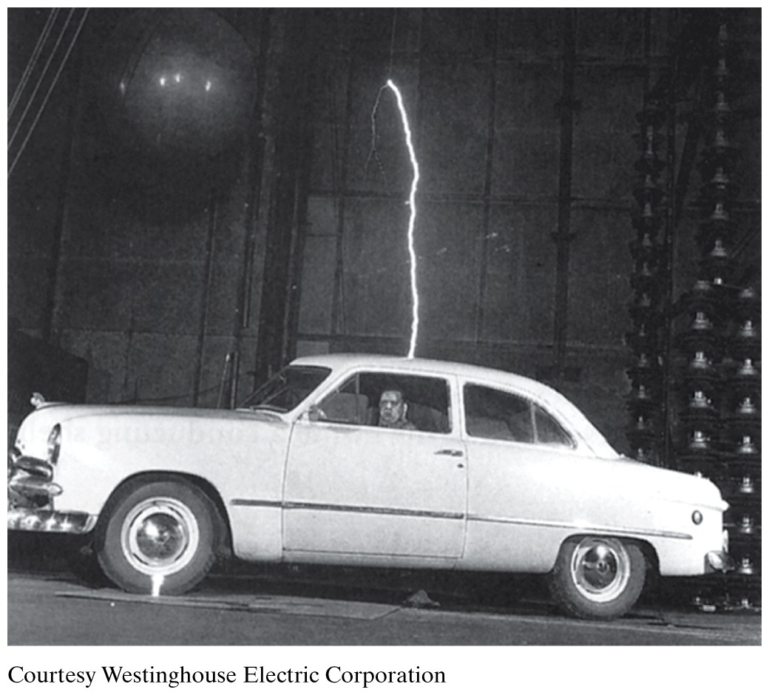
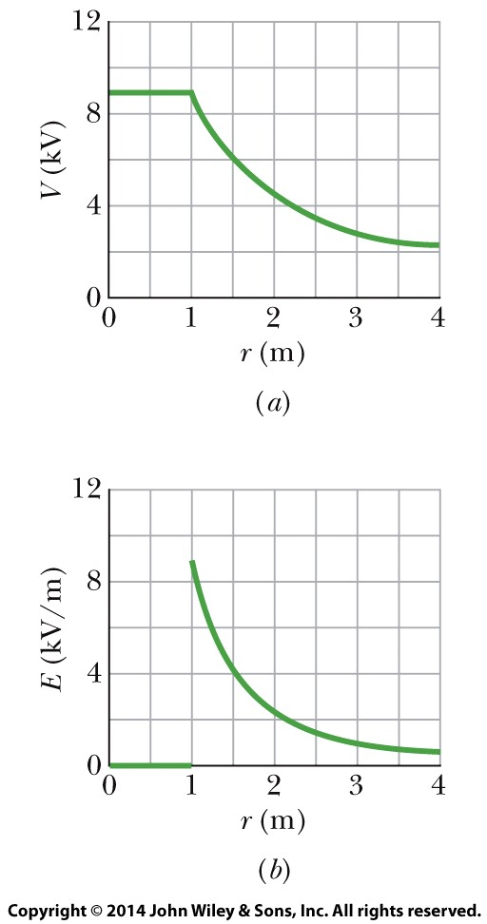
24-8 Potential of a Charged Isolated Conductor
A plot of V(r) both inside and outside a charged spherical shell of radius 1.0 m.
A plot of E(r) for the same shell.
It is wise to enclose yourself in a cavity inside a conducting shell, where the electric field is guaranteed to be zero. A car (unless it is a convertible or made with a plastic body) is almost ideal.

Slide 25
24 Summary
Electric Potential
The electric potential V at point P in the electric field of a charged object:
Mechanical Energy
Applying the conservation of mechanical energy gives the change in kinetic energy:
In case of an applied force in a particle
In a special case when ΔK=0:
Eq. 24-2
Eq. 24-9
Electric Potential Energy
Electric potential energy U of the particle-object system:
If the particle moves through potential ΔV:
Eq. 24-11
Eq. 24-3
Eq. 24-12
Finding V from E
The electric potential difference between two point I and f is:
Eq. 24-4
Eq. 24-18
Notes:
3

Slide 26
24 Summary
Potential due to a Charged Particle
due to a single charged particle at a distance r from that particle :
due to a collection of charged particles
Potential due to a Continuous Charge Distribution
For a continuous distribution of charge:
Eq. 24-26
Eq. 24-32
Calculating E from V
The component of E in any direction is:
Eq. 24-27
Eq. 24-40
Potential due to an Electric Dipole
The electric potential of the dipole is
Electric Potential Energy of a System of Charged Particle
For two particles at separation r:
Eq. 24-30
Eq. 24-46
Notes:
3

