Slide 1
Gauss’ Law
Chapter 23

Slide 2
23-1 Electric Flux
Learning Objectives
23.03 Identify that an area vector for a flat surface is a vector that is perpendicular to the surface and that has a magnitude equal to the area of the surface.
23.04 Identify that any surface can be divided into area elements (patch elements) that are each small enough and flat enough for an area vector dA to be assigned to it, with the vector perpendicular to the element and having a magnitude equal to the area of the element.
23.01 Identify that Gauss’ law relates the electric field at points on a closed surface (real or imaginary, said to be a Gaussian surface) to the net charge enclosed by that surface.
23.02 Identify that the amount of electric field piercing a surface (not skimming along parallel to the surface) is the electric flux Φ through the surface.

Slide 3
23-1 Electric Flux
Learning Objectives (Contd.)
23.05 Calculate the flux Φ through a surface by integrating the dot product of the electric field vector E and the area vector dA (for patch elements) over the surface, in magnitude- angle notation and unit-vector notation.
23.06 For a closed surface, explain the algebraic signs associated with inward flux and outward flux.
23.07 Calculate the net flux ϕ through a closed surface, algebraic sign included, by integrating the dot product of the electric field vector E and the area vector dA (for patch elements) over the full surface.
23.08 Determine whether a closed surface can be broken up into parts (such as the sides of a cube) to simplify the integration that yields the net flux through the surface.

Slide 4
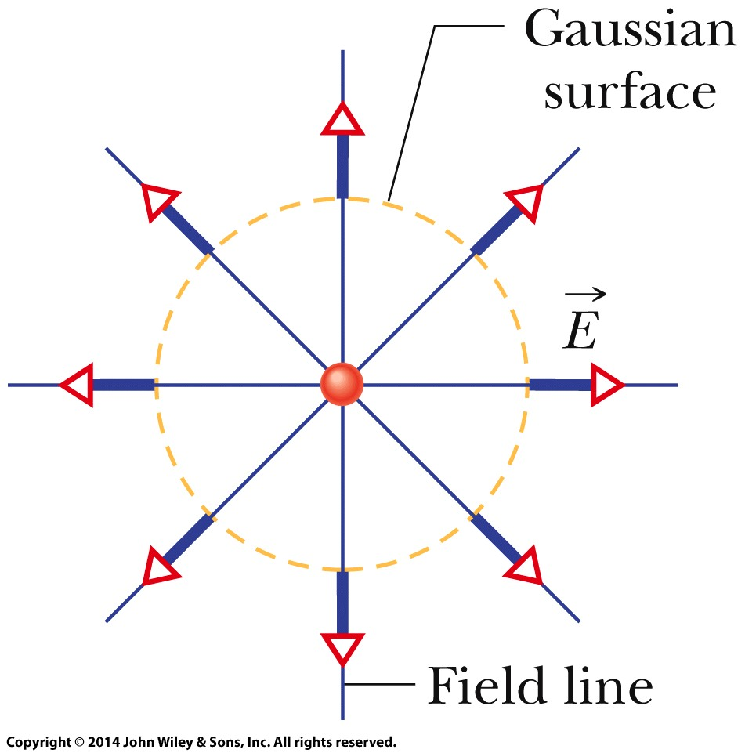
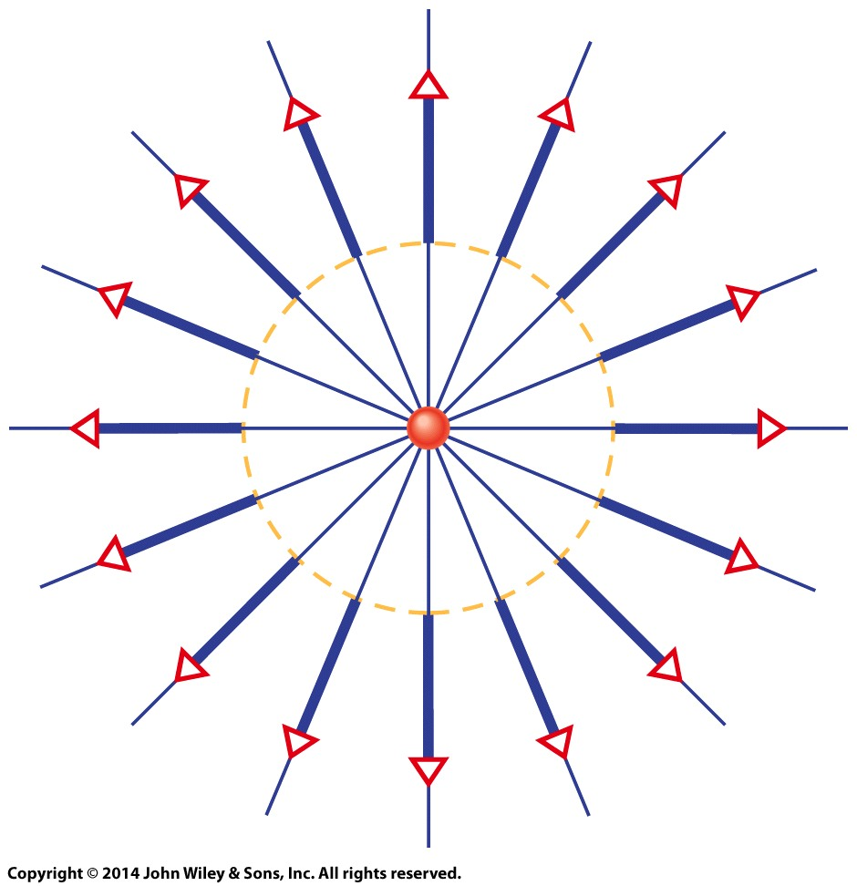
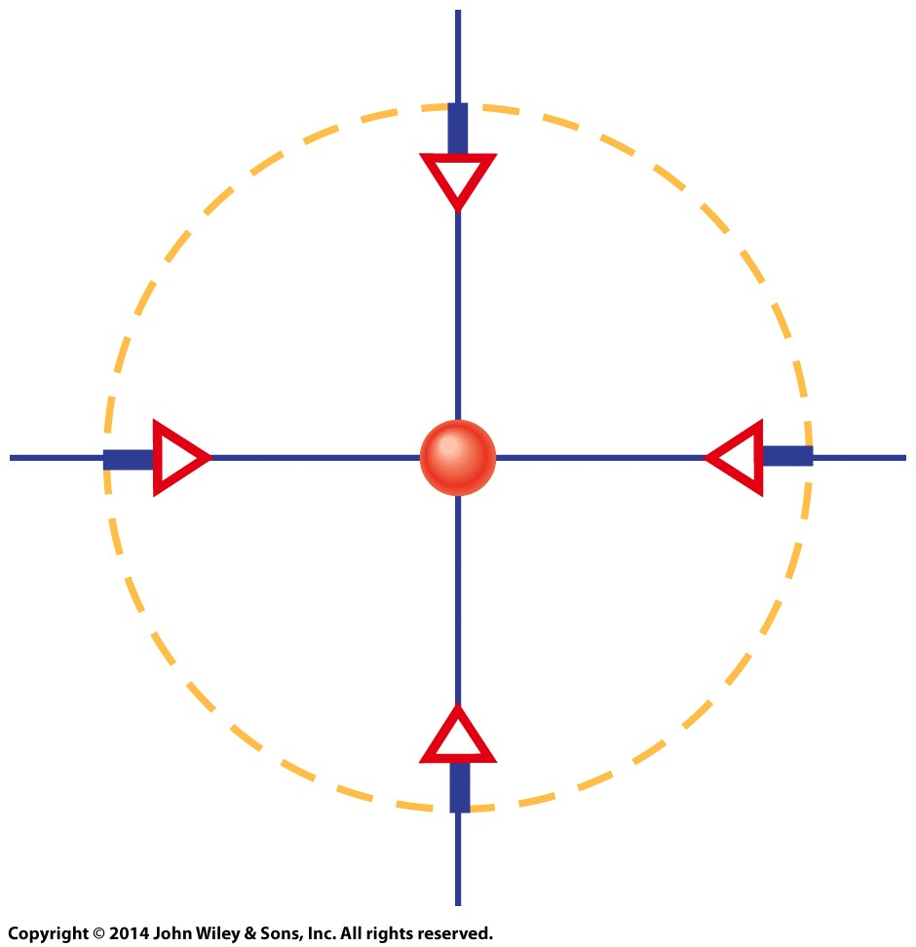
23-1 Electric Flux
Electric field vectors and field lines pierce an imaginary, spherical Gaussian surface that encloses a particle with charge +Q.
Now the enclosed particle has charge +2Q.
Can you tell what the enclosed charge is now?
Answer: -0.5Q

Slide 5
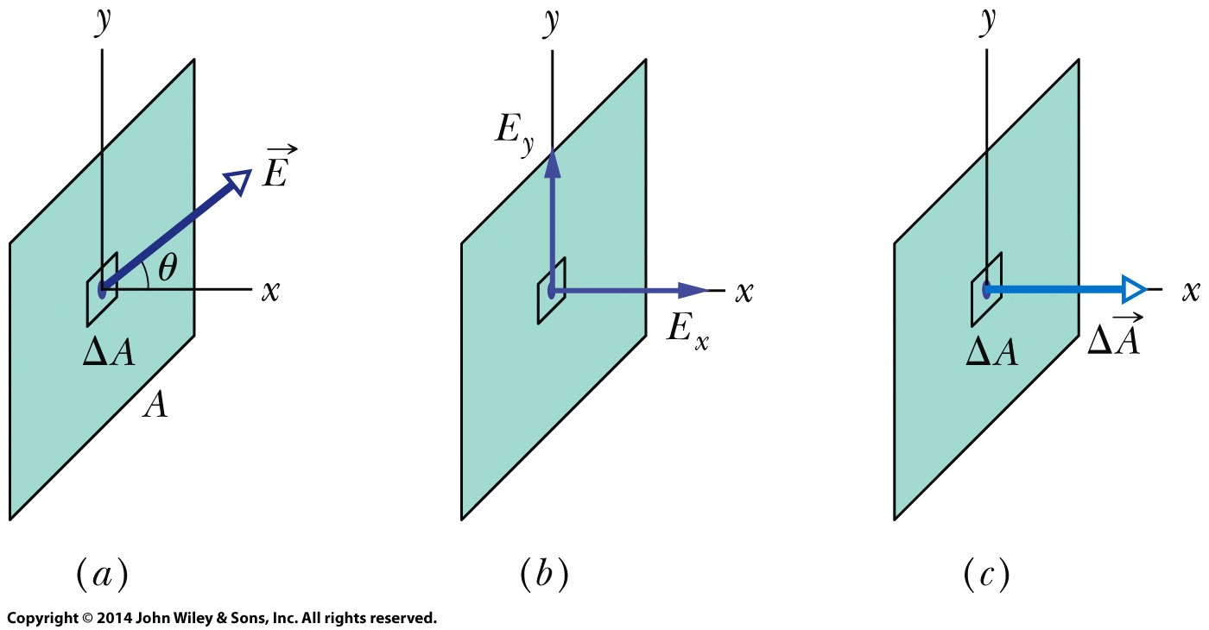
23-1 Electric Flux
The area vector dA for an area element (patch element) on a surface is a vector that is perpendicular to the element and has a magnitude equal to the area dA of the element.
The electric flux dϕ through a patch element with area vector dA is given by a dot product:
Electric Flux
An electric field vector pierces a small square patch on a flat surface.
Only the x component actually pierces the patch; the y component skims across it.
The area vector of the patch is perpendicular to the patch, with a magnitude equal to the patch’s area.

Slide 6
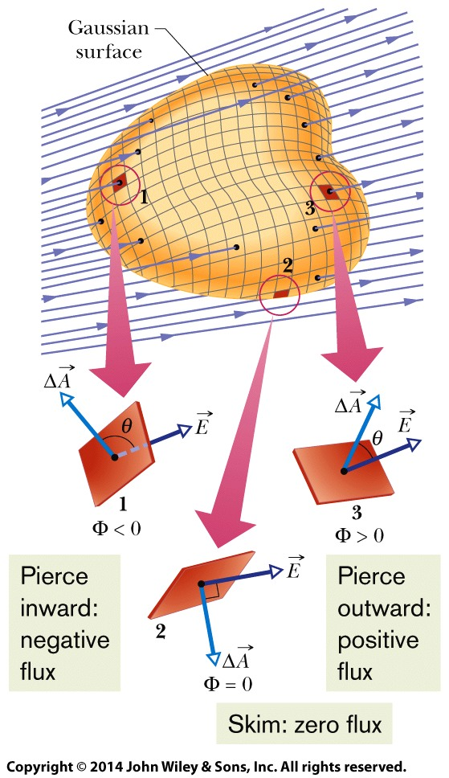
23-1 Electric Flux
Now we can find the total flux by integrating the dot product over the full surface.
The total flux through a surface is given by
The net flux through a closed surface (which is used in Gauss’ law) is given by
where the integration is carried out over the entire surface.

Slide 7
23-1 Electric Flux
Flux through a closed cylinder, uniform field

Slide 8
23-2 Gauss’ Law
Learning Objectives
23.09 Apply Gauss’ law to relate the net flux ϕ through a closed surface to the net enclosed charge q_{enc}.
23.10 Identify how the algebraic sign of the net enclosed charge corresponds to the direction (inward or outward) of the net flux through a Gaussian surface.
23.11 Identify that charge outside a Gaussian surface makes no contribution to the
net flux through the closed surface.
23.12 Derive the expression for the magnitude of the electric field of a charged particle by using Gauss’ law.
23.13 Identify that for a charged particle or uniformly charged sphere, Gauss’ law is applied with a Gaussian surface that is a concentric sphere.

Slide 9
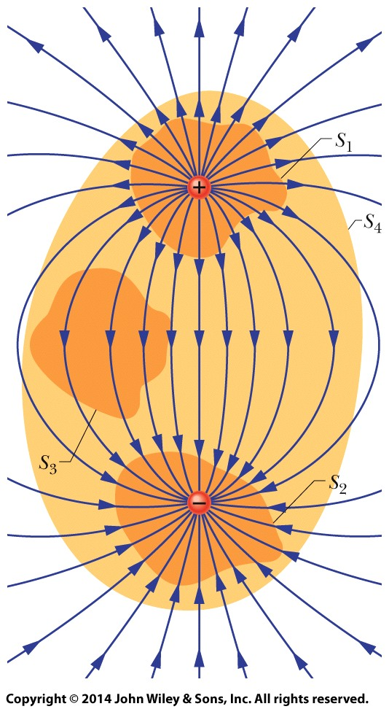
23-2 Gauss’ Law
Gauss’ law relates the net flux ϕ of an electric field through a closed surface (a Gaussian surface) to the net charge q_{enc} that is enclosed by that surface. It tells us that
we can also write Gauss’ law as
Two charges, equal in magnitude but opposite in sign, and the field lines that represent their net electric field. Four Gaussian surfaces are shown in cross section.

Slide 10
23-2 Gauss’ Law
Surface S1.The electric field is outward for all points on this surface. Thus, the flux of the electric field through this surface is positive, and so is the net charge within the surface, as Gauss’ law requires
Surface S2.The electric field is inward for all points on this surface. Thus, the flux of the electric field through this surface is negative and so is the enclosed charge, as Gauss’ law requires.
Two charges, equal in magnitude but opposite in sign, and the field lines that represent their net electric field. Four Gaussian surfaces are shown in cross section.

Slide 11
23-2 Gauss’ Law
Surface S3.This surface encloses no charge, and thus q_{enc} = 0. Gauss’ law requires that the net flux of the electric field through this surface be zero. That is reasonable because all the field lines pass entirely through the surface, entering it at the top and leaving at the bottom.
Surface S4.This surface encloses no net charge, because the enclosed positive and negative charges have equal magnitudes. Gauss’ law requires that the net flux of the electric field through this surface be zero. That is reasonable because there are as many field lines leaving surface S4 as entering it.
Two charges, equal in magnitude but opposite in sign, and the field lines that represent their net electric field. Four Gaussian surfaces are shown in cross section.

Slide 12
23-3 A Charged Isolated Conductor
Learning Objectives
23.17 For a conductor with a cavity that contains a charged object, determine the charge on the cavity wall and on the external surface.
23.18 Explain how Gauss’ law is used to find the electric field magnitude E near an isolated conducting surface with a uniform surface charge density σ.
23.19 For a uniformly charged conducting surface, apply the relationship between the charge density σ and the electric field magnitude E at points near the conductor, and identify the direction of the field vectors.
23.14 Apply the relationship between surface charge density σ and the area over which the charge is uniformly spread.
23.15 Identify that if excess charge (positive or negative) is placed on an isolated conductor, that charge moves to the surface and none is in the interior.
23.16 Identify the value of the electric field inside an isolated conductor.

Slide 13
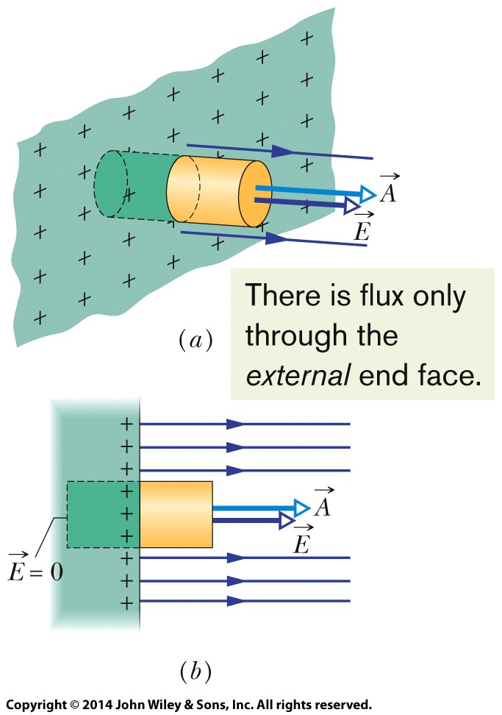
23-3 A Charged Isolated Conductor
Perspective view
Side view of a tiny portion of a large, isolated conductor with excess positive charge on its surface. A (closed) cylindrical Gaussian surface, embedded perpendicularly in the conductor, encloses some of the charge. Electric field lines pierce the external end cap of the cylinder, but not the internal end cap. The external end cap has area A and area vector A.

Slide 14
23-4 Applying Gauss’ Law: Cylindrical Symmetry
Learning Objectives
23.20 Explain how Gauss’ law is used to derive the electric field magnitude outside a line of charge or a cylindrical surface (such as a plastic rod) with a uniform linear charge density λ.
23.21 Apply the relationship between linear charge density λ on a cylindrical surface and the electric field magnitude E at radial distance r from the central axis.
23.22 Explain how Gauss’ law can be used to find the electric field magnitude inside a cylindrical non-conducting surface (such as a plastic rod) with a uniform volume charge density ρ.

Slide 15
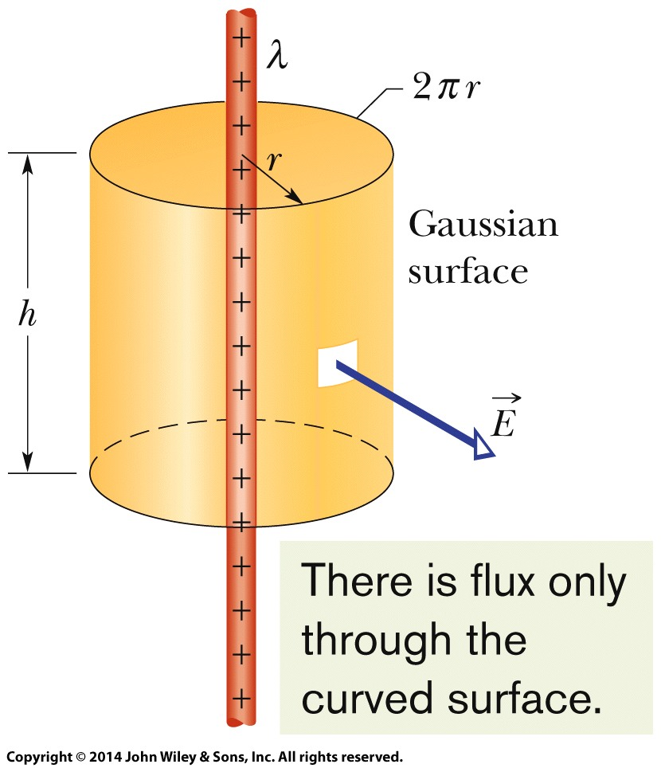
23-4 Applying Gauss’ Law: Cylindrical Symmetry
Figure shows a section of an infinitely long cylindrical plastic rod with a uniform charge density λ. The charge distribution and the field have cylindrical symmetry. To find the field at radius r, we enclose a section of the rod with a concentric Gaussian cylinder of radius r and height h.
The net flux through the cylinder from Gauss’ Law reduces to
yielding
A Gaussian surface in the form of a closed cylinder surrounds a section of a very long, uniformly charged, cylindrical plastic rod.

Slide 16
23-5 Applying Gauss’ Law: Planar Symmetry
Learning Objectives
23.23 Apply Gauss’ law to derive the electric field magnitude E near a large, flat, non-conducting surface with a uniform surface charge density σ.
23.24 For points near a large, flat non-conducting surface with a uniform charge density σ, apply the relationship between the charge density and the electric field magnitude E and also specify the direction of the field.
23.25 For points near two large, flat, parallel, conducting surfaces with a uniform charge density σ, apply the relationship between the charge density and the electric field magnitude E and also specify the direction of the field.

Slide 17
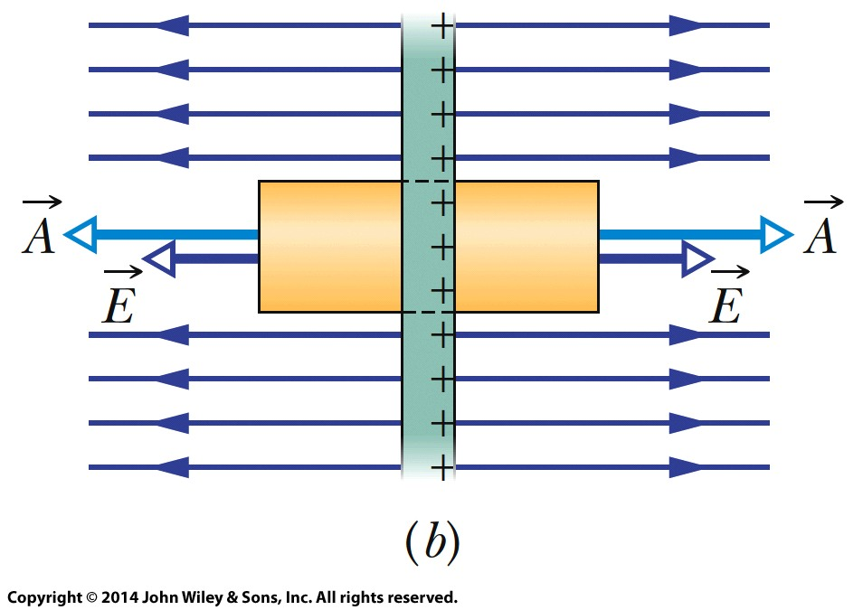
23-5 Applying Gauss’ Law: Planar Symmetry
Non-conducting Sheet
Figure (a-b) shows a portion of a thin, infinite, non-conducting sheet with a uniform (positive) surface charge density σ. A sheet of thin plastic wrap, uniformly charged on one side, can serve as a simple model. Here,
Is simply EdA and thus Gauss’ Law,
becomes
where σA is the charge enclosed by the Gaussian surface. This gives

Slide 18
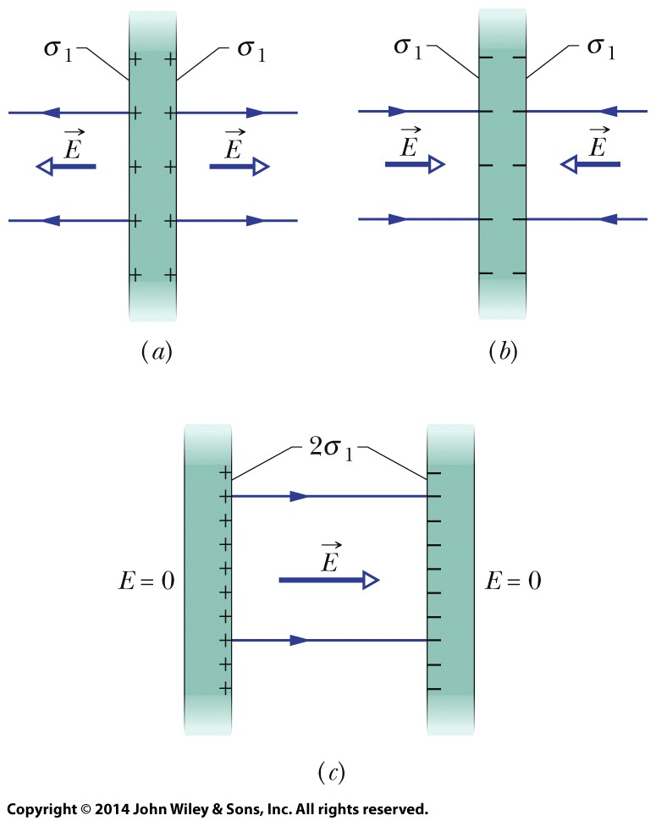
23-5 Applying Gauss’ Law: Planar Symmetry
Two conducting Plates
Figure (a) shows a cross section of a thin, infinite conducting plate with excess positive charge. Figure (b) shows an identical plate with excess negative charge having the same magnitude of surface charge density σ1.
Suppose we arrange for the plates of Figs. a and b to be close to each other and parallel (c). Since the plates are conductors, when we bring them into this arrangement, the excess charge on one plate attracts the excess charge
on the other plate, and all the excess charge moves onto the inner faces of the plates as in Fig.c. With twice as much charge now on each inner face, the electric field at any point between the plates has the magnitude

Slide 19
23-6 Applying Gauss’ Law: Spherical Symmetry
Learning Objectives
23.26 Identify that a shell of uniform charge attracts or repels a charged particle that is outside the shell as if all the shell’s charge is concentrated at the center of the shell.
23.27 Identify that if a charged particle is enclosed by a shell of uniform charge, there is no electrostatic force on the particle from the shell.
23.28 For a point outside a spherical shell with uniform
charge, apply the relationship between the electric field magnitude E, the charge q on the shell, and the distance r from the shell’s center.
23.29 Identify the magnitude of the electric field for points enclosed by a spherical shell with uniform charge.
23.30 For a uniform spherical charge distribution (a uniform ball of charge), determine the magnitude and direction of the electric field at interior and exterior points.

Slide 20
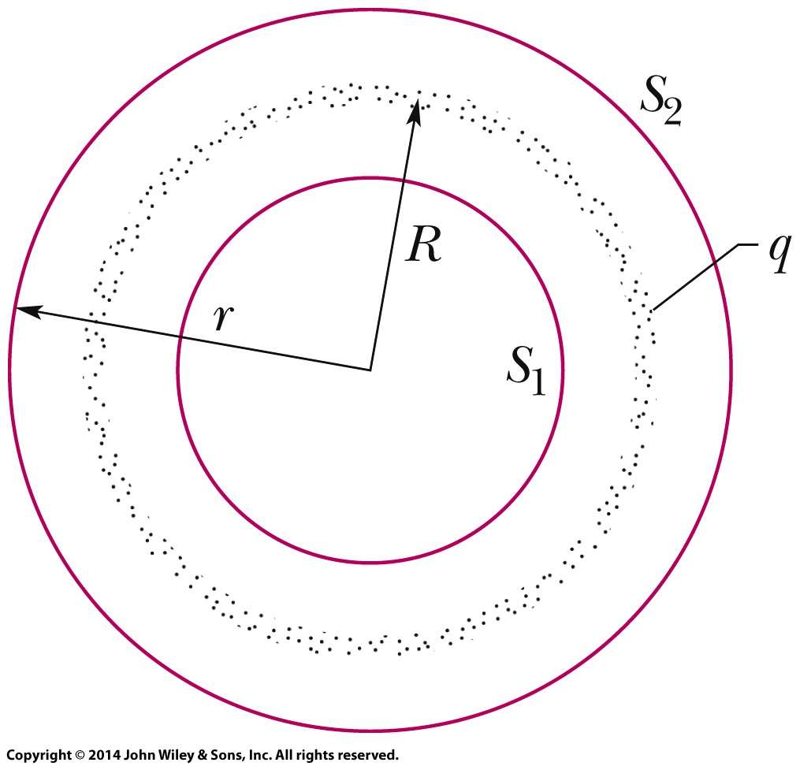
23-6 Applying Gauss’ Law: Spherical Symmetry
In the figure, applying Gauss’ law to surface S₂, for which r ≥ R, we would find that
And, applying Gauss’ law to surface S₁, for which r < R,
A thin, uniformly charged, spherical shell with total charge q, in cross section. Two Gaussian surfaces S1 and S2 are also shown in cross section. Surface S2 encloses the shell, and S1 encloses only the empty interior of the shell.

Slide 21
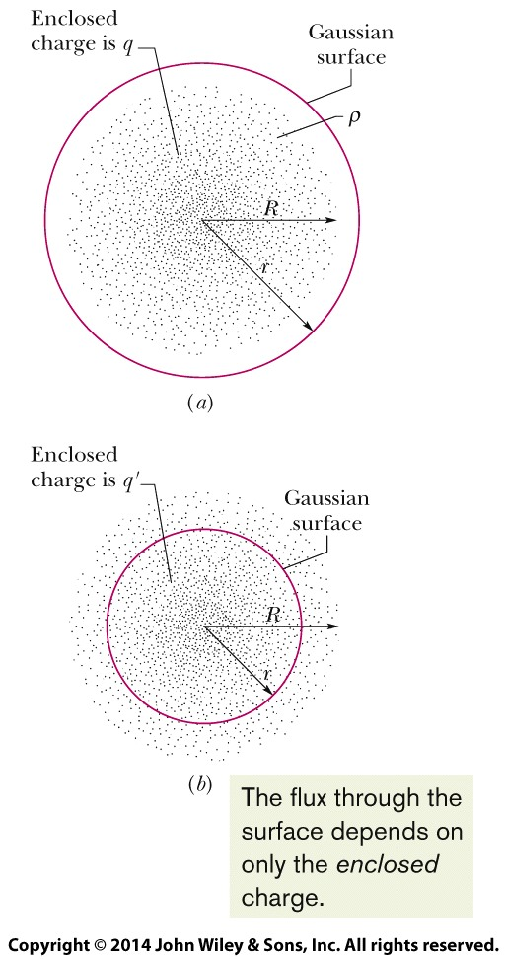
23-6 Applying Gauss’ Law: Spherical Symmetry
Inside a sphere with a uniform volume charge density, the field is radial and has the magnitude
where q is the total charge, R is the sphere’s radius, and r is the radial distance from the center of the sphere to the point of measurement as shown in figure.
A concentric spherical Gaussian surface with r > R is shown in (a). A similar Gaussian surface with r < R is shown in (b).

Slide 22
23 Summary
Gauss’ Law
Gauss’ law is
the net flux of the electric field through the surface:
Infinite non-conducting sheet
Outside a spherical shell of charge
Inside a uniform spherical shell
Inside a uniform sphere of charge
Eq. 23-6
Eq. 23-13
Eq. 23-15
Eq. 23-6
Applications of Gauss’ Law
surface of a charged conductor
Within the surface E=0.
line of charge
Eq. 23-16
Eq. 23-11
Eq. 23-20
Eq. 23-12
Notes:
3

