Slide 1
Electric Fields
Chapter 22

Slide 2
22-1 The Electric Field
Learning Objectives
22.01 Identify that at every point in the space surrounding a charged particle, the particle sets up an electric field E, which is a vector quantity and thus has both magnitude and direction.
22.02 Identify how an electric field E: can be used to explain how a charged particle can exert an electrostatic force F on a second charged particle even though there is no contact between the particles.
22.03 Explain how a small positive test charge is used (in principle) to measure the electric field at any given point.
22.04 Explain electric field lines, including where they originate and terminate and what their spacing represents.

Slide 3
22-1 The Electric Field
?
How does particle 1 “know” of the presence of particle 2? That is, since the particles do not touch, how can particle 2 push on particle 1—how can there be such an action at a distance?

Slide 4
22-1 The Electric Field
Electric Field
The explanation that we shall examine here is this: Particle 2 sets up an electric field at all points in the surrounding space, even if the space is a vacuum. If we place particle 1 at any point in that space, particle 1 knows of the presence of particle 2 because it is affected by the electric field particle 2 has already set up at that point. Thus, particle 2 pushes on particle 1 not by touching it as you would push on a coffee mug by making contact. Instead, particle 2 pushes by means of the electric field it has set up.

Slide 5
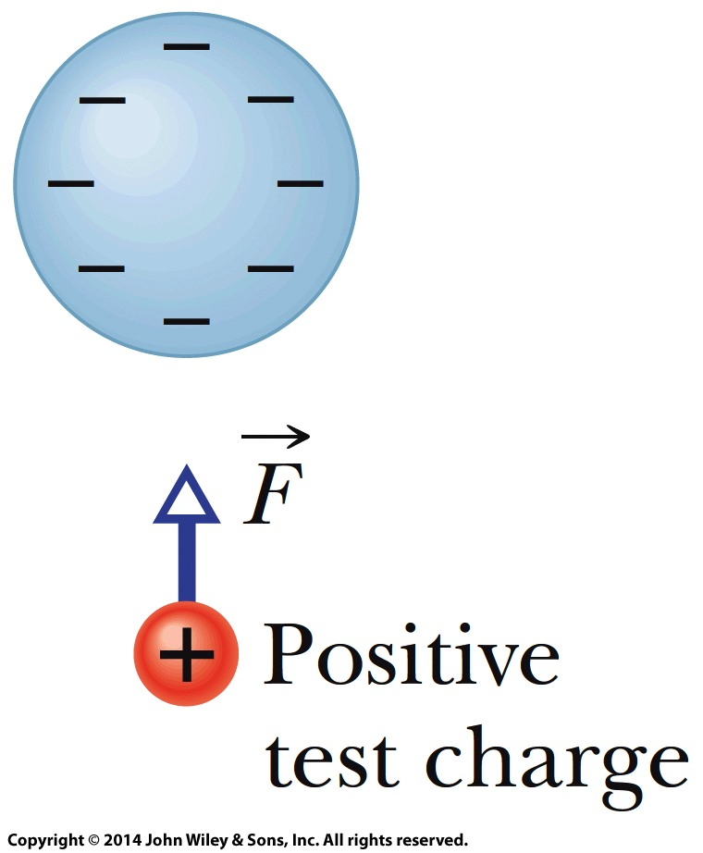
22-1 The Electric Field
Electric Field
The electric field E at any point is defined in terms of the electrostatic force F that would be exerted on a positive test charge q₀ placed there:

Slide 6
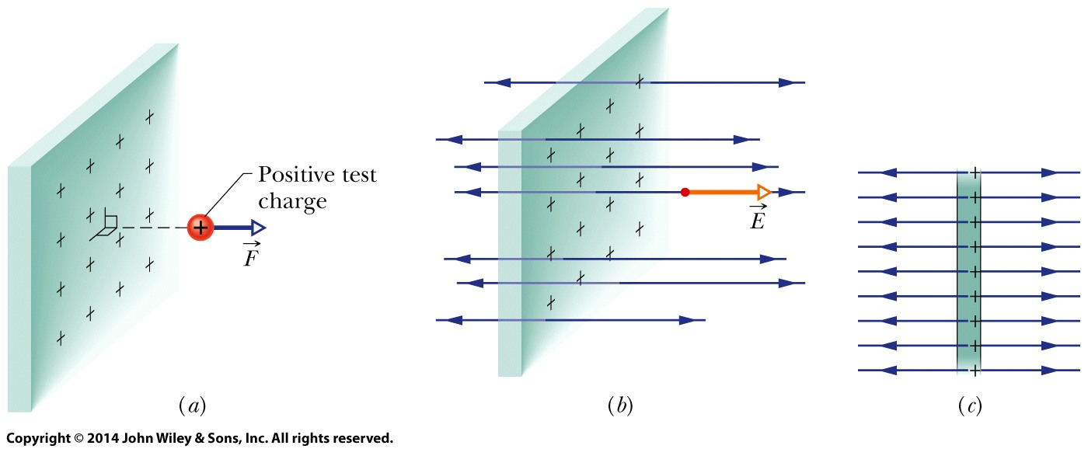
22-1 The Electric Field
Electric Field Lines
Electric field lines help us visualize the direction and magnitude of electric fields. The electric field vector at any point is tangent to the field line through that point. The density of field lines in that region is proportional to the magnitude of the electric field there.
(a) The force on a positive test charge near a very large, non-conducting sheet with uniform positive charge on one side. (b) The electric field vector E at the test charge’s location, and the nearby electric field lines, extending away from the sheet. (c) Side view.

Slide 7
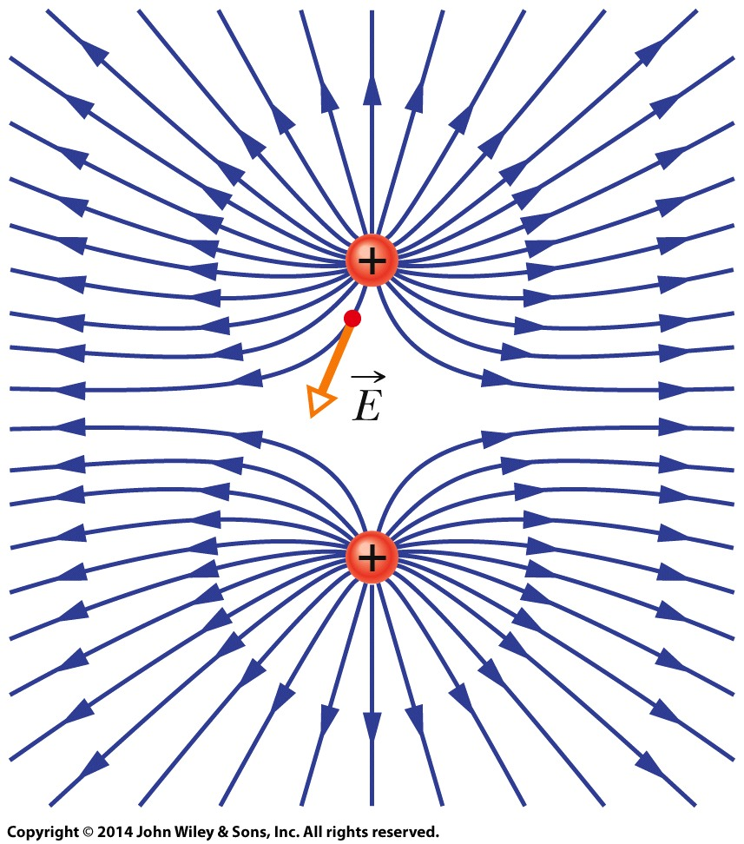
22-1 The Electric Field
Electric Field Lines
The electric field vector at any given point must be tangent to the field line at that point and in the same direction, as shown for one vector.
A closer spacing means a larger field magnitude.
Field lines for two particles with equal positive charge. Doesn’t the pattern itself suggest that the particles repel each other?

Slide 8
22-2 The Electric Field Due to a Charged Particle
Learning Objectives
22.07 For a given point in the electric field of a charged particle, apply the relationship between the field magnitude E, the charge magnitude |q|, and the distance r between the point and the particle.
22.08 Identify that the equation given here for the magnitude of an electric field applies only to a particle, not an extended object.
22.09 If more than one electric field is set up at a point, draw each electric field vector and then find the net electric field by adding the individual electric fields as vectors (not as scalars).
22.05 In a sketch, draw a charged particle, indicate its sign, pick a nearby point, and then draw the electric field vector E: at that point, with its tail anchored on the point.
22.06 For a given point in the electric field of a charged particle, identify the direction of the field vector E: when the particle is positively charged and when it is negatively charged.

Slide 9
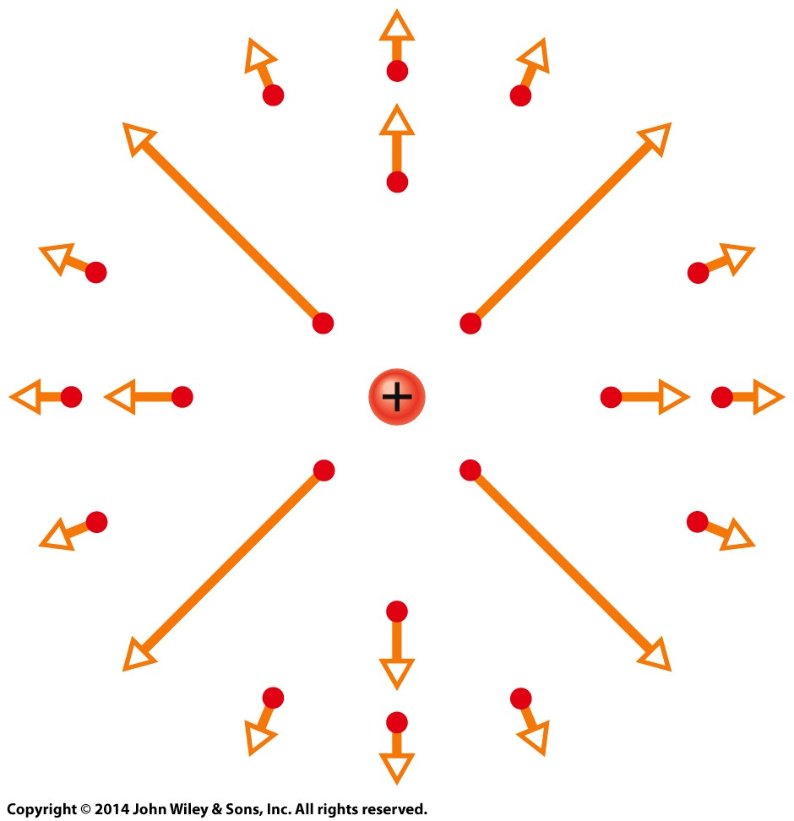
22-2 The Electric Field Due to a Charged Particle
The magnitude of the electric field E set up by a particle with charge q at distance r from the particle is
The electric field vectors set up by a positively charged particle all point directly away from the particle. Those set up by a negatively charged particle all point directly toward the particle.
If more than one charged particle sets up an electric field at a point, the net electric field is the vector sum of the individual electric fields—electric fields obey the superposition principle.
The electric field vectors at various points around a positive point charge.

Slide 10
22-3 The Electric Field Due to a Dipole
Learning Objectives
22.10 Draw an electric dipole, identifying the charges (sizes and signs), dipole axis, and direction of the electric dipole moment.
22.11 Identify the direction of the electric field at any given point along the dipole axis, including between the charges.
22.12 Outline how the equation for the electric field due to an electric dipole is derived from the equations for the electric field due to the individual charged particles that form the dipole.
2.13 For a single charged particle and an electric dipole, compare the rate at which the electric field magnitude decreases with increase in distance. That is, identify which drops off faster.

Slide 11
22-3 The Electric Field Due to a Dipole
Learning Objectives (Contd.)
22.14 For an electric dipole, apply the relationship between the magnitude p of the dipole moment, the separation d between the charges, and the magnitude q of either of the charges.
22.15 For any distant point along a dipole axis, apply the relationship between the electric field magnitude E, the distance z from the center of the dipole, and either the dipole moment magnitude p or the product of charge magnitude q and charge separation d.

Slide 12
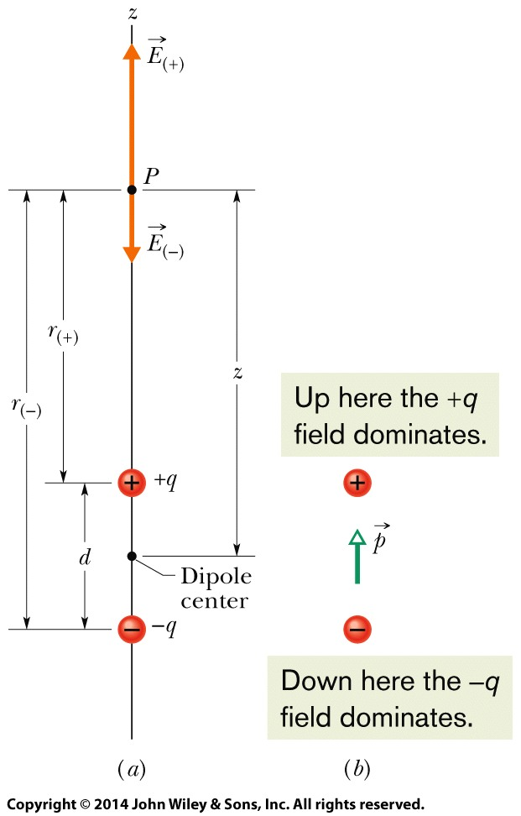
22-3 The Electric Field Due to a Dipole
Electric Dipole
An electric dipole consists of two particles with charges of equal magnitude q but opposite signs, separated by a small distance d.
The magnitude of the electric field set up by an electric dipole at a distant point on the dipole axis (which runs through both particles) can be written in terms of either the product qd or the magnitude p of the dipole moment:
where z is the distance between the point and the center of the dipole.

Slide 13
22-4 The Electric Field Due to a Line of Charge
Learning Objectives
22.16 For a uniform distribution of charge, find the linear charge density λ for charge along a line, the surface charge density σ for charge on a surface, and the volume charge density ρ for charge in a volume.
22.17 For charge that is distributed uniformly along a line, find the net electric field at a given point near the line by splitting the distribution up into charge elements dq and
then summing (by integration) the electric field vectors dE set up at the point by each element.
22.18 Explain how symmetry can be used to simplify the calculation of the electric field at a point near a line of uniformly distributed charge.

Slide 14
22-4 The Electric Field Due to a Line of Charge
Key Concepts
The equation for the electric field set up by a particle does not apply to an extended object with charge (said to have a continuous charge distribution).
To find the electric field of an extended object at a point, we first consider the electric field set up by a charge element dq in the object, where the element is small enough for us to apply the equation for a particle. Then we sum, via integration, components of the electric fields dE from all the charge elements.
Because the individual electric fields dE have different magnitudes and point in different directions, we first see if symmetry allows us to cancel out any of the components of the fields, to simplify the integration.

Slide 15
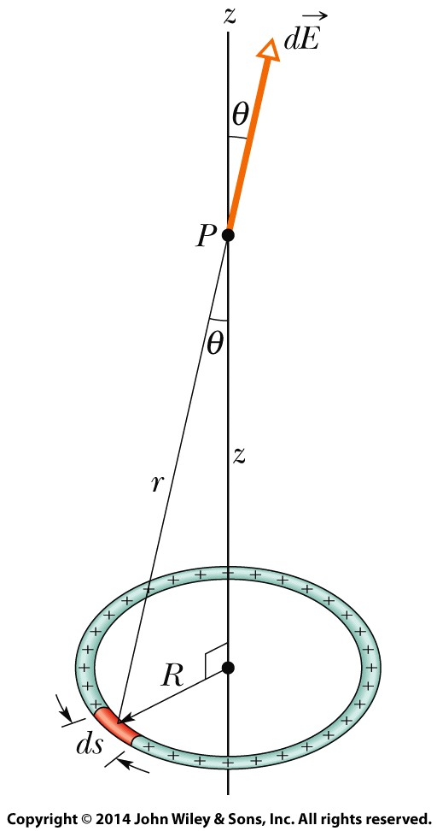
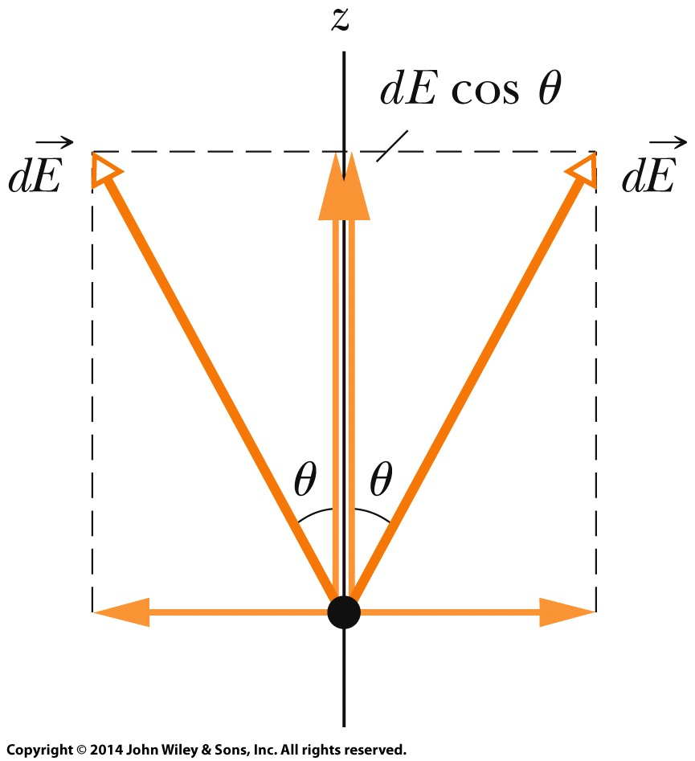
22-4 The Electric Field Due to a Line of Charge
Charged Ring
Canceling Components - Point P is on the axis: In the Figure (right), consider the charge element on the opposite side of the ring. It too contributes the field magnitude dE but the field vector leans at angle θ in the opposite direction from the vector from our first charge element, as indicated in the side view of Figure (bottom). Thus the two perpendicular components cancel. All around the ring, this cancelation occurs for every charge element and its symmetric partner on the opposite side of the ring. So we can neglect all the perpendicular components.
The components perpendicular to the z axis cancel; the parallel components add.
A ring of uniform positive charge. A differential element of charge occupies a length ds (greatly exaggerated for clarity). This element sets up an electric field dE at point P.

Slide 16
22-4 The Electric Field Due to a Line of Charge
Charged Ring
Adding Components. From the figure (bottom), we see that the parallel components each have magnitude dE cosθ. We can replace cosθ by using the right triangle in the Figure (right) to write
And, gives us the parallel
field component from each charge element
The components perpendicular to the z axis cancel; the parallel components add.
A ring of uniform positive charge. A differential element of charge occupies a length ds (greatly exaggerated for clarity). This element sets up an electric field dE at point P.

Slide 17
22-4 The Electric Field Due to a Line of Charge
Charged Ring
Integrating. Because we must sum a huge number of these components, each small, we set up an integral that moves along the ring, from element to element, from a starting point (call it s=0) through the full circumference (s=2πR). Only the quantity s varies as we go through the elements. We find
Finally,
The components perpendicular to the z axis cancel; the parallel components add.
A ring of uniform positive charge. A differential element of charge occupies a length ds (greatly exaggerated for clarity). This element sets up an electric field dE at point P.

Slide 18
22-5 The Electric Field Due to a Charged Disk
Learning Objectives
22.19 Sketch a disk with uniform charge and indicate the direction of the electric field at a point on the central axis if the charge is positive and if it is negative.
22.20 Explain how the equation for the electric field on the central axis of a uniformly charged ring can be used to find the equation for the electric field on the central axis of a uniformly charged disk.
22.21 For a point on the central axis of a uniformly charged disk, apply the relationship between the surface charge density σ, the disk radius R, and the distance z to that point.

Slide 19
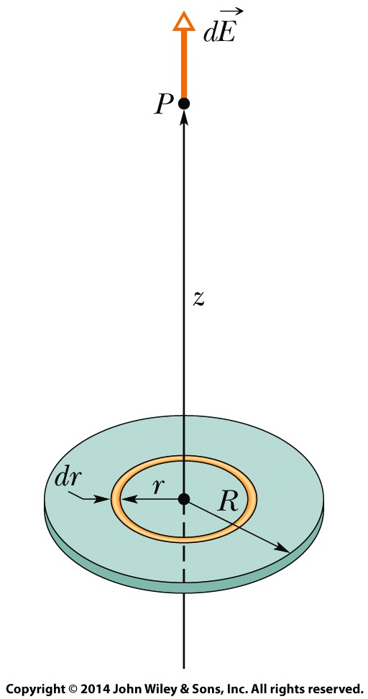
22-5 The Electric Field Due to a Charged Disk
We superimpose a ring on the disk as shown in the Figure, at an arbitrary radius r ≤ R. The ring is so thin that we can treat the charge on it as a charge element dq. To find its small contribution dE to the electric field at point P, on the axis, in terms of the ring’s charge dq and radius r we can write
Then, we can sum all the dE contributions with
We find
A disk of radius R and uniform positive charge. The ring shown has radius r and radial width dr. It sets up a differential electric field dE at point P on its central axis.

Slide 20
22-6 A Point Charge in an Electric Field
Learning Objectives
22.22 For a charged particle placed in an external electric field (a field due to other charged objects), apply the relationship between the electric field E at that point, the particle’s charge q, and the electrostatic force F that acts on the particle, and identify the relative directions of the force and the field when the particle is positively charged and negatively charged.
22.23 Explain Millikan’s procedure of measuring the elementary charge.
22.24 Explain the general mechanism of ink-jet printing.

Slide 21
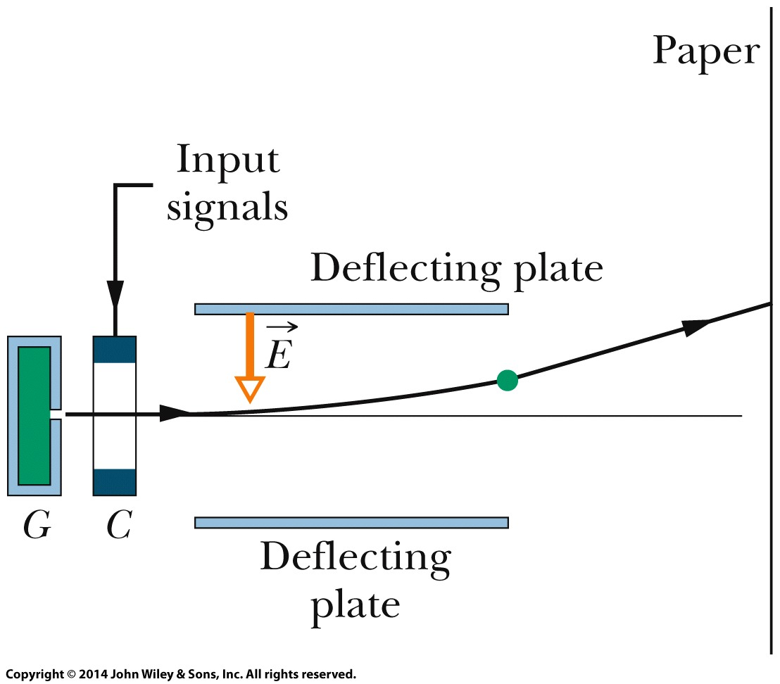
22-6 A Point Charge in an Electric Field
If a particle with charge q is placed in an external electric field E, an electrostatic force F acts on the particle:
Ink-jet printer. Drops shot from generator G receive a charge in charging unit C. An input signal from a computer controls the charge and thus the effect of field E on where the drop lands on the paper.

Slide 22
22-7 A Dipole in an Electric Field
Learning Objectives
22.25 On a sketch of an electric dipole in an external electric field, indicate the direction of the field, the direction of the dipole moment, the direction of the electrostatic forces on the two ends of the dipole, and the direction in which those forces tend to rotate the dipole, and identify the value of the net force on the dipole.
22.26 Calculate the torque on an electric dipole in an external electric field by evaluating a cross product of the dipole moment vector and the electric field vector, in magnitude-angle notation and unit-vector notation.
22.27 For an electric dipole in an external electric field, relate the potential energy of the dipole to the work done by a torque as the dipole rotates in the electric field.

Slide 23
22-7 A Dipole in an Electric Field
Learning Objectives (Contd.)
22.28 For an electric dipole in an external electric field, calculate the potential energy by taking a dot product of the dipole moment vector and the electric field vector, in magnitude-angle notation and unit-vector notation.
22.29 For an electric dipole in an external electric field, identify the angles for the minimum and maximum potential energies and the angles for the minimum and maximum torque magnitudes.

Slide 24
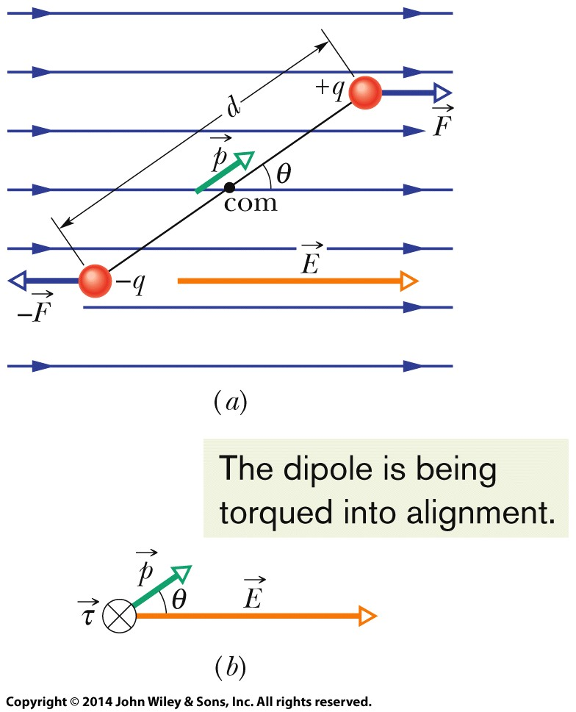
22-7 A Dipole in an Electric Field
The torque on an electric dipole of dipole moment p when placed in an external electric field E is given by a cross product:
A potential energy U is associated with the orientation of the dipole moment in the field, as given by a dot product:
An electric dipole in a uniform external electric field E. Two centers of equal but opposite charge are separated by distance d. The line between them represents their rigid connection.
Field E: causes a torque τ on the dipole. The direction of τ is into the page, as represented by the symbol (x-in a circle) .

Slide 25
22 Summary
Definition of Electric Field
The electric field at any point
Field due to an Electric Dipole
The magnitude of the electric field set up by the dipole at a distant point on the dipole axis is
Eq. 22-1
Electric Field Lines
provide a means for visualizing the directions and the magnitudes of electric fields
Eq. 22-9
Field due to a Charged Disk
The electric field magnitude at a point on the central axis through a uniformly charged disk is given by
Field due to a Point Charge
The magnitude of the electric field E set up by a point charge q at a distance r from the charge is
Eq. 22-26
Eq. 22-3

Slide 26
22 Summary
Force on a Point Charge in an Electric Field
When a point charge q is placed in an external electric field E
Dipole in an Electric Field
The electric field exerts a torque on a dipole
The dipole has a potential energy U associated with its orientation in the field
Eq. 22-34
Eq. 22-28
Eq. 22-38

