Slide 1
Entropy and the Second Law of Thermodynamics
Chapter 20

Slide 2
20-1 Entropy
Learning Objectives
20.01 Identify the second law of thermodynamics: If a process occurs in a closed system, the entropy of the system increases for irreversible processes and remains constant for reversible processes; it never decreases.
20.02 Identify that entropy is a state function (the value for a particular state of the system does not depend on how that state is reached).
20.03 Calculate the change in entropy for a process by integrating the inverse of the temperature (in kelvins) with respect to the heat Q transferred during the process.
20.04 For a phase change with a constant temperature process, apply the relationship between the entropy change ΔS, the total transferred heat Q, and the temperature T (in kelvins).

Slide 3
20-1 Entropy
Learning Objectives (Continued)
20.05 For a temperature change ΔT that is small relative to the temperature T, apply the relationship between the entropy change ΔS, the transferred heat Q, and the average temperature T_{avg} (in kelvins).
20.06 For an ideal gas, apply the relationship between the entropy change ΔS and the initial and final values of the pressure and volume.
20.07 Identify that if a process is an irreversible one, the integration for the entropy change must be done for a reversible process that takes the system between the same initial and final states as the irreversible process.
20.08 For stretched rubber, relate the elastic force to the rate at which the rubber’s entropy changes with the change in the stretching distance.

Slide 4
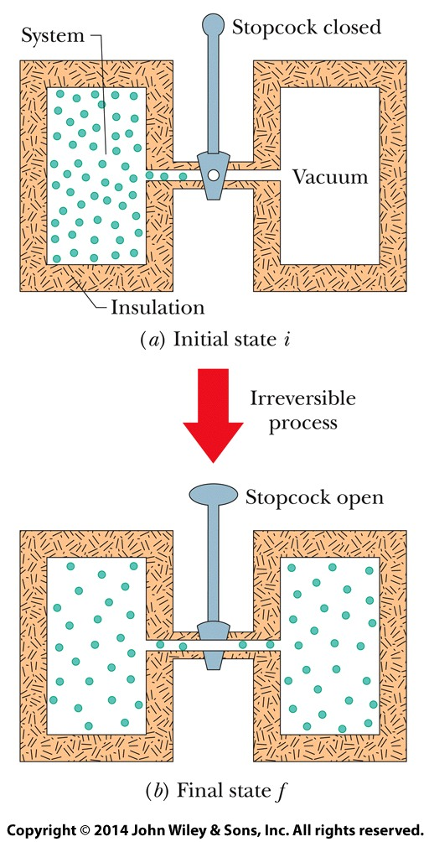
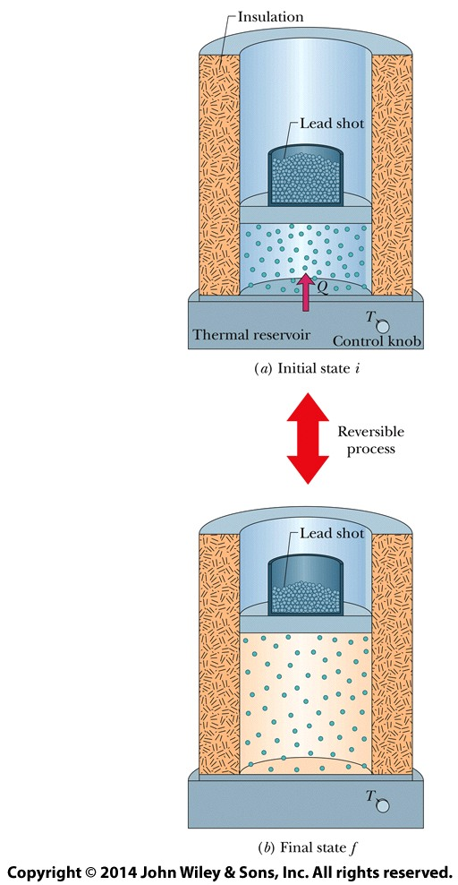
20-1 Entropy
This process is irreversible; that is, it does not occur in reverse, with the gas spontaneously collecting itself in the left half of the container.
The isothermal expansion of an ideal gas, done in a reversible way.
If a process occurs in a closed system, the entropy of the system increases for irreversible processes and remains constant for reversible processes.

Slide 5
20-1 Entropy
Change in Entropy
Here Q is the energy transferred as heat to or from the system during the process, and T is the temperature of the system in kelvins during the process.
To find the entropy change for an irreversible process, replace that process with any reversible process that connects the same initial and final states. Calculate the entropy change for this reversible process with the above equation.

Slide 6
20-1 Entropy
The Second Law of Thermodynamics
where the greater-than sign applies to irreversible processes and the equals sign to reversible processes. Equation applies only to closed systems.

Slide 7
20-2 Entropy in the Real World: Engines
Learning Objectives
20.09 Identify that a heat engine is a device that extracts energy from its environment in the form of heat and does useful work.
20.10 Sketch a p-V diagram for the cycle of a Carnot engine, indicating the direction of cycling, the nature of the processes involved, the work done during each process , the net work done in the cycle, and the heat transferred during each process.
20.11 Sketch a Carnot cycle on a temperature–entropy diagram, indicating the heat transfers.
20.12 Determine the net entropy change around a Carnot cycle.
20.13 Calculate the efficiency ε_{C} of a Carnot engine in terms of the heat transfers and also in terms of the temperatures of the reservoirs.

Slide 8
20-2 Entropy in the Real World: Engines
Learning Objectives (Continued)
20.14 Identify that there are no perfect engines in which the energy transferred as heat Q from a high temperature reservoir goes entirely into the work W done by the engine.
20.15 Sketch a p-V diagram for the cycle of a Stirling engine, indicating the direction of cycling, the nature of the processes involved, the work done during each process (including algebraic sign), the net work done in the cycle, and the heat transfers during each process.

Slide 9
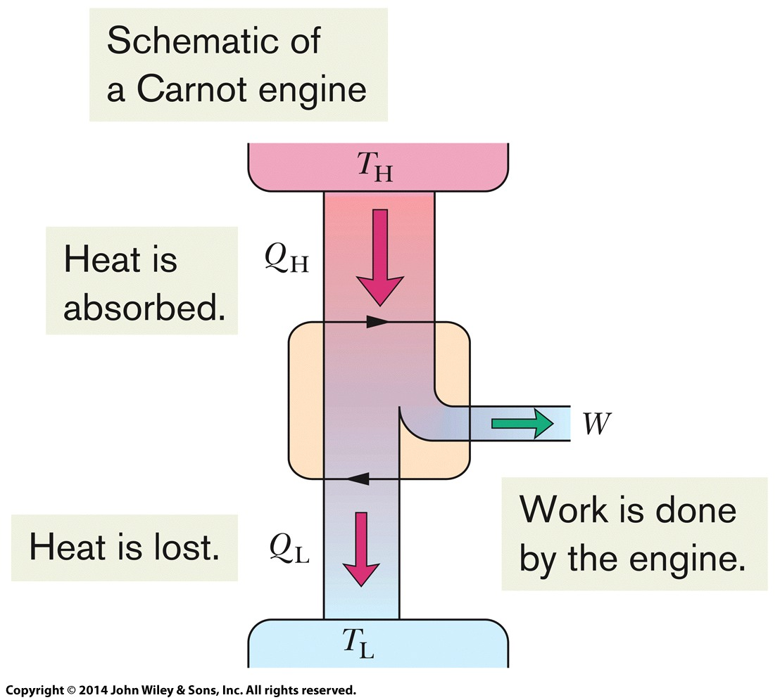
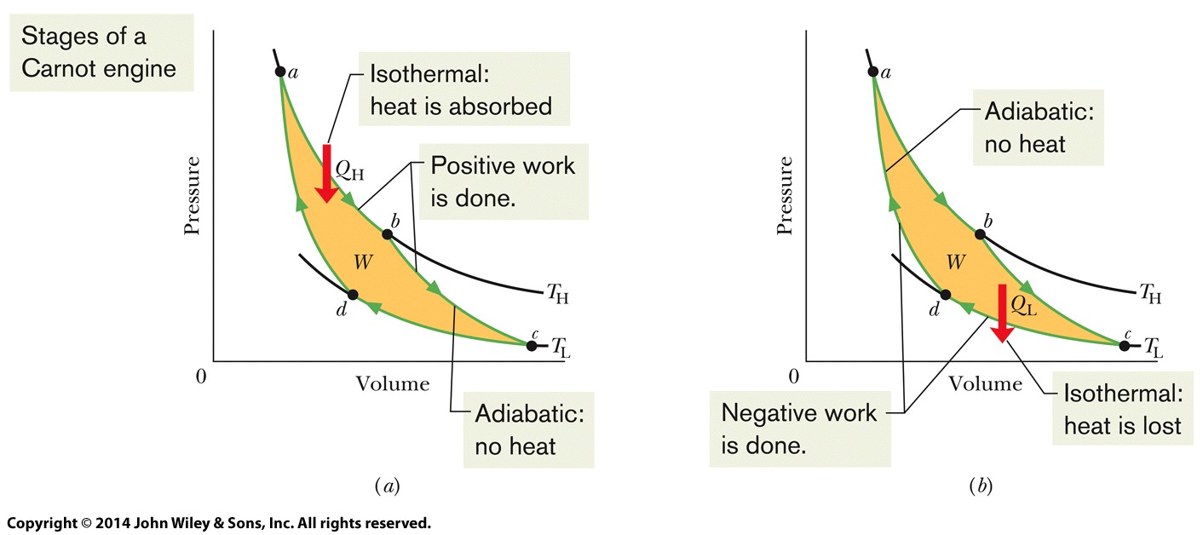
20-2 Entropy in the Real World: Engines
Carnot Engine
A pressure–volume plot (on the left) of the cycle followed by the working substance of the Carnot engine (on the right). The cycle consists of two isothermal (ab and cd) and two adiabatic processes (bc and da). The shaded area enclosed by the cycle is equal to the work W per cycle done by the Carnot engine.
The elements of a Carnot engine. The two black arrowheads on the central loop suggest the working substance operating in a cycle, as if on a p-V plot.

Slide 10
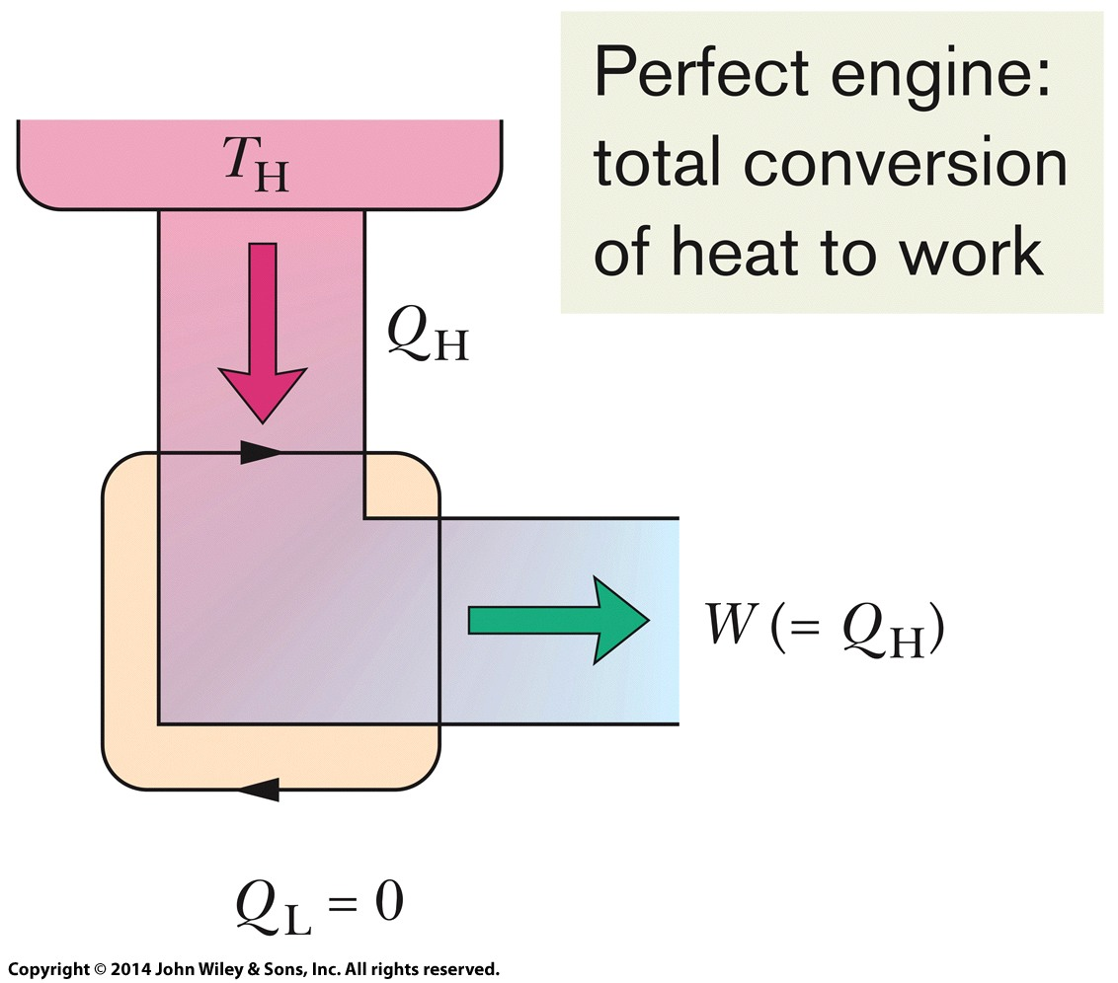
20-2 Entropy in the Real World: Engines
Efficiency of a Carnot Engine
Efficiency of any engine:
The elements of a perfect engine — that is, one that converts heat QH from a high-temperature reservoir directly to work W with 100% efficiency.
Efficiency of Carnot engine:
The elements of a Carnot engine. The two black arrowheads on the central loop suggest the working substance operating in a cycle, as if on a p-V plot.

Slide 11
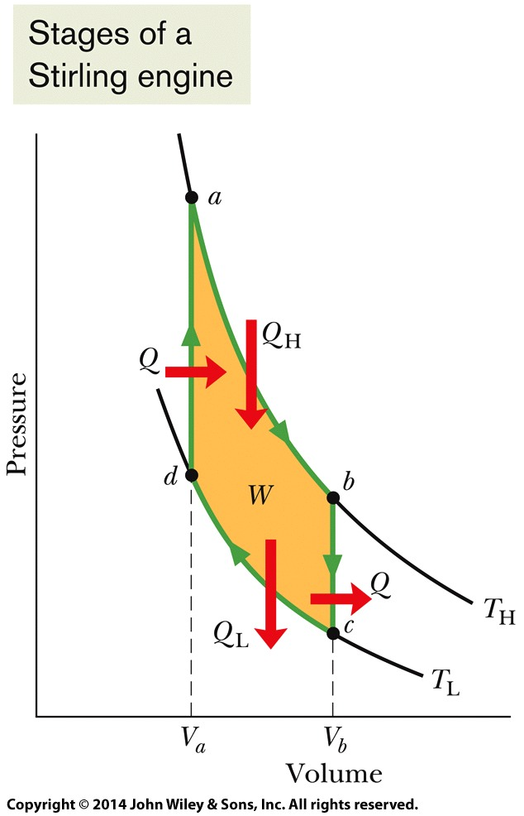
20-2 Entropy in the Real World: Engines
Stirling Engine
The Stirling engine was developed in 1816 by Robert Stirling. This engine, long neglected, is now being developed for use in automobiles and spacecraft.
A p-V plot for the working substance of an ideal Stirling engine, with the working substance assumed for convenience to be an ideal gas.
Answer: (c), (b), (a).

Slide 12
20-3 Refrigerator and Real Engines
Learning Objectives
20.18 Apply the relationship between the coefficient of performance K and the heat exchanges with the reservoirs and the temperatures of the reservoirs.
20.19 Identify that there is no ideal refrigerator in which all of the energy extracted from the low-temperature reservoir is transferred to the high-temperature reservoir.
20.20 Identify that the efficiency of a real engine is less than that of the ideal Carnot engine.
20.16 Identify that a refrigerator is a device that uses work to transfer energy from a low-temperature reservoir to a high-temperature reservoir.
20.17 Sketch a p-V diagram for the cycle of a Carnot refrigerator, indicating the direction of cycling, the nature of the processes involved, the work done during each process, the net work done in the cycle, and the heat transferred during each process (including algebraic sign).

Slide 13
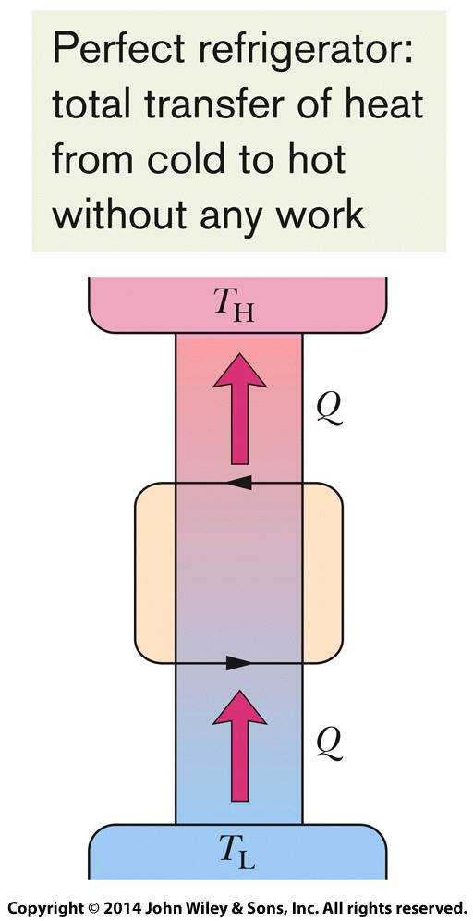
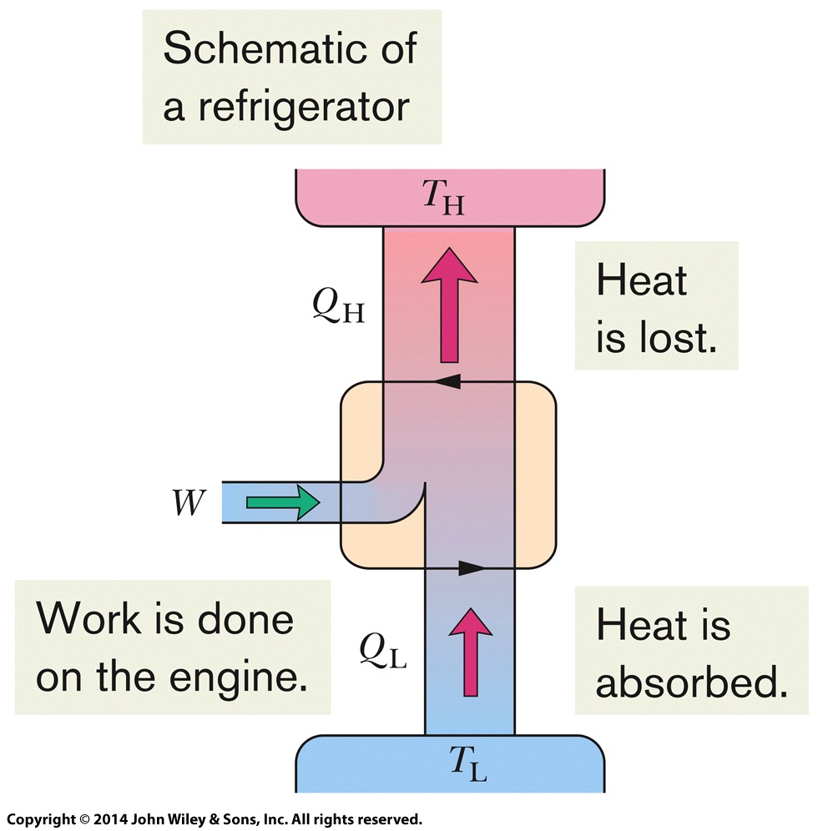
20-3 Refrigerator and Real Engines
Refrigerators
The elements of a refrigerator. Work W is done on the refrigerator (on the working substance) by something in the environment.
The elements of a perfect refrigerator — that is, one that transfers energy from a low-temperature reservoir to a high-temperature reservoir without any input of work.

Slide 14
20-4 A Statistical View of Entropy
Learning Objectives
20.21 Explain what is meant by the configurations of a system of molecules.
20.22 Calculate the multiplicity of a given configuration.
20.23 Identify that all microstates are equally probable but the configurations with more microstates are more probable than the other configurations.
20.24 Apply Boltzmann’s entropy equation to calculate the entropy associated with a multiplicity.

Slide 15
20-4 A Statistical View of Entropy
The entropy of a system can be defined in terms of the possible distributions of its molecules. For identical molecules, each possible distribution of molecules is called a microstate of the system. All equivalent microstates are grouped into a configuration of the system. The number of microstates in a configuration is the multiplicity W of the configuration.
For a system of N molecules that may be distributed between the two halves of a box, the multiplicity is given by
Here n₁ is the number of molecules in one half of the box and n₂ is the number in the other half. A basic assumption of statistical mechanics is that all the microstates are equally probable.

Slide 16
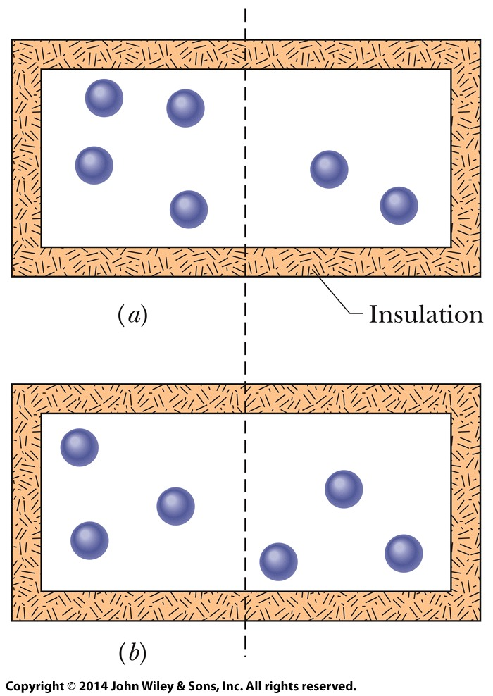
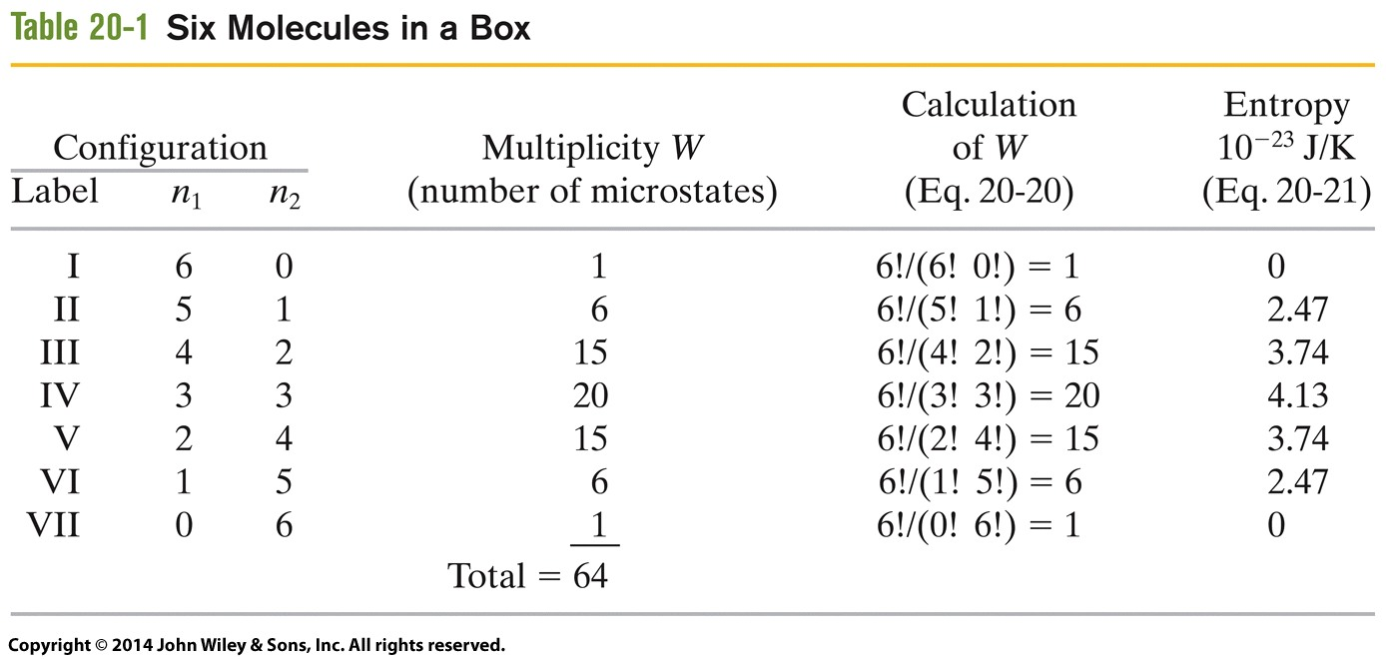
20-4 A Statistical View of Entropy
An insulated box contains six gas molecules. Each molecule has the same probability of being in the left half of the box as in the right half. The arrangement in
corresponds to configuration III in Table 20-1
corresponds to configuration IV.

Slide 17
20-4 A Statistical View of Entropy
Probability and Entropy
The multiplicity W of a configuration of a system and the entropy S of the system in that configuration are related by Boltzmann’s entropy equation:
Here k =1.38 × 10⁻²³ J/K is the Boltzmann constant.
When N is very large (the usual case), we can approximate ln N! with Stirling’s approximation:

Slide 18
20 Summary
Irreversible (one-way) Process
If an irreversible process occurs in a closed system, the entropy of the system always increases.
Second Law of Thermodynamics
If a process occurs in a closed system, the entropy of the system increases for irreversible processes and remains constant for reversible processes.
Eq. 20-5
Entropy Change
Entropy change for reversible process is given by
Entropy Change
The efficiency ε of any engine
Efficiency of Carnot engine
Eq. 20-11
Eq. 20-1
Eq. 20-12&13

Slide 19
20 Summary
Refrigerator
Coefficient of performance of a refrigerator:
Carnot Refrigerator
Entropy from Statistical Point of View
For a system of N molecules:
Boltzmann’s entropy equation:
Stirling’s approximation:
Eq. 20-14
Eq. 20-20
Eq. 20-15&16
Eq. 20-21
Eq. 20-22

