Slide 1
Temperature, Heat, and the First Law of Thermodynamics
Chapter 18

Slide 2
18-1 Temperature
Learning Objectives
18.01 Identify the lowest temperature as 0 on the Kelvin scale (absolute zero).
18.02 Explain the zeroth law of thermodynamics.
18.03 Explain the conditions for the triple-point temperature.
18.04 Explain the conditions for measuring a temperature with a constant-volume gas thermometer.
18.05 For a constant-volume gas thermometer, relate the pressure and temperature of the gas in some given state to the pressure and temperature at the triple point.

Slide 3
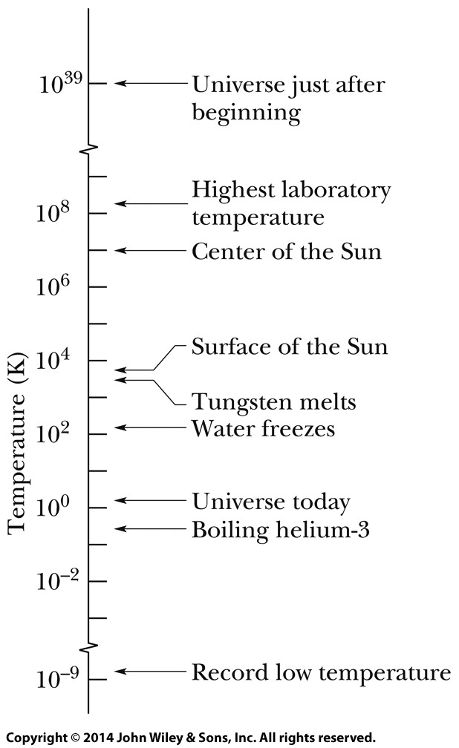
18-1 Temperature
Thermodynamics is the study and application of the thermal energy (often called the internal energy) of systems. One of the central concepts of thermodynamics is temperature.
Temperature is an SI base quantity related to our sense of hot and cold. It is measured with a thermometer, which con- tains a working substance with a measurable property, such as length or pressure, that changes in a regular way as the substance becomes hotter or colder. Physicists measure temperature on the Kelvin scale, which is marked in units called kelvins.

Slide 4
18-1 Temperature
Two bodies are in thermal equilibrium if they are at the same temperature throughout and therefore no heat will flow from one body to the other.
The Zeroth Law of Thermodynamics

Slide 5
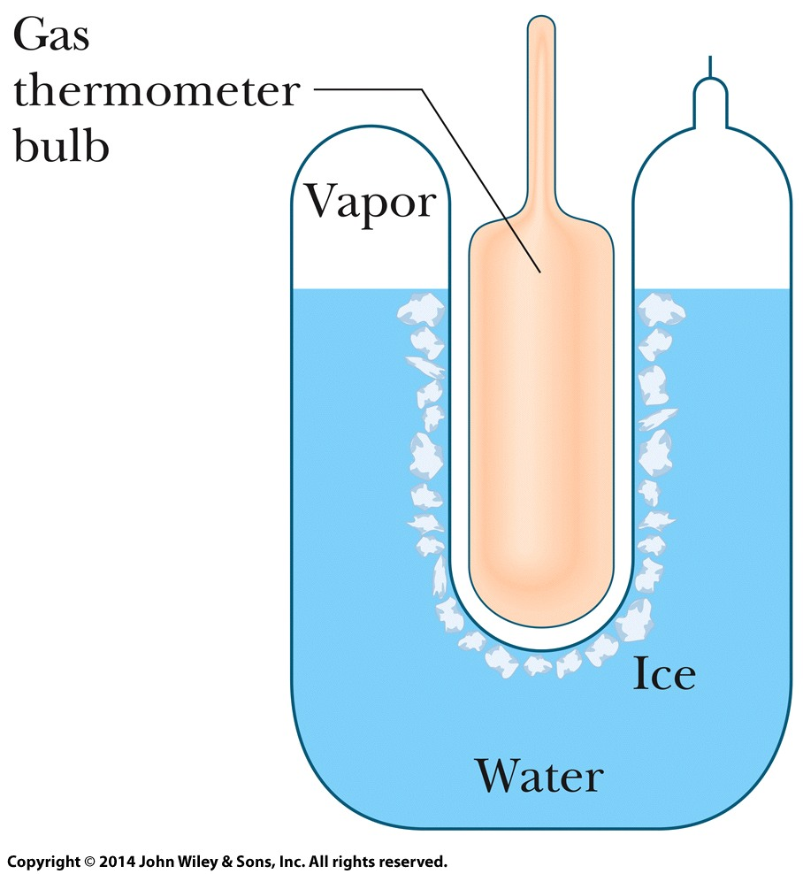
18-1 Temperature
Triple Point of Water
The Triple point of water is the point in which solid ice, liquid water, and water vapor coexist in thermal equilibrium. (This does not occur at normal atmospheric pressure.)
By international agreement, the temperature of this mixture has been defined to be 273.16 K. The bulb of a constant-volume gas thermometer is shown inserted into the well of the cell.
A triple-point cell

Slide 6
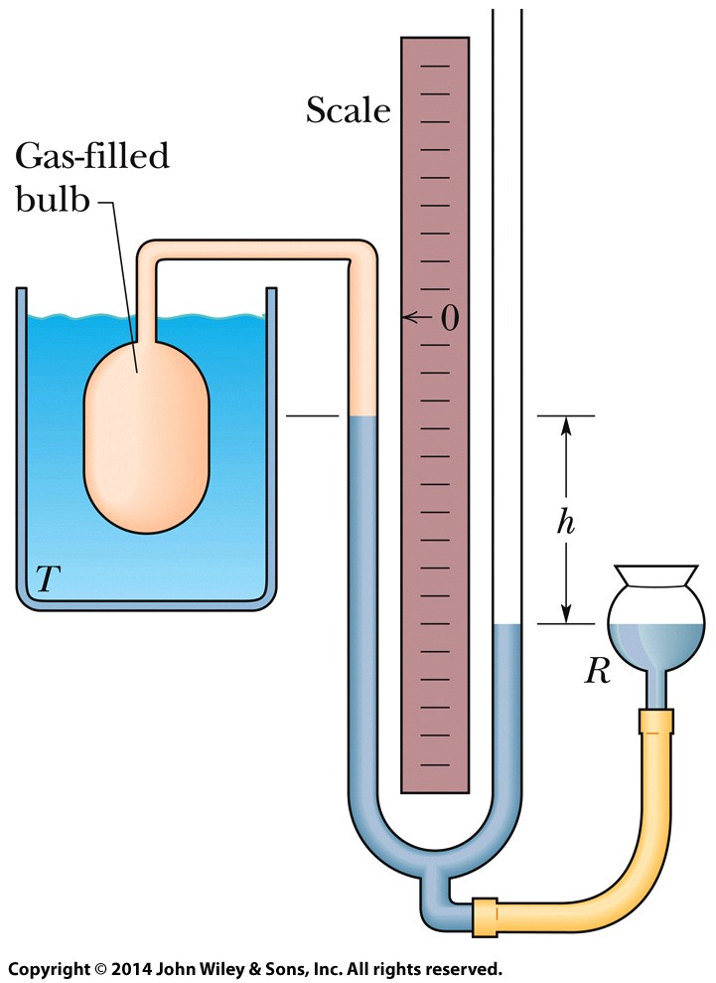
18-1 Temperature
Constant-Volume Gas Thermometer
It consists of a gas-filled bulb connected by a tube to a mercury manometer. By raising and lowering reservoir R, the mercury level in the left arm of the U-tube can always be brought to the zero of the scale to keep the gas volume constant.
the recipe for measuring a temperature with a gas thermometer, where p is the observed pressure and p₃ is the pressure at the triple point of water, is
Constant-Volume Gas Thermometer

Slide 7
18-2 The Celsius and Fahrenheit Scales
Learning Objectives
18.06 Convert a temperature between any two (linear) temperature scales, including the Celsius, Fahrenheit, and Kelvin scales.
18.07 Identify that a change of one degree is the same on the Celsius and Kelvin scales.

Slide 8
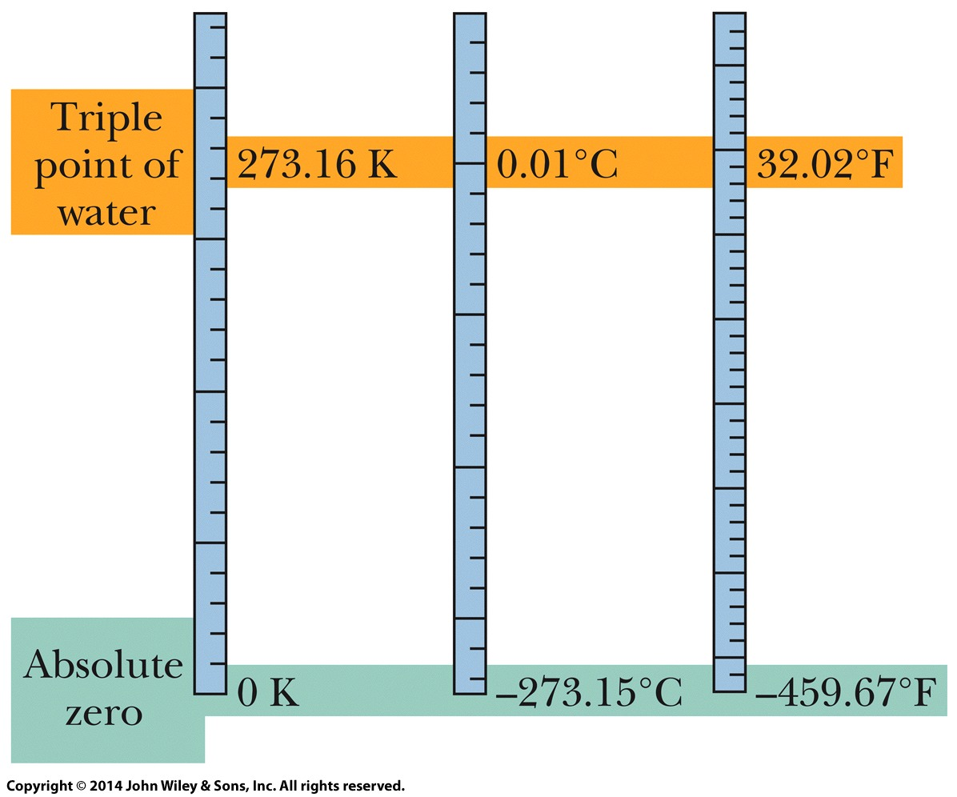
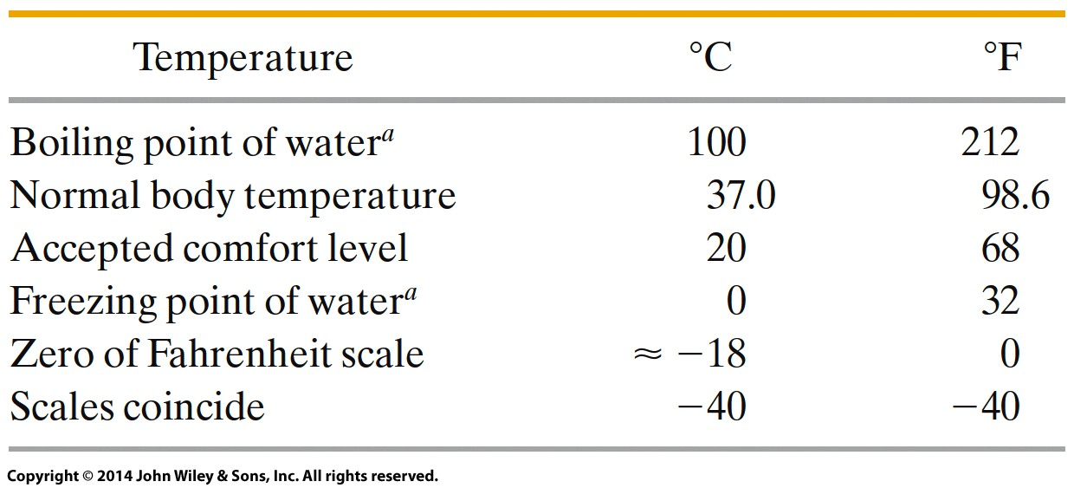
18-2 The Celsius and Fahrenheit Scales
The Celsius temperature scale is defined by
with T in kelvins.
The Fahrenheit temperature scale is defined by
The Kelvin,Celsius,and Fahrenheit temperature scales compared.

Slide 9
18-3 Thermal Expansion
Learning Objectives
18.08 For one-dimensional thermal expansion, apply the relationship between the temperature change ΔT, the length change ΔL, the initial length L, and the coefficient of linear expansion α.
18.09 For two-dimensional thermal expansion, use one dimensional thermal expansion to find the change in area.
18.10 For three-dimensional thermal expansion, apply the relationship between the temperature change ΔT, the volume change ΔV, the initial volume V, and the coefficient of volume expansion β.

Slide 10
18-3 Thermal Expansion
Linear Expansion
All objects change size with changes in temperature. For a temperature change ΔT, a change ΔL in any linear dimension L is given by
in which α is the coefficient of linear expansion.
The strip bends as shown at tempera tures above this reference temperature. Below the reference temperature the strip bends the other way. Many thermo- stats operate on this principle, making and breaking an electrical contact as the temperature rises and falls.

Slide 11
18-3 Thermal Expansion
Volume Expansion
If the temperature of a solid or liquid whose volume is V is increased by an amount ΔT, the increase in volume is found to be
in which β is the coefficient of volume expansion and is related to linear expansion in this way,
Answer: (a) – 2 and 3 (same increase in height), then 1, and then 4
(b) – 3, then 2, then 1 and 4 (identical increase in area)

Slide 12
18-4 Absorption of Heat
Learning Objectives
18.11 Identify that thermal energy is associated with the random motions of the microscopic bodies in an object.
18.12 Identify that heat Q is the amount of transferred energy (either to or from an object’s thermal energy) due to a temperature difference between the object and its environment.
18.13 Convert energy units between various measurement systems.
18.14 Convert between mechanical or electrical energy and thermal energy.
18.15 For a temperature change ΔT of a substance, relate the change to the heat transfer Q and the substance’s heat capacity C.
18.16 For a temperature change ΔT of a substance, relate the change to the heat transfer Q and the substance’s specific heat c and mass m.

Slide 13
18-4 Absorption of Heat
Learning Objectives (continued…)
18.17 Identify the three phases of matter.
18.18 For a phase change of a substance, relate the heat transfer Q, the heat of transformation L, and the amount of mass m transformed.
18.19 Identify that if a heat transfer Q takes a substance across a phase-change temperature, the transfer must be calculated in steps: (a) a temperature change to reach the phase-change temperature, (b) the phase change, and then (c) any temperature change that moves the substance away from the phase-change temperature.

Slide 14
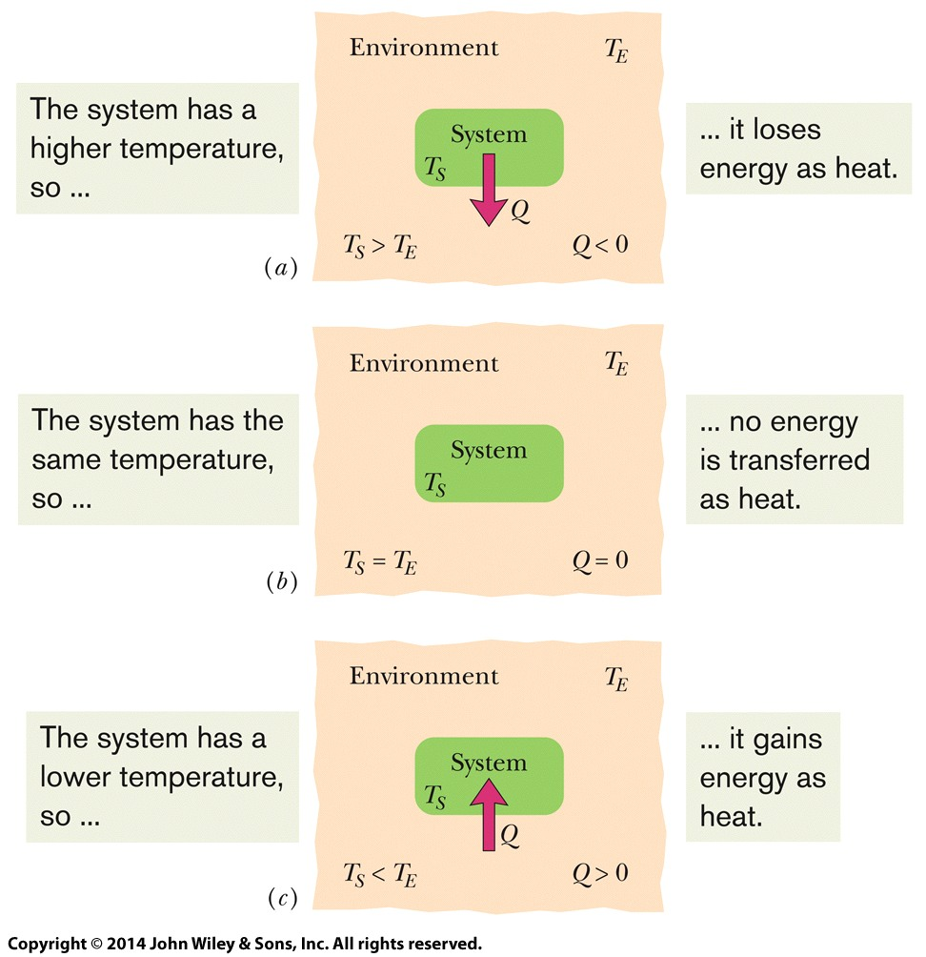
18-4 Absorption of Heat
Temperature and Heat
Heat Q is energy that is transferred between a system and its environment because of a temperature difference between them.
It can be measured in joules (J), calories (cal), kilocalories (Cal or kcal), or British thermal units (Btu), with

Slide 15
18-4 Absorption of Heat
Absorption of Heat by Solids and Liquids
The heat capacity C of an object is the proportionality constant between the heat Q that the object absorbs or loses and the resulting temperature change ΔT of the object; that is, in which T_{i} and T_{f} are the initial and final temperatures of the object. If the object has mass m, then, where c is the specific heat of the material making up the object.
Answer: Material A has the greater specific heat

Slide 16
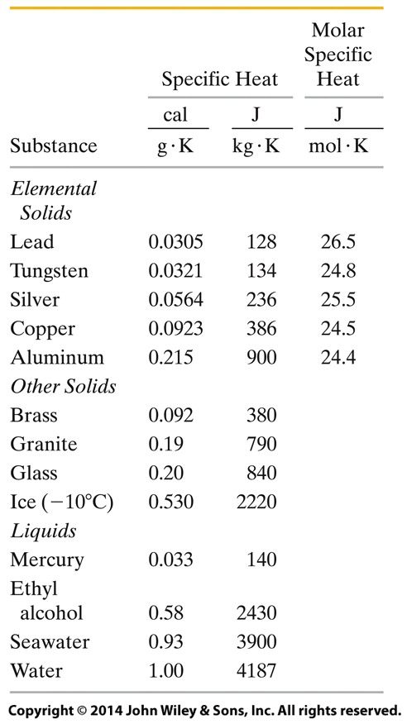
18-4 Absorption of Heat
When quantities are expressed in moles, specific heats must also involve moles (rather than a mass unit); they are then called molar specific heats. Table shows the values for some elemental solids (each consisting of a single element) at room temperature.
The amount of energy per unit mass that must be transferred as heat when a sample completely undergoes a phase change is called the heat of transformation L. Thus, when a sample of mass m completely undergoes a phase change, the total energy transferred is

Slide 17
18-5 The First Law of Thermodynamics
Learning Objectives
calculate the work by using graphical integration.
18.23 On a p-V graph of pressure versus volume for a gas, identify the algebraic sign of the work associated with a right-going process and a left-going process.
18.24 Apply the first law of thermodynamics to relate the change in the internal energy ΔE_{int} of a gas, the energy Q transferred as heat to or from the gas, and the work W done on or by the gas.
18.20 If an enclosed gas expands or contracts, calculate the work W done by the gas by integrating the gas pressure with respect to the volume of the enclosure.
18.21 Identify the algebraic sign of work W associated with expansion and contraction of a gas.
18.22 Given a p-V graph of pressure versus volume for a process, identify the starting point (the initial state) and the final point (the final state) and

Slide 18
18-5 The First Law of Thermodynamics
Learning Objectives (Continued)
18.25 Identify the algebraic sign of a heat transfer Q that is associated with a transfer to a gas and a transfer from the gas.
18.26 Identify that the internal energy ΔE_{int} of a gas tends to increase if the heat transfer is to the gas, and it tends to decrease if the gas does work on its environment.
18.27 Identify that in an adiabatic process with a gas, there is no heat transfer Q with the environment.
18.28 Identify that in a constant-volume process with a gas, there is no work W done by the gas.
18.29 Identify that in a cyclical process with a gas, there is no net change in the internal energy ΔE_{int}.
18.30 Identify that in a free expansion with a gas, the heat transfer Q, work done W, and change in internal energy ΔE_{int} are each zero.

Slide 19
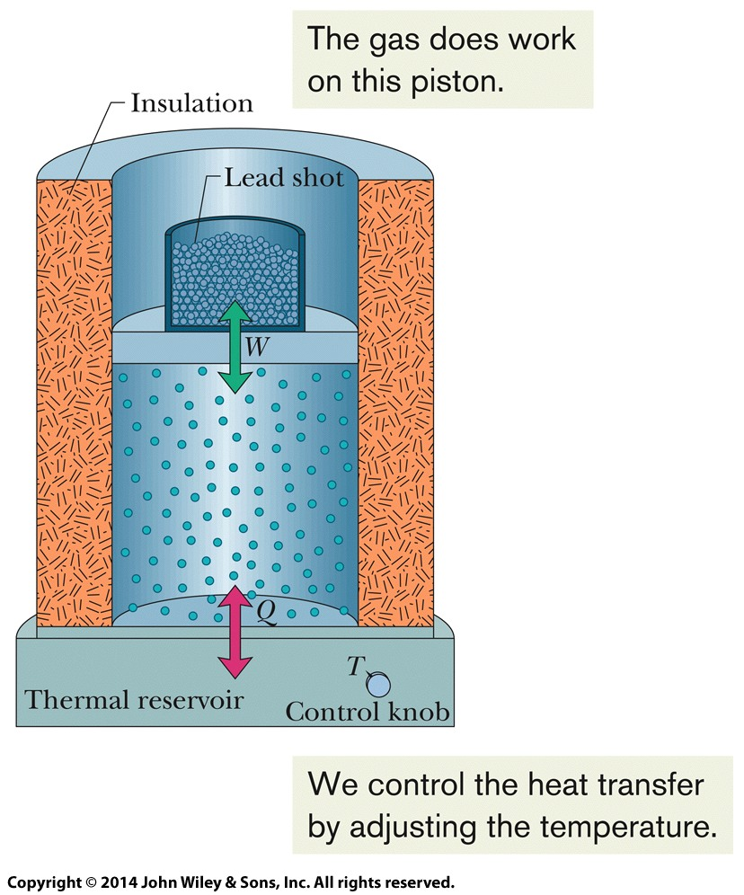
18-5 The First Law of Thermodynamics
Heat and Work
A gas may exchange energy with its surroundings through work. The amount of work W done by a gas as it expands or contracts from an initial volume V_{i} to a final volume V_{f} is given by
The integration is necessary because the pressure p may vary during the volume change.
A gas confined to a cylinder with a movable piston.

Slide 20
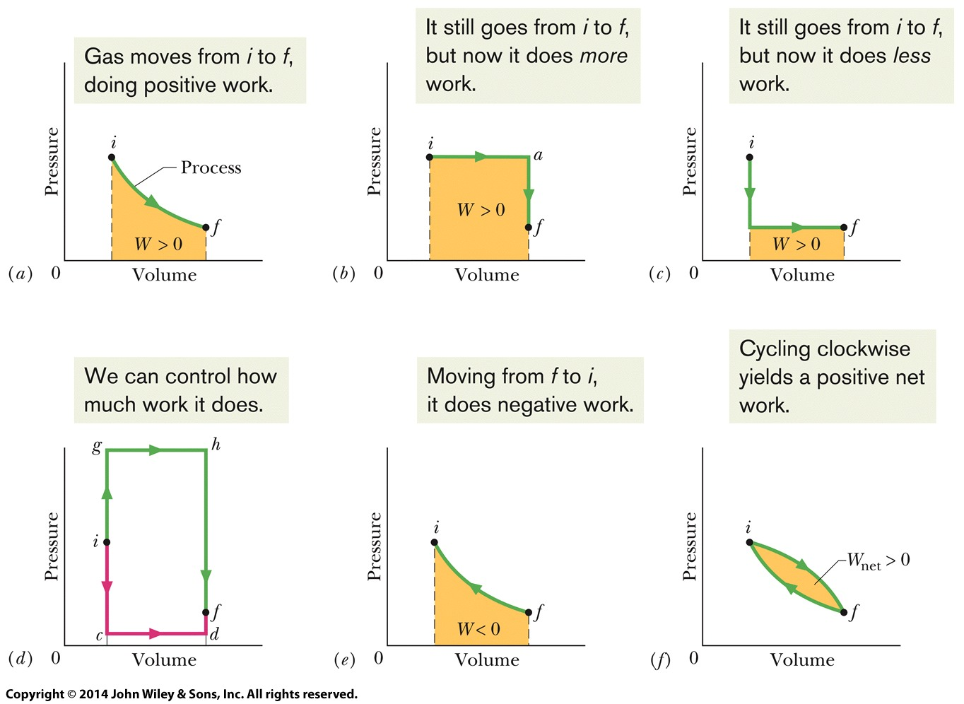
18-5 The First Law of Thermodynamics
Heat and Work
A gas confined to a cylinder with a movable piston.

Slide 21
18-5 The First Law of Thermodynamics
The First Law of Thermodynamics
The principle of conservation of energy for a thermodynamic process is expressed in the first law of thermodynamics, which may assume either of the forms:
Or, if the thermodynamic system undergoes only a differential change, we can write the first law as:

Slide 22
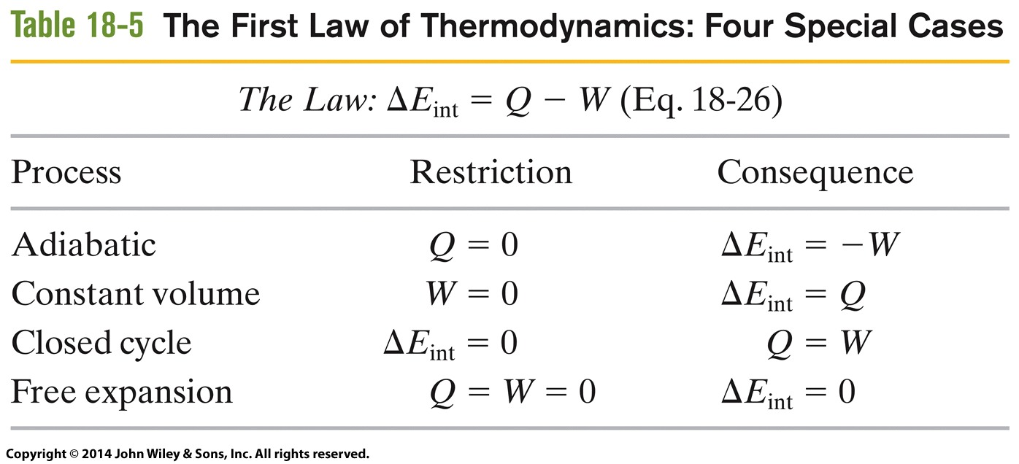
18-5 The First Law of Thermodynamics

Slide 23
18-6 Heat Transfer Mechanisms
Learning Objectives
18.31 For thermal conduction through a layer, apply the relationship between the energy-transfer rate P_{cond} and the layer’s area A, thermal conductivity k, thickness L, and temperature difference ΔT (between its two sides).
18.32 For a composite slab (two or more layers) that has reached the steady state in which temperatures are no longer changing, identify that (by the conservation of energy)
the rates of thermal conduction P_{cond} through the layers must be equal.
18.33 For thermal conduction through a layer, apply the relationship between thermal resistance R, thickness L, and thermal conductivity k.
18.34 Identify that thermal energy can be transferred by convection, in which a warmer fluid (gas or liquid) tends to rise in a cooler fluid.

Slide 24
18-6 Heat Transfer Mechanisms
Learning Objectives (Continued)
18.35 In the emission of thermal radiation by an object, apply the relationship between the energy-transfer rate P_{rad} and the object’s surface area A, emissivity ε, and surface temperature T (in kelvins).
18.36 In the absorption of thermal radiation by an object, apply the relationship between the energy-transfer rate P_{abs} and the object’s surface area A and emissivity ε, and the environmental temperature
T (in kelvins).
18.37 Calculate the net energy transfer rate P_{net} of an object emitting radiation to its environment and absorbing radiation from that environment.

Slide 25
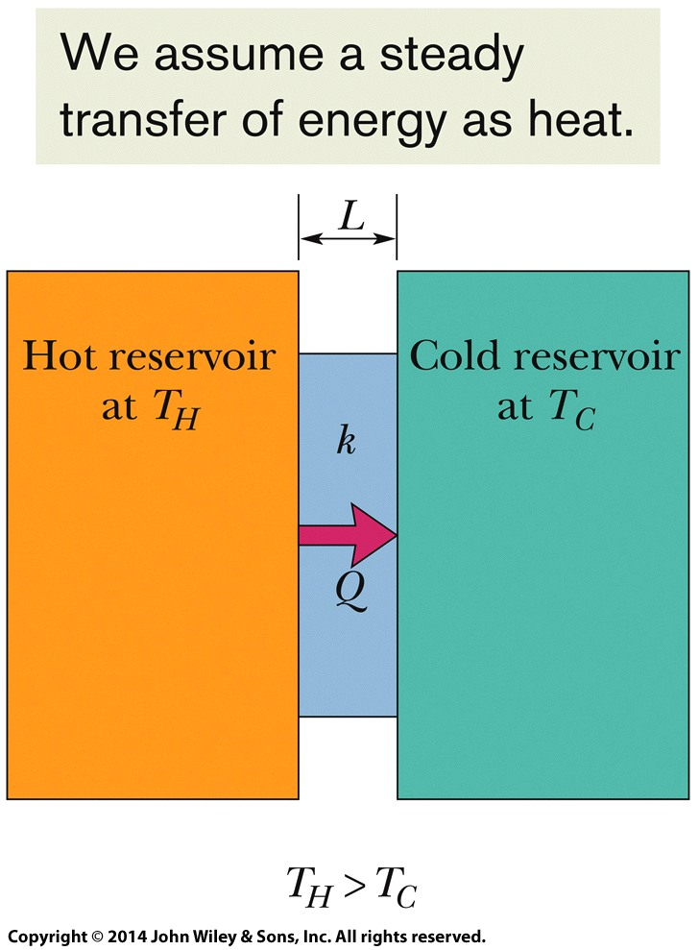
18-6 Heat Transfer Mechanisms
Thermal Conduction
The rate P_{cond} at which energy is conducted through a slab for which one face is maintained at the higher temperature T_{H} and the other face is maintained at the lower temperature T_{C} is
Here each face of the slab has area A, the length of the slab (the distance between the faces) is L, and k is the thermal conductivity of the material.
Energy is transferred as heat from a reservoir at temperature T_{H} to a cooler reservoir at temperature T_{C} through a conducting slab of thickness L and thermal conductivity k.

Slide 26
18-6 Heat Transfer Mechanisms
Convection
Convection occurs when temperature differences cause an energy transfer by motion within a fluid.
When you look at the flame of a candle or a match, you are watching thermal energy being transported upward by convection.
Convection is part of many natural processes. Atmospheric convection plays a fundamental role in determining global climate patterns and daily weather vari- ations. Glider pilots and birds alike seek rising thermals (convection currents of warm air) that keep them aloft. Huge energy transfers take place within the oceans by the same process.

Slide 27
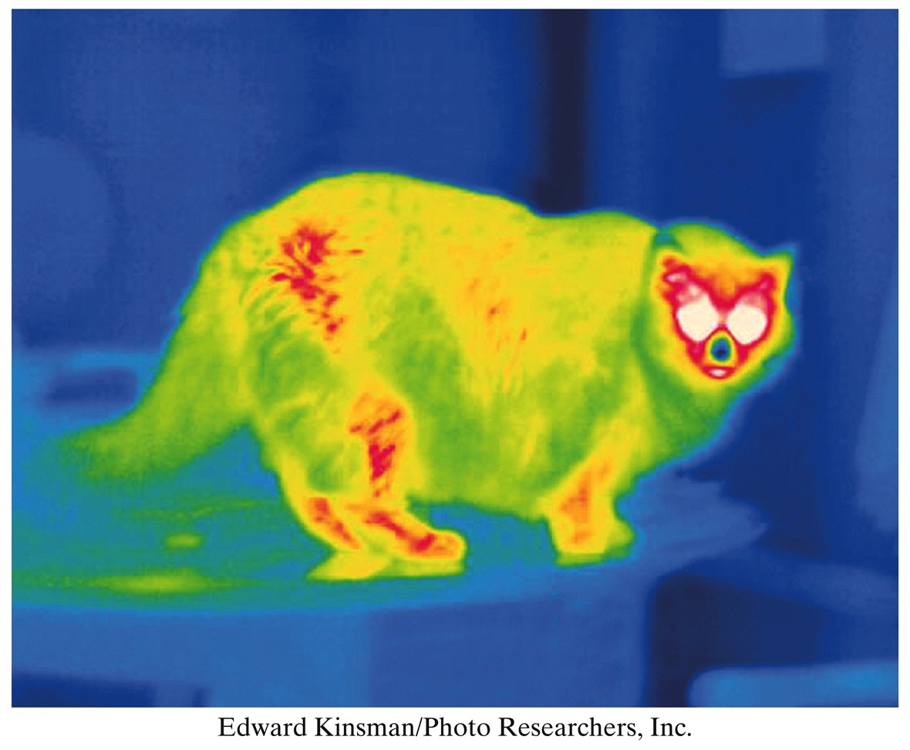
18-6 Heat Transfer Mechanisms
Thermal Radiation
Radiation is an energy transfer via the emission of electromagnetic energy. The rate P_{rad} at which an object emits energy via thermal radiation is
Here σ (= 5.6704×10⁻⁸ W/m².K⁴) is the Stefan– Boltzmann constant, ε is the emissivity of the object’s surface, A is its surface area, and T is its surface temperature (in kelvins). The rate P_{abs} at which an object absorbs energy via thermal radiation from its environment, which is at the uniform temperature T_{env} (in kelvins), is

Slide 28
18 Summary
Temperature and Thermometer
SI base quantity related to our sense of hot and cold.
It is measured using thermometer
Celsius and Fahrenheit Scale
The Celsius temperature scale is defined by
The Fahrenheit temperature scale is defined by
Eq. 18-7
Zeroth Law of Thermodynamics
If bodies A and B are each in thermal equilibrium with a third body C (the thermometer), then A and B are in thermal equilibrium with each other.
Eq. 18-8
Thermal Expansion
Linear Expansion
Volume Expansion
Eq. 18-9
The Kelvin Temperature Scale
We define the temperature T as measured with a gas thermometer to be
Eq. 18-10
Eq. 18-6

Slide 29
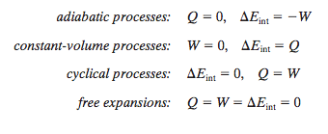
18 Summary
Heat Capacity and Specific Heat
Heat Capacity:
Specific Heat
Application of First Law
Eq. 18-13
Eq. 18-14
First Law of Thermodynamics
The principle of conservation of energy for a thermodynamic process is expressed in:
Conduction, Convection, Radiation
Conduction
Radiation:
Eq. 18-32
Eq. 18-26
Eq. 18-27
Eq. 18-39

