Slide 1
Waves - II
Chapter 17

Slide 2
17-1 Speed of Sound
Learning Objectives
17.01 Distinguish between a longitudinal wave and a transverse wave.
17.02 Explain wavefronts and rays.
17.03 Apply the relationship between the speed of sound through a material, the material’s bulk modulus, and the material’s density.
17.04 Apply the relationship between the speed of sound, the distance traveled by a sound wave, and the time required to travel that distance.

Slide 3
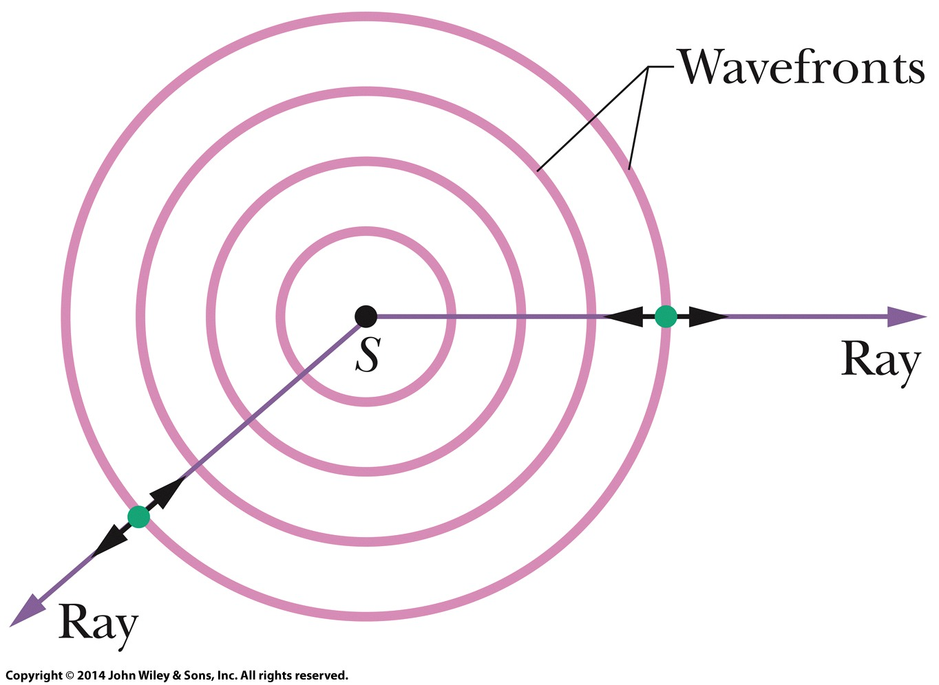
17-1 Speed of Sound
Sound waves are longitudinal mechanical waves that can travel through solids, liquids, or gases.
Point S represents a tiny sound source, called a point source, that emits sound waves in all directions. A sound wave travels from a point source S through a three-dimensional medium. The wavefronts (surfaces over which the oscillations due to the sound wave have the same value) form spheres centered on S; the rays are radial to S. The short, double-headed arrows indicate that elements of the medium oscillate parallel to the rays.

Slide 4
17-1 Speed of Sound
The speed ν of a sound wave in a medium having bulk modulus B and density ρ is
An element of air of width Δx moves toward the pulse with speed v.
Through direct application of Newton’s Second law.
The leading face of the element enters the pulse. The forces acting on the leading and trailing faces (due to air pressure) are shown.

Slide 5
17-2 Traveling Sound Waves
Learning Objectives
17.05 For any particular time and position, calculate the displacement s(x,t) of an element of air as a sound wave travels through its location.
17.06 Given a displacement function s(x,t) for a sound wave, calculate the time between two given displacements.
17.07 Apply the relationships between wave speed v, angular frequency ω, angular wave number k, wavelength λ, period T, and frequency ƒ.
17.08 Sketch a graph of the displacement s(x) of an element of air as a function of position, and identify the amplitude s_{m} and wavelength λ.
17.09 For any particular time and position, calculate the pressure variation Δp (variation from atmospheric pressure) of an element of air as a sound wave travels through its location.

Slide 6
17-2 Traveling Sound Waves
Learning Objectives (Continued)
17.10 Sketch a graph of the pressure variation Δp(x) of an element as a function of position, and identify the amplitude Δp_{m} and wavelength λ.
17.11 Apply the relationship between pressure-variation amplitude Δp_{m} and displacement amplitude s_{m}.
17.12 Given a graph of position s versus time for a sound wave, determine the amplitude s_{m} and the period T.
17.13 Given a graph of pressure variation Δp versus time for a sound wave, determine the amplitude Δp_{m} and the period T.

Slide 7
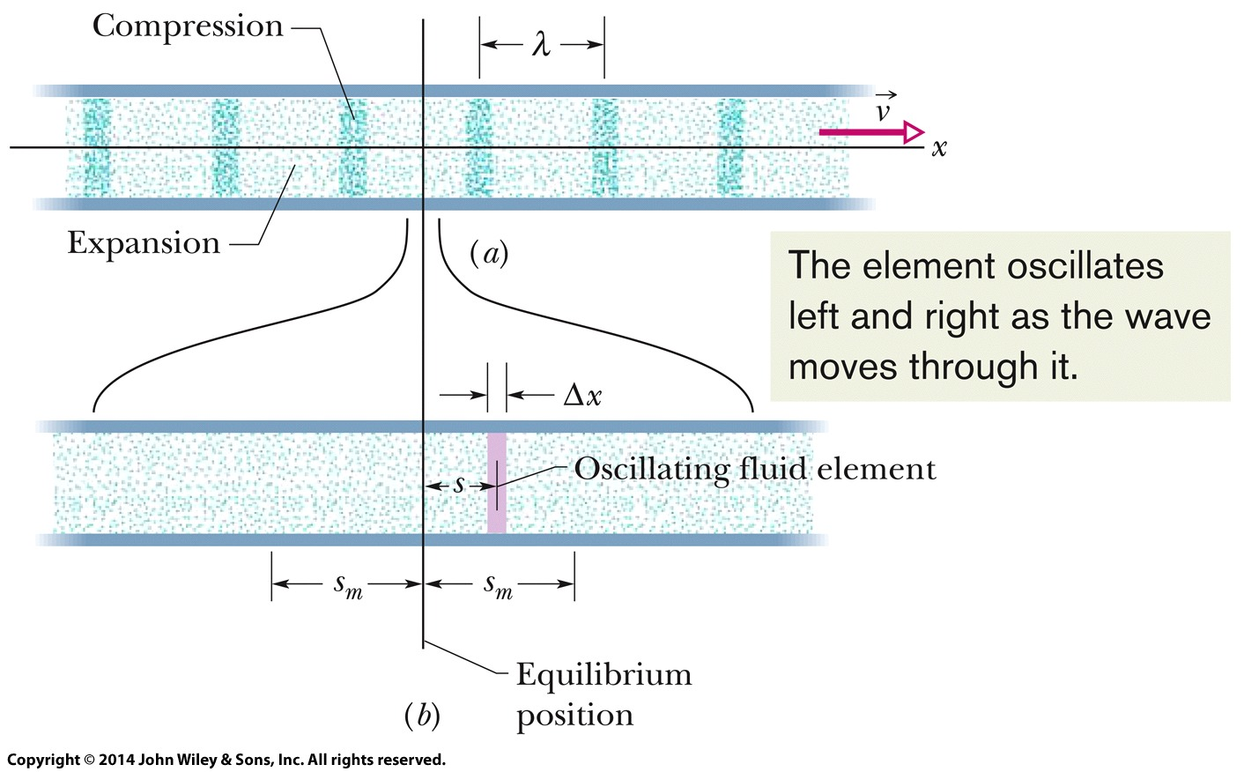
17-2 Traveling Sound Waves
(a) A sound wave, traveling through a long air-filled tube with speed v, consists of a moving, periodic pattern of expansions and compressions of the air. The wave is shown at an arbitrary instant.
(b) A horizontally expanded view of a short piece of the tube. As the wave passes, an air element of thickness Δx oscillates left and right in simple harmonic motion about its equilibrium position. At the instant shown in (b), the element happens to be displaced a distance s to the right of its equilibrium position. Its maximum displacement, either right or left, is s_{m}.

Slide 8
17-2 Traveling Sound Waves
Displacement: A sound wave causes a longitudinal displacement s of a mass element in a medium as given by
where s_{m} is the displacement amplitude (maximum displacement) from equilibrium, k = 2π/λ, and ω=2πƒ, λ and ƒ being the wavelength and frequency, respectively, of the sound wave.
Pressure: The sound wave also causes a pressure change Δp of the medium from the equilibrium pressure:
where the pressure amplitude is

Slide 9
17-3 Interference
Learning Objectives
17.14 If two waves with the same wavelength begin in phase but reach a common point by traveling along different paths, calculate their phase difference Φ at that point by relating the path length difference ΔL to the wavelength λ.
17.15 Given the phase difference between two sound waves with the same amplitude, wavelength, and travel direction, determine the type of interference between the waves (fully destructive interference, fully constructive interference, or indeterminate interference).
17.16 Convert a phase difference between radians, degrees, and number of wavelengths.

Slide 10
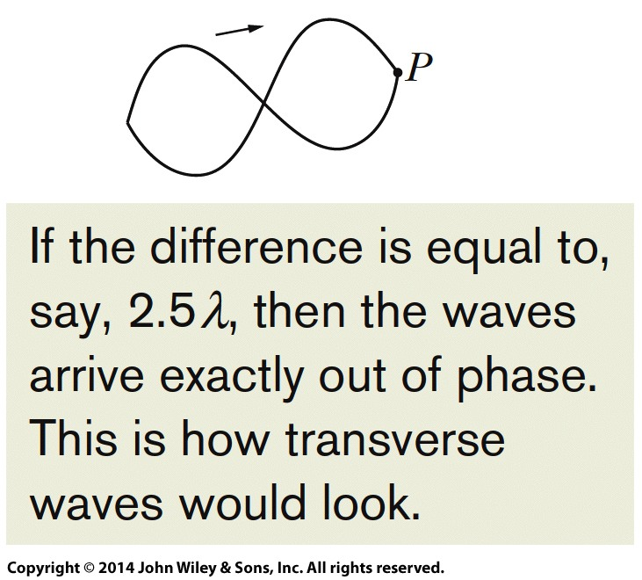
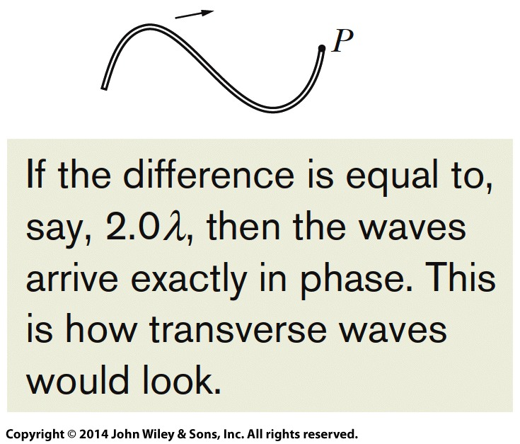
17-3 Interference
Two point sources S₁ and S₂ emit spherical sound waves in phase. The rays indicate that the waves pass through a common point P. The waves (represented with transverse waves) arrive at P.
Fully
Destructive Interference
(exactly out of phase)
Fully
Constructive Interference
(exactly in phase)

Slide 11
17-3 Interference
Path Length Difference
The interference of two sound waves with identical wavelengths passing through a common point depends on their phase difference there ϕ . If the sound waves were emitted in phase and are traveling in approximately the same direction, ϕ is given by
where ΔL is their path length difference.

Slide 12
17-3 Interference
Fully constructive interference occurs when ϕ is an integer and multiple of 2π,
and, equivalently, when ΔL is related to wavelength λ by
Fully destructive interference occurs when ϕ is an odd multiple of π,
and, equivalently, when ΔL is related to wavelength λ by

Slide 13
17-4 Intensity And Sound Level
Learning Objectives
the distance r to a detector, and the sound intensity I at the detector.
17.21 Apply the relationship between the sound level β, the sound intensity I, and the standard reference intensity I₀.
17.22 Evaluate a logarithm function (log) and an antilogarithm function (log⁻¹).
17.23 Relate the change in a sound level to the change in sound intensity.
17.17 Calculate the sound intensity I at a surface as the ratio of the power P to the surface area A.
17.18 Apply the relationship between the sound intensity I and the displacement amplitude s_{m} of the sound wave.
17.19 Identify an isotropic point source of sound.
17.20 For an isotropic point source, apply the relationship involving the emitting power P_{s},

Slide 14
17-4 Intensity And Sound Level
The intensity I of a sound wave at a surface is the average rate per unit area at which energy is transferred by the wave through or onto the surface
where P is the time rate of energy transfer (power) of the sound wave and A is the area of the surface intercepting the sound. The intensity I is related to the displacement amplitude s_{m} of the sound wave by

Slide 15
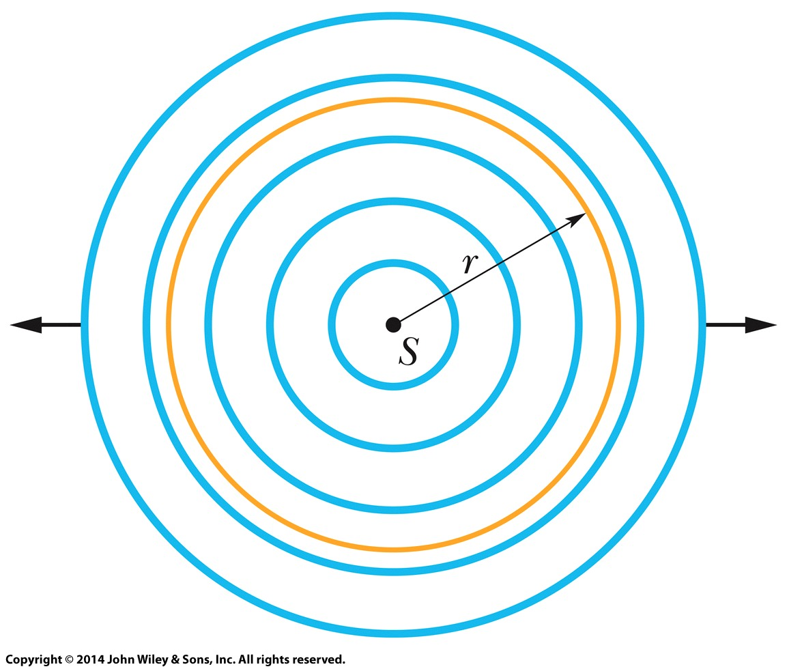
17-4 Intensity And Sound Level
The intensity at a distance r from a point source that emits sound waves of power P_{s} equally in all directions isotropically i.e. with equal intensity in all directions,
A point source S emits sound waves uniformly in all directions. The waves pass through an imaginary sphere of radius r that is centered on S.
where 4πr² is the area of the sphere.

Slide 16
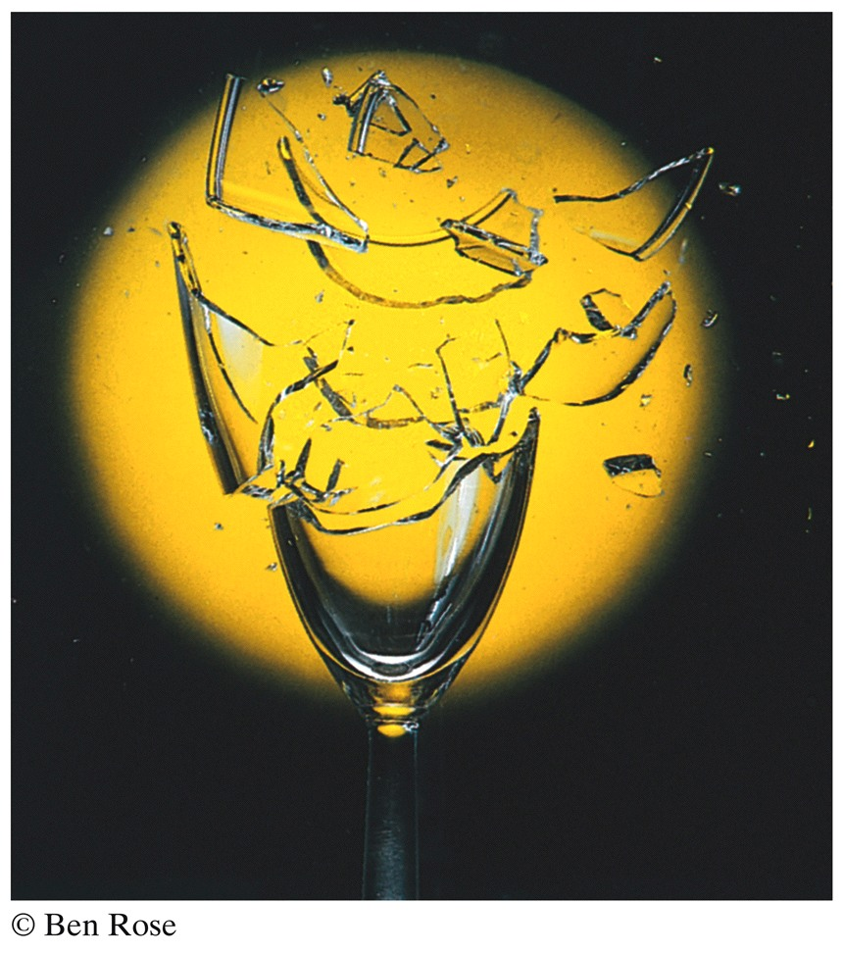
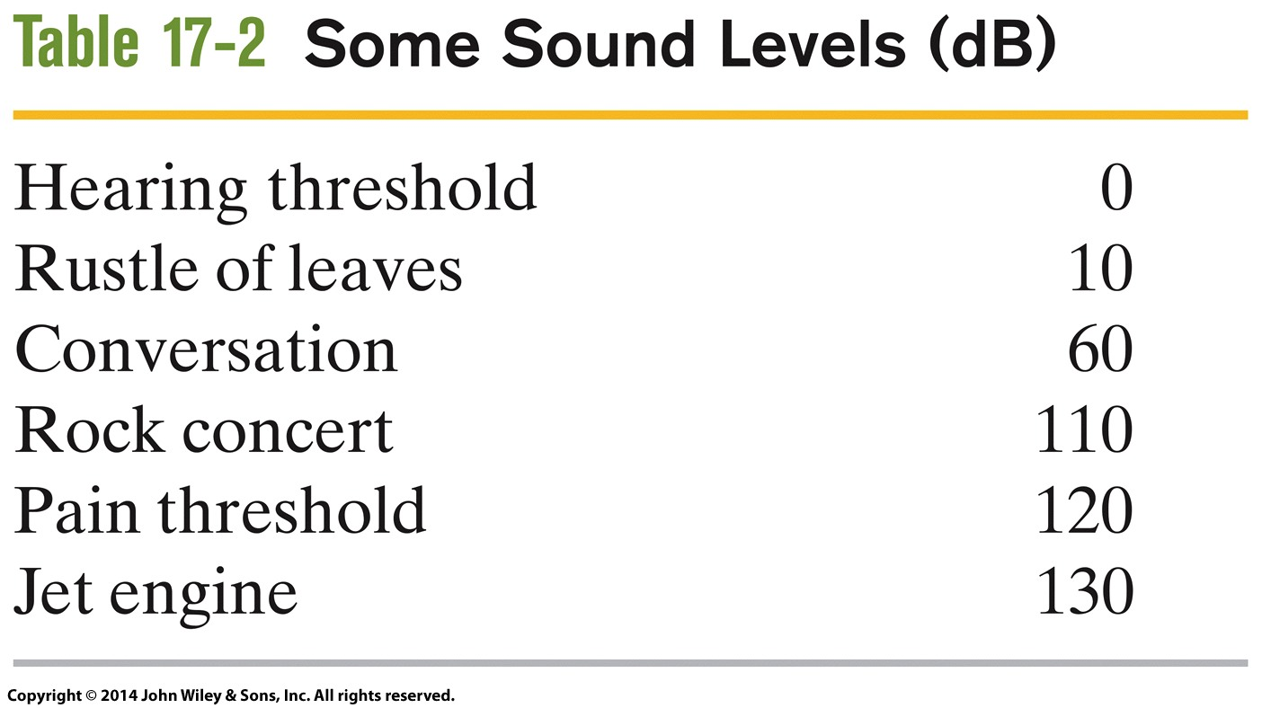
17-4 Intensity And Sound Level
The Decibel Scale
The sound level β in decibels (dB) is defined as
where I₀ (= 10⁻¹² W/m²) is a reference intensity level to which all intensities are compared. For every factor-of-10 increase in intensity, 10 dB is added to the sound level.
Sound can cause the wall of a drinking glass to oscillate. If the sound produces a standing wave of oscillations and if the intensity of the sound is large enough, the glass will shatter.

Slide 17
17-5 Sources of Musical Sound
Learning Objectives
17.26 Identify which type of pipe has even harmonics.
17.27 For any given harmonic and for a pipe with only one open end or with two open ends, apply the relationships between the pipe length L, the speed of sound v, the wavelength λ, the harmonic frequency ƒ, and the harmonic number n.
17.24 Using standing wave patterns for string waves, sketch the standing wave patterns for the first several acoustical harmonics of a pipe with only one open end and with two open ends.
17.25 For a standing wave of sound, relate the distance between nodes and the wavelength.

Slide 18
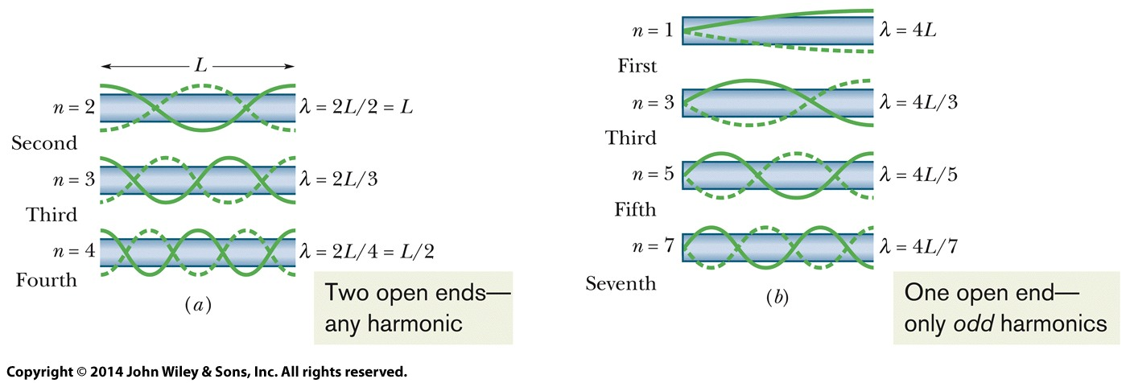
17-5 Sources of Musical Sound
Standing sound wave patterns can be set up in pipes (that is, resonance can be set up) if sound of the proper wave- length is introduced in the pipe.
Two Open Ends.
One Open End.
A pipe open at both ends will resonate at frequencies
A pipe closed at one end and open at the other will resonate at frequencies

Slide 19
17-6 Beats
Learning Objectives
17.28 Explain how beats are produced.
17.29 Add the displacement equations for two sound waves of the same amplitude and slightly different angular frequencies to find the displacement equation of the resultant wave and identify the time-varying amplitude.
17.30 Apply the relationship between the beat frequency and the frequencies of two sound waves that have the same amplitude when the frequencies (or, equivalently, the angular frequencies) differ by a small amount.

Slide 20
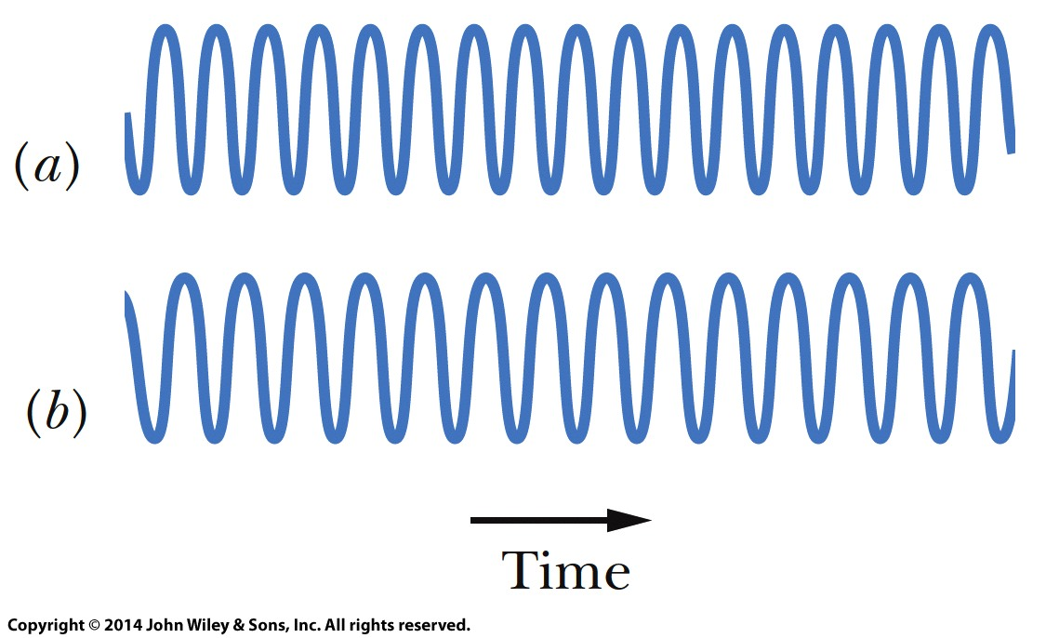
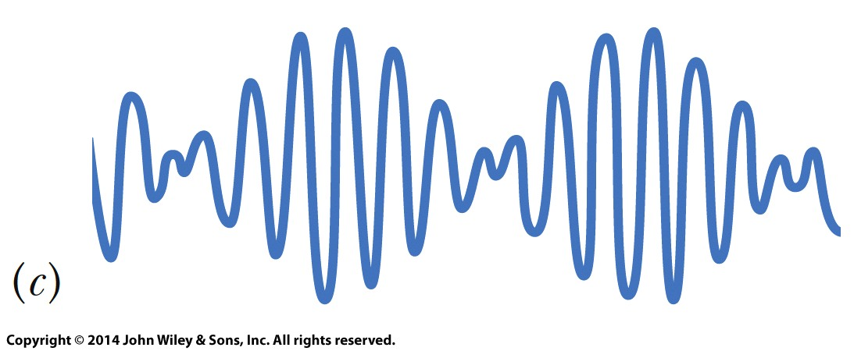
17-6 Beats
Beats arise when two waves having slightly different frequencies, ƒ₁ and ƒ₂, are detected together. The beat frequency is
(a,b) The pressure variations Δp of two sound waves as they would be detected separately. The frequencies of the waves are nearly equal.
(c) The resultant pressure variation if the two waves are detected simultaneously.

Slide 21
17-7 The Doppler Effect
Learning Objectives
moving either directly toward or away from a stationary detector, (b) a detector moving either directly toward or away from a stationary source, and (c) both source and detector moving either directly toward each other or directly away from each other.
17.34 Identify that for relative motion between a sound source and a sound detector, motion toward tends to shift the frequency up and motion away tends to shift it down.
17.31 Identify that the Doppler effect is the shift in the de- tected frequency from the frequency emitted by a sound source due to the relative motion between the source and the detector.
17.32 Identify that in calculating the Doppler shift in sound, the speeds are measured relative to the medium (such as air or water), which may be moving.
17.33 Calculate the shift in sound frequency for (a) a source

Slide 22
17-7 The Doppler Effect
The Doppler effect is a change in the observed frequency of a wave when the source or the detector moves relative to the transmitting medium (such as air). For sound, the observed frequency ƒ’ is given in terms of the source frequency ƒ by
where v is the speed of sound through the air, v_{D} is the detector’s speed relative to the air, and v_{S} is the source’s speed relative to the air.
In the numerator, the plus sign applies when the detector moves toward the source and the minus sign applies when the detector moves away from the source.
In the denominator the minus sign is used when the source moves toward the detector, the plus sign applies when the source moves away from the detector.

Slide 23
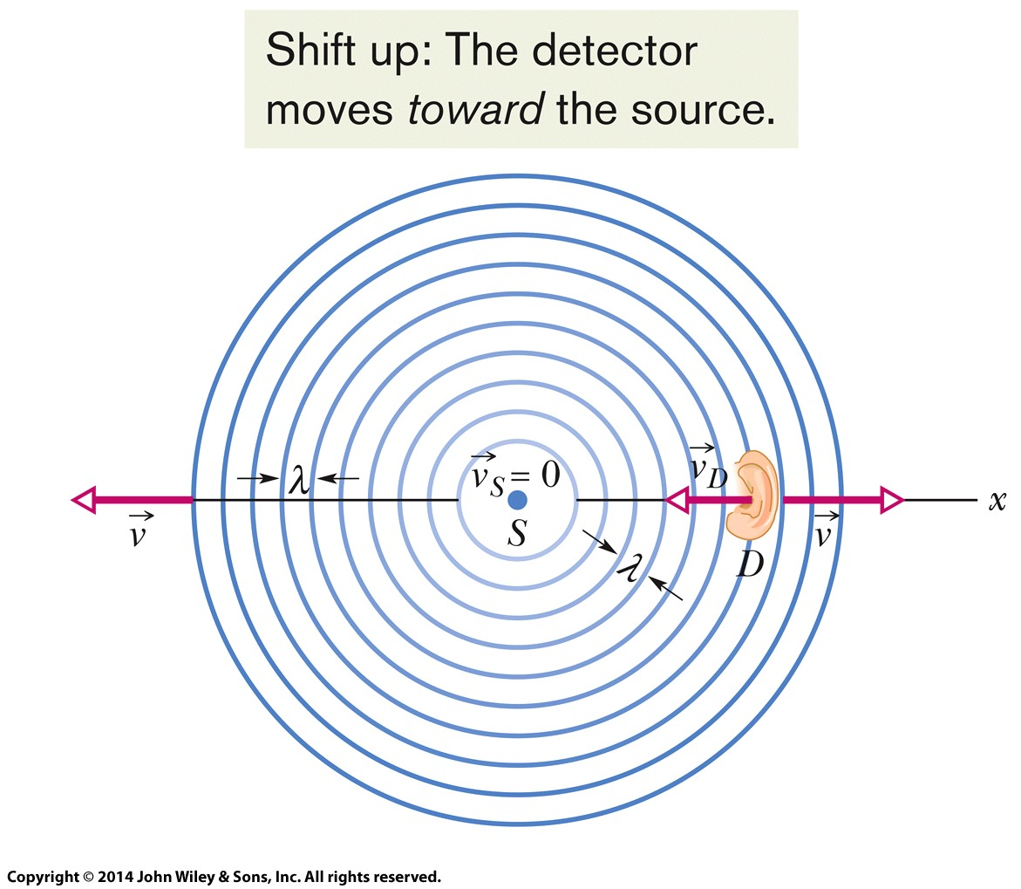
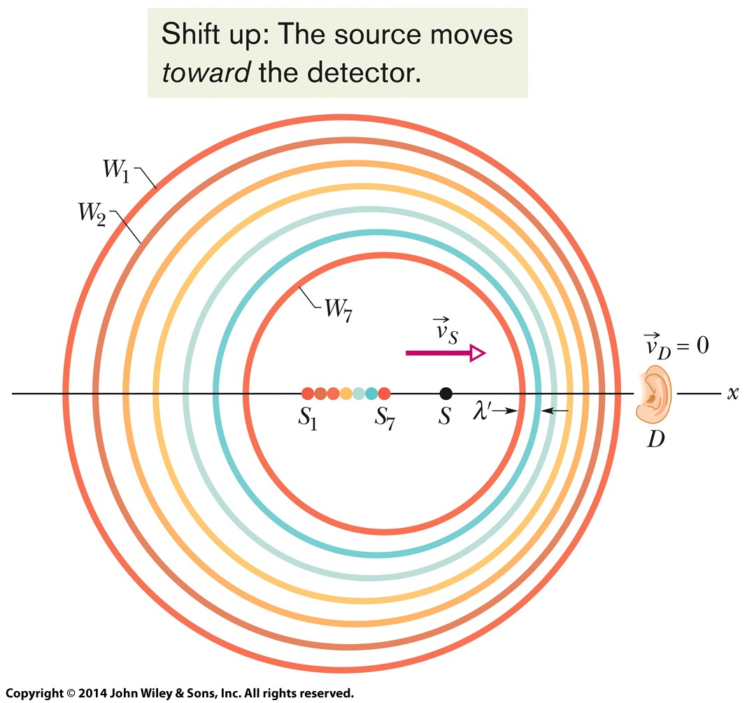
17-7 The Doppler Effect
Detector Moving Source Stationary
Source Moving Detector Stationary

Slide 24
17-8 Supersonic Speeds, Shock Waves
Learning Objectives
17.35 Sketch the bunching of wavefronts for a sound source traveling at the speed of sound or faster.
17.36 Calculate the Mach number for a sound source exceeding the speed of sound.
7.37 For a sound source exceeding the speed of sound, apply the relationship between the Mach cone angle, the speed of sound, and the speed of the source.

Slide 25
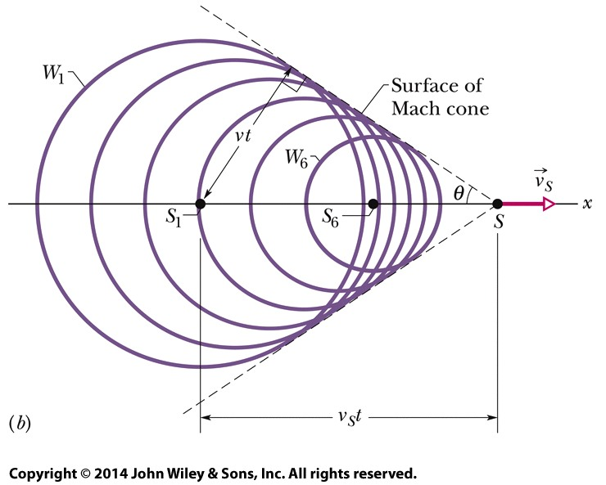
17-8 Supersonic Speeds, Shock Waves
If the speed of a source relative to the medium exceeds the speed of sound in the medium, the Doppler equation no longer applies. In such a case, shock waves result. The half-angle θ of the Mach cone is given by
A source S moves at speed v_{S} faster than the speed of sound and thus faster than the wavefronts. When the source was at position S₁ it generated wavefront W₁, and at position S₆ it generated W₆. All the spherical wavefronts expand at the speed of sound v and bunch along the surface of a cone called the Mach cone, forming a shock wave. The surface of the cone has half-angle θ and is tangent to all the wavefronts.

Slide 26
17 Summary
Sound Waves
Speed of sound waves in a medium having bulk modulus and density
Sound Intensity
The intensity at a distance r from a point source that emits sound waves of power Ps is
Eq. (17-3)
Eq. (17-28)
Interference
If the sound waves were emitted in phase and are traveling in approximately the same direction, ϕ is given by
Sound Level in Decibel
The sound level b in decibels (dB) is defined as where I₀ (= 10⁻¹² W/m²) is a reference intensity
Eq. (17-29)
Eq. (17-21)

Slide 27
17 Summary
Standing Waves in Pipes
A pipe open at both ends
A pipe closed at one end and open at the other
Sound Intensity
The half-angle θ of the Mach cone is given by
Eq. (17-39)
Eq. (17-57)
Eq. (17-41)
The Doppler Effect
For sound the observed frequency ƒ’ is given in terms of the source frequency ƒ by
Eq. (17-47)

