Slide 1

Chapter 12
Equilibrium and Elasticity
Notes:
1

Slide 2
12-1 Equilibrium
Learning Objectives
12.01 Distinguish between equilibrium and static equilibrium.
12.02 Specify the four conditions for static equilibrium.
12.03 Explain center of gravity and how it relates to center of mass.
12.04 For a given distribution of particles, calculate the coordinates of the center of gravity and the center of mass.
Notes:
2

Slide 3
12-1 Equilibrium
We often want objects to be stable despite forces acting on them
Consider a book resting on a table, a puck sliding with constant velocity, a rotating ceiling fan, a rolling bicycle wheel with constant velocity
These objects have the characteristics that:
  The linear momentum of the center of mass is constant
  The angular momentum about the center of mass, or any other point, is constant
Notes:
3

Slide 4

12-1 Equilibrium
Such objects are in equilibrium
In this chapter we are largely concerned with objects that are not moving at all; P = L = 0
These objects are in static equilibrium
The only one of the examples from the previous page in static equilibrium is the book at rest on the table
Eq. (12-1)
Notes:
4

Slide 5
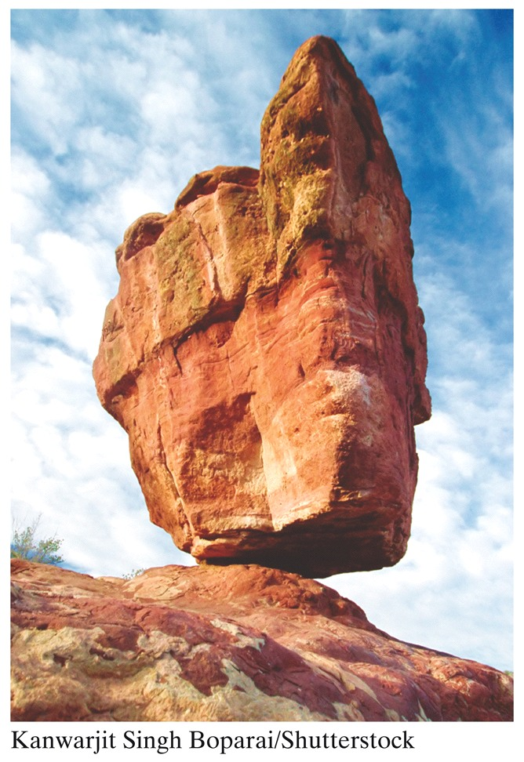
12-1 Equilibrium
As discussed in 8-3, if a body returns to static equilibrium after a slight displacement, it is in stable static equilibrium
If a small displacement ends equilibrium, it is unstable
Despite appearances, this rock is in stable static equilibrium, otherwise it would topple at the slightest gust of wind
Figure 12-1
Notes:
5

Slide 6
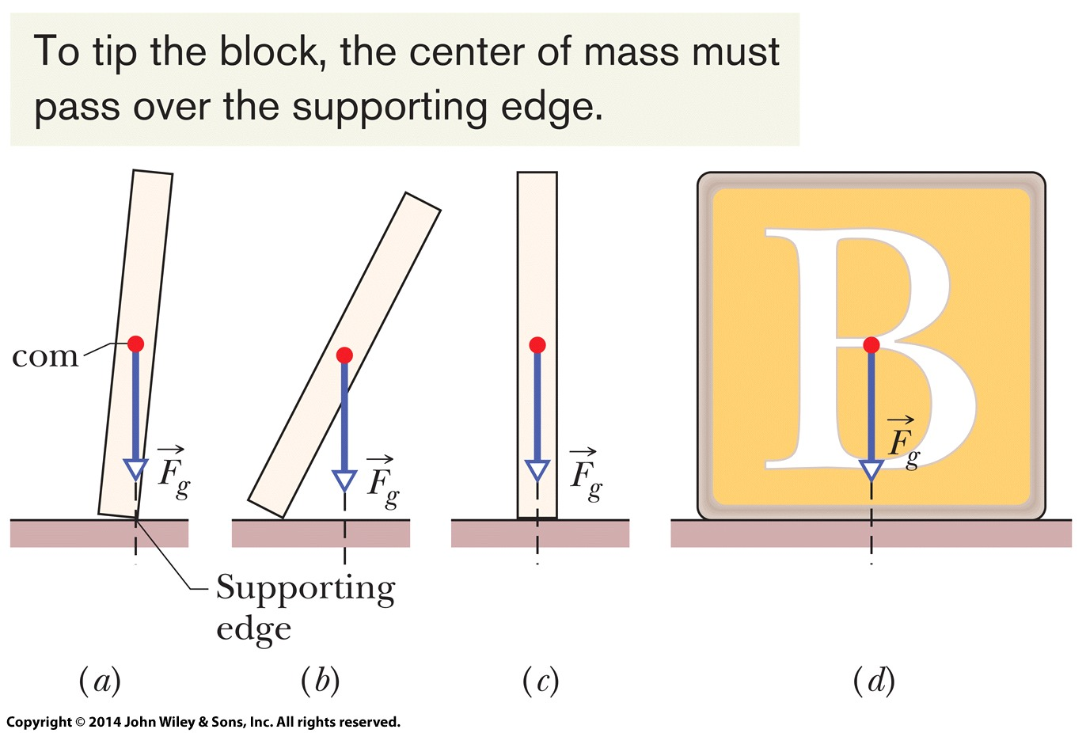
12-1 Equilibrium
In part (a) of the figure, we have unstable equilibrium
A small force to the right results in (b)
In (c) equilibrium is stable, but push the domino so it passes the position shown in (a) and it falls
The block in (d) is even more stable
Figure 12-2
Notes:
6

Slide 7


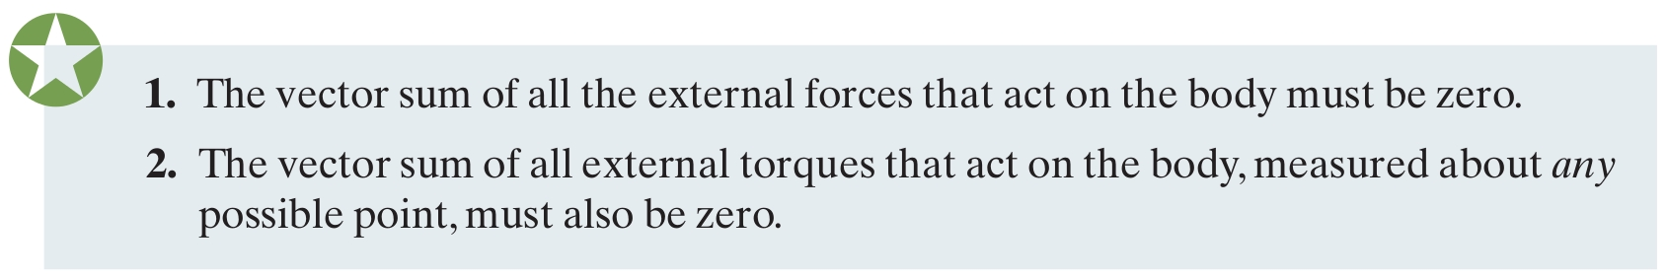
12-1 Equilibrium
Requirements for equilibrium are given by Newton's second law, in linear and rotational form
Therefore we have for equilibrium:
Eq. (12-3)
Eq. (12-5)
Notes:
7

Slide 8



12-1 Equilibrium
We often simplify matters by considering forces only in the xy plane, giving:
Note that for static equilibrium we have the additional requirements that:
  4. The angular momentum of the body L must be zero.
Eq. (12-7)
Eq. (12-8)
Eq. (12-9)
Notes:
8

Slide 9
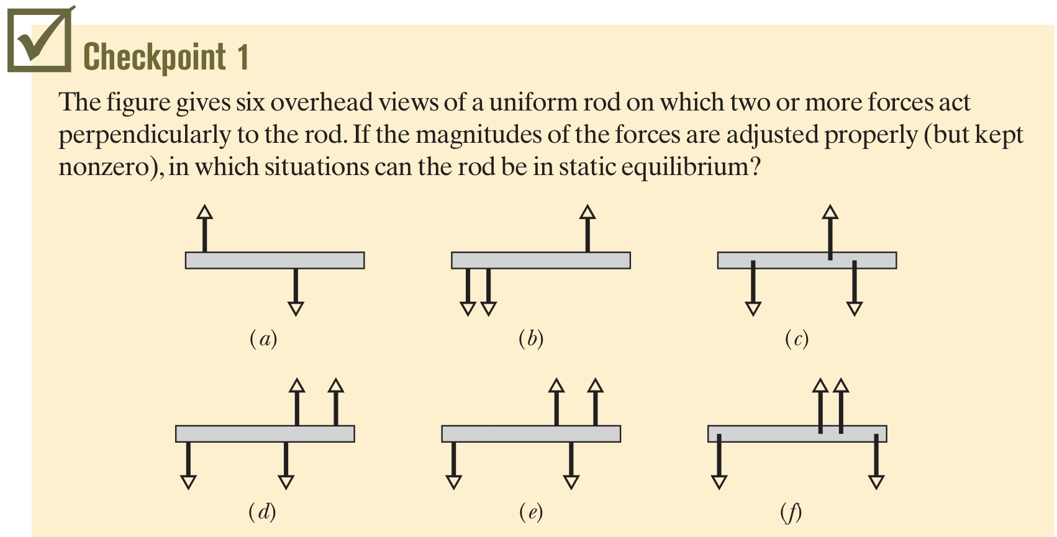
12-1 Equilibrium
Answer: (c), (e), (f)
Notes:
9

Slide 10
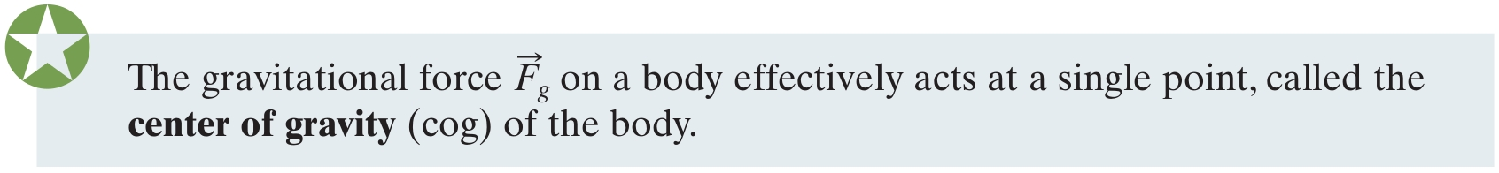
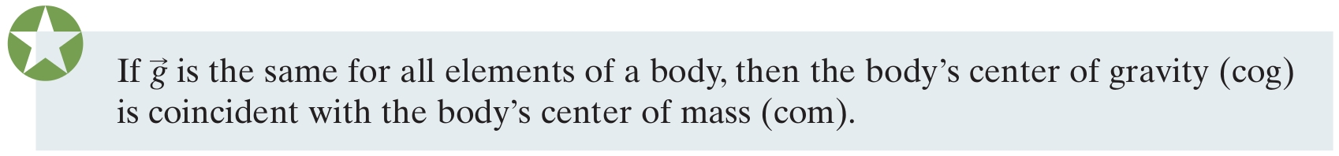
12-1 Equilibrium
The gravitational force on a body is the sum of gravitational forces acting on individual elements (atoms) of the body
We can simplify this by saying:
Until now we have assumed that the gravitational force acts at the center of mass
This is approximately true for the everyday case:
Notes:
10

Slide 11
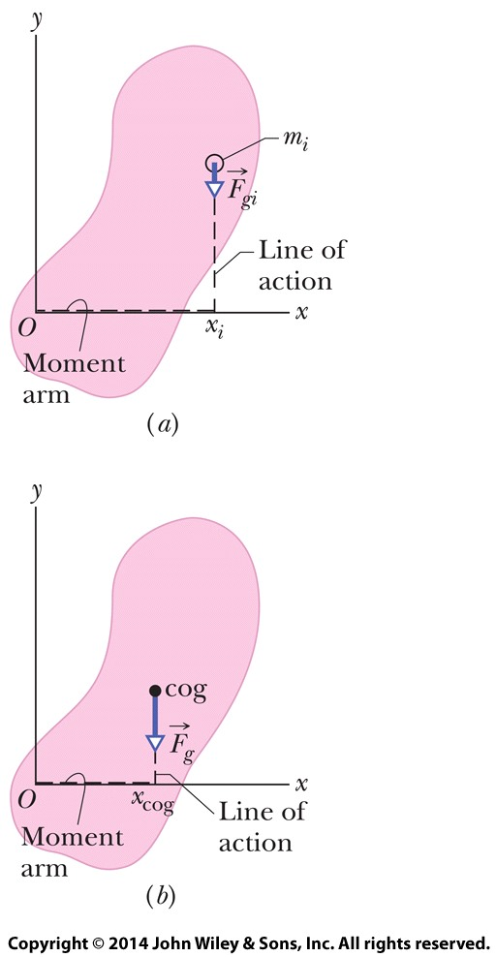

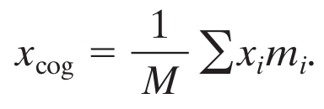
12-1 Equilibrium
We can show this by considering a sum of torques on each element vs. the torque caused by the gravitational force at the cog
Substitute m_{i}g_{i} for F_{gi}
Cancel g (= g_{i} for all i)and divide by the total mass, leaving:
The term on the right is the com
Eq. (12-16)
Figure 12-4
Notes:
11

Slide 12
12-2 Some Examples of Static Equilibrium
Learning Objectives
12.05 Apply the force and torque conditions for static equilibrium.
12.06 Identify that a wise choice about the placement of the origin (about which to calculate torques) can simplify the calculations by eliminating one or more unknown forces from the torque equation.
Notes:
12

Slide 13
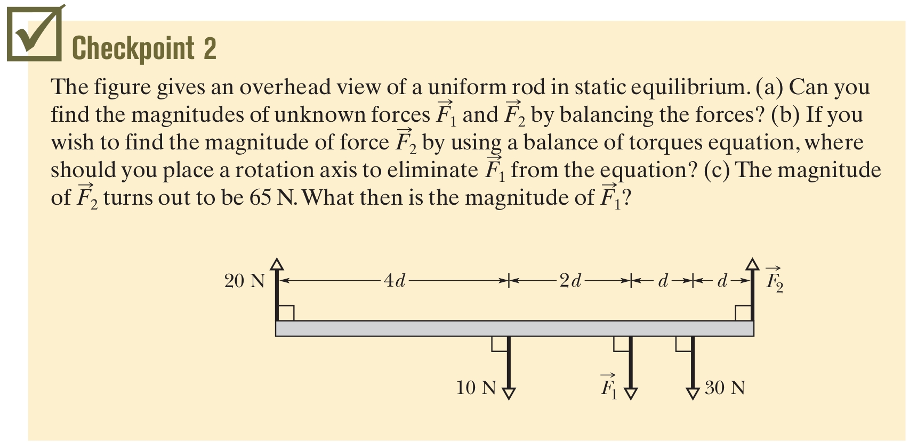
12-2 Some Examples of Static Equilibrium
This section consists of example problems, for forces in the xy plane
Answer: (a) No (b) place the rotation axis at the location where F1 is applied to the beam (c) 45 N
Notes:
13

Slide 14
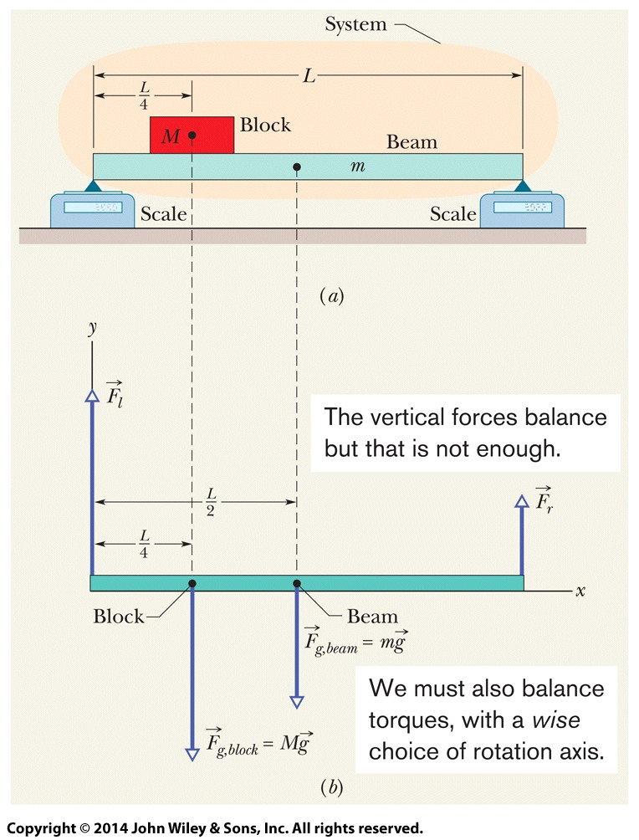
12-2 Some Examples of Static Equilibrium
Example Balancing a horizontal beam
  M = 2.7 kg, m = 1.8 kg
  Set rotation axis at x = 0
  Sum torques
  ¼ Mg L+ ½ mgL = F_{r}L
  so F_{r}= 15 N
  Balance vertical forces
    F_{l} = (M + m)g – F_{r}
    = 29 N
Figure 12-5
Notes:
14

Slide 15
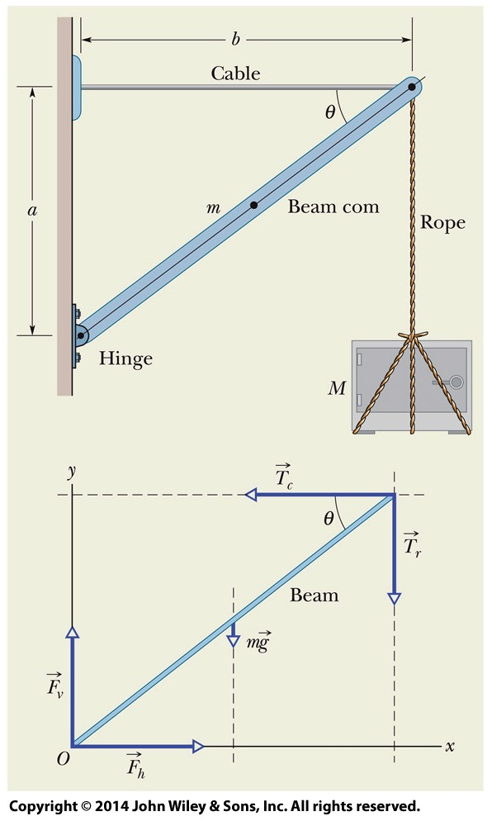
12-2 Some Examples of Static Equilibrium
Example Balancing a leaning boom:
Find the tension in the cable, in the rope
and the size of force F by the hinge.
M = 430 kg, m = 85 kg, a = 1.9 m, b = 2.5 m
  Set rotation axis at x = 0, y = 0
  Sum torques (using T_{r} = Mg)
    a T_{c} – b T_{r} – ½ b mg = 0
    T_{c} = 6100 N N
  Balance forces
    F_{h} = T_{c} = 6100 N
    F_{v} = (m + M) g = 5050 N
    F = 7900 N
Figure 12-6
Notes:
15

Slide 16
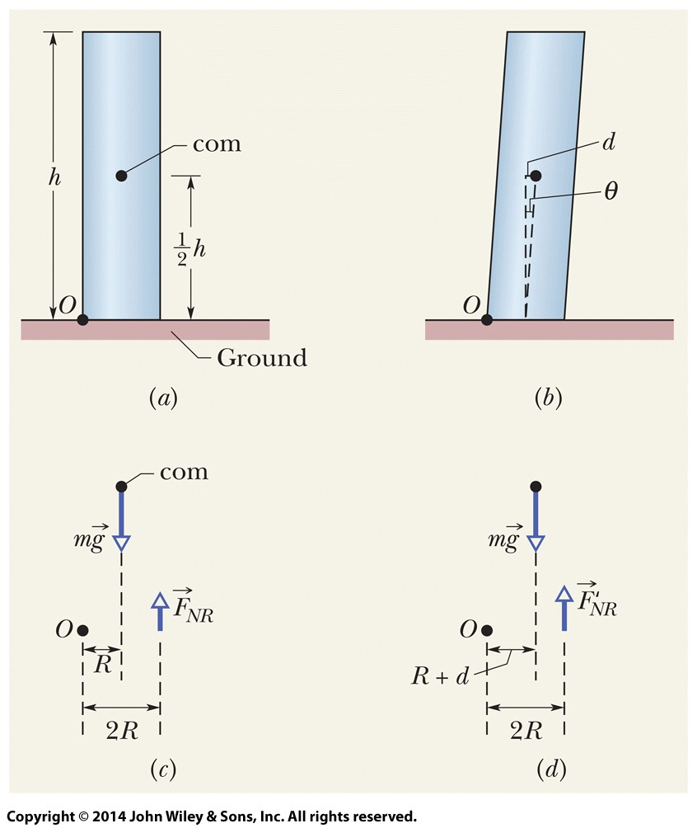
12-2 Some Examples of Static Equilibrium
Example Leaning Tower of Pisa
  R = 9.8 m, h = 60 m, θ = 5.5°
  Model: supported by 2 forces, at left and right edges
  No lean: F_{NR} = ½ mg
  Lean shifts com by
    d = ½ h tan θ
  New force:
    F'_{NR} = (R + d)mg / 2R
  Force increases by 30%
    F'_{NR}/F_{NR} = 1.29
Figure 12-8
Notes:
16

Slide 17
12-3 Elasticity
Learning Objectives
12.07 Explain what an indeterminate situation is.
12.08 For tension and compression, apply the equation that relates stress to strain and Young's modulus.
12.09 Distinguish between yield strength and ultimate strength.
12.10 For shearing, apply the equation that relates stress to strain and the shear modulus.
12.11 For hydraulic stress, apply the equation that relates fluid pressure to strain and the bulk modulus.
Notes:
17

Slide 18
12-3 Elasticity
For problems in the xy plane we have 3 independent equations
Therefore we can solve for 3 unknowns
If we have more unknown forces, we cannot solve for them and the situation is indeterminate
This assumes that bodies are rigid and do not deform (there are no such bodies)
With some knowledge of elasticity, we can solve more problems
Notes:
18

Slide 19
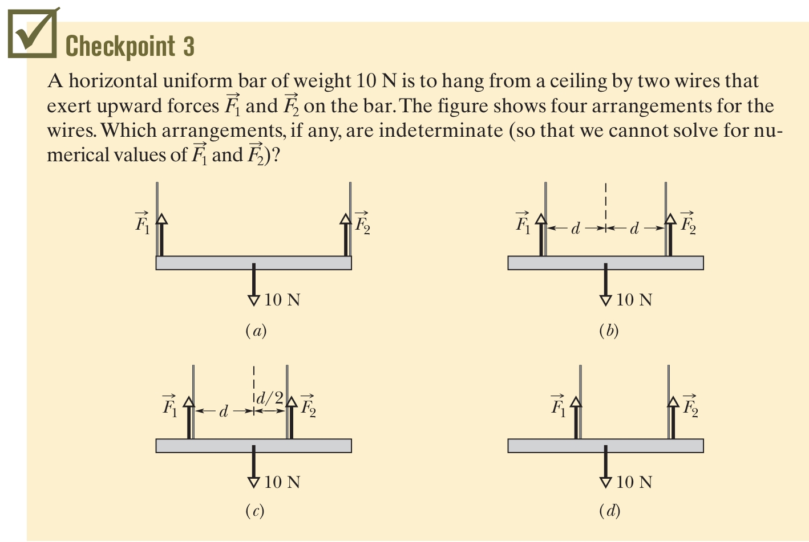
12-3 Elasticity
Answer: (d)
Notes:
19

Slide 20
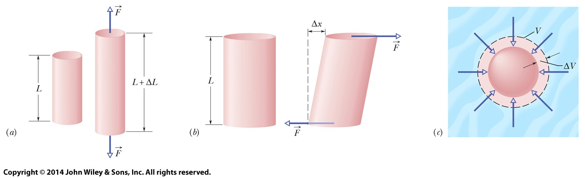
12-3 Elasticity
All rigid bodies are partially elastic, meaning we can change their dimensions by applying forces
A stress, deforming force per unit area, produces a strain, or unit deformation
There are 3 main types of stress:
  Tensile (a), Shearing (b), Hydraulic ©
Figure 12-11
Notes:
20

Slide 21

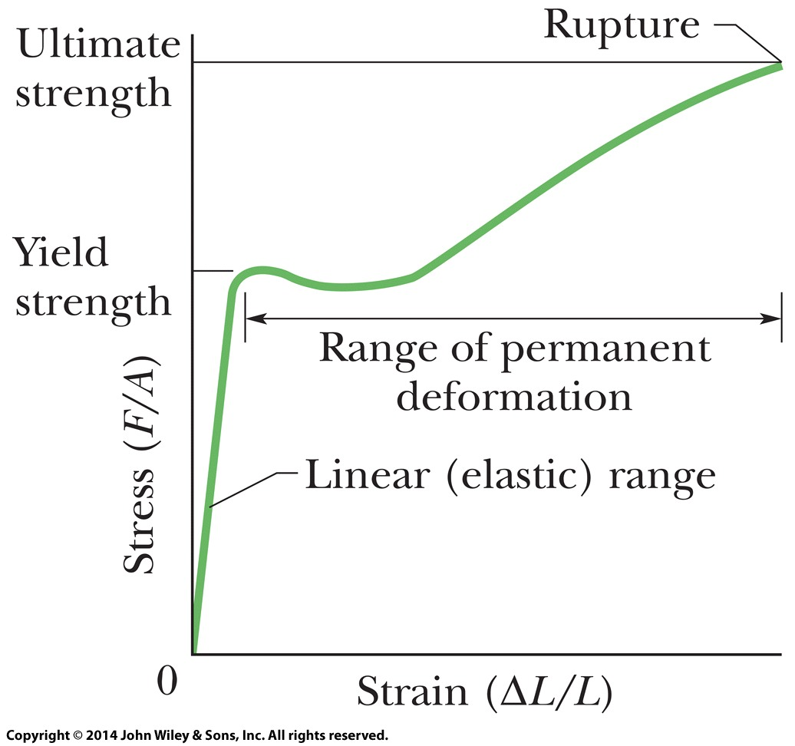
12-3 Elasticity
Stress and strain are proportional in the elastic range
Related by the modulus of elasticity:
As stress increases, eventually a yield strength is reached and the material deforms permanently
At the ultimate strength,
the material breaks
Eq. (12-22)
Figure 12-13
Notes:
21

Slide 22
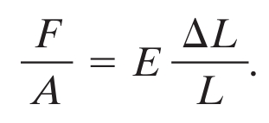
12-3 Elasticity
In simple tension/compression, stress is F/A
The strain is the dimensionless quantity ΔL/L
Young's modulus, E, used for tension/compression
Note that many materials have very different tensile and compressive strengths, despite the same modulus being used for both
E.g., concrete: high compressive strength, very low tensile strength
Eq. (12-23)
Notes:
22

Slide 23
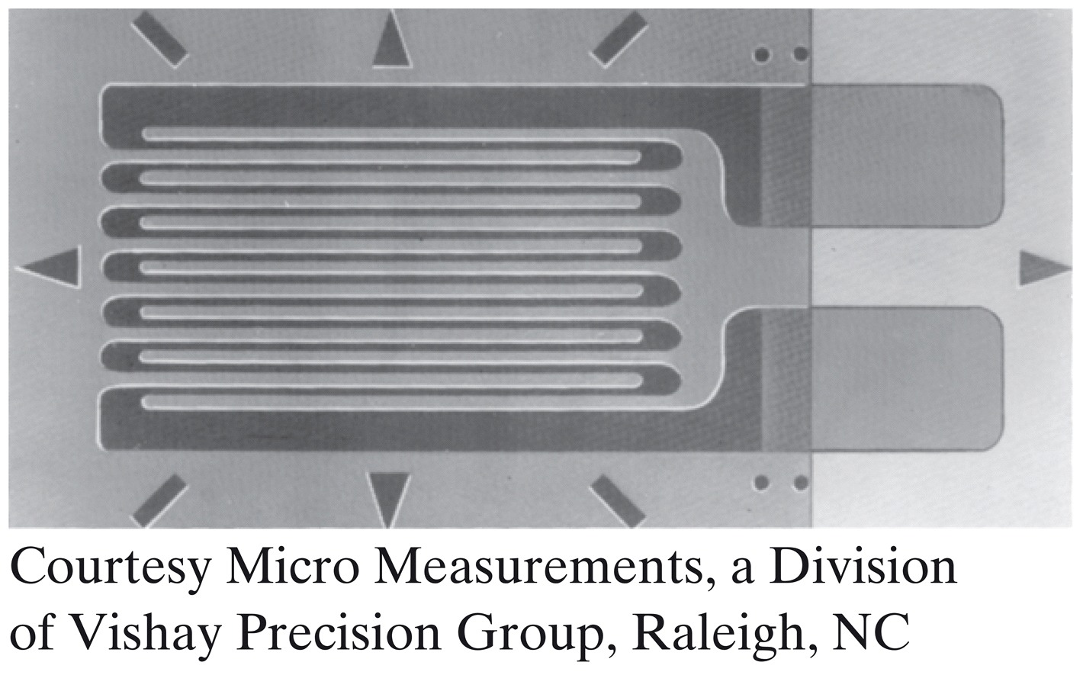
12-3 Elasticity
Strain can be measured by a strain gage
Placed on the material, it becomes subject to the same strain
Strain can be read out as a change in electrical resistance, for strains up to 3%
Figure 12-14
Notes:
23

Slide 24
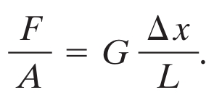
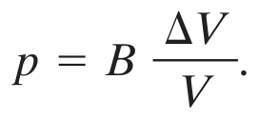
12-3 Elasticity
Shear modulus, G, used for shearing
Δx is along a different axis than L
Bulk modulus, B, used for hydraulic compression
Relates pressure to volume change
Eq. (12-24)
Eq. (12-25)
Notes:
24

Slide 25
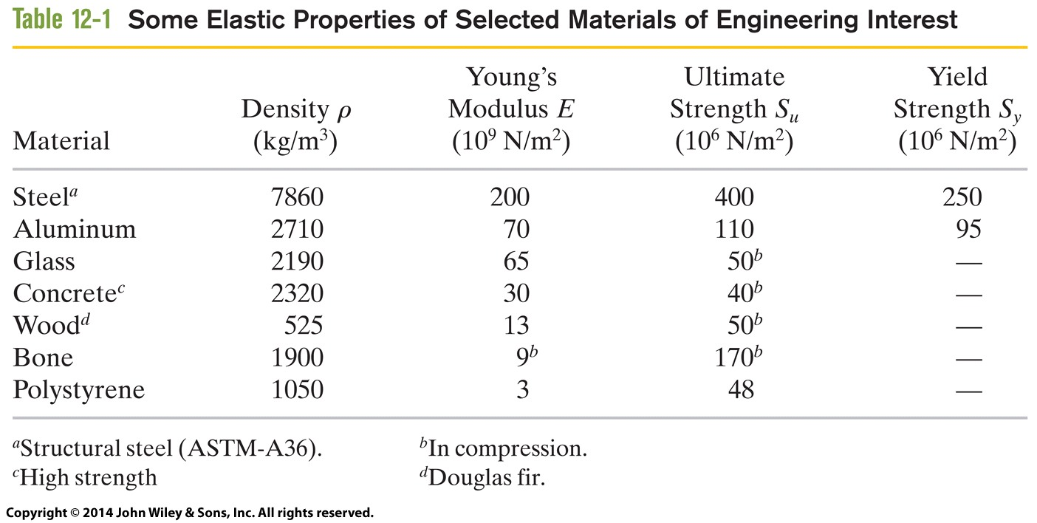
12-3 Elasticity
The table shows some elastic properties for common materials, for comparison purposes
Table 12-1
Notes:
25

Slide 26
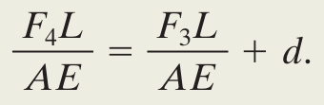
12-3 Elasticity
Example Balancing a wobbly table
  Three legs of 1.00 m, a fourth longer by 0.50 mm
  Compressed by M = 290 kg so all four legs are compressed but not buckled and the table does not wobble
  Legs are wooden cylinders with area A = 1.0 sq cm
  E = 1.3 x 10¹⁰ N/m²
  The 3 shorter legs must compress the same amount, the longer leg compresses more
  Write length comparison, use the stress-strain equation, and approximate all legs to be length L
Eq. (12-27)
Notes:
26

Slide 27

12-3 Elasticity
Example Balancing a wobbly table (continued)
  Get a second equation by balancing forces
  Solve the simultaneous equations to find
    F₃ = 550 N
    F₄ = 1200 N
  Each short leg is compressed by 0.42 mm, and the long leg is compressed by 0.92 mm
Eq. (12-28)
Notes:
27

Slide 28
12 Summary
Static Equilibrium
Center of Gravity
If the gravitational acceleration is the same for all elements of the body, the cog is at the com.
Eq. (12-3)
Eq. (12-5)
Elastic Moduli
Three elastic moduli
Strain: fractional length change
Stress: force per unit area
Tension and Compression
E is Young's modulus
Eq. (12-23)
Eq. (12-22)
Notes:
28

Slide 29
12 Summary
Shearing
G is the shear modulus
Hydraulic Stress
B is the bulk modulus
Eq. (12-24)
Eq. (12-25)
Notes:
29

