Slide 1

Chapter 10
Rotation
Notes:
1

Slide 2
10-1 Rotational Varibles
Learning Objectives
10.01 Identify that if all parts of a body rotate around a fixed axis locked together, the body is a rigid body.
10.02 Identify that the angular position of a rotating rigid body is the angle that an internal reference line makes with a fixed, external reference line.
10.03 Apply the relationship between angular displacement and the initial and final angular positions.
10.04 Apply the relationship between average angular velocity, angular displacement, and the time interval for that displacement.
10.05 Apply the relationship between average angular acceleration, change in angular velocity, and the time interval for that change.
Notes:
2

Slide 3
10.06 Identify that counterclockwise motion is in the positive direction and clockwise motion is in the negative direction.
10.07 Given angular position as a function of time, calculate the instantaneous angular velocity at any particular time and the average angular velocity between any two particular times.
10.08 Given a graph of angular position versus time, determine the instantaneous angular velocity at a particular time and the average angular velocity between any two particular times.
10.09 Identify instantaneous angular speed as the magnitude of the instantaneous angular velocity.

Slide 4
10.10 Given angular velocity as a function of time, calculate the instantaneous angular acceleration at any particular time and the average angular acceleration between any two particular times.
10.11 Given a graph of angular velocity versus time, determine the instantaneous angular acceleration at any particular time and the average angular acceleration between any two particular times.
10.12 Calculate a body’s change in angular velocity by integrating its angular acceleration function with respect to time.
10.13 Calculate a body’s change in angular position by integrating its angular velocity function with respect to time.

Slide 5
10-1 Rotational Variables
We now look at motion of rotation
We will find the same laws apply
But we will need new quantities to express them
Torque
Rotational inertia
A rigid body rotates as a unit, locked together
We look at rotation about a fixed axis
These requirements exclude from consideration:
The Sun, where layers of gas rotate separately
A rolling bowling ball, where rotation and translation occur
Notes:
5

Slide 6
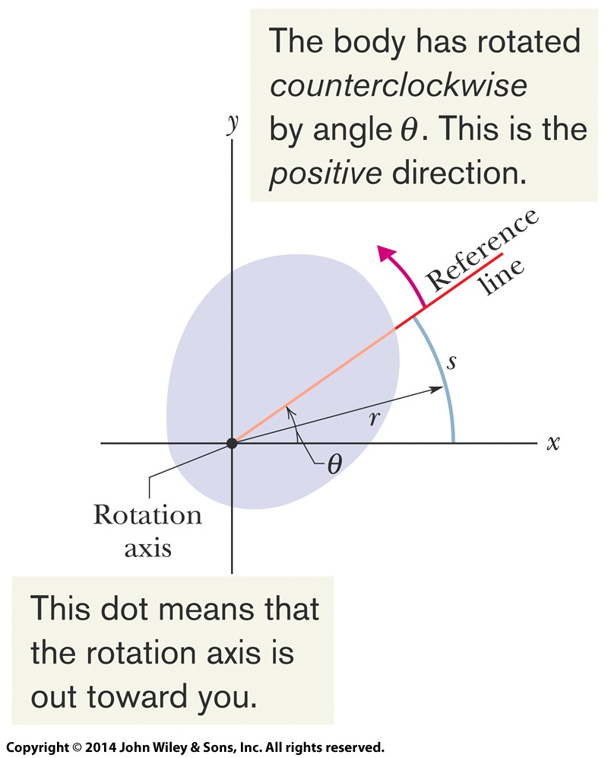
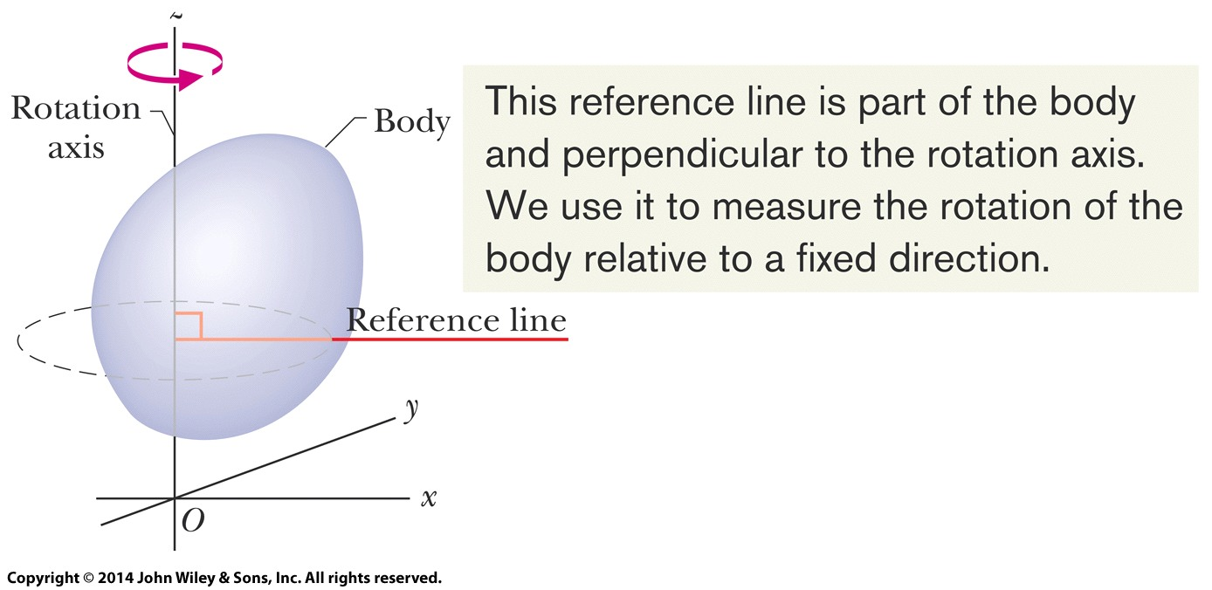
10-1 Rotational Variables
The fixed axis is called the axis of rotation
Figs 10-2, 10-3 show a reference line
The angular position of this line (and of the object) is taken relative to a fixed direction, the zero angular position
Figure 10-2
Figure 10-3
Notes:
6

Slide 7
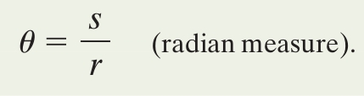
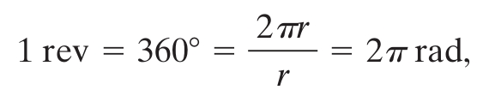

10-1 Rotational Variables
Measure using radians (rad): dimensionless
Do not reset θ to zero after a full rotation
We know all there is to know about the kinematics of rotation if we have θ(t) for an object
Define angular displacement as:
Eq. (10-1)
Eq. (10-2)
Eq. (10-4)
Notes:
7

Slide 8

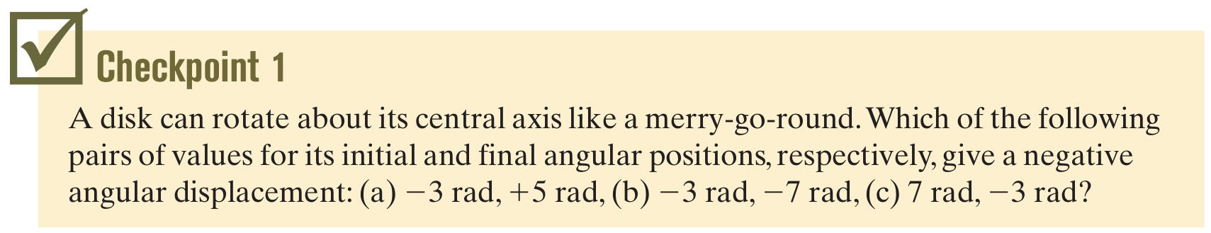
10-1 Rotational Variables
“Clocks are negative”:
Answer: Choices (b) and (c)
Notes:
8

Slide 9
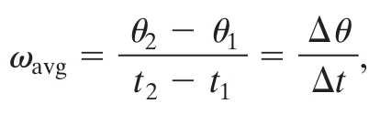
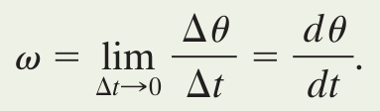
10-1 Rotational Variables
Average angular velocity: angular displacement during a time interval
Instantaneous angular velocity: limit as Δt → 0
If the body is rigid, these equations hold for all points on the body
Magnitude of angular velocity = angular speed
Eq. (10-5)
Eq. (10-6)
Notes:
9

Slide 10
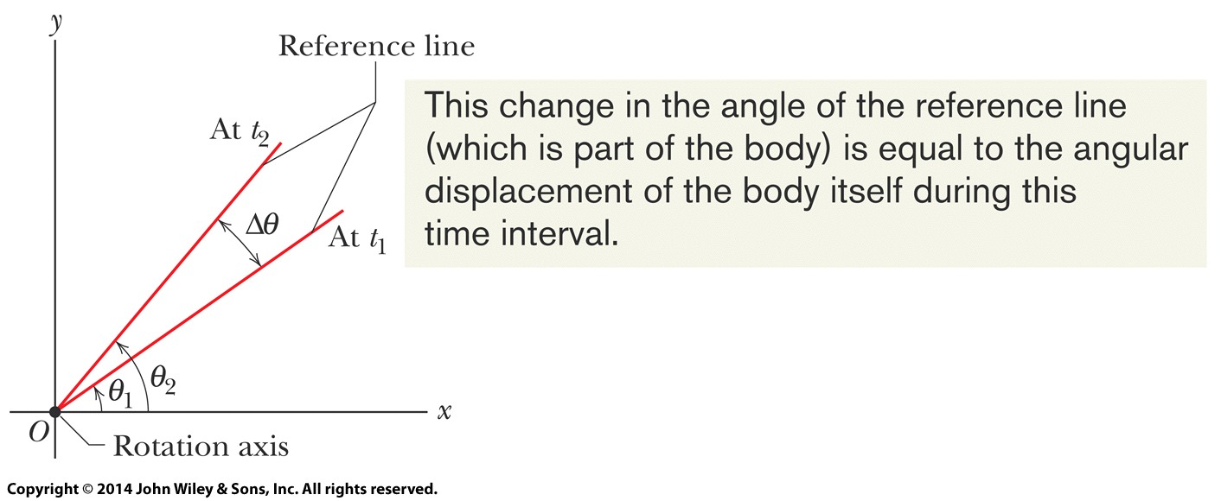
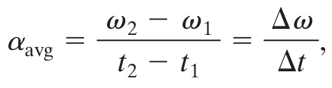
10-1 Rotational Variables
Figure 10-4 shows the values for a calculation of average angular velocity
Figure 10-4
Average angular acceleration: angular velocity change during a time interval
Eq. (10-7)
Notes:
10

Slide 11
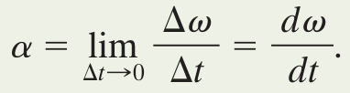
10-1 Rotational Variables
Instantaneous angular velocity: limit as Δt → 0
If the body is rigid, these equations hold for all points on the body
With right-hand rule to determine direction, angular velocity & acceleration can be written as vectors
If the body rotates around the vector, then the vector points along the axis of rotation
Angular displacements are not vectors, because the order of rotation matters for rotations around different axes
Eq. (10-8)
Notes:
11

Slide 12
10-2 Rotation with Constant Angular Acceleration
Learning Objectives
10.14 For constant angular acceleration, apply the relationships between angular position, angular displacement, angular velocity, angular acceleration, and elapsed time (Table 10-1).
Notes:
12

Slide 13
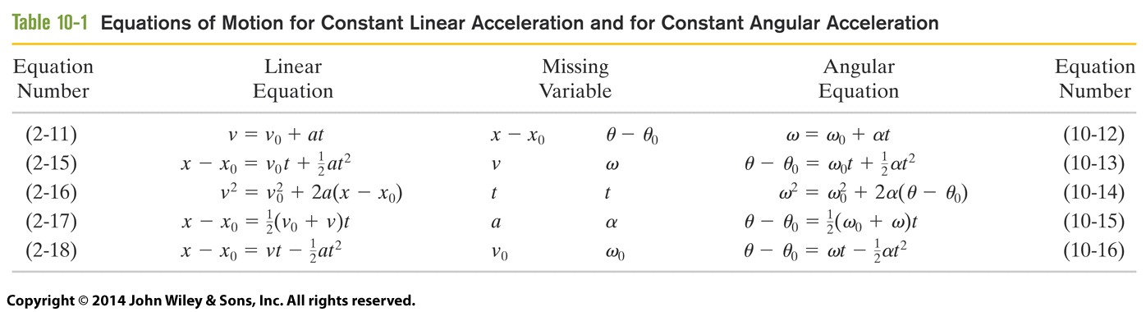
10-2 Rotation with Constant Angular Acceleration
The same equations hold as for constant linear acceleration, see Table 10-1
We simply change linear quantities to angular ones
Eqs. 10-12 and 10-13 are the basic equations: all others can be derived from them
Table 10-1
Notes:
13

Slide 14
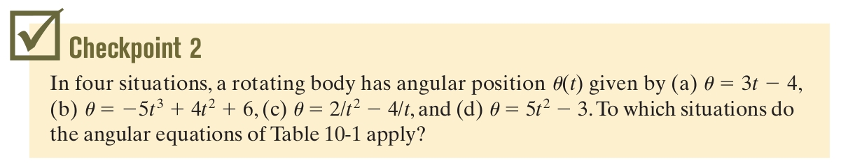
10-2 Rotation with Constant Angular Acceleration
Answer: Situations (a) and (d); the others do not have constant angular acceleration
Notes:
14

Slide 15
10-3 Relating the Linear and Angular Variables
Learning Objectives
10.15 For a rigid body rotating about a fixed axis, relate the angular variables of the body (angular position, angular velocity, and angular acceleration) and the linear variables of a particle on the body (position, velocity, and acceleration) at any given radius.
10.16 Distinguish between tangential acceleration and radial acceleration, and draw a vector for each in a sketch of a particle on a body rotating about an axis, for both an increase in angular speed and a decrease.
Notes:
15

Slide 16


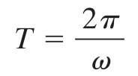
10-3 Relating the Linear and Angular Variables
Linear and angular variables are related by r, perpendicular distance from the rotational axis
Position (note θ must be in radians):
Speed (note ω must be in radian measure):
We can express the period in radian measure:
Eq. (10-17)
Eq. (10-18)
Eq. (10-20)
Notes:
16

Slide 17
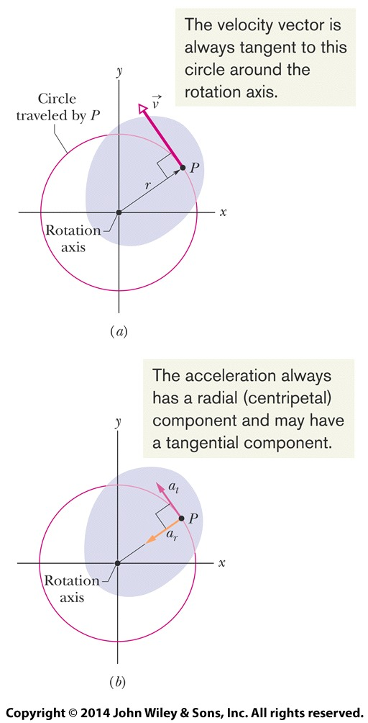

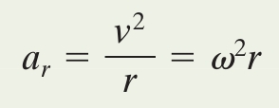
10-3 Relating the Linear and Angular Variables
Tangential acceleration (radians):
We can write the radial acceleration in terms of angular velocity (radians):
Eq. (10-22)
Eq. (10-23)
Figure 10-9
Notes:
17

Slide 18
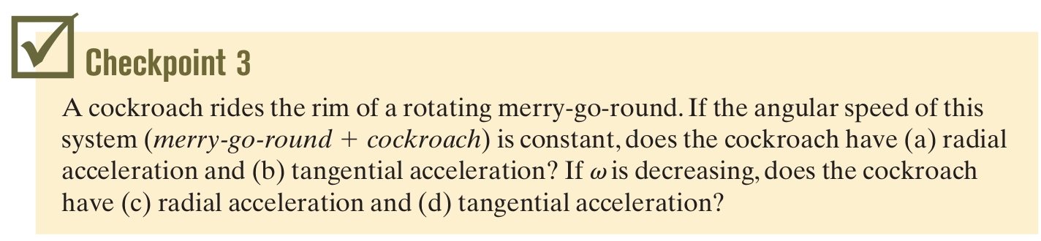
10-3 Relating the Linear and Angular Variables
Answer: (a) yes (b) no (c) yes (d) yes
Notes:
18

Slide 19
10-4 Kinetic Energy of Rotation
Learning Objectives
10.17 Find the rotational inertia of a particle about a point.
10.18 Find the total rotational inertia of many particles moving around the same fixed axis.
10.19 Calculate the rotational kinetic energy of a body in terms of its rotational inertia and its angular speed.
Notes:
19

Slide 20

10-4 Kinetic Energy of Rotation
Apply the kinetic energy formula for a point particle and sum over all the particles K = Σ ½m_{i}v_{i}²
different linear velocities (same angular velocity for all particles but possibly different radii )
Then write velocity in terms of angular velocity: We call the quantity in parentheses on the right side the rotational inertia, or moment of inertia, I
This is a constant for a rigid object and given rotational axis
Caution: the axis for I must always be specified
Eq. (10-32)
Notes:
20

Slide 21


10-4 Kinetic Energy of Rotation
We can write:
And rewrite the kinetic energy as:
Use these equations for a finite set of rotating particles
Rotational inertia corresponds to how difficult it is to change the state of rotation (speed up, slow down or change the axis of rotation)
Eq. (10-33)
Eq. (10-34)
Notes:
21

Slide 22
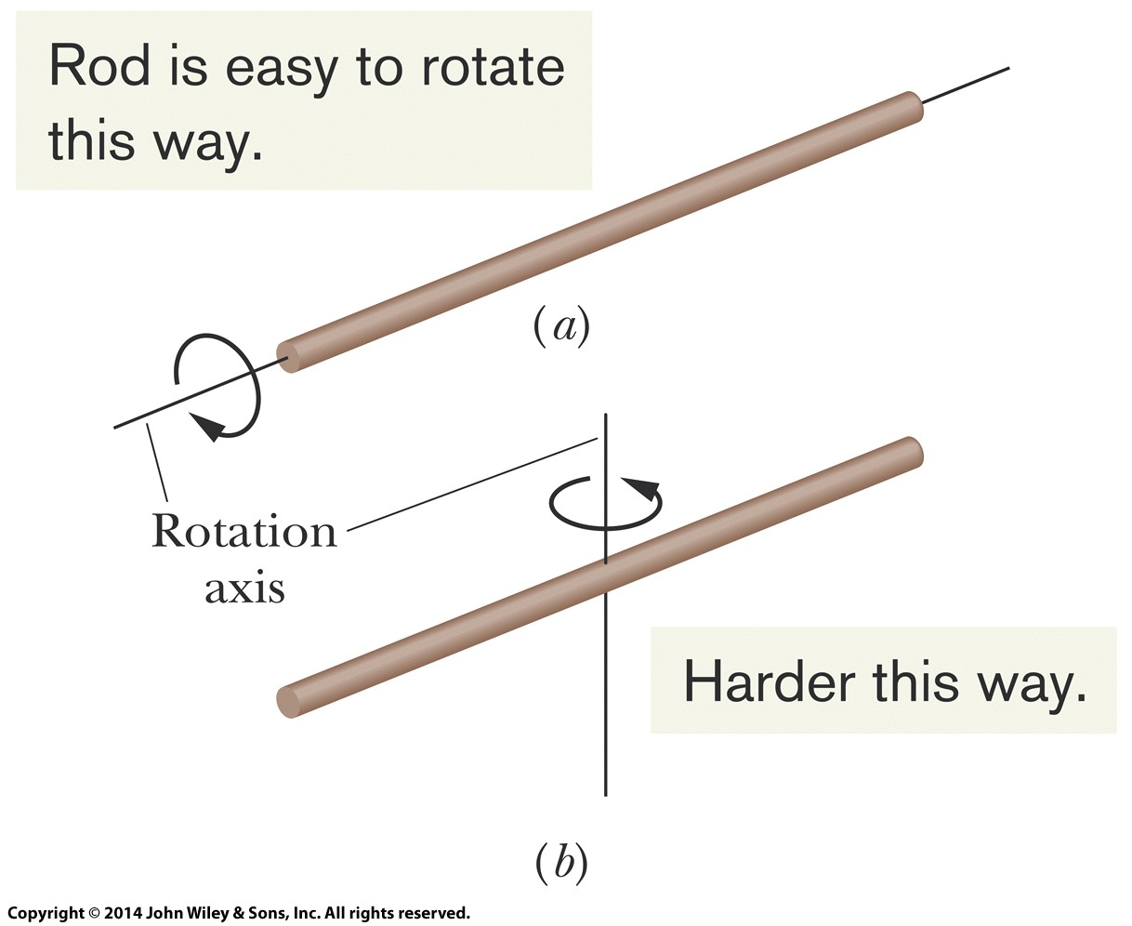
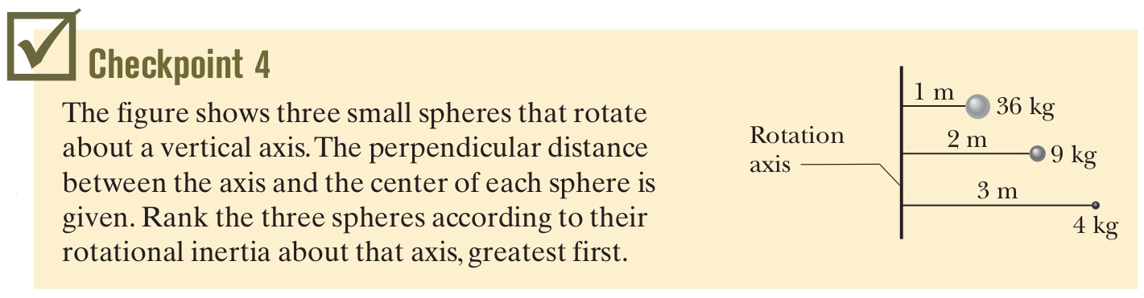
10-4 Kinetic Energy of Rotation
Figure 10-11
Answer: They are all equal!
Notes:
22

Slide 23
10-5 Calculating the Rotational Inertia
Learning Objectives
10.20 Determine the rotational inertia of a body if it is given in Table 10-2.
10.21 Calculate the rotational inertia of body by integration over the mass elements of the body.
10.22 Apply the parallel-axis theorem for a rotation axis that is displaced from a parallel axis through the center of mass of a body.
Notes:
23

Slide 24
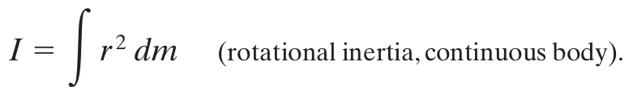
10-5 Calculating the Rotational Inertia
Integrating Eq. 10-33 over a continuous body:
In principle we can always use this equation
But there is a set of common shapes for which values have already been calculated (Table 10-2) for common axes
Eq. (10-35)
Notes:
24

Slide 25
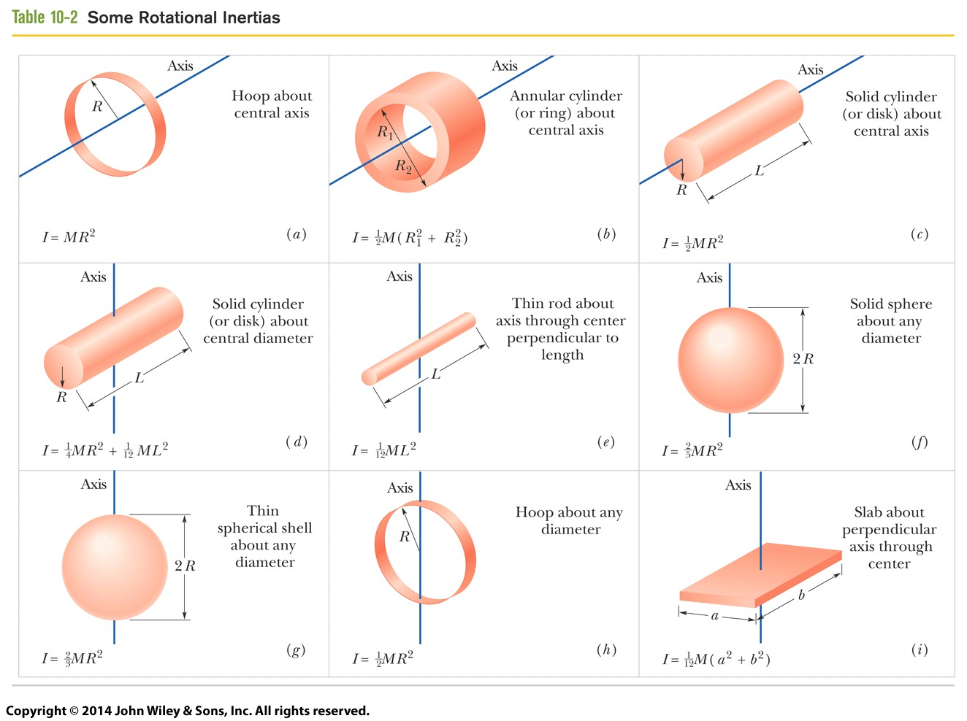
10-5 Calculating the Rotational Inertia
Table 10-2
Notes:
25

Slide 26
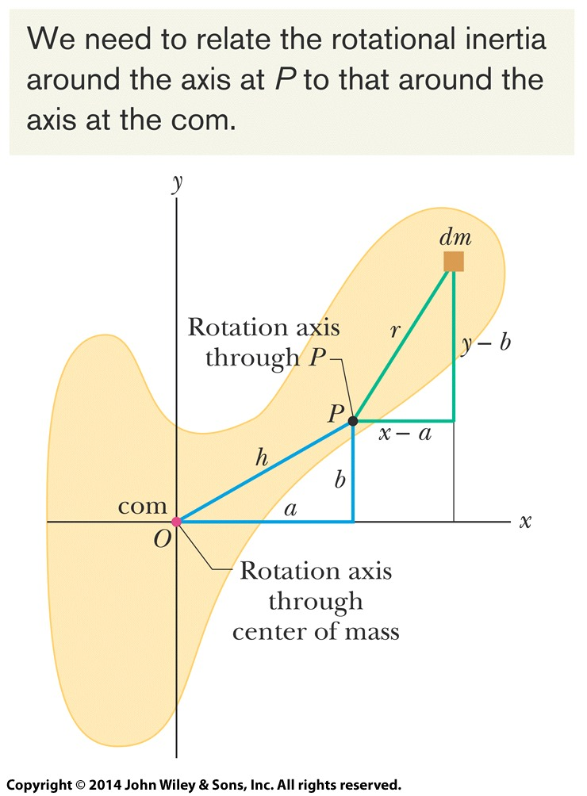

10-5 Calculating the Rotational Inertia
If we know the moment of inertia for the center of mass axis, we can find the moment of inertia for a parallel axis with the parallel-axis theorem:
Eq. (10-36)
Note the axes must be parallel, and the first must go through the center of mass
This does not relate the moment of inertia for two arbitrary axes
Figure 10-12
Notes:
26

Slide 27
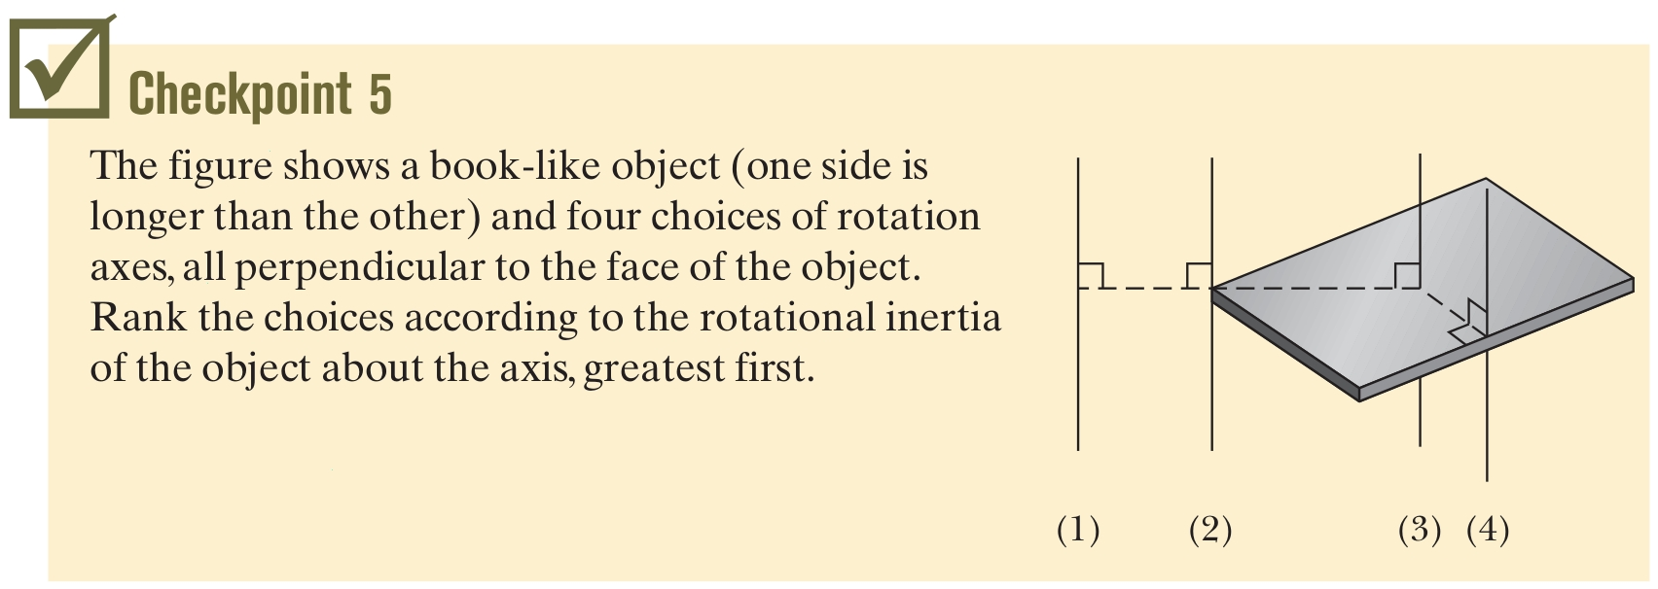
10-5 Calculating the Rotational Inertia
Answer: (1), (2), (4), (3)
Notes:
27

Slide 28

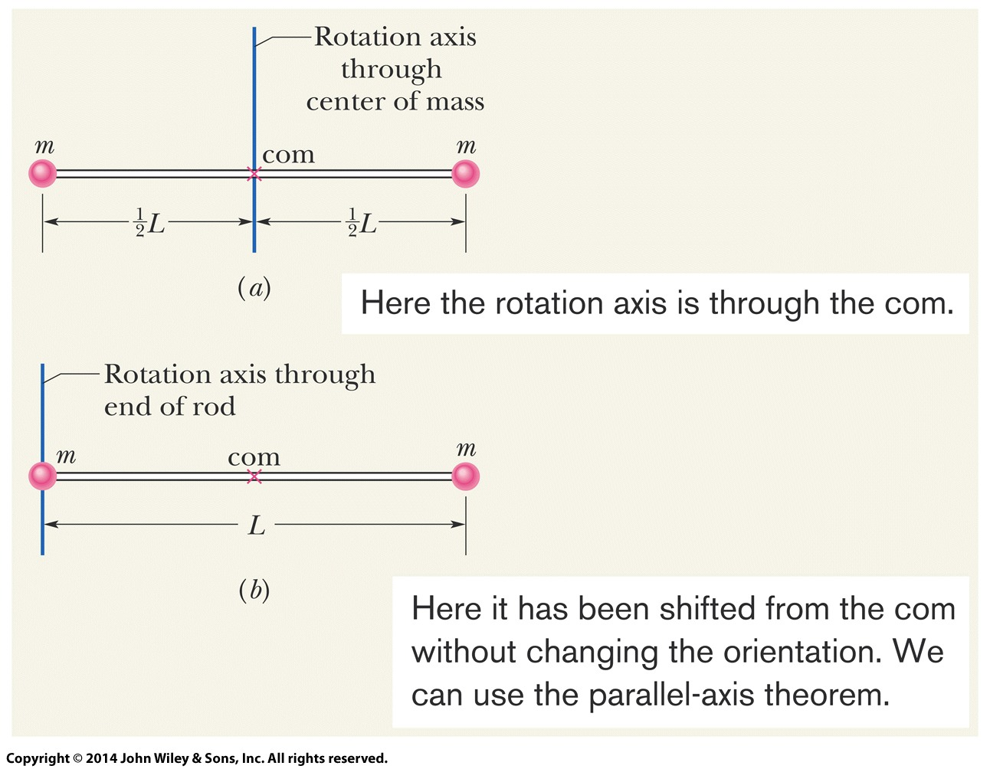
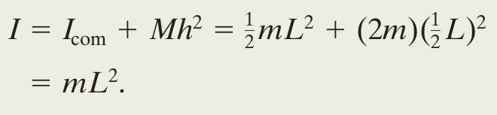
10-5 Calculating the Rotational Inertial
Example Calculate the moment of inertia for Fig. 10-13 (b)
Summing by particle:
Use the parallel-axis theorem
Figure 10-13
Notes:
28

Slide 29
10-6 Torque
Learning Objectives
10.25 Identify that a rotation axis must always be specified to calculate a torque.
10.26 Identify that a torque is assigned a positive or negative sign depending on the direction it tends to make the body rotate about a specified rotation axis: “clocks are negative.”
10.27 When more than one torque acts on a body about a rotation axis, calculate the net torque.
10.23 Identify that a torque on a body involves a force and a position vector, which extends from a rotation axis to the point where the force is applied.
10.24 Calculate the torque by using (a) the angle between the position vector and the force vector, (b) the line of action and the moment arm of the force, and (c) the force component perpendicular to the position vector.
Notes:
29

Slide 30
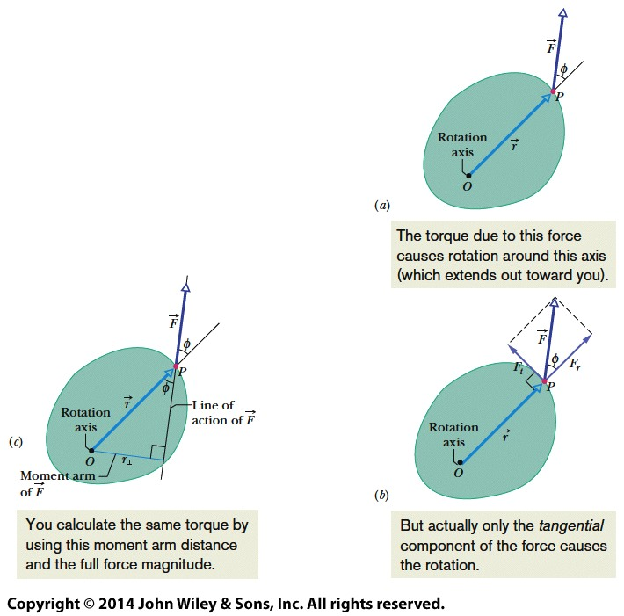
10-6 Torque
The force necessary to rotate an object depends on the angle of the force and where it is applied
We can resolve the force into components to see how it affects rotation
Figure 10-16
Notes:
30

Slide 31

10-6 Torque
Torque takes these factors into account:
A line extended through the applied force is called the line of action of the force
The perpendicular distance from the line of action to the axis is called the moment arm
The unit of torque is the newton-meter, N m
Note that 1 J = 1 N m, but torques are never expressed in joules, torque is not energy
Eq. (10-39)
Notes:
31

Slide 32
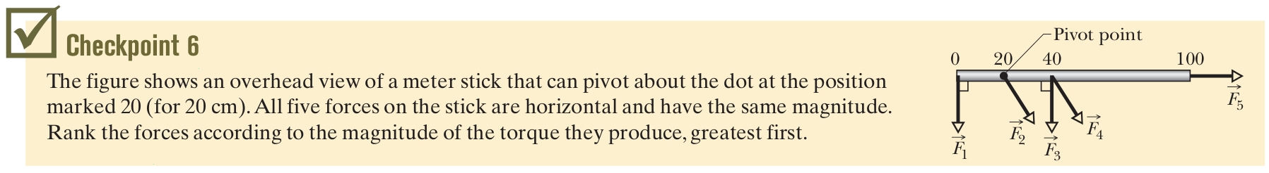
10-6 Torque
Again, torque is positive if it would cause a counterclockwise rotation, otherwise negative
For several torques, the net torque or resultant torque is the sum of individual torques
Answer: F₁ & F₃, F₄, F₂ & F₅
Notes:
32

Slide 33
10-7 Newton's Second Law for Rotation
Learning Objectives
10.28 Apply Newton's second law for rotation to relate the net torque on a body to the body's rotational inertia and rotational acceleration, all calculated relative to a specified rotation axis.
Notes:
33

Slide 34

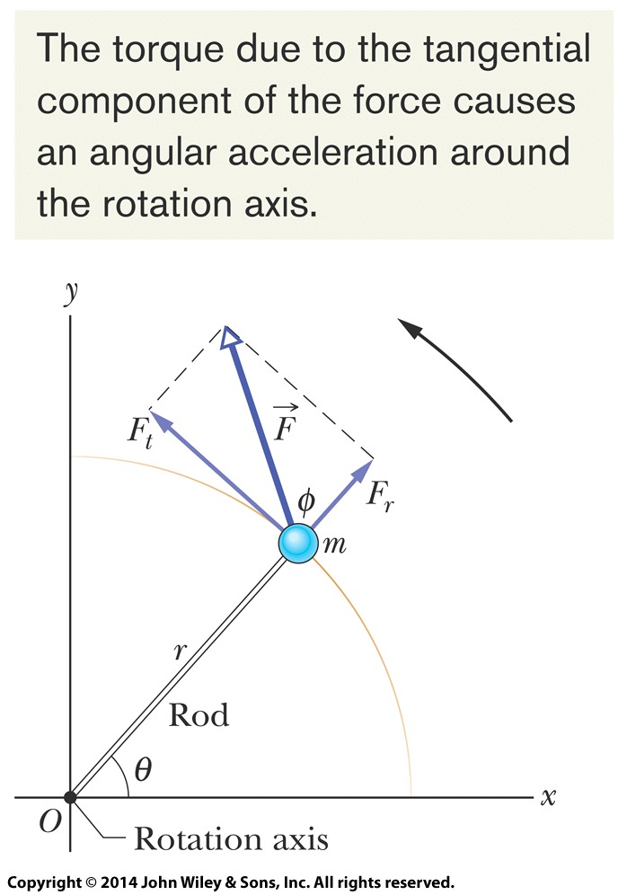
10-7 Newton's Second Law for Rotation
Rewrite F = ma with rotational variables:
Eq. (10-42)
It is torque that causes angular acceleration
Figure 10-17
Notes:
34

Slide 35
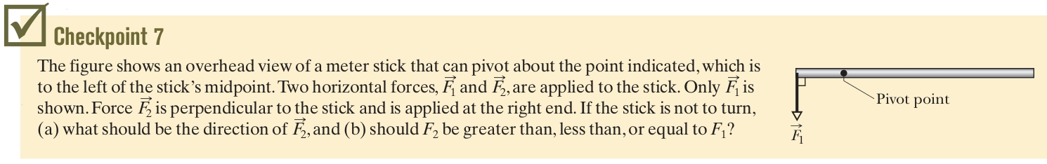
10-7 Newton's Second Law for Rotation
Answer: (a) F₂ should point downward, and
(b) should have a smaller magnitude than F₁
Notes:
35

Slide 36
10-8 Work and Rotational Kinetic Energy
Learning Objectives
10.29 Calculate the work done by a torque acting on a rotating body by integrating the torque with respect to the angle of rotation.
10.30 Apply the work-kinetic energy theorem to relate the work done by a torque to the resulting change in the rotational kinetic energy of the body.
10.31 Calculate the work done by a constant torque by relating the work to the angle through which the body rotates.
10.32 Calculate the power of a torque by finding the rate at which work is done.
10.33 Calculate the power of a torque at any given instant by relating it to the torque and the angular velocity at that instant.
Notes:
36

Slide 37
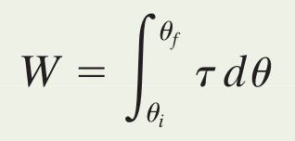
10-8 Work and Rotational Kinetic Energy
The rotational work-kinetic energy theorem states:
The work done in a rotation about a fixed axis can be calculated by:
Which, for a constant torque, reduces to:
Eq. (10-52)
Eq. (10-53)
Eq. (10-54)
Notes:
37

Slide 38
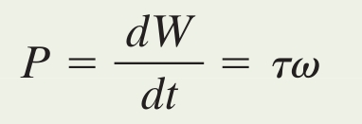
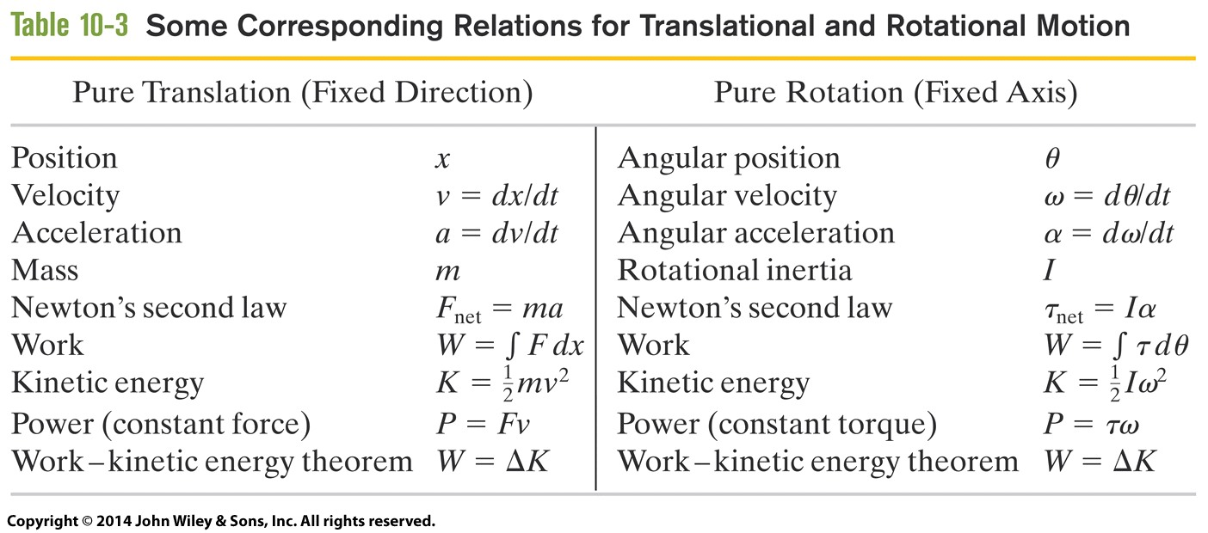
10-8 Work and Rotational Kinetic Energy
We can relate work to power with the equation:
Table 10-3 shows corresponding quantities for linear and rotational motion:
Eq. (10-55)
Tab. 10-3
Notes:
38

Slide 39
10 Summary
Angular Position
Measured around a rotation axis, relative to a reference line:
Angular Displacement
A change in angular position
Eq. (10-4)
Eq. (10-1)
Angular Velocity and Speed
Average and instantaneous values:
Angular Acceleration
Average and instantaneous values:
Eq. (10-5)
Eq. (10-7)
Eq. (10-6)
Eq. (10-8)
Notes:
39

Slide 40
10 Summary
Kinematic Equations
Given in Table 10-1 for constant acceleration
Match the linear case
Linear and Angular Variables Related
Linear and angular displacement, velocity, and acceleration are related by r
Rotational Kinetic Energy and Rotational Inertia
The Parallel-Axis Theorem
Relate moment of inertia around any parallel axis to value around com axis
Eq. (10-34)
Eq. (10-36)
Eq. (10-33)
Notes:
40

Slide 41
10 Summary
Torque
Force applied at distance from an axis:
Moment arm: perpendicular distance to the rotation axis
Newton's Second Law in Angular Form
Eq. (10-39)
Eq. (10-42)
Work and Rotational Kinetic Energy
Eq. (10-53)
Eq. (10-55)
Notes:
41

