Slide 1

Chapter 6
Force and Motion–II
Notes:
1

Slide 2
6-1 Friction
Learning Objectives
6.01 Distinguish between friction in a static situation and a kinetic situation.
6.02 Determine direction and magnitude of a frictional force.
6.03 For objects on horizontal, vertical, or inclined planes in situations involving friction, draw free-body diagrams and apply Newton's second law.
Notes:
2

Slide 3
6-1 Friction
Friction forces are essential:
  Picking things up
  Walking, biking, driving anywhere
  Writing with a pencil
  Building with nails, weaving cloth
But overcoming friction forces is also important:
  Efficiency in engines
  (20% of the gasoline used in an automobile goes to counteract friction in the drive train)
  Roller skates, fans
  Anything that we want to remain in motion
Notes:
3

Slide 4
6-1 Friction
Three experiments:
  Slide a book across a counter. The book slows and stops, so there must be an acceleration parallel to the surface and opposite the direction of motion.
  Push a book at a constant speed across the counter. There must be an equal and opposite force opposing you, otherwise the book would accelerate. Again the force is parallel to the surface and opposite the direction of motion.
  Push a crate or other heavy object that does not move. To keep the crate stationary, an equal and opposite force must oppose you. If you push harder, the opposing force must also increase to keep the crate stationary. Keep pushing harder. Eventually the opposing force will reach a maximum, and the crate will slide.
Notes:
4

Slide 5
6-1 Friction
Two types of friction
The static frictional force:
  The opposing force that prevents an object from moving
  Can have any magnitude from 0 N up to a maximum
  Once the maximum is reached, forces are no longer in equilibrium and the object slides
The kinetic frictional force:
  The opposing force that acts on an object in motion
  Has only one value
  Generally smaller than the maximum static frictional force
Notes:
5

Slide 6
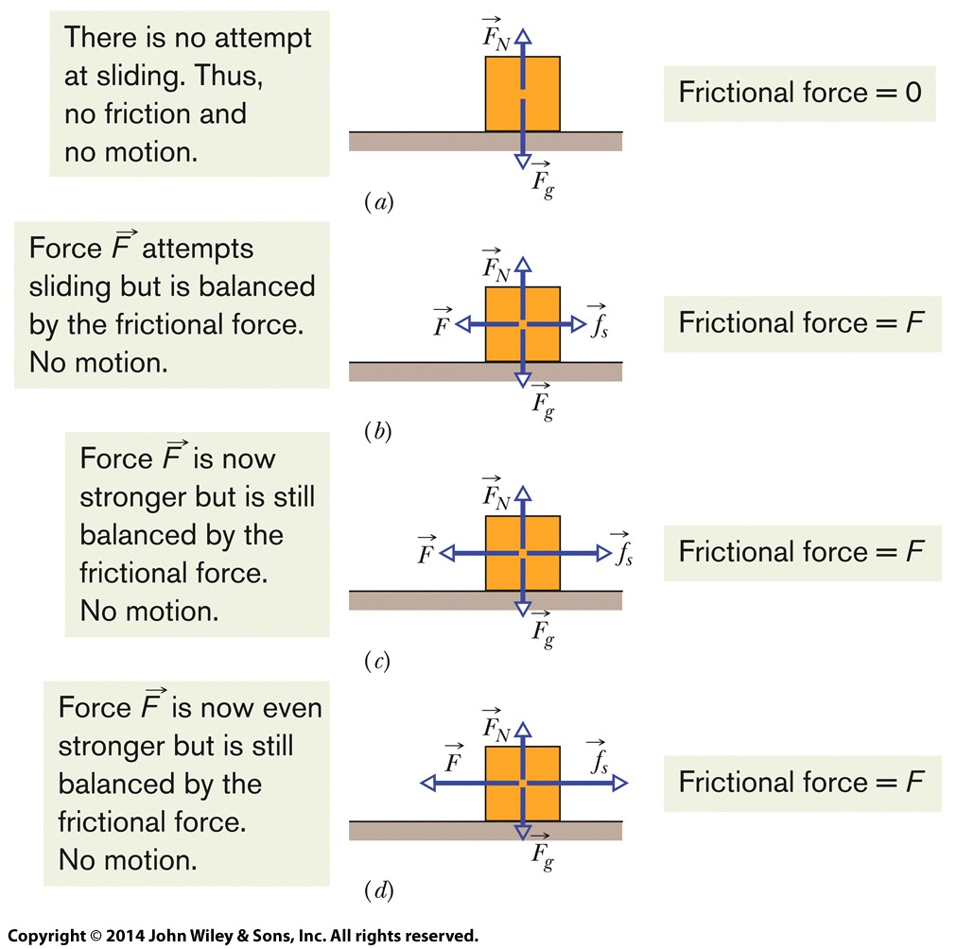
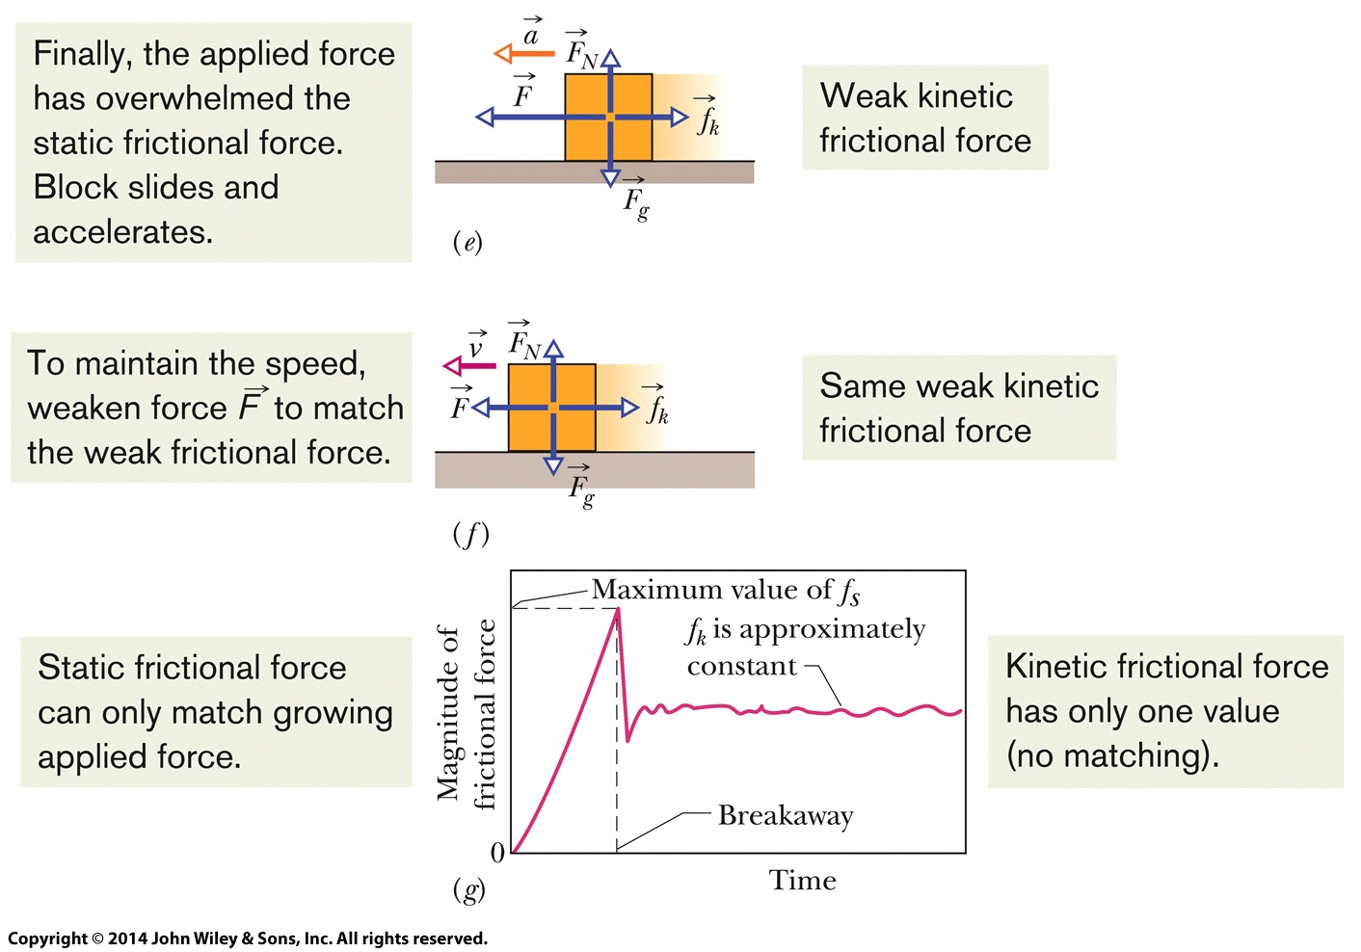
6-1 Friction
Figure 6-1
Notes:
6

Slide 7
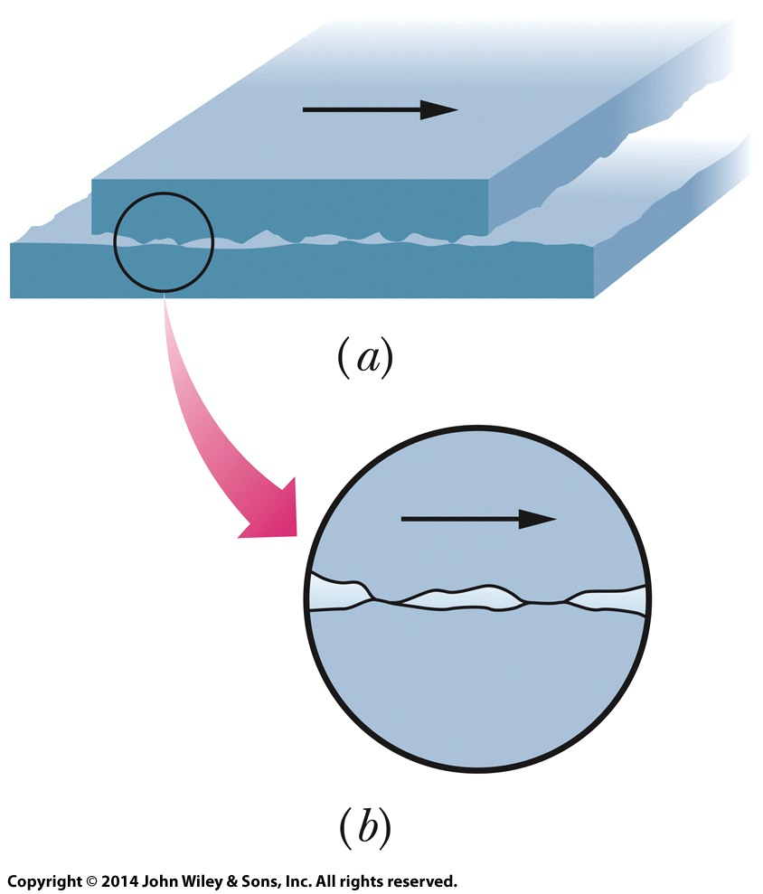
6-1 Friction
Microscopic picture: surfaces are bumpy
Friction occurs as contact points slide over each other
Two specially prepared metal surfaces can cold-weld together and become impossible to slide, because there is so much contact between the surfaces
Greater force normal to the contact plane increases the friction because the surfaces are pressed together and make more contact
Sliding that is jerky, due to the ridges on the surface, produces squeaking/squealing/sound
Figure 6-2
Notes:
7

Slide 8

6-1 Friction
The properties of friction
  If the body does not move, then the applied force and frictional force balance along the direction parallel to the surface: equal in magnitude, opposite in direction
  The magnitude of f_{s} has a maximum f_{s,max} given by:
  where μ_{s} is the coefficient of static friction. If the applied force increases past f_{s,max}, sliding begins.
Eq. (6-1)
Notes:
8

Slide 9

6-1 Friction
The properties of friction
  Once sliding begins, the frictional force decreases to f_{k} given by:
  where μ_{k} is the coefficient of kinetic friction.
Magnitude F_{N} of the normal force measures how strongly the surfaces are pushed together
The values of the friction coefficients are unitless and must be determined experimentally
Eq. (6-2)
Notes:
9

Slide 10
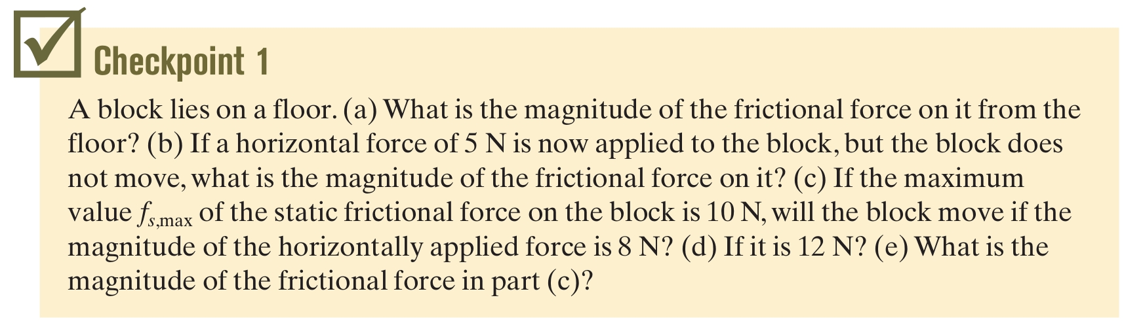
6-1 Friction
Assume that μ_{k} does not depend on velocity
Note that these equations are not vector equations
Answer: (a) 0 (b) 5 N (c) no (d) yes (e) 8 N
Notes:
10

Slide 11
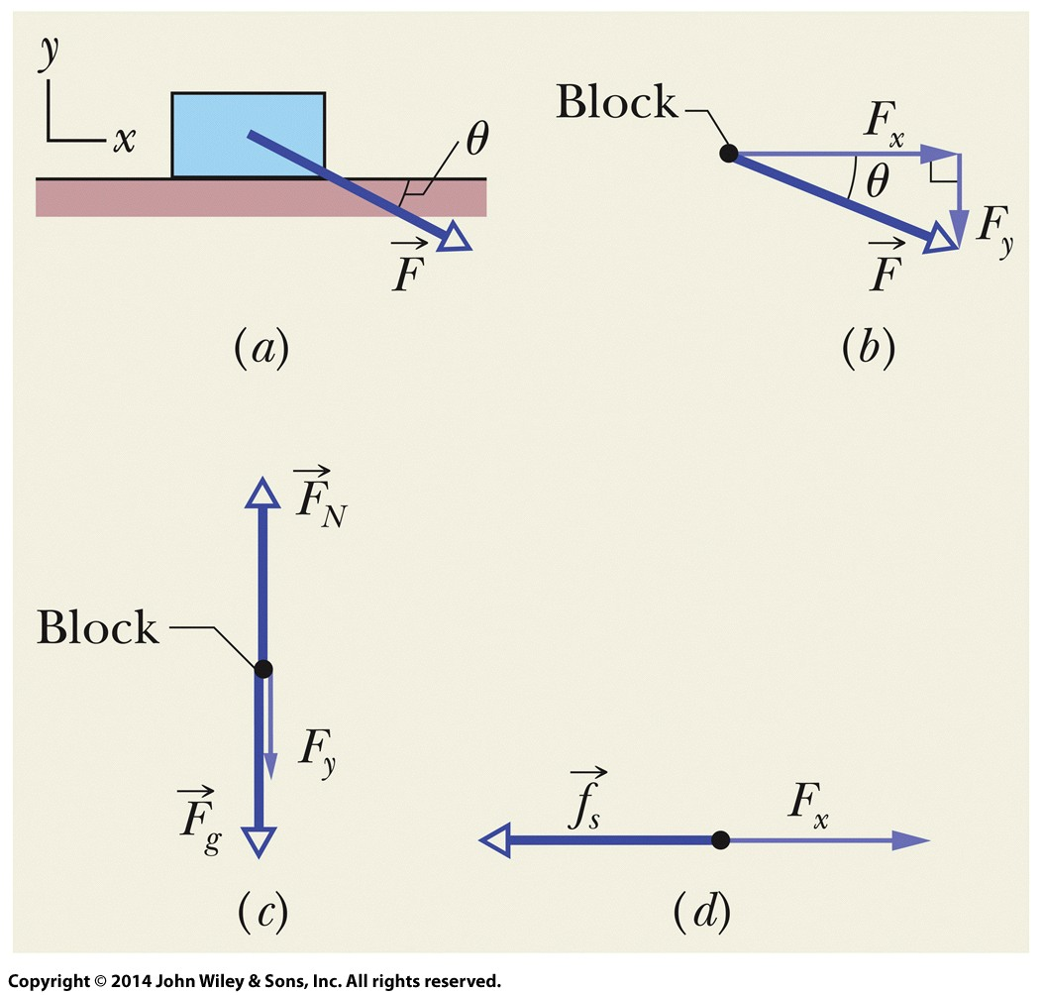
6-1 Friction
Example For a force applied at an angle:
  Decompose the force into x and y components
  Balance the vertical components (F_{N}, F_{g}, F_{y})
  Balance the horizontal components (f, F_{x})
  Solve for your unknown,
  noting that F_{N} and f are related
Figure 6-3
Notes:
11

Slide 12
6-2 The Drag Force and Terminal Speed
Learning Objectives
6.04 Apply the relationship between the drag force on an object moving through the air and the speed of the object.
6.05 Determine the terminal speed of an object falling through the air.
Notes:
12

Slide 13
6-2 The Drag Force and Terminal Speed
A fluid is anything that can flow (gas or liquid)
When there is relative velocity between fluid and an object there is a drag force:
  That opposes the relative motion
  And points along the direction of the flow, relative to the body
Here we examine the drag force for
  Air
  With a body that is not streamlined
  For motion fast enough that the air becomes turbulent (breaks into swirls)
Notes:
13

Slide 14
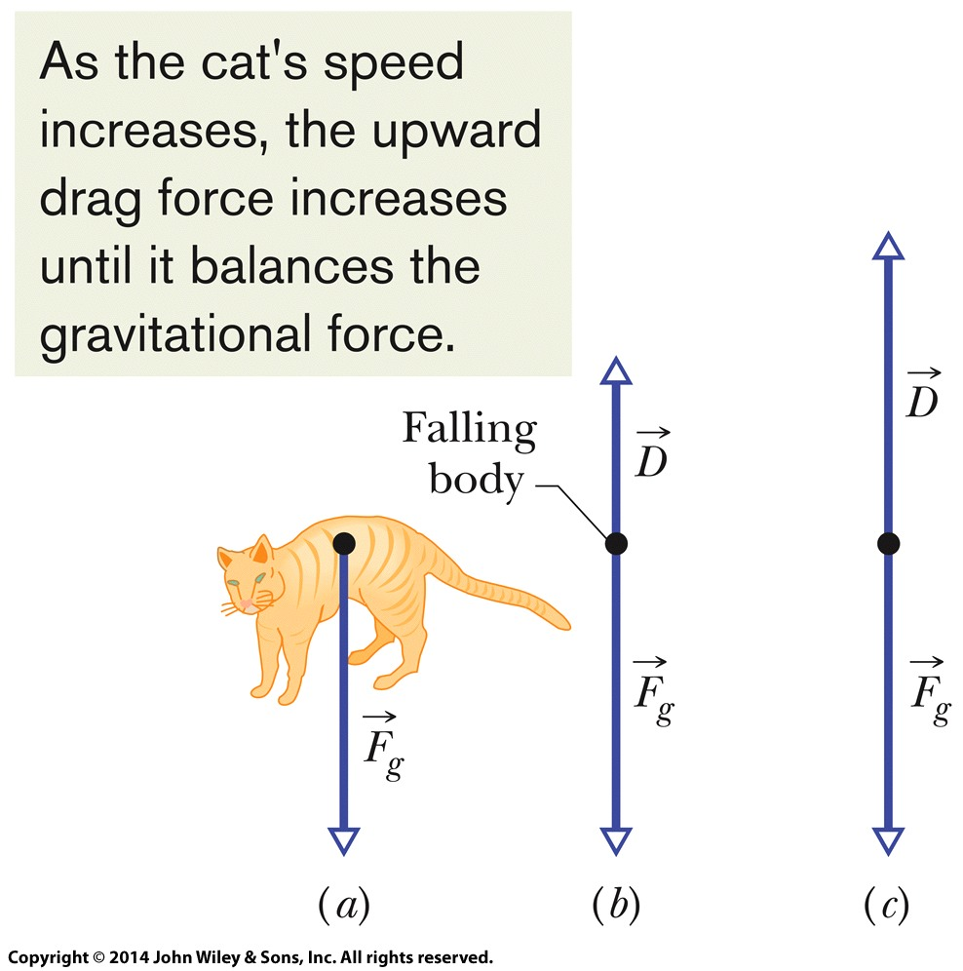

6-2 The Drag Force and Terminal Speed
For this case, the drag force is:
Where:
  v is the relative velocity
  ρ is the air density (mass/volume)
  C is the experimentally determined drag coefficient
  A is the effective cross-sectional area of the body (the area taken perpendicular to the relative velocity)
In reality, C is not constant for all values of v
Eq. (6-14)
Figure 6-6
Notes:
14

Slide 15

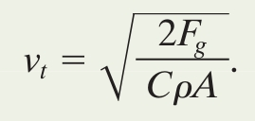
6-2 The Drag Force and Terminal Speed
The drag force from the air opposes a falling object
Once the drag force equals the gravitational force, the object falls at a constant terminal speed:
Terminal speed can be increased by reducing A
Terminal speed can be decreased by increasing A
Skydivers use this to control descent
Eq. (6-15)
Eq. (6-16)
Notes:
15

Slide 16

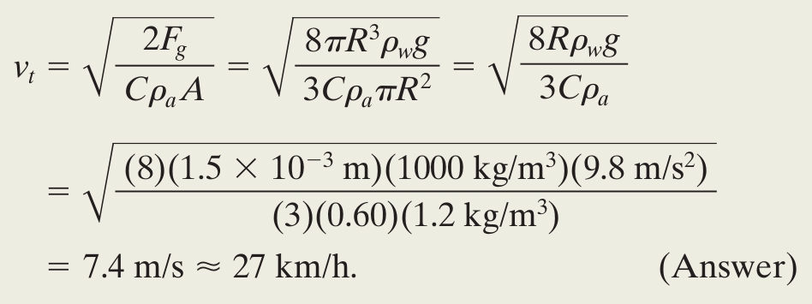
6-2 The Drag Force and Terminal Speed
Example Speed of a rain drop:
  Spherical drop feels gravitational force F = mg:
    Express in terms of density of water
  So plug in to the terminal velocity equation using the values provided in the text:
    Use A = πR² for the cross-sectional area

Slide 17
6-3 Uniform Circular Motion
Learning Objectives
6.06 Sketch the path taken in uniform circular motion and explain the velocity, acceleration, and force vectors (magnitudes and directions) during the motion.
6.07 Identify that unless there is a radially inward net force (a centripetal force), an object cannot move in circular motion.
6.08 For a particle in uniform circular motion, apply the relationship between the radius of the path, the particle's speed and mass, and the net force acting on the particle.
Notes:
17

Slide 18
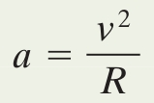
6-3 Uniform Circular Motion
Recall that circular motion requires a centripetal acceleration
Eq. (6-17)
Examples You are a passenger:
  For a car, rounding a curve, the car accelerates toward the center of the curve due to a centripetal force provided by the inward friction on the tires. Your inertia makes you want to go straight ahead so you may feel friction from your seat and may also be pushed against the side of the car. These inward forces keep you in uniform circular motion in the car.
  For a space shuttle, the shuttle is kept in orbit by the gravitational pull of Earth acting as a centripetal force. This force also acts on every atom in your body, and keeps you in orbit around the Earth. You float with no sensation of force, but are subject to a centripetal acceleration.
Notes:
18

Slide 19
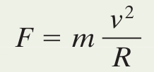
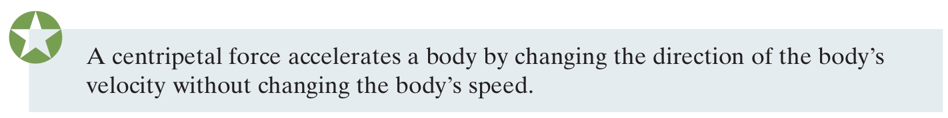
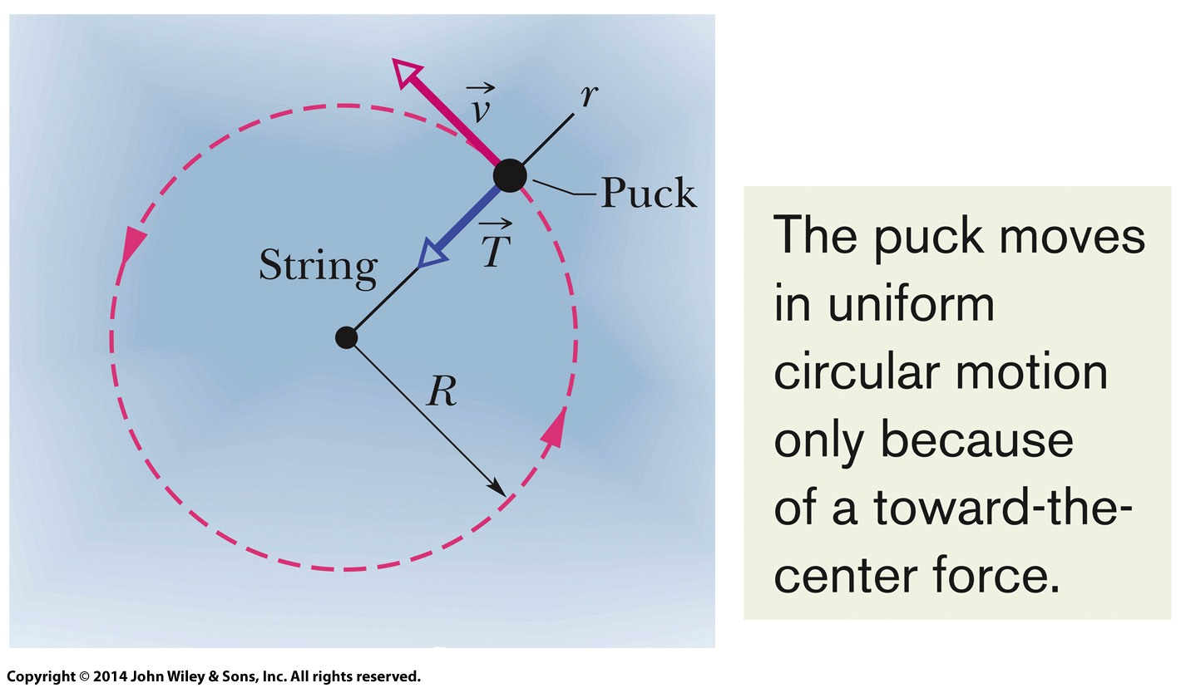
6-3 Uniform Circular Motion
Centripetal force is not a new kind of force, it is simply an application of force
Eq. (6-18)
For the puck on a string, the string tension supplies the centripetal force necessary to maintain circular motion
Figure 6-8
Notes:
19

Slide 20
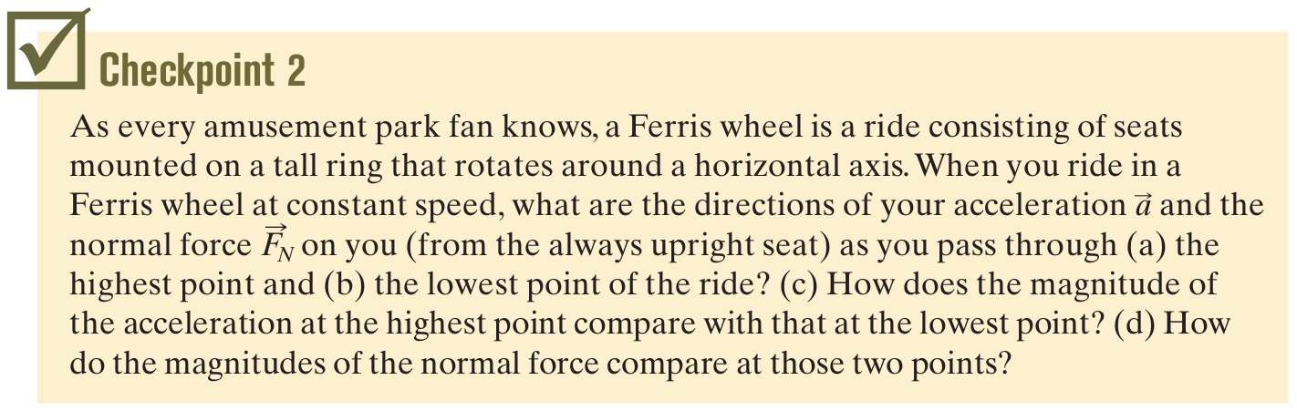
6-3 Uniform Circular Motion
Answer: (a) accel downward, F_{N} upward
(b) accel upward, F_{N} upward
(c) the magnitudes must be equal for the motion to be uniform
(d) F_{N} is greater in (b) than in (a)
Notes:
20

Slide 21
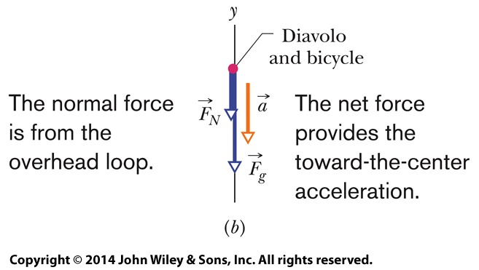
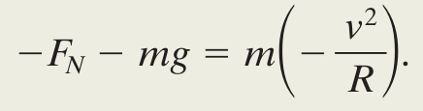
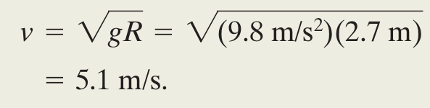
6-3 Uniform Circular Motion
Example Bicycle going around a vertical loop:
  At the top of the loop we have:
  Solve for v and plug in our known values,
  including F_{N} = 0 for the minimum answer:
Figure 6-9
Eq. (6-19)
Notes:
21

Slide 22
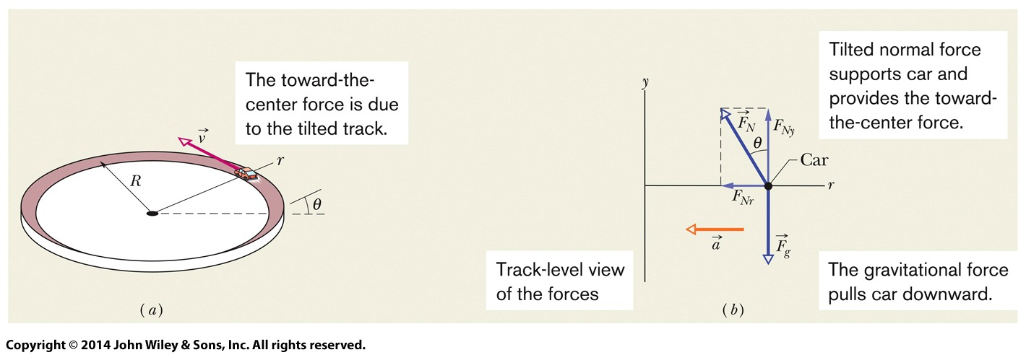
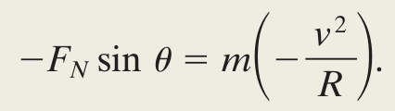

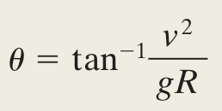
6-3 Uniform Circular Motion
Example Car in a banked circular turn:
  Sum components along the radial direction:
  Sum components along the vertical direction:
  Divide and replace (sin θ)/(cos θ) with tangent.
Figure 6-11
Eq. (6-23)
Eq. (6-24)
Notes:
22

Slide 23
6 Summary
Friction
Opposes the direction of motion or attempted motion
Static if the object does not slide
Static friction can increase to a maximum
Kinetic if it does slide
Drag Force
Resistance between a fluid and an object
Opposes relative motion
Drag coefficient C experimentally determined
Use the effective cross-sectional area (area perpendicular to the velocity)
Eq. (6-1)
Eq. (6-14)
Eq. (6-2)
Notes:
23

Slide 24
6 Summary
Terminal Speed
The maximum velocity of a falling object due to drag
Uniform Circular Motion
Centripetal acceleration required to maintain the motion
Corresponds to a centripetal force
Force points toward the center of curvature
Eq. (6-16)
Eq. (6-17)
Eq. (6-18)
Notes:
24

