Slide 1
Chapter 3
Vectors
Notes:
1

Slide 2
3-1 Vectors and Their Components
Learning Objectives
3.01 Add vectors by drawing them in head-to-tail arrangements, applying the commutative and associative laws.
3.02 Subtract a vector from a second one.
3.03 Calculate the components of a vector on a given coordinate system, showing them in a drawing.
3.04 Given the components of a vector, draw the vector and determine its magnitude and orientation.
3.05 Convert angle measures between degrees and radians.
Notes:
2

Slide 3
3-1 Vectors and Their Components
Physics deals with quantities that have both size and direction
A vector is a mathematical object with size and direction
A vector quantity is a quantity that can be represented by a vector
Examples: position, velocity, acceleration
Vectors have their own rules for manipulation
A scalar is a quantity that does not have a direction
Examples: time, temperature, energy, mass
Scalars are manipulated with ordinary algebra
Notes:
3

Slide 4
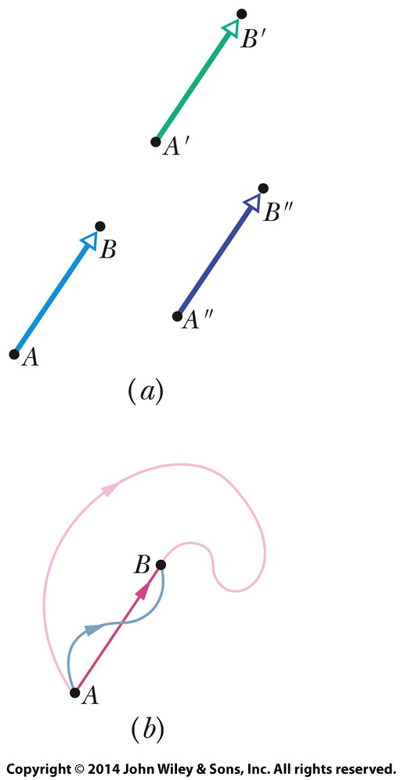
3-1 Vectors and Their Components
The simplest example is a displacement vector
If a particle changes position from A to B, we represent this by a vector arrow pointing from A to B
In (a) we see that all three arrows have the same magnitude and direction: they are identical displacement vectors.
In (b) we see that all three paths correspond to the same displacement vector. The vector tells us nothing about the actual path that was taken between A and B.
Figure 3-1
Notes:
4

Slide 5
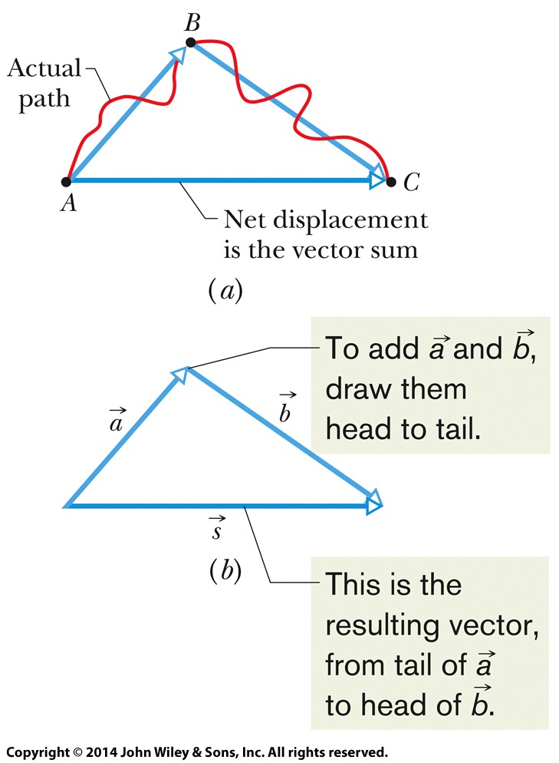
3-1 Vectors and Their Components
The vector sum, or resultant
Is the result of performing vector addition
Represents the net displacement of two or more displacement vectors
Can be added graphically as shown:
Eq. (3-1)
Figure 3-2
Notes:
5

Slide 6
3-1 Vectors and Their Components
Vector addition is commutative
We can add vectors in any order
Eq. (3-2)
Figure (3-3)
Notes:
6

Slide 7
3-1 Vectors and Their Components
Vector addition is associative
We can group vector addition however we like
Eq. (3-3)
Figure (3-4)
Notes:
7

Slide 8
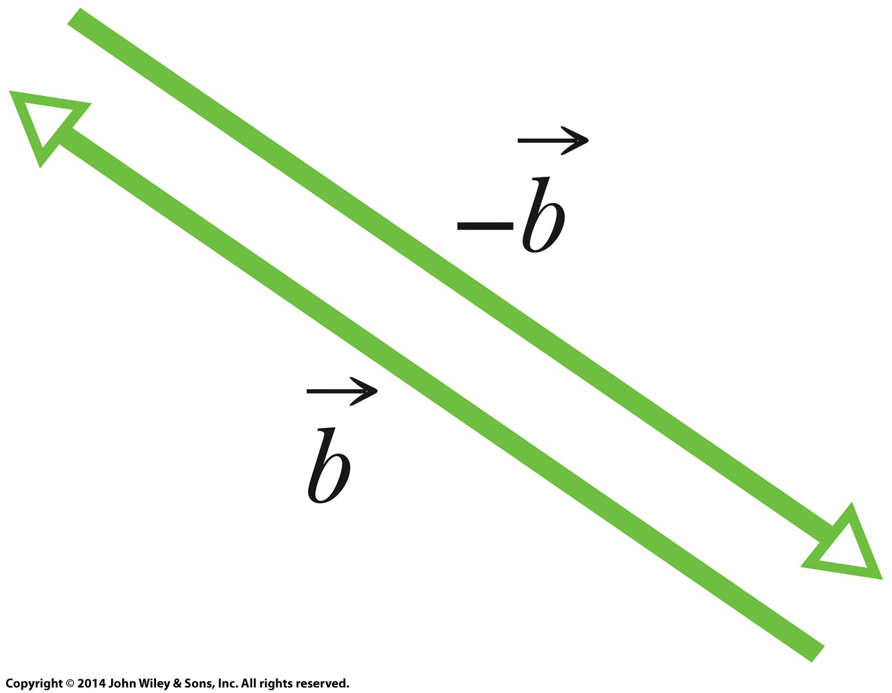
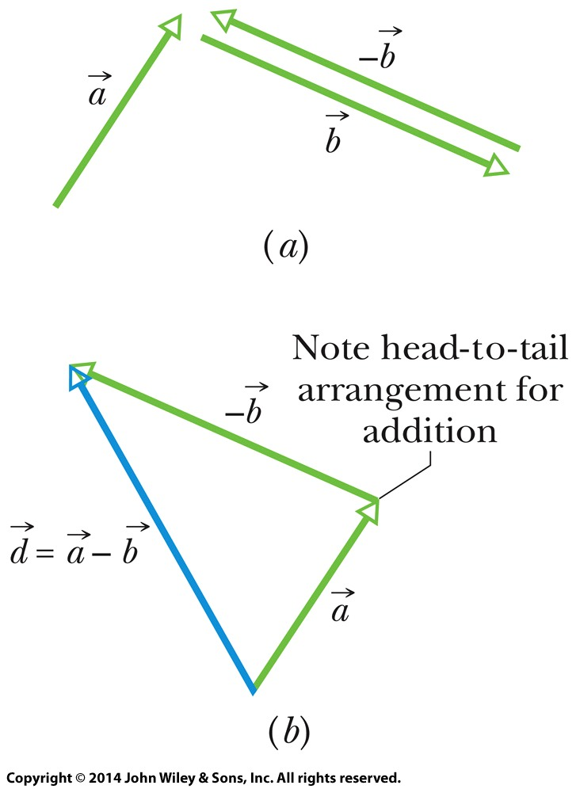
3-1 Vectors and Their Components
A negative sign reverses vector direction
We use this to define vector subtraction
Figure (3-5)
Eq. (3-4)
Figure (3-6)
Notes:
8

Slide 9
3-1 Vectors and Their Components
These rules hold for all vectors, whether they represent displacement, velocity, etc.
Only vectors of the same kind can be added
(distance) + (distance) makes sense
(distance) + (velocity) does not
Answer:
(a) 3 m + 4 m = 7 m (b) 4 m - 3 m = 1 m
Notes:
9

Slide 10
3-1 Vectors and Their Components
Rather than using a graphical method, vectors can be added by components
A component is the projection of a vector on an axis
The process of finding components is called resolving the vector
The components of a vector can be positive or negative.
They are unchanged if the vector is shifted in any direction (but not rotated).
Figure (3-8)
Notes:
10

Slide 11
3-1 Vectors and Their Components
Components in two dimensions can be found by:
Where θ is the angle the vector makes with the positive x axis, and a is the vector length
The length and angle can also be found if the components are known
Therefore, components fully define a vector
Eq. (3-5)
Eq. (3-6)
Notes:
11

Slide 12
3-1 Vectors and Their Components
In the three dimensional case we need more components to specify a vector
(a,θ,φ) or (a_{x},a_{y},a_{z})
Answer: choices (c), (d), and (f) show the components properly arranged to form the vector
Notes:
12

Slide 13
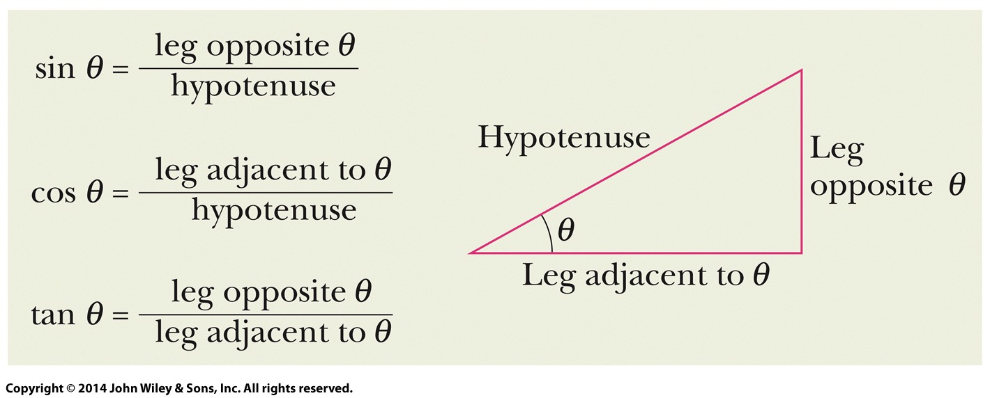
3-1 Vectors and Their Components
Angles may be measured in degrees or radians
Recall that a full circle is 360˚, or 2π rad
Know the three basic trigonometric functions
Figure (3-11)
Notes:
13

Slide 14
3-2 Unit Vectors, Adding Vectors by Components
Learning Objectives
3.06 Convert a vector between magnitude-angle and unit-vector notations.
3.07 Add and subtract vectors in magnitude-angle notation and in unit-vector notation.
3.08 Identify that, for a given vector, rotating the coordinate system about the origin can change the vector's components, but not the vector itself.
Notes:
14

Slide 15
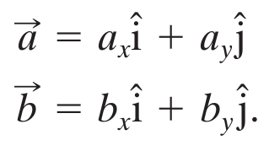
3-2 Unit Vectors, Adding Vectors by Components
A unit vector
Has magnitude 1
Has a particular direction
Lacks both dimension and unit
Is labeled with a hat: ^
We use a right-handed coordinate system
Remains right-handed when rotated
Eq. (3-7)
Eq. (3-8)
Figure (3-13)
Notes:
15

Slide 16
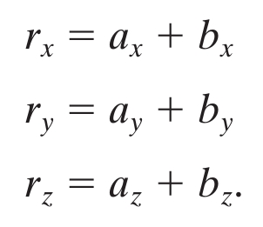
3-2 Unit Vectors, Adding Vectors by Components
The quantities a_{x}i and a_{y}j are vector components
The quantities a_{x} and a_{y} alone are scalar components
Or just “components” as before
Eq. (3-7)
Eq. (3-8)
Vectors can be added using components
Eq. (3-9)
→
Eq. (3-10)
Eq. (3-11)
Eq. (3-12)
Notes:
16

Slide 17
3-2 Unit Vectors, Adding Vectors by Components
To subtract two vectors, we subtract components
Eq. (3-13)
Unit Vectors, Adding Vectors by Components
Answer: (a) positive, positive (b) positive, negative
(c) positive, positive
Notes:
17

Slide 18
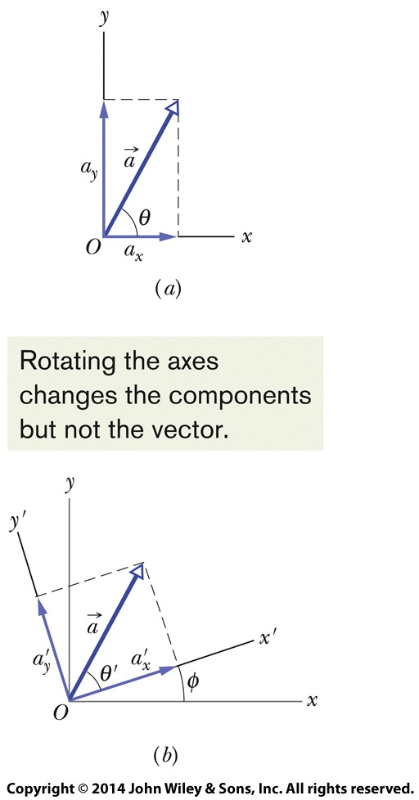
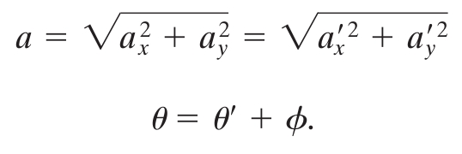
3-2 Unit Vectors, Adding Vectors by Components
Vectors are independent of the coordinate system used to measure them
We can rotate the coordinate system, without rotating the vector, and the vector remains the same
All such coordinate systems are equally valid
Eq. (3-14)
Eq. (3-15)
Figure (3-15)
Notes:
18

Slide 19
3-3 Multiplying Vectors
Learning Objectives
3.09 Multiply vectors by scalars.
3.10 Identify that multiplying a vector by a scalar gives a vector, the dot product gives a scalar, and the cross product gives a perpendicular vector.
3.11 Find the dot product of two vectors.
3.12 Find the angle between two vectors by taking their dot product.
3.13 Given two vectors, use the dot product to find out how much of one vector lies along the other.
3.14 Find the cross product of two vectors.
3.15 Use the right-hand rule to find the direction of the resultant vector.
3.16 In nested products, start with the innermost product and work outward.
Notes:
19

Slide 20
3-3 Multiplying Vectors
Multiplying a vector z by a scalar c
Results in a new vector
Its magnitude is the magnitude of vector z times |c|
Its direction is the same as vector z, or opposite if c is negative
To achieve this, we can simply multiply each of the components of vector z by c
To divide a vector by a scalar we multiply by 1/c
Example Multiply vector z by 5
z = -3 i + 5 j
5 z = -15 i + 25 j
Notes:
20

Slide 21
3-3 Multiplying Vectors
Multiplying two vectors: the scalar product
Also called the dot product
Results in a scalar, where a and b are magnitudes and φ is the angle between the directions of the two vectors:
The commutative law applies, and we can do the dot product in component form
Eq. (3-20)
Eq. (3-22)
Eq. (3-23)
Notes:
21

Slide 22
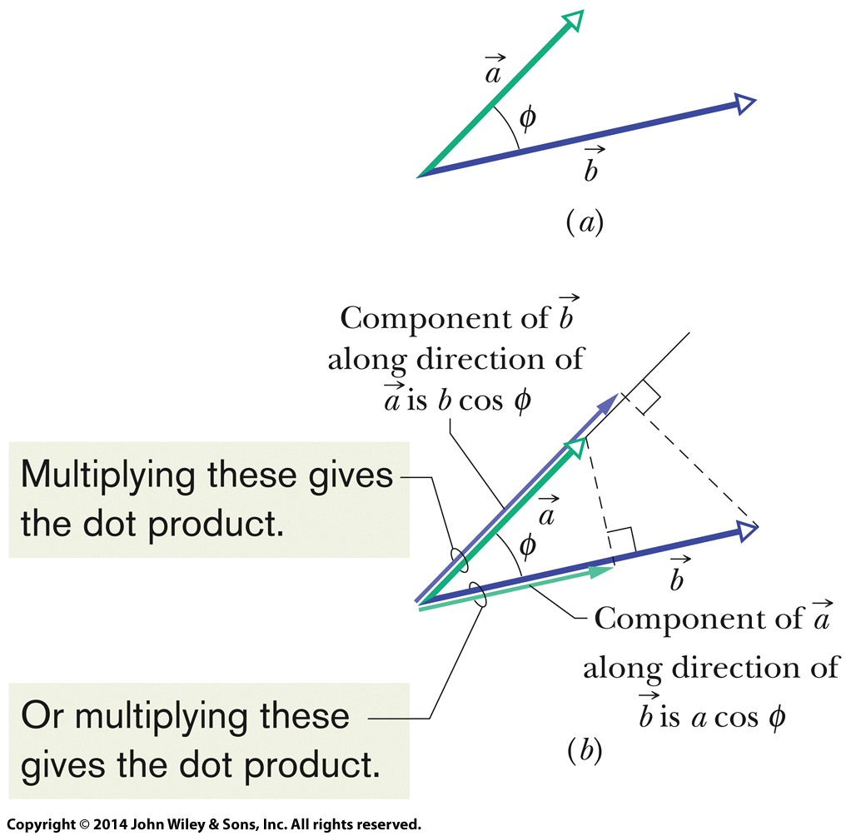
3-3 Multiplying Vectors
A dot product is: the product of the magnitude of one vector times the scalar component of the other vector in the direction of the first vector
Eq. (3-21)
Figure (3-18)
Either projection of one vector onto the other can be used
To multiply a vector by the projection, multiply the magnitudes
Notes:
22

Slide 23
3-3 Multiplying Vectors
Answer: (a) 90 degrees (b) 0 degrees (c) 180 degrees
Notes:
23

Slide 24
3-3 Multiplying Vectors
Multiplying two vectors: the vector product
The cross product of two vectors with magnitudes a & b, separated by angle φ, produces a vector with magnitude:
And a direction perpendicular to both original vectors
Direction is determined by the right-hand rule
Place vectors tail-to-tail, sweep fingers from the first to the second, and thumb points in the direction of the resultant vector
Eq. (3-24)
Notes:
24

Slide 25
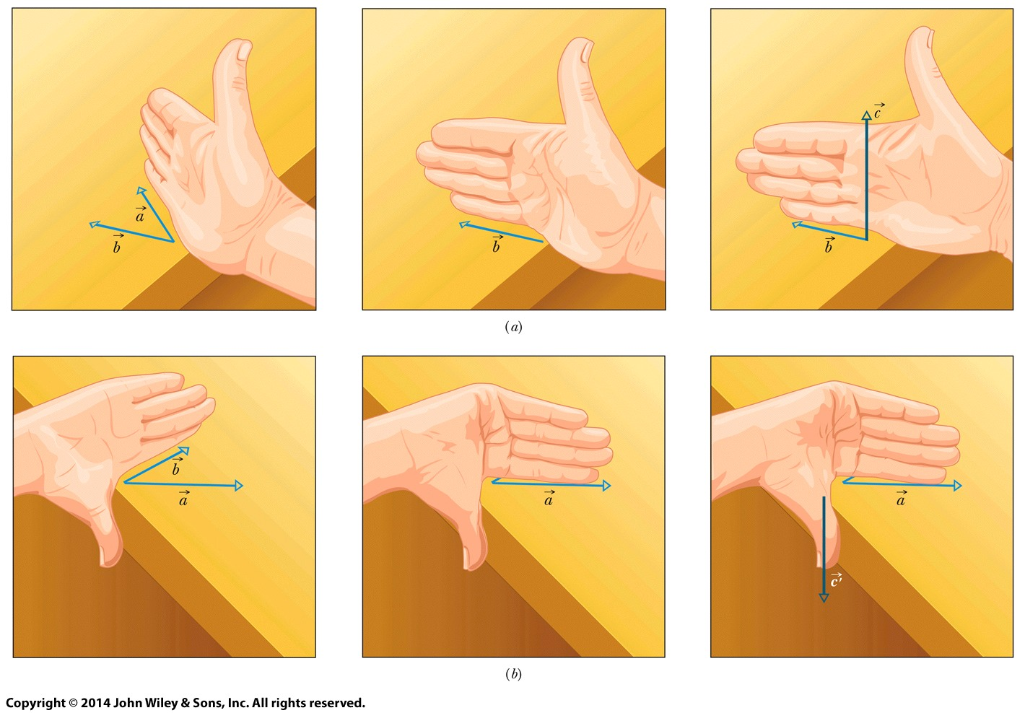
3-3 Multiplying Vectors
Figure (3-19)
The upper shows vector a cross vector b, the lower shows vector b cross vector a
Notes:
25

Slide 26
3-3 Multiplying Vectors
The cross product is not commutative
To evaluate, we distribute over components:
Therefore, by expanding (3-26):
Eq. (3-25)
Eq. (3-26)
Eq. (3-27)
Notes:
26

Slide 27
3-3 Multiplying Vectors
Answer: (a) 0 degrees (b) 90 degrees
Notes:
27

Slide 28
3 Summary
Scalars and Vectors
Scalars have magnitude only
Vectors have magnitude and direction
Both have units!
Adding Geometrically
Obeys commutative and associative laws
Eq. (3-2)
Eq. (3-3)
Vector Components
Given by
Related back by
Unit Vector Notation
We can write vectors in terms of unit vectors
Eq. (3-5)
Eq. (3-7)
Eq. (3-6)
Notes:
28

Slide 29
3 Summary
Adding by Components
Add component-by-component
Scalar Times a Vector
Product is a new vector
Magnitude is multiplied by scalar
Direction is same or opposite
Eqs. (3-10) - (3-12)
Scalar Product
Dot product
Cross Product
Produces a new vector in perpendicular direction
Direction determined by right-hand rule
Eq. (3-20)
Eq. (3-24)
Eq. (3-22)
Notes:
29

