Slide 1
Motion Along a Straight Line
Chapter 2

Slide 2
2-1 Position, Displacement, and Average Velocity
Learning Objectives
2.01 Identify that if all parts of an object move in the same direction at the same rate, we can treat it as a (point-like) particle.
2.02 Identify that the position of a particle is its location on a scaled axis.
2.03 Apply the relationship between a particle's displacement and its initial and final positions.
2.04 Apply the relationship between a particle's average velocity, its displacement, and the time interval.
2.05 Apply the relationship between a particle's average speed, the total distance it moves, and the time interval.
2.06 Given a graph of a particle's position versus time, determine the average velocity between two times.

Slide 3
2-1 Position, Displacement, and Average Velocity
Kinematics is the classification and comparison of motions
For this chapter, we restrict motion in three ways:
We consider motion along a straight line only
We discuss only the motion itself, not the forces that cause it
We consider the moving object to be a particle
A particle is either:
A point-like object (such as an electron)
Or an object that moves such that each part travels in the same direction at the same rate (no rotation or stretching)

Slide 4
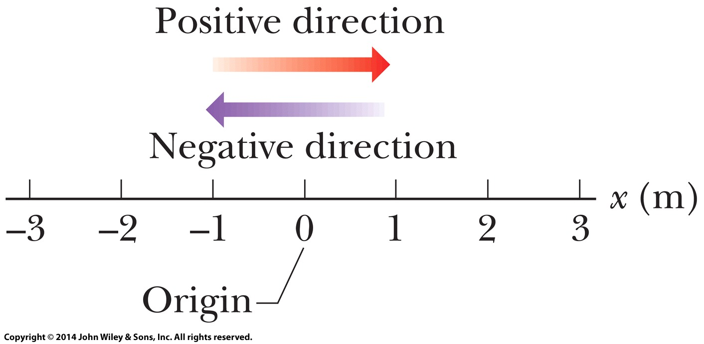
2-1 Position, Displacement, and Average Velocity
Position is measured relative to a reference point:
The origin, or zero point, of an axis
Position has a sign:
Positive direction is in the direction of increasing numbers
Negative direction is opposite the positive
Figure 2-1

Slide 5
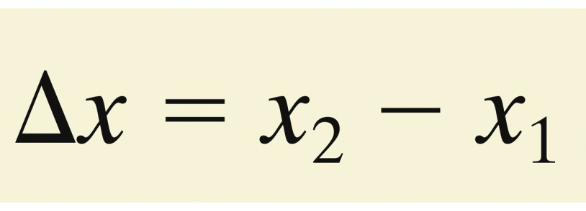
2-1 Position, Displacement, and Average Velocity
A change in position is called displacement
∆x is the change in x, (final position) – (initial position)
Eq. (2-1)
Examples A particle moves . . .
From x = 5 m to x = 12 m: ∆x = 7 m (positive direction)
From x = 5 m to x = 1 m: ∆x = -4 m (negative direction)
From x = 5 m to x = 200 m to x = 5 m: ∆x = 0 m
The actual distance covered is irrelevant

Slide 6
2-1 Position, Displacement, and Average Velocity
Displacement is therefore a vector quantity
Direction: along a single axis, given by sign (+ or -)
Magnitude: length or distance, in this case meters or feet
Ignoring sign, we get its magnitude (absolute value)
The magnitude of ∆x = -4 m is 4 m.
Answer: pairs (b) and (c)
(b) -7 m – -3 m = -4 m (c) -3 m – 7 m = -10 m

Slide 7
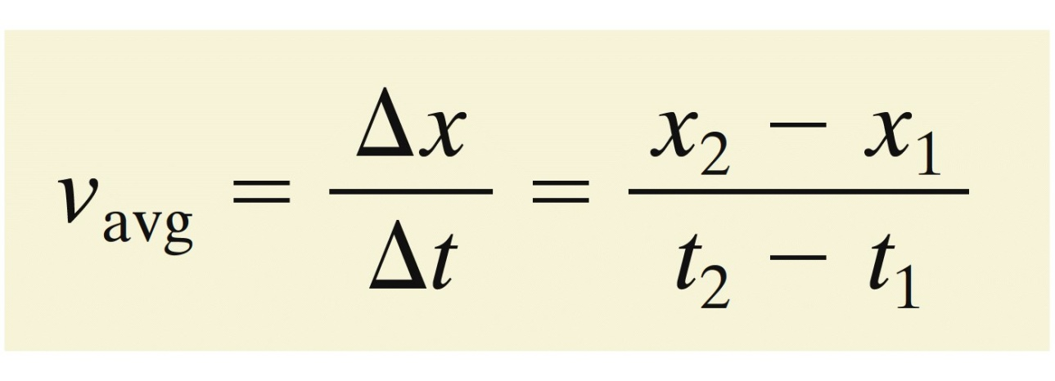
2-1 Position, Displacement, and Average Velocity
Average velocity is the ratio of:
A displacement, ∆x
To the time interval in which the displacement occurred, ∆t
Eq. (2-2)
Average velocity has units of (distance) / (time)
Meters per second, m/s

Slide 8
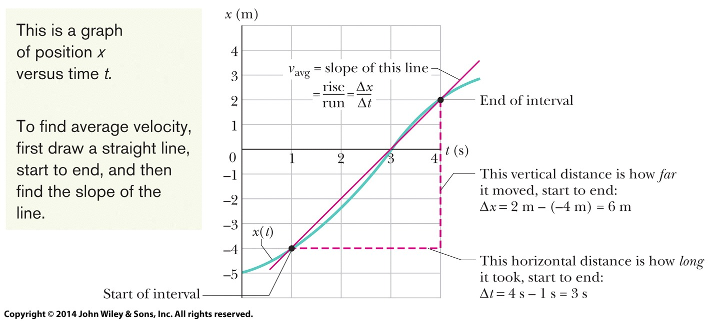
2-1 Position, Displacement, and Average Velocity
On a graph of x vs. t, the average velocity is the slope of the straight line that connects two points
Average velocity is therefore a vector quantity
Positive slope means positive average velocity
Negative slope means negative average velocity
Figure 2-4

Slide 9
2-1 Position, Displacement, and Average Velocity
Average speed is the ratio of:
The total distance covered
To the time interval in which the distance was covered, ∆t
Eq. (2-3)
Average speed is always positive (no direction)
Example A particle moves from x = 3 m to x = -3 m in 2 seconds.
Average velocity = -3 m/s; average speed = 3 m/s

Slide 10
2-2 Instantaneous Velocity and Speed
Learning Objectives
2.07 Given a particle's position as a function of time, calculate the instantaneous velocity for any particular time.
2.08 Given a graph of a particle's position versus time, determine the instantaneous velocity for any particular time.
2.09 Identify speed as the magnitude of instantaneous velocity.

Slide 11
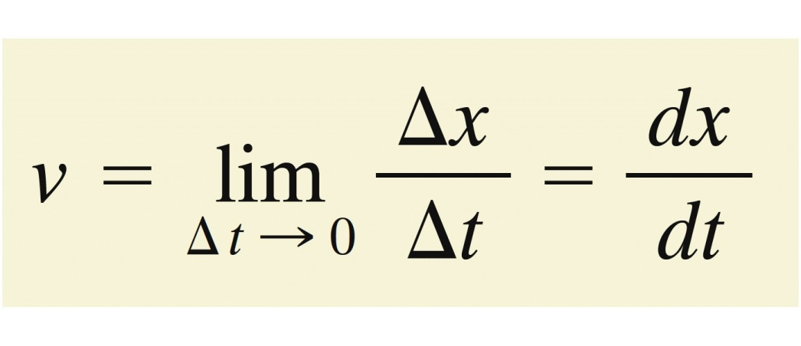
2-2 Instantaneous Velocity and Speed
Instantaneous velocity, or just velocity, v, is:
At a single moment in time
Obtained from average velocity by shrinking ∆t
The slope of the position-time curve for a particle at an instant (the derivative of position)
A vector quantity with units (distance) / (time)
The sign of the velocity represents its direction
Eq. (2-4)

Slide 12
2-2 Instantaneous Velocity and Speed
Speed is the magnitude of (instantaneous) velocity
Example A velocity of 5 m/s and -5 m/s both have an associated speed of 5 m/s.
Answers:
(a) Situations 1 and 4 (zero)
(b) Situations 2 and 3

Slide 13
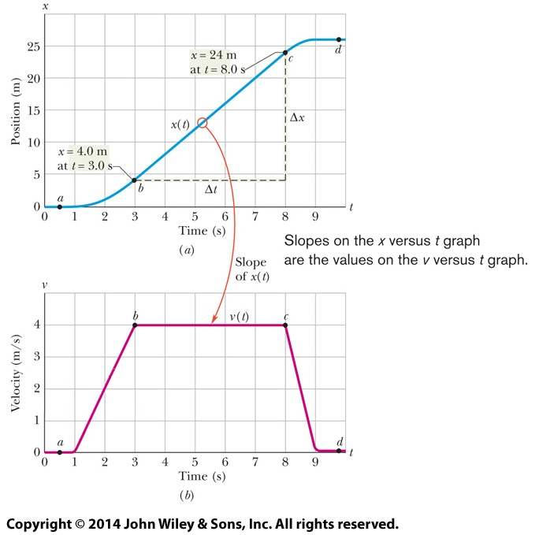
2-2 Instantaneous Velocity and Speed
Example
The graph shows the position and velocity of an elevator cab over time.
The slope of x(t), and so also the velocity v, is zero from 0 to 1 s, and from 9s on.
During the interval bc, the slope is constant and nonzero, so the cab moves with constant velocity (4 m/s).
Figure 2-6

Slide 14
2-3 Acceleration
Learning Objectives
2.10 Apply the relationship between a particle's average acceleration, its change in velocity, and the time interval for that change.
2.11 Given a particle's velocity as a function of time, calculate the instantaneous acceleration for any particular time.
2.12 Given a graph of a particle's velocity versus time, determine the instantaneous acceleration for any particular time and the average acceleration between any two particular times.

Slide 15
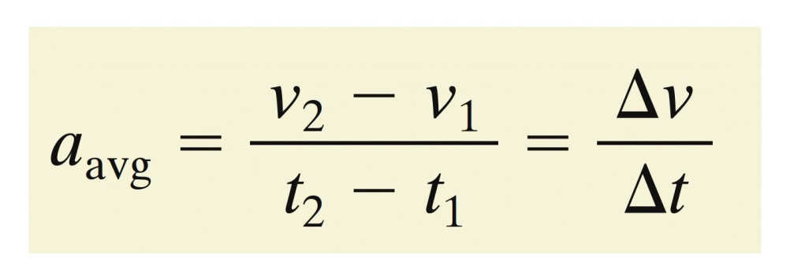
2-3 Acceleration
A change in a particle's velocity is acceleration
Average acceleration over a time interval ∆t is
Eq. (2-7)
Instantaneous acceleration (or just acceleration), a, for a single moment in time is:
Slope of velocity vs. time graph
Eq. (2-8)

Slide 16
2-3 Acceleration
Combining Eqs. 2-8 and 2-4:
Eq. (2-9)
Acceleration is a vector quantity:
Positive sign means in the positive coordinate direction
Negative sign means the opposite
Units of (distance) / (time squared)

Slide 17
2-3 Acceleration
Example If a car with velocity v = -25 m/s is braked to a stop in 5.0 s, then a = + 5.0 m/s². Acceleration is positive, but speed has decreased.
Note: accelerations can be expressed in units of g
Eq. (2-10)
Answers: (a) + (b) - (c) - (d) +

Slide 18
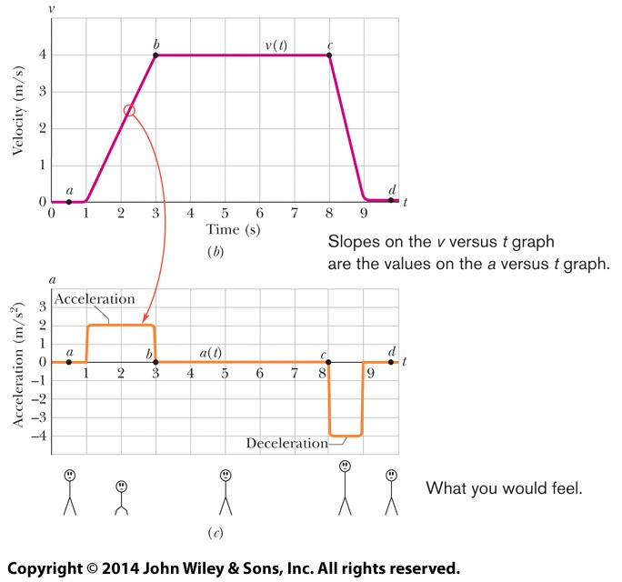
2-3 Acceleration
Example
The graph shows the velocity and acceleration of an elevator cab over time.
When acceleration is 0 (e.g. interval bc) velocity is constant.
When acceleration is positive (ab) upward velocity increases.
When acceleration is negative (cd) upward velocity decreases.
Steeper slope of the velocity-time graph indicates a larger magnitude of acceleration: the cab stops in half the time it takes to get up to speed.
Figure 2-6

Slide 19
2-4 Constant Acceleration
Learning Objectives
2.13 For constant acceleration, apply the relationships between position, velocity, acceleration, and elapsed time (Table 2-1).
2.14 Calculate a particle's change in velocity by integrating its acceleration function with respect to time.
2.15 Calculate a particle's change in position by integrating its velocity function with respect to time.

Slide 20
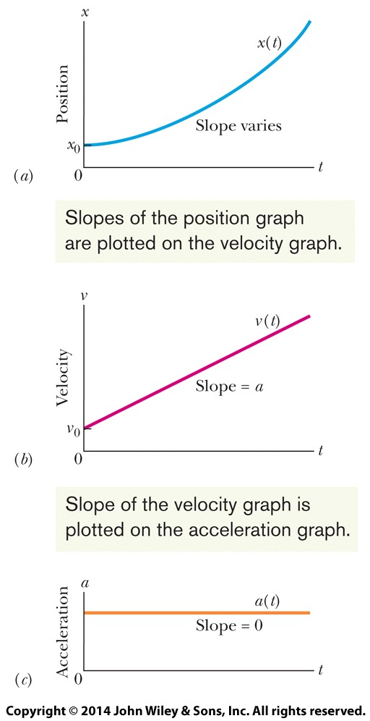
2-4 Constant Acceleration
In many cases acceleration is constant, or nearly so.
For these cases, 5 special equations can be used.
Note that constant acceleration means a velocity with a constant slope, and a position with varying slope (unless a = 0).
Figure 2-9

Slide 21
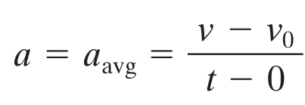
2-4 Constant Acceleration
First basic equation
When the acceleration is constant, the average and instantaneous accelerations are equal
Rewrite Eq. 2-7 and rearrange
Eq. (2-11)
This equation reduces to v = v₀ for t = 0
Its derivative yields the definition of a, dv/dt

Slide 22
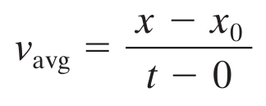
2-4 Constant Acceleration
Second basic equation
Rewrite Eq. 2-2 and rearrange
Eq. (2-12)
Average = ((initial) + (final)) / 2:
Substitute 2-11 into 2-13
Eq. (2-13)
Eq. (2-14)
Substitute 2-14 into 2-12
Eq. (2-15)

Slide 23
2-4 Constant Acceleration
These two equations can be obtained by integrating a constant acceleration
Enough to solve any constant acceleration problem
Solve as simultaneous equations
Additional useful forms:
Eq. (2-16)
Eq. (2-17)
Eq. (2-18)

Slide 24
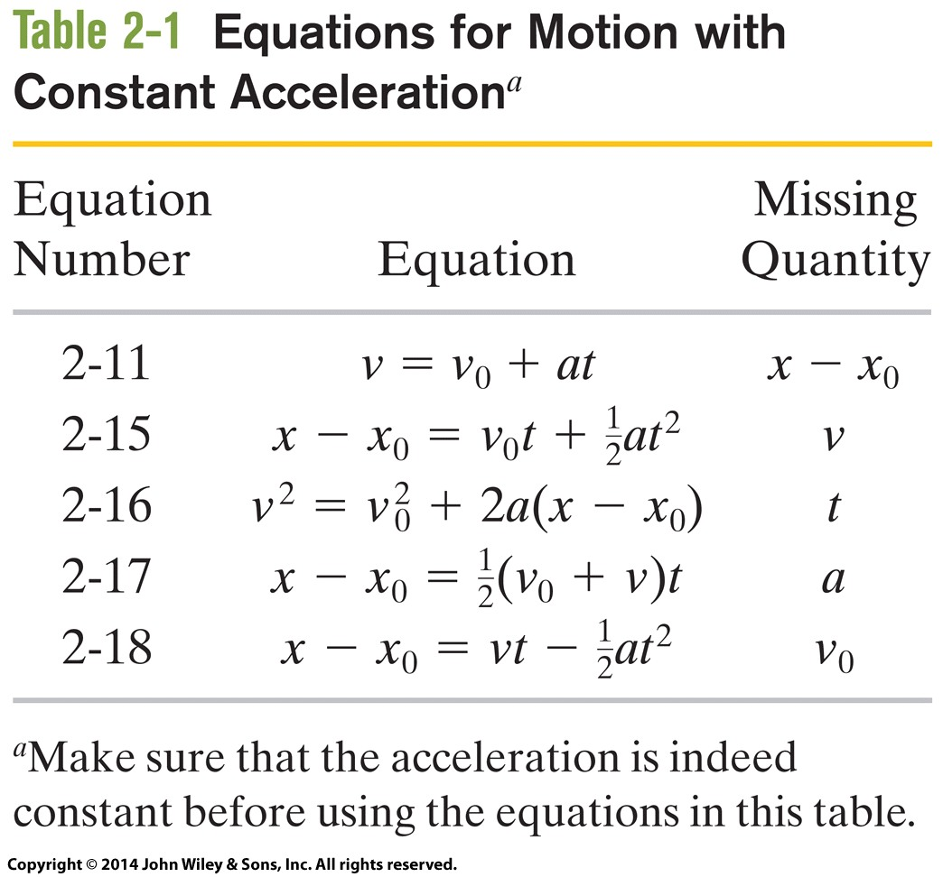
2-4 Constant Acceleration
Table 2-1 shows the 5 equations and the quantities missing from them.
Table 2-1
Answer: Situations 1 (a = 0) and 4.

Slide 25
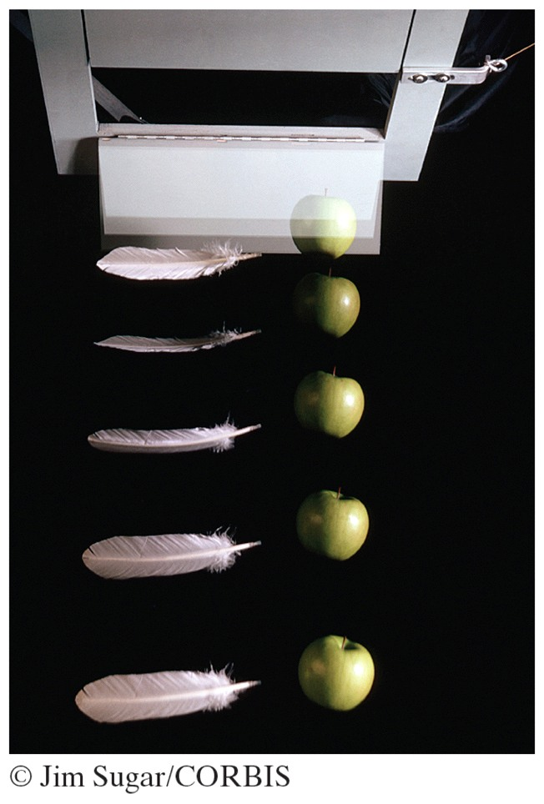
2-5 Free-Fall Acceleration
Learning Objectives
2.16 Identify that if a particle is in free flight (whether upward or downward) and if we can neglect the effects of air on its motion, the particle has a constant downward acceleration with a magnitude g that we take to be 9.8m/s².
2.17 Apply the constant acceleration equations (Table 2-1) to free-fall motion.
Figure 2-12

Slide 26
2-5 Free-Fall Acceleration
Free-fall acceleration is the rate at which an object accelerates downward in the absence of air resistance
Varies with latitude and elevation
Written as g, standard value of 9.8 m/s²
Independent of the properties of the object (mass, density, shape, see Figure 2-12)
The equations of motion in Table 2-1 apply to objects in free-fall near Earth's surface
In vertical flight (along the y axis)
Where air resistance can be neglected

Slide 27
2-5 Free-Fall Acceleration
The free-fall acceleration is downward (-y direction)
Value -g in the constant acceleration equations
Answers:
(a) The sign is positive (the ball moves upward); (b) The sign is negative (the ball moves downward); (c) The ball's acceleration is always -9.8 m/s² at all points along its trajectory

Slide 28
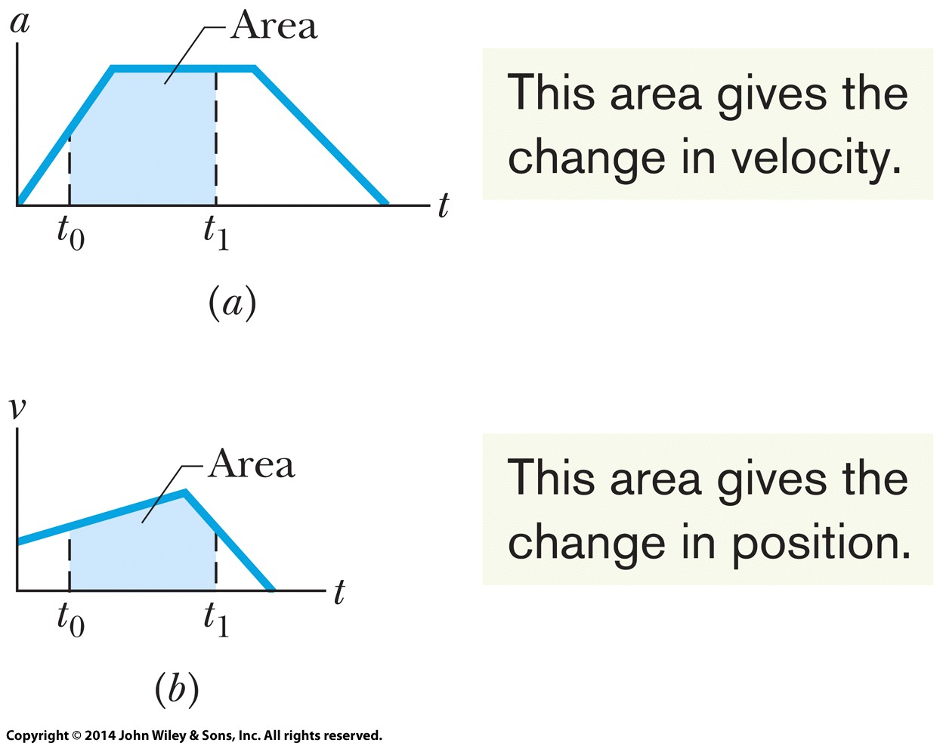
2-6 Graphical Integration in Motion Analysis
Learning Objectives
2.18 Determine a particle's change in velocity by graphical integration on a graph of acceleration versus time.
2.19 Determine a particle's change in position by graphical integration on a graph of velocity versus time.

Slide 29
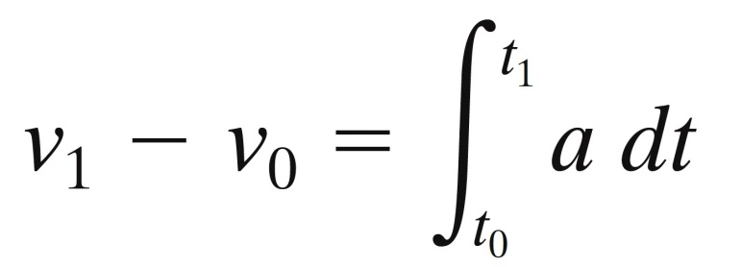
2-6 Graphical Integration in Motion Analysis
Integrating acceleration:
Given a graph of an object's acceleration a versus time t, we can integrate to find velocity
The Fundamental Theorem of Calculus gives:
Eq. (2-27)
The definite integral on the right can be evaluated from a graph:
Eq. (2-28)

Slide 30
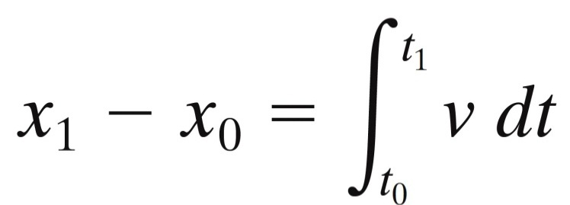
2-6 Graphical Integration in Motion Analysis
Integrating velocity:
Given a graph of an object's velocity v versus time t, we can integrate to find position
The Fundamental Theorem of Calculus gives:
Eq. (2-29)
The definite integral on the right can be evaluated from a graph:
Eq. (2-30)

Slide 31
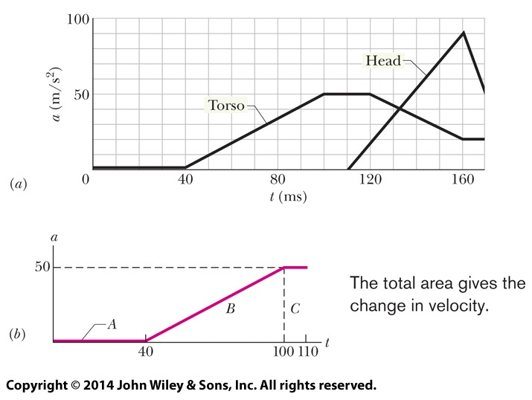
2-6 Graphical Integration in Motion Analysis
Example
The graph shows the acceleration of a person's head and torso in a whiplash incident.
To calculate the torso speed at t = 0.110 s (assuming an initial speed of 0), find the area under the pink curve:
area A = 0
area B = 0.5 (0.060 s) (50 m/s²) = 1.5 m/s
area C = (0.010 s) (50 m/s²) = 0.50 m/s
total area = 2.0 m/s

Slide 32
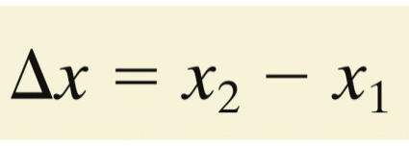
2 Summary
Position
Relative to origin
Positive and negative directions
Displacement
Change in position (vector)
Eq. (2-1)
Average Velocity
Displacement / time (vector)
Average Speed
Distance traveled / time
Eq. (2-2)
Eq. (2-3)

Slide 33
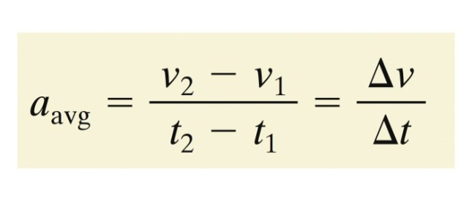
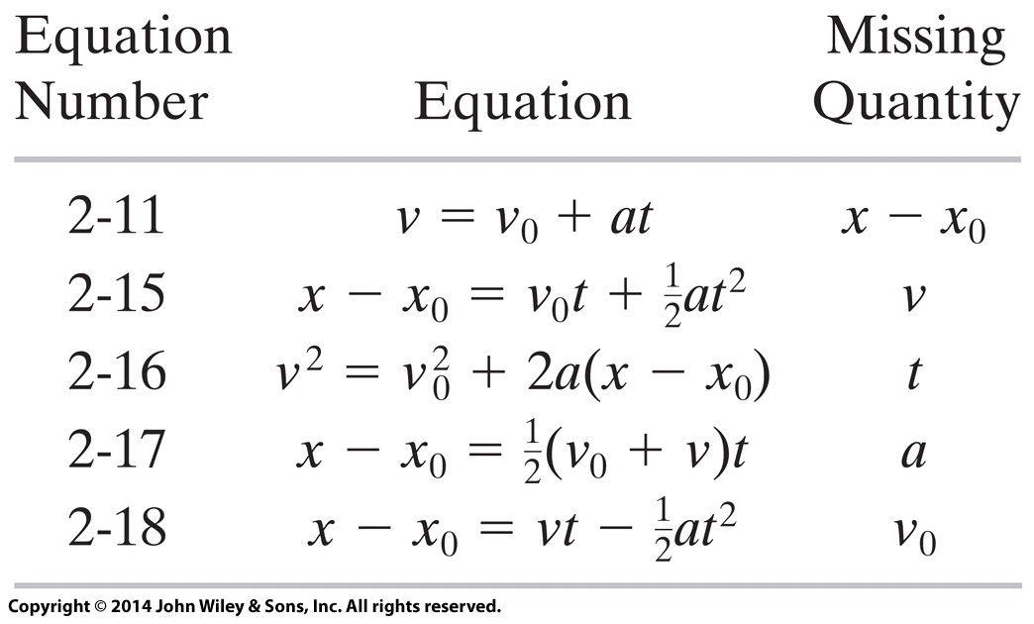
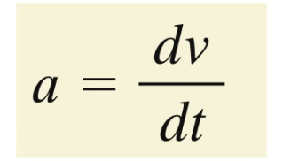
2 Summary
Instantaneous Velocity
At a moment in time
Speed is its magnitude
Average Acceleration
Ratio of change in velocity to change in time
Eq. (2-4)
Eq. (2-7)
Instantaneous Acceleration
First derivative of velocity
Second derivative of position
Constant Acceleration
Includes free-fall, where a = -g along the vertical axis
Eq. (2-8)
Tab. (2-1)

