Slide 1

Chapter 1
Measurement
Notes:
1

Slide 2
1-1 Measuring Things, Including Lengths
Learning Objectives
1.01 Identify the base quantities in the SI system.
1.02 Name the most frequently used prefixes for SI units.
1.03 Change units (here for length, area, and volume) by using chain-link conversions.
1.04 Explain that the meter is defined in terms of the speed of light in a vacuum.
Notes:
2

Slide 3
1-1 Measuring Things, Including Lengths
Physics and engineering are based on the precise measurement of physical quantities
Therefore, we need:
Rules for measurement and comparison
Units for measurement
A unit:
Is the unique name assigned to the measure of a quantity (mass, time, length, pressure, etc.)
Corresponds to a standard, a physical quantity with value 1.0 unit (e.g. 1.0 meter = distance traveled by light in a vacuum over a certain fraction of a second)
Notes:
3

Slide 4
1-1 Measuring Things, Including Lengths
There are many different physical quantities, but not all are independent: distance vs. speed (distance/time)
Base quantities:
Are seven fundamental quantities such as length, time
Three are needed for mechanics: length, time, mass
All have been assigned standards
Are used to define all other physical quantities
Base standards must be:
Accessible, so precise measurements can be taken
Invariable, so measurements do not change over time
Notes:
4

Slide 5
1-1 Measuring Things, Including Lengths
SI units (the metric system) form the International System of Units
SI base units include
Meters (length)
Seconds (time)
Kilograms (mass)
SI has many derived units, which are written in terms of base units
Joules (work-energy): 1 J = 1 kg m²/s²
Watts (power): 1 W = 1 J/s = 1 kg m²/s³
Notes:
5

Slide 6
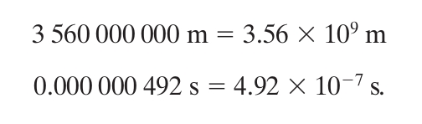
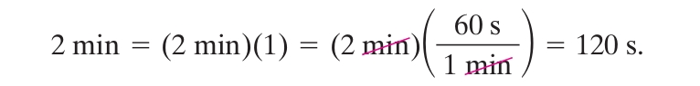
1-1 Measuring Things, Including Lengths
Scientific notation employs powers of 10 to write large or small numbers
A conversion factor is
A ratio of units that is equal to 1
Used to convert between units
Units obey the same algebraic rules as variables and numbers
Notes:
6

Slide 7
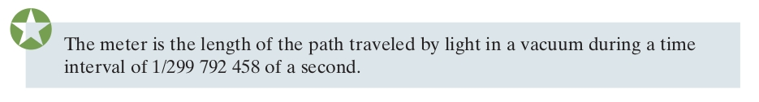
1-1 Measuring Things, Including Lengths
Needs for accuracy in science have driven changes in the standards for units
In the past, 1 meter has been defined by:
One ten-millionth of the distance from the North pole to the equator
A platinum-iridium standard meter bar kept in France
1 650 763.73 wavelengths of an emission line of Kr-86
Today,
In each transition, the new distance was chosen so that the approximate length of 1 meter was preserved
Notes:
7

Slide 8
1-1 Measuring Things, Including Lengths
Significant figures are meaningful digits
Generally, round to the least number of significant figures of the given data
25 x 18 → 2 significant figures; 25 x 18975 → still 2
Round up for 5+ (13.5 → 14, but 13.4 → 13)
Significant figures are not decimal places
0.00356 has 5 decimal places, 3 significant figures
In general, trailing zeros are not significant
In other words, 3000 may have 4 significant figures
but usually 3000 will have only 1 significant figure!
When in doubt, use scientific notation 3.000 x 10³ or 3 x 10³
Notes:
8

Slide 9
1-1 Measuring Things, Including Lengths
Examples Chain-link conversions:
1.3 km x (1000 m)/(1 km) = 1300 m = 1.3 x 10³
0.8 km x (1000 m)/(1 km) x (100 cm)/(1 m) = 80 000 cm
= 8 x 10⁴
2845 mm x (1 m)/(1000 mm) x (3.281 ft)/(1 m) = 9.334 ft

Slide 10
1-2 Time
Learning Objectives
1.05 Change units for time using chain-link conversions.
1.06 Use various measures of time, such as for motion or as measured on different clocks.1
Notes:
10

Slide 11
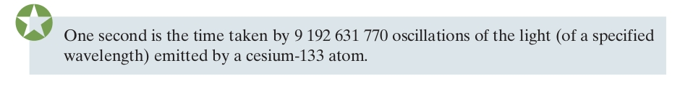
1-2 Time
Any standard of time needs to be able to answer:
When did a thing happen?
What was its duration?
Times follow the same conversion process as lengths
Standards of time in the past have included:
Rotation of Earth
Quartz vibrations
Atomic clocks (cesium), with time signals sent out by radio so others can calibrate their clocks
Notes:
11

Slide 12
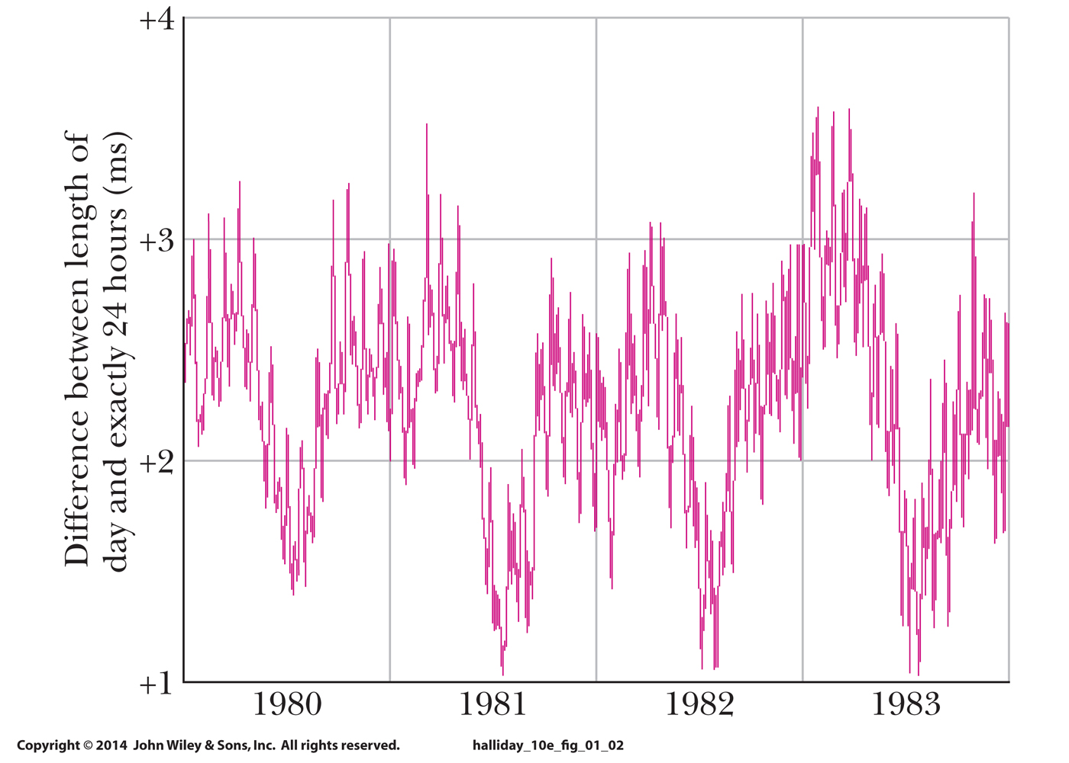
1-2 Time
The variation in the length of a day as measured by an atomic clock:
The vertical scale here amounts to only 3 ms, or 0.003 s.
This shows the precision of atomic clocks, and the relative imprecision of Earth's rotation (affected by tides, winds)
Figure 1-2
Notes:
12

Slide 13
1-3 Mass
Learning Objectives
1.07 Change units for mass using chain-link conversions.
1.08 Relate density to mass and volume when the mass is uniformly distributed.
Notes:
13

Slide 14
1-3 Mass
The standard kilogram is a cylinder of platinum and iridium stored in France.
Accurate copies have been sent around the world, other masses can be measured by comparing them against these copies
The atomic mass unit (u) is a second mass standard
1 atom of Carbon-12 is assigned a mass 12 u
Used for measuring masses of atoms and molecules
1 u = 1.660 538 86 x 10⁻²⁷ kg (+/- 10 x 10⁻³⁵ kg)
Masses follow the same conversion process as lengths and times
Notes:
14

Slide 15
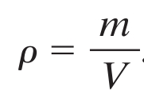
1-3 Mass
Mass per unit volume is called density
Eq. (1-8)
Examples Calculate . . .
Density of material: (18 kg) / (0.032 m³) = 560 kg/m³
Mass of object: (380 kg/m³) x (0.0040 m³) = 1.5 kg
Volume of object: (250 kg) / (1280 kg/m³) = 0.20 m³
Notes:
15

Slide 16
1 Summary
Measurement
Defined by relationships to base quantities
Each defined by a standard, and given a unit
SI Units
International System of Units
Each base unit has an accessible standard of measurement
Changing Units
Use chain-link conversions
Write conversion factors as unity
Manipulate units as algebraic quantities
Length
Meter is defined by the distance traveled by light in a vacuum in a specified time interval
Notes:
16

Slide 17
1 Summary
Time
Second is defined in terms of oscillations of light emitted by a cesium-133 source
Atomic clocks are used as the time standard
Mass
Kilogram is defined in terms of a platinum-iridium standard mass
Atomic-scale masses are measured in u, defined as mass of a carbon-12 atom
Density
Mass/volume
Eq. (1-8)
Notes:
17

