Slide 1
Chapter 4-GK
General Properties of Radiation
Detectors
Lec-5
Notes:
1

Slide 2
I. SIMPLIFIED DETECTOR MODEL…1-GK General Properties of Radiation Detectors

Slide 3
I. SIMPLIFIED DETECTOR MODEL…2-GK General Properties of Radiation Detectors

Slide 4
II. MODES OF DETECTOR OPERATION …3-GK General Properties of Radiation Detectors

Slide 5
A. Current Mode …4-GK II. MODES OF DETECTOR OPERATION

Slide 6
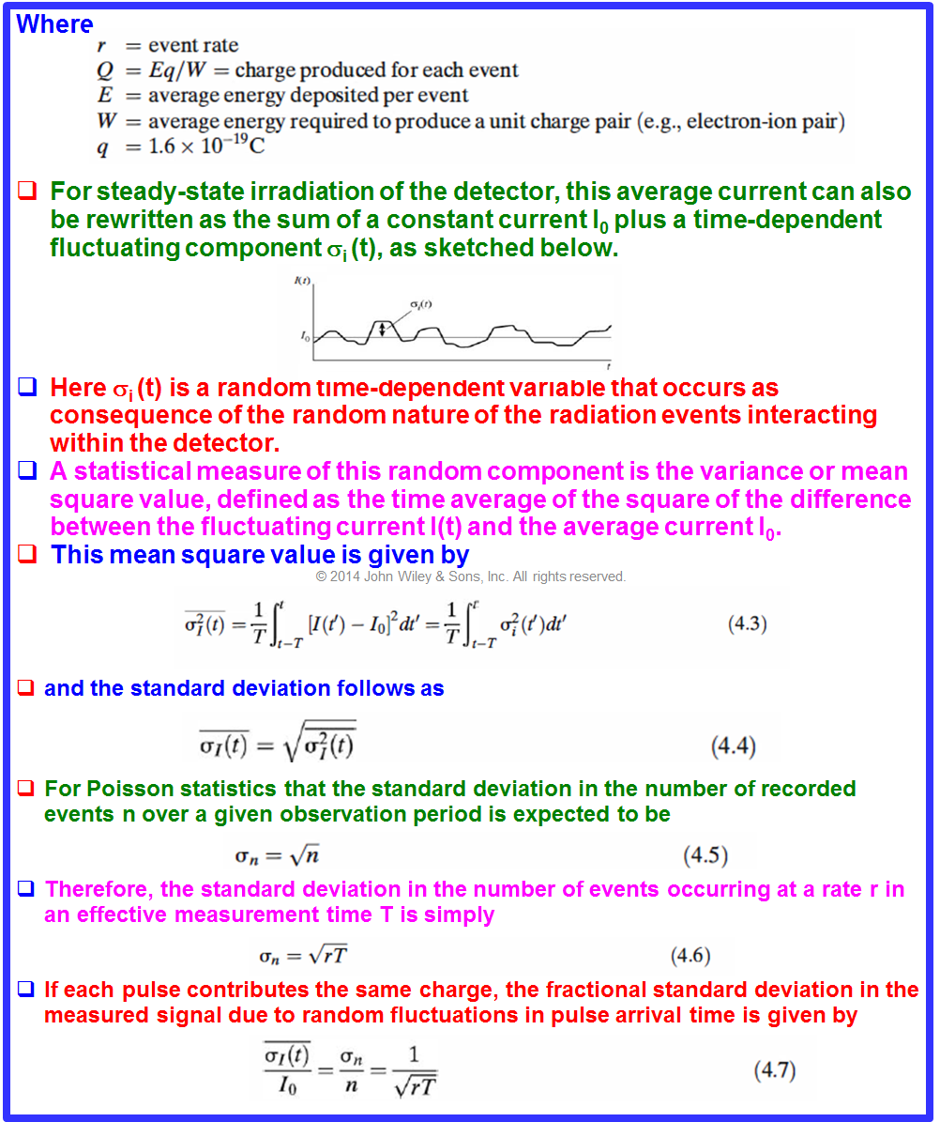
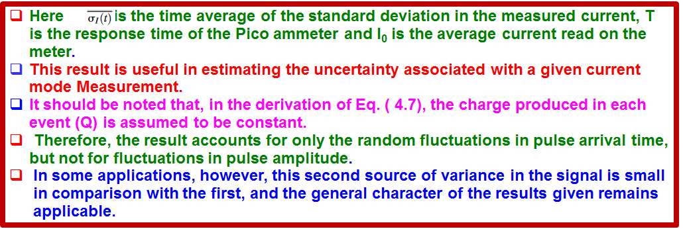
A. Current Mode …5-GK II. MODES OF DETECTOR OPERATION

Slide 7
B… MSV Mode …6-GK II. MODES OF DETECTOR OPERATION

Slide 8
C… Pulse Mode …7-GK II. MODES OF DETECTOR OPERATION

Slide 9
C… Pulse Mode …8-GK II. MODES OF DETECTOR OPERATION

Slide 10
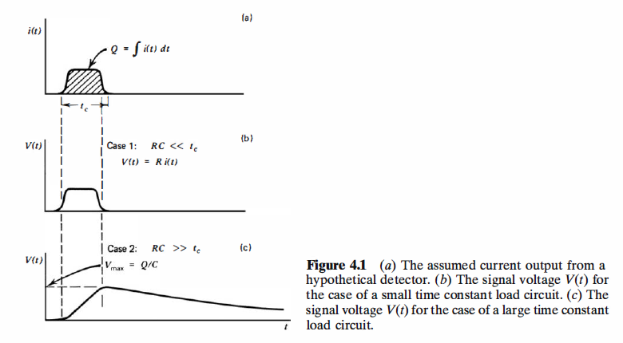
C… Pulse Mode …9-GK II. MODES OF DETECTOR OPERATION

Slide 11
C… Pulse Mode …10-GK II. MODES OF DETECTOR OPERATION

Slide 12
C… Pulse Mode …11-GK II. MODES OF DETECTOR OPERATION

Slide 13
III. PULSE HEIGHT SPECTRA-12-GK

Slide 14
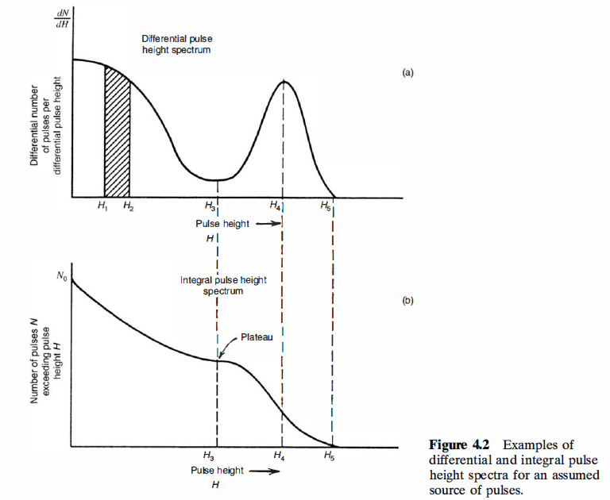
III. PULSE HEIGHT SPECTRA-13-GK

Slide 15
III. PULSE HEIGHT SPECTRA-14-GK

Slide 16
III. PULSE HEIGHT SPECTRA-15-GK

Slide 17
IV. COUNTING CURVES AND PLATEAUS-16-GK

Slide 18
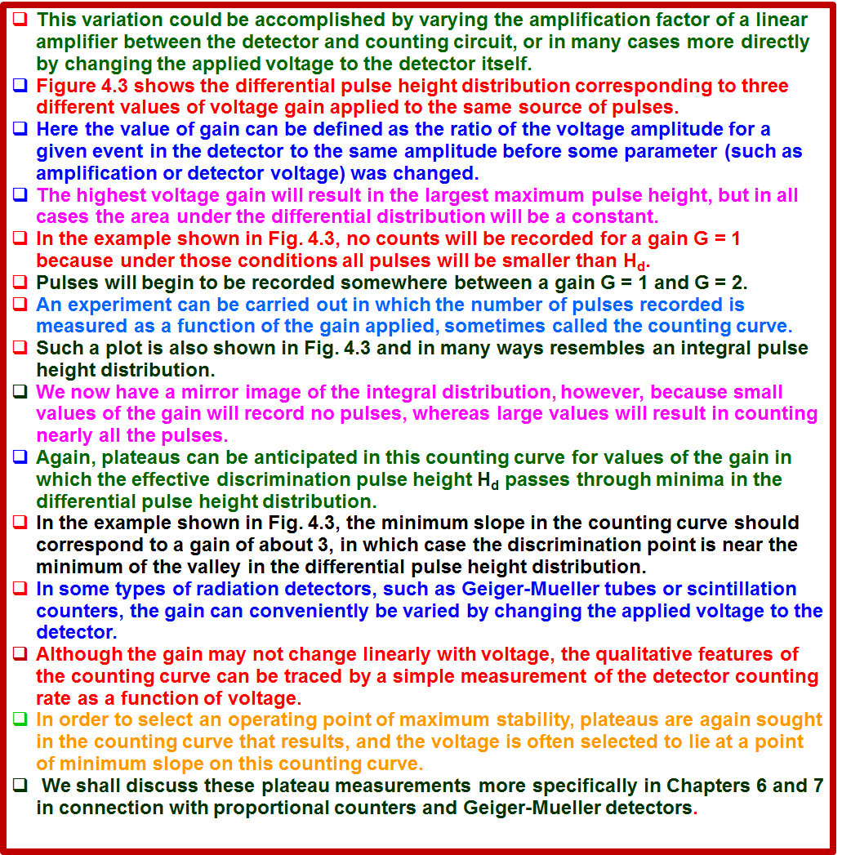
IV. COUNTING CURVES AND PLATEAUS- 17-GK

Slide 19
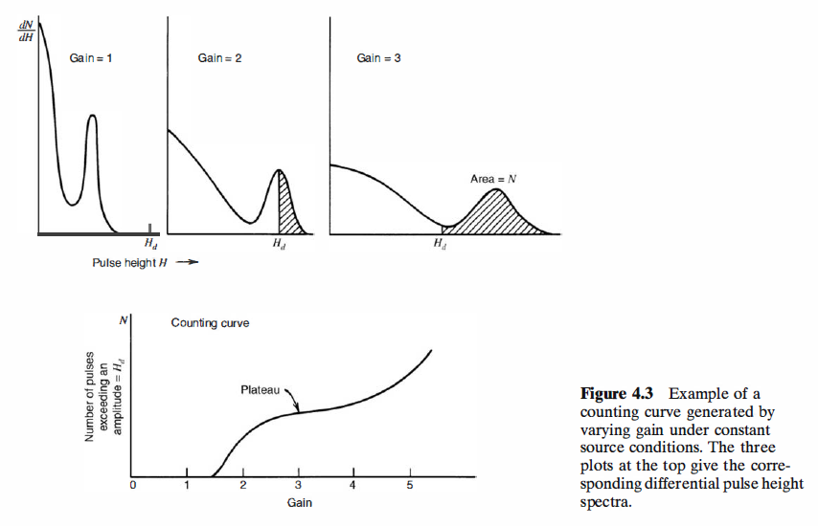
IV. COUNTING CURVES AND PLATEAUS- 17-GK

Slide 20
v. ENERGY RESOLUTION
v. ENERGY RESOLUTION
the objective of the study to measure the energy distribution of the incident radiation is called radiation spectroscopy.
discuss some general properties of detectors when applied to radiation spectroscopy and introduce some definitions.
One important property of a detector in radiation spectroscopy is 'its response to a monoenergetic source of that radiation.
Figure 4.4 illustrates the differential pulse height distribution that might be produced by a detector under these conditions.
This distribution is called the response function of the detector for the energy used in the determination.
The curve labeled "Good resolution" illustrates one possible distribution around an average pulse height H₀.
The second curve, labeled "Poor resolution,“ illustrates the response of a detector with inferior performance.
Provided the same number of pulses are recorded in both cases, the areas under each peak are equal.
Although both distributions are centered at the same average value H₀, the width of the distribution in the poor resolution case is much greater.
This width reflects the fact that a large amount of fluctuation was recorded from pulse to pulse even though the same energy was deposited in the detector for each event.
If the amount of these fluctuations is made smaller, the width of the corresponding distribution will also become smaller and the peak will approach a sharp spike or a mathematical delta function.
The ability of a given measurement to resolve fine detail in the incident energy of the radiation is obviously improved as the width of the response function (illustrated in Fig. 4.4) becomes smaller and smaller.
A formal definition of detector energy resolution is shown in Fig. 4.5. The differential pulse height distribution for a hypothetical detector is shown under the same assumption that only radiation for a single energy is being recorded.
The full width at half maximum (FWHM) is illustrated in the figure and is defined as the width of the distribution at a level that is just half the maximum ordinate of the peak.
This definition assumes that any background or continuum on which the peak may be superimposed is negligible or has been subtracted away.
The energy resolution of the detector is conventionally defined as the FWHM divided by the location of the peak centroid H₀.
The energy resolution R is thus a dimensionless fraction conventionally expressed as a percentage.

Slide 21
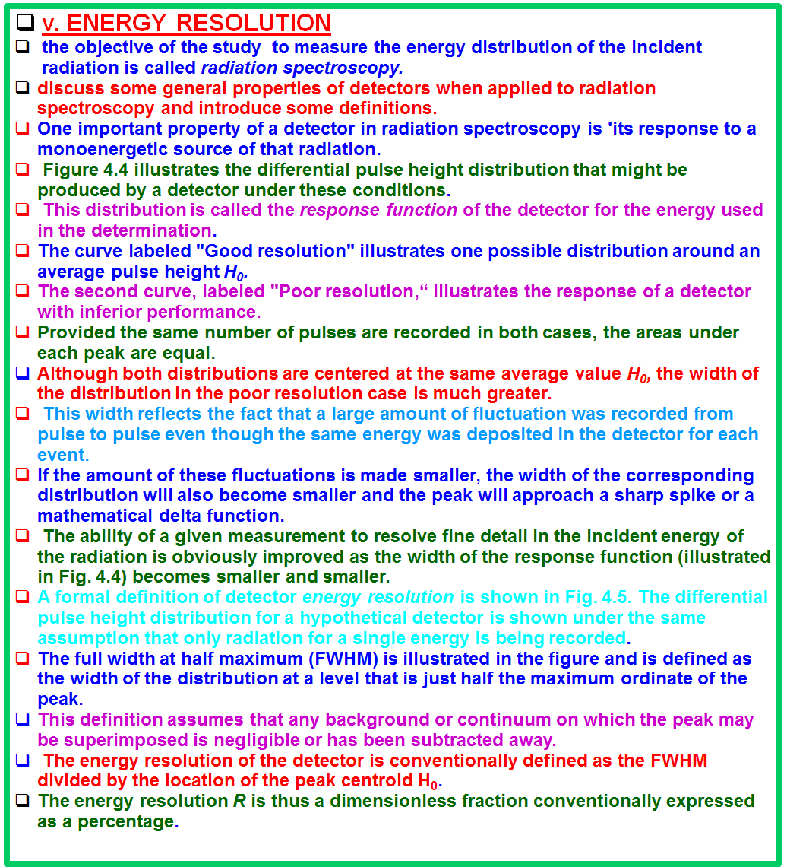
v. ENERGY RESOLUTION-GK-18

Slide 22
v. ENERGY RESOLUTION-GK-19
Semiconductor diode detectors have an energy resolution less than 1 %, whereas scintillation detectors normally show an energy resolution in the range of 5-10%.
the smaller the energy resolution, the better the detector capability to distinguish between two radiations whose energies lie near each other.
Rule of thumb :one should be able to resolve two energies that are separated by more than one value of the detector FWHM.
Potential sources of fluctuation resulting in detector imperfect energy resolution.
any drift of the operating characteristics of the detector during the course of the measurements,
sources of random noise within the detector and instrumentation system,
and statistical noise arising from the discrete nature of the measured signal itself.
The third source is the most important because it represents an irreducible minimum amount of fluctuation that will always be present in the detector signal no matter how perfect the remainder of the system is made.
the statistical noise represents the dominant source of fluctuation in the signal and thus sets an important limit on detector performance.
The statistical noise arises from the fact that the charge Q generated within the detector by a quantum of radiation is not a continuous variable but instead represents a discrete number of charge carriers.
For an ion chamber the charge carriers are the ion pairs produced by the passage of the charged particle through the chamber, while in a scintillation counter they are the number of electrons collected from the photocathode of the photomultiplier tube.
In all cases the number of carriers is discrete and subject to random fluctuation from event to event even though exactly the same amount of energy is deposited in the detector.

Slide 23
v. ENERGY RESOLUTION-GK-19

Slide 24
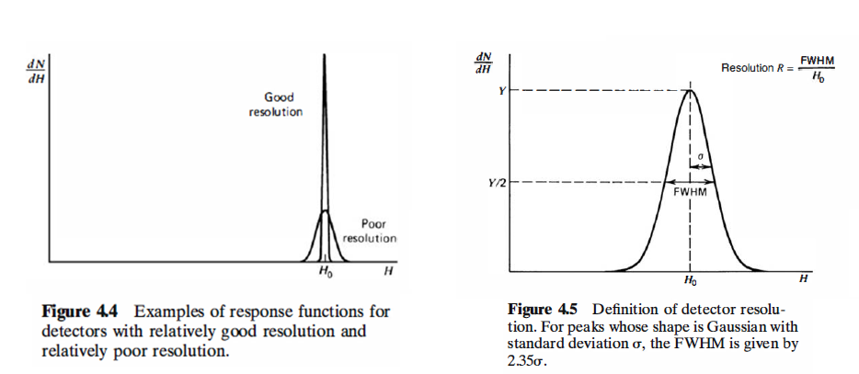
v. ENERGY RESOLUTION-GK-20

Slide 25
An estimate can be made of the amount of inherent fluctuation by assuming that the formation of each charge carrier is a Poisson process.
if a total number N of Charge carriers is generated on the average, one would expect a standard deviation of √N to characterize the inherent statistical fluctuations in that number [see Eq. (3.29)].
If this were the only source of fluctuation in the signal, the response function, as shown in Fig. 4.5, should have a Gaussian shape, because N is typically a large number.
In this case, the Gaussian function introduced in Chapter 3 is most conveniently written
The width parameter σ determines the FWHM of any Gaussian through the relation FWHM = 2.35σ. (The remaining two parameters, H₀ and A, represent the centroid and area, respectively.)
The response of many detectors is approximately linear, so that the average pulse
amplitude H₀ = KN, where K is a proportionality constant.
The standard deviation σ of the peak in the pulse height spectrum is then σ = K√N and its FWHM is 2.35K √N.
We then would calculate a limiting resolution R due only to statistical fluctuations in the number of charge carriers as
Note that this limiting value of R depends only on the number of charge carriers N, and the resolution improves (R will decrease) as N is increased.
From Eq. ( 4.13) we see that in order to achieve an energy resolution better than 1 %, one must have N greater than 55,000.
An ideal detector would have as many charge carriers generated per event as possible, so that this limiting resolution would be as small a percentage as possible.
The great popularity of semiconductor detectors stems from the fact that a very large number of charge carriers are generated in these devices per unit energy lost by the incident radiation.

Slide 26
v. ENERGY RESOLUTION-GK-21

Slide 27
measurements of the energy resolution of some types of radiation detectors have shown that the values for R can be lower by a factor as large as 3 or 4 than the minimum predicted by the statistical arguments given above.
These results would indicate that the processes that give rise to the formation of each individual charge carrier are not independent, and therefore the total number of charge carriers cannot be described by simple Poisson statistics.
The Fano factor has been introduced in an attempt to quantify the departure of the observed statistical fluctuations in the number of charge carriers from pure Poisson statistics and is defined as
Although the Fano factor is substantially less than unity for semiconductor diode detectors and proportional counters, other types such as many scintillation detectors appear to show a limiting resolution consistent with Poisson statistics and the Fano factor would, in these cases, be unity.
The fact that Fano factors of less than one are observed for some detectors can be considered to be a consequence of the partitioning process of the original energy carried in by the incident particle.
A simple argument suffices to show that one would expect to observe a Fano factor of less than unity in the outcome for sampling experiments of a general nature in which there is a constraint on the total quantity that is subject to sampling.

Slide 28
v. ENERGY RESOLUTION-GK-22

Slide 29
In the case of an ionizing particle losing its energy in the detector material, a "sample" represents the amount of energy that goes into creating a charge carrier, and the assumption is made that this energy is subject to sample-to-sample variation.
This variation reflects differing amounts of energy that are lost to thermal processes as individual charge carriers are formed along the particle track.
Adding the constraint that the sum of all energy losses must equal the initial particle energy, it is then predicted that the number of charge carriers produced will fluctuate with a variance that is less than that of a Poisson distribution.
Any other source of fluctuations in the signal chain will combine with the inherent statistical fluctuations from the detector to give the overall energy resolution of the measuring system.
It is sometimes possible to measure the contribution to the overall FWHM due to a single component alone.
For example, if the detector is replaced by a stable pulse generator, the measured response of the remainder of the system will show a fluctuation due primarily to electronic noise.
If there are several sources of fluctuation present and each is symmetric and independent, statistical theory predicts that the overall response function will always tend toward a Gaussian shape, even if the individual sources are characterized by distributions of different shape.
As a result, the Gaussian function given in Eq. ( 4.12) is widely used to represent the response function of detector systems in which many different factors may contribute to the overall energy resolution.
Then the total FWHM will be the quadrature sum of the FWHM values for each individual source of fluctuation:
Each term on the right is the square of the FWHM that would be observed if all other sources of fluctuation were zero.

Slide 30
v. ENERGY RESOLUTION-GK-23

