Slide 1
Ch-1-T162 BASIC CONCEPTS

Slide 7
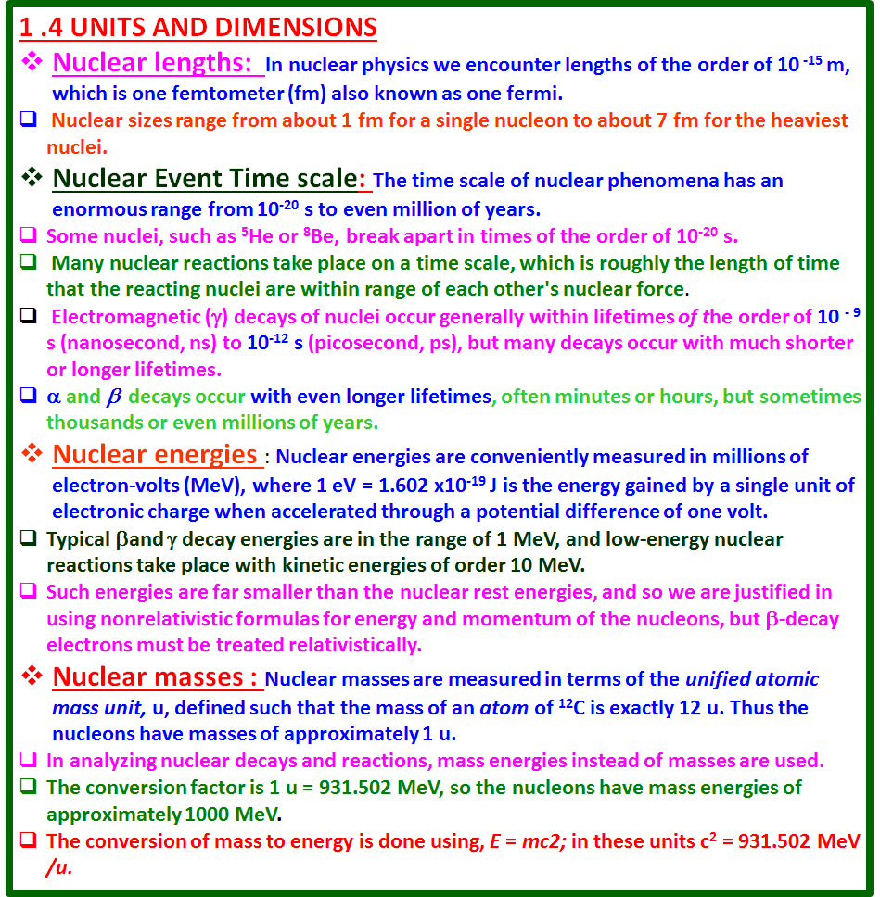

Slide 11
The neutron is electrically neutral and has a mass about equal to the proton mass (actually about 0.1% larger).
A nucleus has Z protons and A - Z neutrons .
a specific nuclear species, or nuclide, is enoted by use the form where X is the chemical symbol and N is the neutron number, A - Z.
The symbols for some nuclides are
The chemical symbol and the atomic number Z are redundant-every H nucleus has Z = 1, every U nucleus has Z = 92 and so on It is therefore not necessary to write Z. It is also not necessary to" write N, since we can always find it from A - Z.
Neutrons and protons are the two members of the family of nucleons.
When we discuss nuclear particles without reference to whether they are protons or neutrons, we use the term nucleons. Thus a nucleus of mass number A contains A nucleons.
Nuclides with the same proton number but different neutron numbers are called isotopes; for example, the element chlorine has two isotopes that are stable against radioactive decay, ³⁵Cl and ³⁷Cl. It also has many other unstable isotopes that are artificially produced in nuclear reactions; these are the radioactive isotopes (or radioisotopes) of Cl.
Nuclides with the same N but different Z are called isotones. The stable isotones with N = 1 are ²H and ³He.
Nuclides with the same mass number A are known as isobars; thus stable 3He and radioactive 3H are isobars.

Slide 12
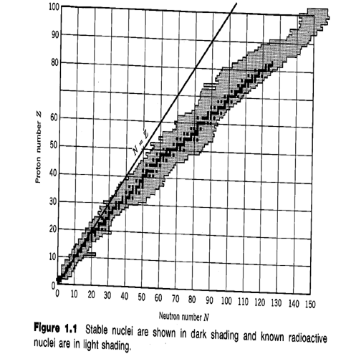
1.3 NUCLEAR PROPERTIES
Nuclear properties are:
Mass,
Radius,
Relative abundance (for stable nuclides),
Decay modes and half-lives (for radioactive nuclides),
Reaction modes and cross sections,
Spin,
Magnetic dipole and electric quadrupole moments,
Excited states.

Slide 13
1 .4 UNITS AND DIMENSIONS
Nuclear lengths: In nuclear physics we encounter lengths of the order of 10 ⁻¹⁵ m, which is one femtometer (fm) also known as one fermi.
Nuclear sizes range from about 1 fm for a single nucleon to about 7 fm for the heaviest nuclei.
Nuclear Event Time scale: The time scale of nuclear phenomena has an enormous range from 10⁻²⁰ s to even million of years.
Some nuclei, such as ⁵He or ⁸Be, break apart in times of the order of 10⁻²⁰ s.
Many nuclear reactions take place on a time scale, which is roughly the length of time that the reacting nuclei are within range of each other's nuclear force.
Electromagnetic (γ) decays of nuclei occur generally within lifetimes of the order of 10 ⁻ ⁹ s (nanosecond, ns) to 10⁻¹² s (picosecond, ps), but many decays occur with much shorter or longer lifetimes.
α and β decays occur with even longer lifetimes, often minutes or hours, but sometimes thousands or even millions of years.
Nuclear energies : Nuclear energies are conveniently measured in millions of electron-volts (MeV), where 1 eV = 1.602 x10⁻¹⁹ J is the energy gained by a single unit of electronic charge when accelerated through a potential difference of one volt.
Typical βand γ decay energies are in the range of 1 MeV, and low-energy nuclear reactions take place with kinetic energies of order 10 MeV.
Such energies are far smaller than the nuclear rest energies, and so we are justified in using nonrelativistic formulas for energy and momentum of the nucleons, but β-decay electrons must be treated relativistically.
Nuclear masses : Nuclear masses are measured in terms of the unified atomic mass unit, u, defined such that the mass of an atom of ¹²C is exactly 12 u. Thus the nucleons have masses of approximately 1 u.
In analyzing nuclear decays and reactions, mass energies instead of masses are used.
The conversion factor is 1 u = 931.502 MeV, so the nucleons have mass energies of approximately 1000 MeV.
The conversion of mass to energy is done using, E = mc2; in these units c² = 931.502 MeV /u.

