Slide 1
CHAPTER 7-1
CORRELATION
PROBABILITY

Slide 2
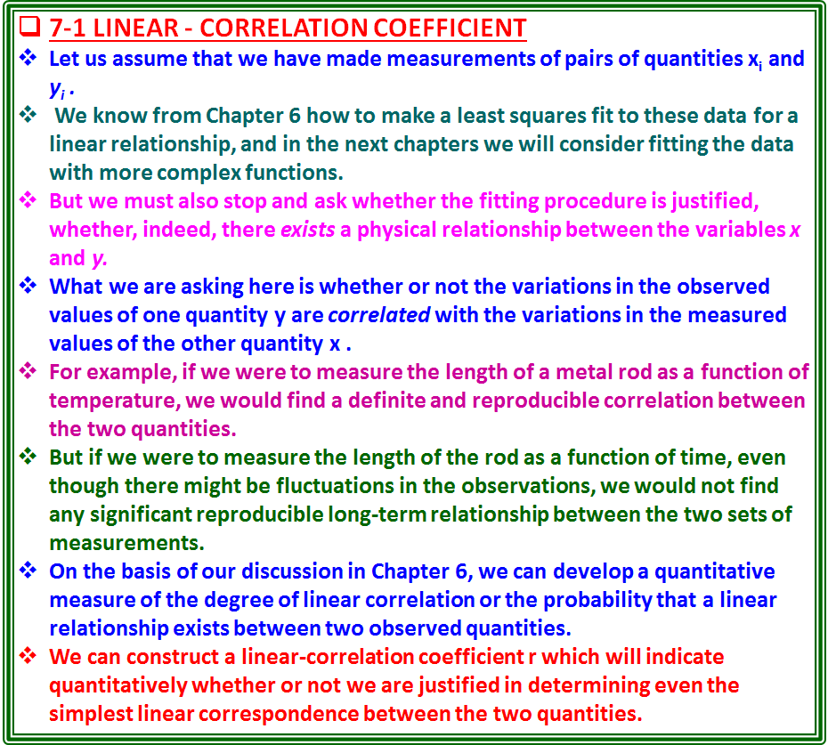

Slide 3
Reciprocity in fitting x VB. y
Our data consist of pairs of measurements (x_{i} , y_{i} ).
If we consider the quantity V to be the dependent variable, then we want to know if the data correspond to a straight line of the form
y=a + bx (7-1)
We have already developed the analytical solution for the coefficient b which represents the slope of the fitted line given in Equation (6-9),
where the weighting factors σ_{i} have been omitted for clarity.
If there is no correlation between the quantities x and y, then there will be no tendency for the values of y to increase or decrease with increasing x, and, therefore, the least squares fit must yield a horizontal straight line with a slope b = 0.
But the value of b by itself cannot be a good measure of the degree of correlation since a relationship might exist which included a very small slope.
Since we are discussing the interrelationship between the variables x and y, we can equally well consider x as a function of y and ask if the data correspond to a straight line of the form
x = a' + b'y (7-3)

Slide 4
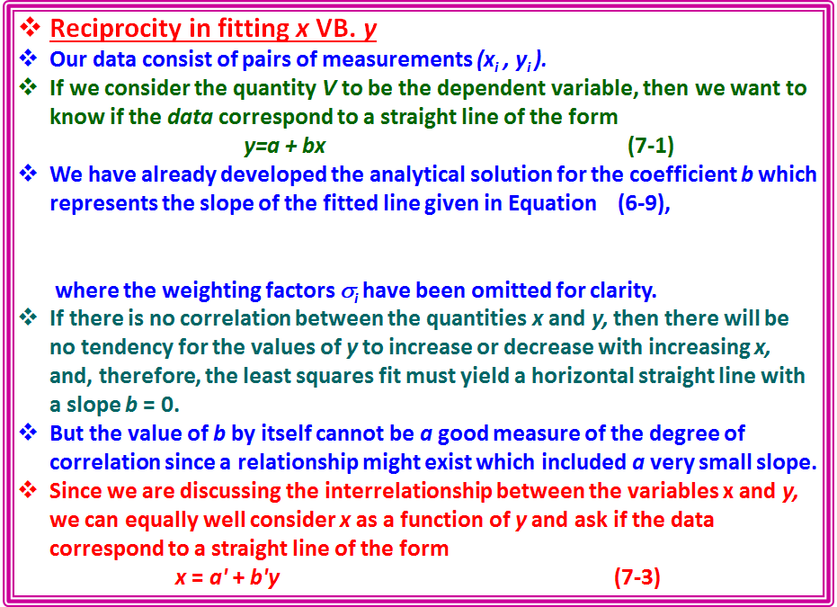

Slide 5
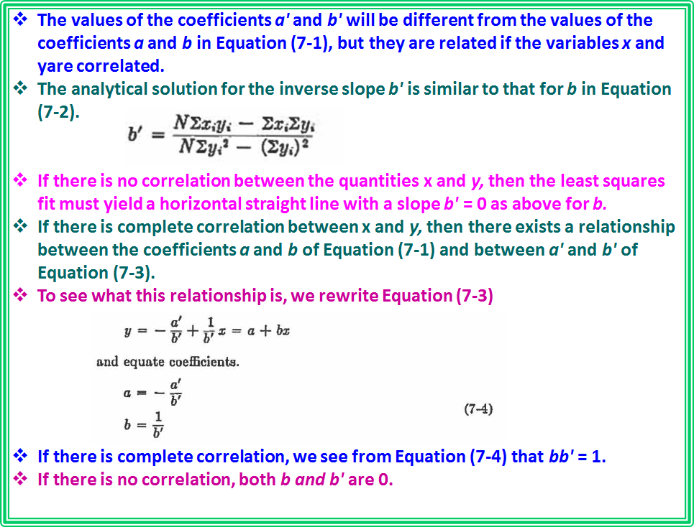

Slide 6
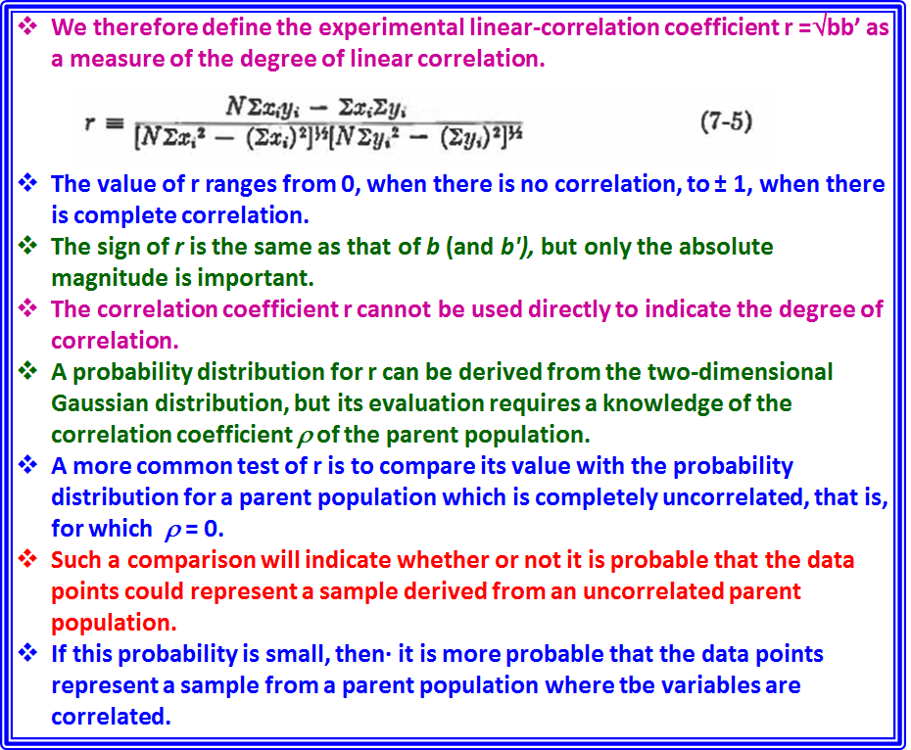

Slide 7
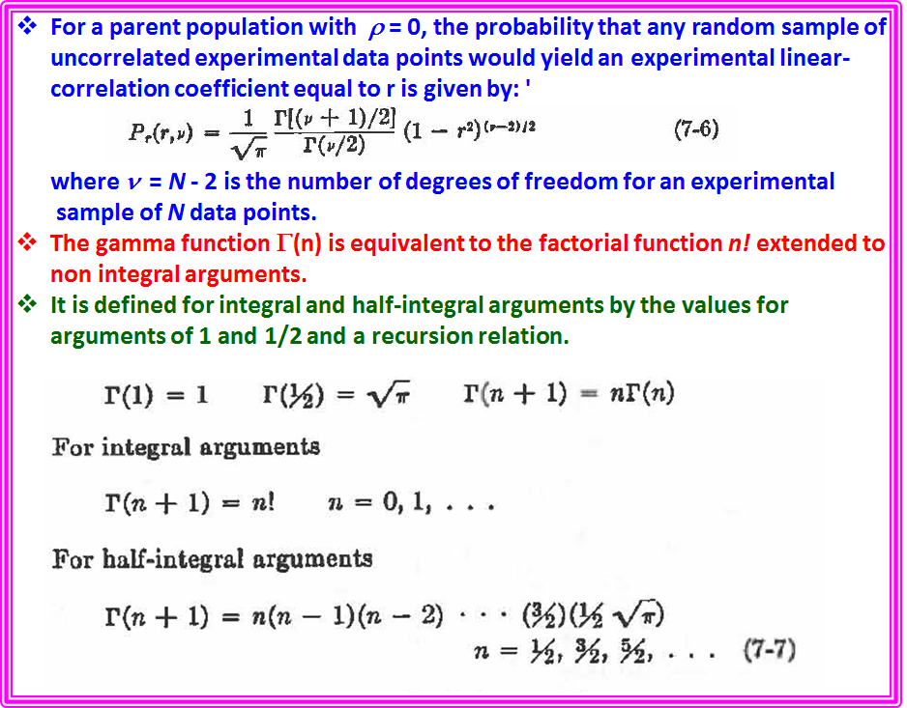

Slide 8
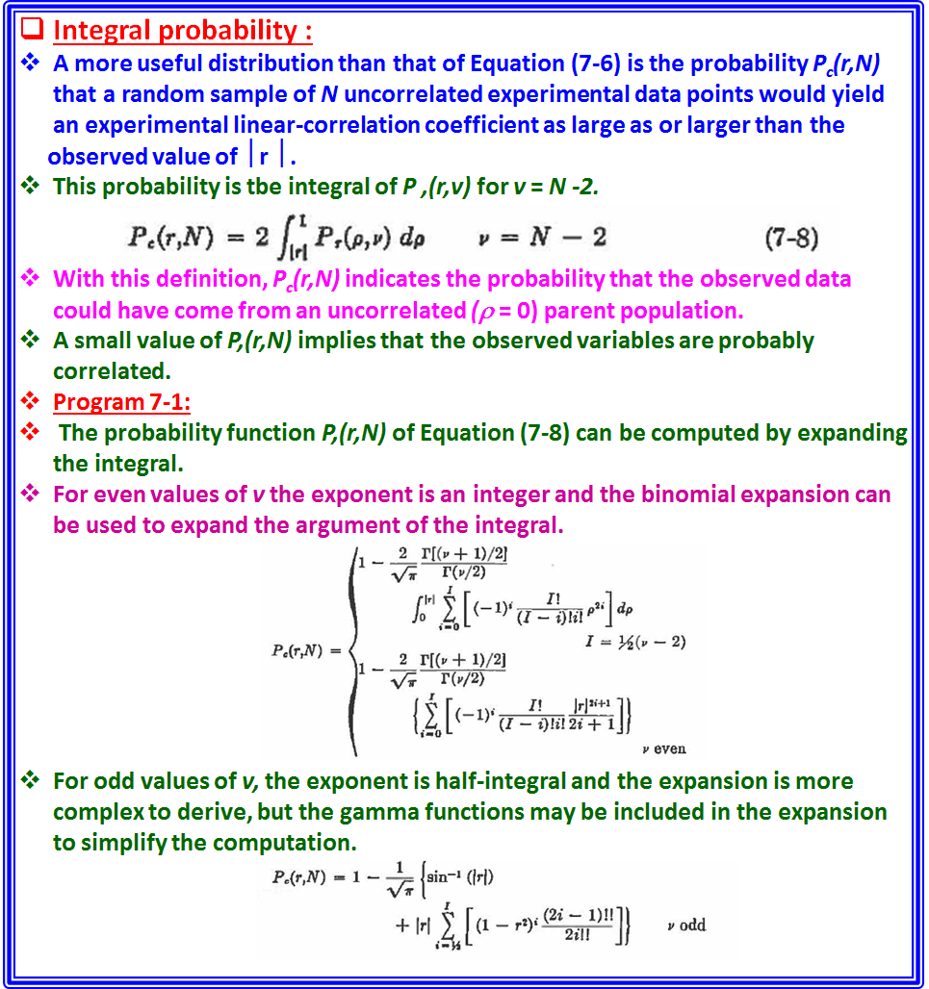

Slide 9
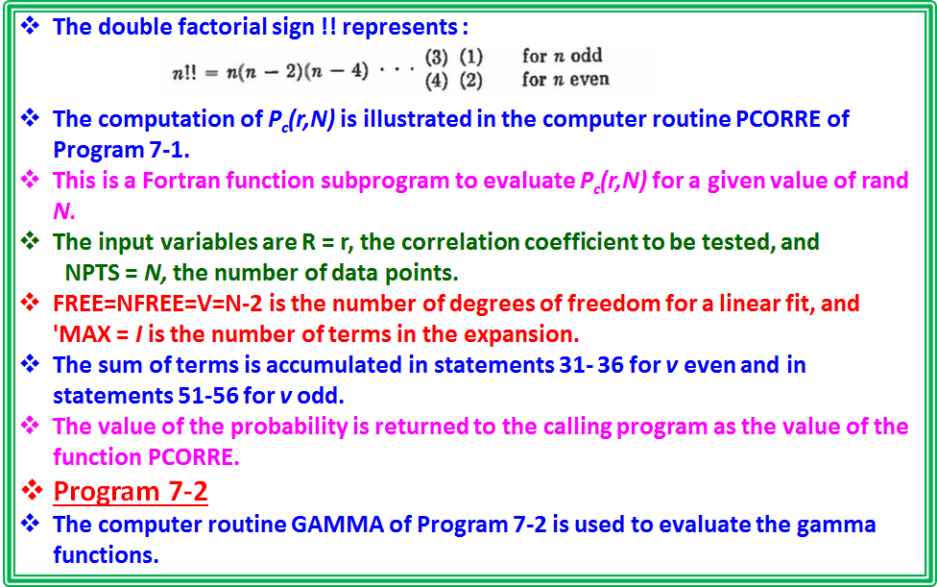

Slide 10
