Slide 1
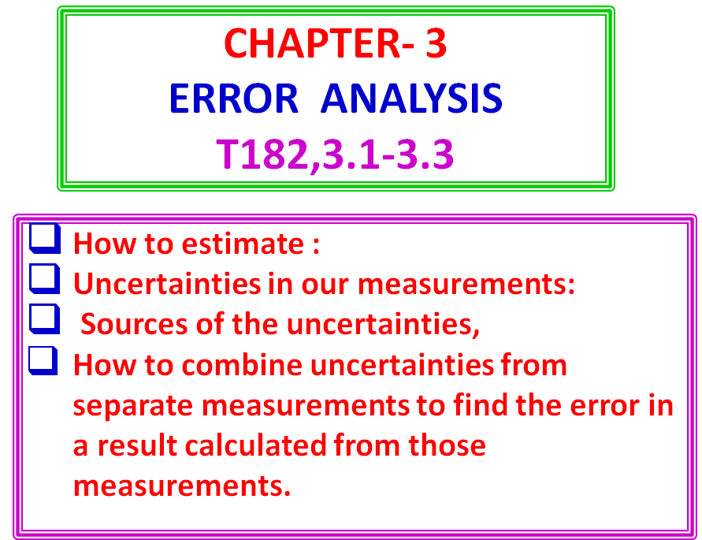

Slide 2
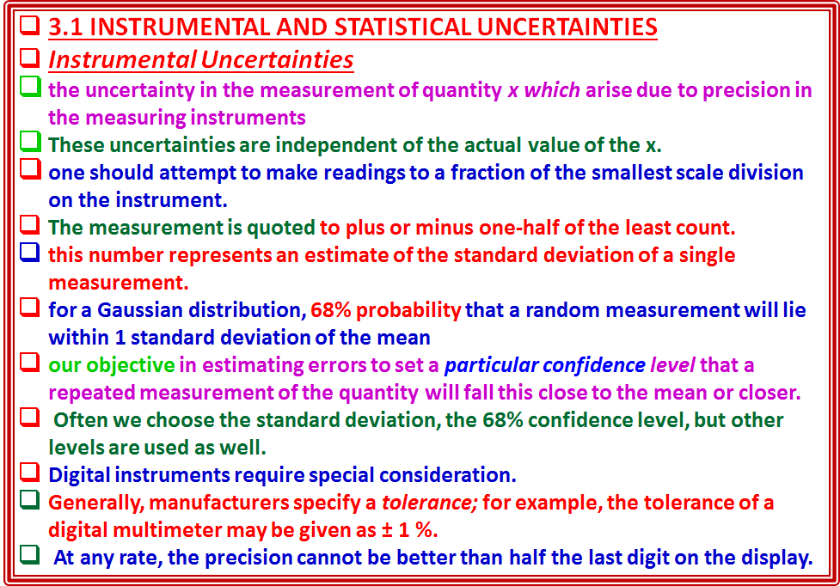

Slide 3
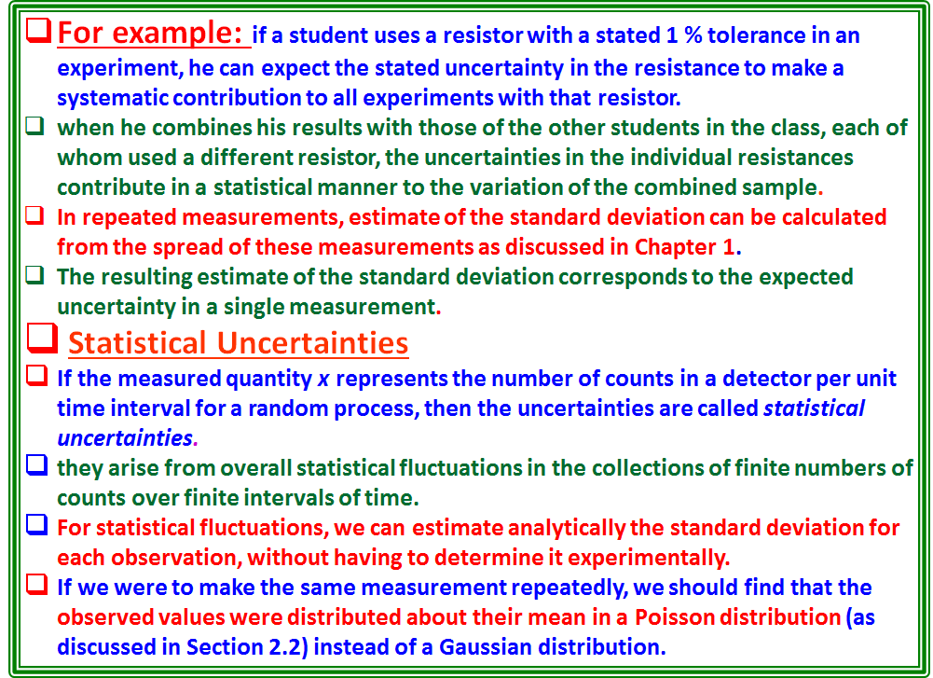

Slide 4
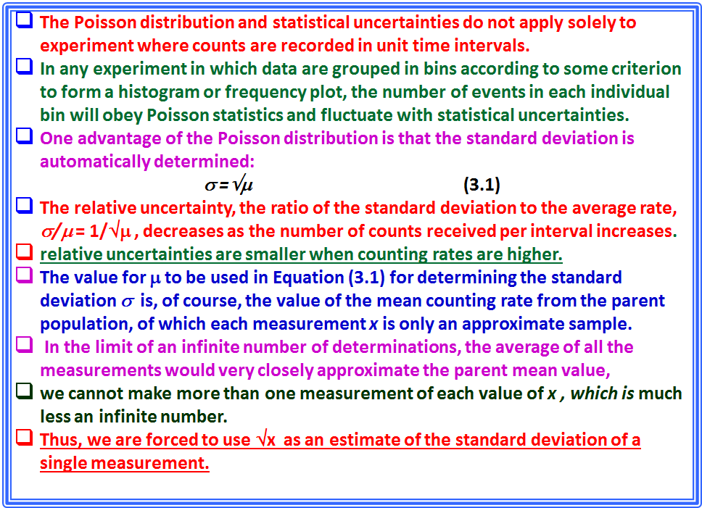

Slide 5
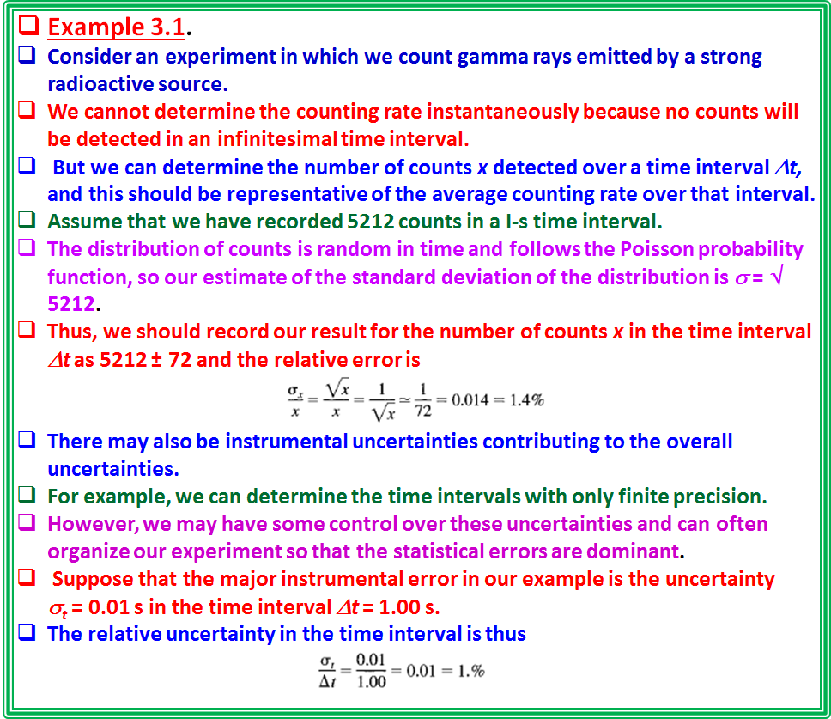

Slide 6
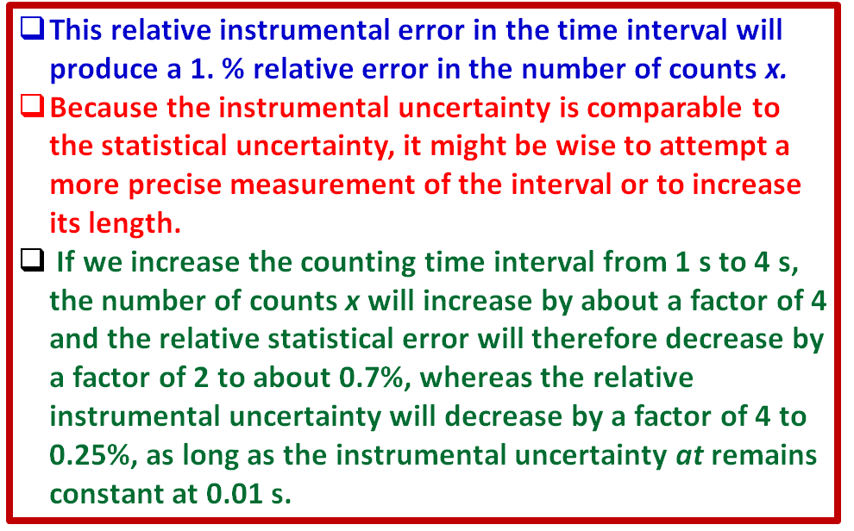

Slide 7
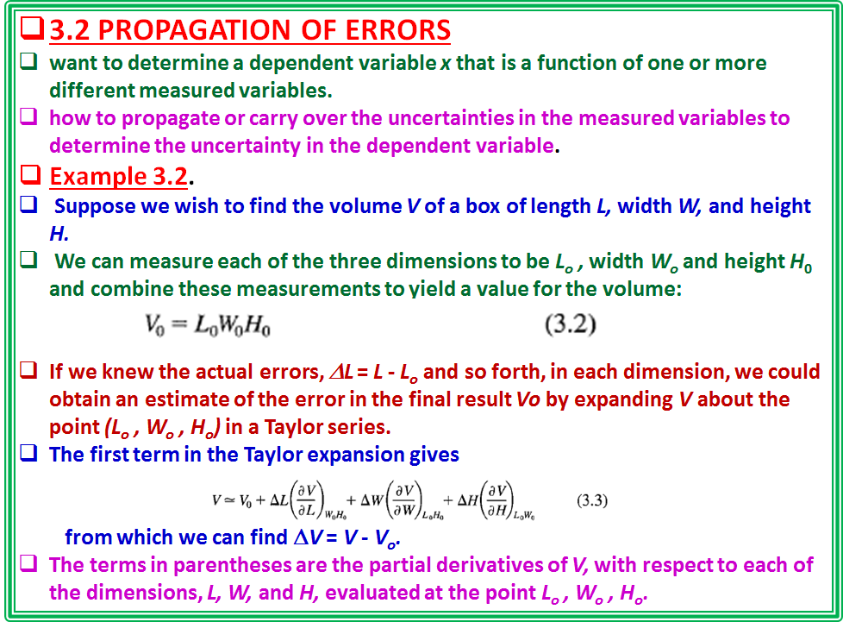

Slide 8
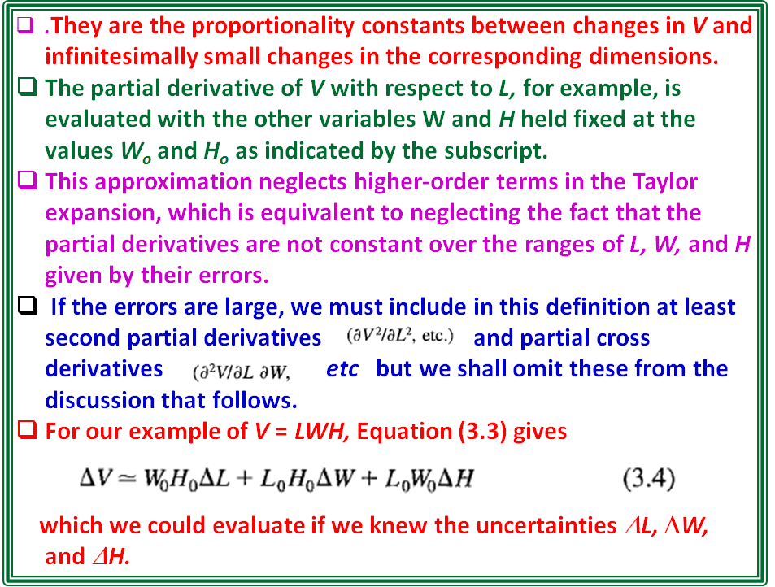

Slide 9
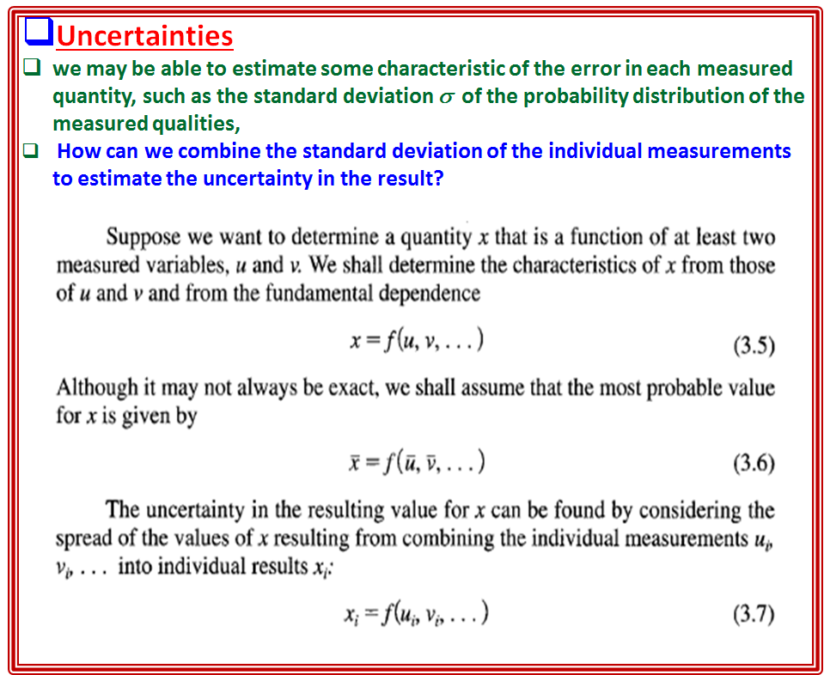

Slide 10
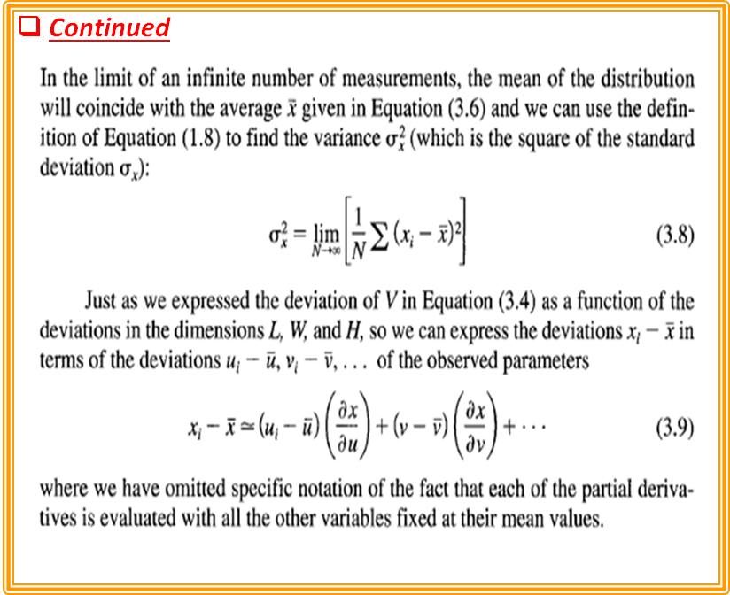

Slide 11
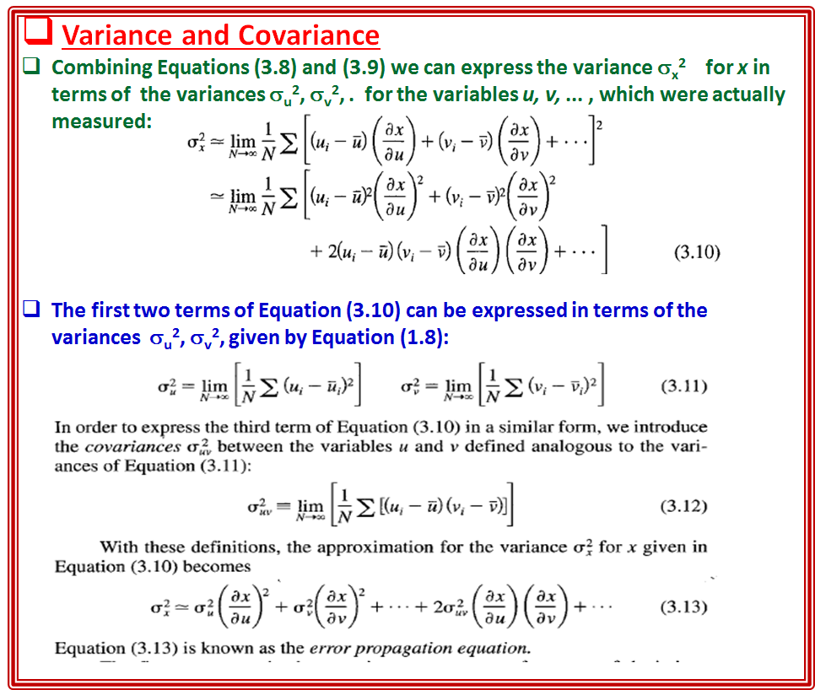

Slide 12
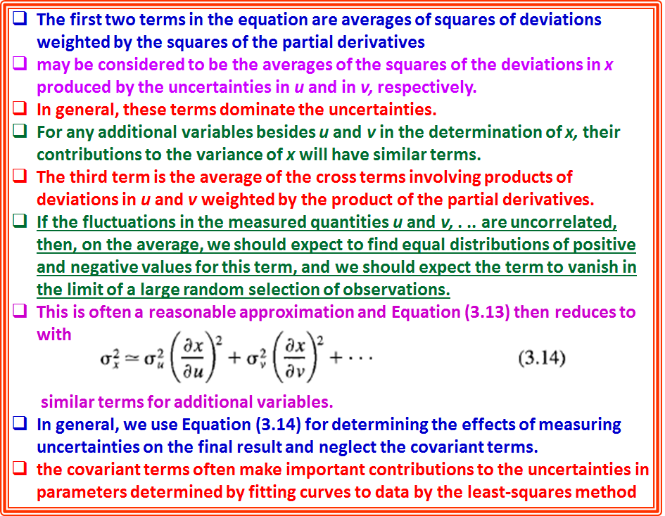

Slide 13
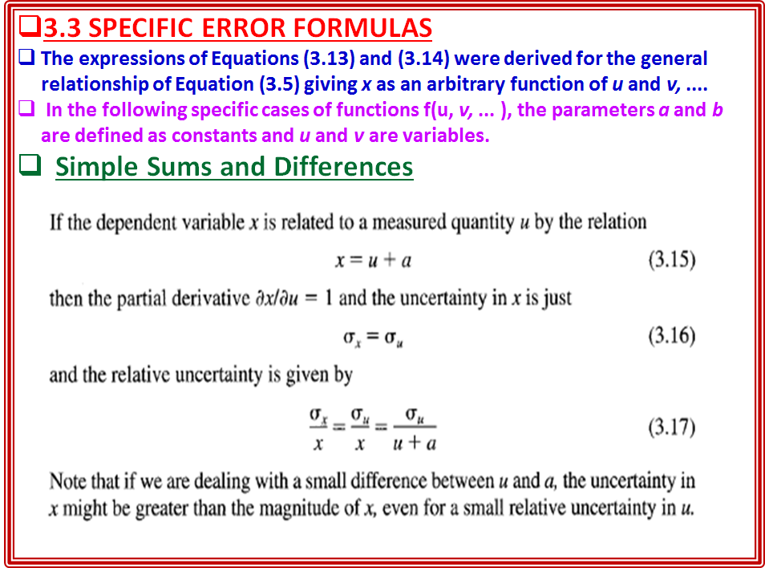

Slide 14
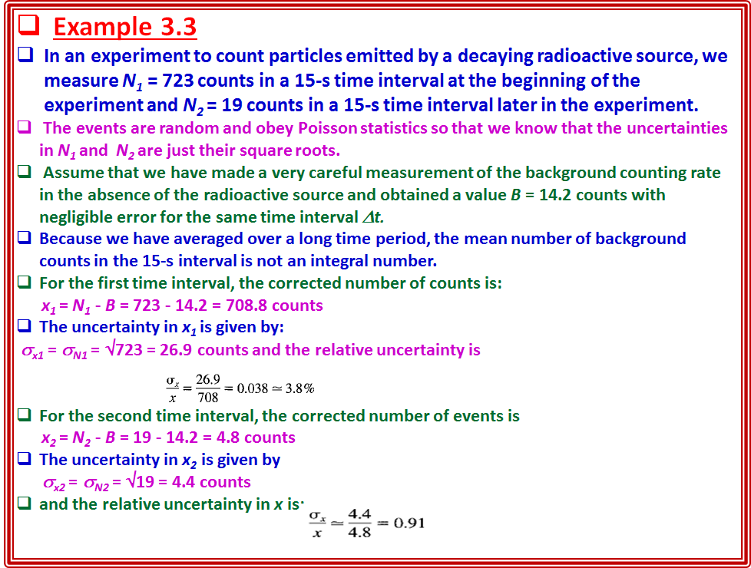

Slide 15
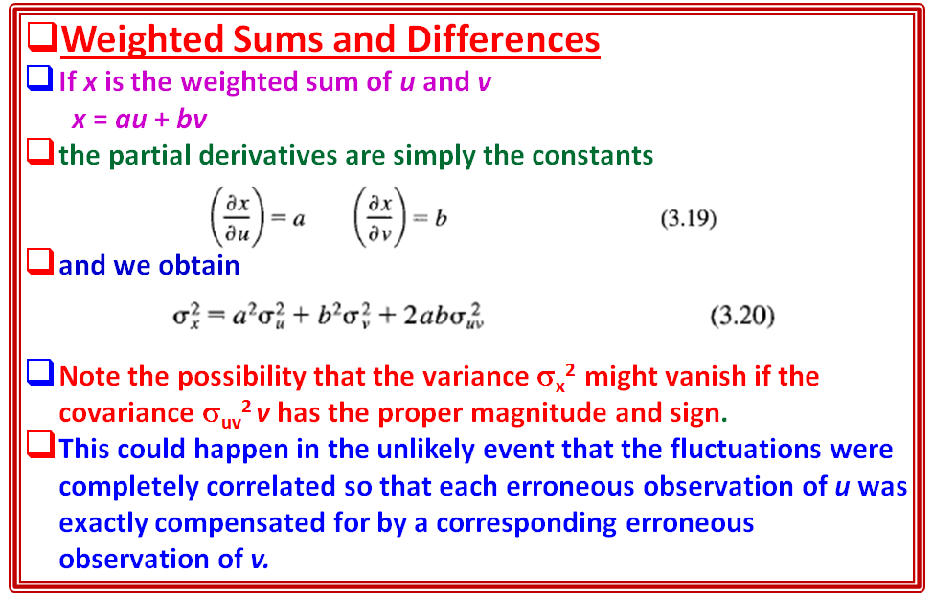

Slide 16
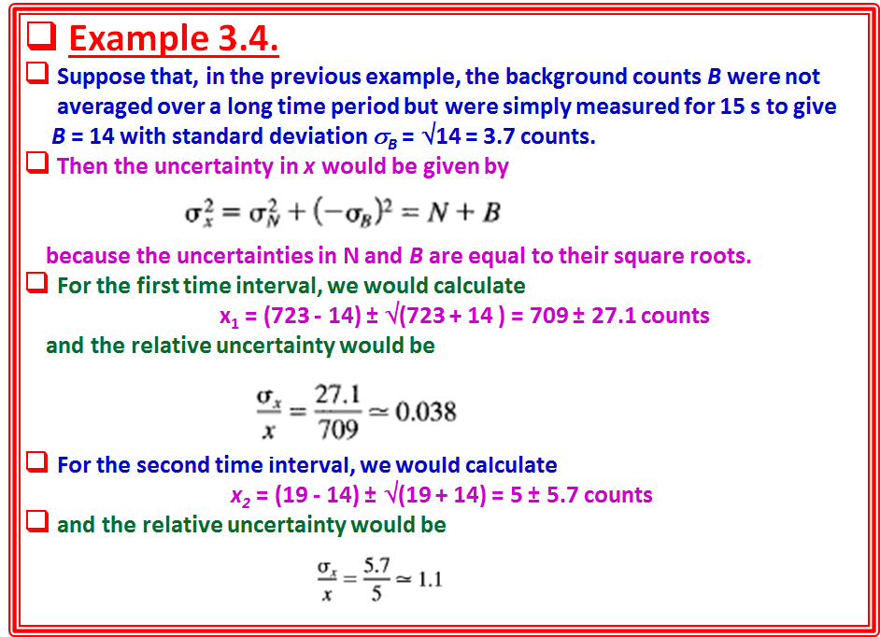

Slide 17
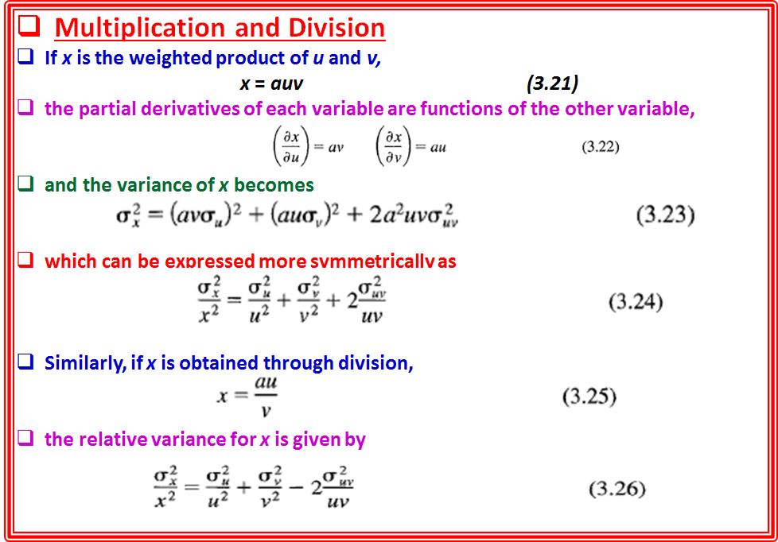

Slide 18
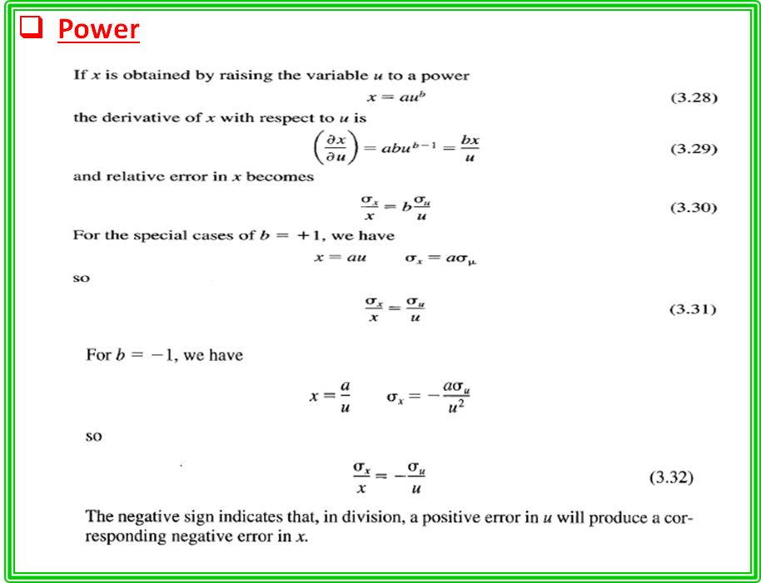

Slide 19
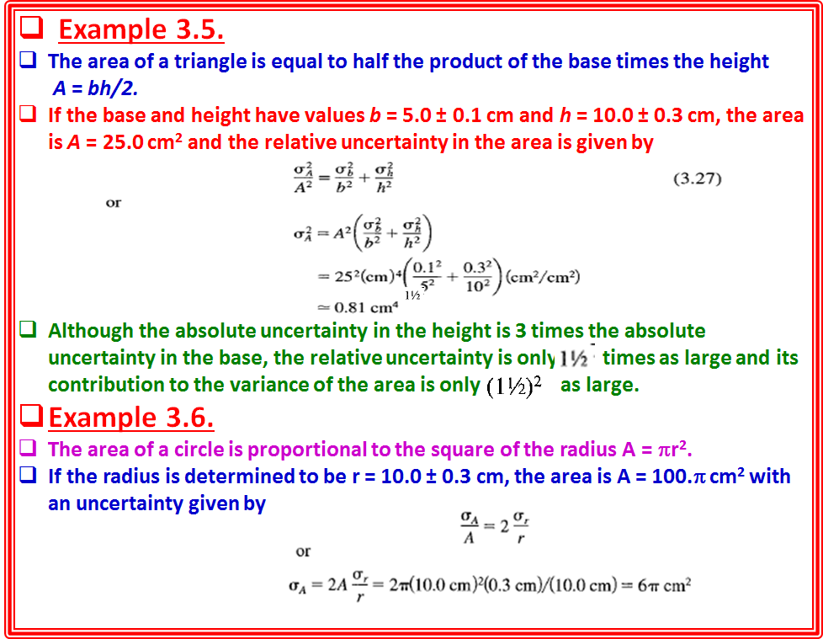

Slide 20
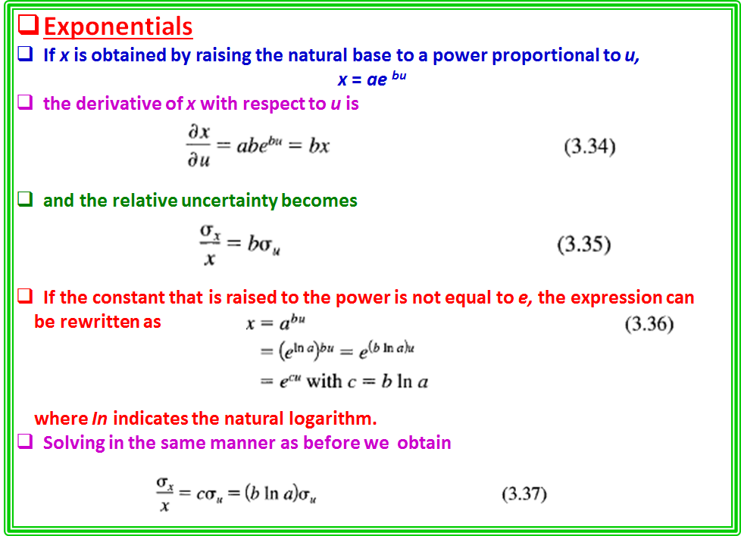

Slide 21
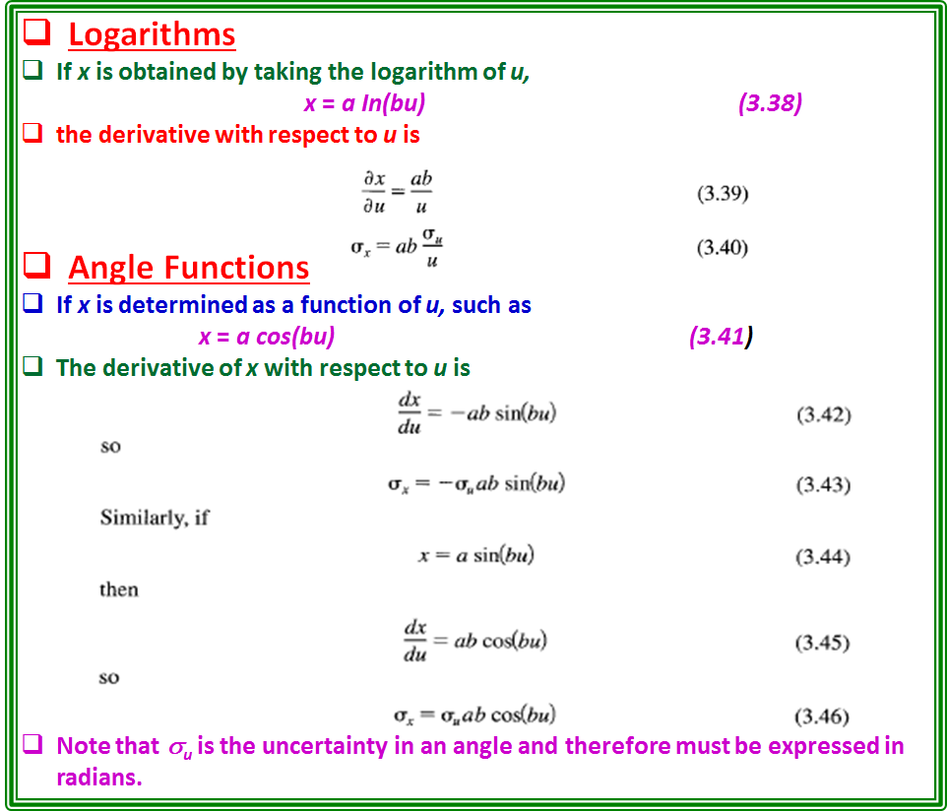

Slide 22
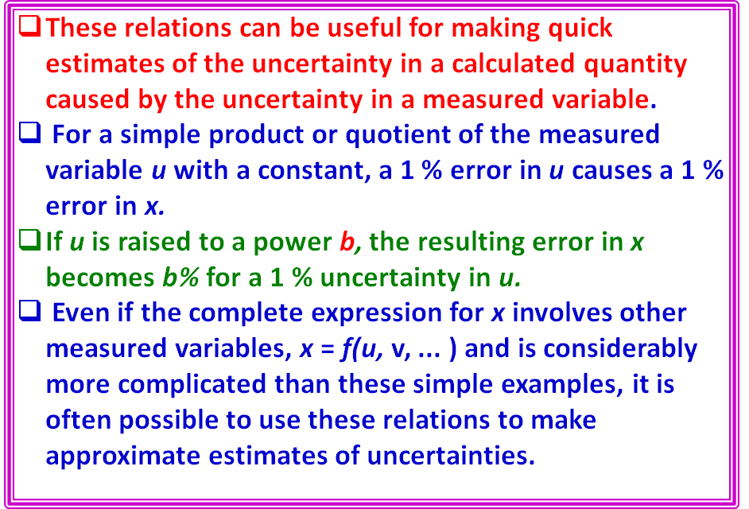

Slide 23
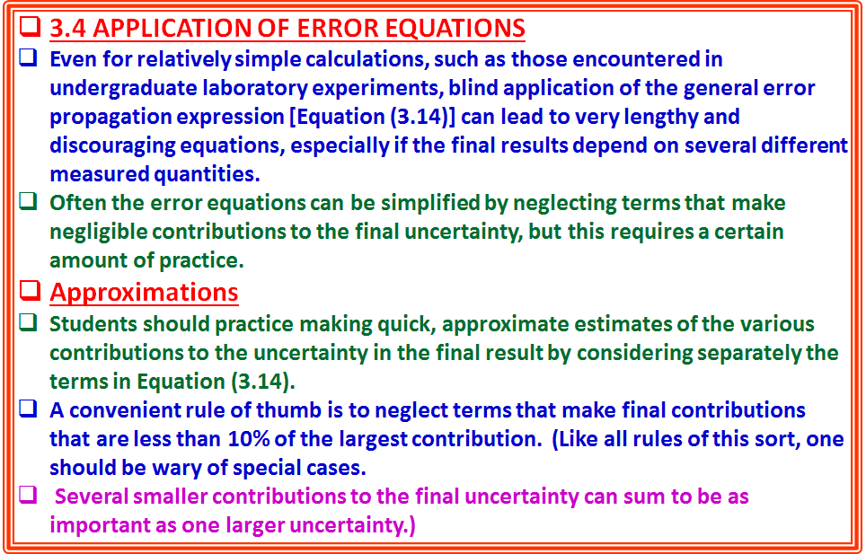

Slide 24
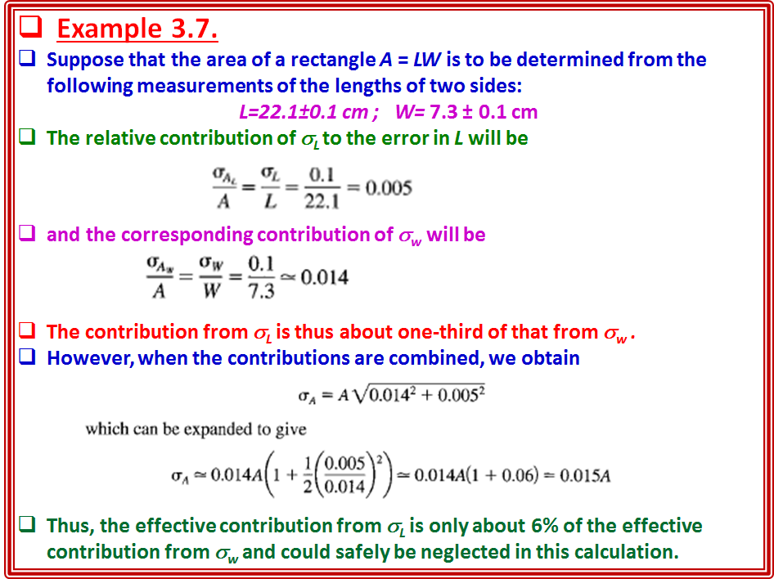

Slide 25
Computer Calculation of Uncertainties
Finding analytic forms for the partial derivatives is sometimes quite difficult.
One should always break Equation (3.14) into separate components and not attempt to find one complete equation that incorporates all error terms.
In fact, if the analysis is being done by computer, it may not even be necessary to find the derivatives explicitly.
The computer can find numerically the variations in the dependent variable
caused by variations in each independent, or measured, variable.
Suppose that we have a particularly complicated equation, or set of equations,
relating our final result x to the individually measured variables u, v, and so forth.
Let us assume that the actual equations are programmed as a computer function
CALCULATE, which returns the single variable x when called with arguments
corresponding to the measured parameters
x = CALCULATE(U, Y, W ... )
We shall further assume that correlations are small so that the covariances may be ignored.
Then, to find the variations of x with the measured quantities u, v, and so
forth, we can make successive calls to the function of the form
DXU = CALCULATE(U + DU, Y, W, ... ) -x,
DXY = CALCULATE(U, Y + DY, W,. ) - x,
DXW = CALCULATE(U, Y, W + DW, ... ) - x, ETC.
where DU, DV, DW, and so forth are the standard deviations σ_{u} , σ_{v} ,σ_{w} and so on.
The resulting contributions to the uncertainty in x are combined in quadrature as
DX = SQRT(SQR(DXU) + SQR(DXY) + SQR(DXW) + ... )
Note that it would not be correct to incorporate all the variations into one equation such as
DX = CALCULATE(U + DU, Y + DY, W + DW, ... ) - x
because this would imply that the errors DU, DV, and so on were actually known
quantities, rather than independent, estimated variations of the measured quantities, corresponding to estimates of the widths of the distributions of the measured variables.

